Slide 1
MRAD 285: Applied Radiographic Skills
Venipuncture

Slide 2
Learning Outcome
Perform venipuncture

Slide 3
Objectives
Discuss anatomy and procedures associated with venipuncture.
Describe all the equipment required to perform venipuncture.
Describe the procedural steps involved in venipuncture.
Perform techniques used in vein assessment.
Describe the infection control measures needed for maintaining aseptic technique in venipuncture.
Describe the challenges of venipuncture and how to overcome them.

Slide 4
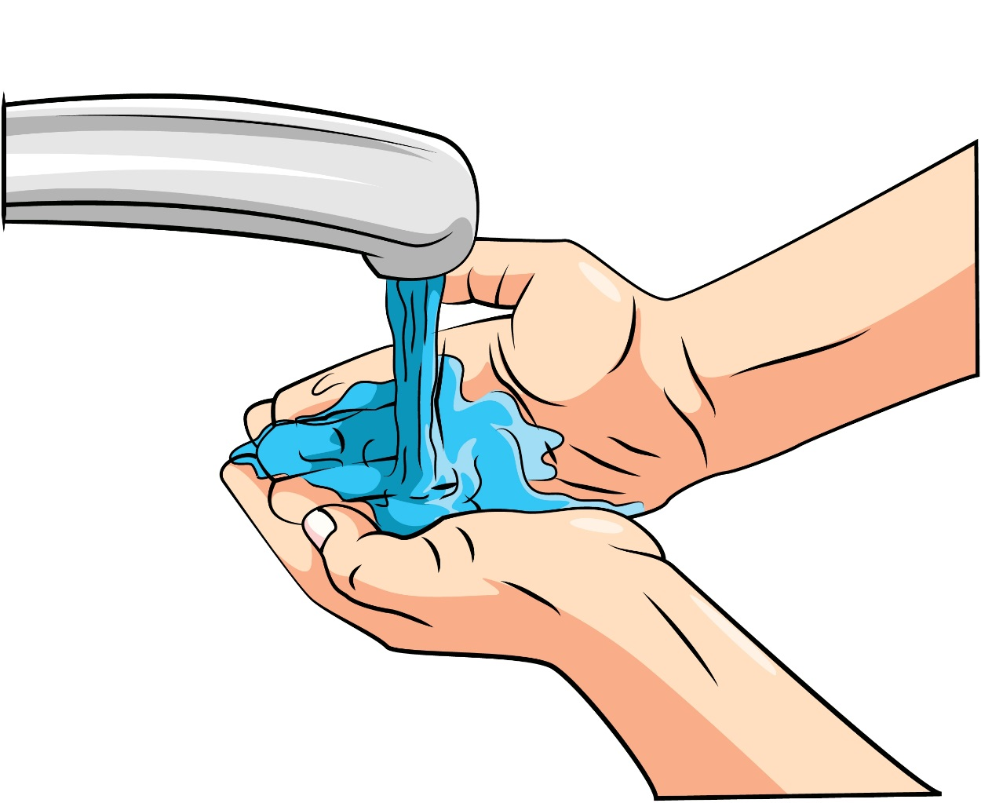
Source: Colourbox.com, Image # 11325676
Notes:
Thorough washing of hands required

Slide 5
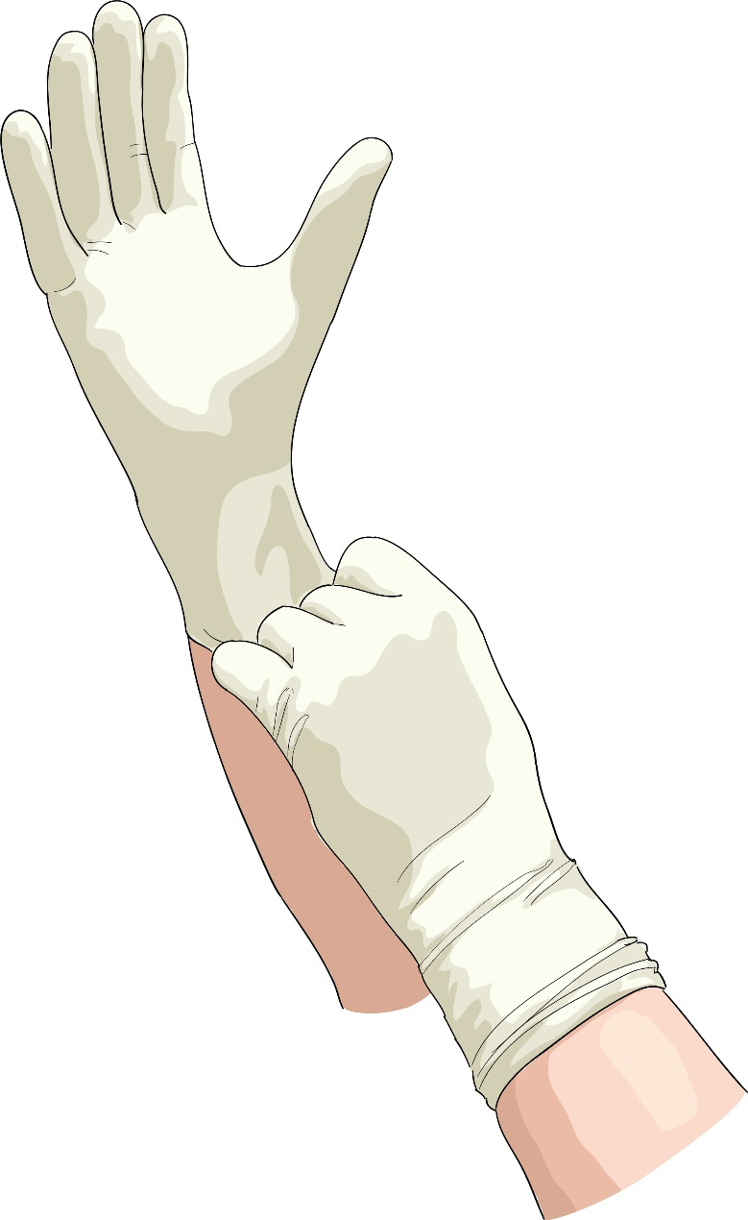
Source: Colourbox.com, Image # 6321437

Slide 6

Source: Colourbox.com, Image # 18857124
Notes:
Introduction

Slide 7

Source: Colourbox.com, Image # 17798600
Notes:
Identification of patient,

Slide 8
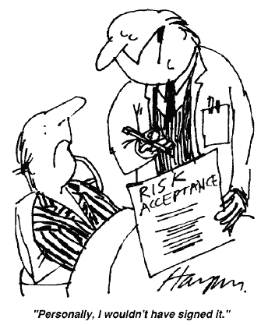
Source: Reproduced and used in accordance with SAIT’s Fair Dealing Policy (Schedule A, Copyright of External Materials Procedure AC.2.12.1); further distribution may infringe copyright. Retrieved from http://allcare-management.blogspot.ca/2010/06/risk-acceptance.html
Notes:
Informed consent signed?

Slide 9


Source: Dr. Amit Karkare. Reproduced and used in accordance with SAIT’s Fair Dealing Policy (Schedule A, Copyright of External Materials Procedure AC.2.12.1); further distribution may infringe copyright. Retrieved from http://tryhomeopathy.blogspot.ca/2010/06/handling-syncope-with-homeopathy.html
Source: Colourbox.com, Image # 13816510
Notes:
Checking of emotional status

Slide 10
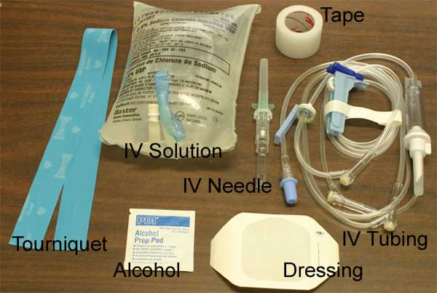
Notes:
Preparation of equipment

Slide 11

Source: Vige, Colourbox.com, Image # 17212423
Notes:
Good to go!

Slide 12
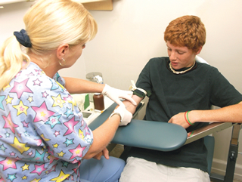
Source: Textbook of Radiographic Positioning and Related Anatomy, Bontrager & Lampignano. © Mosby Elsevier. Used with Permission.
Notes:
Ensure patient is comfortable and arm is supported-adjust the height of the arm to match the appropriate working level of the technologist

Slide 13
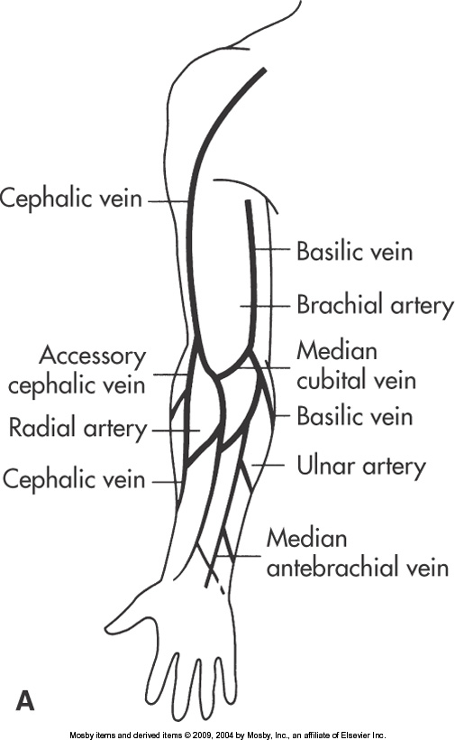
Source: Textbook of Radiographic Positioning and Related Anatomy, Bontrager & Lampignano. © Mosby Elsevier. Used with Permission.

Slide 14
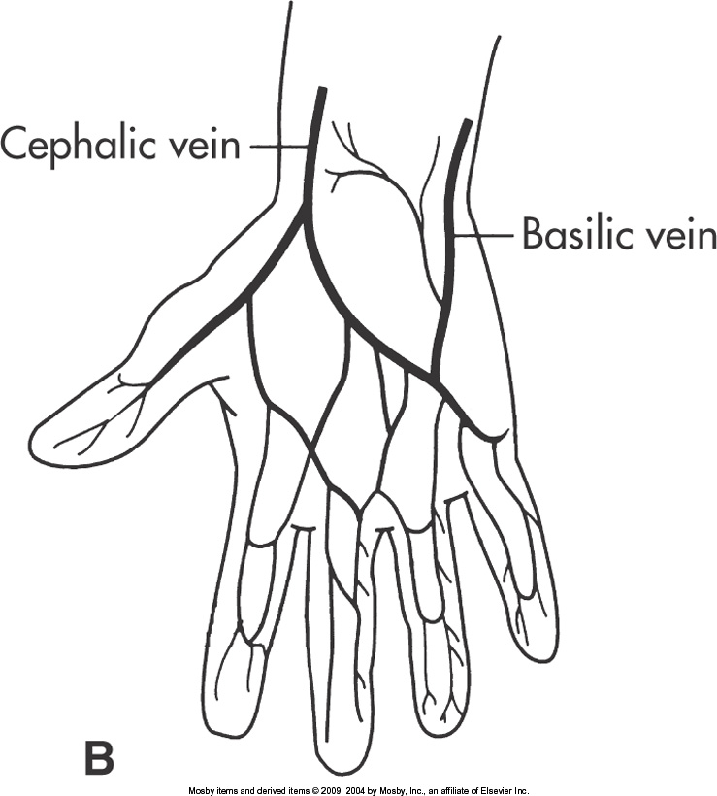
Source: Textbook of Radiographic Positioning and Related Anatomy, Bontrager & Lampignano. © 2013, Mosby Elsevier. Used with Permission.
Notes:
Avoid use of junction sites if possible

Slide 15
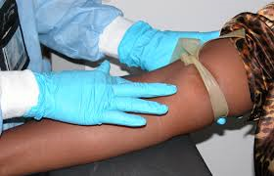
Source: Textbook of Radiographic Positioning and Related Anatomy, Bontrager & Lampignano. © 2013, Mosby Elsevier. Used with Permission.
Notes:
Correct tourniquet placement- 3 to 4 inches ( 7.5 to 10 cm above the site
Select the injection site by using your finger on you non-dominant hand
Tighten the tourniquet sufficiently to dilate veins
(Check the radial artery pulse to verify that the tourniquet is sufficiently tight to compress the veins but still allow blood flow to the distal regions

Slide 16
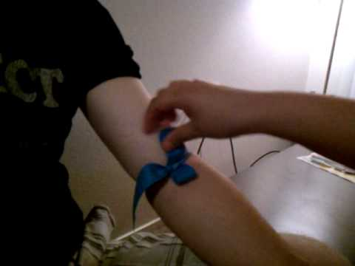
Source: Textbook of Radiographic Positioning and Related Anatomy, Bontrager & Lampignano. © Mosby Elsevier. Used with Permission.
Notes:
Release the tourniquet

Slide 17
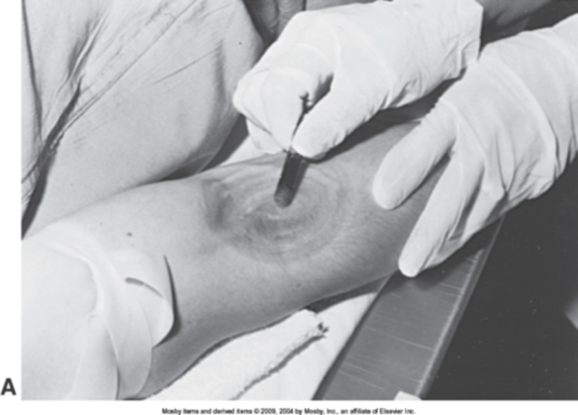
Source: Textbook of Radiographic Positioning and Related Anatomy, Bontrager & Lampignano. © Mosby Elsevier. Used with Permission.
Notes:
Cleanse the selected site in a circular motion from the center outward ( 2-3 inches minimum
30 sec minute time limit
Allow the site to dry

Slide 18
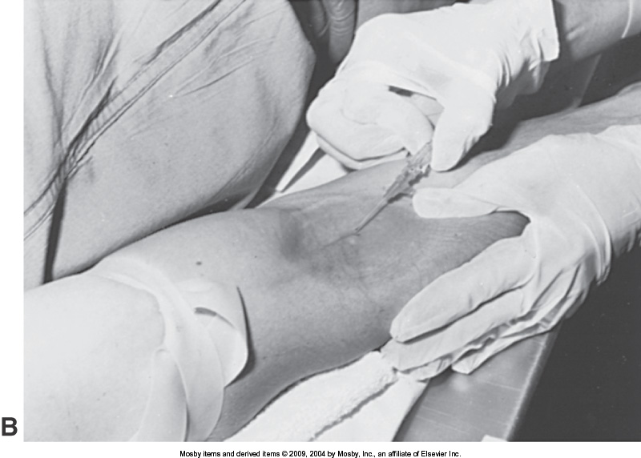
Source: Textbook of Radiographic Positioning and Related Anatomy, Bontrager & Lampignano. © 2013, Mosby Elsevier. Used with Permission.
Notes:
Retighten the tourniquet
Using the non dominant anchor the selected vein by making the skin taunt
With the bevel of the needle facing upward-approach the vein at an angle of 20-45 degrees
Advance the needle thru the skin just superior to the vein of interest until a slight pop is felt

Slide 19
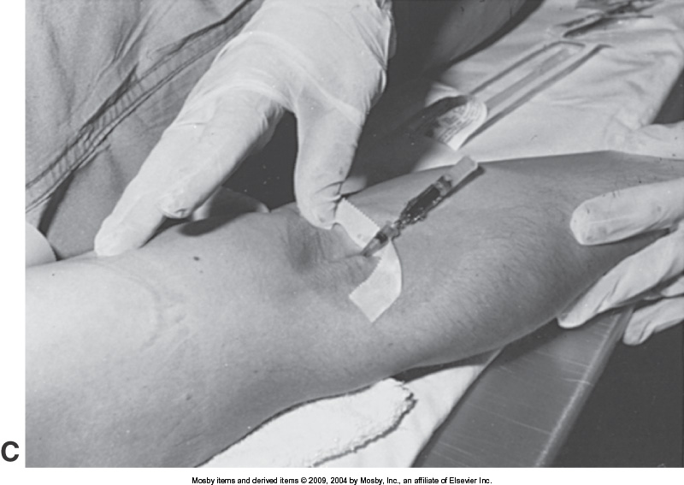
Source: Textbook of Radiographic Positioning and Related Anatomy, Bontrager & Lampignano. © Mosby Elsevier. Used with Permission.
Notes:
Decrease the angle of the needle to run parallel with the vein-advance the needle farther into the vein-approximately ¼0 of an inch ( 0.6 cm)

Slide 20
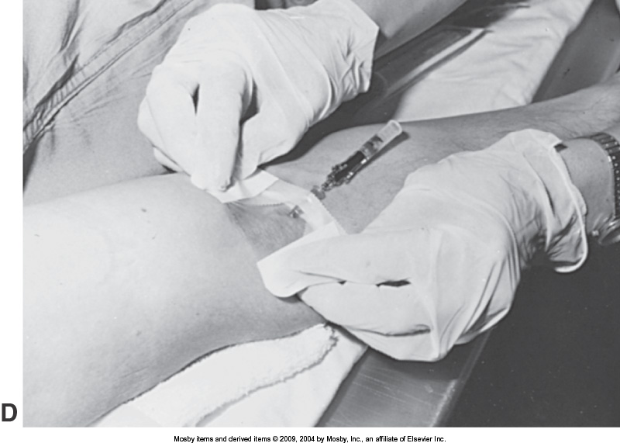
Source: Textbook of Radiographic Positioning and Related Anatomy, Bontrager & Lampignano. © Mosby Elsevier. Used with Permission.
Notes:
Observe retrograde flow of blood
Release the tourniquet
Stabilize the needle and advance the catheter fully into the vein

Slide 21
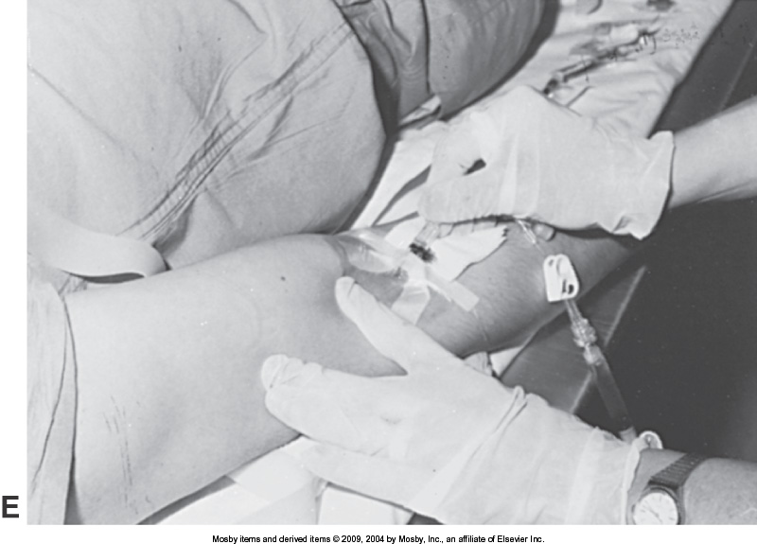
Source: Textbook of Radiographic Positioning and Related Anatomy, Bontrager & Lampignano. © Mosby Elsevier. Used with Permission.
Notes:
Apply pressure above the insertion site
Retract the needle and dispose in sharps container

Slide 22
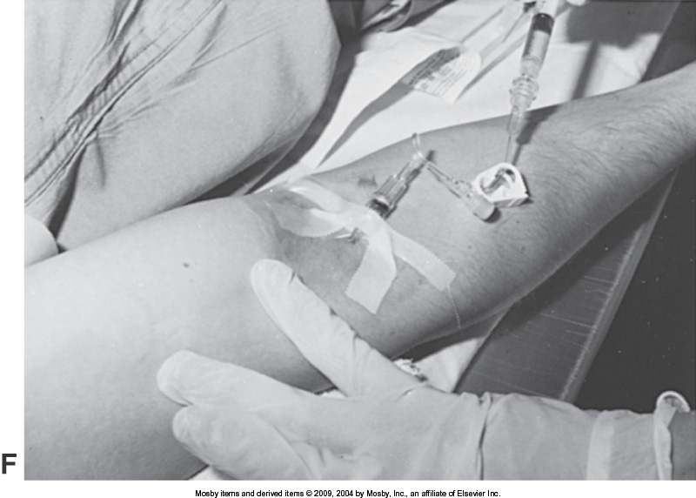
Source: Textbook of Radiographic Positioning and Related Anatomy, Bontrager & Lampignano. © Mosby Elsevier. Used with Permission.
Notes:
Attach IV tubing or adaptor to the catheter
Secure catheter in place using tape or op site.

Slide 23
Challenge Time
Assemble into your lab groups.
Write down –in order all the steps required to perform venipuncture.
NO RESOURCES ALLOWED
Your team has 7 minutes to complete this challenge.
Place your group name on the top of the sheet.
Listen to instructor directions for marking details.

