Slide 1

Colors

Slide 2
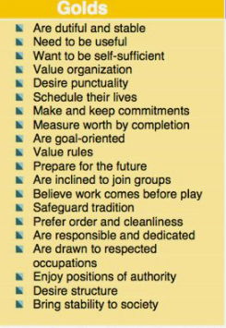


Slide 3

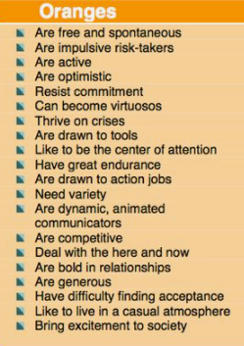

Slide 4

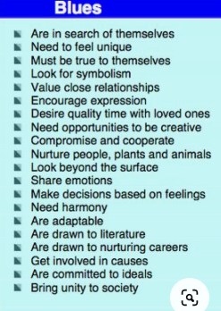

Slide 5
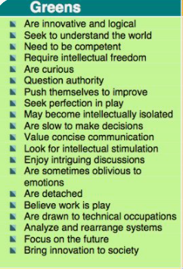


Slide 6
Designate a secretary to write the answers
Question 1 What type of work situations make you lose moticvation
How can your other color team mates help you feel appreciated

Slide 7
If you all as a team had a song, what song would that be ( you can play it for us later )
If you all as team would have a frase, what frase would that be

