Slide 1
X-Ray Production: Recipe for X-Rays
Objectives:
1.1 Describe the sequence of events while creating an image.
1.4 Describe how x-rays are produced.

Slide 2
Ingredients…
O 1. Source of electrons
O 2. Means to accelerate the electrons
O 3. Means to decelerate the electrons (Target)
O 4. Tube Voltage
O 5. Vacuum

Slide 3
Where do we get the ingredients?
O Source of Electrons
O Heated filament
O Releases the negative electrons
O Means to accelerate the electrons
O Positive Anode
    O Potential difference
    O Attracts electrons

Slide 4
Where do we get the ingredients?
O Target to decelerate the electrons
O Anode
O Tungsten target to slow the electrons
O Tube Voltage
O Power supplied by the generator
O Vacuum
O All of the action occurs in the glass envelope

Slide 5
Directions
O Electrons gather in a thermionic cloud at the cathode
O Incident electrons from the thermionic cloud accelerate to the anode
O Aka projectile or high speed electrons
O As they collide with the target (rotating at high speed), they are slowed down
O Several types of interactions occur:
O Production of heat
O Production of radiation

Slide 6
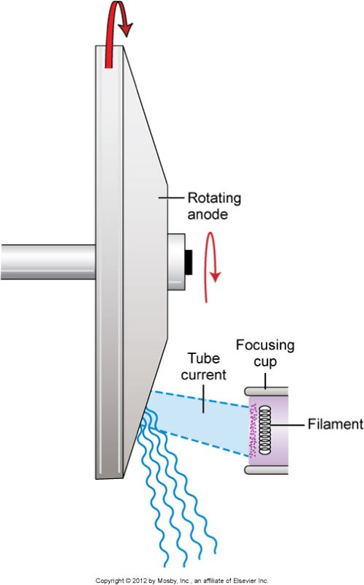
Recipe Yields:
O99% Heat
O1% X-ray Photons

