Slide 1


Perform Makeup Application Techniques

Slide 2
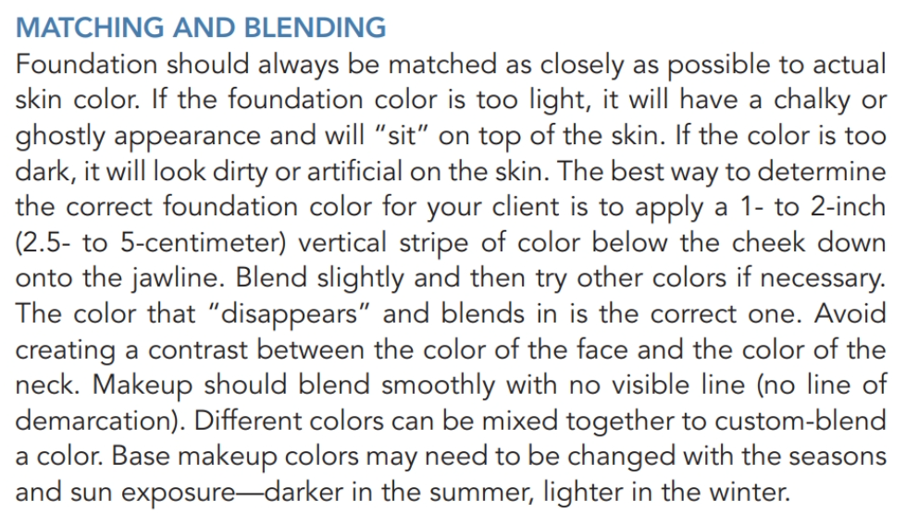
Foundation Application

Slide 3
Concealing!
Concealing is an art!
You might have watched thousands of Instagram posts about highlighted cheeks, contouring and heavy concealers, but the reality is, this techniques do not look good on real-life close-up events, only on camara with filters and edited pictures
Clients will pay for services that make them look flawless, for long periods of time, and the makeup should be HD and not cakey except if is for Theater performance.
Most of your paying clients will be clients above 30’s because of their buying power, so developing the skill of them looking them younger and satisfied is a skill you will have to practice over and over, on many different skin types, and many different skin colors

Slide 4
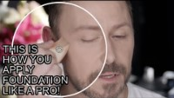

Slide 5
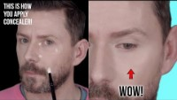

Slide 6
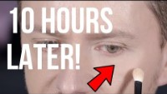

Slide 7


Slide 8
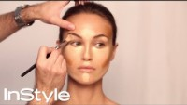

Slide 9
Face Powder Application
Face powder should match the natural skin tone and the foundation.
Do not use too much powder as it can make skin appear dry and draw attention to wrinkles
Powder sets the foundation and finishes the makeup.
Apply face powder using a brush. Use a brush to blend and remove the excess powder

Slide 10
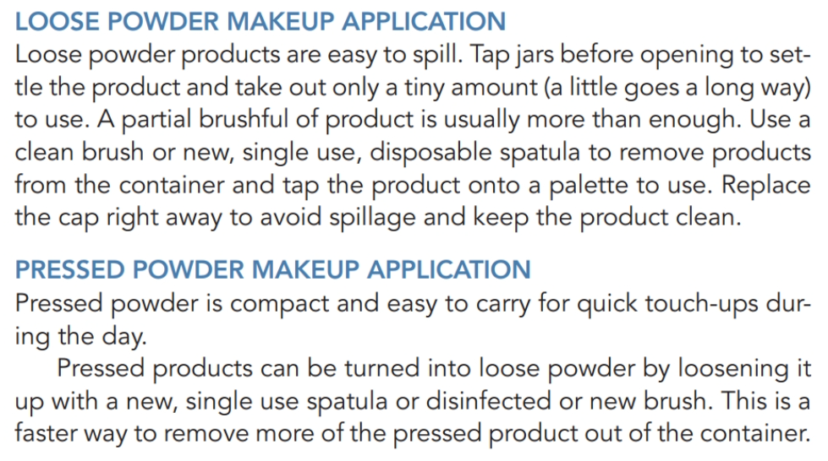

Slide 11
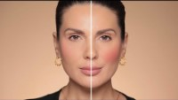
Blush Application

Slide 12
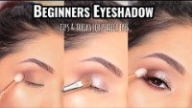
Eye Shadow Application

Slide 13
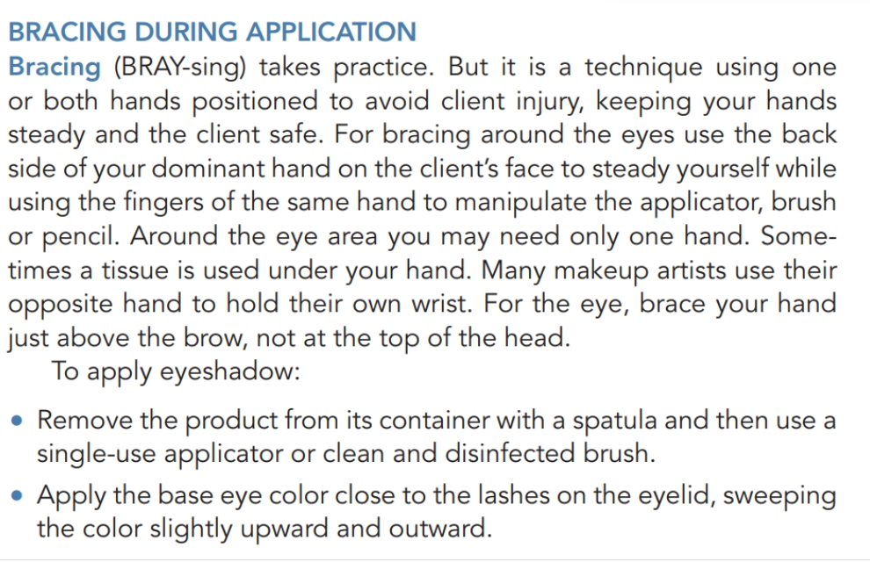
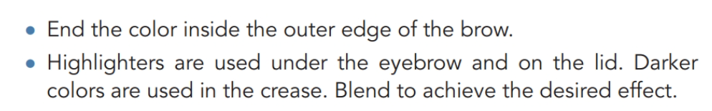

Slide 14

Eye Liner Application

Slide 15
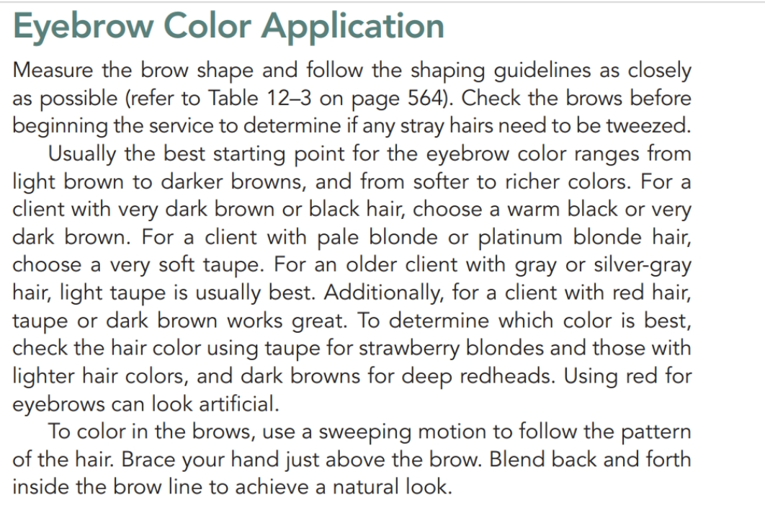

Slide 16
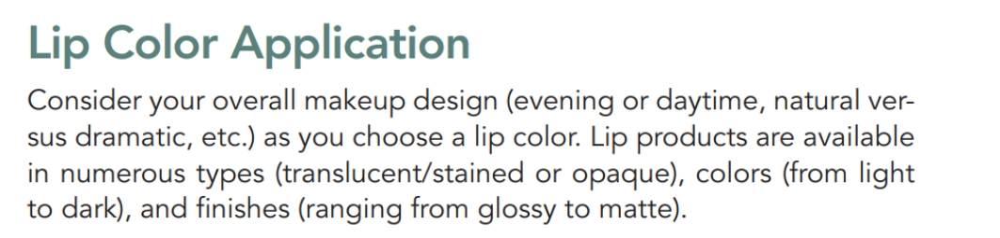

Slide 17
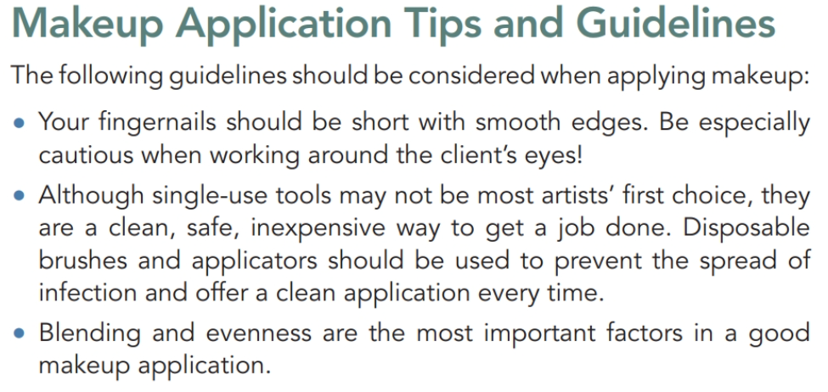

Slide 18
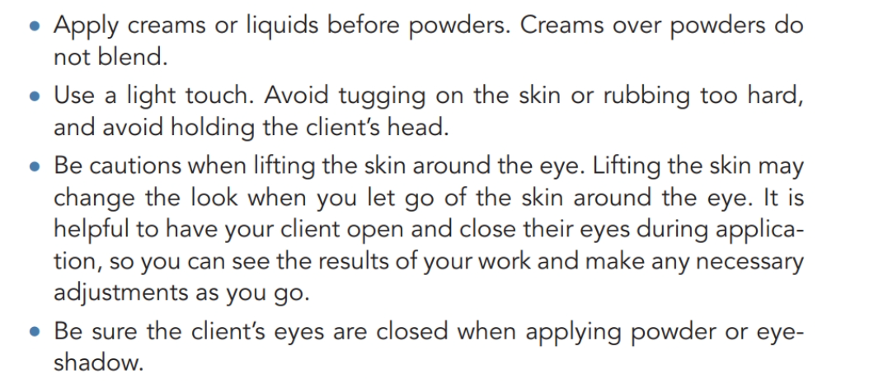

Slide 19
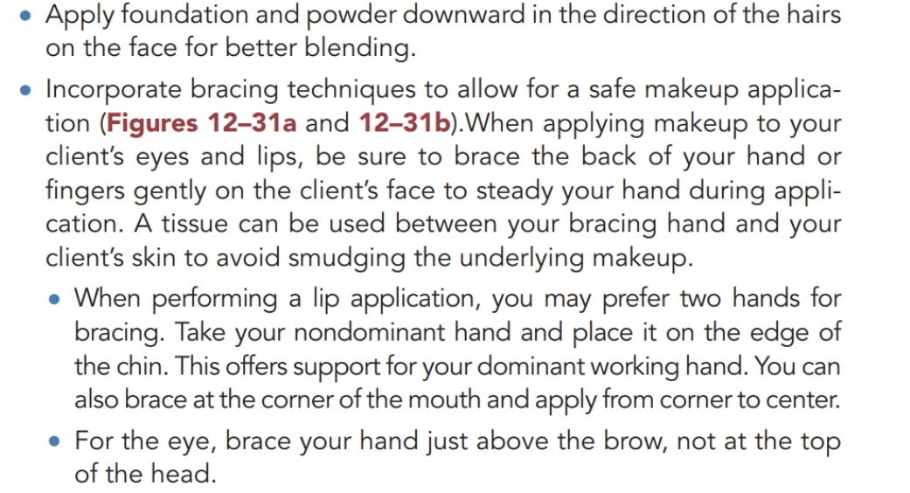

Slide 20
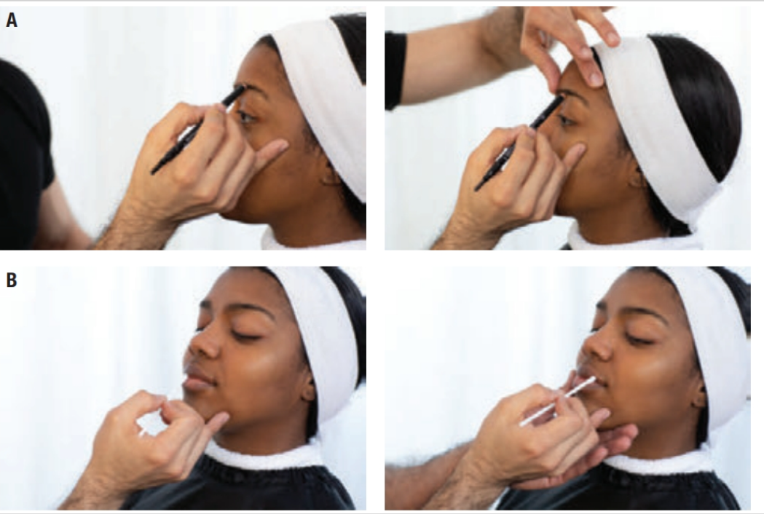

Slide 21
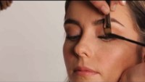
Mascara Application

Slide 22

QUESTIONS?

