Slide 1
MRAD 204:
Radiographic Technique 1
Outcome 6-10:
Image Critique – Patella, IC Fossa, and Tib/fib

Slide 2
Affiliated Readings
Bontrager Reading
Pgs: 244→245
Pgs: 253→255
Pgs: 256→261
Emphasis on the “pink box” Evaluation Criteria

Slide 3
Overview
Image Critique – Patella
Image Critique – IC Fossa
Image Critique – Tibia & Fibula

Slide 4
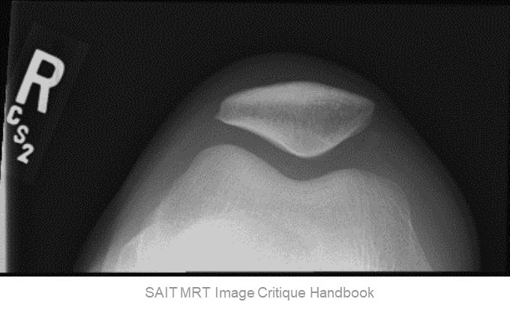
Image Critique – Patella
Anatomy
R
R
Ideally, “skyline” patella radiographs should display:
Entire patella
Intercondylar sulcus
Femoral condyles
Patellofemoral joint space

Slide 5
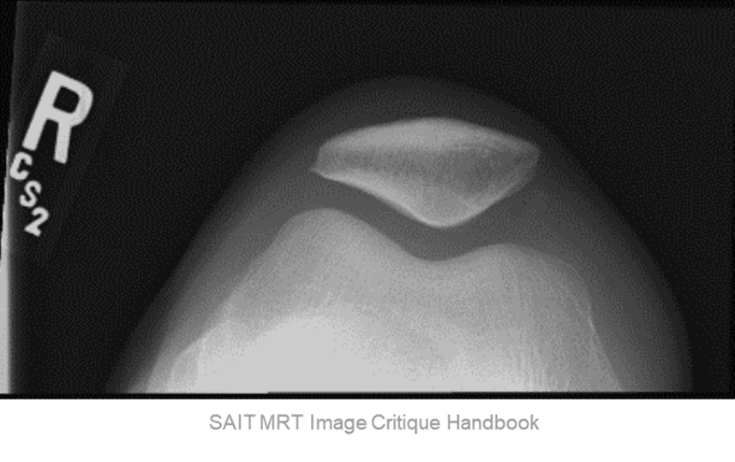
Image Critique – Patella
Exposure & Technique
R
Tangential patella radiographs should display:
Optimal density and contrast:
  no motion (i.e. blur)
  soft tissue margins visible
  clear bony trabecular markings
R
kVp range of 70→80

Slide 6
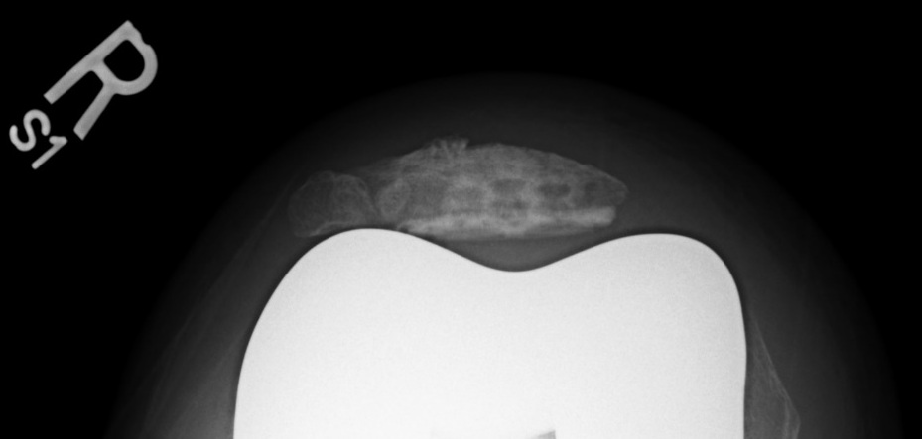
Image Critique – Patella
Marker Placement &/or artifacts
Marker placement: in the superior lateral corner of the light field, not obscuring soft-tissue anatomy
Note: A radiograph may demonstrate a surgical implant (i.e. internal fixation device)
R
No removable artifacts are visible

Slide 7
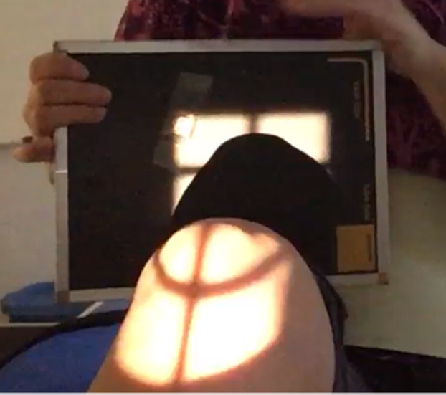

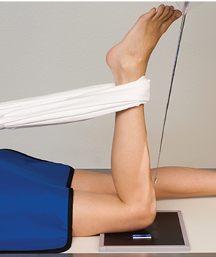
Image Critique – Patella
CR & Collimation
Note: crosshair will appear distorted in the 90/20 Settegast & Hughston Methods
Four sided collimation with lengthwise crosshair centered over the patellofemoral joint space
Bontrager pg. 260 Fig. 6.137

Slide 8
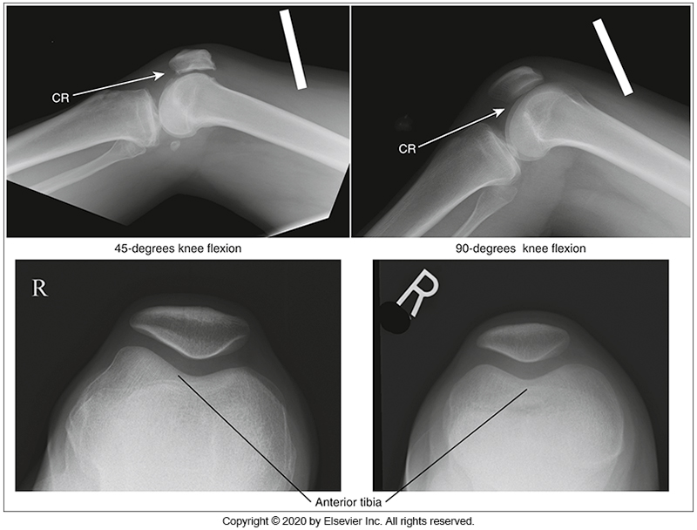
Image Critique – Patella
Position
@ 70 kVp
Note: a 45⁰ flexion will demonstrate the lateral femoral condyle superior to the medial
Note: a “true” Seated Settegast (with 90⁰ flexion) will demonstrate femoral condyles at the same height
McQuillen Martensen 5th Ed. pg. 409 Fig. 6.242
Patella and intercondylar sulcus in profile
Open patellofemoral joint space

Slide 9
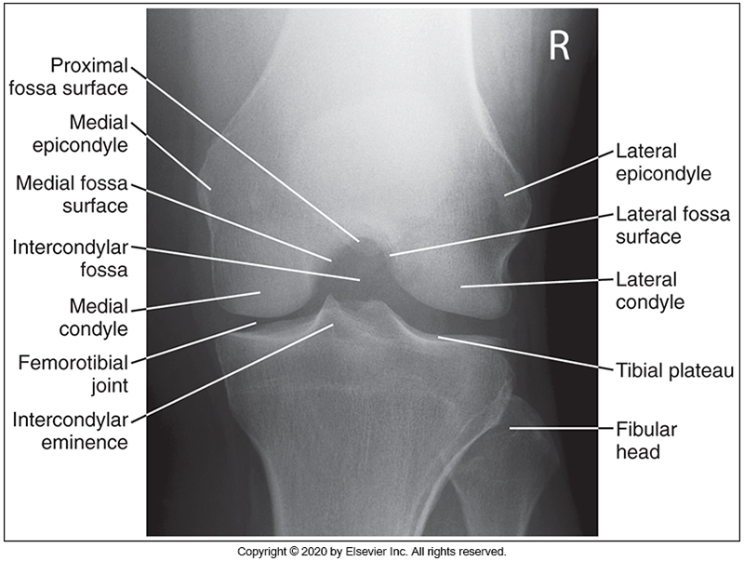
Image Critique – IC Fossa
Anatomy
L
Ideally, IC Fossa radiographs should display:
IC Fossa
Femoral epicondyles
Femorotibial joint space
R
Fibular head
Articular facets
Apex of patella
McQuillen Martensen 5th Ed. pg. 391 Fig. 6.200

Slide 10
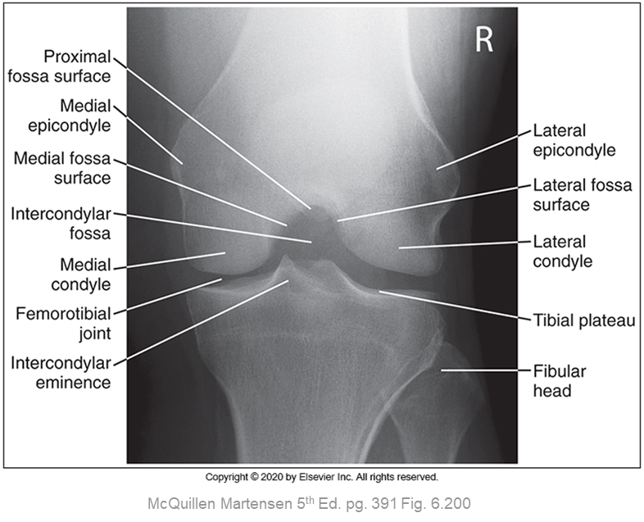
Image Critique – IC Fossa
Exposure & Technique
R
Tangential patella radiographs should display:
R
kVp range of 70→80
Optimal density and contrast:
  no motion (i.e. blur)
  soft tissue margins visible
  clear bony trabecular markings

Slide 11
Image Critique – IC Fossa
Marker Placement &/or artifacts
Marker placement: on the lateral side, not obscuring bony anatomy
No removable artifacts are visible
R

Slide 12
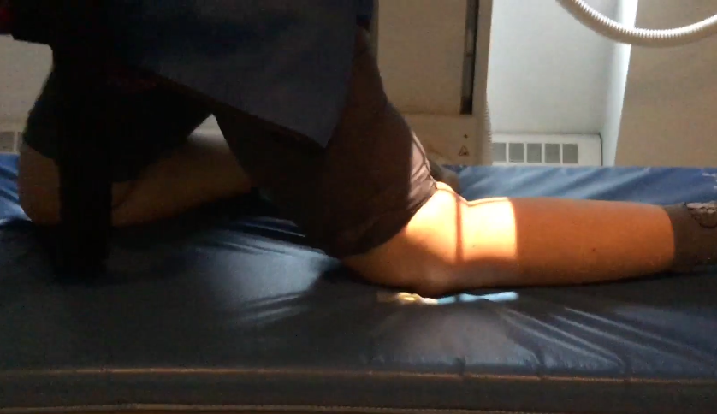
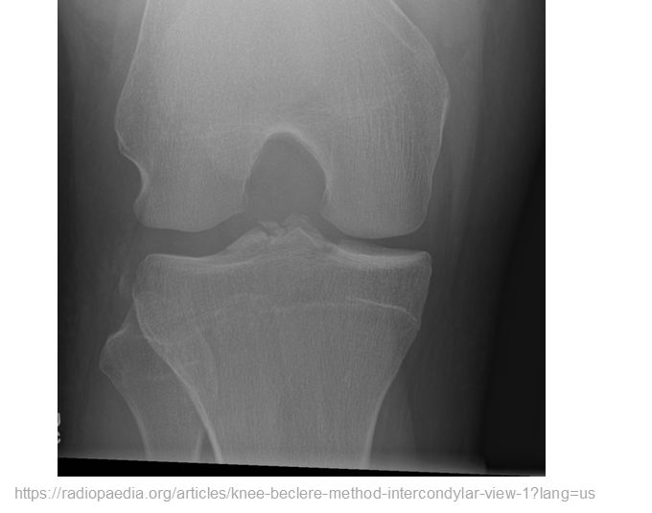
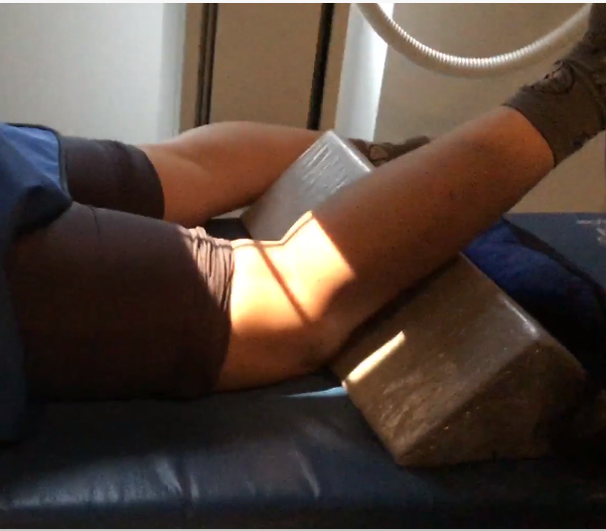
Image Critique – IC Fossa
CR & Collimation
Note: degree of flexion will cause the crosshair to appear distorted in both methods
Four sided collimation with lengthwise crosshair centered over the femorotibial joint space

Slide 13
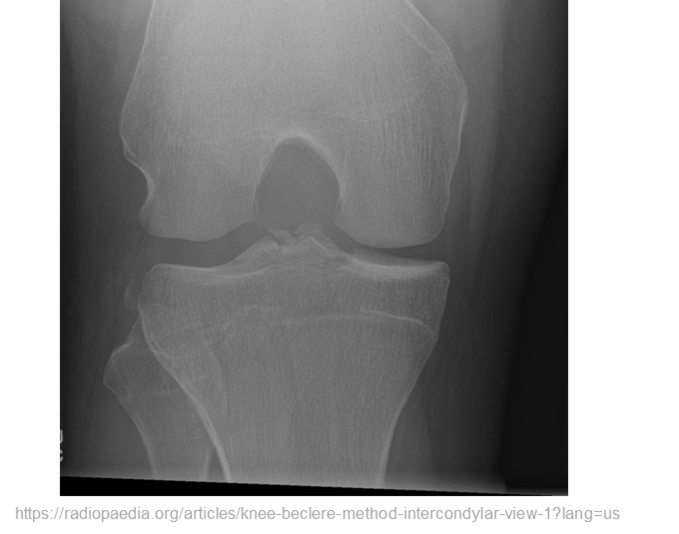
Image Critique – IC Fossa
Position
@ 70 kVp
~½ of fibular head superimposed by tibia
Intercondylar eminence in center of IC fossa
IC fossa in profile
  No superimposition of patella
Open tibiofemoral joint space

Slide 14
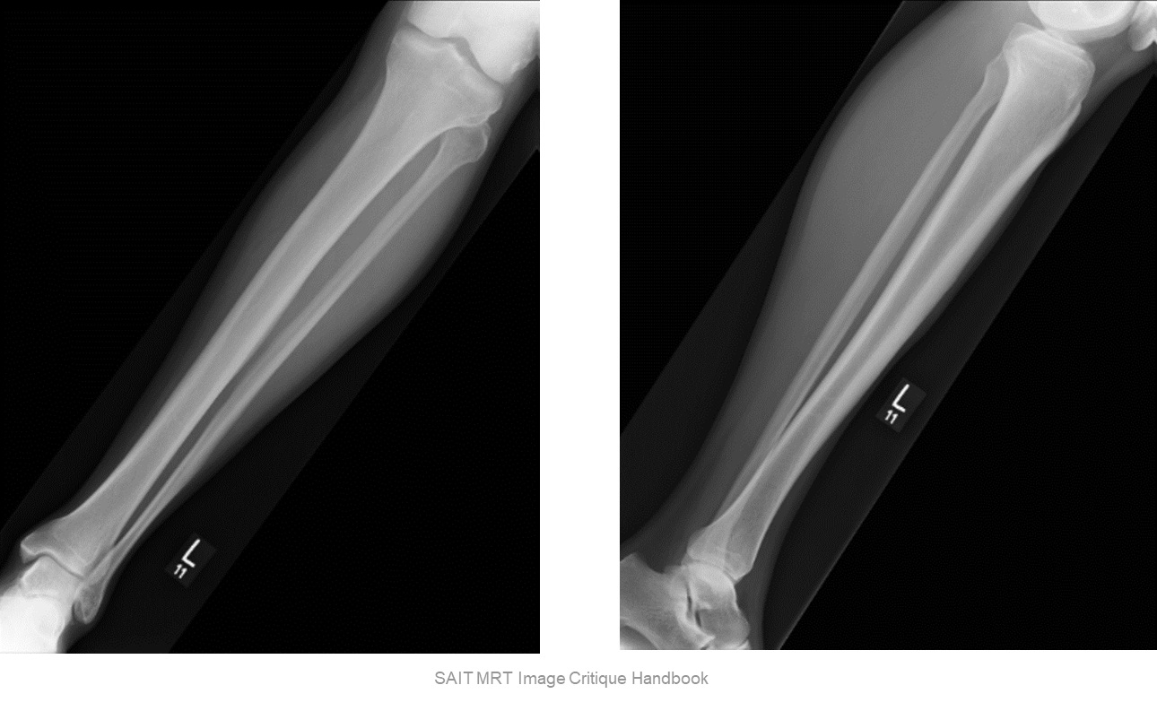
Image Critique – Tib/Fib
Anatomy
Ideally, all routine Tibia & Fibula radiographs should display:
R
Knee & Ankle joint
Entire Tibia & Fibula
Femoral condyles
All soft-tissue of lower leg

Slide 15

Image Critique – Tib/Fib
Exposure & Technique
ALL routine hip radiographs should display:
kVp range of 70→80
Optimal density and contrast:
  no motion (i.e. blur)
  soft tissue margins visible
  clear bony trabecular markings

Slide 16
Image Critique – Tib/Fib
Marker Placement &/or artifacts
Marker placement, not obscuring soft-tissue:
AP projection: lateral edge of light-field
Lateral projection: anterior edge of light field
No removable artifacts are visible

Slide 17
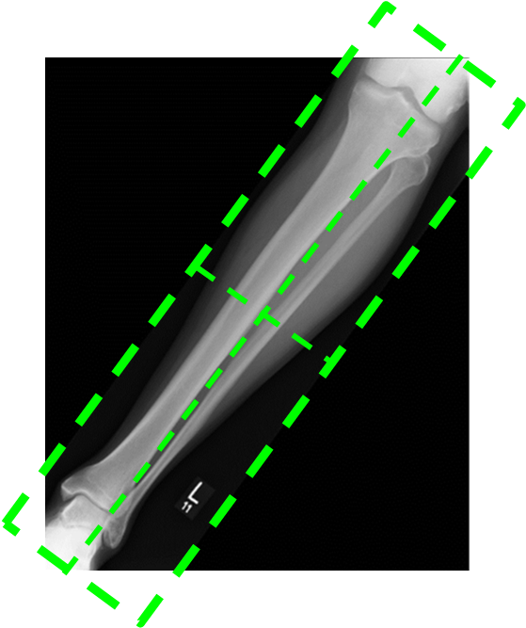
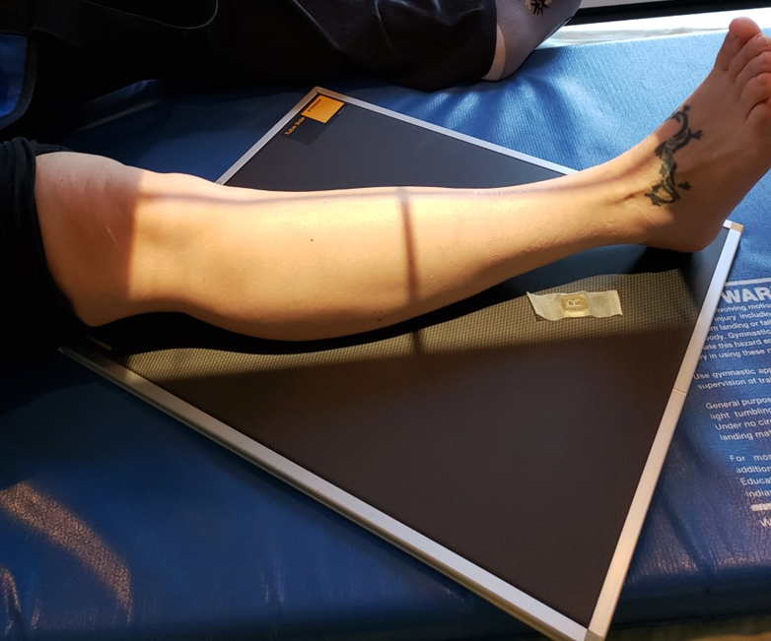
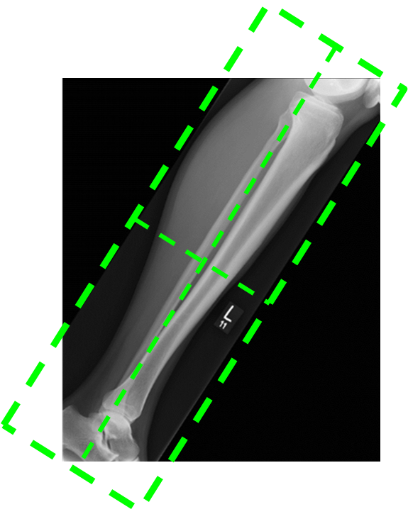
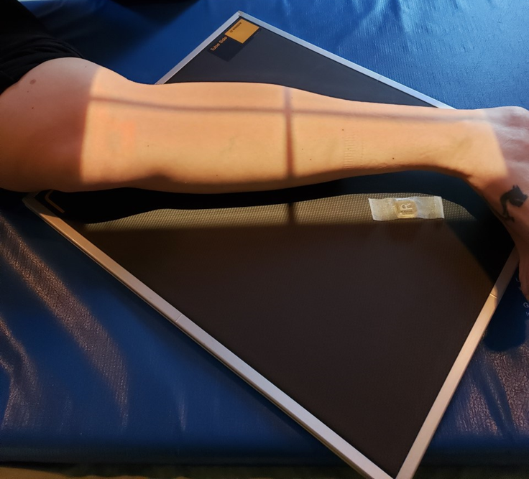
Image Critique – Tib/Fib
Four sided collimation centered to mid-knee joint
CR & Collimation

Slide 18
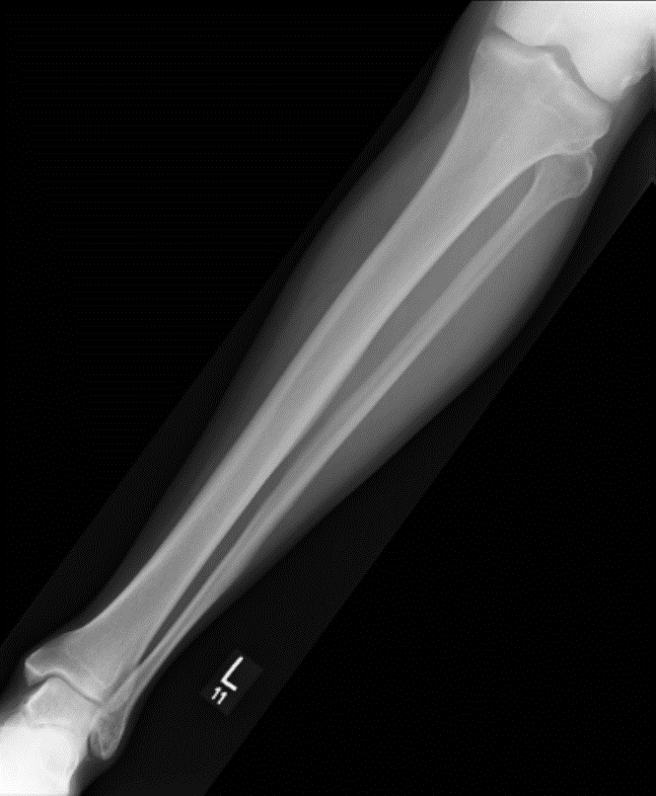
Image Critique – AP Tib/Fib
Position
@ 70 kVp
Femoral and tibial condyles in profile
Intercondylar eminence centered within intercondylar fossa
Head of fibula partly superimposed by tibia
Distal tibia and talus partially superimposing fibula
R

Slide 19
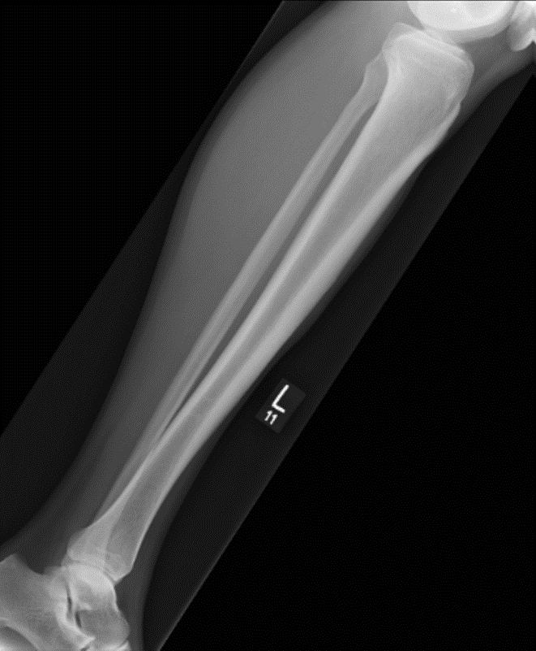
Image Critique – Lateral Tib/Fib
Position
@ 70 kVp
Tibial tuberosity in profile
Head of fibula partly superimposed by tibia
Distal fibula superimposed by the posterior ½ of tibia
Posterior borders of femoral condyles superimposed
R

