Slide 1
MRAD 256
Radiographic Technique 2
Positioning of the Thoracic Spine

Slide 2
Routine Thoracic Spine Protocol
AP
Lateral
Swimmer’s view

Slide 3
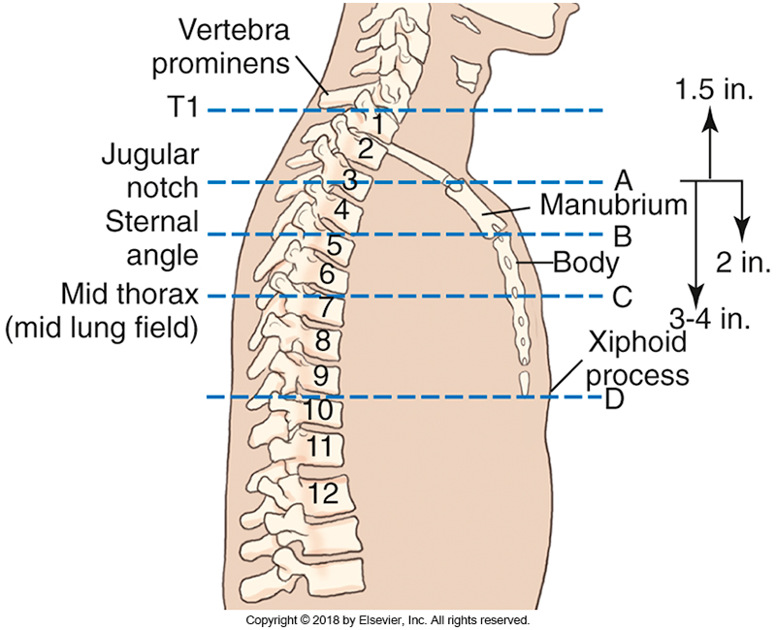
External Landmarks
~3.5 cm
~4.5 cm
~7-9.5 cm
Bontrager 9th ed. 8-40

Slide 4
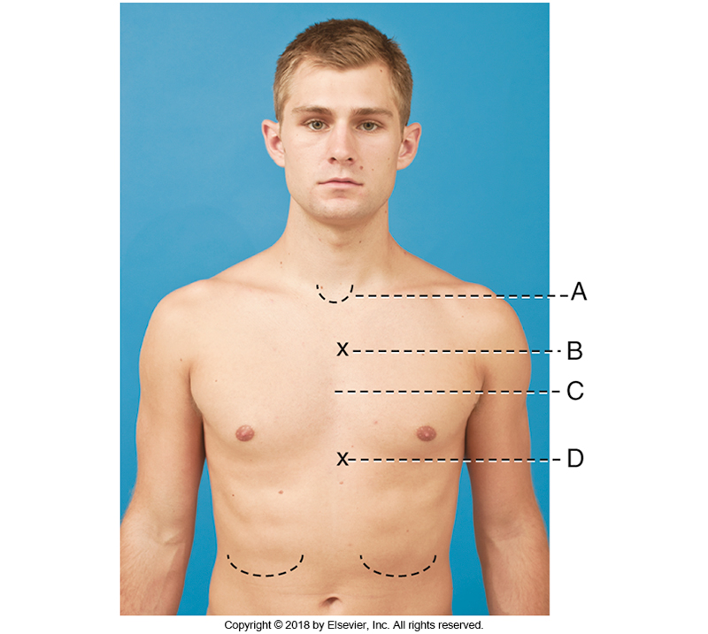
External Landmarks

Slide 5
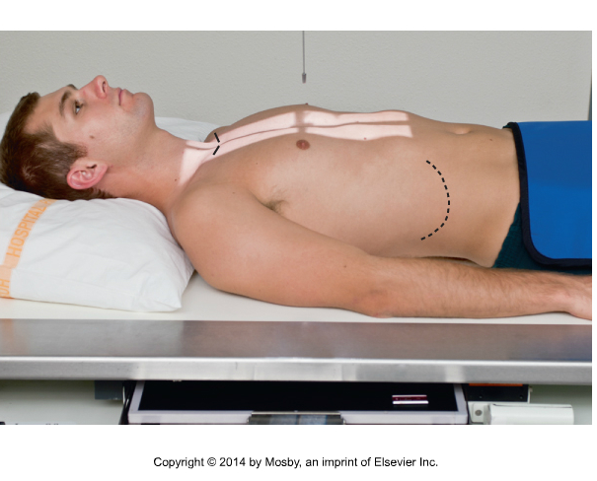
AP Projection
SID is 110 cm
CR is directed to the mid-thorax, approximately 8-10 cm below the jugular notch
Top of light-field 5 cm above jugular notch; bottom of light-field should be at the level of the LCM on the lateral side of the body
Side-to-side collimation – to the ~width of the neck
Suspend on full expiration
C7/T1
L3
Remember to adjust the collimation so that it will be the correct size when it passes the required anatomy

Slide 6
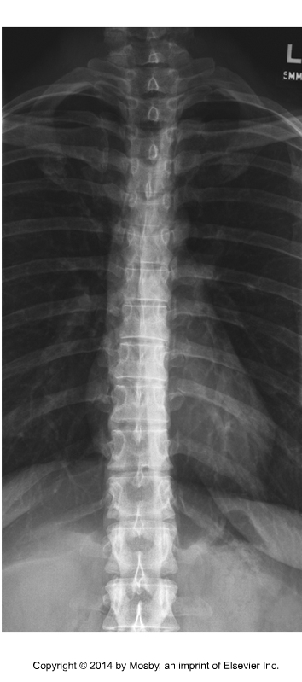
Evaluation Criteria
C7 – L1
Open intervertebral joint spaces
No rotation: spinous processes centered in vertebral bodies and SC joints equidistant from spine
Transverse processes
Costovertebral joints
L

Slide 7
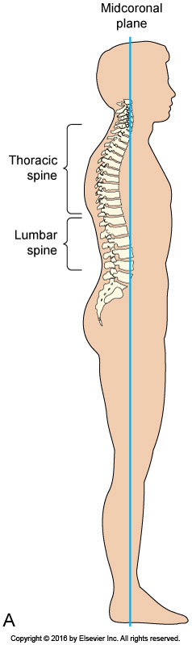
The T-spine is posterior
to the mid-coronal plane
Fig 8-72 Frank, Eugene D., Long, Bruce W., Smith, Barbara J., (2016). Merrills Atlas of Radiographic Positioning and Procedures (13th ed.). St. Louis, MO: Elsevier

Slide 8
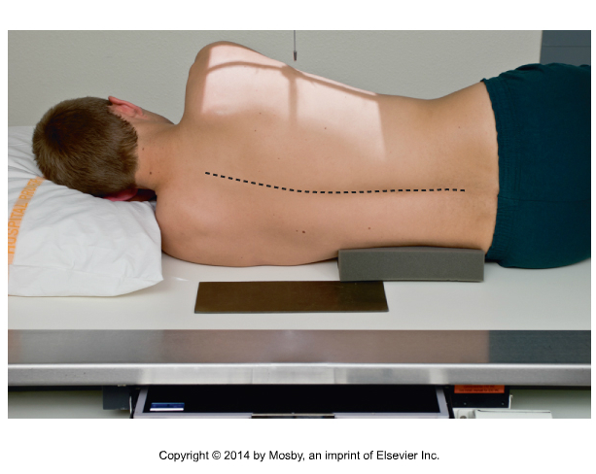
Lateral Projection
Place knees and arms at right angles to body, and sponge between knees for comfort if needed
Use a sponge or a tube angle to ensure vertebral column is  to CR
CR centered at level of T7 in posterior half of thorax
Hold on expiration
T2/T3
T12/L1
Bontrager 9th ed. 8-83

Slide 9
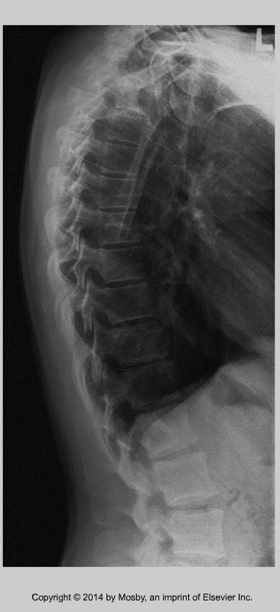
Evaluation Criteria
T3 to T12
Open intervertebral joint spaces (no tilt)
Open intervertebral foramina
Superimposition of posterior aspects of vertebral bodies (no rotation)
< 1. 25 cm space between right and left posterior ribs (no rotation)
Bontrager 8-84
You need to see L1, to prove you have T12

Slide 10
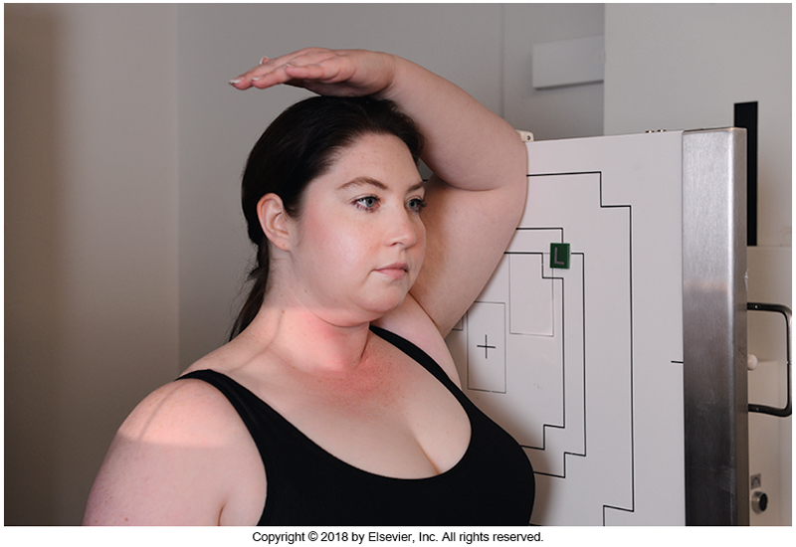
Swimmer’s Lateral (Twinings)
SID 150 or 180 cm if erect
Rotate collimator so lengthwise
crosshairs are parallel to MCP of neck
Angle CR 5º caudad, and center at the
level of vertebral prominens
Collimate to include C5-T3
Elevate left arm and have patient
reach for toes with right arm
Suspend on expiration
Bontrager 9th ed. 8-62

Slide 11
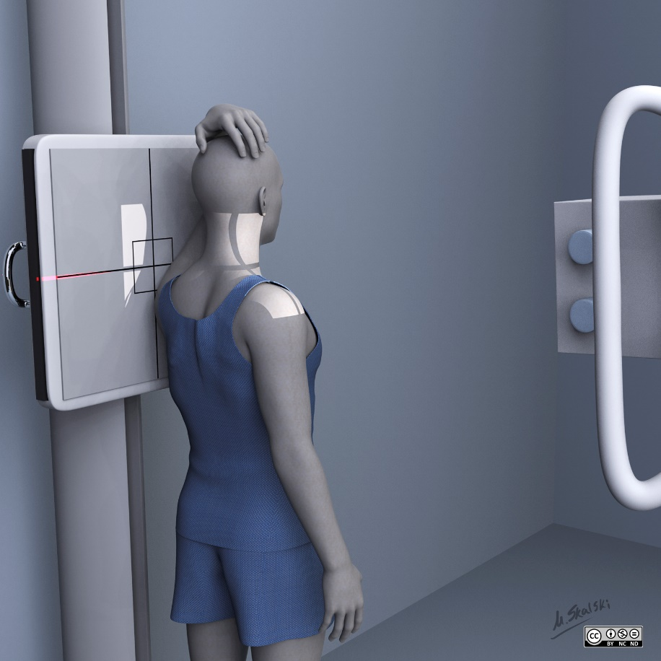
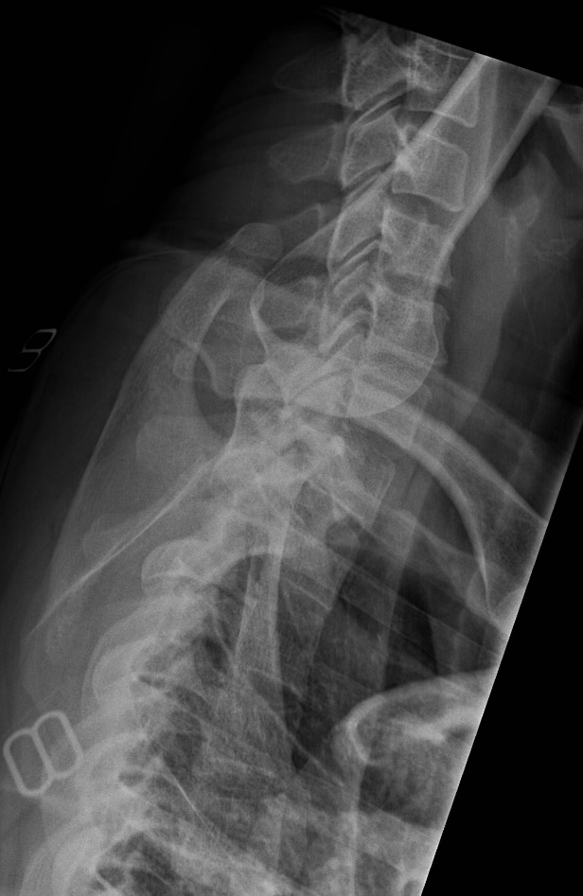
Swimmer’s Lateral (Twinings)
Case courtesy of Dr. Matt Skalski, Radiopaedia.org, rID: 83452
Case courtesy of Andrew Murphy, Radiopaedia.org, rID: 48418

Slide 12
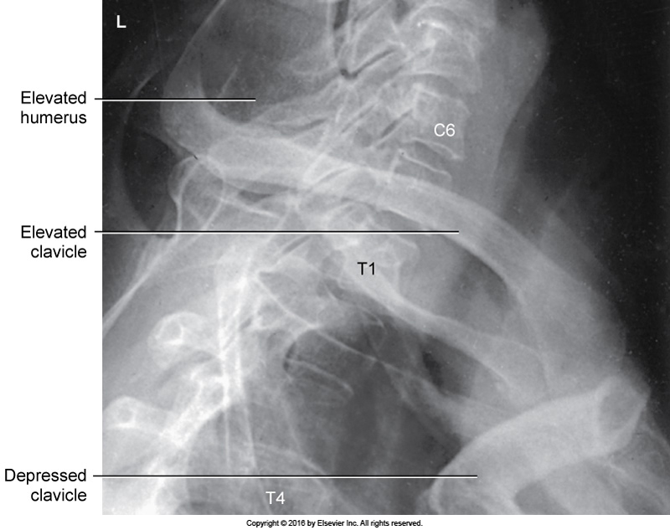
Evaluation Criteria
Lateral view of C5 to T3 for non- trauma
Superimposed zygapophyseal joints (no rotation)
Separated humeral heads
Penetrated shoulder area

Slide 13
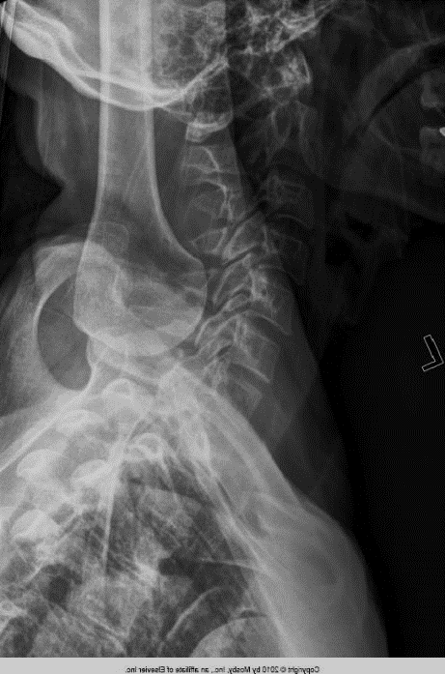
Radiographic Criteria - Trauma
X-table trauma swimmer’s: skull base to T4

Slide 14
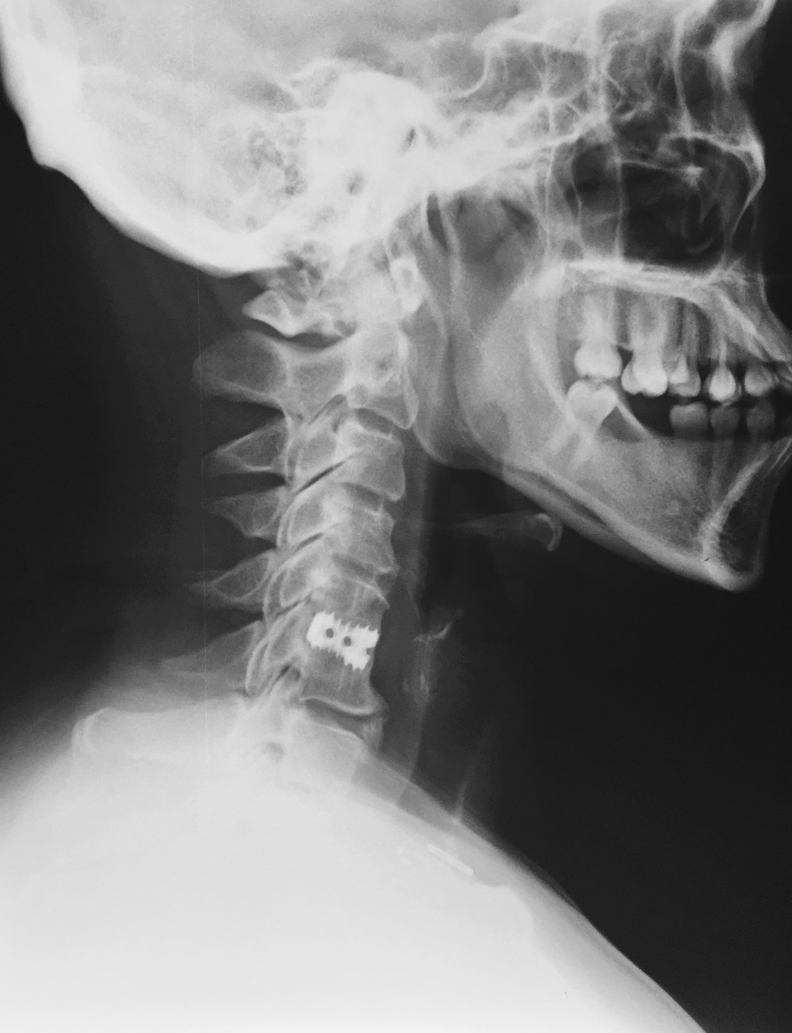
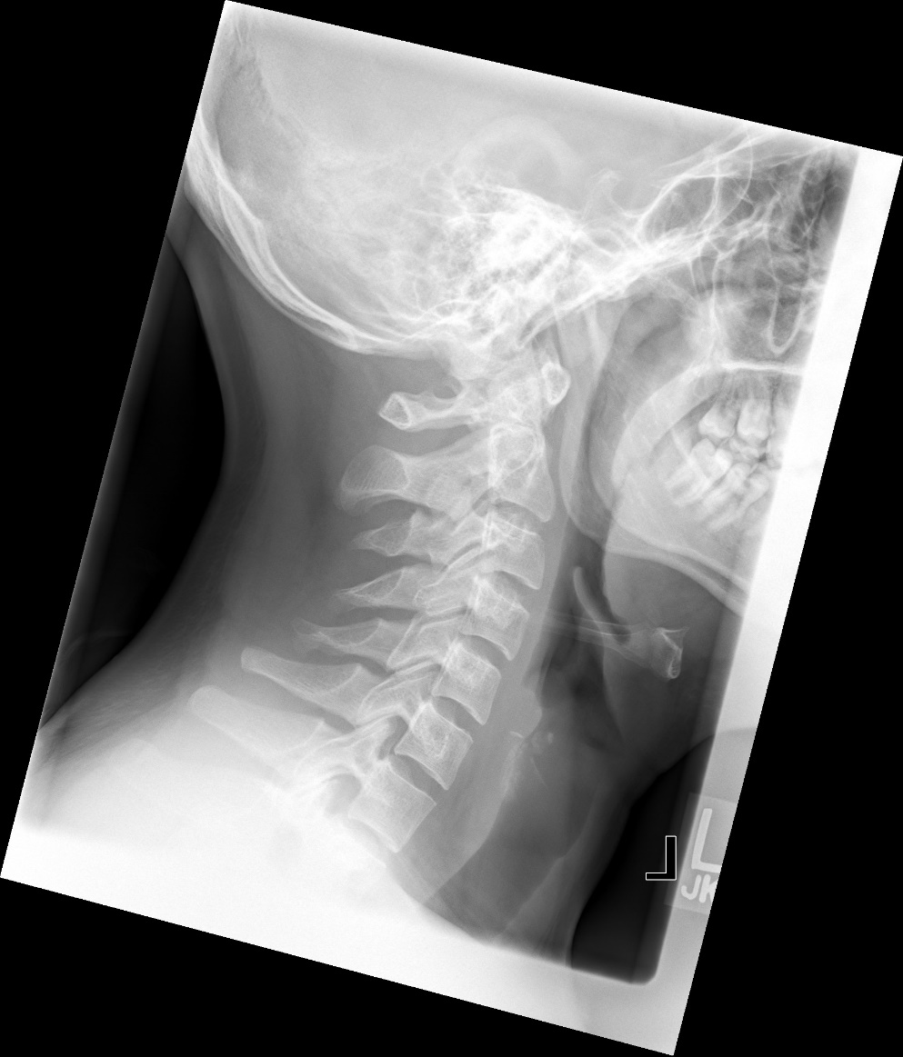
Swimmers for C-Spine
Case courtesy of Dr. Ian Bickle, Radiopaedia.org, rID: 49612

Slide 15
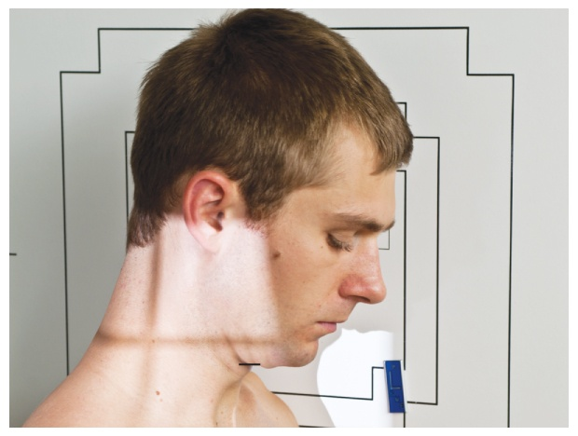
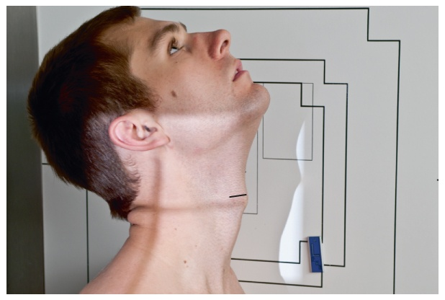
Additional C-Spine requests
Flexion and Extension Lateral Cervical Spine
Special request as a functional study
Non-trauma patients
Performed to assess spinal stability

Slide 16
Performed the same as a true cervical spine lateral
Patient tucks chin down, remaining in lateral position for flexion image
Patient extends head back, remaining in lateral position for extension image
Images are appropriately labeled with radiographic “Flexion” and “Extension” markers
Flexion
Extension

Slide 17
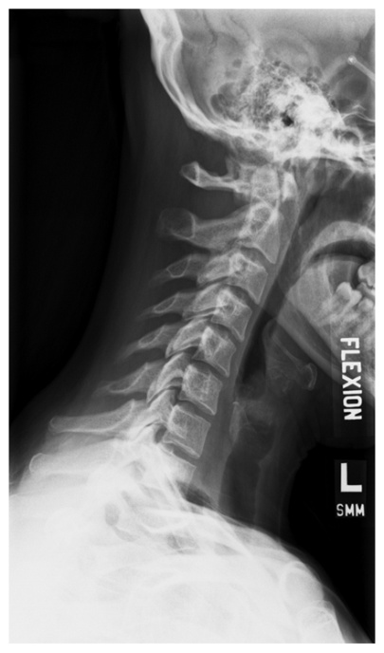
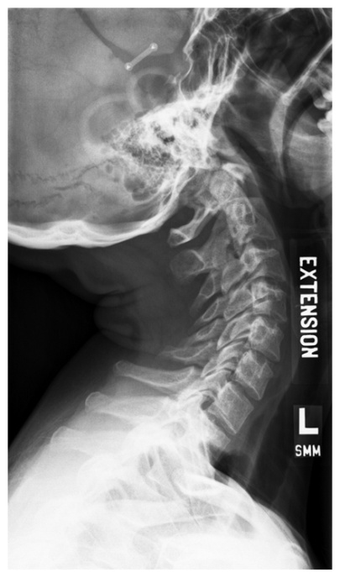
Evaluation Criteria
C1-C7 visualized
No rotation
Flexion
  Spinous processes well separated
Extension
  Spinous processes in close proximity
Optimal exposure factors

