Slide 1

MRAD 251: CT Theory 1
Outcome 7 (Part 2):
Summarize the use of contrast media and intravenous injections in computed tomography (CT)

Slide 2
Objectives
2.5 Explain the components and operation of contrast medium injection devices
Outline the factors that determine the route of the contrast media and equipment selection
Identify proper sterile techniques when performing intravenous injections

Slide 3
IV Access
Stable IV access is necessary for contrast media administration.
IV line can be established in the CT department
Or the IV line could be pre-established
  Indwelling peripheral catheters
  CVADs
AC or large forearm vein is preferred when using a pressure injector
  Bending at the IV site may cause the injection to fail
  Flow rates need to be ↓ if accessing a smaller vein and a smaller bore/larger gauge is required
•

Slide 4
Pre-existing Vascular Access
When a pt. arrives in the CT department with an existing indwelling peripheral venous catheter, it must be carefully evaluated before it can be used to administer contrast media.
Location
Age
Un-accessed connecting hub or port
  Okay if accessed by saline or dextrose in water
No redness, blanching or swelling in the surrounding skin

Slide 5
Central Venous Access Device (CVAD)
Designed to deliver medications & fluids directly into the SVC (superior vena cava), IVC (inferior vena cava), or RA (right atrium).
Used for days, weeks, months, or years
Durable
  Not as easily blocked or infected
May contain 1-3 lumens
  Each should be used as an independent catheter port
    Prevents mixing of meds
  Catheters can have open or closed ends

Slide 6
Central Venous Access Device (CVAD)
PICC’s (peripherally inserted central catheter)
•
Must be clamped when not in use
Should be flushed with heparinized saline to maintain the catheters patency between uses
Close ended catheters:
Contain a valve that controls fluid flow & prevents reflux of blood into the catheter
Only requires a saline flush to maintain patency

Slide 7
PICCs
Only specially designed PICCs can handle a mechanical injection.
Make sure you verify it can be used
  If not, start a separate IV
    Must establish standard peripheral IV’s for contrast admin.
  Or, decrease injection rate & perform a hand injection NOT mechanical
Accessing & de-accessing an implanted port requires special training & is beyond the scope of a CT tech
  Example: Tunneled CVC (central venous catheters)

Slide 8
CVAD’s
Only sterile devices or needles are used to access CVADs
Disinfect the injection caps & dry prior to use
Before administering ANY substance the patency of the central line must be verified
  Demonstrate blood aspiration
    Most sites use a 10mL saline syringe
  Contraindications to injecting contrast media:
    Inability to demonstrate blood aspiration can indicate catheter malposition or
occlusion
    Resistance to flushing a CVAD may cause the catheter to rupture
    *Dialysis catheters should never be used for contrast administration

Slide 9

Basic Principles of IV Contrast Administration
Protocols establish proper injection parameters:
Goal is to select parameters that consistently improve images & facilitate studies
  Volume & Concentration
  Flow rate(s)
  Pressure limits
  Timing of injection & scan acquisitions
Documentation is required (such as):
Name of agent used & Lot number
Dose
Flow rate(s)
Injection site

Slide 10
Injection Methods
Method of injecting IV contrast depends on:
Vascular access
Type of exam
Exams clinical indications
Can be injected via the following methods:
Drip infusion
Hand
•
  Most common IV method

Slide 11
Mechanical Injectors
(Aka. Power Injector, Pressure Injector or Pump)
Used to deliver a bolus of contrast in a short period of time
Provide reproducible levels of contrast media enhancement
Considerations:
Connection tubing must be capable of withstanding the pressure of the injection
Air bubbles in the syringes & tubing must be cleared prior to making the (final) patient connection
  Prevents possibility of potentially fatal air emboli
Patency of the established IV site must be checked with blood aspiration, resistance, and a saline flush prior to use

Slide 12
Mechanical Injector Risks
Risk | Symptoms | Prevention | Management
Infiltration Contrast media leaking into surrounding tissues | Pain at injection site Swelling at injection site Possible Hematoma | Ensure patient’s arm is straight and IV line is not kinked Ensure proper dose is delivered Ensure stability of vein by flushing IV with saline prior to injection Choose a large enough vein for injection (consider rate and volume) | Stop injection if patient complains of pain at injection site or if you notice swelling at injection site Remove needle immediately, maintain pressure on the vein to prevent hematoma Apply cold pack to help reduce pain
Extravasation Contrast media accidentally injected into surrounding tissue IV becomes dislodged
 |  | Choose a large bore IV catheter

Slide 13
Mechanical Injector Components
Warming device(s)
Syringe(s)
  pistons
Pressure mechanism
Control panel

Slide 14
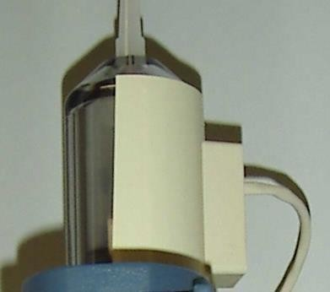


Mechanical Injector Components
Warming Device:
Attaches to a syringe
Maintains temperature of the contrast agent at or near body temperature (37ºC)
•
  Contrast agent must be warmed prior to being drawn into the pressure injector syringe
SAIT MRT Program 2011

Slide 15
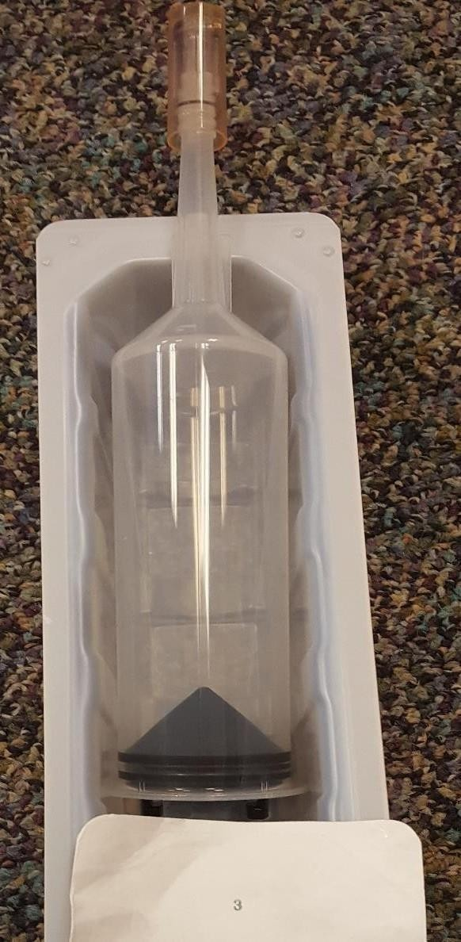


Mechanical Injector Components
Syringes:
Removable, pre- sterilized & disposable
  Common sizes:
o 150→200mL
Attaches to the loading assembly (i.e. top of the “pressure mechanism”)
Contains the pistons for contrast loading & delivery
SAIT MRT Program 2017

Slide 16
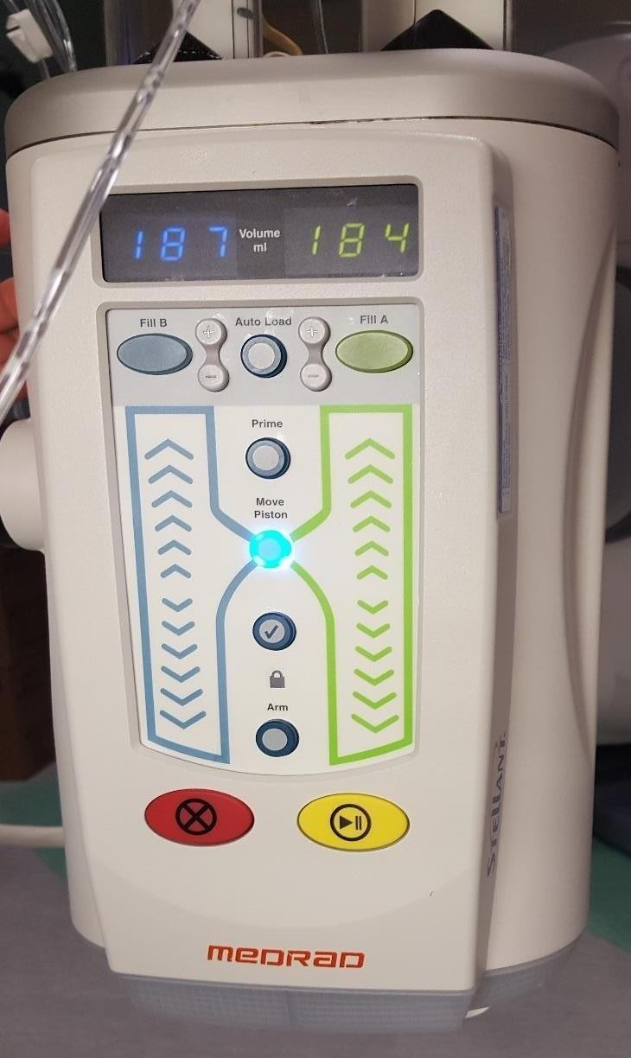
Mechanical Injector Components
Pressure Mechanism:
The ‘body’ of the system
  Ceiling or floor mounted
    Mobile
      (can be used on either side of the pt.)
Consists of an electromechanical motor
  Used to drive piston movement
•
Safety devices built-in
  Programmable pressure limits
  Audible alarm
Image taken @ RRDTC Dec. 6th 2016

Slide 17
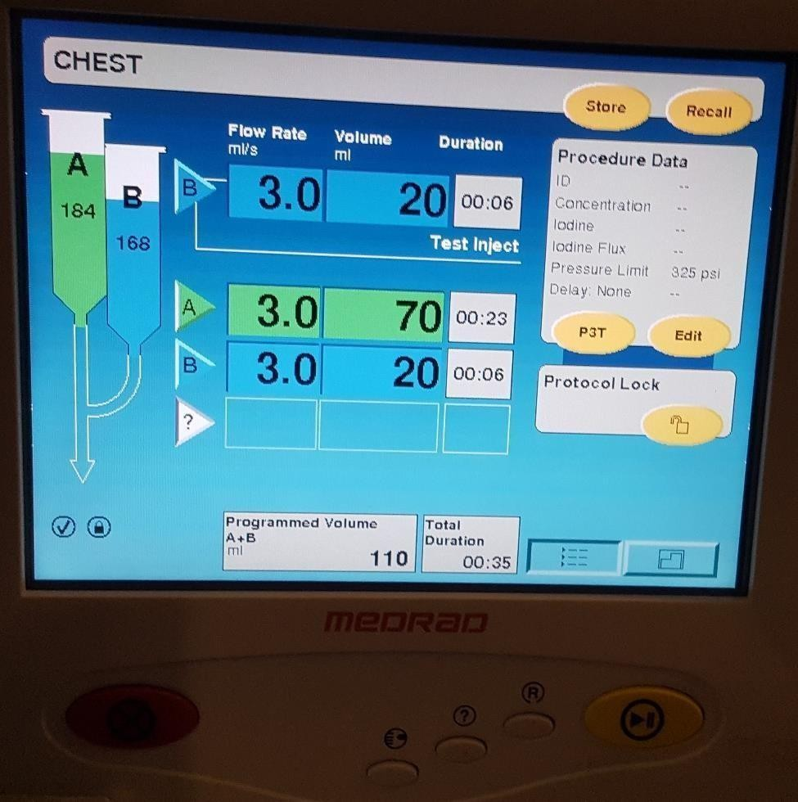
Mechanical Injector Components
Control Panel:
Enables technologist manipulation of injection parameters, such as:
  Flow rate
  Volume
  Pressure Limit
    (PSI; pounds per square inch)
Stores injection parameter protocols into their memory
•
Can also provide a patients injection history
Image taken @ RRDTC Dec. 6th 2016

Slide 18
Timing of IV Contrast
Timing is very important for injections
Blood flow dilutes the contrast media very quickly
Determines when image acquisition would demonstrate optimal contrast enhancement within the anatomy of interest
Software allows the injector to be electronically connected to the imaging equipment, synchronizing the injection with image acquisition
  Usually built into the software and scanning parameters

Slide 19
General Phases of Tissue Enhancement
Three phases:
Bolus
Non-equilibrium
Equilibrium
Phases are classified by rate of contrast enhancement
  Helps determine ideal time between the initial administration of contrast media & scan acquisition

Slide 20
Bolus Phase
(Aka. Arterial phase)
•
IVC & Aorta have a difference of 30 or more HU’s
Arterial structures are filled with contrast
  Venous structures are not yet enhanced
•
Peak Aortic enhancement commonly occurs within 24-45 seconds after bolus injection
  Peak organ enhancement occurs about 5-15 seconds later
Plateau typically lasts 10→15 seconds
Imaging usually occurs during the plateau

Slide 21
Enhancement Considerations
Imaging during the “plateau” enhancement period enables more consistent imaging
Most organs have an arterial blood supply
Examples: pancreas, bowel, & bladder
Kidneys are an exception
  They also excrete contrast
  Peak enhancement is 80→120 seconds after injection
    A scan delay should be used between liver and kidney scans
Liver has a dual blood supply
Portal vein & hepatic artery
  Portal venous scans of the liver occur 60 seconds after a bolus injection
    Includes arterial & venous enhancement

Slide 22
Enhancement Considerations
Routine brain scanning
For metastases or primary central nervous system tumors
Enhancement is due to BBB disruptions, not the vascularity of the tissue
  Injection rate is of no importance
  Scan delay is an important consideration
    4 minutes or longer
Non routine brain scans:
CT angiography or CT brain perfusion scans
  Must follow routine contrast injection protocols

Slide 23
Non-equilibrium Phase
(Aka. Venous phase)
Follows the arterial phase
•
Has a 10→30 HU difference
  Aka. AVID (arteriovenous iodine difference)
Contrast is still brighter in the arteries than the parenchyma of organs, but venous structures are now opacified
•
  Depends on volume & flow rate of contrast agent
Most routine (non-angiography) images are acquired in this phase

Slide 24
Equilibrium Phase
(Aka. Delayed phase)
•
Contrast media is emptied from the arteries, diluted from the veins & soaked the organ parenchyma
AVID of less than 10HU
Worst phase for liver scans

Slide 25
Timing Factors
The exact timing of the start and end of each of the three phases are affected by the following factors:
Pharmacokinetic
Patient
Equipment

Slide 26
Pharmacokinetic Factors
Are controllable and include:
Contrast media:
  Volume
  Flow Rate
  Flow Duration
  Scan delay time
  Total scan time
Affect peak enhancement time
Contrast media characteristics
  Osmolality
  Viscosity
  Concentration

Slide 27
Total Volume Calculations
Total volume of contrast media injected can be calculated using this formula:
V= (mL/sec)sec
V = Total Volume
mL/sec = Flow Rate
sec = Injection time in seconds

Slide 28
IV Contrast Media Concentration
Higher concentrations are:
Compensated with a lower injection rate & decreased volume
  To maintain adequate enhancement/dose
  Higher injection rates ↑risk of extravasation
  Higher volumes also challenge the stability of the IV
Good for CT angiography studies
More viscous
More likely to cause streak artifacts

Slide 29
Time-Density Curves
Depict effects of aortic & hepatic enhancement
Aortic enhancement effects are more pronounced
For constant injection rates:
  ↑contrast volume = ↑peak enhancement & ↑time to reach peak
    i.e. Overall levels of enhancement are maintained longer
For constant volumes/doses of contrast:
  ↑flow rate = ↓time to peak enhancement
    Scan delay should be adjusted to flow rate
  Flow rates are typically uniphasic
    Can be manipulated to change characteristics of the time-density curve
      (aka. Bolus Shaping)
Prolongs peak enhancement, ↓need for precise scan timing

Slide 30
Patient Factors
The following patient factors affect contrast enhancement:
Age
Gender
Weight
Height
Cardiovascular status
i.e. Cardiac output
Renal function
Presence of disease
Injection parameters can be adjusted to compensate for the patient factors that affect contrast enhancement

Slide 31
Equipment Factors
CT Scanner capabilities affect scan timing & contrast administration
Faster scanners:
  Delay between injection of contrast media & scan acquisition must be increased
    Ensures scanning will occur during peak enhancement
  ↓ scan time = ↑ scan delay
  May enable the use of a smaller volume of contrast media
    However, if volume is ↓peak enhancement will also ↓
      Injection rate or concentration must be increased to compensate

Slide 32


Automated Injection Triggering
Two methods:
1. Test Bolus
Useful for vascular (CTA) studies
Ensures imaging during peak enhancement regardless of patient:
  Age
  Disease
  Cardiac output

Slide 33
Test Bolus
Injection of a 10→20mL IV bolus of contrast media
Test injection is delivered at the same rate as the diagnostic scan
Trial “image slices” are taken
  Using the lowest mA setting possible
    2 second intervals are common @ the same anatomical location
      Total of 10→15 images acquired
  Determines the length of time from injection to peak enhancement
    Identifies ideal duration of delay between injection & scan acquisition
•

Slide 34
Bolus Triggering
Aka. Bolus tracking, or Automated triggering
More efficient than Test Bolus technique
Uses the contrast bolus itself to initiate scan acquisition
A single cross-sectional slice is used to place an ROI
Uses a series of low-dose “image slices” to monitor contrast bolus
progression over the selected ROI
  Aka. “Monitor scans”
Once the desired HU is achieved (computer automatically triggers) or the technologist will manually trigger the scan acquisition
  Table needs time to move the patient into the appropriate “start” position
•

Slide 35

Bolus Triggering
Limitations/Special Considerations:
Delay between last monitor scan & the start of scanning may ↓ accuracy of imaging during peak aortic enhancement
  Compensate for delay by triggering scan acquisition early
Technologist is not able to stay in the room with the patient during contrast administration
  ↑risk of extravasation
•
  Bolus Triggering should only be used for vascular (CTA) studies

Slide 36
Things to Take Away
IV Access & Basic Principles:
Pre-existing access devices
  CVAD’s
  PICC’s
Mechanical Injectors:
Purpose
Components
Timing
  Tissue Enhancement factors
  Automated Injection Triggering

