Slide 1
Radiographic Anatomy of the Skull
MRAD 256
Radiographic Technique 2

Slide 2
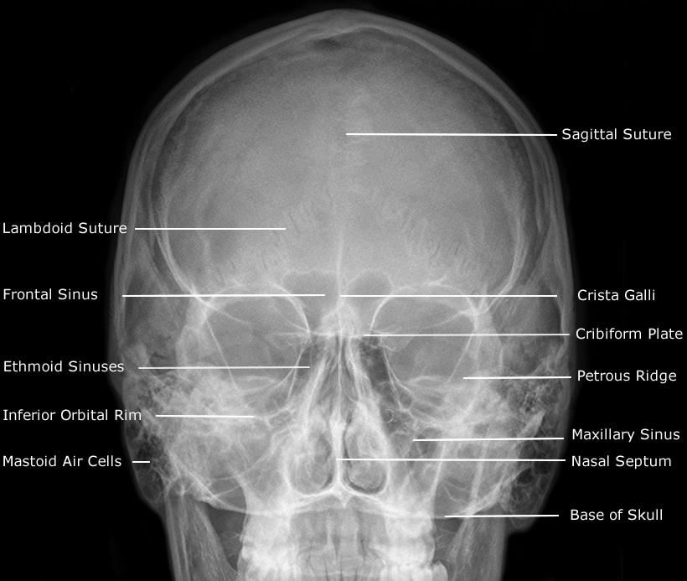
Radiographic Anatomy of the Skull

Slide 3
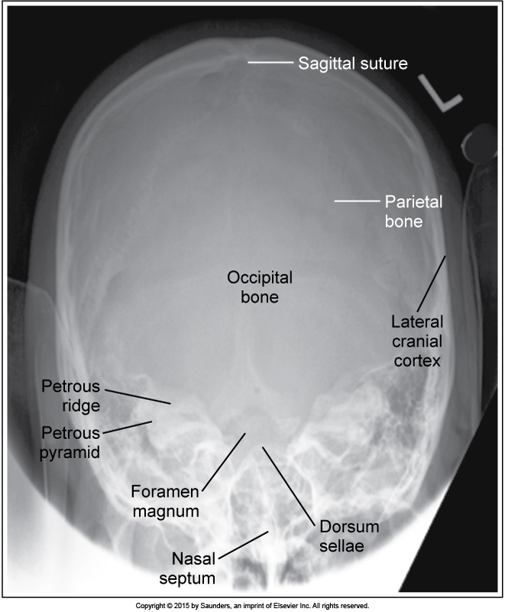

Slide 4


