Slide 1
MRAD 256
Radiographic Technique 2
Mandible Anatomy

Slide 2
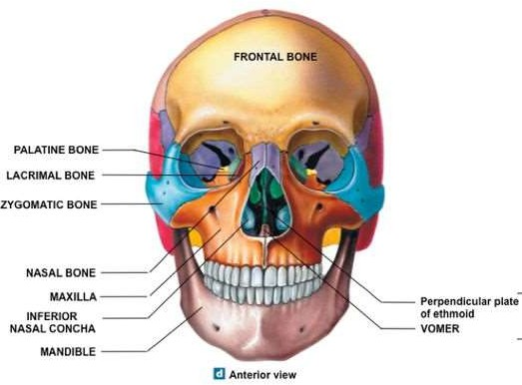

Slide 3
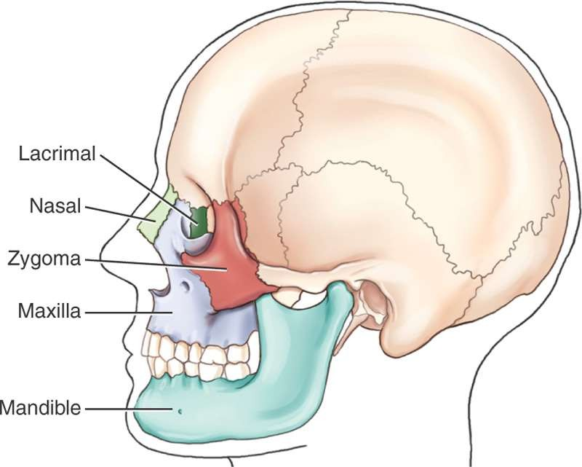
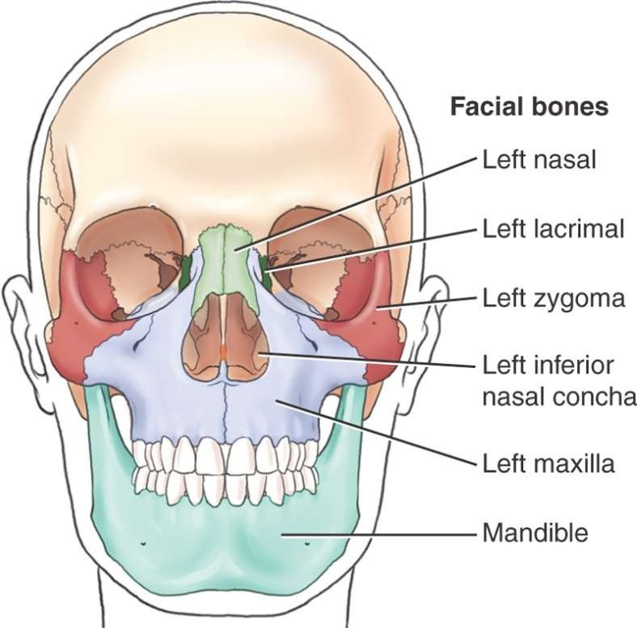

Slide 4
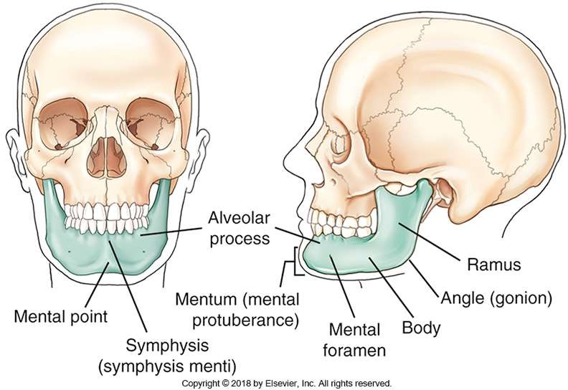

Slide 5
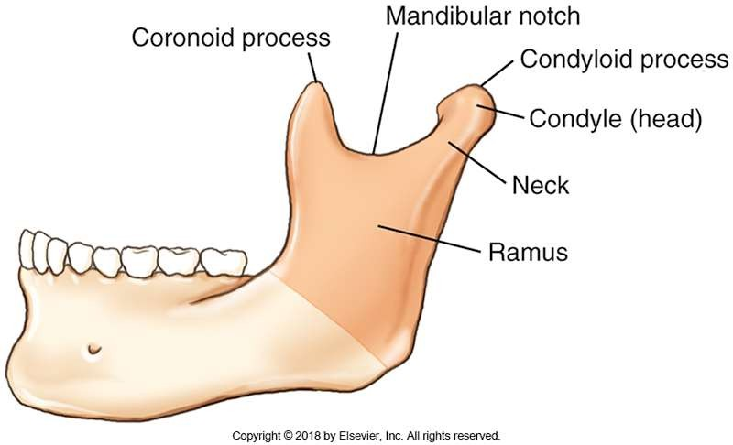

Slide 6
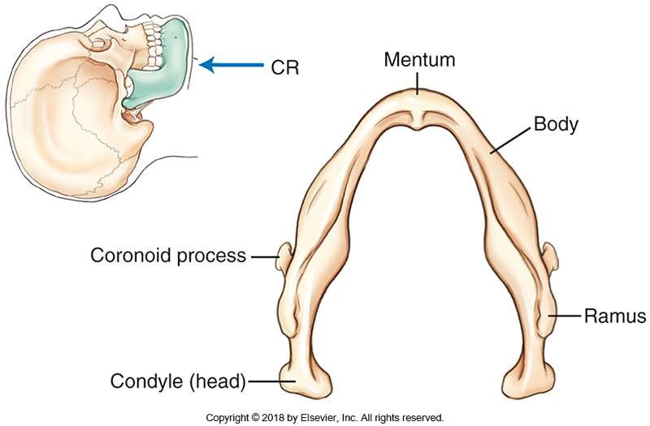

Slide 7

➢
➢
➢
➢
➢
➢
➢

Slide 8
➢
➢
➢
➢
➢
➢
➢

Slide 9


➢
➢
➢

Slide 10

➢
➢
➢

Slide 11
➢
➢

Slide 12
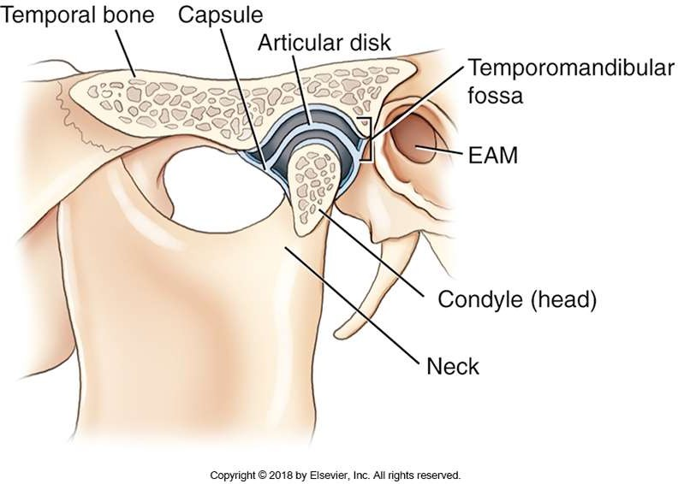

Slide 13








