Slide 1
MRAD 204:
Radiographic Technique 1
Outcome 1-5:
Image Critique – Hand & Thumb

Slide 2
Affiliated Readings
Bontrager
Pgs: 143→145
Pgs: 148-150
Emphasis on the “pink box” Evaluation Criteria

Slide 3
Overview
Evaluation Criteria
Image Critique – Hand
Image Critique – Thumb

Slide 4
Evaluation Criteria
Aka. How to Evaluate/Critique any Radiograph
Anatomy
Positioning
Exposure & Technique
CR & Collimation
Marker placement & artifacts
*reference your “Image Critique” Handout

Slide 5
Image Critique – PA Hand
Entire hand and wrist included radiographically
#1. Anatomy
@ 55 kVp
You can visualize:
  All 8 carpals
  All 5 metacarpals
  All 14 phalanges
1” (2.5cm) of distal forearm
SAIT Image Critique Handbook

Slide 6
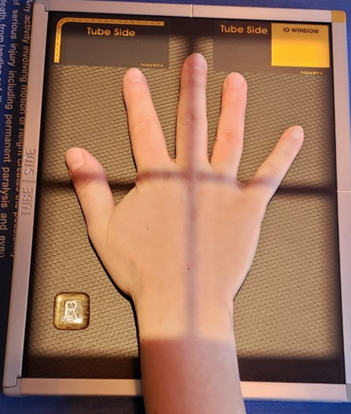
Image Critique – PA Hand
If a properly positioned PA Hand was exposed, how should it appear radiographically?
#2. Position
@ 55 kVp
SAIT Image Critique Handbook
SAIT Campus 2021

Slide 7
Image Critique – PA Hand
#2. Position
@ 55 kVp
MCP and IP joints appear open – indicates correct CR location and complete “pronation” (hand is flat on the IR)
SAIT Image Critique Handbook

Slide 8
Image Critique – PA Hand
#2. Position
@ 55 kVp
Oblique view of the thumb
Long axis of the wrist is aligned with the long axis of the IR
Bontrager 9th Ed. pg. 150 Fig. 4.68

Slide 9
Image Critique – PA Hand
#2. Position
@ 55 kVp
No rotation: equal concavity on both sides of metacarpal shafts 2→5, and equal soft tissue around phalanges
No soft tissue overlap
SAIT Image Critique Handbook

Slide 10
Image Critique – PA Hand
#3. Exposure & Technique
@ 55 kVp
Optimal density and contrast:
  no motion (i.e. blur)
  soft tissue margins visible
  clear bony trabecular markings
kVp range of 55-65
  *Note: Ideal = 55
SAIT Image Critique Handbook

Slide 11
Image Critique – PA Hand
#4. CR & Collimation
@ 55 kVp
Four sided collimation centered to 3rd MCP joint
SAIT Image Critique Handbook

Slide 12
Image Critique – PA Hand
#5. Marker Placement &/or artifacts
@ 55 kVp
No removable artifacts are visible
Marker placement is on the lateral side, not obscuring anatomy of interest
SAIT Image Critique Handbook

Slide 13
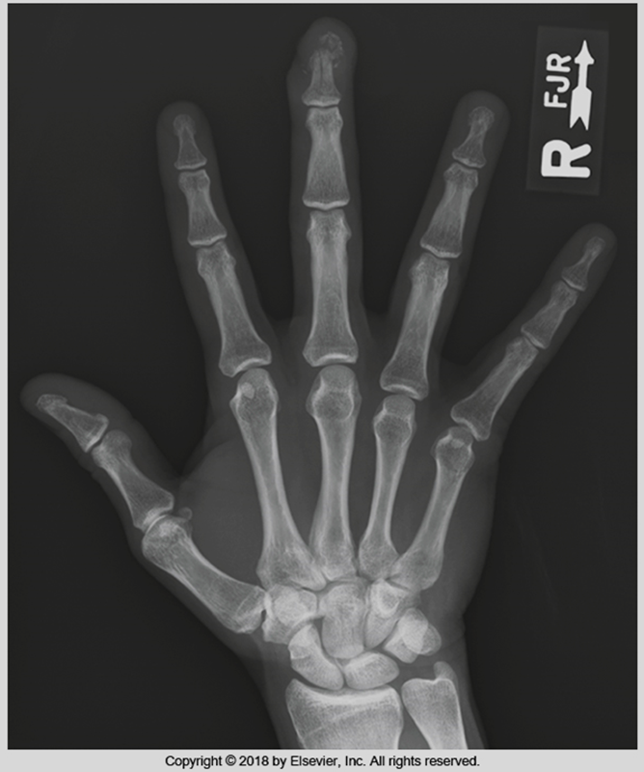
Image Critique – PA Hand; You try…
Is this a diagnostic radiograph?
@ 60 kVp
1. Anatomy:
2. Positioning:
3. Exposure & Technique:
4. CR & Collimation:
5. Marker place./artifacts:
Bontrager 9th Ed. pg. 150 Fig. 4.68

Slide 14
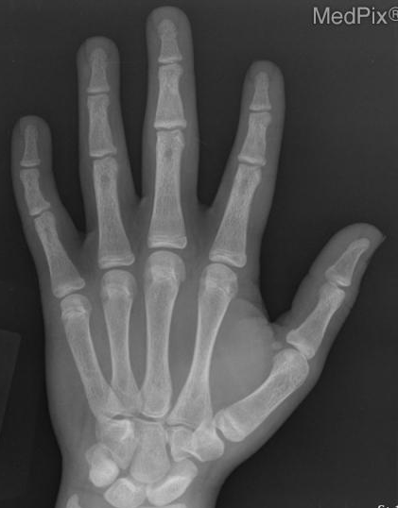
Image Critique – PA Hand; You try…
Is this a diagnostic radiograph?
@ 60 kVp
1. Anatomy:
2. Positioning:
3. Exposure & Technique:
4. CR & Collimation:
5. Marker place./artifacts:
https://medpix.nlm.nih.gov/search?allen=true&allt=true&alli=true&query=hand

Slide 15
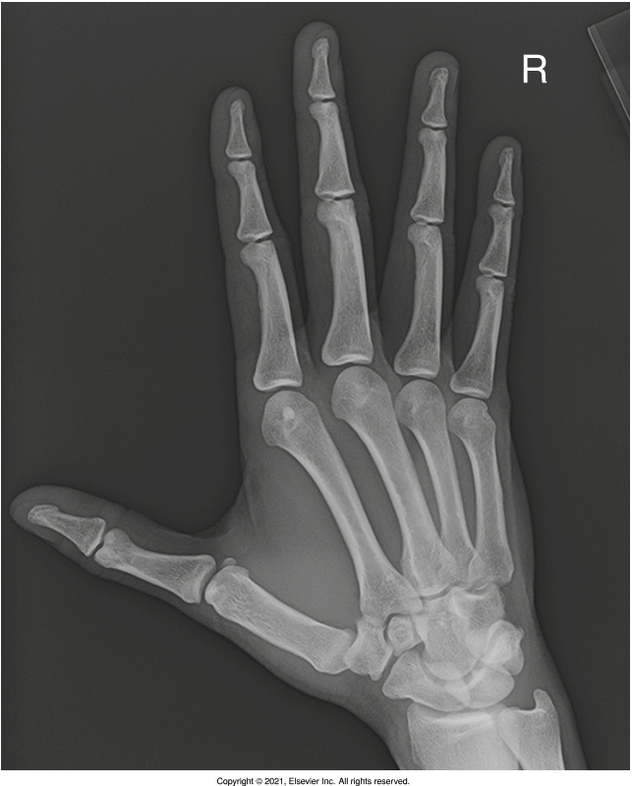
Image Critique – PA Oblique Hand
#1. Anatomy
@ 55 kVp
Entire hand and wrist included radiographically
You can visualize:
  All 8 carpals
  All 5 metacarpals
  All 14 phalanges
1” (2.5cm) of distal forearm
R
Bontrager pg. 149 Fig. 4.72

Slide 16
Image Critique – PA Oblique Hand
#2. Position
@ 55 kVp
How would you achieve this radiograph of the digits and metacarpals?
Position the fingers perpendicular to the IR
Position the fingers parallel to the IR
Have the patient make a fist
Have the patient come back when you are finished this unit
R
Bontrager pg. 149 Fig. 4.72

Slide 17
Image Critique – PA Oblique Hand
#2. Position
@ 55 kVp
Are the bodies of the metacarpals “free of overlap”?
Do the heads of the 3rd, 4th, & 5th metacarpals overlap slightly?
Is there separation of the 2nd & 3rd metacarpal heads?
R
Bontrager pg. 149 Fig. 4.72

Slide 18
Image Critique – PA Oblique Hand
#3. Exposure & Technique
@ 55 kVp
Was the kVp within the acceptable range?
Is there optimal density and contrast?
  Is there motion?
  Are soft tissue margins visible?
  Are there clear bony trabecular markings?
R
Bontrager pg. 149 Fig. 4.72

Slide 19
Image Critique – PA Oblique Hand
#4. CR & Collimation
@ 55 kVp
Is there four sided collimation centered around the 3rd MCP joint?
R
Bontrager pg. 149 Fig. 4.72

Slide 20
Image Critique – PA Oblique Hand
#5. Marker Placement &/or artifacts
@ 55 kVp
Are there any removable artifacts visible?
Does the marker comply with Anderson marker rules?
R
Bontrager pg. 149 Fig. 4.72

Slide 21
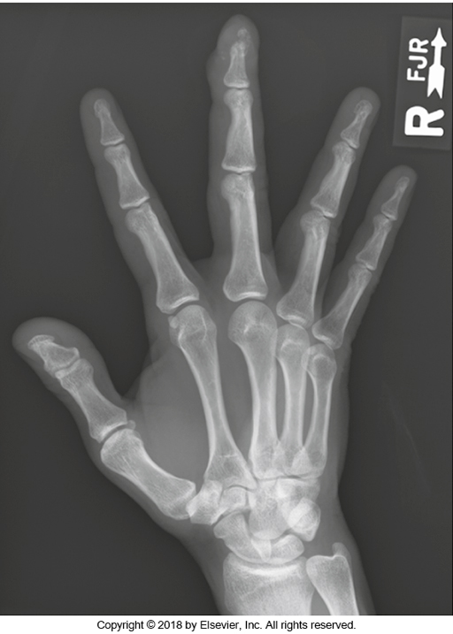
Image Critique – PA Oblique Hand; You try…
Is this a diagnostic radiograph?
@ 65 kVp
@ 60 kVp
1. Anatomy:
2. Positioning:
3. Exposure & Technique:
4. CR & Collimation:
5. Marker place./artifacts:
Bontrager pg. 151 Fig. 4.72

Slide 22
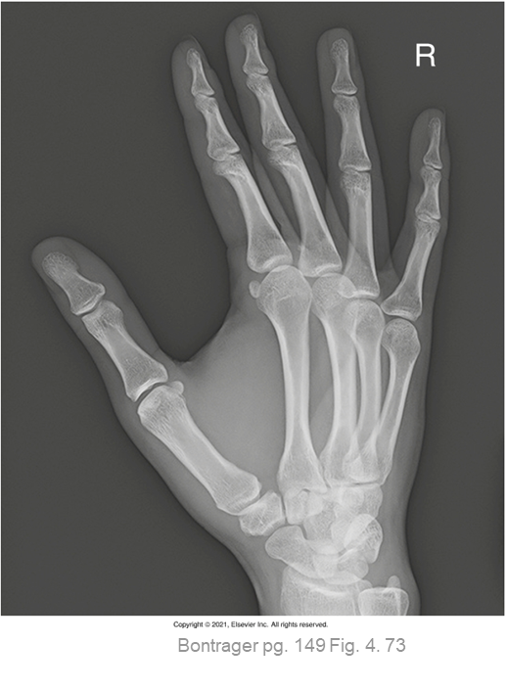
Image Critique – PA Oblique Hand; You try…
Is this a diagnostic radiograph?
@ 50 kVp
@ 60 kVp
1. Anatomy:
2. Positioning:
3. Exposure & Technique:
4. CR & Collimation:
5. Marker place./artifacts:
© 2021, Southern Alberta Institute of Technology

Slide 23
Image Critique – Fan Lateral Hand
#1. Anatomy
@ 60 kVp
Entire hand and wrist included radiographically
You can visualize:
  All 8 carpals
  All 5 metacarpals
  All 14 phalanges
1” (2.5cm) of distal forearm
SAIT Imaging Library

Slide 24
Image Critique – Fan Lateral Hand
#2. Position
Long axis of the wrist is aligned with the long axis of the IR
@ 60 kVp
IP joints appear open – indicates digits were parallel to the IR
Slight oblique view of the thumb
Digits separated equally (with minimal soft tissue superimposition)
True lateral evidenced by: superimposed metacarpals & distal radius and ulna
SAIT Imaging Library

Slide 25
Image Critique – Fan Lateral Hand
#3. Exposure & Technique
@ 60 kVp
Was the kVp within the acceptable range?
Is there optimal density and contrast?
  Is there motion?
  Are soft tissue margins visible?
  Are there clear bony trabecular markings?
SAIT Imaging Library

Slide 26
Image Critique – Fan Lateral Hand
#4. CR & Collimation
@ 60 kVp
Is there four sided collimation centered around the 3rd MCP joint?
SAIT Imaging Library

Slide 27
Image Critique – Fan Lateral Hand
#5. Marker Placement &/or artifacts
@ 60 kVp
Are there any removable artifacts visible?
Does the marker comply with Anderson marker rules?
SAIT Imaging Library

Slide 28
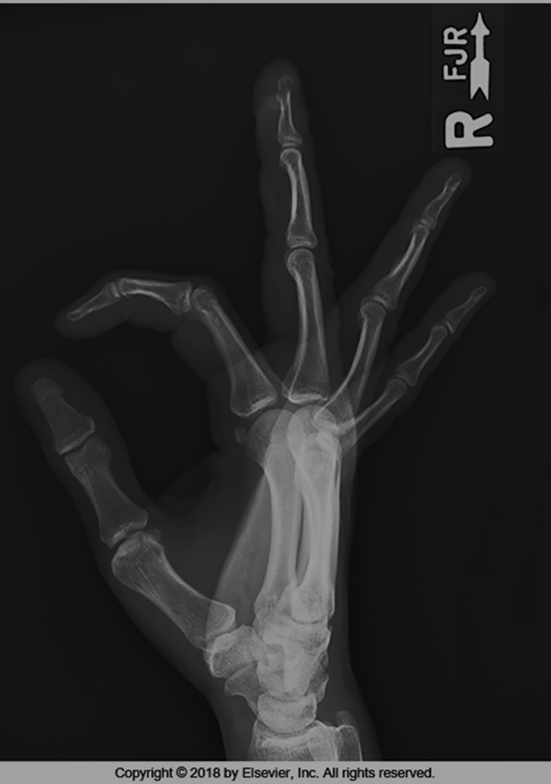
Image Critique – Fan Lateral Hand; You try…
Is this a diagnostic radiograph?
@ 50 kVp
@ 70 kVp
1. Anatomy:
@ 60 kVp
2. Positioning:
3. Exposure & Technique:
4. CR & Collimation:
5. Marker place./artifacts:
Bontrager pg. 150 Fig 4.76

Slide 29
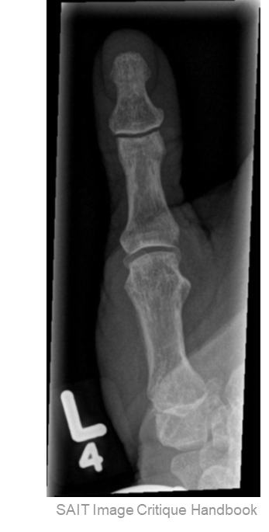
Image Critique – AP Thumb
#1. Anatomy
Entire thumb included radiographically
@ 55 kVp
@ 55 kVp
You can visualize:
  Both phalanges
  Entire 1st metacarpal
Entire Trapezium visualized
  *includes joint spaces around the trapezium

Slide 30
Image Critique – AP Thumb
#2. Position
Entire thumb appears parallel to long axis of IR
@ 55 kVp
No rotation evidenced by: equal concavity & amounts of soft tissue along sides of phalanges
Open IP & MCP joint – indicating thumb was fully extended & correct CR location used

Slide 31
Image Critique – AP Thumb
#3. Exposure & Technique
@ 55 kVp
Was the kVp within the acceptable range?
Is there optimal density and contrast?
  Is there motion?
  Are soft tissue margins visible?
  Are there clear bony trabecular markings?

Slide 32
Image Critique – AP Thumb
#4. CR & Collimation
#5. Marker Placement &/or artifacts
@ 55 kVp
Are there any removable artifacts visible?
Is there four sided collimation centered around the 1st MCP joint?
Does the marker comply with Anderson marker rules?

Slide 33
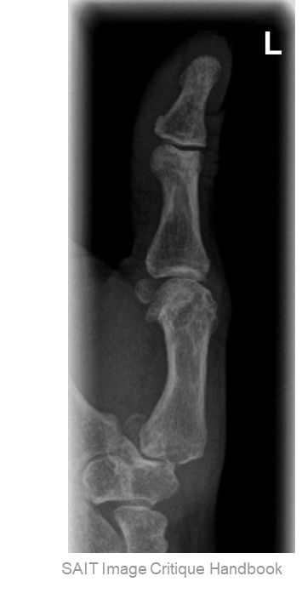
Image Critique – PA Oblique Thumb
#1. Anatomy
Entire thumb included radiographically
@ 55 kVp
@ 55 kVp
@ 55 kVp
You can visualize:
  Both phalanges
  Entire 1st metacarpal
Entire Trapezium visualized
  *includes joint spaces around the trapezium

Slide 34
Image Critique – PA Oblique Thumb
#2. Position
Entire thumb appears parallel to long axis of IR
@ 55 kVp
@ 55 kVp
@ 55 kVp
Proper obliquity evidenced by: uneven concavity of metacarpal and phalangeal bodies (lateral edge will appear “straighter”)
Open IP & MCP joint – indicating thumb was fully extended & correct CR location used

Slide 35
Image Critique – PA Oblique Thumb
#3. Exposure & Technique
@ 55 kVp
@ 55 kVp
Was the kVp within the acceptable range?
Is there optimal density and contrast?
  Is there motion?
  Are soft tissue margins visible?
  Are there clear bony trabecular markings?
@ 55 kVp

Slide 36
Image Critique – PA Oblique Thumb
#4. CR & Collimation
#5. Marker Placement &/or artifacts
@ 55 kVp
@ 55 kVp
@ 55 kVp
Are there any removable artifacts visible?
Is there four sided collimation centered around the 1st MCP joint?
Does the marker comply with Anderson marker rules?

Slide 37
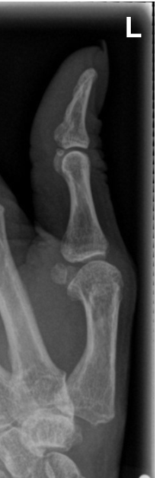
Image Critique – Lateral Thumb
#1. Anatomy
Entire thumb included radiographically
@ 55 kVp
You can visualize:
  Both phalanges
  Entire 1st metacarpal
Entire Trapezium visualized
  *includes joint spaces around the trapezium
SAIT Image Critique Handbook

Slide 38
Image Critique – Lateral Thumb
#2. Position
@ 55 kVp
Entire thumb appears parallel to long axis of IR
True lateral evidenced by: concave anterior surface & straight posterior surface of the metacarpal proximal phalanx bodies, with rounded heads
Open IP & MCP joint – indicating thumb was fully extended & correct CR location used
SAIT Image Critique Handbook

Slide 39
Image Critique – Lateral Thumb
#3. Exposure & Technique
@ 55 kVp
Was the kVp within the acceptable range?
Is there optimal density and contrast?
  Is there motion?
  Are soft tissue margins visible?
  Are there clear bony trabecular markings?
SAIT Image Critique Handbook

Slide 40
Image Critique – Lateral Thumb
#4. CR & Collimation
#5. Marker Placement &/or artifacts
@ 55 kVp
Are there any removable artifacts visible?
Is there four sided collimation centered around the 1st MCP joint?
Does the marker comply with Anderson marker rules?
SAIT Image Critique Handbook

Slide 41
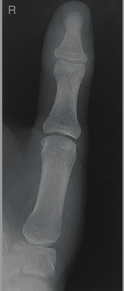
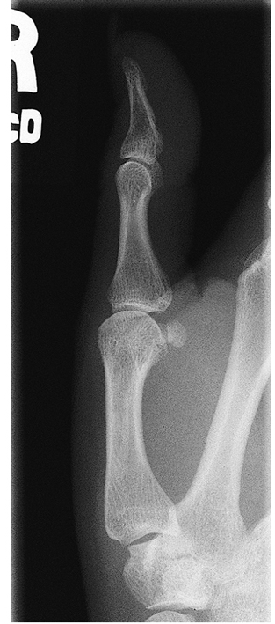
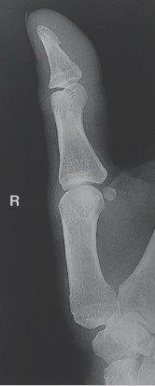
Which Projection is Which?
Bontrager pg. 145-147 Fig. 4.53, 4.56 & 4.59

Slide 42
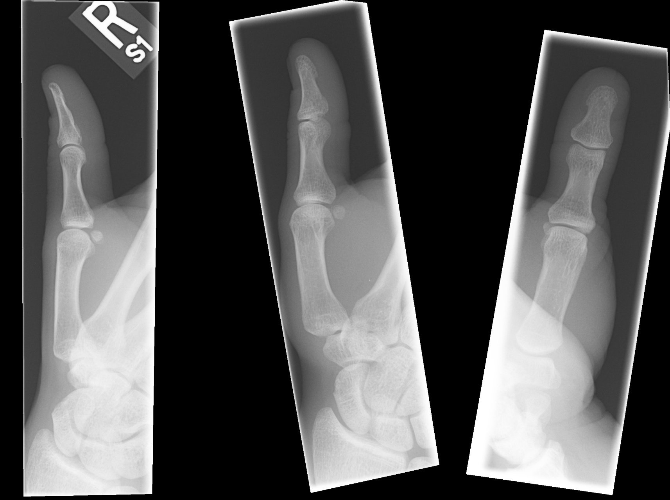
Which Projection is Which?
Notes:
Now try this one

