Slide 1

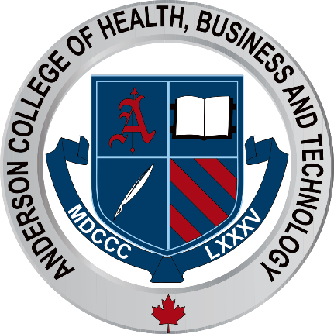
Laser Treatment of Ethnic Skin

Slide 2
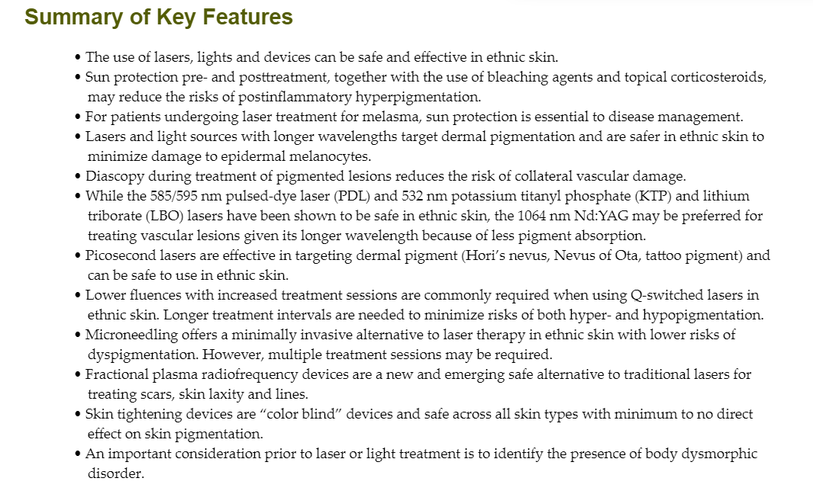

Slide 3
Evaluating the Ethnic Skin Paitent
It is critical that all patients undergo a complete history and exam prior to treatment
Medical History
Skin type
Current practices for UV protection
Hyperpigmentation or keloid formation
Patient expectations

Slide 4
Postinflammatory Hyperpigmentation
Postinflammatory hyperpigmentation (PIH) frequently ranks among the top 10 concerns in ethnic skin patients. It commonly occurs after inflammatory cutaneous eruptions including acne, folliculitis or various rashes. However, it can also be iatrogenic from minimally invasive interventions such as laser and other energy-based therapies.

Slide 5
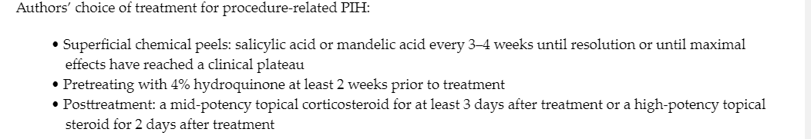

Slide 6
Introduction to Lasers and Lights in Ethnic Skin
Laser selection should focus on identifying the proper target chromophore: water, hemoglobin or melanin, to achieve clinical goals. Other considerations for laser selection include the ability to modify settings for minimally invasive treatment. This can be achieved by using lower fluences. Another example of this includes the selection of ablative versus nonablative lasers

Slide 7
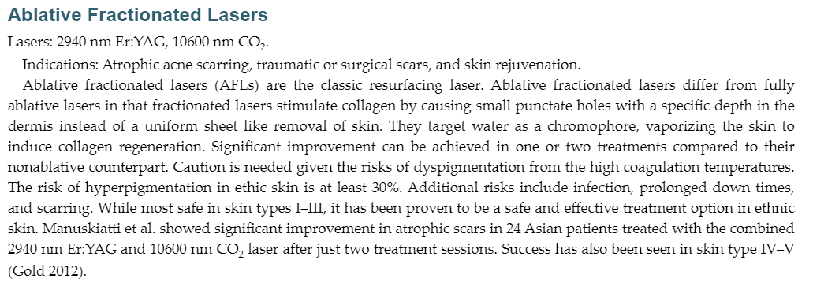
Do you know…

Slide 8
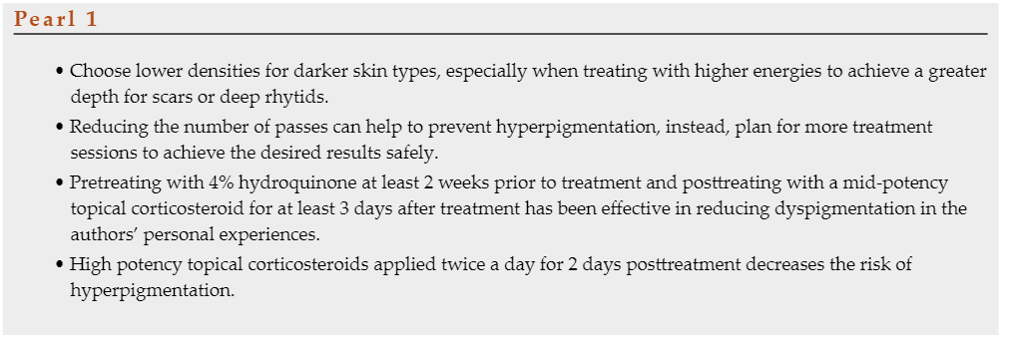

Slide 9
Nonablative Fractioned Lasers
Lasers: 1927 /1550 nm, 1927 nm thulium, 1927 nm diode, 1064 nm Nd:YAG, 1550 nm erbium, 1440 nm diode, 755-nm and 1064 nm fractional picosecond lasers.

Slide 10
Vascular Lasers
Lasers: 585/595 nm pulsed dye laser (PDL), combined 532 nm KTP/1064 nm Nd:YAG, 1064 nm Nd:YAG, 532 nm KTP or LBO.
Indications: Port-wine stain (PWS), facial erythema, telangiectasia, and scars.
Vascular lasers target hemoglobin to induce vessel injury with absorption peaks of oxyhemoglobin being primarily at 577 nm and 700–1100 nm to a lesser extent. The 585 nm PDL is the classic vascular laser used because of the close relationship with hemoglobin absorption peaks. Use of the 585/595 nm PDL and 532 KTP or LBO lasers in darker skin patients can be challenging due to the overlap with melanin absorption, increasing risks for procedure related dyspigmentation. The 1064 nm Nd:YAG laser is considered to be a safer alternative in the treatment of vascular lesions in ethnic skin patients because of its longer wavelength.

Slide 11
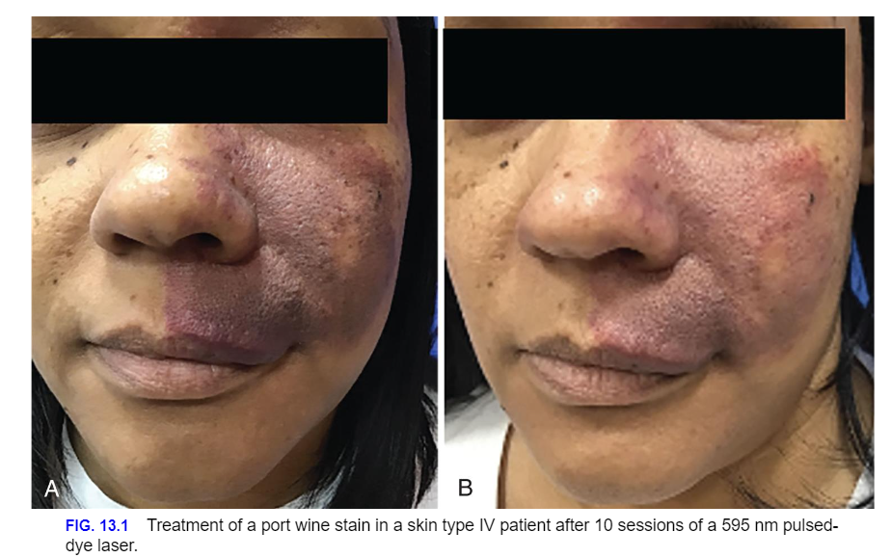

Slide 12
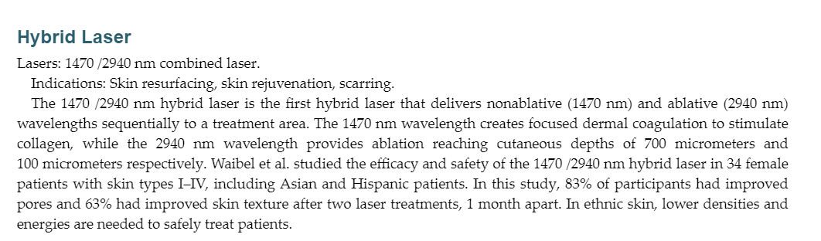

Slide 13
Laser Hair Removal
Longer wavelengths allow for more targeted treatment. To date, two laser devices are approved by the Food and Drug Administration (FDA) for laser hair removal in ethnic skin, the 810-nm diode, and the 1064 nm Nd:YAG. Both lasers have long wavelengths which penetrate into the dermis, long pulse durations (100 milliseconds or longer for the 810 nm diode and over 30 milliseconds for the 1064 nm Nd:YAG) and concurrent epidermal cooling. In ethnic skin, the 1064 nm Nd:YAG is considered the gold standard for hair removal in skin type IV–VI. Because of its long wavelength, the energy

Slide 14
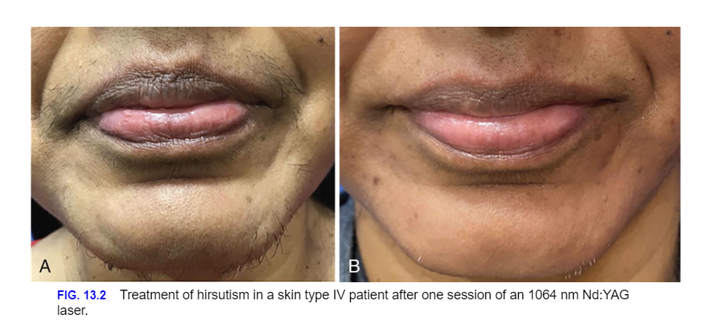

Slide 15
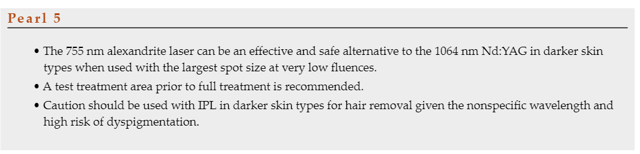

Slide 16
650-Microsecond 1064 nm Laser
The 650-microsecond 1064 nm Nd:YAG laser is considered to be one of the safest lasers in ethnic skin given the long wavelengths, bypassing melanin chromophores. It has revolutionized the use of the Nd:YAG laser in ethnic skin given its relatively short pulse duration of 0.65 ms and long wavelength. In hair removal, the pulse duration is less than the thermal relaxation time of 0.8 ms for skin around the hair follicle. This allows for painless treatment sessions that do not require cooling. It is also unique in that it is contactless since a collimated beam is used, unchanged by fluence or spot size.

Slide 17
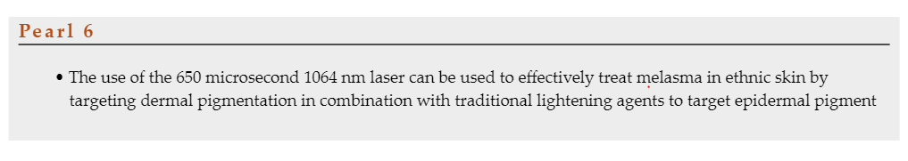

Slide 18
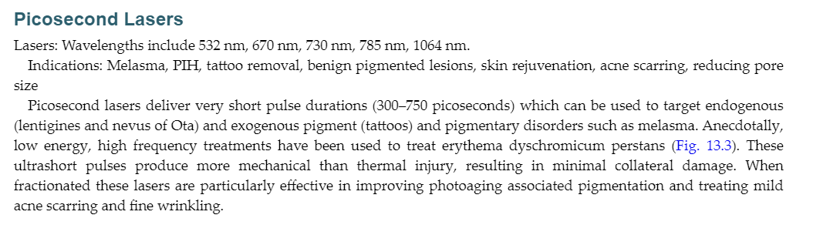

Slide 19
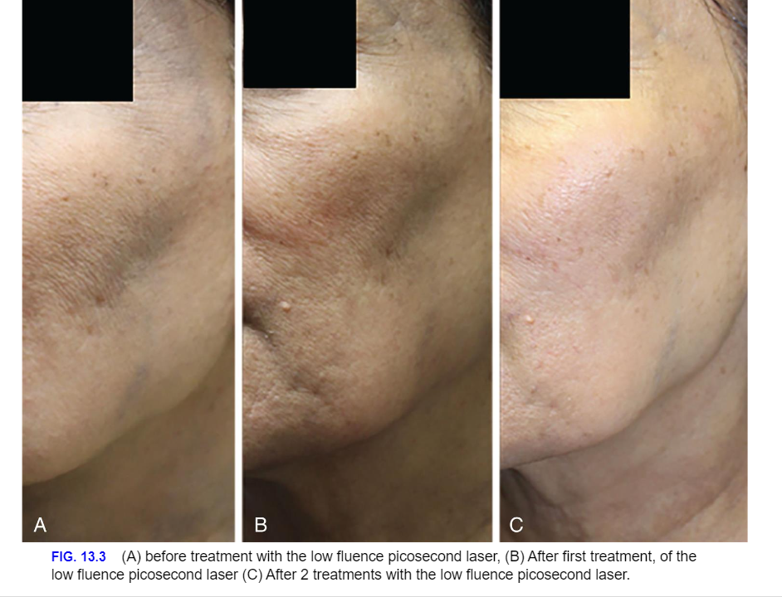

Slide 20
Q-Switched Lasers
Indications: Tattoo removal, freckles and lentigines, nevus of Ota/Ito, Hori’s nevus, Becker nevus.
Q-switched lasers deliver high powered, short pulses (nanoseconds). In ethnic skin, lower fluences are recommended. As a result, more treatment sessions are needed to have comparable results to nonethnic skin. Low fluence 1064 nm Nd:YAG, often termed laser toning is well tolerated and effective in skin types III and IV. Kaminaka et al. studied the efficacy of the 1064 nm Nd:YAG in 22 Japanese patients treated with 10 sessions for melasma and solar lentigines. All patients improved. Although lower fluences allow for the use of Q-switched lasers in ethnic skin, hypopigmentation is a significant concern. Shah and Aurangabadkar reviewed the technique of laser toning in 10 studies with the 1064 nm Q-switched Nd:YAG for melasma.

Slide 21
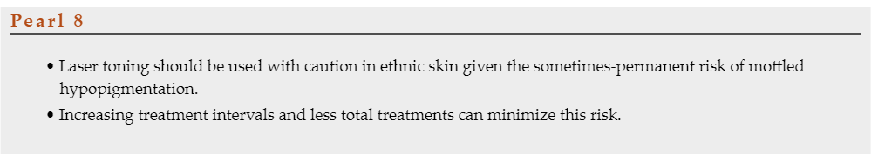

Slide 22
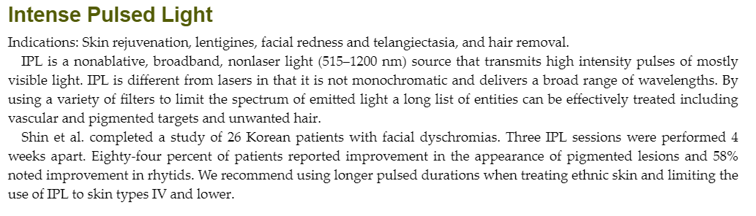

Slide 23
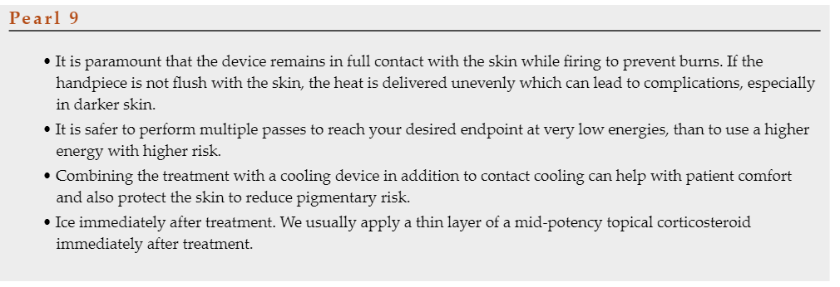

Slide 24
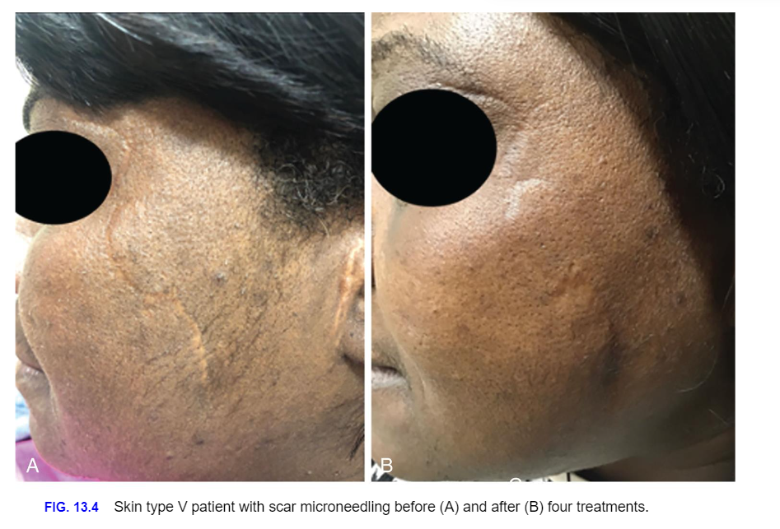
Microneedling

Slide 25
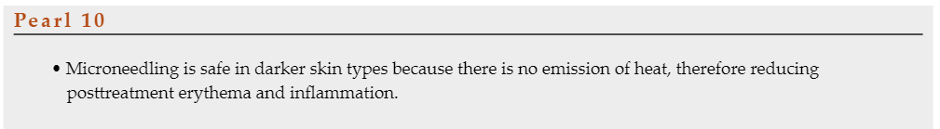

Slide 26
Microplasma Radiofrequency
Microplasma RF is an FDA-cleared micro-ablative high-frequency (>40 MHz) unipolar device, combining RF with plasma. It functions as a fractional resurfacing device using metal pins that transmit RF energy to the skin in a grid like pattern. It provides a quick (<20 minutes) alternative to traditional lasers with comparable results with a smaller number of treatments and minimal recovery time

Slide 27
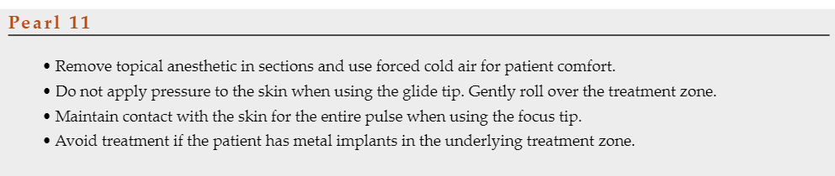

Slide 28
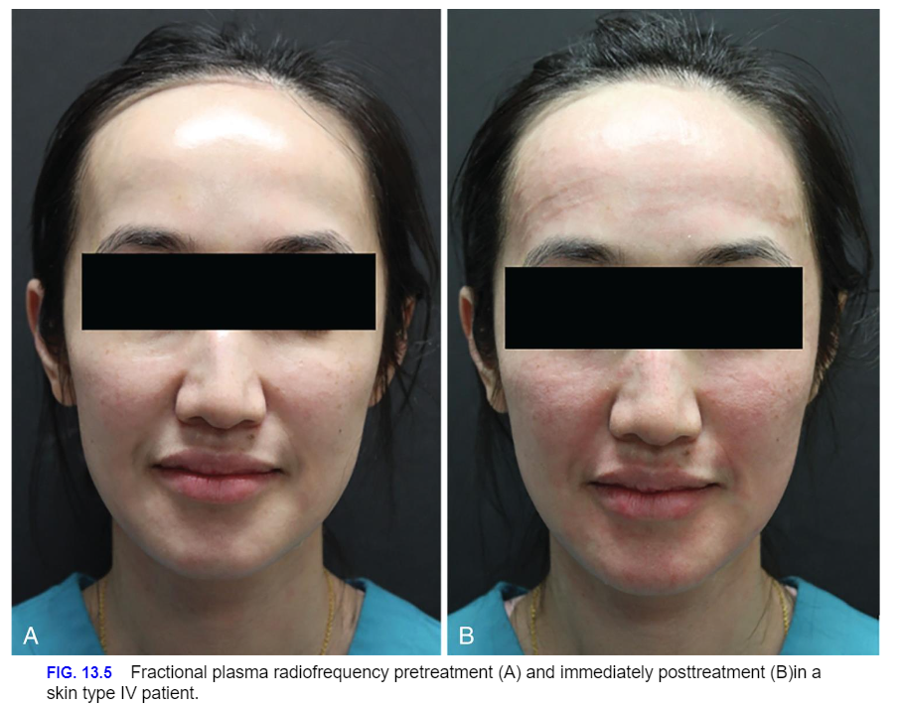

Slide 29
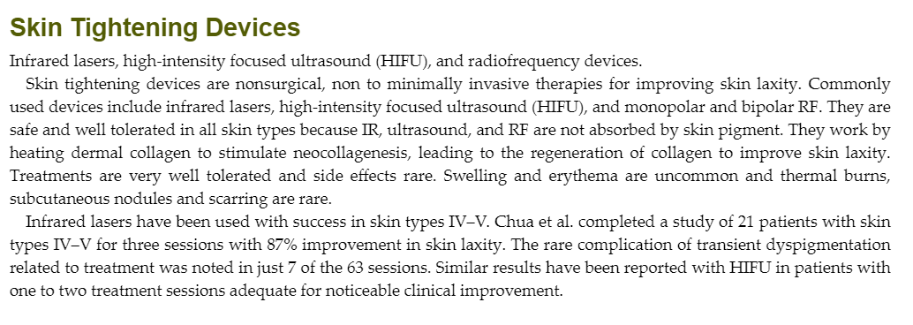

Slide 30
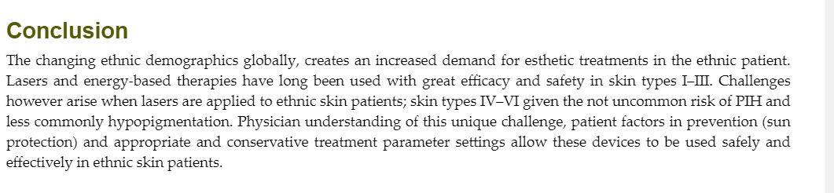

Slide 31

QUESTIONS?

