Slide 1


Medical Esthetics
Digestion

Slide 2
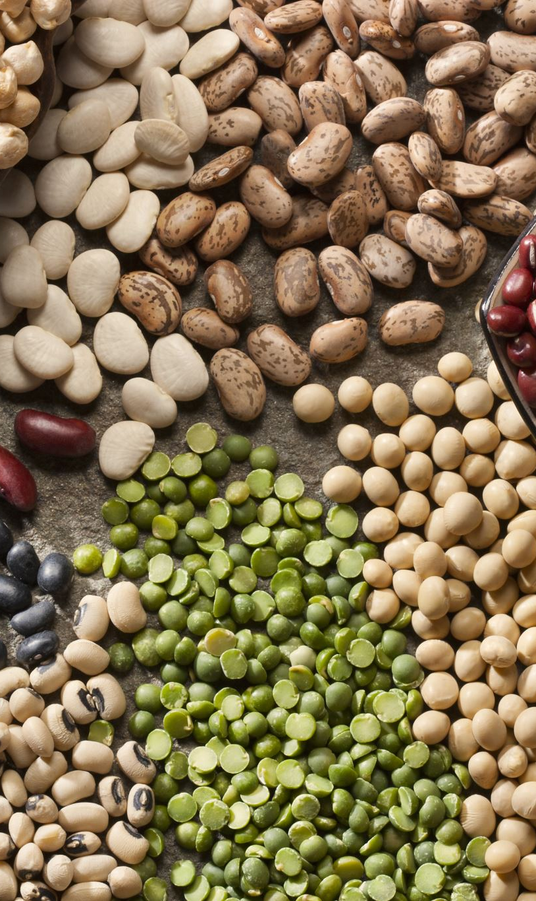
OUR JOURNEY TODAY
The digestive system is also called the gastrointestinal system.

Slide 3
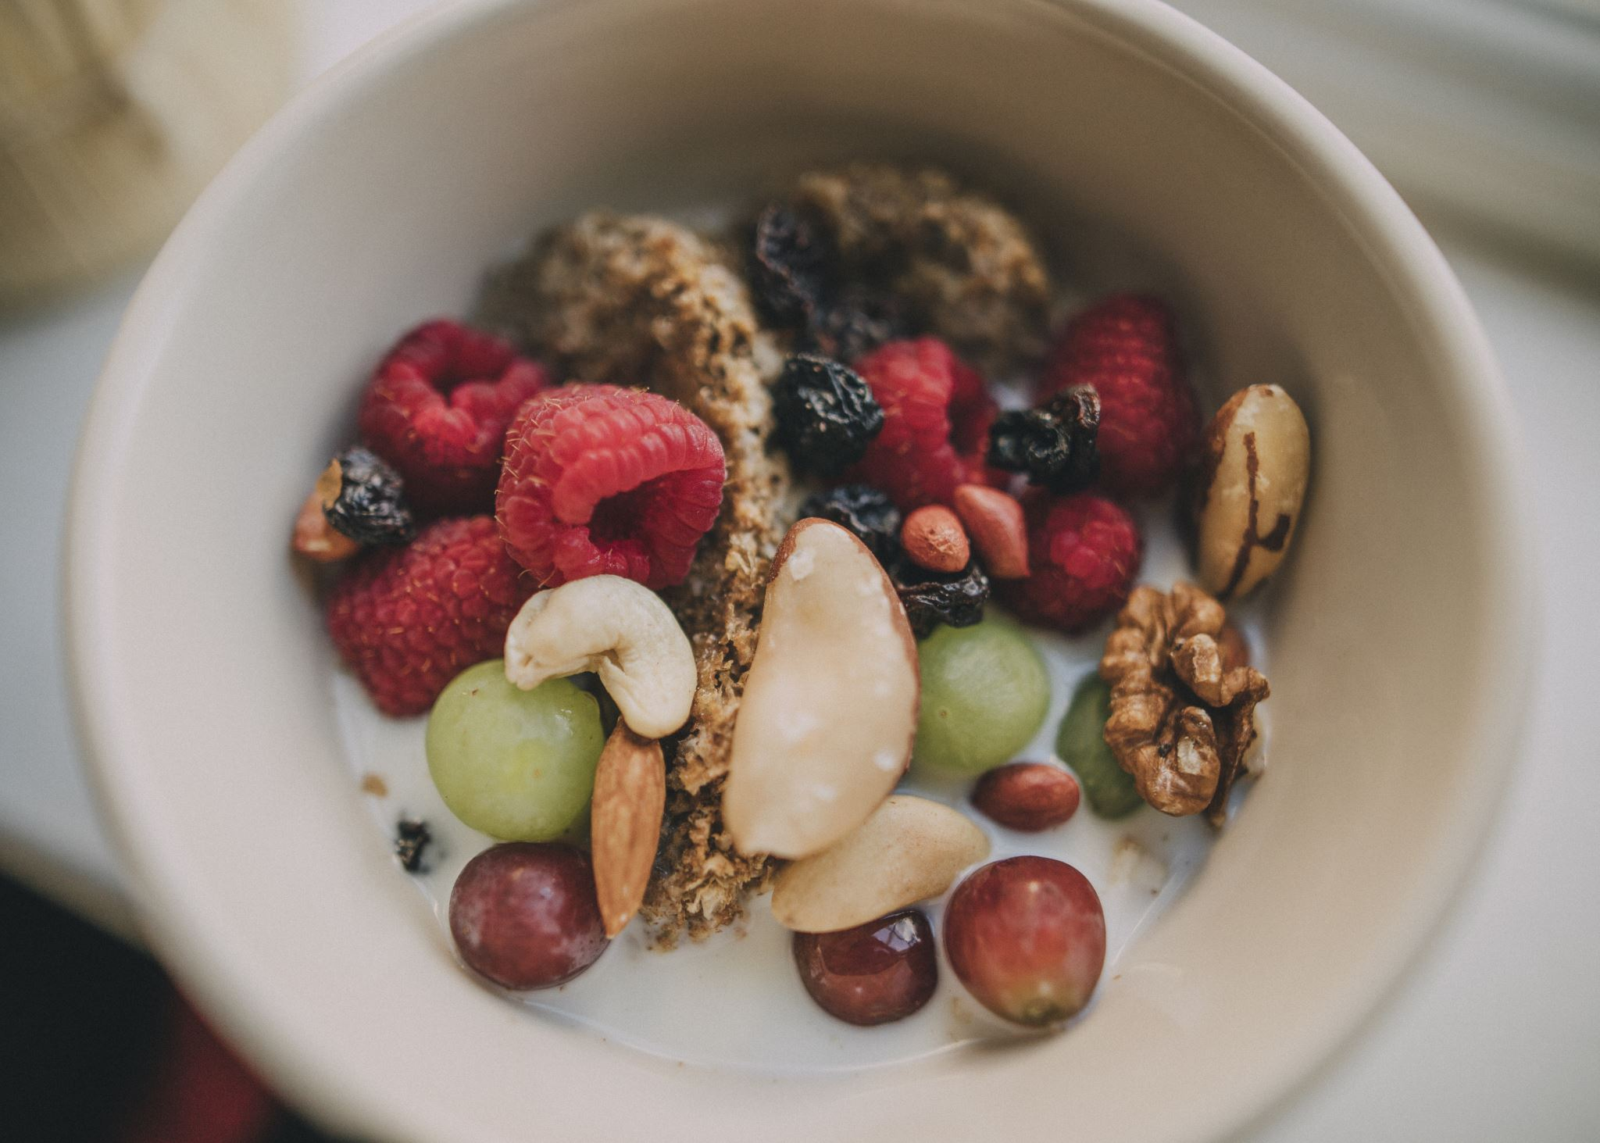
Is responsible for changing food into nutrients and waste

Slide 4
Digestive enzymes are chemicals that break down food into a form that can be used by the body. The food, now in soluble form, is transported by the bloodstream and used by the body’s cells and tissues.

Slide 5
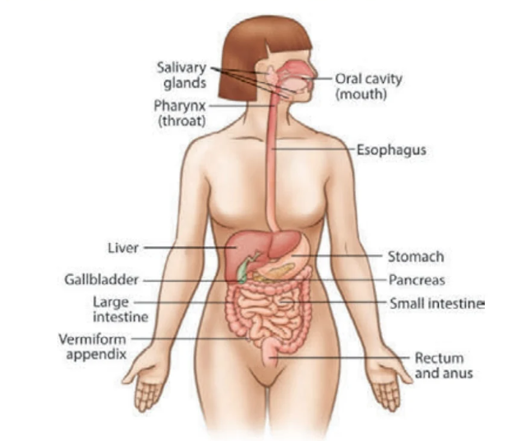



Slide 6
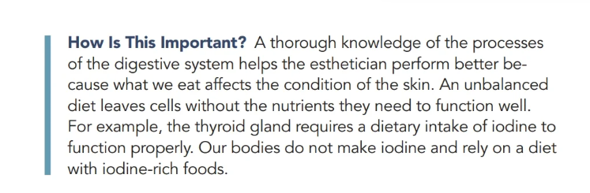

Slide 7
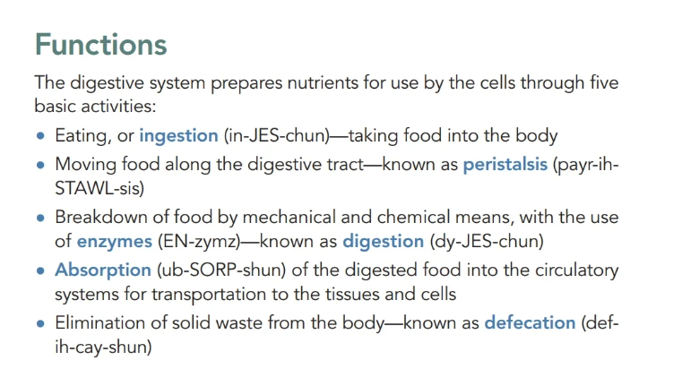

Slide 8

QUESTIONS?

