Slide 1


Medical Esthetics
Infection Control Lesson 1

Slide 2
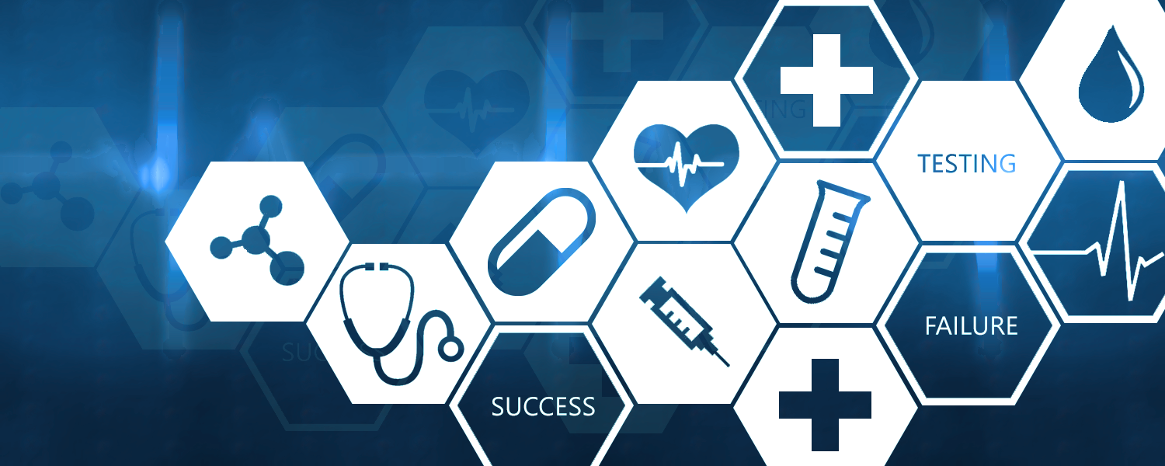
This week we will learn the principles of infection control

Slide 3
By the end we will be able to...
•Describe the Bloodborne Pathogens Standard.
•Discuss autoimmune disorders caused by blood-borne pathogens.
•Outline the principles of infection control.
•Identify potential hazards an esthetician may encounter.
•Establish and use safety guidelines for estheticians.

Slide 4

Quiz Time
What do you think infection control relates to?
Why you think Infection Control is relevant in the Medical Esthetics field

Slide 5
Infection Control
Refers to the methods used to eliminate or reduce the transmission of infectious organisms from one individual to another
Since transmission can also occur when using contaminated implements, tools, or equipment, the performance of effective infection control procedures must be a top priority in the salon, spa, and barbershop.

Slide 6
Infection Control Vocabulary
Cleaning is a mechanical process using soap and water or detergent and water to remove all visible dirt, debris, and many disease-causing germs. Cleaning also removes invisible debris that interferes with disinfection.
Sanitizing is a chemical process for reducing the number of disease-causing germs on cleaned surfaces to a safe level. Infection control professionals consider sanitation to be a layperson’s term or a product marketing term (as in hand sanitizers), preferring cleaning to describe the step before disinfecting.
Disinfecting is a chemical process for use with nonporous items that uses specific products to destroy harmful organisms including bacteria, viruses and fungi (except bacterial spores) on implements and environmental surfaces.
Sterilizing is the process that destroys all microbial life, including spores, generally with the use of an autoclave.

Slide 7
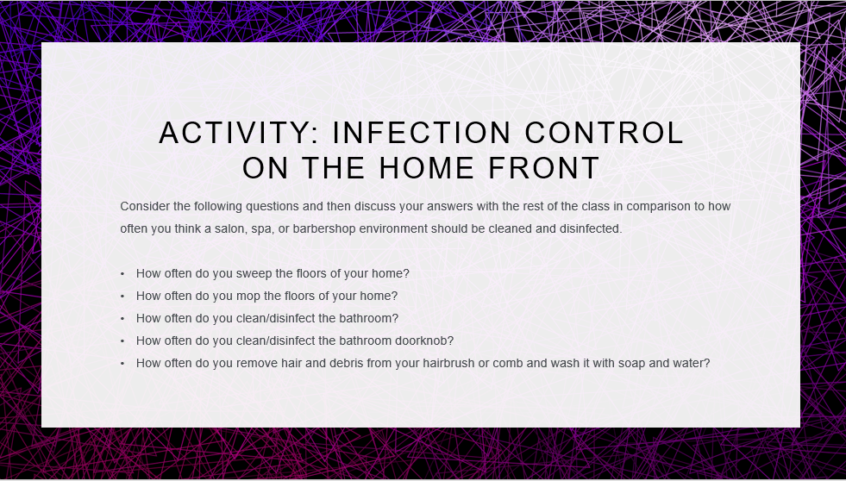

Slide 8
Choose the correct answer
a. What is a mechanical process using soap and water or detergent
b. What is a chemical process for reducing the number of disease-causing germs
c. What is a chemical process for use with nonporous items that uses specific products to destroy harmful organisms including bacteria, viruses and fungi (except bacterial spores) on implements and environmental surfaces.
d. What is the process that destroys all microbial life, including spores.

Slide 9
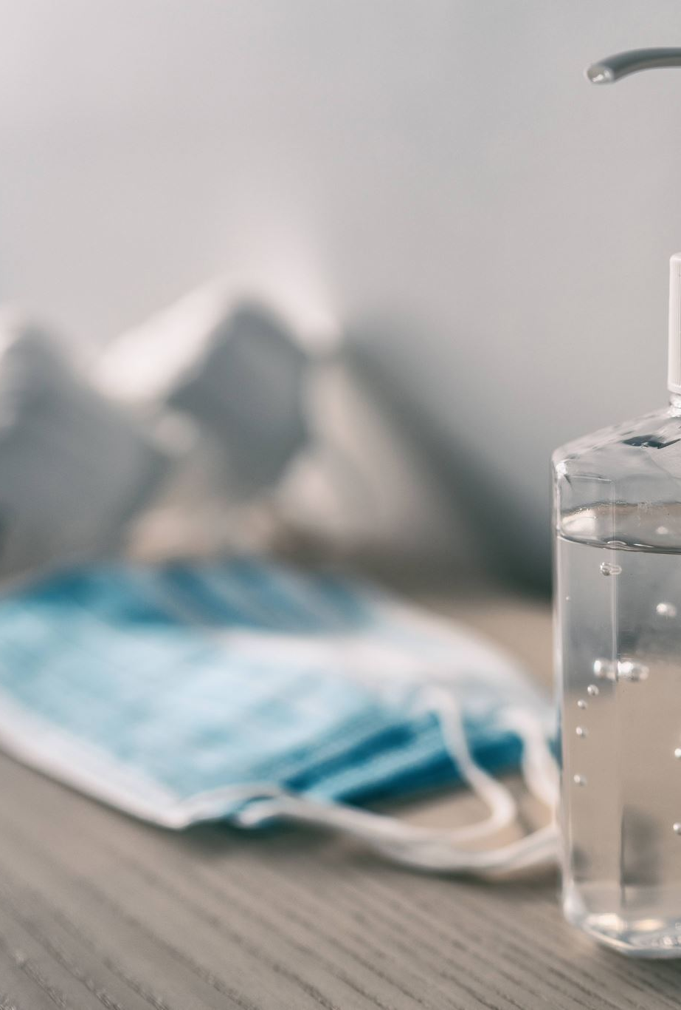
Quiz time
What is sanitizing

Slide 10
Chose the correct answer
a.is the process that destroys all microbial life, including spores, generally with the use of an autoclave.
b. a chemical process for reducing the number of disease-causing germs on cleaned surfaces to a safe level.
c.is a chemical process for use with nonporous items that uses specific products to destroy harmful organisms including bacteria, viruses and fungi (except bacterial spores) on implements and environmental surfaces.
d.is a mechanical process using soap and water or detergent and water to remove all visible dirt, debris, and many disease-causing germs

Slide 11
Lets Take a Look!
https://www.youtube.com/watch?v=YaZhpj2MoXs

Slide 12
Close your books !
Explain the difference between
Cleaning
Sanitizing
Desinfecting
Sterilizing

Slide 13
Canada
CCOHS is Canada's national resource for the advancement of workplace health and safety
CCOHS is the Canadian equivalent of OSHA, providing legislation and enforcement as well as resources for employers who need to stay compliant

Slide 14
Regulatory Agencies
The role of the Health department with the effort of the regulatory agencies are to regulate and enforce safety and health standards to protect employees in the workplace. The standards are important to beauty professionals because of the products they use daily. This standards address issues relating to the handling, mixing, storing, and disposing of products; general safety in the workplace; and your right to know about any potentially hazardous ingredients contained in the products and how to avoid these hazards. It also controls and makes sure that all medical settings are safe for the public.

Slide 15
What does the Health Department do?
The goal is to protect beauty professionals’ and their customers’ health and safety during services. Enforcement of the rules through inspections and investigations of consumer complaints is also part of an agency’s responsibility.

Slide 16
Did you know?
An agency can issue penalties against both owners and beauty professional.
Penalties vary and include warnings, fines, probation, and suspension or revocation of licenses.
It is vital that you understand and follow the laws and rules of your province at all times.
Your professional reputation, your license, and your clients’ safety depend on it.

Slide 17
Recap
Why is it important for the Esthetician to understanding infection control?
Why is important for the health department to regulate safety in the beauty facilities?
What are the different types of controlling infection in a Medi-Spa, salon or barber shop?

Slide 18

QUESTIONS?

