Slide 1
RADP 215: Radiation Protection
Protecting the Patient

Slide 2
Reducing Patient Dose
Many methods can be used to reduce patient dose
  Technical factors
  Collimation
  Filtration
  Equipment (e.g., grids, immobilization devices)
  Quality Control
  Communication

Slide 3
Technical Factors
Appropriate techniques are essential in order to achieve a diagnostic image with minimal patient dose.
Anatomically Programmed Radiography (APR) and room technique charts:
  Standardized for each generator
  Consult technique charts before exposure when not using Automatic Exposure Control (AEC)
  Lists the body part and size to give you a starting technique for a specific room
  Allows for an accurate educated guess

Slide 4
Technical Factors
High kVp and low mAs equals less dose
kVp controls quality
  Penetration or power of the beam
  Higher power, more photons
  Less absorption by patient
  Less mAs is required to maintain density of image
mAs is the quantity
  Directly related to dose
  More photons, more dose

Slide 5
Technical Factors
High kVp and low mAs combination may produce a poor-quality image
Reducing radiographic contrast
Technique used must balance image quality and dose
Using the highest practical kVp and lowest mAs that will produce an optimal image for each exam
Maintains the radiographic contrast

Slide 6
Source to Image Distance (SID)
Important to have an accurate SID when positioning
Technique charts and settings are developed using a specific SID
  Usually 100 cm, 110 cm, 180 cm
Too short – Overexposure
  Extra unnecessary dose
Too long – Underexposure
  Mottled, grainy or noisy images
    May require repeat exposures

Slide 7
Collimation
The first and most important step in gonadal protection.
An appropriately collimated beam will reduce dose more effectively than shielding.
Primary x-ray beam can not be larger than the size of the image receptor (IR) being used for the exam.
  Decreased field size = Decreased dose
  Also, less scatter = improved image contrast

Slide 8
Beam Limitation Devices
PBL – Positive Beam Limitation
  Sensors in a detector that automatically send a signal to the collimators about the field size
Additional Equipment
  Aperture diaphragm, cones and cylinders
  Equipment attaches to tube housing
  Usually for specific exams like skull work, sinuses, dental units, etc.

Slide 9
Beam Filtration
Purpose:
  Absorbs most of the lower-energy photons from x-ray beam
  Reduces exposure to patient’s skin and superficial tissue
  ‘Hardens’ the beam
Photons remaining in beam are more penetrating and less likely to be absorbed
  Low-energy photons would contribute only to dose and not to the image process
Different filters for different equipment, depending on purpose
  E.g., mammography – soft tissue images
Notes:
Look at nomogram

Slide 10
Filtration
Compensating filters
  When imaging anatomy that has large variance in thickness or tissue composition
  Can help to even out the density on the image
  All anatomy visualized on one image, instead of having to take two images

Slide 11
Grids
Purpose:
  Remove scattered photons from the patient before reaching the image receptor (IR)
Placed between patient and IR
Device made of parallel or focused radiopaque strips alternating with a low-attenuation material (plastic, aluminum)
Advantage:
  Significantly improves contrast and detail

Slide 12
Grids
Disadvantages:
  Increases patient dose, as additional technique needs to be used
  Patient dose increases as grid ratio increases
But, the benefit in improved image quality greatly outweighs the additional dose!
  Greater quantity of diagnostic information made available with grid usage

Slide 13
Immobilization
Patient movement during an exposure will result in a blurry image.
  Little/no diagnostic value
Two types of motion:
  Voluntary
  Involuntary

Slide 14
Immobilization (cont’d)
Purpose:
  Eliminate voluntary motion
  Minimize repeat images
Use equipment to effectively immobilize the patient or the body part:
  Sponges
  Tape
  Support Stands
  Pigg-o-Stat
  Octostop
  Sandbags

Slide 15
Quality Control
Absolutely essential!
Monitoring and maintenance of all processing and imaging display equipment in the facility.
Ensures production of optimal quality images.
  Equipment function and monitoring
Includes procedures for performance, monitoring and quality control.

Slide 16
Quality Control
Without a program, additional images may be needed.
  What if the technique you set is not what was actually produced?
  What if your collimation was off?
  What if the centering was off?
Results in a repeated image and additional unnecessary dose to your patient.

Slide 17
Communication
What can good communication with your patient do?
  Reduce anxiety and stress
  Enhance your professional image as a healthcare professional
  Increase the chance of a successful x-ray examination
    Dose reduction!
  If you ask a question, listen to the answer

Slide 18
Communication
Explain procedures, especially lengthy exams—the unknown is scary!
Do not lie to the patient if something is going to be uncomfortable or painful—tell them, don’t let it be a surprise.
Don’t overemphasize that aspect of the exam.
Patient must understand what you need from them and you must understand any patient limitations (e.g., unable to stand, cannot lay on side, etc.).

Slide 19
Communication
Allow the patient to ask questions.
Listen to them and answer truthfully in an appropriate tone of voice.
Always answer in accordance with ethical guidelines.
This will create trust between the patient and technologist.

Slide 20
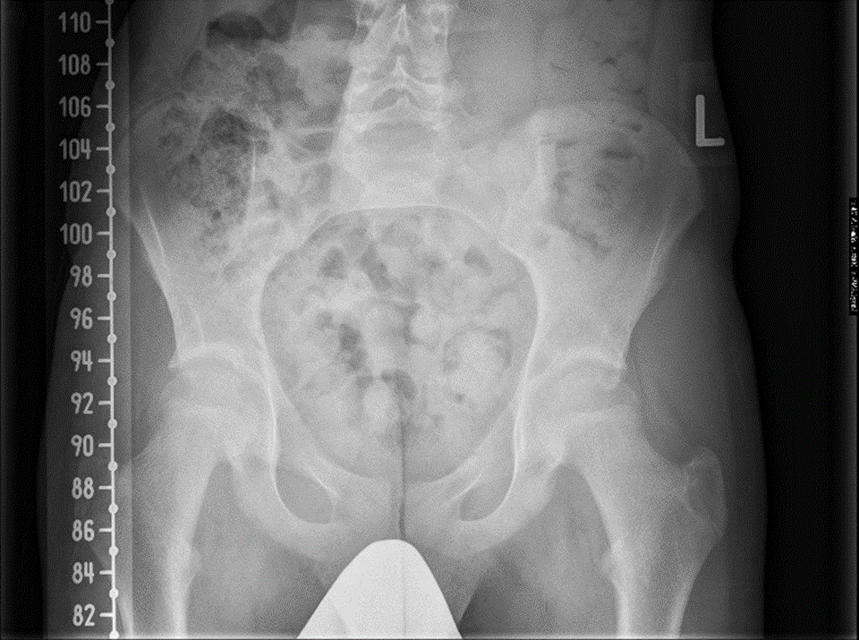
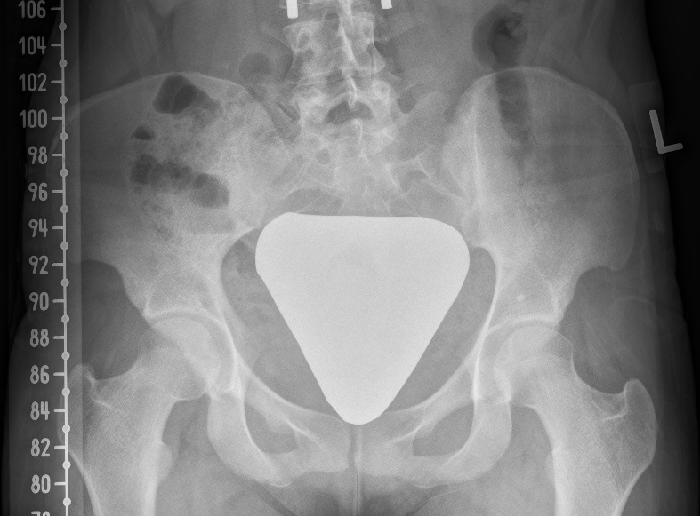
Gonadal Shielding – past practice example

