Slide 1
APPH 226: Apparatus and Image Management
Introduction to Equipment Objectives: 1.2, 2.2

Slide 2
Types of X-Ray Units
Diagnostic X-Ray imaging system
  Tube currents: 100-1200 mA
  Exposure times: very short, measured in ms
  Tube voltages: 25 – 150 kVp
Therapeutic X-Ray Unit
  Tube current: Below 20 mA
  Exposure times: 1-60 minutes
  Tube voltages: 4-40 meV (million electron volts)

Slide 3
Principle Components
Operating Console
X-Ray Tube
High Voltage Generator

Slide 4
Operating Console
Allows operator to select the exposure factors
Control the x-ray beam
  Tube current (mA), voltage (kVp), exposure time (ms)
  X-ray beam quality and quantity
Image receptor selection
Meters display actual exposure taken
Exposure switch is considered to be part of the console

Slide 5
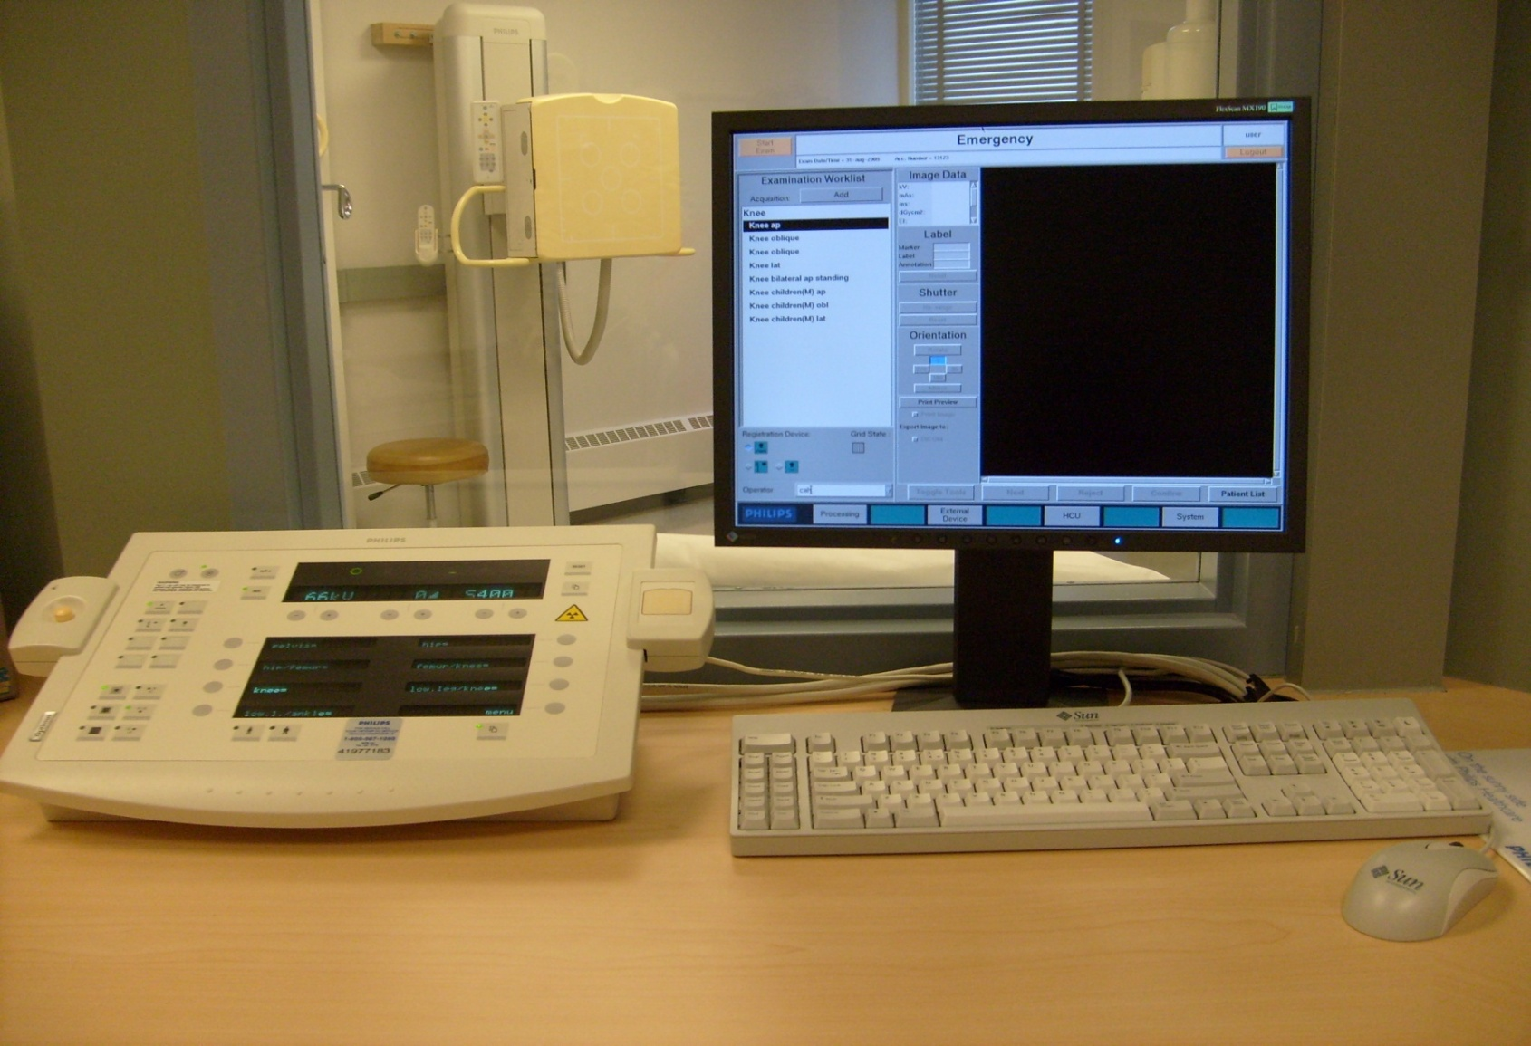
Control Panel – Example

Slide 6
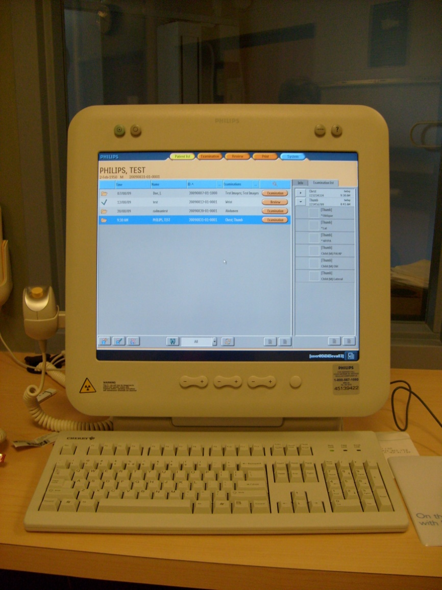
Control Panel – Example

Slide 7
Operating Console
Operating Console includes:
  On/off switch
  Exposure switch
  Settings for kVp and mA
  Exposure time
  Focal Spot size selector
  AEC (automatic exposure control)
  APR (anatomically programmed radiography)
  Back up timer

Slide 8
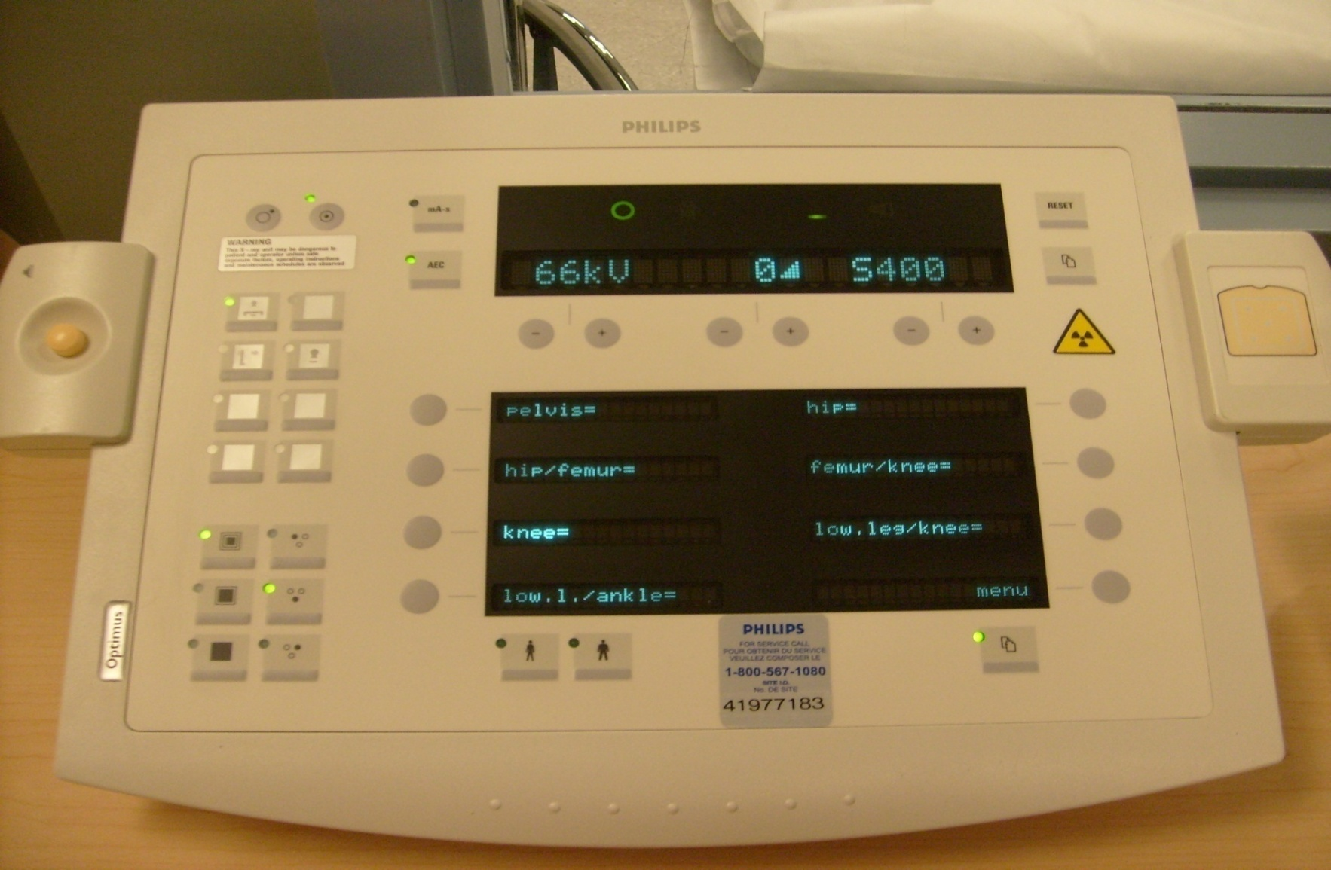
Control Panel – Example
AEC Button
kVp Readout
mAs Readout
On/Off
Exposure /Rotor
Button
Focal Spot Selector
APR Button

Slide 9
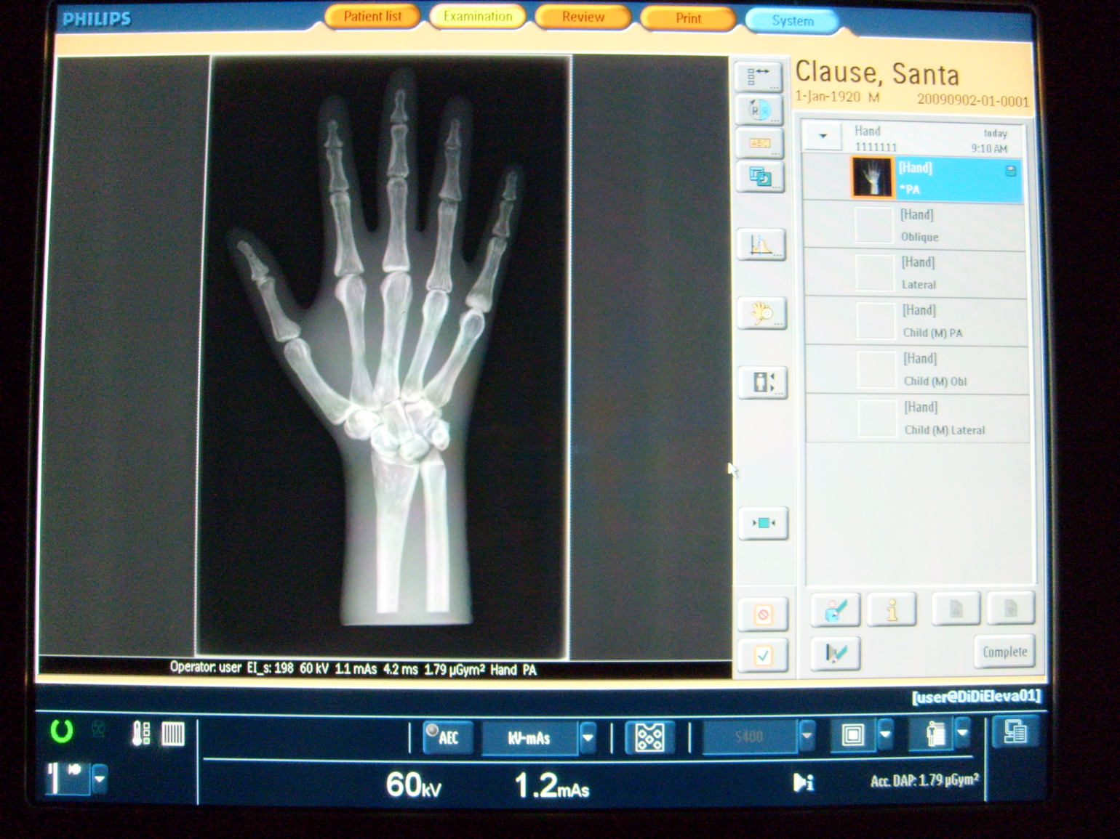
Control Panel – Example
AEC Button
kVp
mAs
Focal Spot Selector

Slide 10
X-ray Tube Assembly
Main functions on the tube assembly
  Digital Distance Measure
  Angulation Measure
  Locks (Longitudinal, transverse détentes)
  Light field
  Collimator Scale
  Collimator Adjustment Knob
  Manual measuring tape

Slide 11
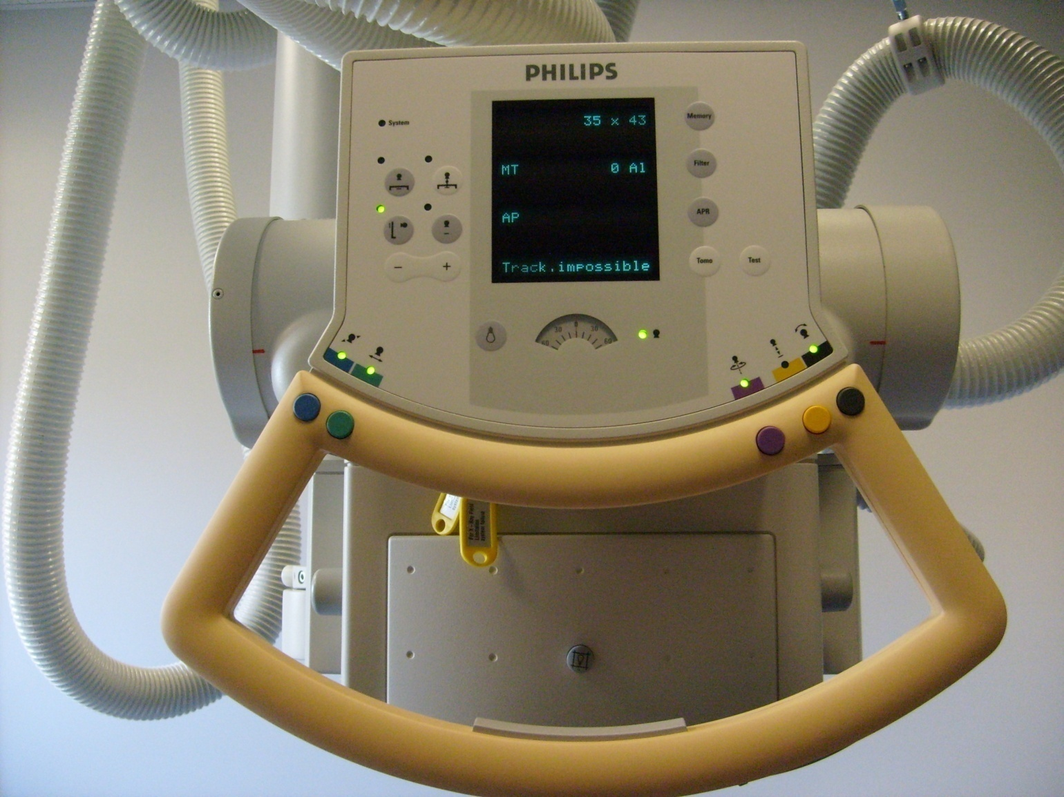
Tube and Tube Support
Light Field/Laser
Detector Selection
Locks
Collimation Controls
Light Field Only
All Locks Release

Slide 12
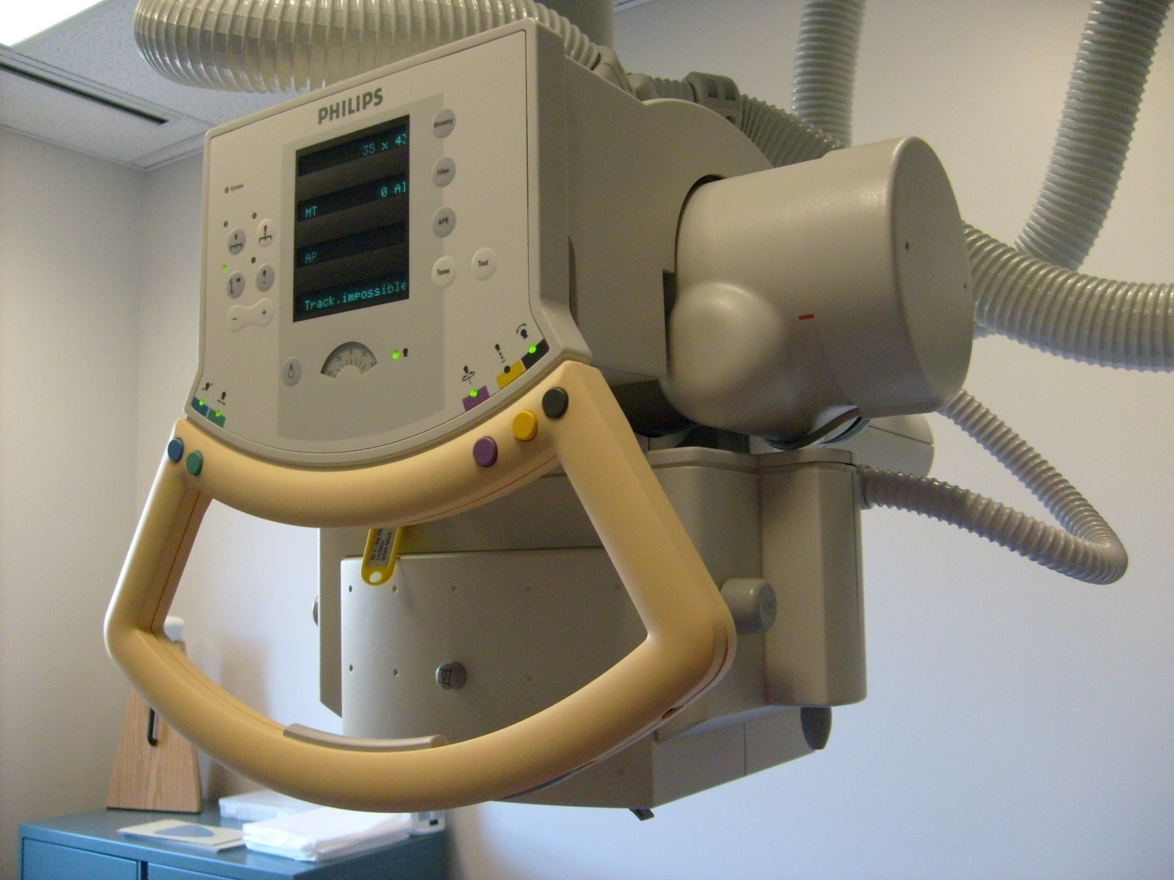

Tube and Tube Support
SID Readout
System Button
Angulation Scale
Measuring Tape

Slide 13
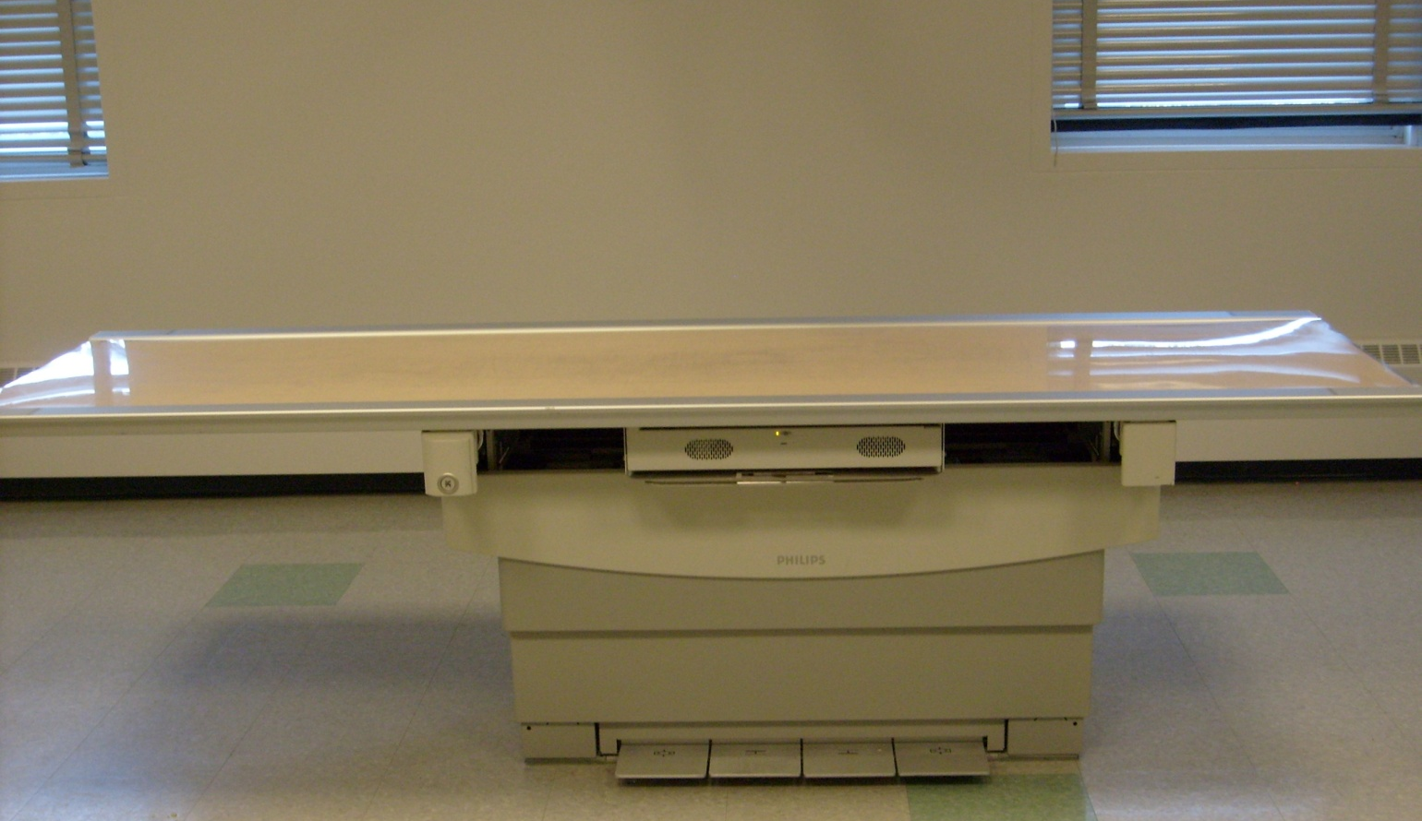
Table – Example
Notes:
Center pedestal

Slide 14
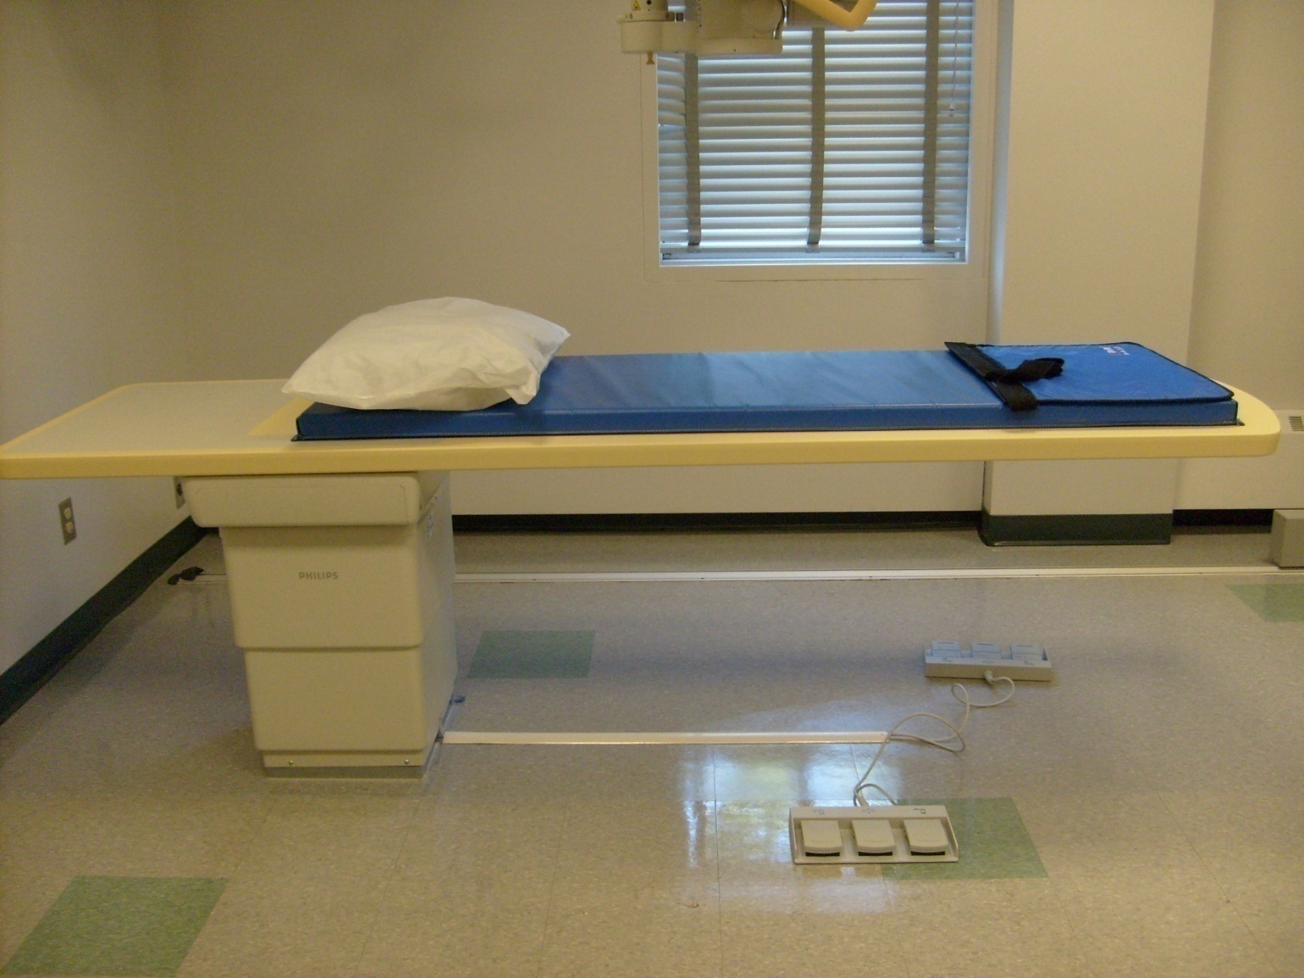
Table – Example
Notes:
Off center pedestal

Slide 15
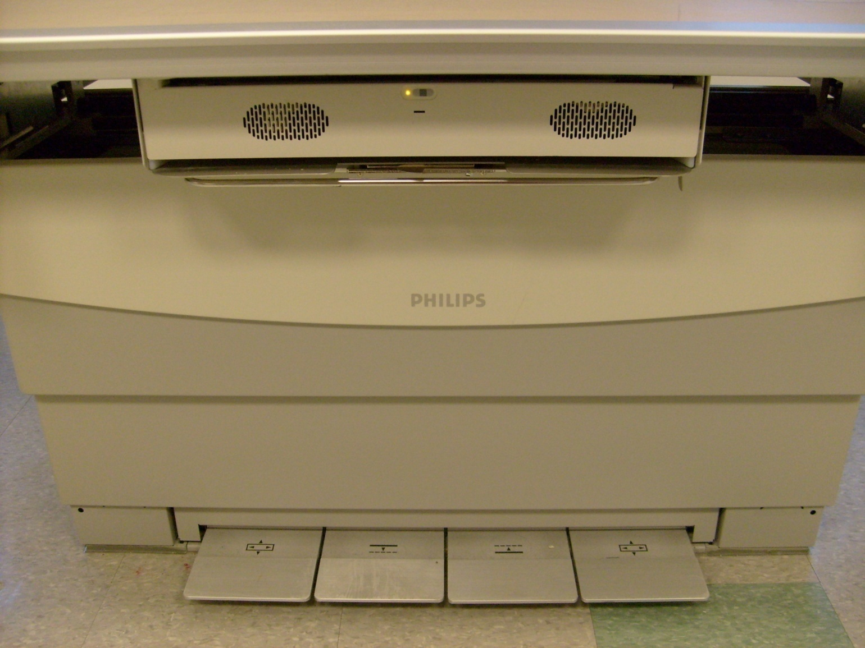
Table – Example
Detector Lock
Table Release
Table Up/Down

Slide 16
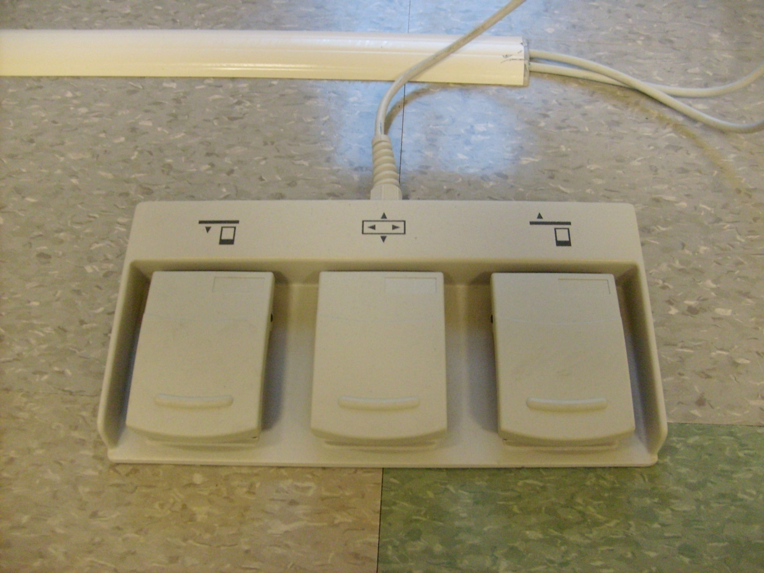
Table – Example
Table Up/Down
Floating Table Release

Slide 17
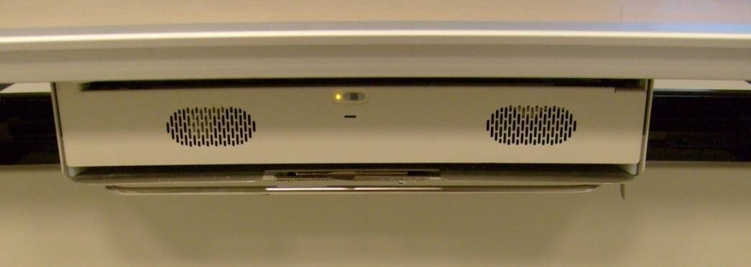
Detectors
Images can be attained using cassettes or detectors
Detectors can also be called “cassette-less” systems

Slide 18
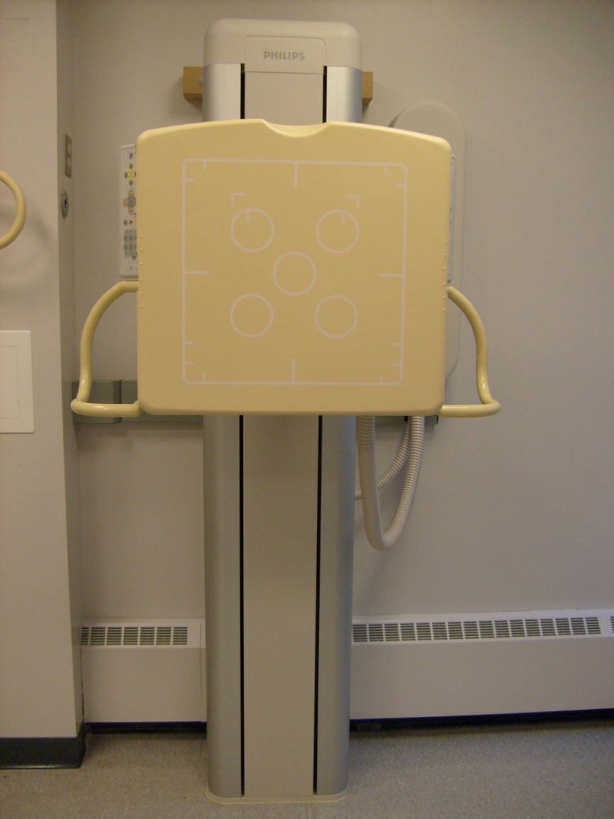
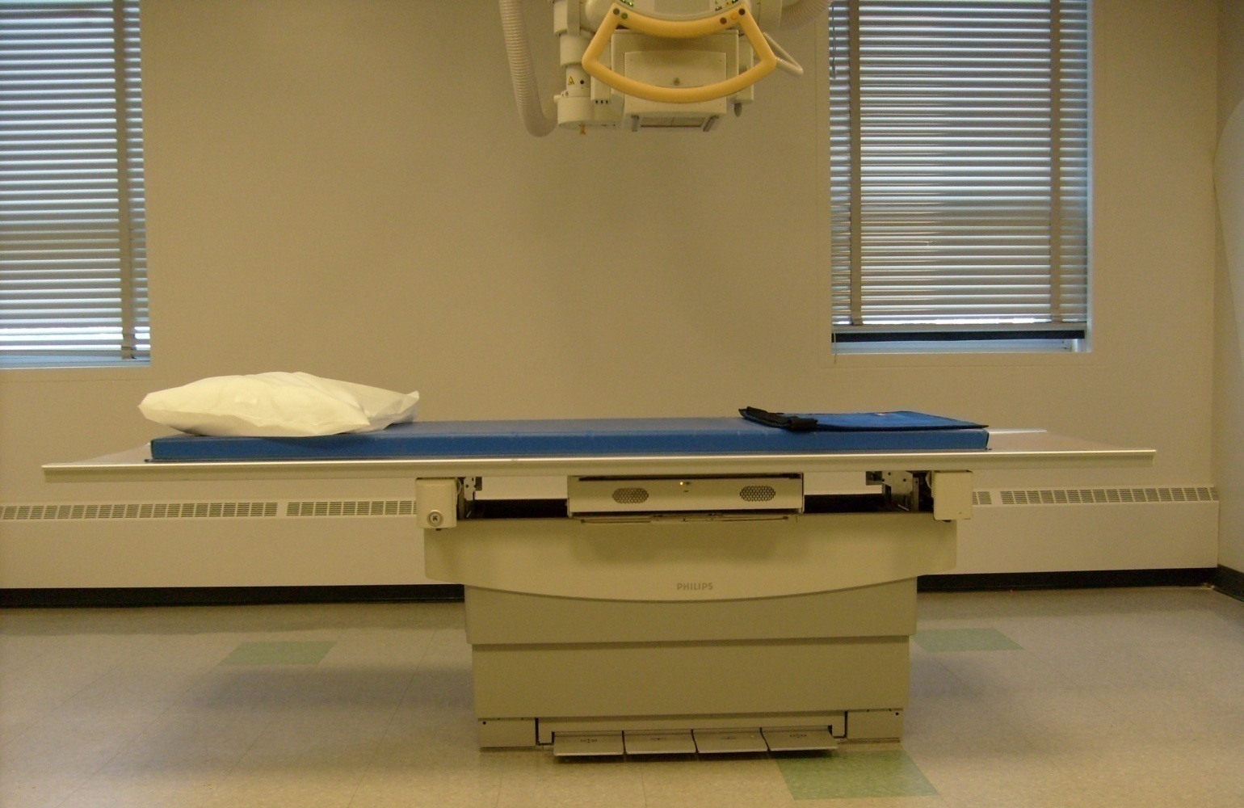
Dual Detector Room

Slide 19
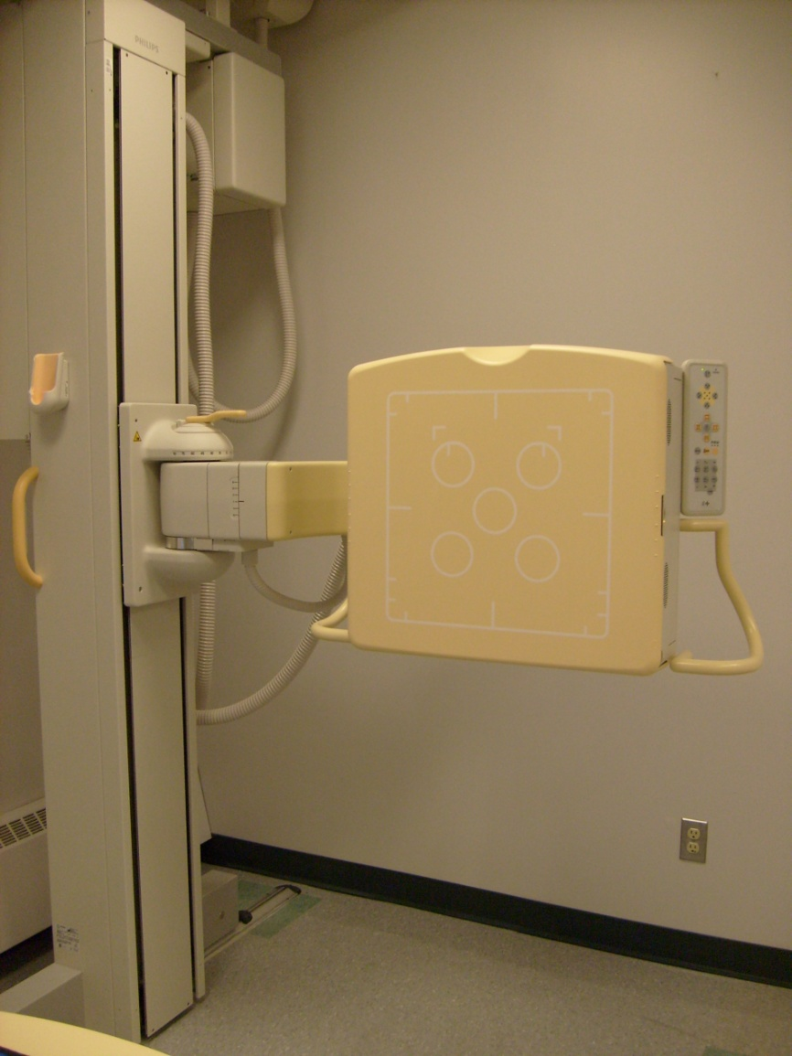
Upright Single Detector - Example

Slide 20
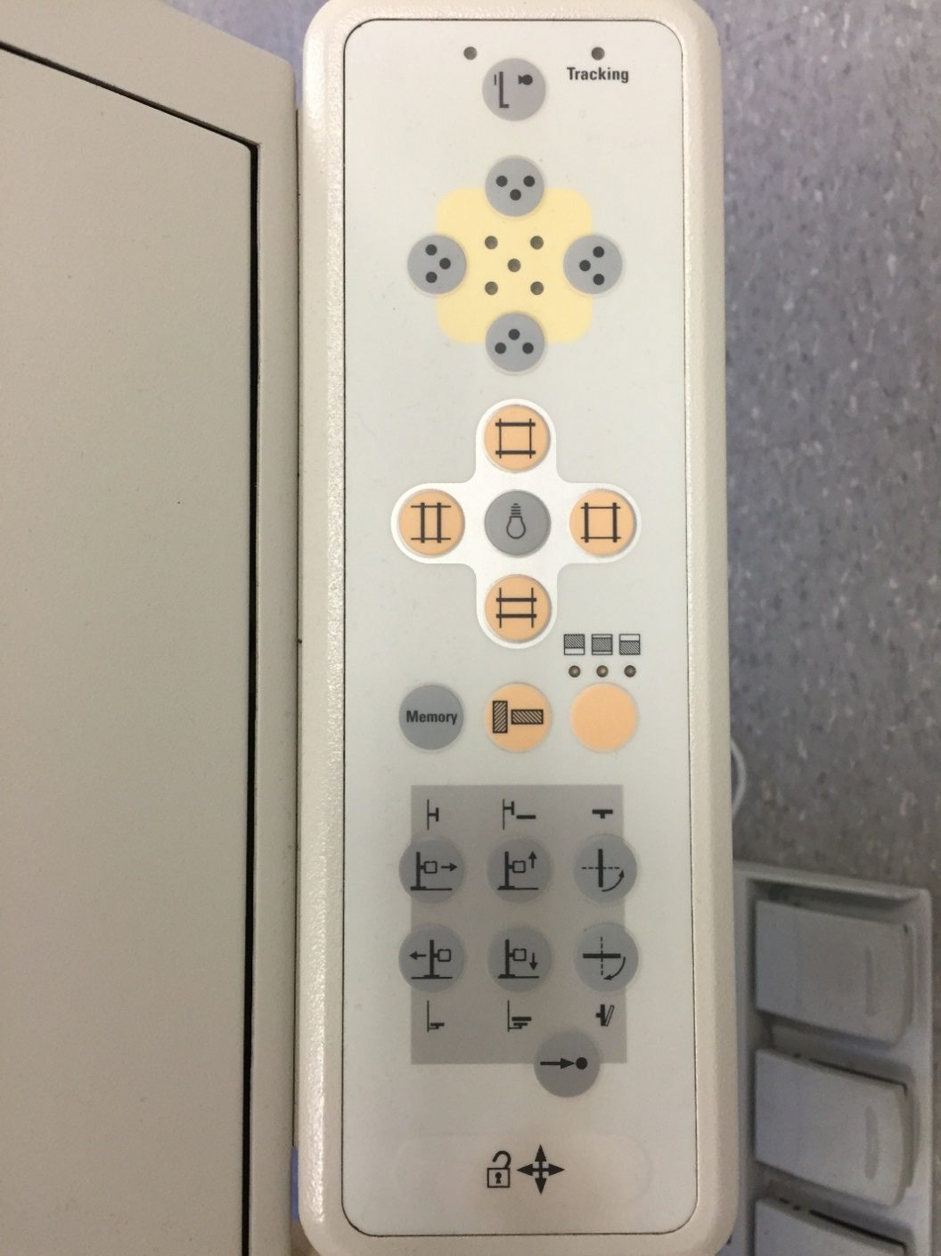
Detector Controls
Tracking
AEC Indicator
Light Field
Collimators
Moves detector position
Secondary function
All locks release

Slide 21
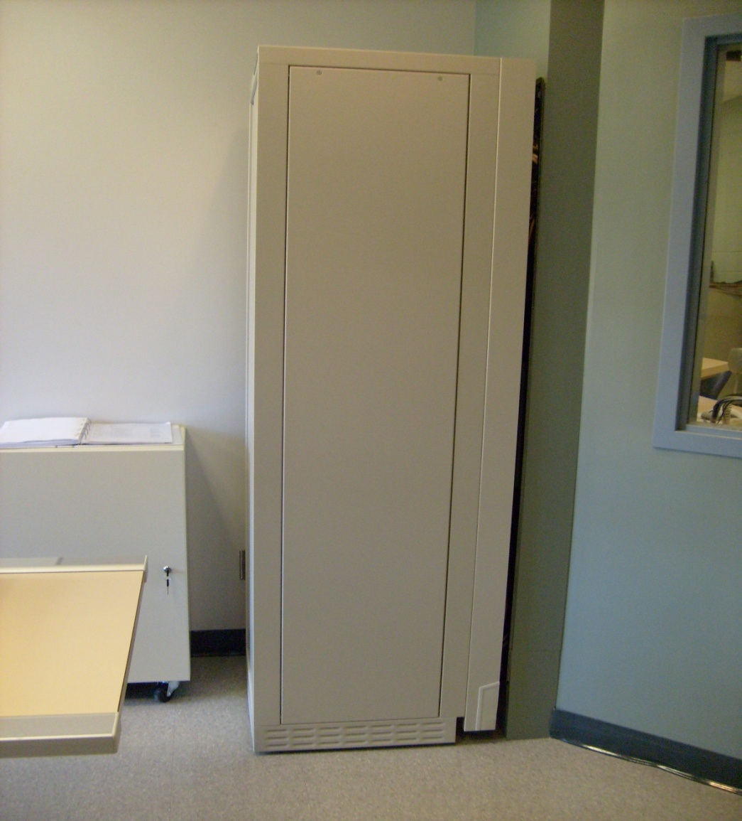
High Voltage Generator

Slide 22
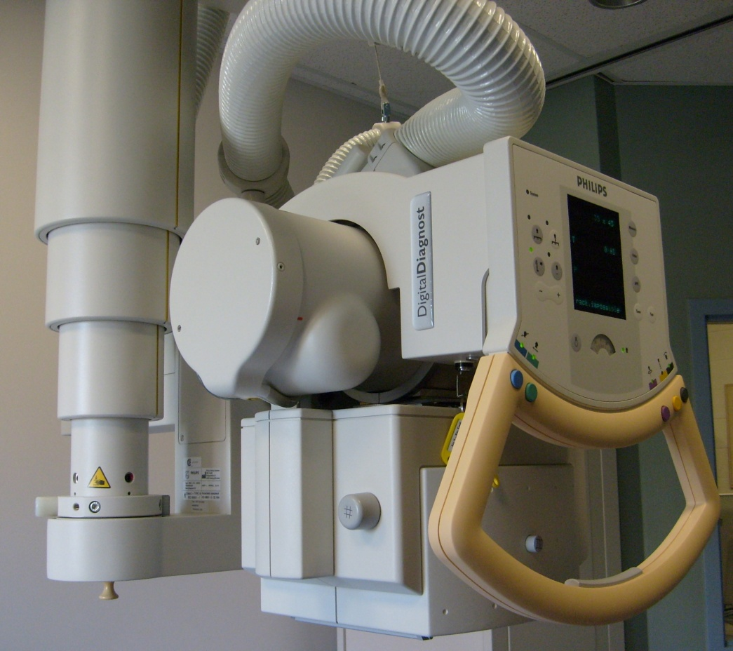
Tube Supports
Tube supports are part of the external structure of the x-ray tube
  Physical support of the assembly
  Made up of rails, column, tube head, housing and tube
Other external structures include the protective housing & glass or metal envelope

Slide 23
Tube Supports
Purpose: to support the x-ray tube and housing assembly for manipulation and immobilization as required
Types of Tube Suspension systems
  Ceiling mounted
  Floor-to-Ceiling mounted
  Floor mounted
  C-arm

Slide 24
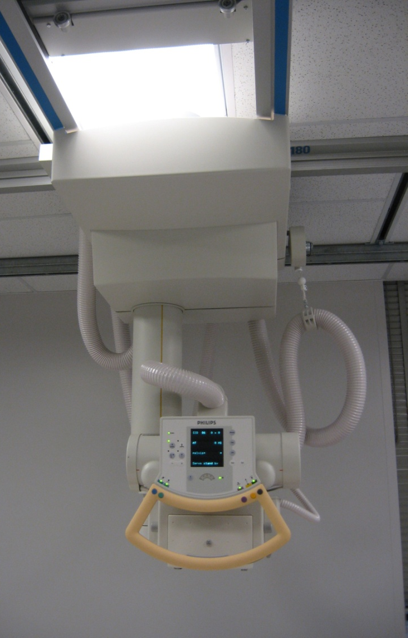
Ceiling Tube Mount
Likely the most common installation
Most versatility
Two perpendicular sets of rails
Telescoping column
  Angulation
  Rotation
Limited only by the range of the rails

Slide 25

Floor to Ceiling Support system
Single column attached to two rails
  Ceiling rail and floor rail
Limited movement of the x-ray tube
  Travel along rails
  Tube attached to a telescoping arm to allow transverse movement and angulation
  Adjustable column allows for vertical movement
Less versatile than the ceiling mount

Slide 26
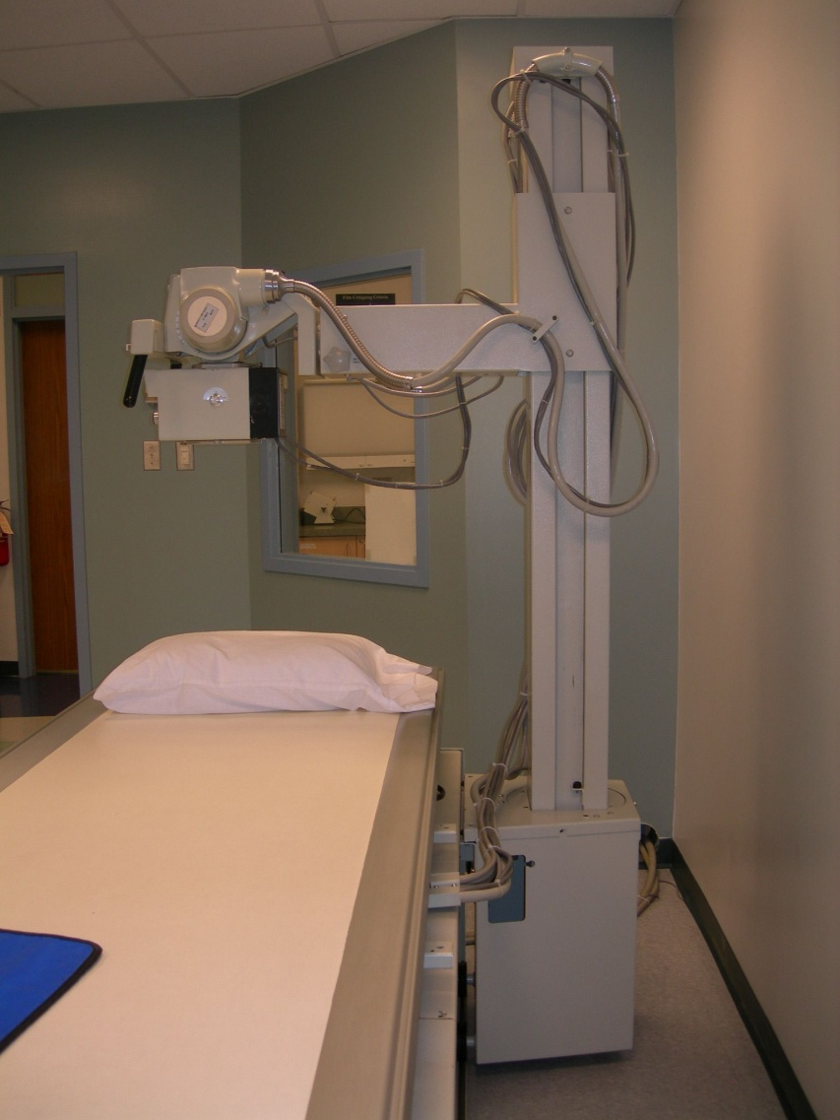
Floor Mounted System
Attached to floor and table pedestal
Column allows vertical movement
Telescoping arm allows for transverse movement and angulation
  Rotation capabilities common
Movement is most restricted with this system

Slide 27
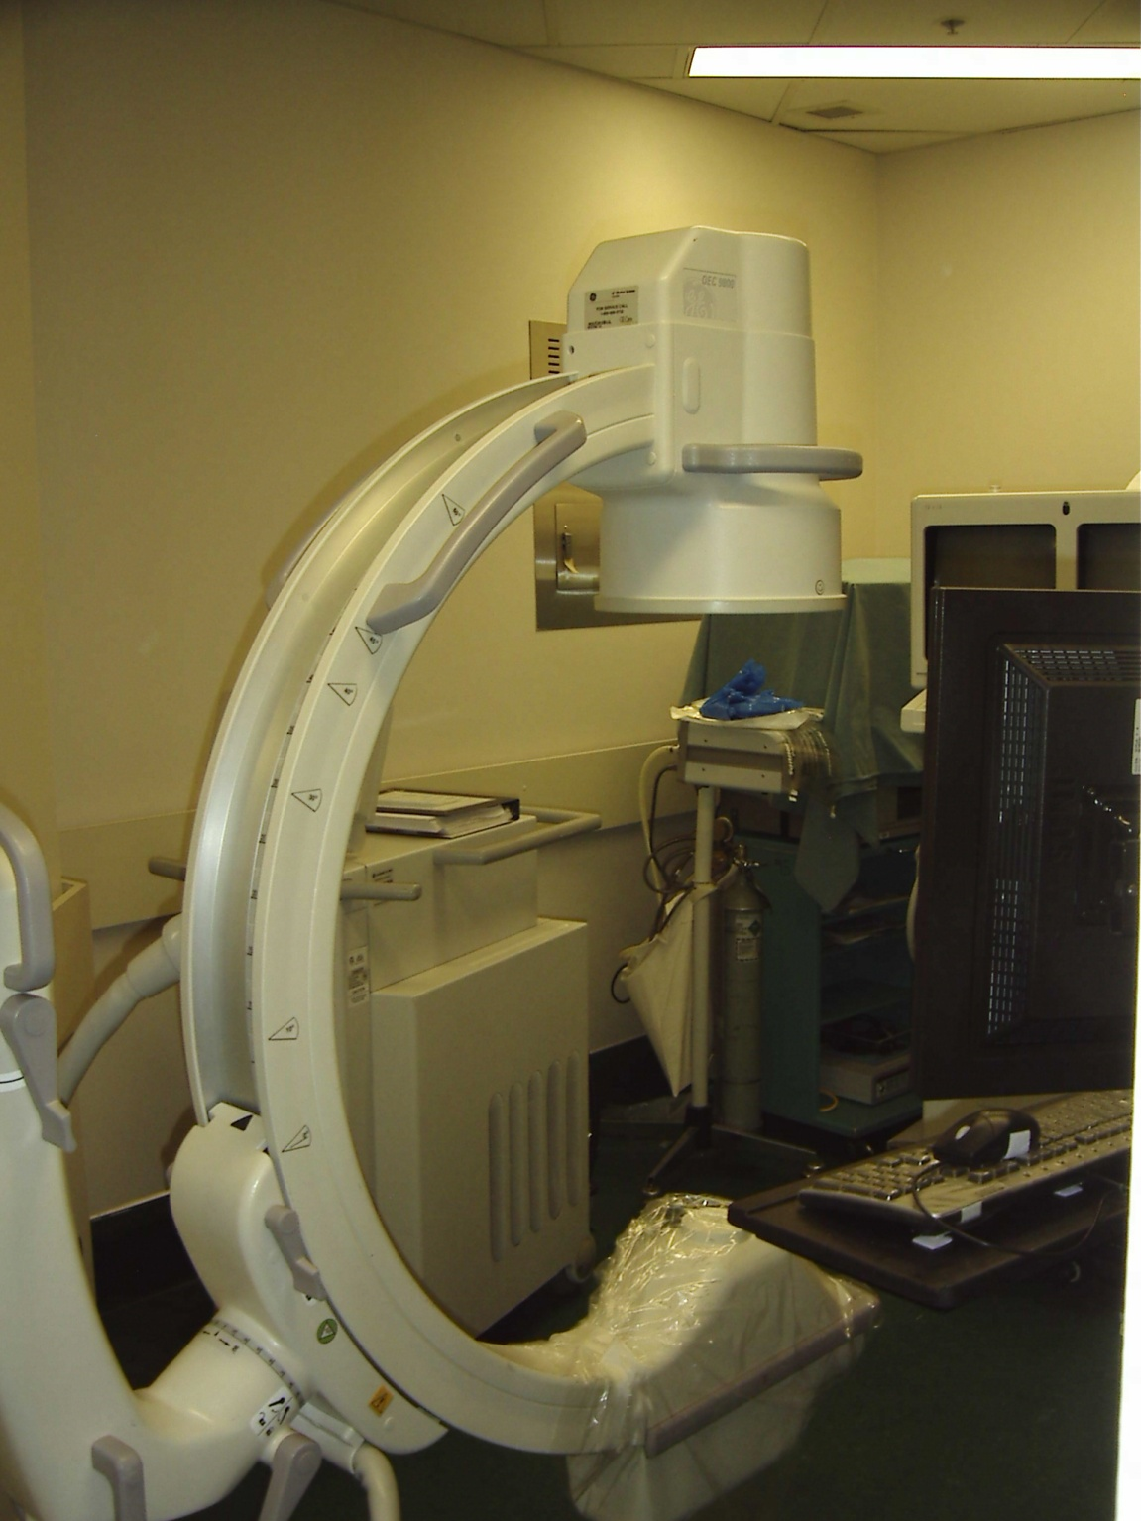
C-arm
Can be ceiling mounted or standalone (mobile)
Commonly used:
  OR (operating rooms)
  Trauma Bay
  Interventional/Angiography suites
  Fluoroscopy suites
X-ray tube on one side, IR on the other
Some have capabilities for dynamic (fluoroscopic) imaging
S.A.I.T. Medical Radiology Program 2011

Slide 28
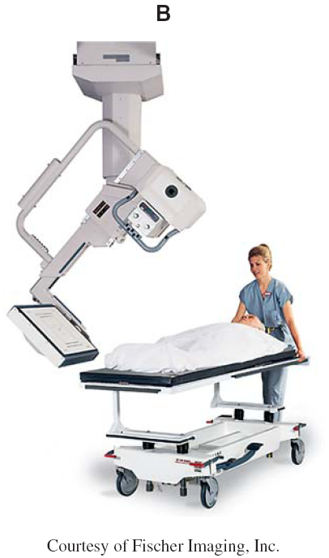
C-arm
Efficient
Design allows for obtaining images without having to move the patient
  Critical for trauma and OR scenarios
  Trauma imaging often requires images at 90 degrees to each other (AP and lateral)

Slide 29
Table Characteristics
Shape
  Flat – most common for general radiography
  Curved – angiography, CT
Uniform radiolucency
Durable
  Must stand up to wear/tear
  Able to support patient’s weight
Carbon fiber is most common
  Strong
  Minimal absorption of radiation

Slide 30
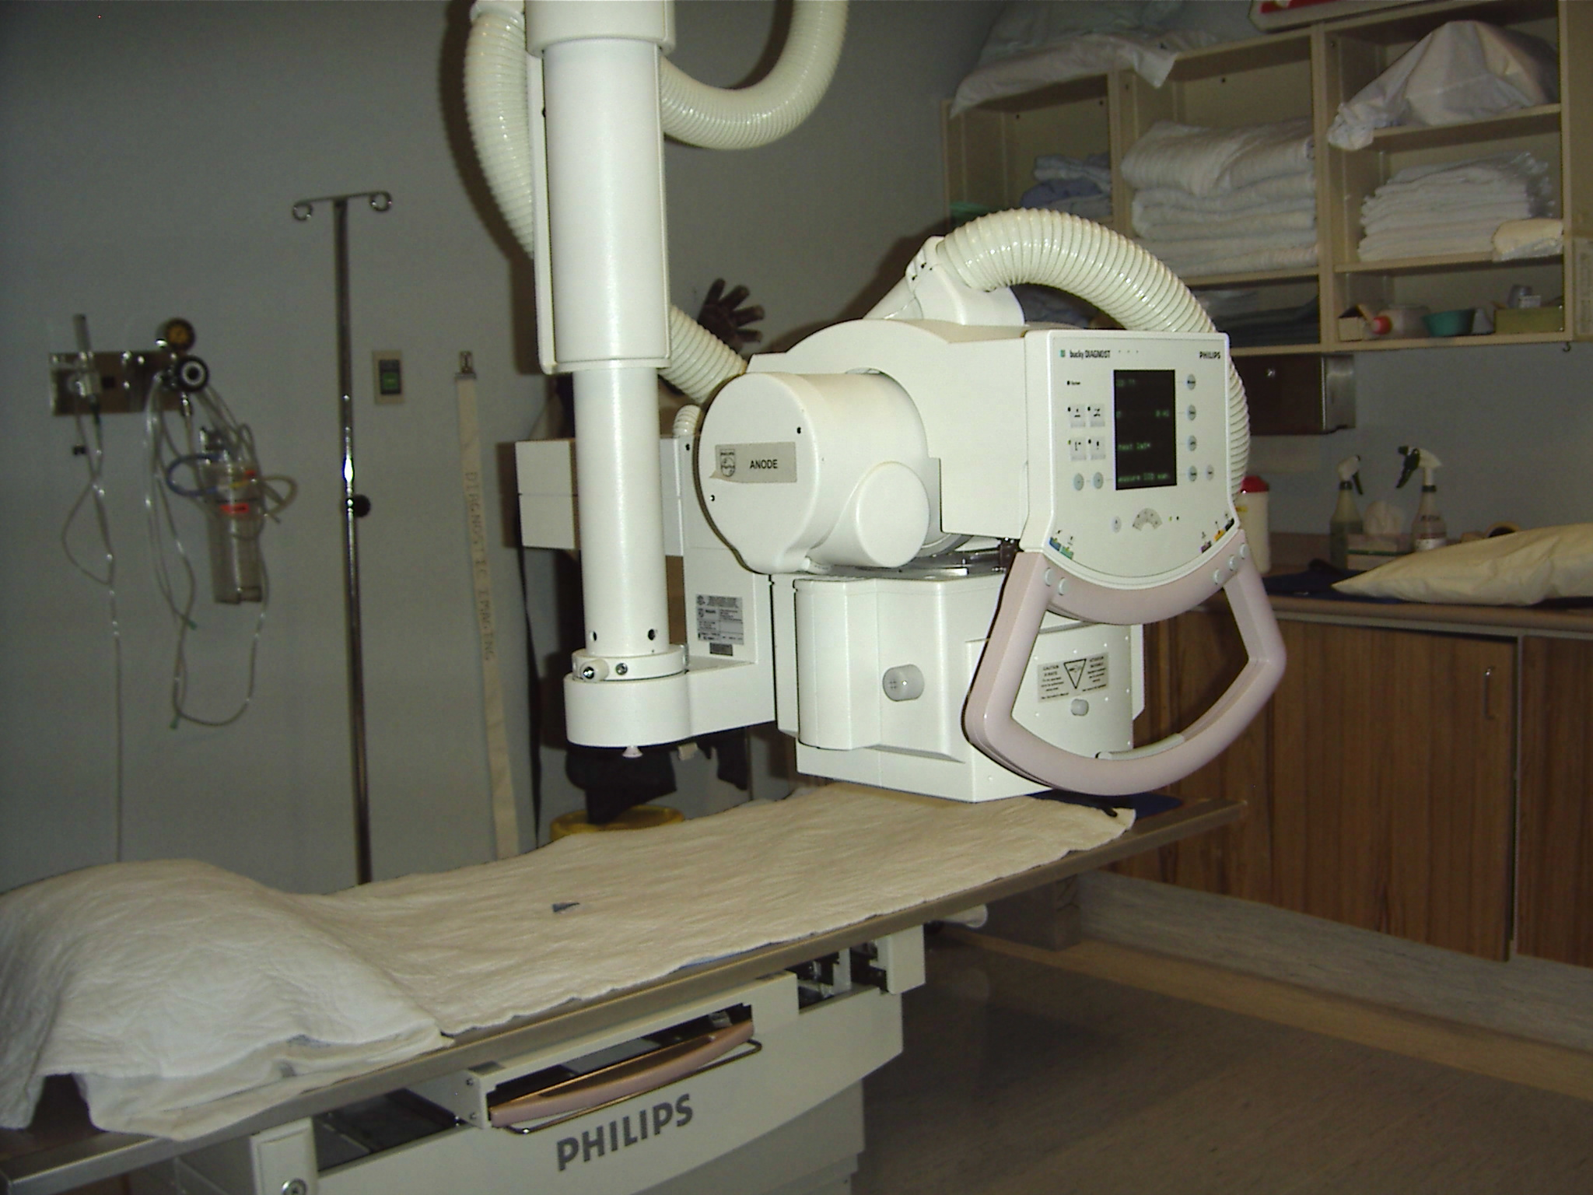
Table Characteristics
Easy to clean
  Removal of body fluids and debris
Hard to scratch
No crevices
High weight limit
Can include a detector, or cassette holder (bucky)
  Bucky-Potter tray
  Has oscillating grid and holds cassettes
  Grid is activated and moves automatically during the exposure

Slide 31
Fixed vs. Tilting
Majority of tables are floating table tops, some are motor driven
Tilting
  Move 90º to upright(standing) and 15-30º head down
  Fixed height
Fixed
  Can be adjustable in height for patients and technologists

Slide 32
Readings
Radiologic Science For Technologists, Mosby 11th Ed.
  Pg. 85-87,105

