Slide 1
INFC 215 – Infection Prevention and Control
Handwashing
MRT Program

Slide 2
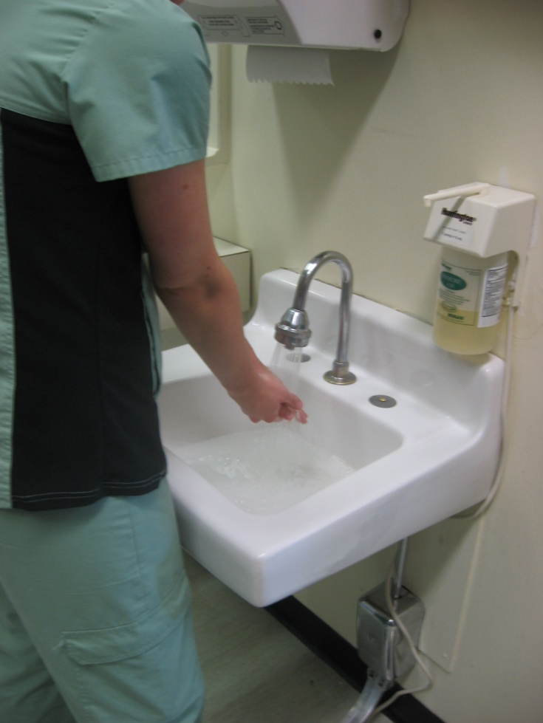
1. Turn on water and adjust water temperature and flow.

Slide 3
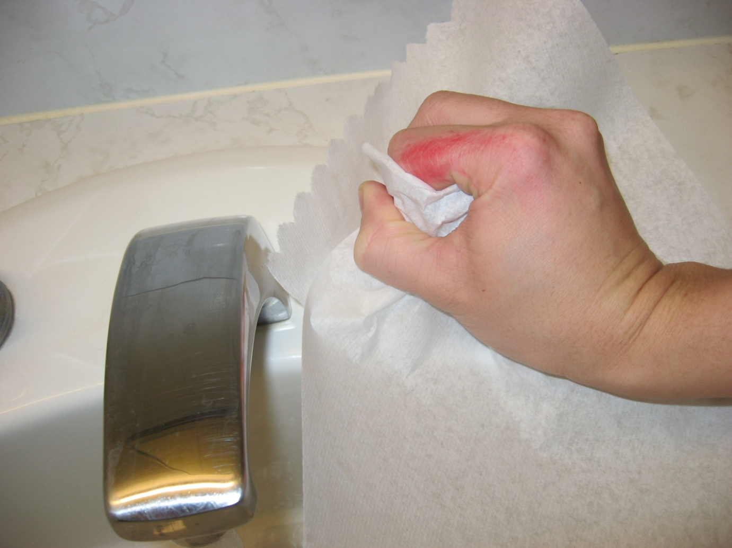
1. a. If hands are soiled turn on taps with paper towel.

Slide 4
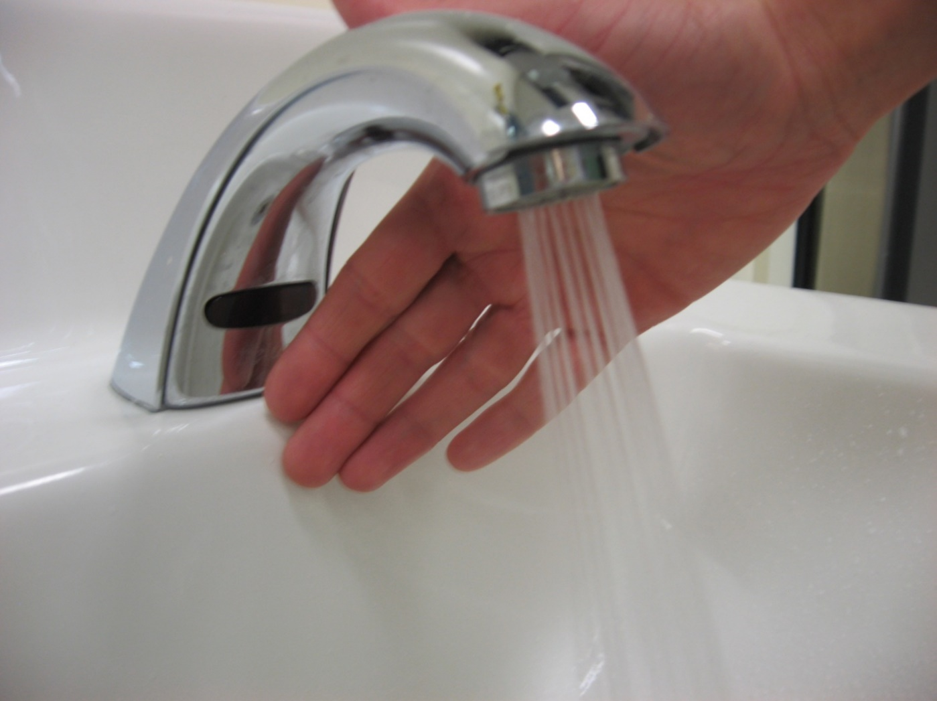
1. b. If present, activate electronic eye.

Slide 5
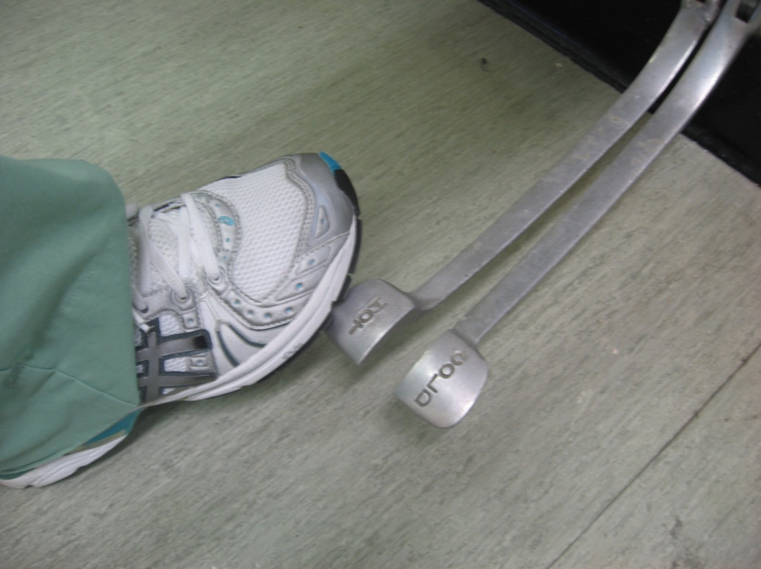
1. c. If present, adjust the foot pedals

Slide 6
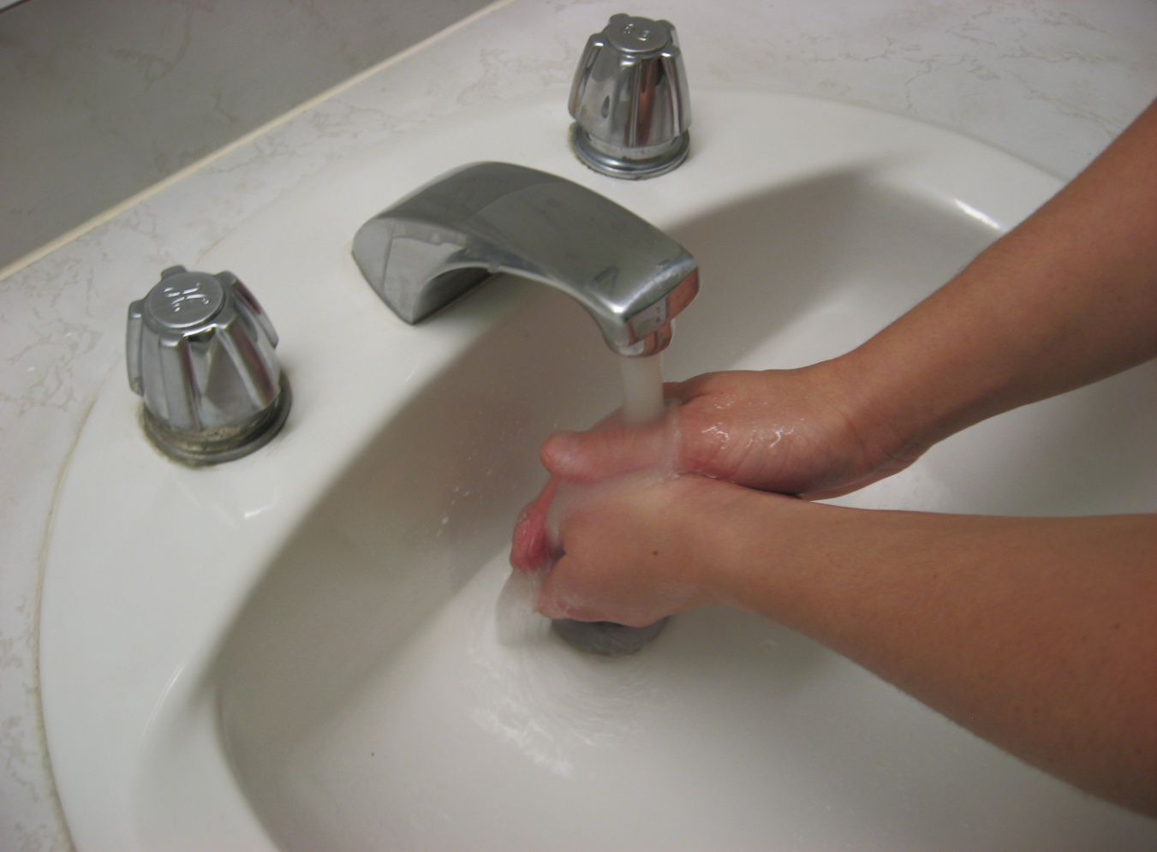
2. Wet hands with running water.

Slide 7
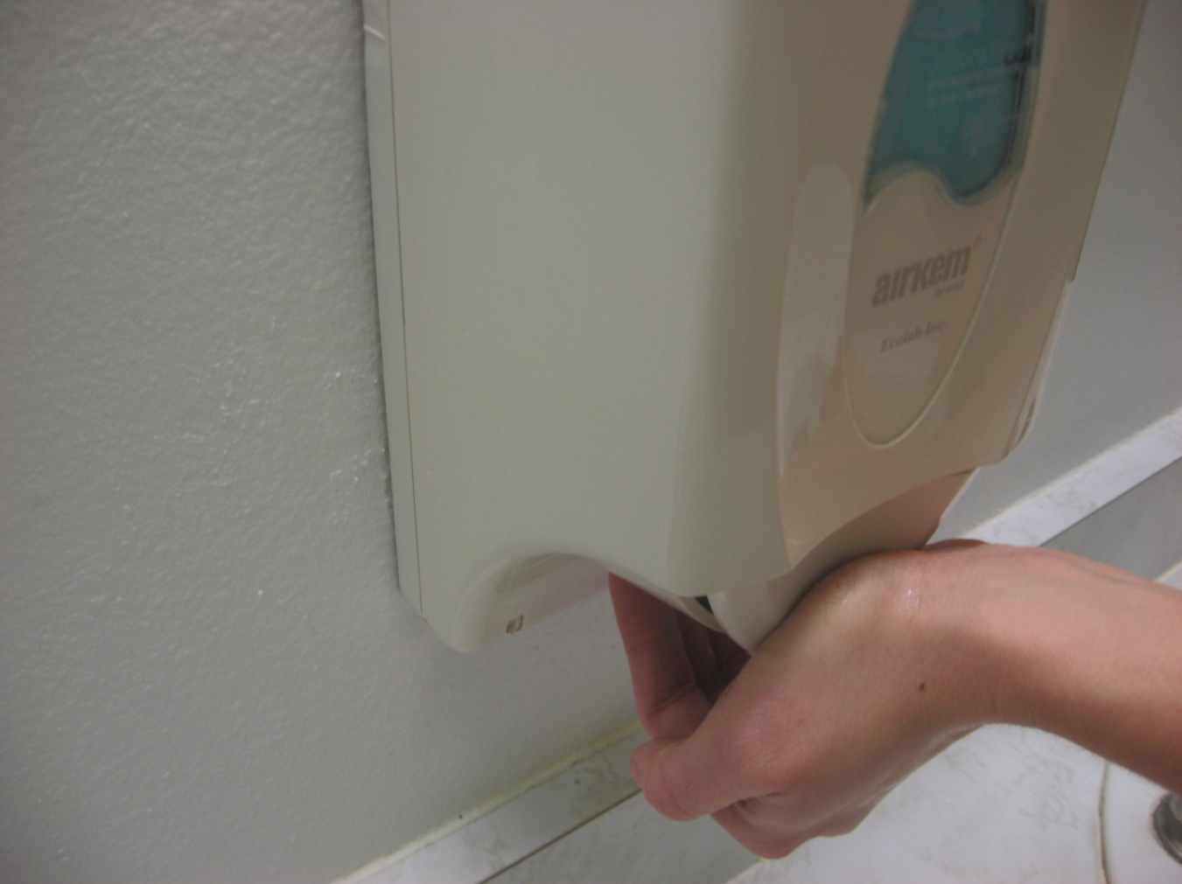
3. Apply sufficient soap to obtain a lather ( 5 ml/ 1 teaspoon).

Slide 8
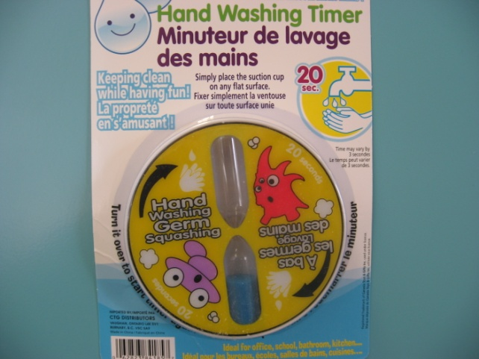
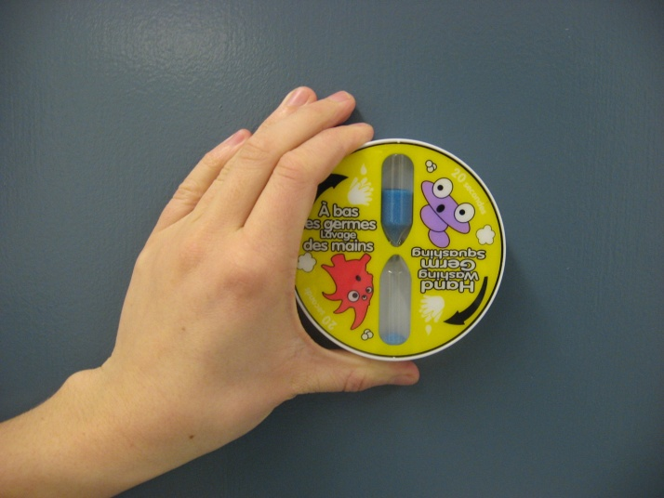
4. Start Timing
Sing your favorite song; recite alphabet
15 - 20 seconds

Slide 9
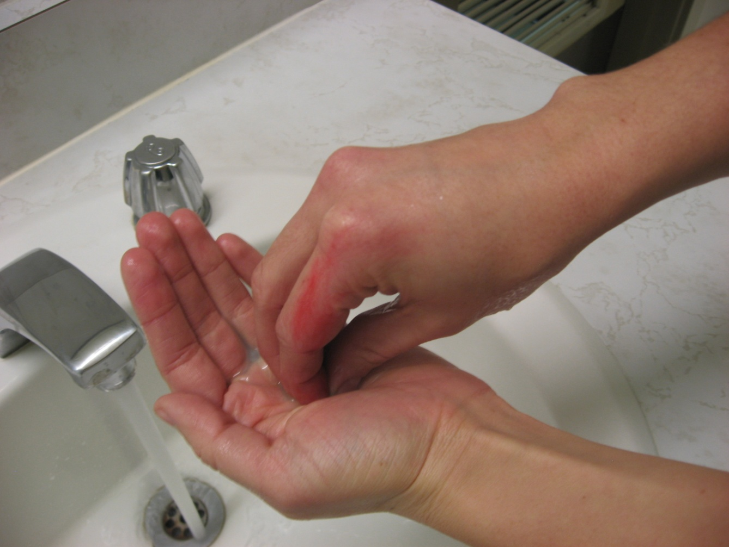
5. Rub nails of one hand into soap.

Slide 10
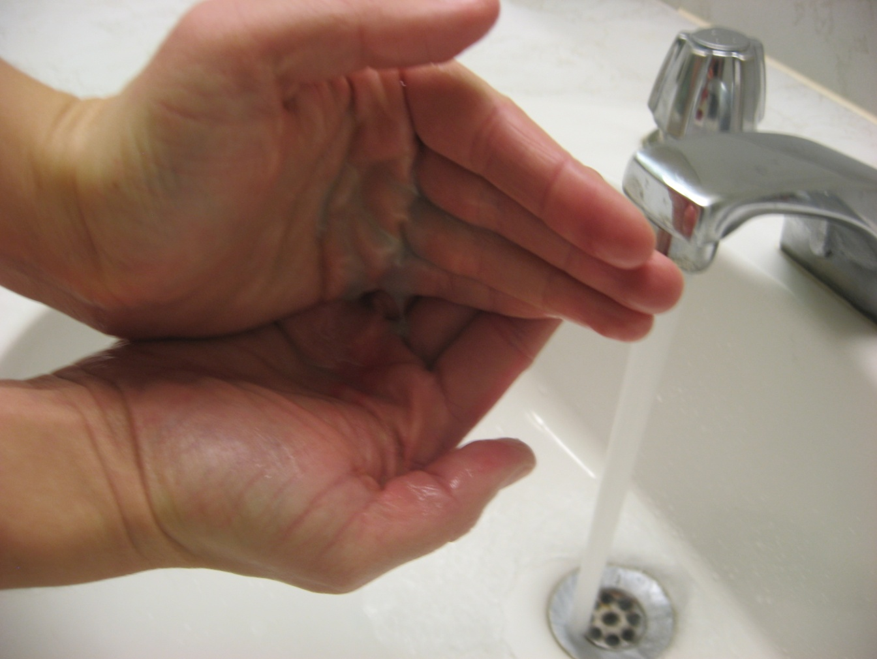
6. Dump soap into opposite palm.

Slide 11
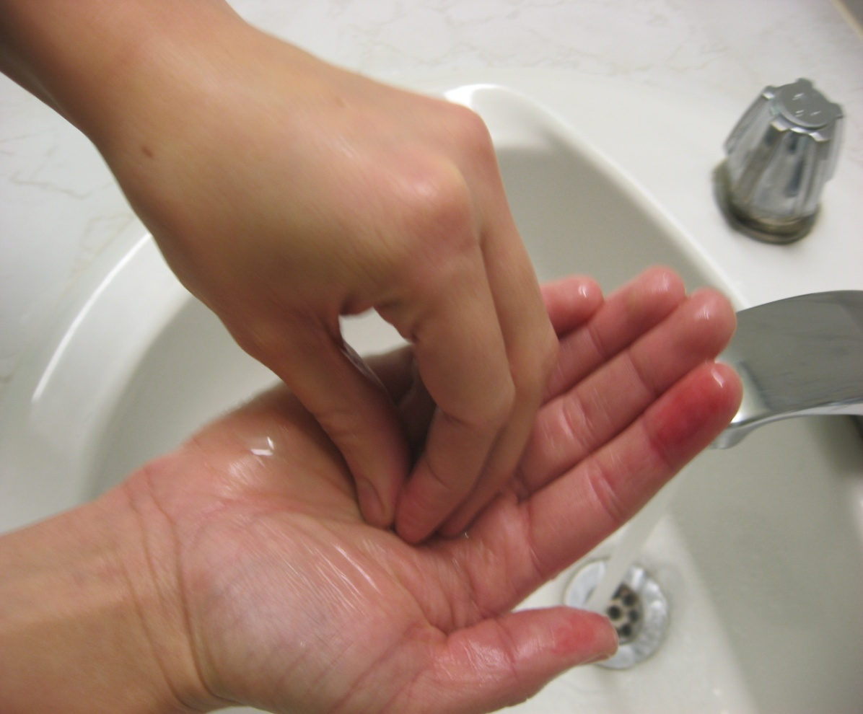
7. Rub nails of other hand in to soap.

Slide 12
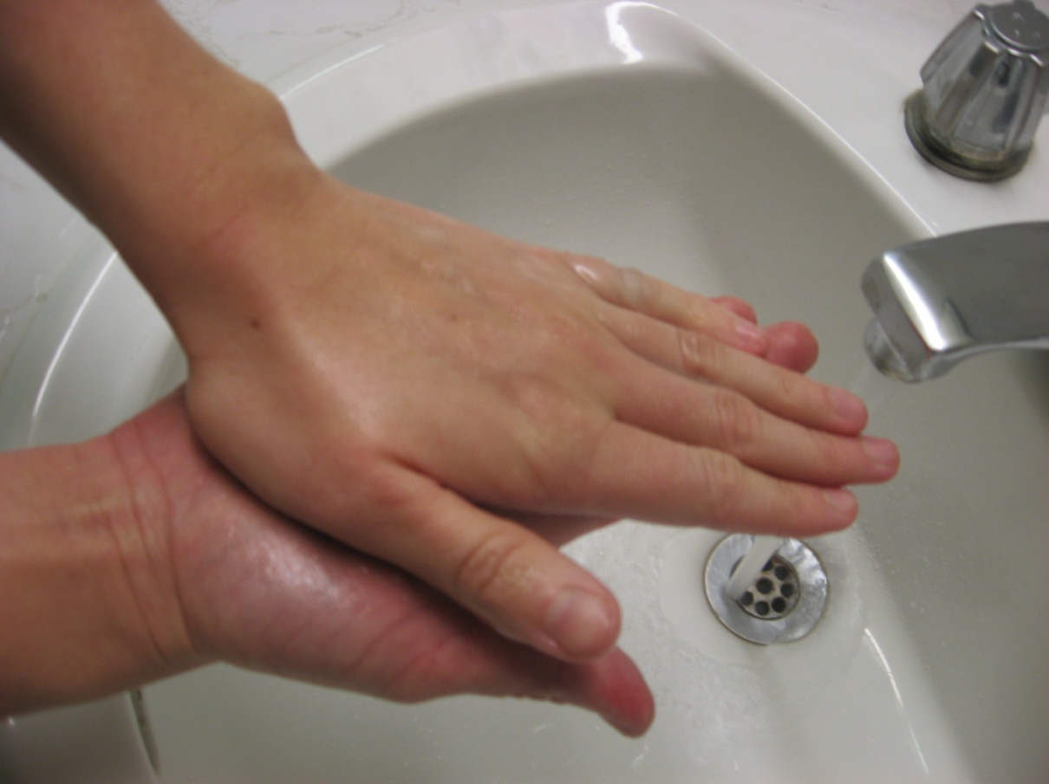
8. Rub palms together.

Slide 13
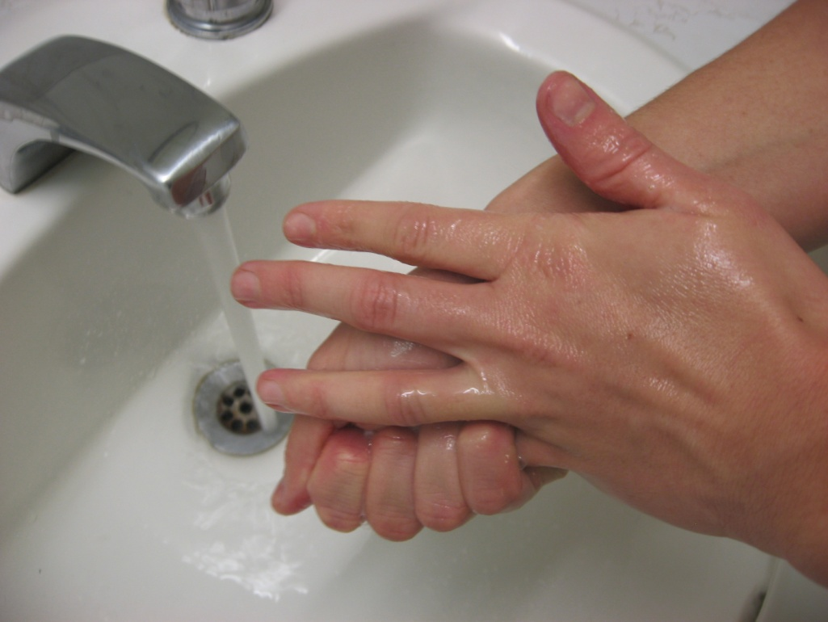
9. Rub each finger.
Work left to right in an organized manner
Start with little finger on left hand

Slide 14
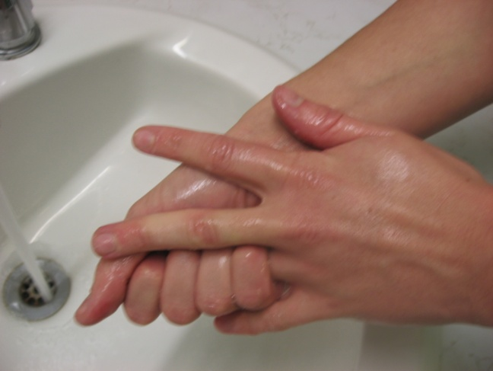
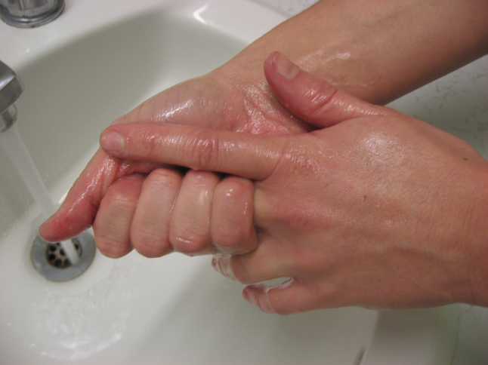
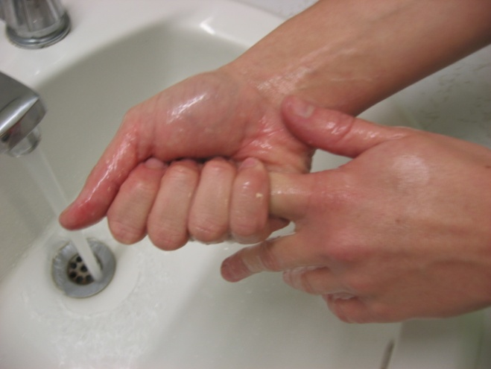
9. b . Ring finger, middle finger, index finger.

Slide 15
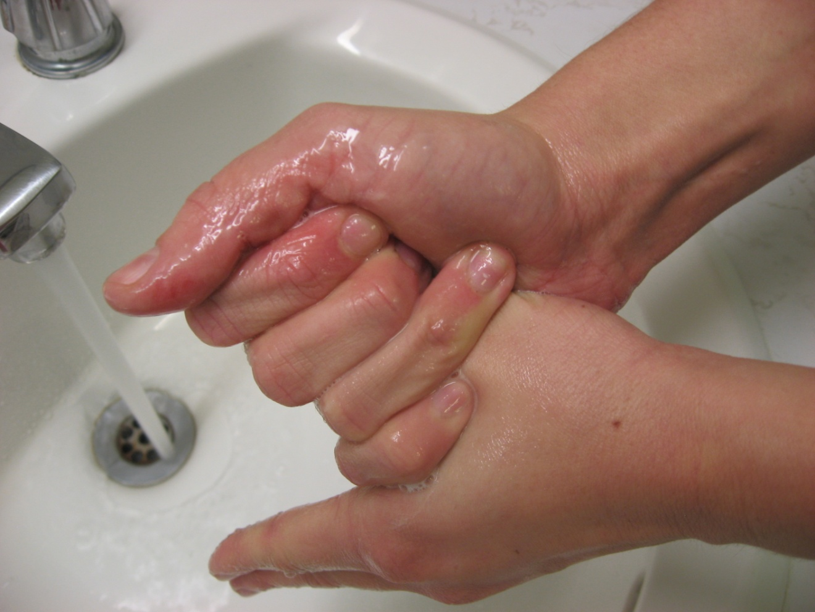
9. c. Don’t forget your thumb.

Slide 16
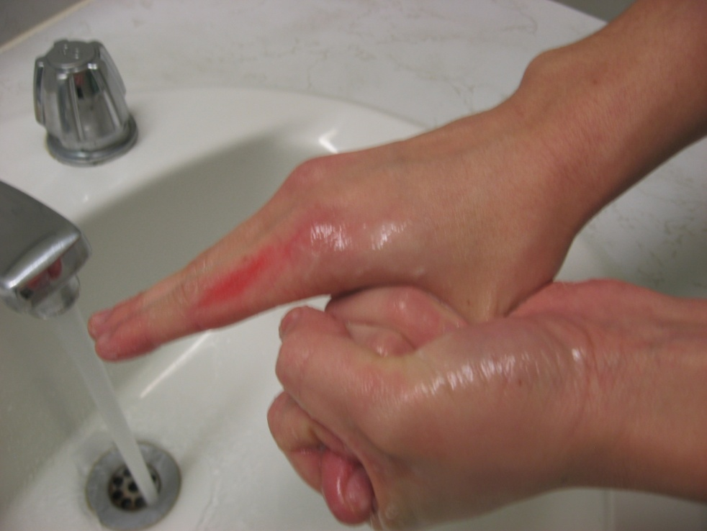
10. Then do the fingers of the right hand.
Start with the thumb
Thumbs are the most often forgotten digit when handwashing

Slide 17
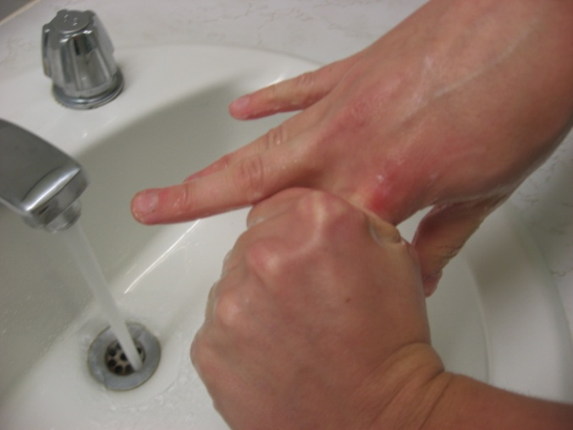
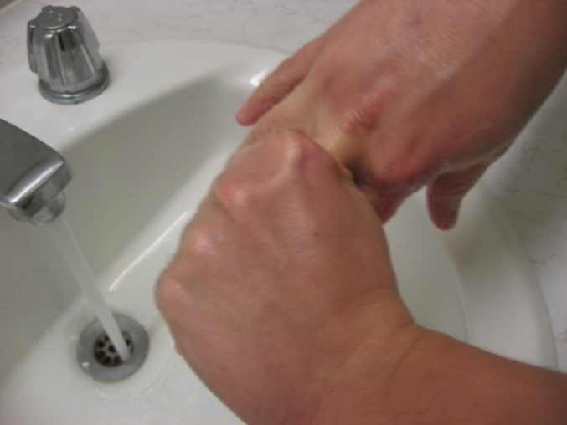
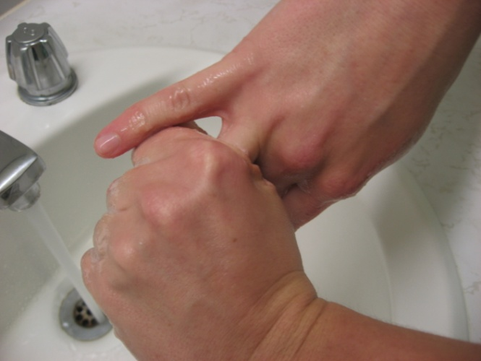
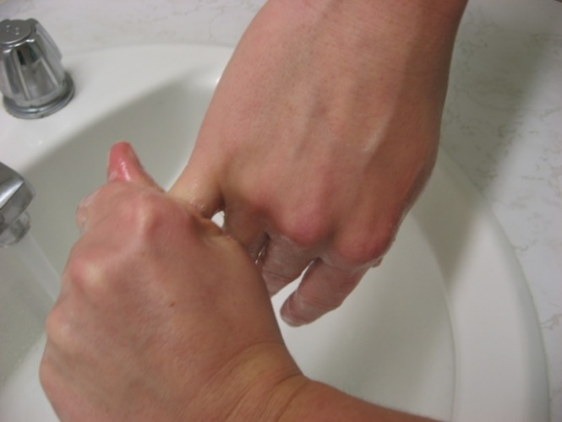
10. b. Continue rubbing other fingers in order.

Slide 18
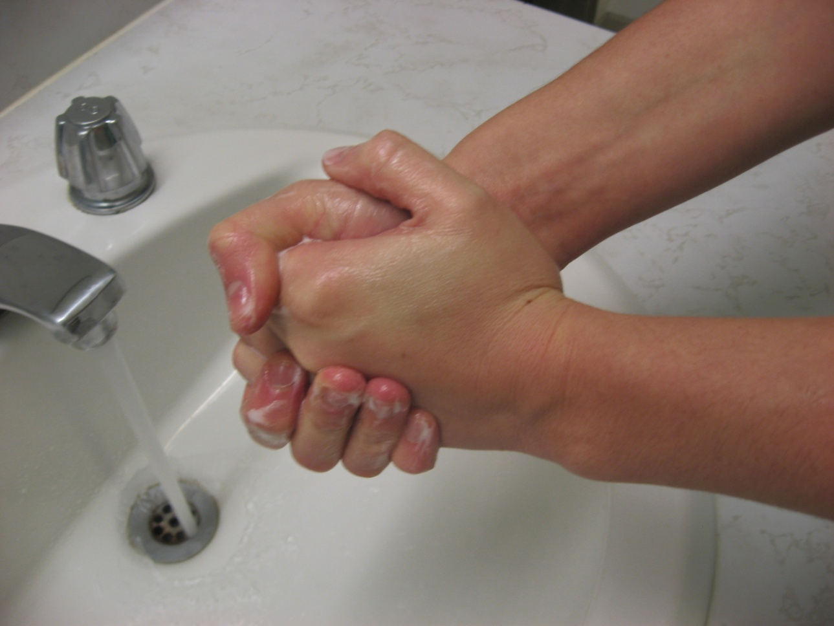
11. Rub sides of hands.

Slide 19
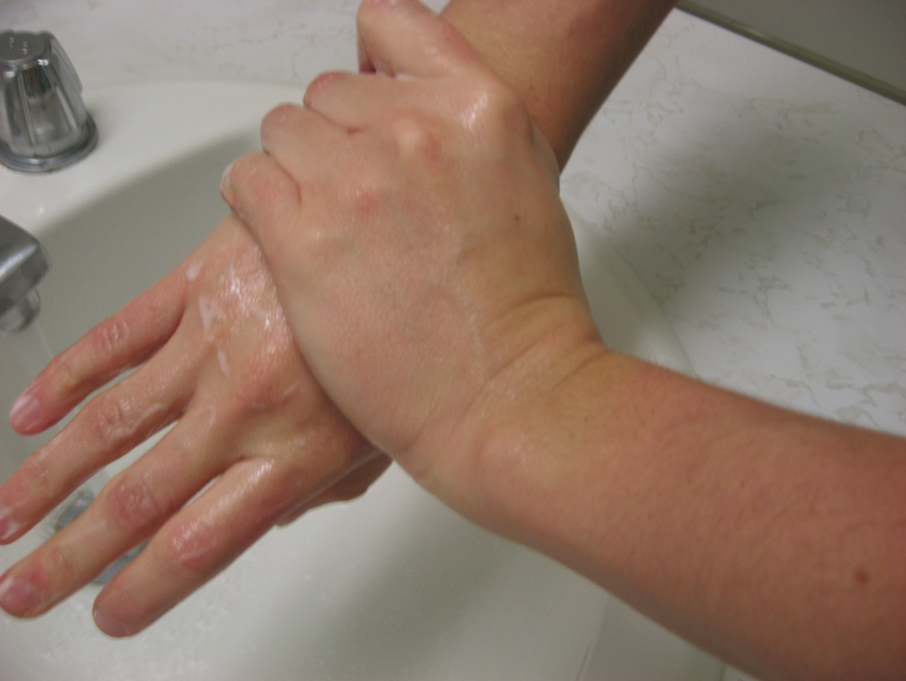
12. Rub back of hands.

Slide 20
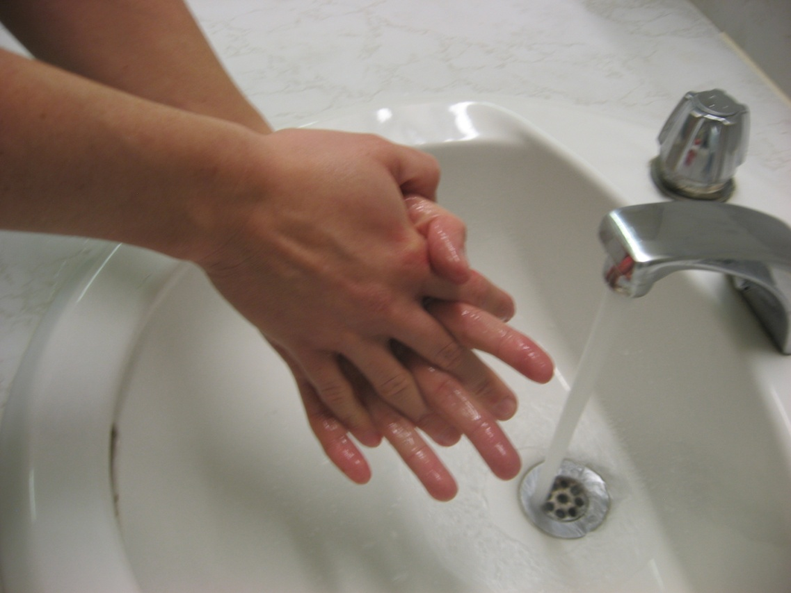
13. Rub between fingers.

Slide 21
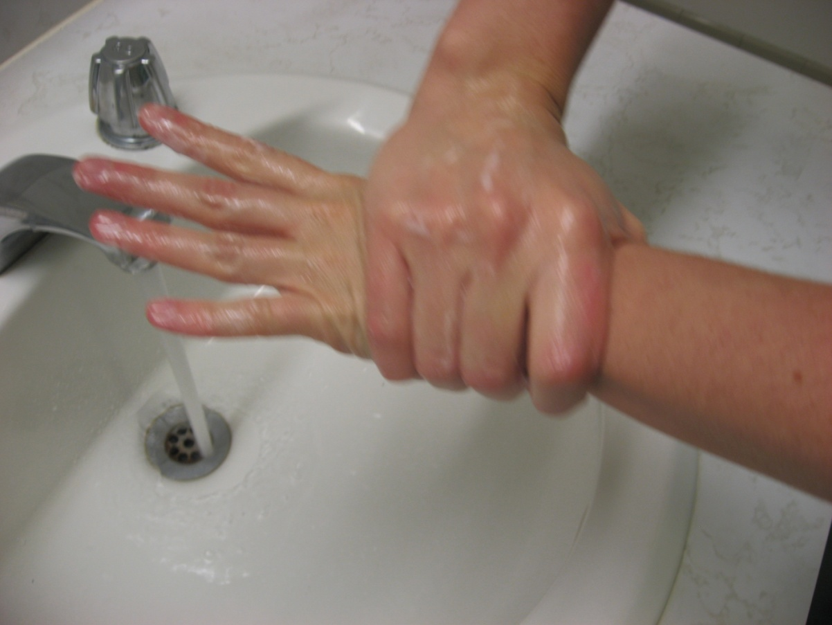
14. Rub wrists.

Slide 22
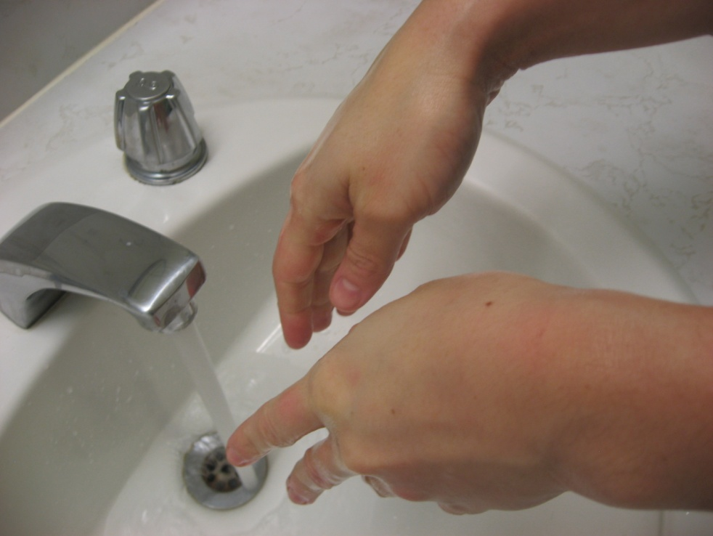
15. During this procedure:
Keep the hands and forearms at elbow level or below and hands pointed down
Not under running water

Slide 23
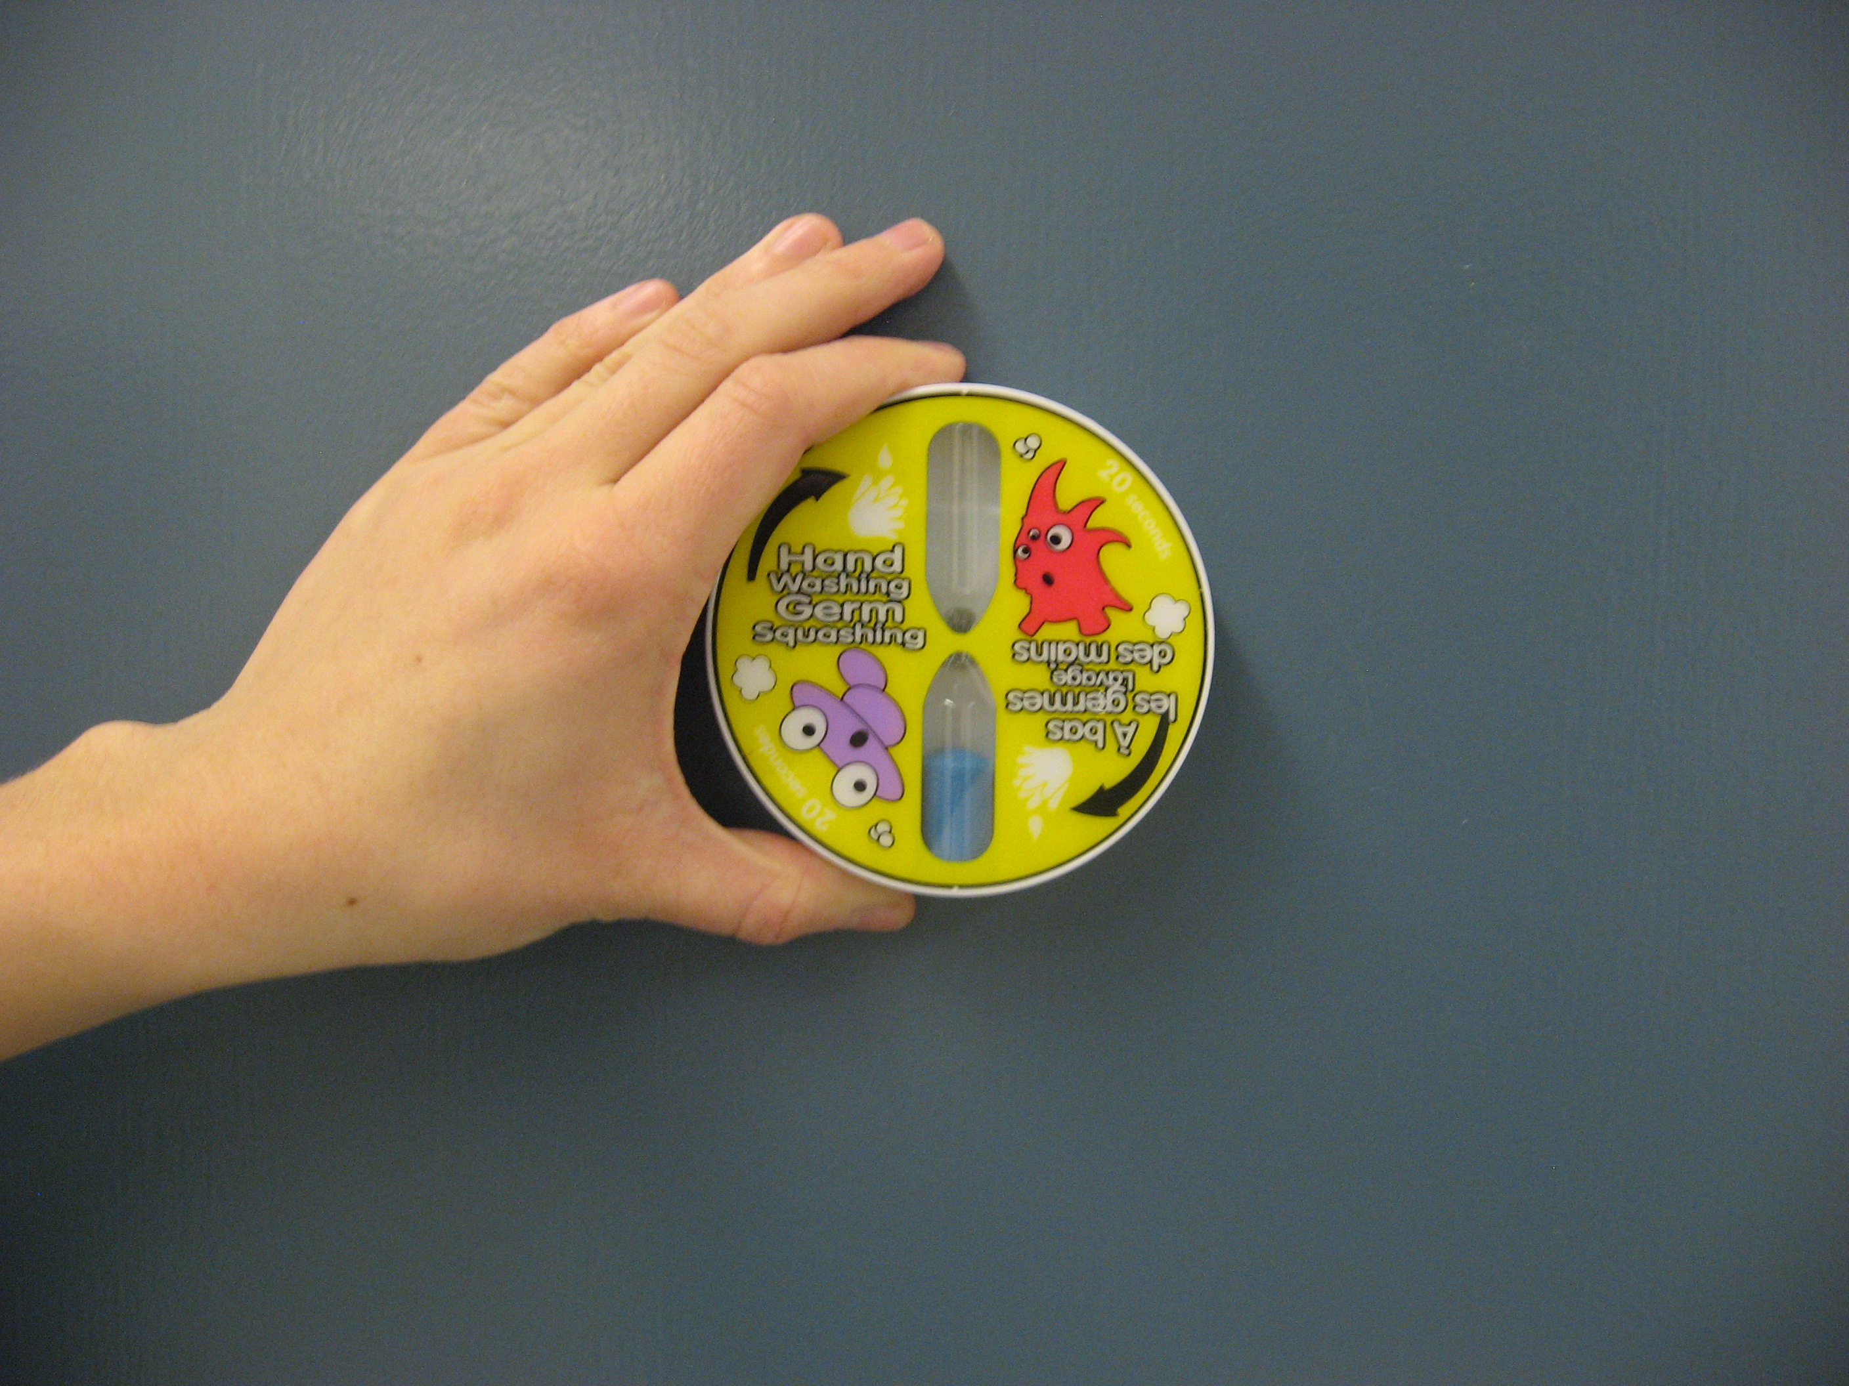
16. Stop timing - @ approximately 15- 20 seconds.

Slide 24
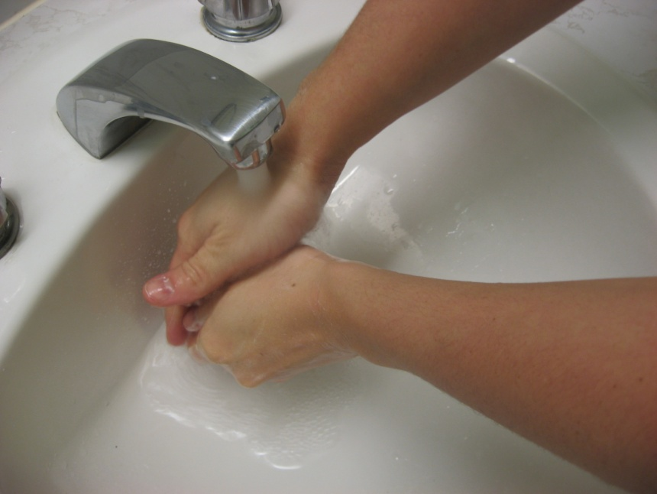
17. Lower hands and rinse.
Hold under the running water so that the water flows from the wrists to the fingertips

Slide 25
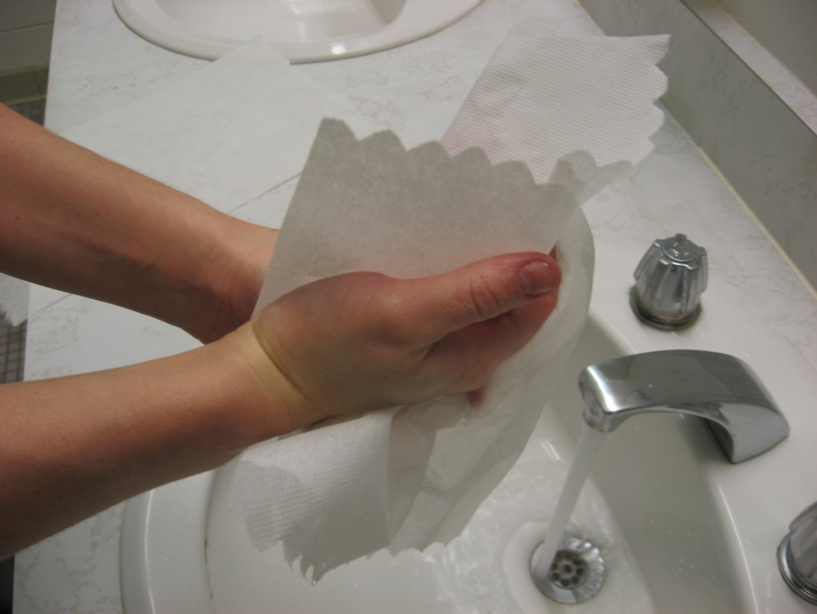
18 . Dry hands and forearms with paper towels.

Slide 26
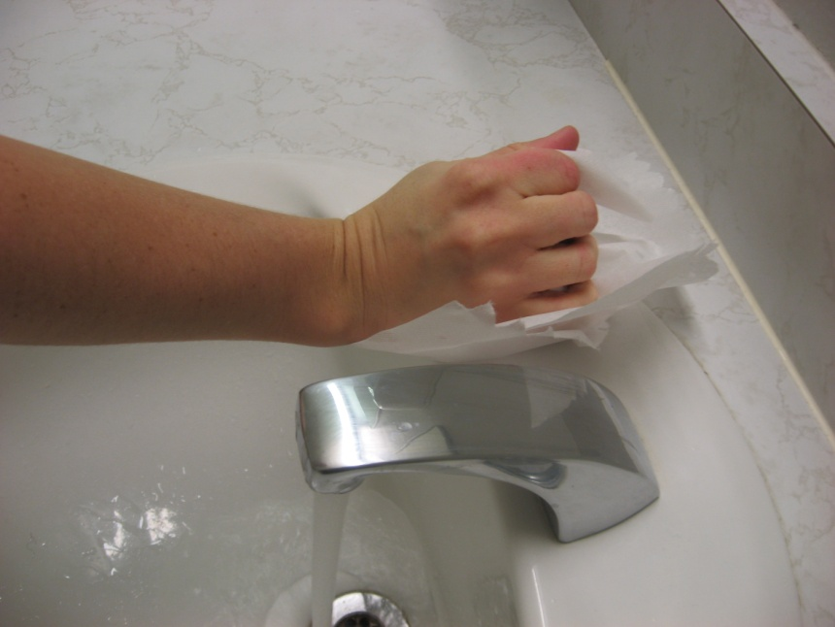
19. Protect hands from any contamination on the taps.

Slide 27

QUESTIONS?

