Slide 1
MRAD 256
Radiographic Technique 2
Positioning of the Facial Bones

Slide 2
Facial Bones Routine
Lateral
Caldwell
Water’s
Towne’s
SMV (submentovertical)

Slide 3
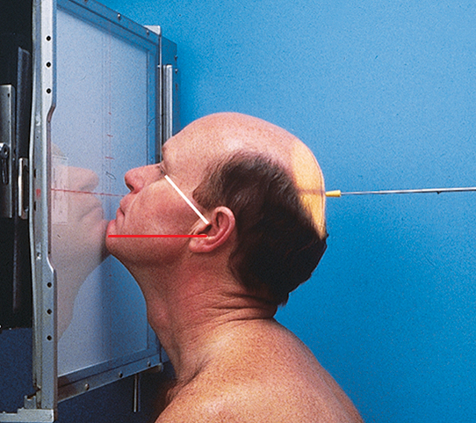
Water’s (Parietoacanthial)
Extend neck to place the MML perpendicular to the IR
  Red line shows MML perpendicular to IR
  White line shows OML at 37° to IR
Adjust CR to exit at level of acanthion

Slide 4

Water’s (Parietoacanthial)
Collimate to include orbits, maxillae and zygomas

Slide 5
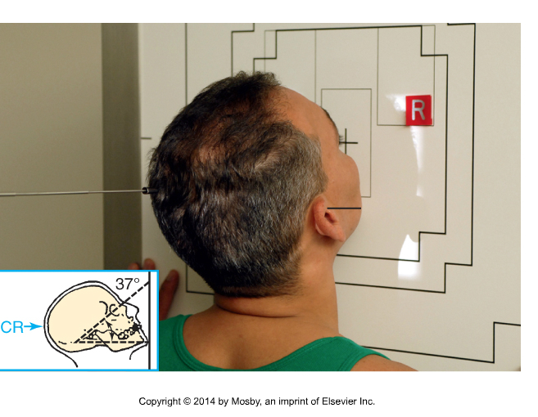
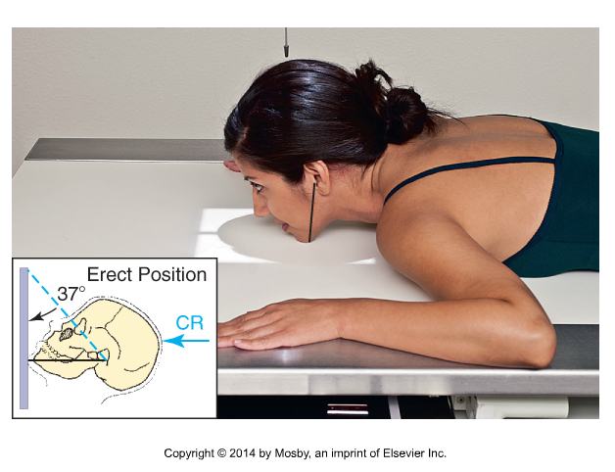
Collimation for Waters…
Collimate to include orbits, maxillae, zygomatic bones
Bontrager 11- 126 and 189

Slide 6
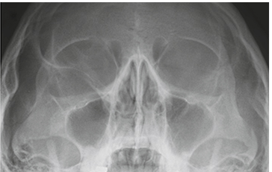
Evaluation criteria…
  Orbits, maxillae and zygomatic bones are seen
  Orbits are foreshortened
  Petrous ridges are projected immediately below the maxillary sinuses
  No rotation or tilt
R

Slide 7
Reverse Waters (Acanthioparietal)
Supine position (AP projection)
TEA and corner of mouth form a line perpendicular to IR
Central ray enters near the acanthion

Slide 8
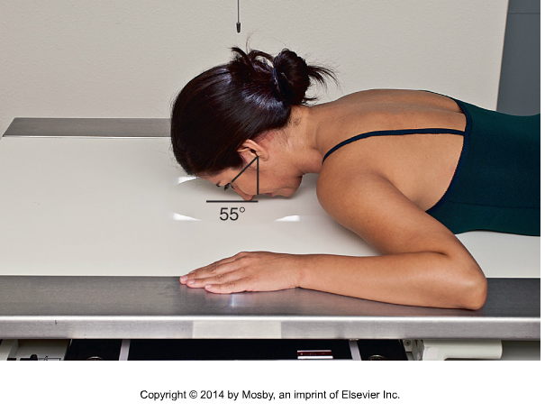
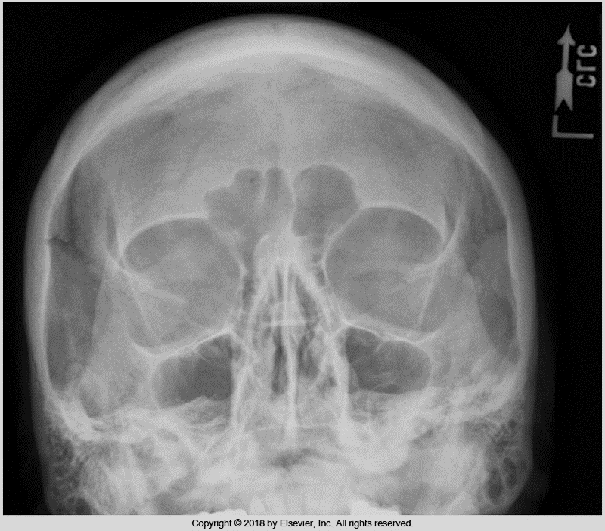
Modified Waters Method
Sometimes called a “Shallow” Water’s:
LML is perpendicular to the IR
Demonstrates orbital floors perpendicular to the IR.
Taken for “blow-out” # of orbital floor,
Bontrager 9th ed. 11-135 and 11-136

Slide 9
Evaluation criteria
Petrous ridges in lower half of maxillary sinuses
Demonstrates inferior displacement of the orbital floor and/or fluid in the maxillary sinus
Orbits are less foreshortened than in a routine waters.
Bontrager 11-136

Slide 10
Compare the two

Slide 11
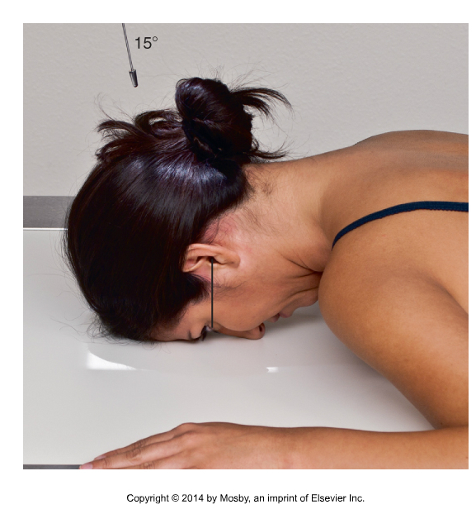
Caldwell for facial bones
Place the OML perpendicular to the IR
Angle 15 degrees caudad to exit the nasion
Collimate to include the inferior margin of the maxilla, the lateral tables of the skull, and the entire perimeter of the cranial vault.
Bontrager 11-132

Slide 12
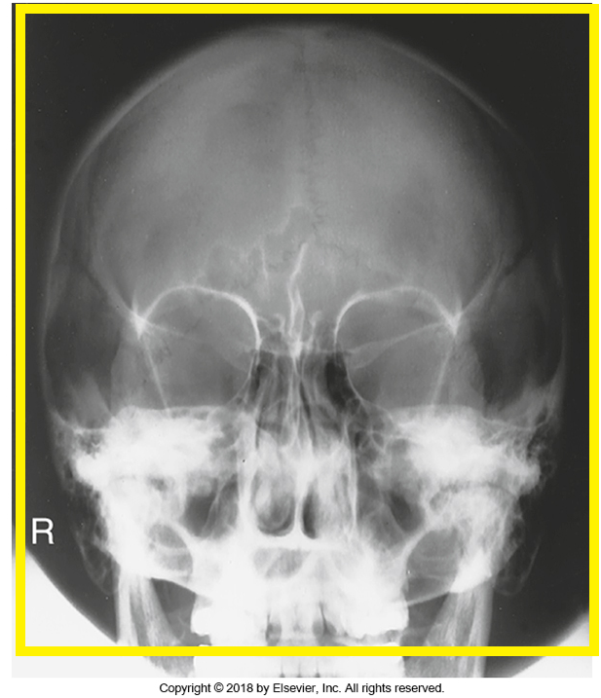
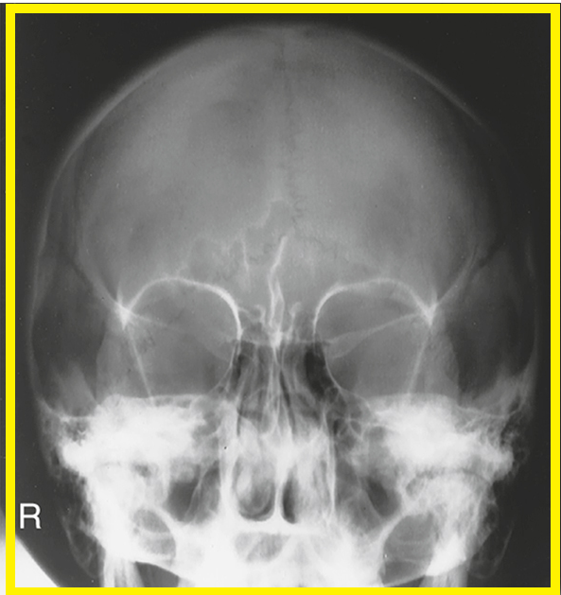
Caldwell for facial bones
Same position, different collimation
R
Collimation for facial bones…
Collimation for skull…
Bontrager 9th ed. Fig. 11. 115

Slide 13
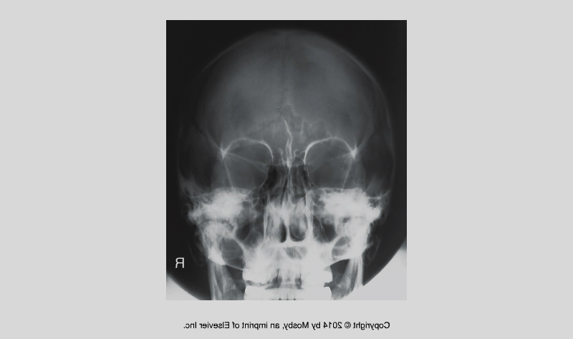
Evaluation criteria
All anatomy superior to the maxillae is visualized: orbits, nasal septum, zygomatic bones, nasal bones, and the entire perimeter of the skull
No rotation or tilt
R
R
Bontrager 11-115

Slide 14
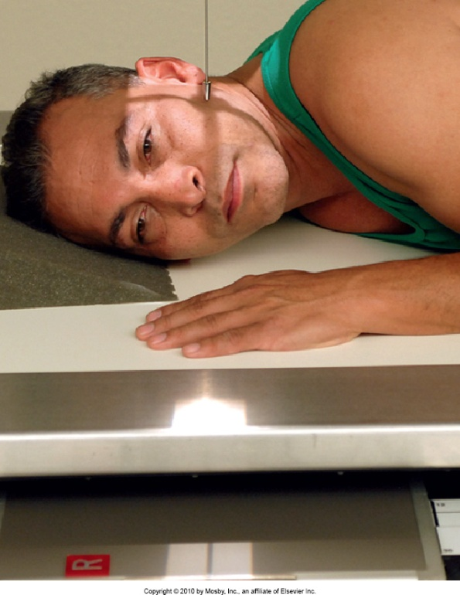
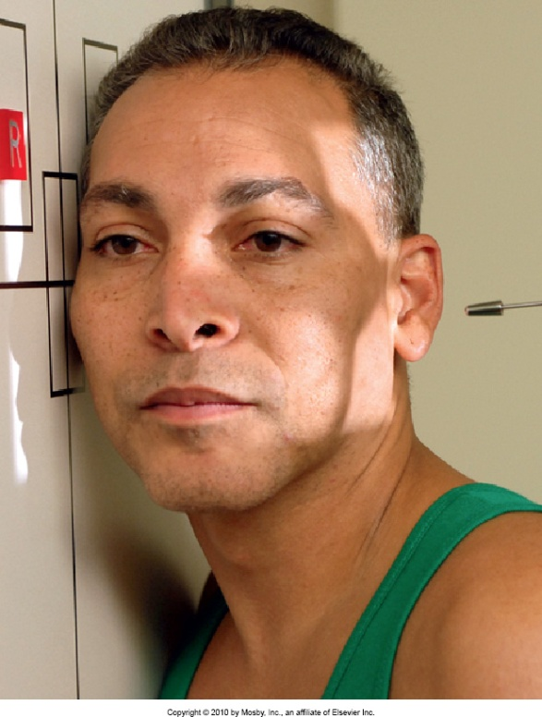
Lateral- R or L position
Affected side against IR
CR centered on zygoma (halfway between the outer canthus and the EAM)
Collimate to include mandible, and all facial bones anterior to EAM
Bontrager 9th ed.
11-125, 11-126

Slide 15
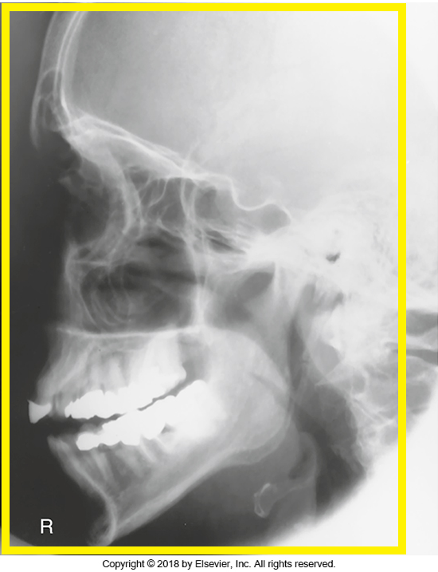
Evaluation criteria…
  Mandible and all facial bones anterior to the EAM are seen
  No rotation or tilt: superimposed orbital roofs, EAMS, greater wings and lesser wings of sphenoid, TMJ’s
Bontrager 9th ed. 11-127

Slide 16
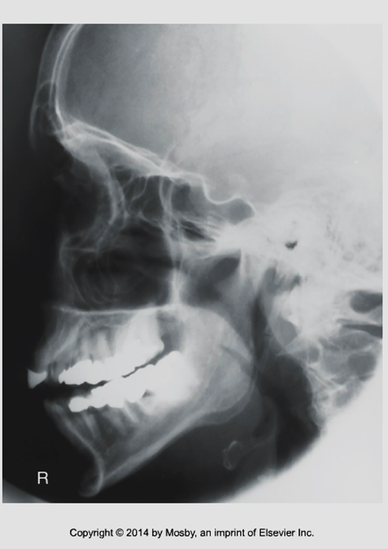
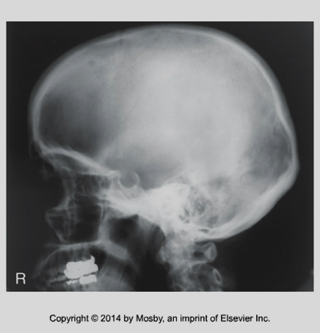
Comparison of collimation for lateral facial bones versus skull…
Bontrager 7th ed. Fig 12-52
Bontrager 9th ed. Fig 11-27

Slide 17
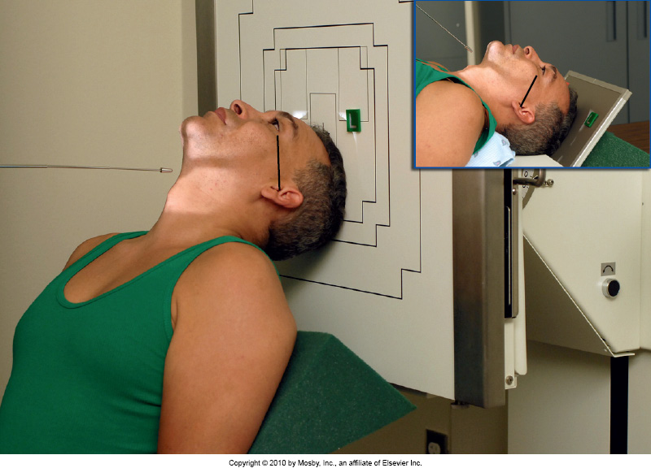
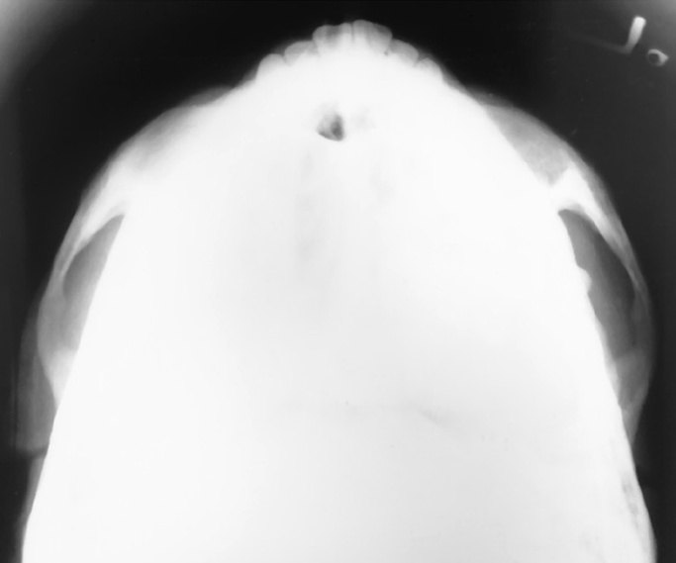
Submentovertical Projection
(Zygomatic Arches)
Bontrager 9th ed. 11-143, and 11-144

Slide 18
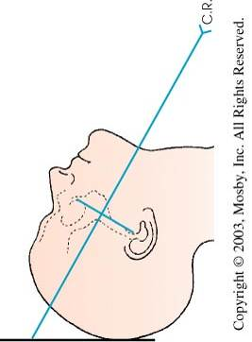
Submentovertical Projection (Zygomatic Arches)
Fig 21-23 Frank, Eugene D., Long, Bruce W., Smith, Barbara J., (2012). Merrills Atlas of Radiographic Positioning and Procedures Volume 2 (12th ed.). St. Louis, MO: Elsevier Mosby. pg. 338
CR ┴ to the IOML
IOML parallel to IR if possible
Center on midsagittal plane, at the level of the gonions
60 º
18 X 24 cm cassette
60 º

Slide 19
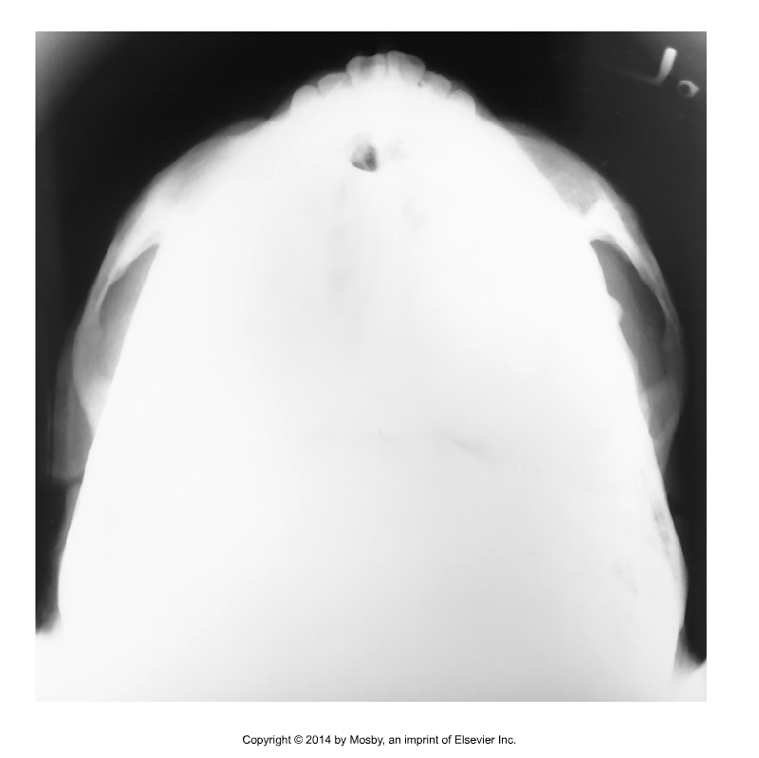
Evaluation criteria
  Symmetric zygomatic arches free of superimposition.
  No rotation or tilt.
Bontrager 9th ed. 11-144

Slide 20
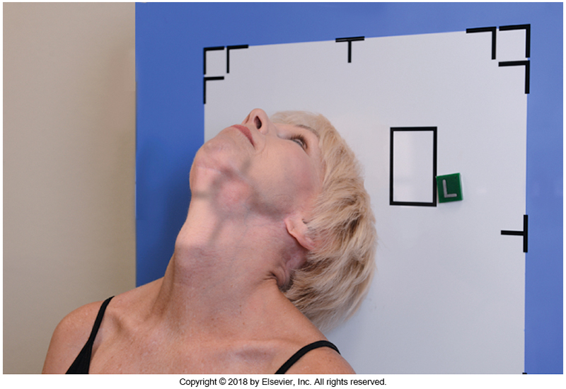
Zygomatic Arches
(tangential projection)
Rotate head 15° toward the affected side
Tilt chin 15° toward affected side
Bontrager 11-146

Slide 21
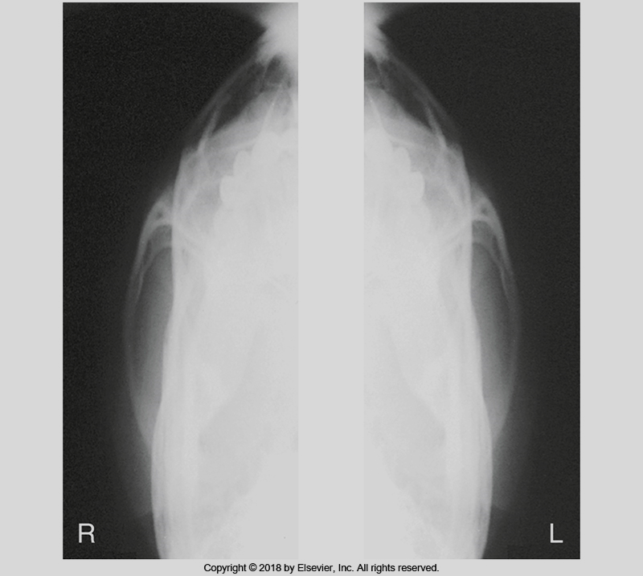
Evaluation criteria
  Zygomatic arch free of superimposition from mandible or parietal bone
Bontrager 11- 147

Slide 22
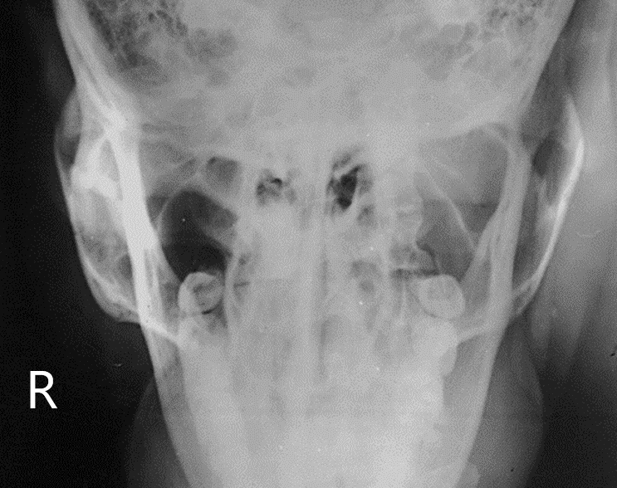
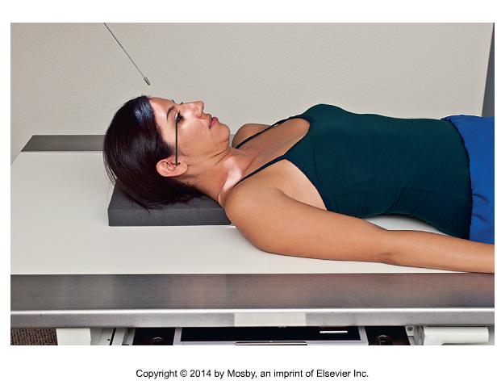
30˚ modified Towne projection
(for mandibular rami/zygomatic arches – pg. 427)
Bontrager 9th ed. 11-149
R
R

Slide 23
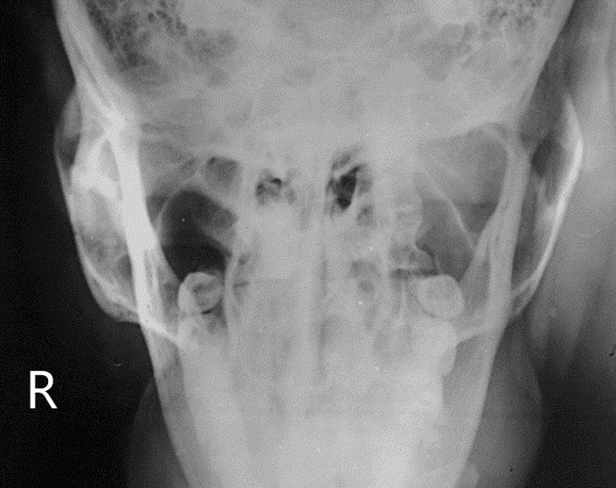
Evaluation criteria
Bilateral zygomatic arches, free of superimposition
Mandibular rami demonstrated

