Slide 1
MRAD 256:
RADIOGRAPHIC TECHNIQUE 2
Lumbar Spine Anatomy

Slide 2
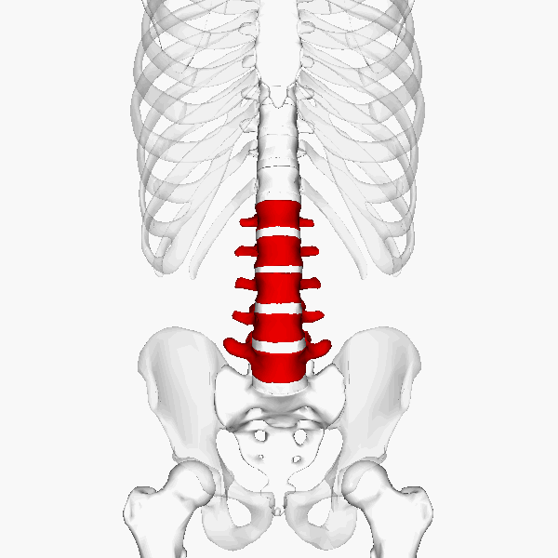
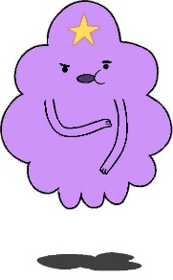
Lumbar Spine

Slide 3
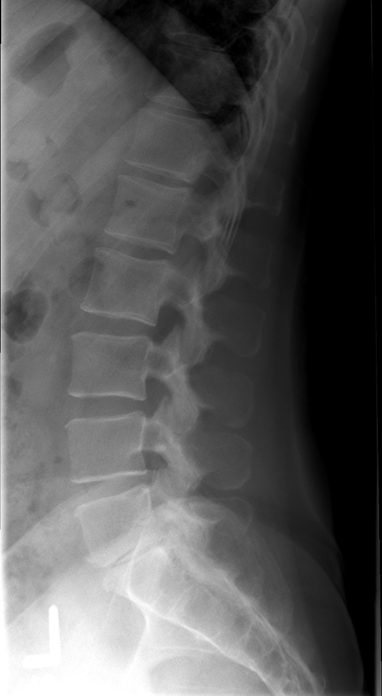
Lumbar Spine

Slide 4
Lumbar Vertebrae
5 lumbar vertebra
Largest and strongest in vertebral column
Carry heaviest load of body weight, therefore the intervertebral discs are a common site for injury
Notes:
Largest and strongest because load of the body increases toward the inferior end of the column

Slide 5
Lumbar Vertebra
Body
  Kidney shaped body
Pedicles and Laminae
  Shorter and thicker
Vertebral Foramen
  Triangular
  Conus medullaris ends approximately at L1-2

Slide 6
Lumbar Vertebra
Intervertebral Foramen
  90° relative to midsagittal plane
Transverse Processes
  Fairly small
Spinous Process
  Short, bulky and flat
  Project directly backward
  Palpable lower tip lies at the level of the intervertebral disc space inferior to the vertebral body
Notes:
Palpable lower tip of each lumbar spinous process lies at the level of the intervertebral disk space inferior to each vertebral body

Slide 7
Lumbar Vertebra
Zygapophyseal Joints
  30° to 50° to the midsagittal plane
Pars Interarticularis
  The portion of each lamina between superior and inferior articular processes
Notes:
On an anterior oblique radiograph of the lumbar spine, the pars is the neck of the imaginary Scottie dog; the Scottie dog's eye is the pedicle,^{[3]} its hindlegs the spinous process, its nose the transverse process, its ear the superior articular facet and its forelegs the inferior articular facet.^{[4]}

Slide 8
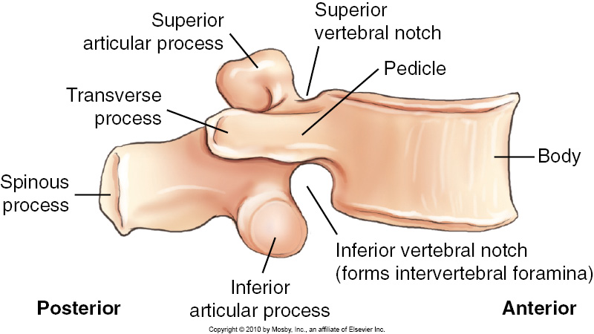
Lumbar Vertebra Lateral View

Slide 9
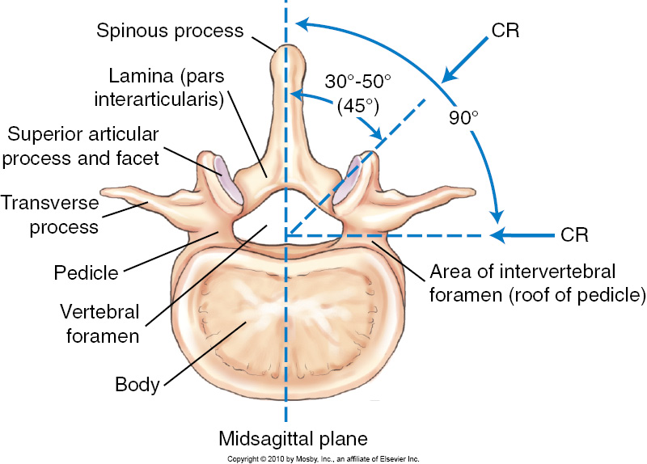
Lumbar Vertebra Superior View

Slide 10
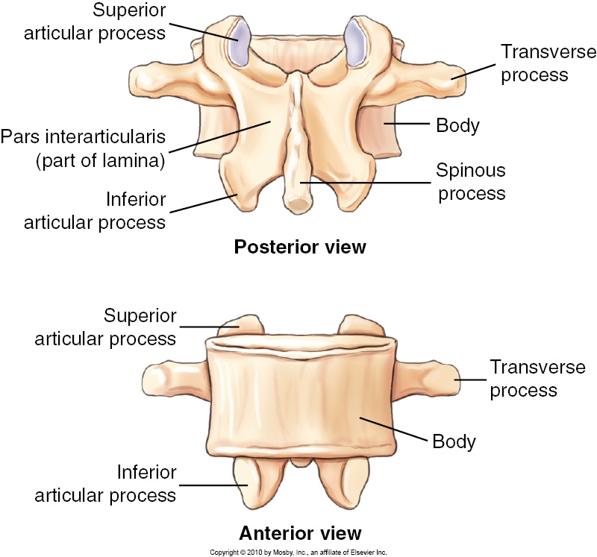
Lumbar Vertebra Posterior View

Slide 11
Lumbar Vertebra Anterior View

Slide 12
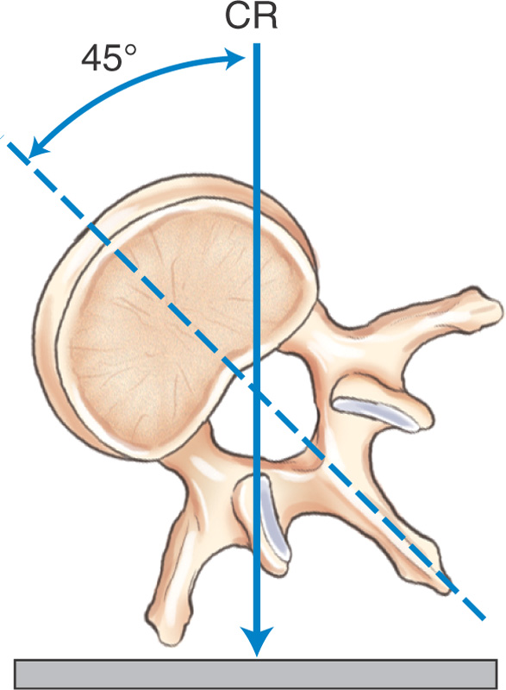
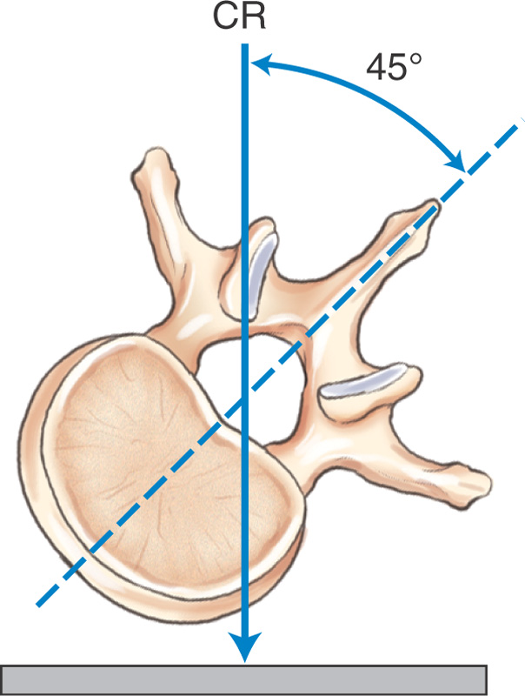
Zygapophyseal Joints
Downside joints (posterior oblique)
Upside joints (anterior oblique)

Slide 13
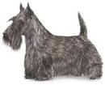
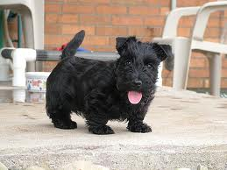
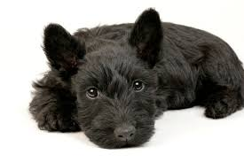
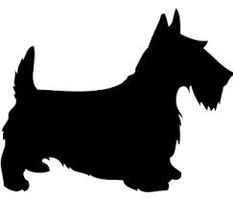
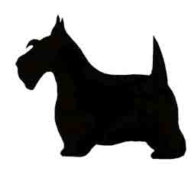

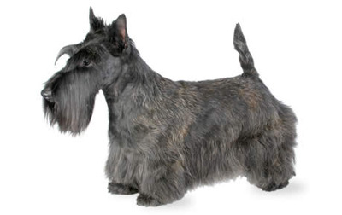
Scottie Dogs are VERY important!

Slide 14
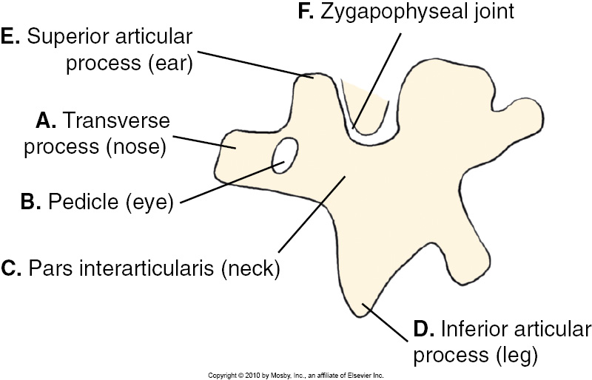
Scottie Dog
Notes:
On an anterior oblique radiograph of the lumbar spine, the pars is the neck of the imaginary Scottie dog; the Scottie dog's eye is the pedicle,^{[3]} its hindlegs the spinous process, its nose the transverse process, its ear the superior articular facet and its forelegs the inferior articular facet.^{[4]}

Slide 15
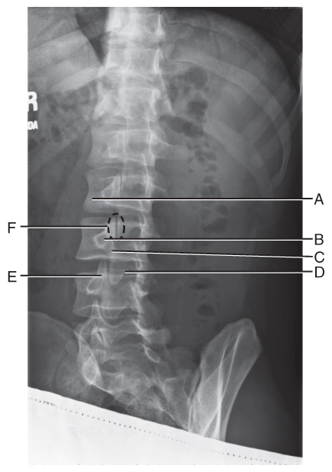
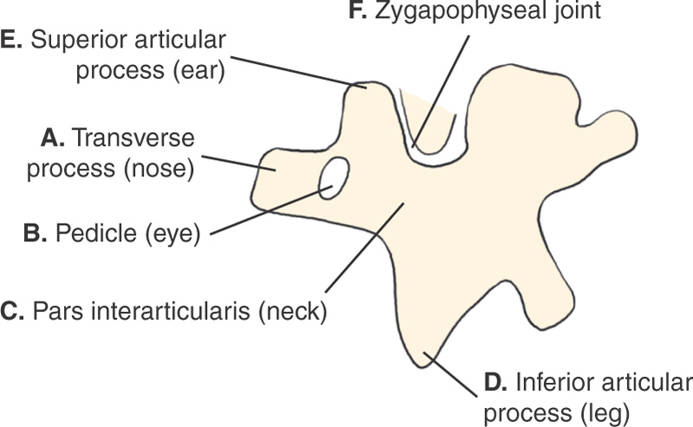
“Scottie Dog”

Slide 16
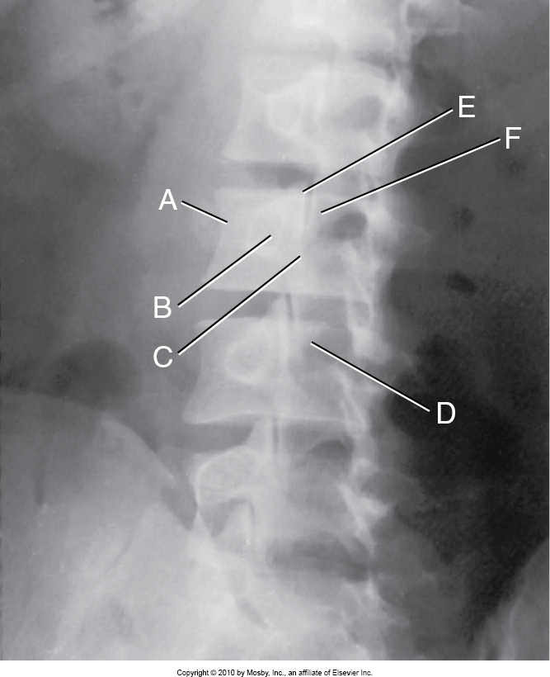
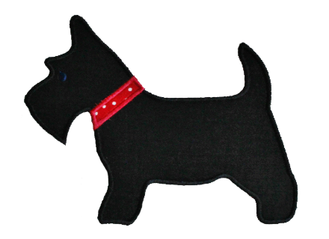
Oblique Lumbar Spine
Each of the 5 lumbar vertebrae should assume a similar Scottie dog appearance, with zygapophaseal joint spaces open on a correctly rotated lumbar radiograph.
Notes:
Nose of the Scottie dog, formed by one transverse process
Eye, one pedicle seen on end
Neck of the dog, pars interarticularis
Front leg of the dog, one inferior articular process
Pointed ear, one of the superior articular processes
Zygapophyseal joint, formed by front leg of the Scottie above and ear of the Scottie below

Slide 17
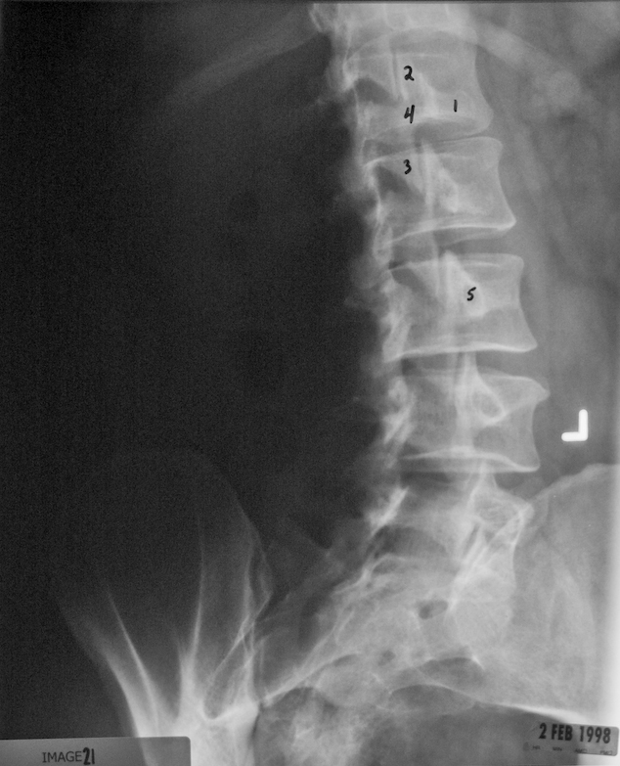
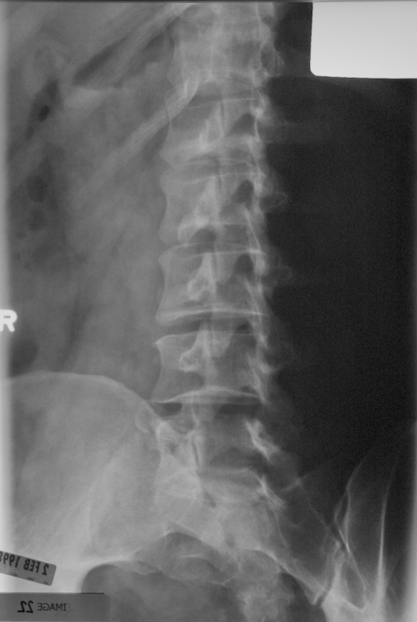

Slide 18
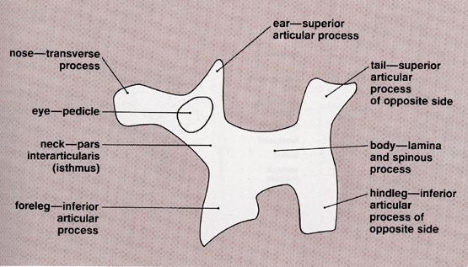

Slide 19
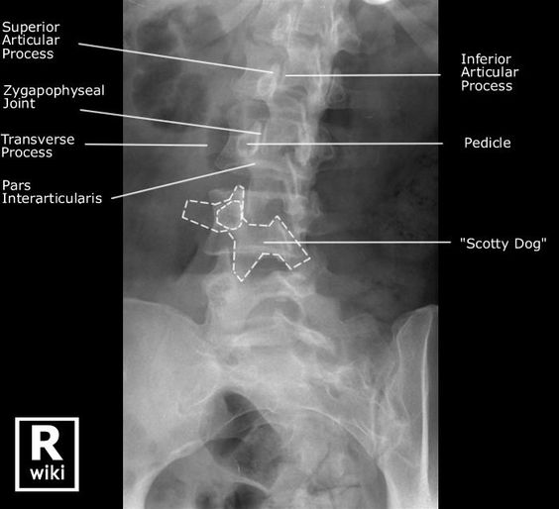

Slide 20
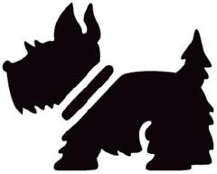
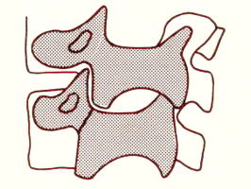
Spondylolysis
A defect in the lumbar vertebra, caused by dissolution of vertebra such as from aplasia and separation of the pars interarticularis, or can occur with repeated trauma to the lumbar spine or strenuous sports like football or wrestling
Most common at L4 or L5
Radiographically seen on oblique lumbar spine, where the Scottie dog appears to wear a collar

Slide 21
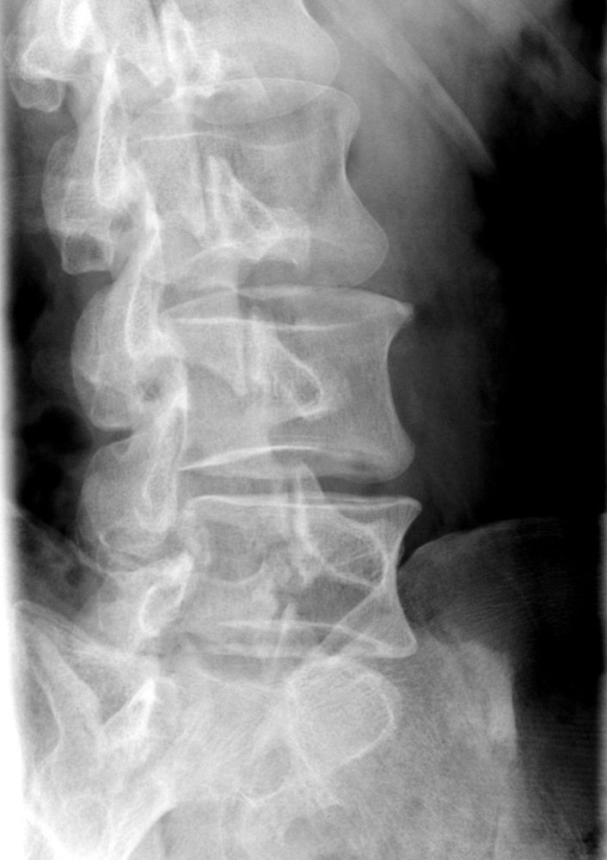

Slide 22
Abnormalities
Lumbarization
  Lumbar spine appears to have 6 vertebrae
  Caused by the nonfusion of the first and second sacral segments.
  the 6th “extra” vertebra is termed a transitional vertebra

Slide 23
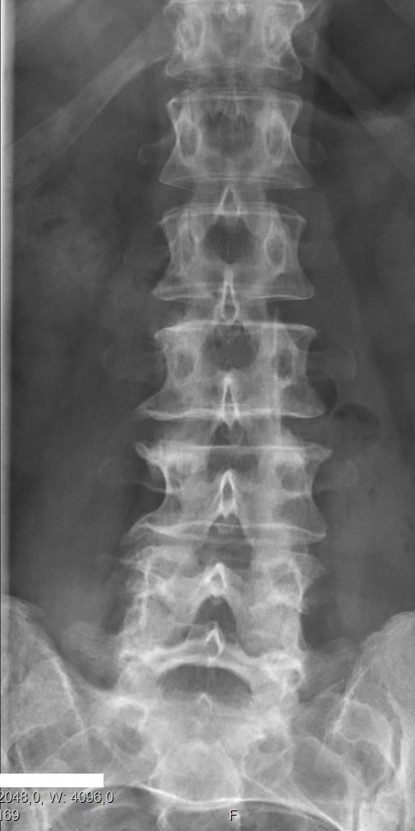
By Mikael Häggström - Own work, CC0, https://commons.wikimedia.org/w/index.php?curid=54908366

Slide 24
Sacralization L5
when the transverse process of L5 fuses to the sacrum, can be unilateral or bilateral
Sacralization L6
L6 attached to S1 as a joint
allows additional motion, causing back pain and stress in the lumbar spine

Slide 25
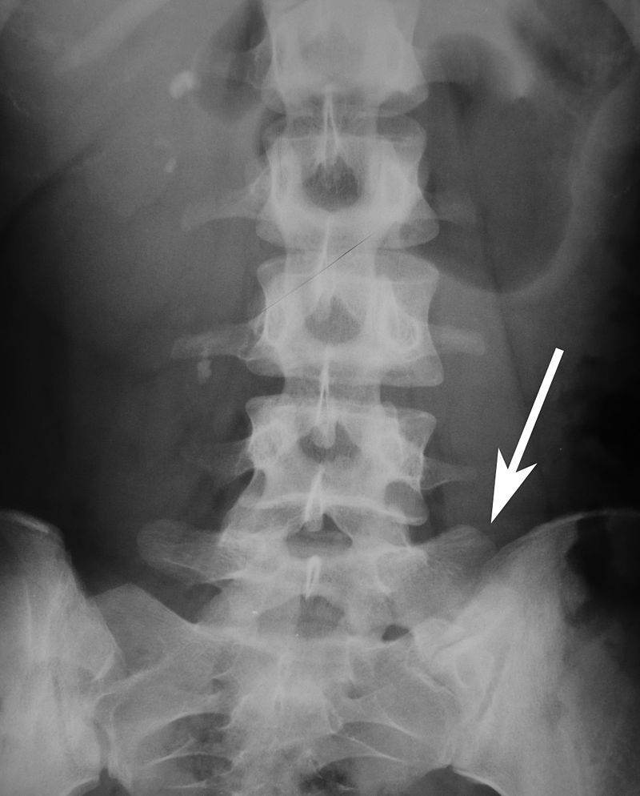
By Patrick87 - This file was derived from: Radiology 1300236 cr.jpg, CC BY-SA 3.0, https://commons.wikimedia.org/w/index.php?curid=25656849

Slide 26
Extra (13th rib)
typically an incidental finding
arises from the transverse process of L1
can be unilateral or bilateral

Slide 27
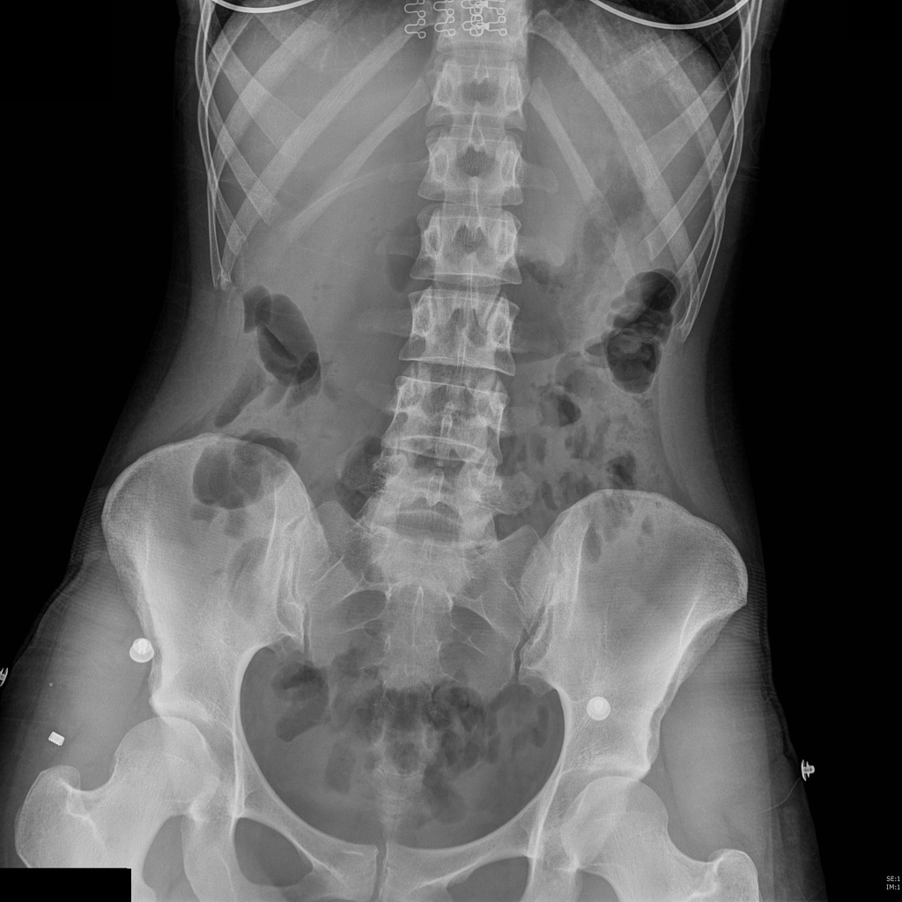

Slide 28
Summary of Joints in the Lumbar Spine
Joints
Zygapopheseal Joints
Intervertebral Joints
Classification
Synovial
Cartilaginous
(symphysis)
Movement Type
Plane (gliding)
N/A

Slide 29
Vertebral Column Comparison
 | CERVICAL | THORACIC | LUMBAR
Typical Vertebra | 3,4,5,6 | 2,3,4,5,6,7,8 | 1,2,3,4
Body | Small, transversely wide, lateral margins are upturned | Larger, heart-shaped, deeper behind than in front, 4 demifacets for heads of ribs | Largest, deeper in front than behind, kidney shaped, wide transversely
Pedicles | Extend laterally and posteriorly | Short, project posteriorly | Thick, short, project posteriorly
Laminae | Steep angle, narrow, thin | Short, deep, thick, overlap lower lamina | Thick, short, deep
Vertebral Foramen | Large, triangular | Round | Triangular
Vertebral Notches | Upper and lower are equal depth | Inferior notches are deeper than superior | Inferior notches are deeper than superior

Slide 30
Vertebral Column Comparison
 | CERVICAL | THORACIC | LUMBAR
Transverse Processes | Short, wide with transverse foramen | Club-shaped, project laterally, has facet for tubercle of rib | Thin, tapered
Superior and Inferior articulating processes | Form articular pillar, behind transverse process | Almost vertical in position
Facets | Oval, flat, superior facets face superior and posterior, inferior facets face inferior and anterior | Vertical in position. Superior facets face posterior, inferior facets face anterior | Superior facets face posterior and medially, inferior facets face anterior and laterally
Zygapophyseal Joints | 90 degrees to MSP | 70-75 degrees to MSP, open anteriorly | 45 degrees (30-50)to MSP, open posteriorly

Slide 31
Vertebral Column Comparison
 | CERVICAL | THORACIC | LUMBAR
Intervertebral Foramina | 45 degrees to MSP, open anteriorly and 15 degrees inferiorly | 90 degrees to MSP | 90 degrees to MSP
Intervertebral Foramina | 45 degrees to MSP, open anteriorly and 15 degrees inferiorly | 90 degrees to MSP | 90 degrees to MSP
Spinous Process | Bifid tips, directed posteriorly and inferiorly, short | Long, slender, directed posteriorly and inferiorly | Large, blunt, directed posteriorly
Movements | Greatest range of motion, flex, ext, rotation, circumduction, | Least movement, but can rotate | Flex, ext, lateral flex, minimal if any rotation
Curves | Secondary | Primary | Secondary
Atypical Vertebrae | 1,2,7 | 1,9,10,11,12 | 5

