Slide 1
MRAD 204:
Radiographic Technique 1
Outcome 1-5:
Image Critique – Shoulder & Clavicle

Slide 2
Affiliated Readings
Bontrager
Pgs: 183, 191→193, 196, 199 & 201
Pg: 204
Emphasis on the “pink box” Evaluation Criteria

Slide 3
Overview
Image Critique – Clavicle
Image Critique – Shoulder
Tips & Tricks

Slide 4
Protocol
Routine:
AP shoulder with external rotation
AP Oblique for glenoid cavity
PA Scapular Y (lateral)
Superoinferior axial

Slide 5
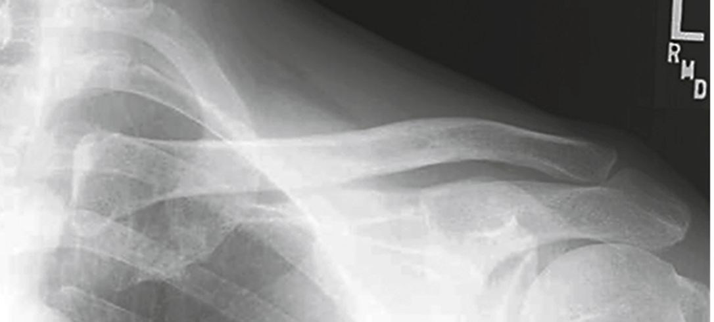
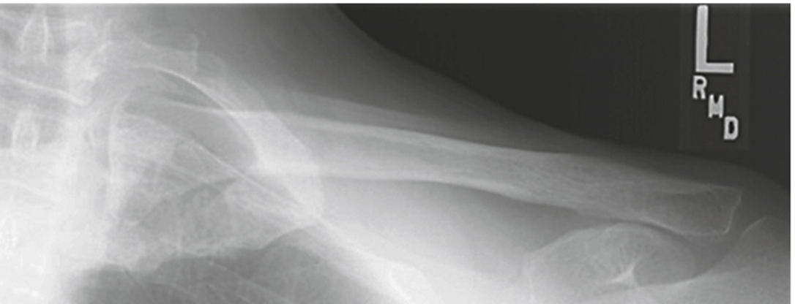
Image Critique – Routine Clavicle Projections
Anatomy
R
Bontrager 9th Ed. pg. 204 Fig. 5.87A & B
R
Ideally, BOTH clavicle radiographs should display:
Entire Clavicle
AC joint
Acromion
SC joint

Slide 6

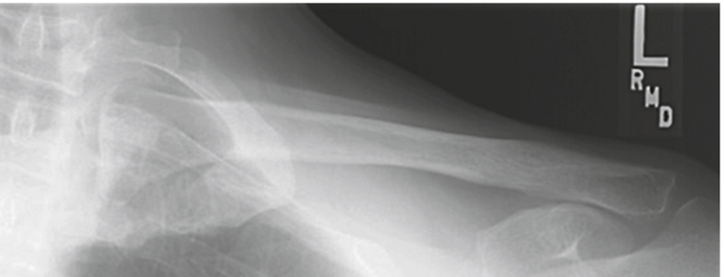
Image Critique – Routine Clavicle Projections
Exposure & Technique
R
Bontrager 9th Ed. pg. 204 Fig. 5.87A & B
R
BOTH routine clavicle radiographs should display:
kVp range of 70→85
Optimal density and contrast:
  no motion (i.e. blur)
  soft tissue margins visible
  clear bony trabecular markings

Slide 7
Image Critique – Routine Clavicle Projections
Marker Placement &/or artifacts
Marker placement: lateral side; not obscuring anatomy of interest
Note: Axial projection requires an “up” arrow
Bontrager 9th Ed. pg. 204 Fig. 5.87A & B
R
No removable artifacts are visible

Slide 8
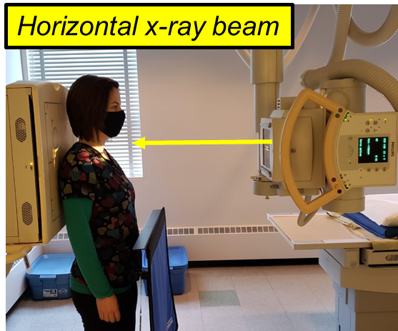
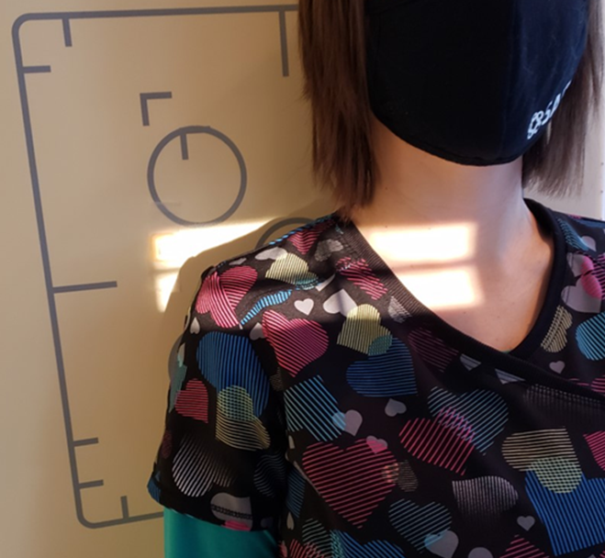
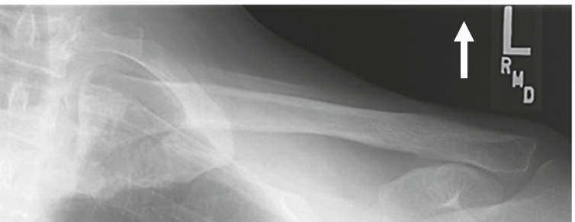
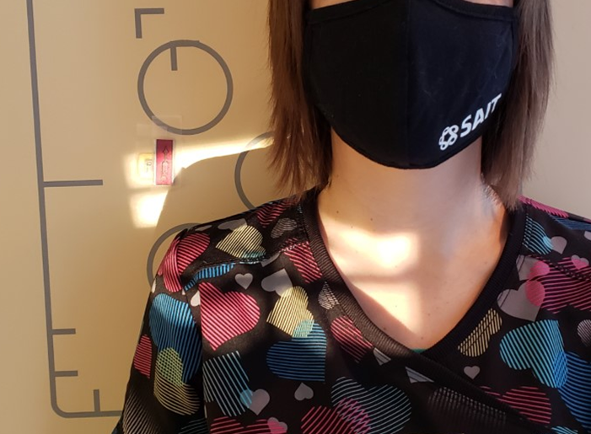
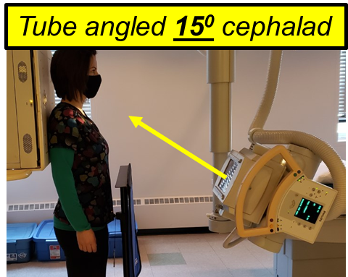
Image Critique – Routine Clavicle Projections
CR & Collimation
R
Four sided collimation centered to mid-clavicle
SAIT Campus 2021
Bontrager 9th Ed. pg. 204 Fig. 5.87A & B

Slide 9
Image Critique – AP Clavicle
Position
@ 70 kVp
Bontrager 9th Ed. pg. 204 Fig. 5.87A
Clavicle demonstrated without foreshortening
Midclavicle superimposed on the superior scapular angle

Slide 10
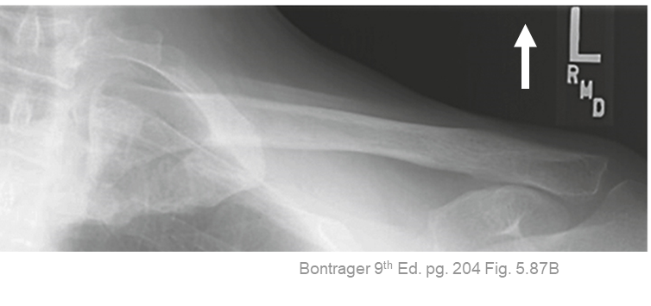
Image Critique – AP Clavicle
Position
@ 70 kVp
Only the medial portion of the clavicle is superimposed by the first and second ribs
*Note: Clavicle appears more “horizontal” in shape

Slide 11
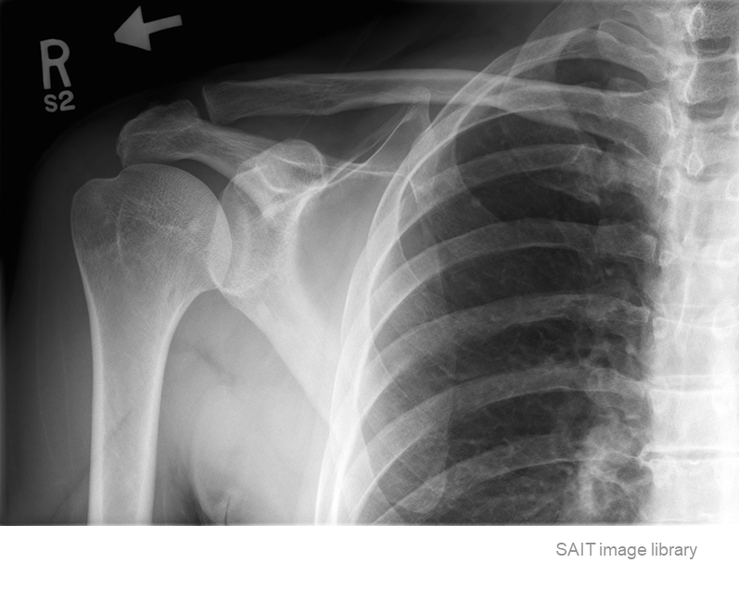
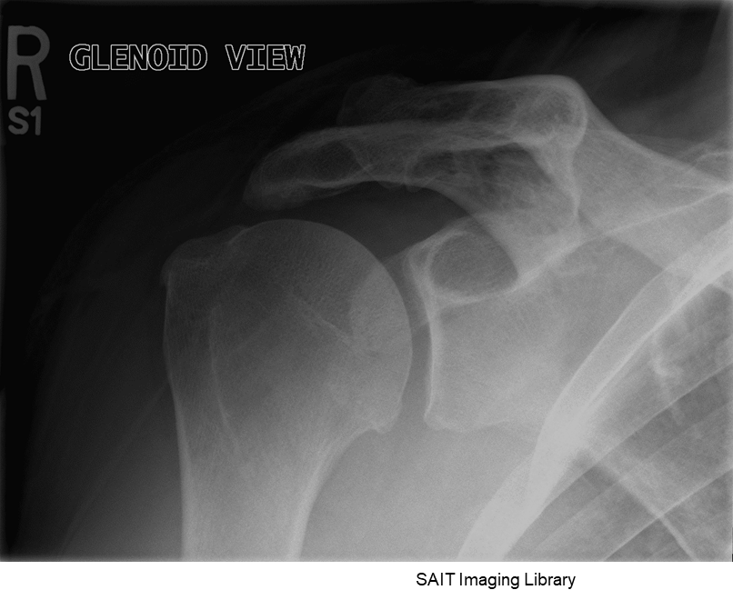
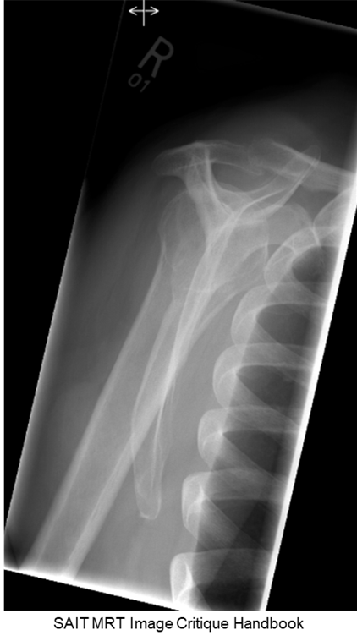
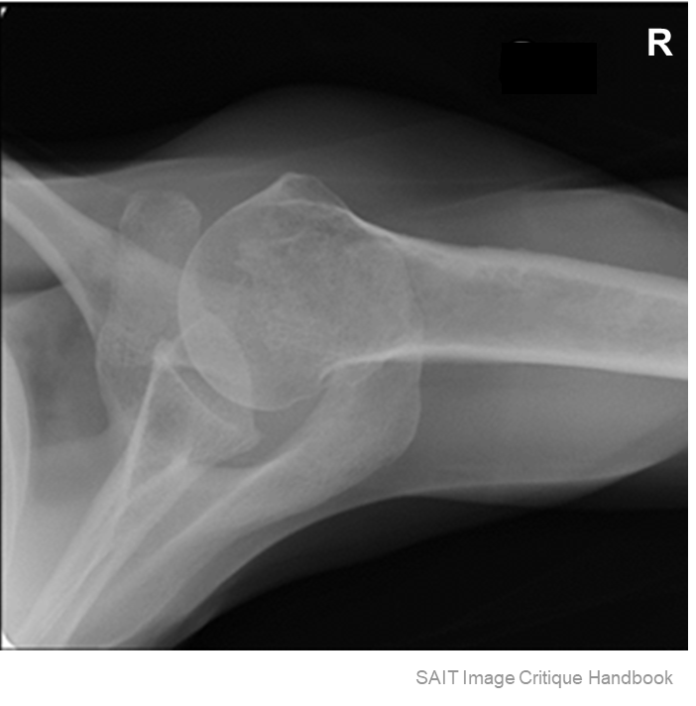
Image Critique – Routine Shoulder Projections
Exposure & Technique
ALL routine shoulder radiographs should display:
kVp range of 70→85
Optimal density and contrast:
  no motion (i.e. blur)
  soft tissue margins visible
  clear bony trabecular markings

Slide 12
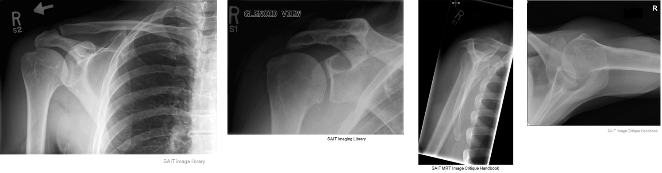
Image Critique – Routine Shoulder Projections
Marker Placement &/or artifacts
Marker placement; not obscuring anatomy of interest
AP, Glenoid, & Scap Y
  Lateral side
Superoinferior Axial
  Anterior side “walking along the humerus”
R
R
No removable artifacts are visible

Slide 13
Image Critique – AP Shoulder (external rotation)
Anatomy
R
R
Entire clavicle
Entire Scapula
Proximal humerus
½ sternum (crosswise)

Slide 14

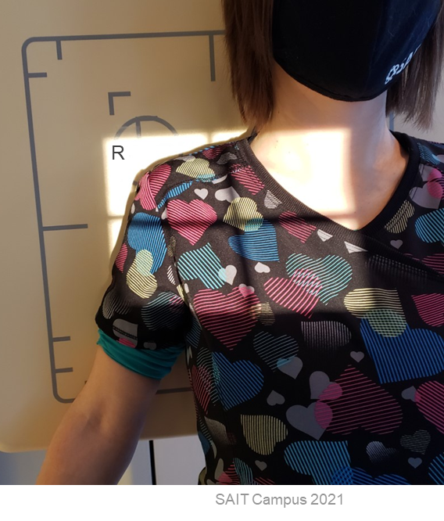
Image Critique – AP Shoulder (external rotation)
Four sided cross-wise collimation; centered to ~mid clavicle (side-side) & ~2 inches inferior
CR & Collimation

Slide 15

Image Critique – AP Shoulder (external rotation)
Position
@ 70 kVp
Greater tubercle in full profile laterally
Lesser tubercle superimposed over humeral head
Minimal superimposition of glenoid cavity and humeral head

Slide 16
Image Critique – AP Oblique Shoulder (Glenoid)
Anatomy
R
Glenoid cavity in profile without superimposition of humeral head
R
Acromion
Coracoid process

Slide 17
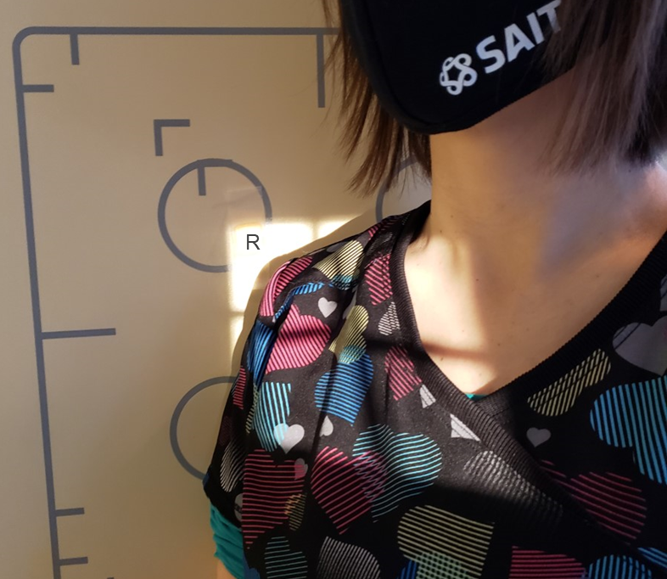
Image Critique – AP Oblique Shoulder (Glenoid)
Four sided collimation centered to ~mid scapulohumeral joint
CR & Collimation

Slide 18
Image Critique – AP Oblique Shoulder (Glenoid)
Position
Open scapulohumeral joint space
Superimposed anterior & posterior rims of glenoid cavity
@ 70 kVp

Slide 19
Image Critique –PA Oblique (Scap Y Lateral)
Anatomy
R
Scapulohumeral joint
R
Entire scapula
Proximal humerus

Slide 20
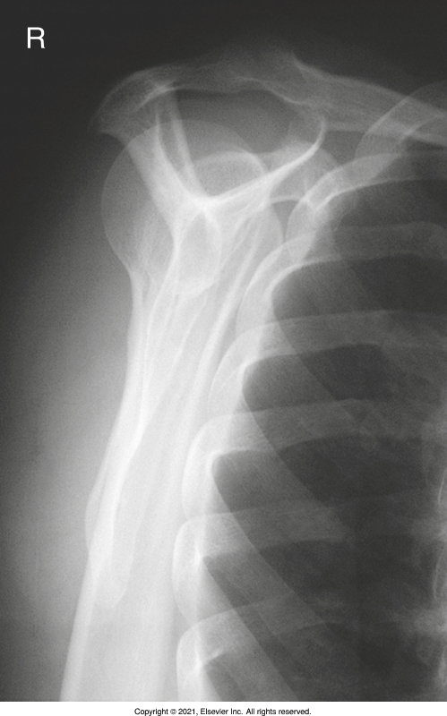
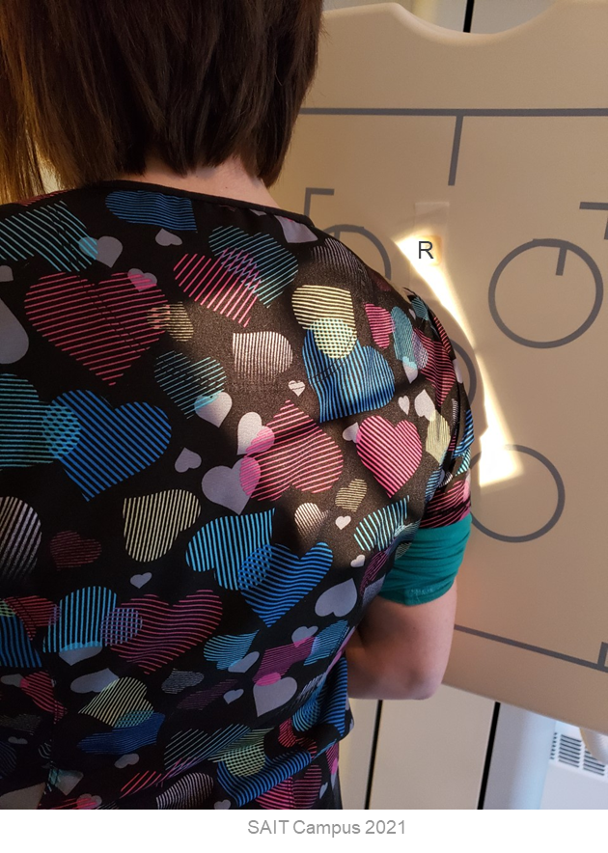
Image Critique –PA Oblique (Scap Y Lateral)
CR & Collimation
Four sided collimation, parallel to medial border of scapula; centered to mid-scapula
Bontrager pg. 201 Fig. 5.75

Slide 21
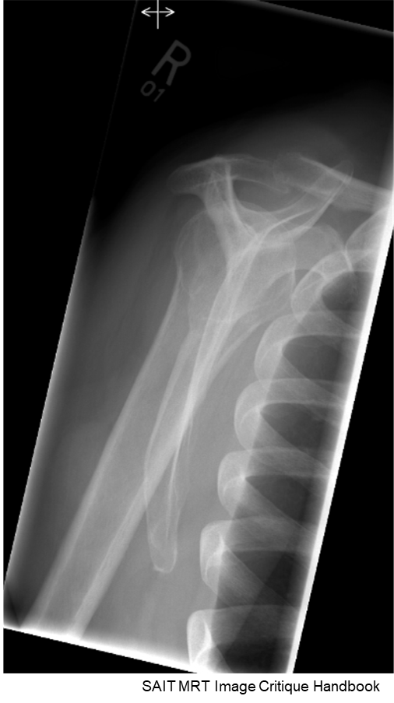
Image Critique –PA Oblique (Scap Y Lateral)
Position
@ 70 kVp
Scapula in true lateral with superimposed lateral & medial borders
No superimposition of scapular body & thorax (i.e. ribs)
Acromion & coracoid nearly symmetrical “upper limbs of the Y”
Humeral head superimposing the base of the “Y” (on ‘normal’ shoulders)

Slide 22
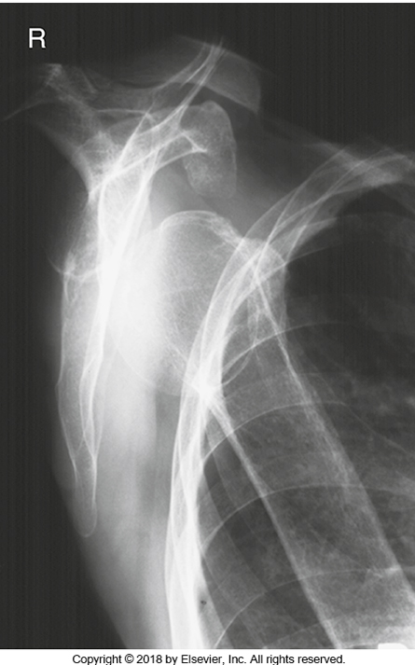
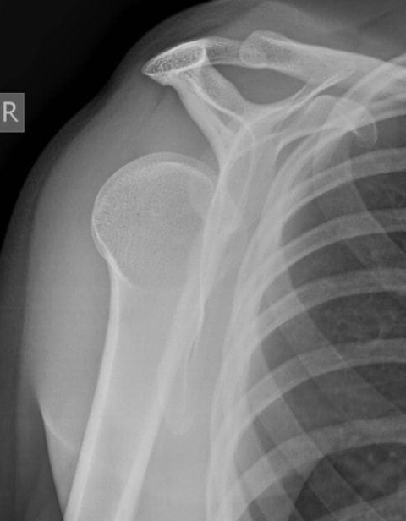
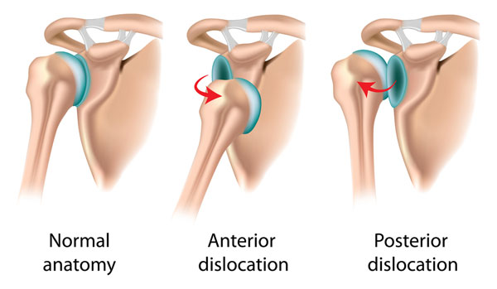
Image Critique –PA Oblique (Scap Y Lateral)
Used to demonstrate dislocations
Anterior: humeral head beneath coracoid process
Posterior: humeral head beneath acromion
Vs.
https://www.sportsinjuryclinic.net/sport-injuries/shoulder-pain/acute-shoulder-injuries/dislocated-shoulder
Bontrager pg. 201 Fig. 5.77
https://litfl.com/posterior-shoulder-dislocation/#jp-carousel-175094

Slide 23
Image Critique – Superoinferior (0-15º) Axial
Anatomy
R
Scapulohumeral joint
Coracoid process
Acromion
R
Lateral end of clavicle
Proximal humerus
Soft tissue

Slide 24
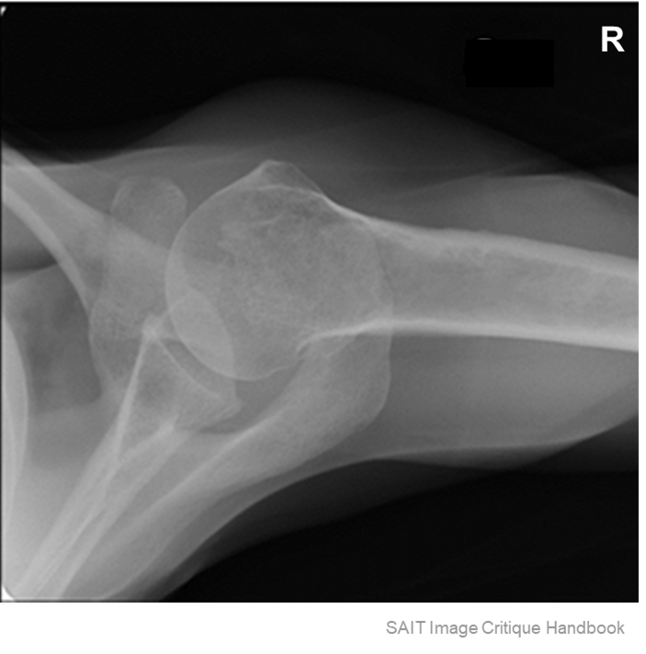
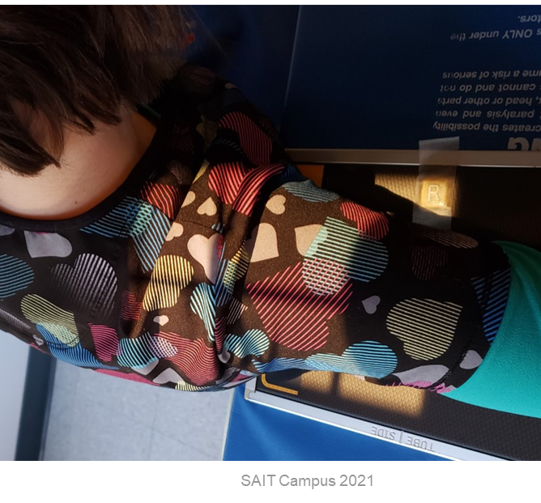
Image Critique – Superoinferior (0-15º) Axial
Note: cannot center anatomy on IR
CR & Collimation
Four sided collimation centered to scapulohumeral joint

Slide 25
Image Critique – Superoinferior (0-15º) Axial
@ 70 kVp
Position
Open scapulohumeral joint (not open on patients with limited flexibility)
Coracoid process in profile, projected anterior to the clavicle
Lesser tubercle in profile
AC joint superimposed by humeral head
Body of humerus parallel to IR (i.e. “straight”)

Slide 26
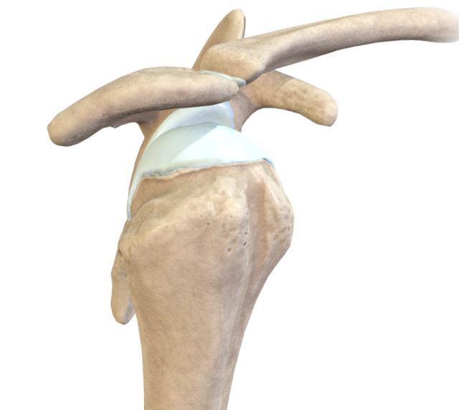
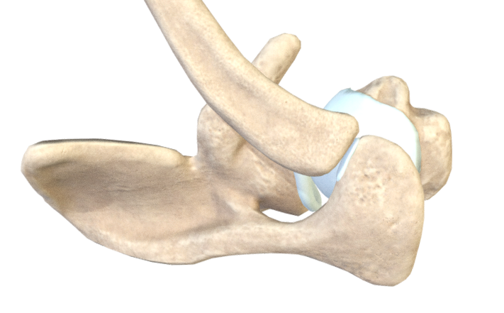
Shoulder
Anatomical Relationship
The position of the clavicle is on the anterior aspect of anatomy.
Superior
“birds eye view”
Clavicle
Anterior
Medial
Clavicle
Lateral
Posterior
Anterior
Inferior
Posterior
https://sketchfab.com/3d-models/bony-elements-of-the-glenohumeral-joint-577fc05f069046d6a5759633587d5119

Slide 27
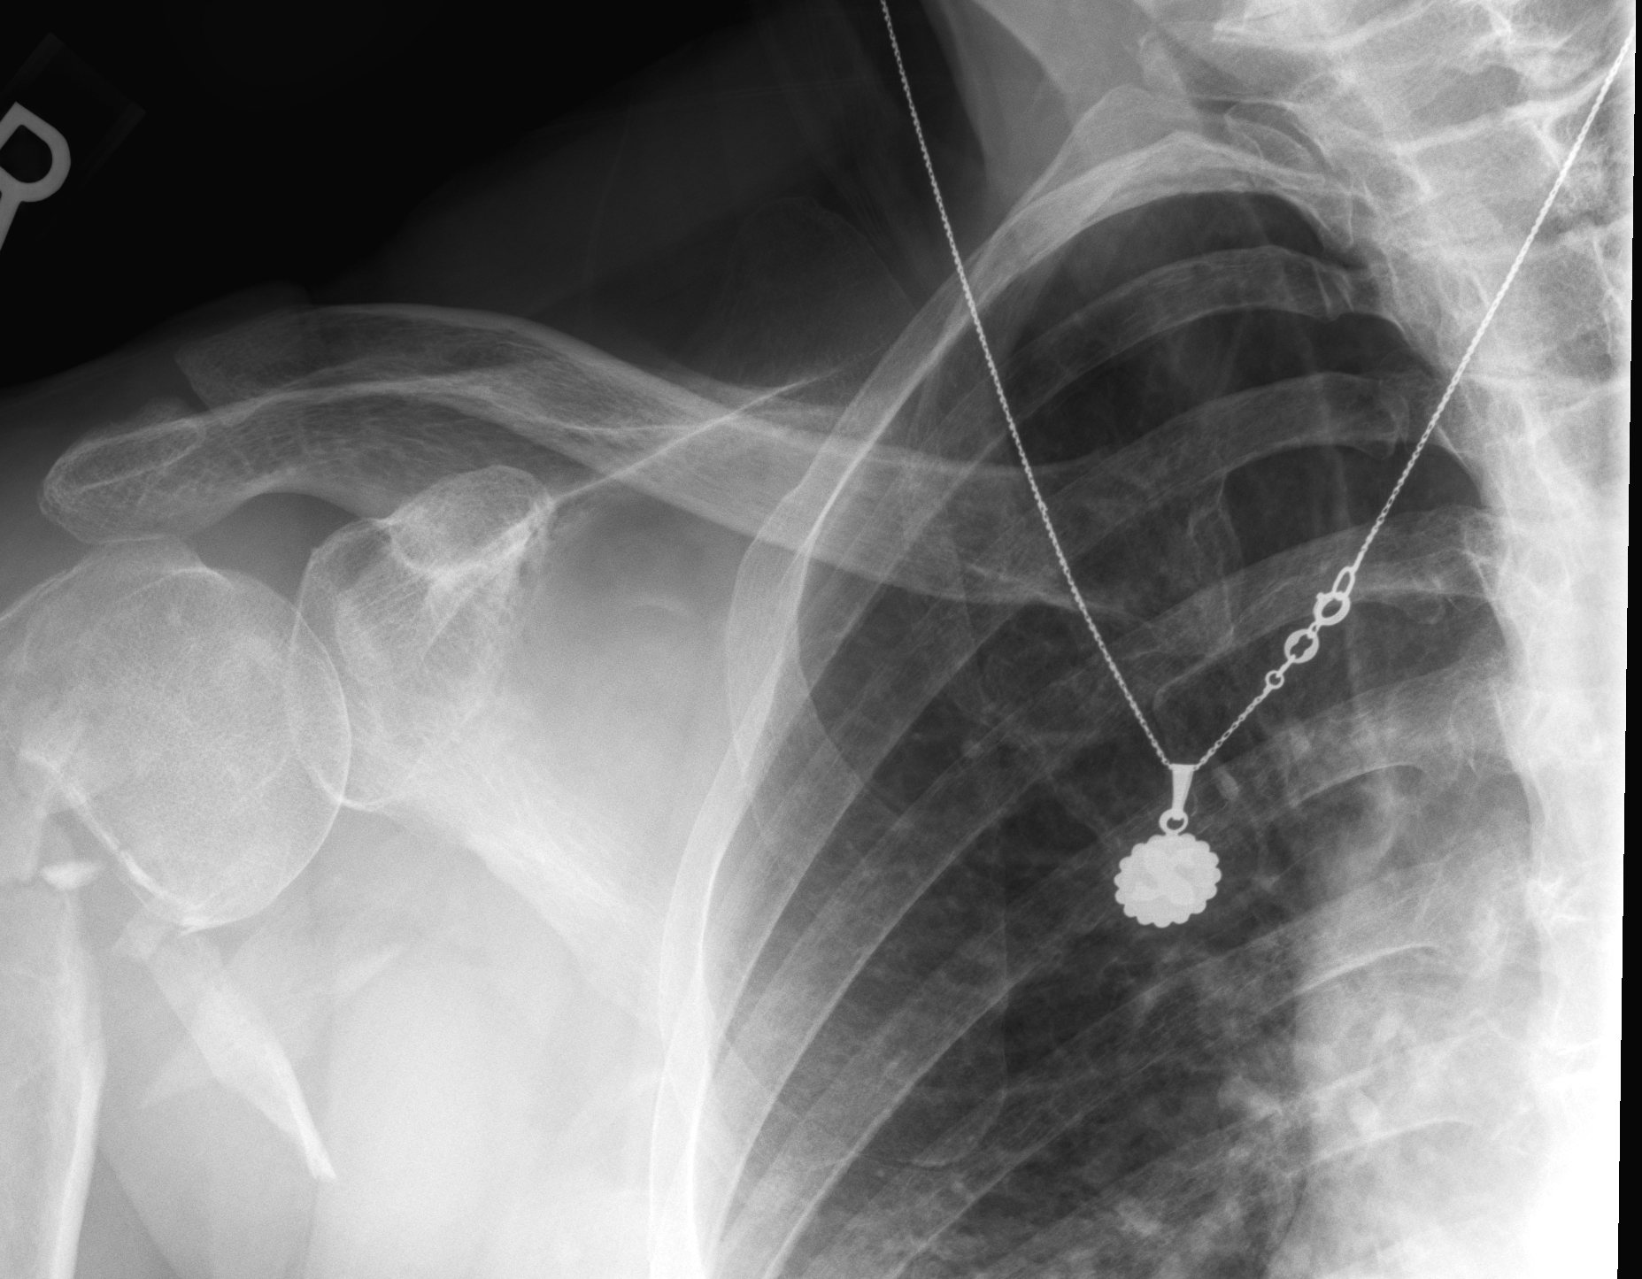
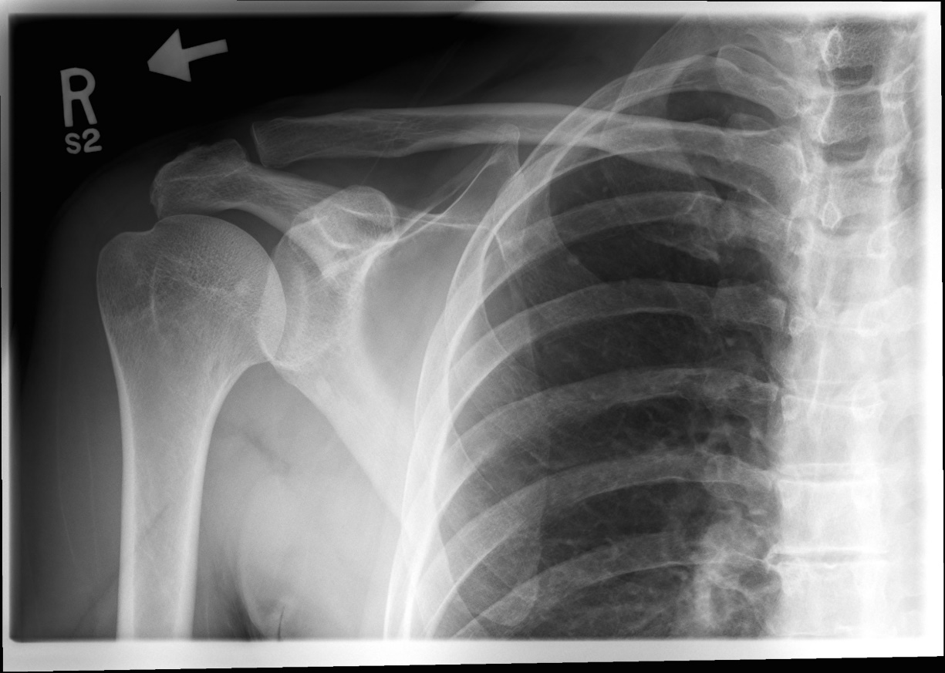
Tips & Tricks – Identifying Rotation
More space = more rotation
It’s all about distance between the spine & clavicle
For AP projections:
More space on Rt. Side
=
Rt. Sided rotation
SAIT Imaging Library

Slide 28
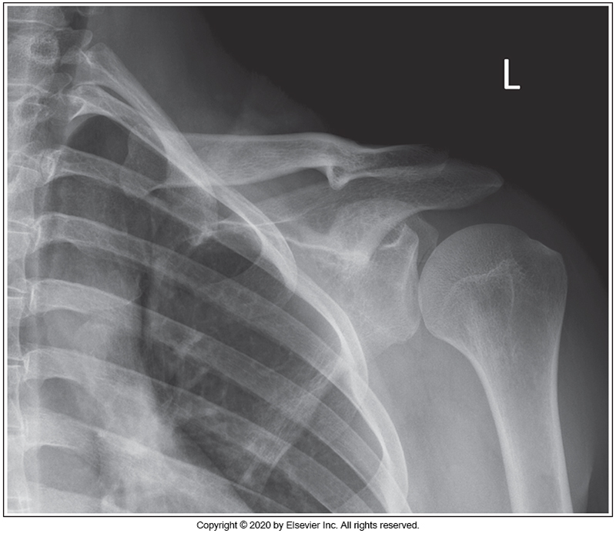
Rotation – Shoulder: You Try
Which way was the patient rotated?
  To the Right
  To the Left (more space on the left side)
  RPO
  LAO
McQuillen Martensen 5th Ed. Fig. 5-3

