Slide 1


Color Theory

Slide 2
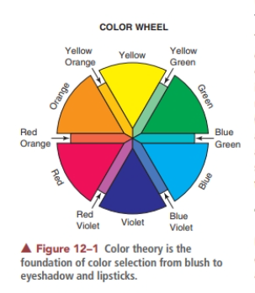
OUR JOURNEY TODAY
Principles of Cosmetic Color Theory

Slide 3
Your selection of colors will depend on the rules of color theory.
Color theory is the foundation of color selection, impacting every area of makeup from foundations to blush, eyeshadow, and lipsticks .
It is important in helping clients resolve issues and create a harmonious look on every face.
It will guide you as you choose proper makeup colors to enhance your clients’ skin tone,

Slide 4
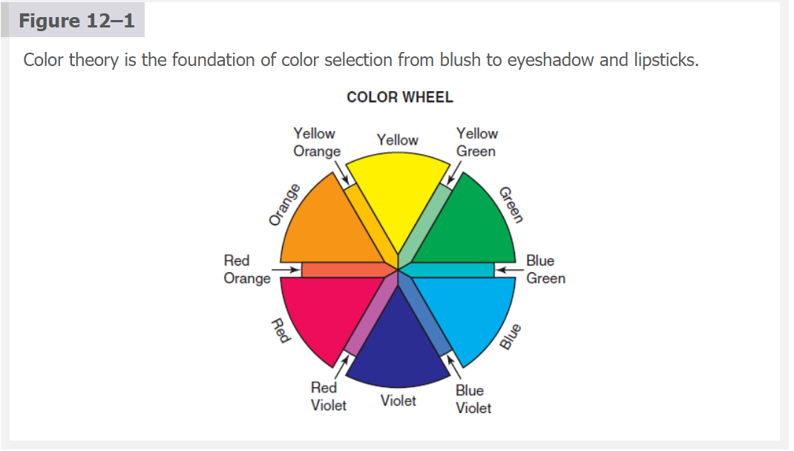

Slide 5
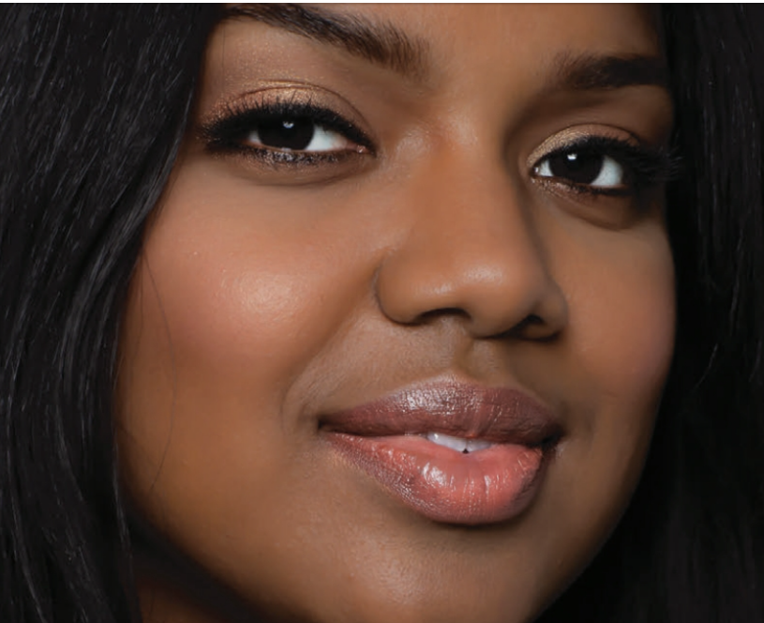
The color wheel is based on the three primary colors: red, yellow, and blue.

Slide 6
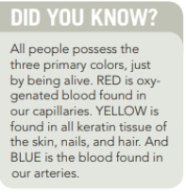
The traditional color wheel is a creation of the various combinations of colors stemming from the three primary hues and resulting in 12 main divisions.
The term hue refers to any color in its purest form, lacking any black (shade) or white (tint).
The hue of a color represents just one dimension of a particular color.
The color wheel does not change and will always serve as your core color selection guide.

Slide 7
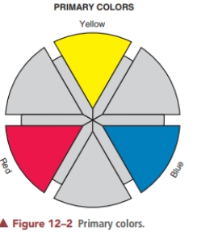
PRIMARY COLORS
Primary colors are fundamental colors that can-not be obtained from a mixture.
The primary colors are
Red
Yellow
Blue
These are the main spectral colors of light seen in a prism from sunlight.

Slide 8
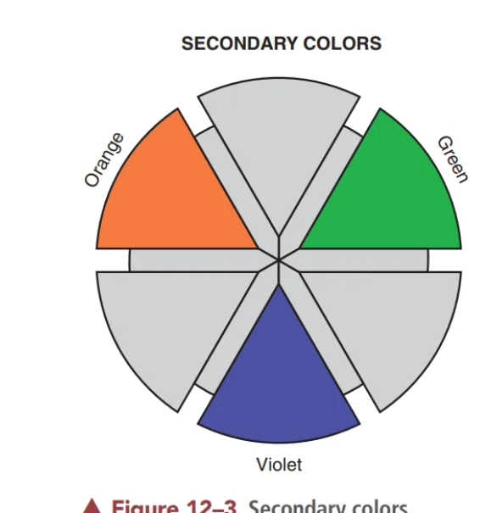
Secondary Colors
Are obtained by mixing equal parts of two primary colors.
The secondary colors include
Orange
Green
Violet
+ =
+ =
+ =
Notice on the color wheel the triangular positioning of the primary colors in relation to one another and how the secondary colors fall between them

Slide 9
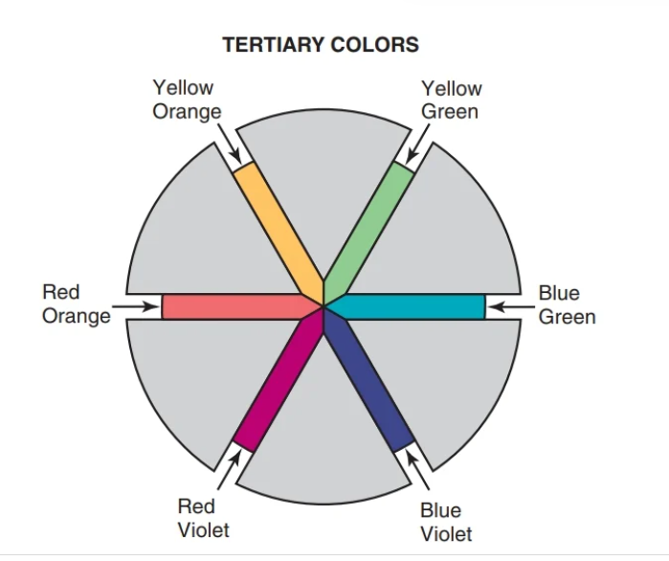
Tertiary Colors
Are formed by mixing equal amounts of a primary color and its neighboring secondary color on the color wheel.
These colors are named by primary color first, secondary color second. For example,
+ =
+ =
+ =

Slide 10
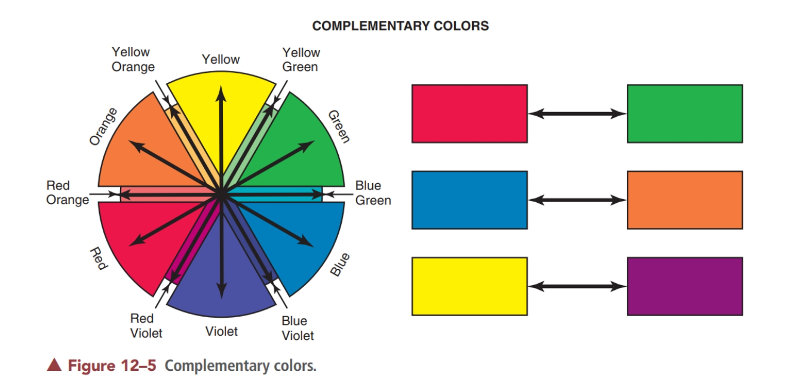

Slide 11
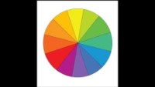

Slide 12

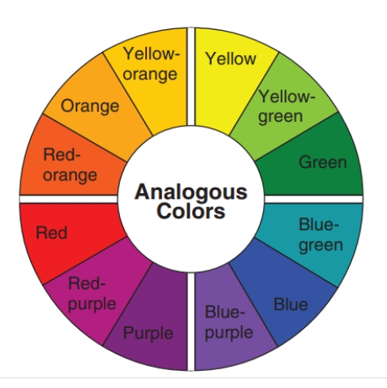

Slide 13
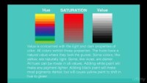

Slide 14
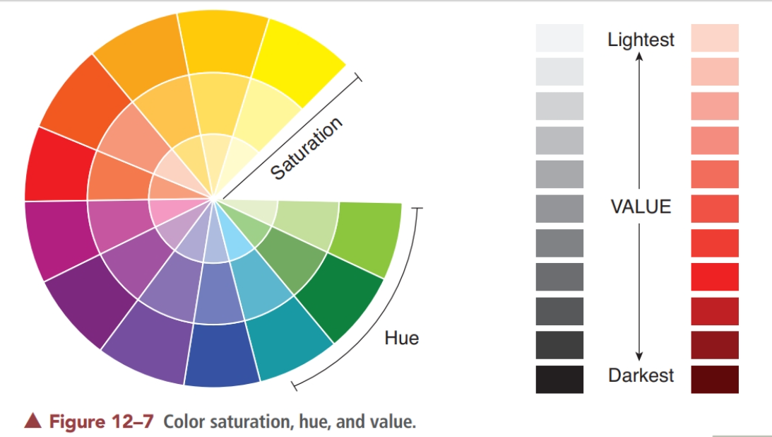

Slide 15
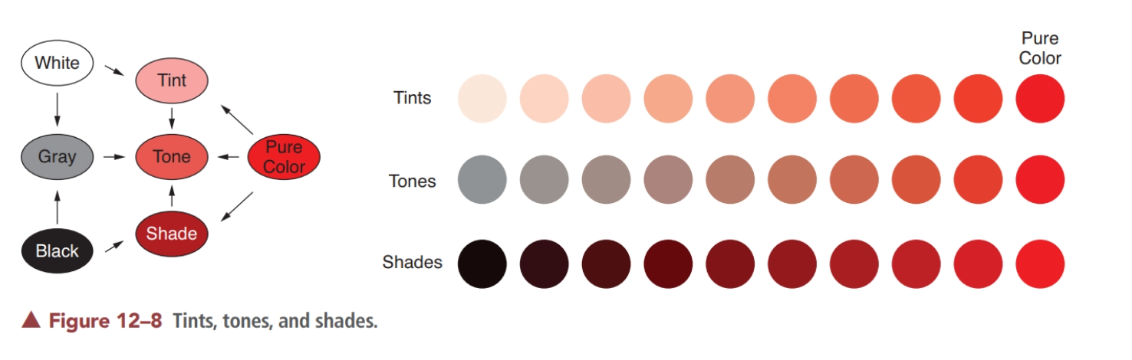
Tints, Tones and Shades

Slide 16
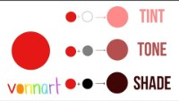

Slide 17
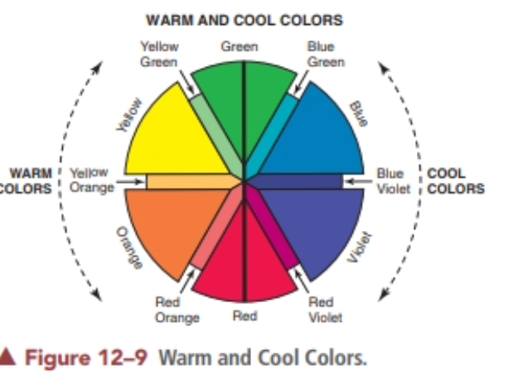

Slide 18


Slide 19
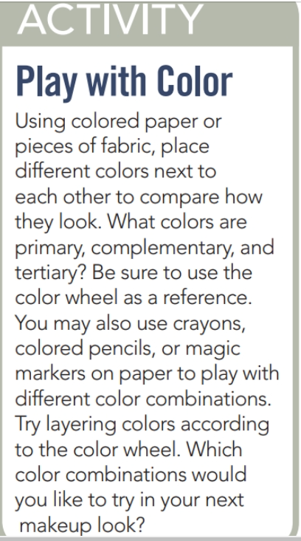


Slide 20

QUESTIONS?

