Slide 1


Medium Peels

Slide 2
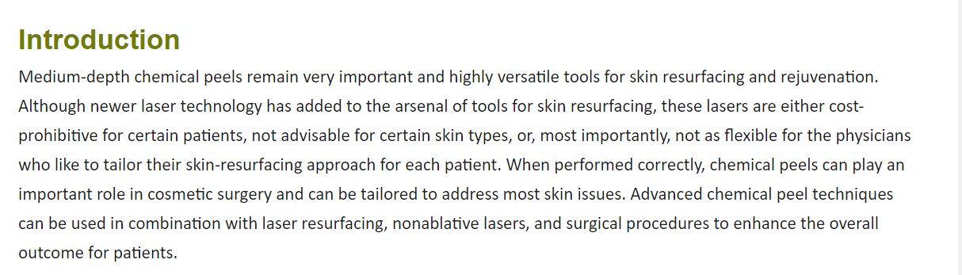

Slide 3
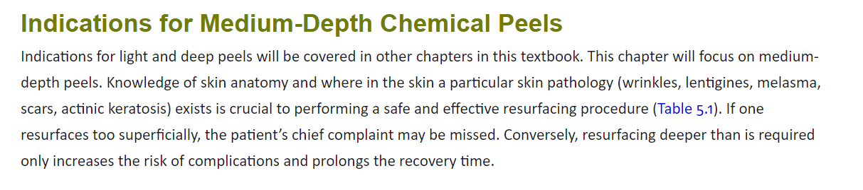

Slide 4
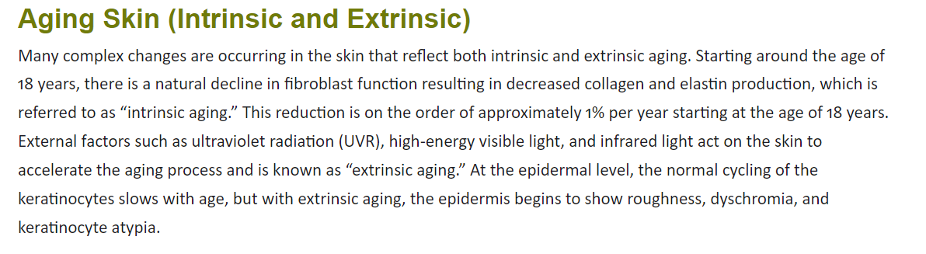

Slide 5
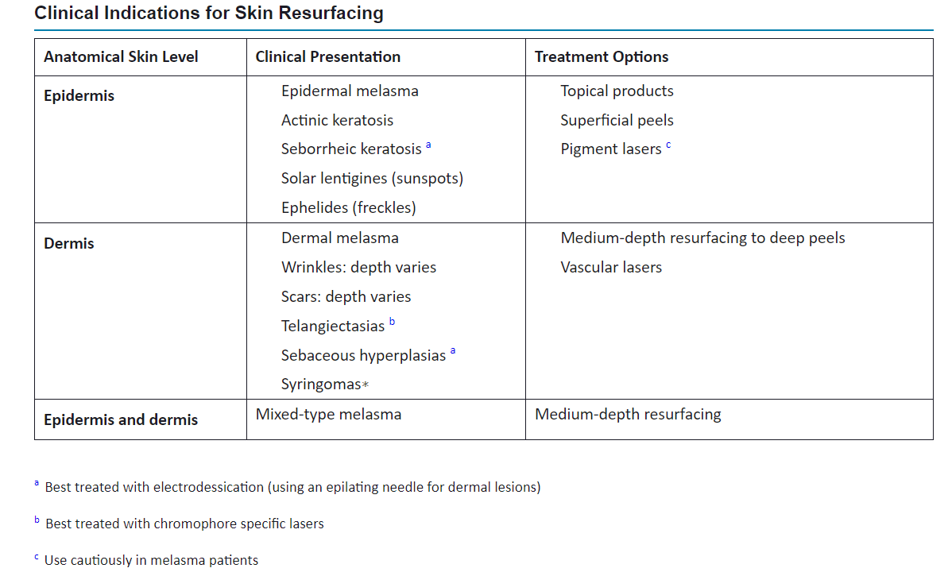

Slide 6
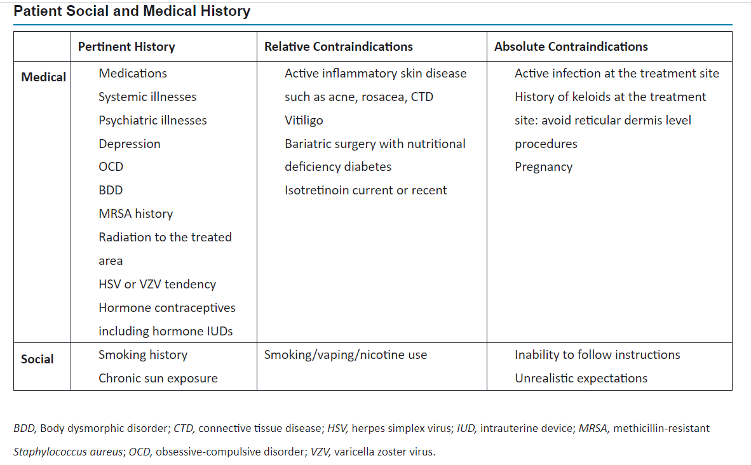

Slide 7
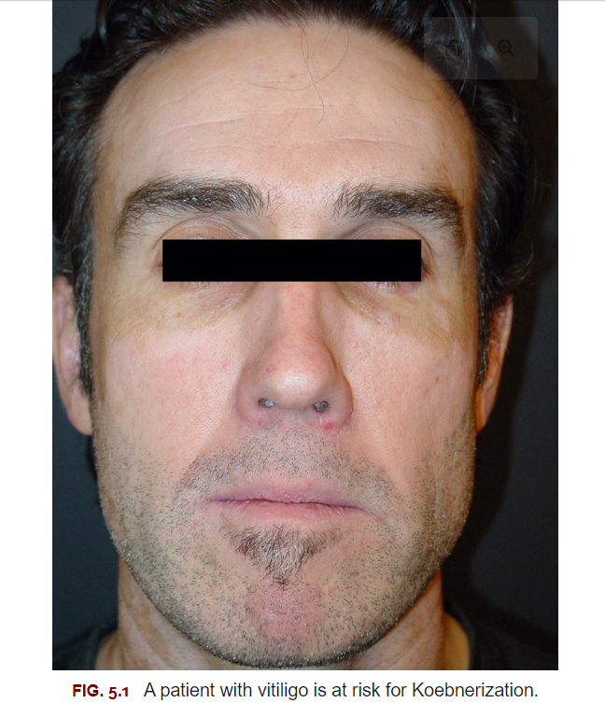

Slide 8
Consideration in Medium-Depth Skin Resurfacing
Review of Chapter 2!

Slide 9
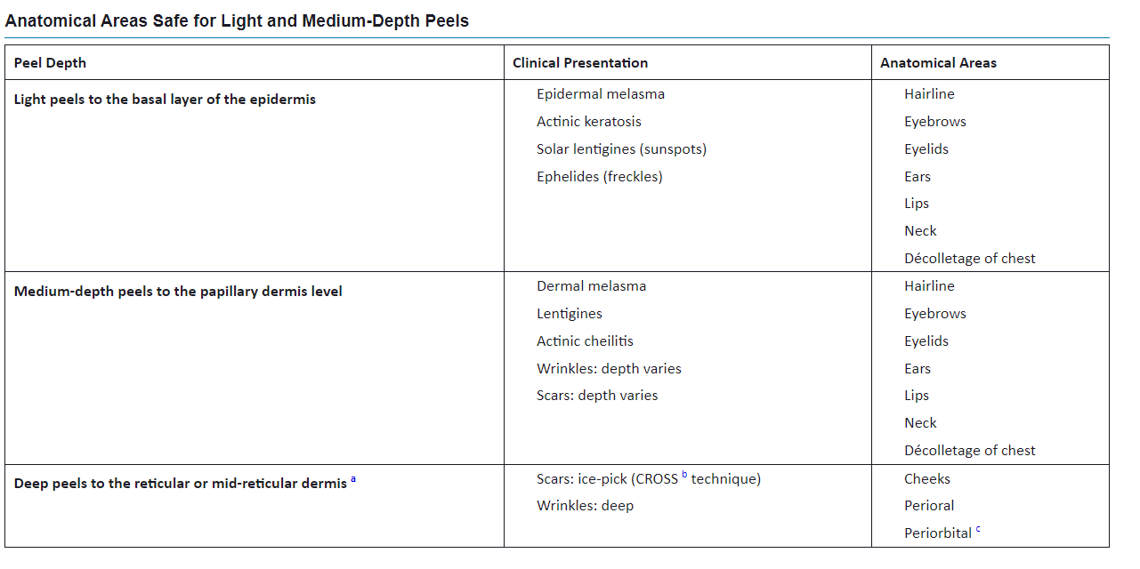

Slide 10
Medium-Depth Skin Resurfacing
Mechanisms of Action
For medium-depth peeling, it is important to understand the main mechanism of action of the acid on the skin, especially when performing combination peels (Table 5.4). This is either a keratolytic effect or a protein denaturant effect. The keratolytics are mainly used for superficial, exfoliative procedures, whereas the protein denaturants can be used for superficial or deeper peels.

Slide 11
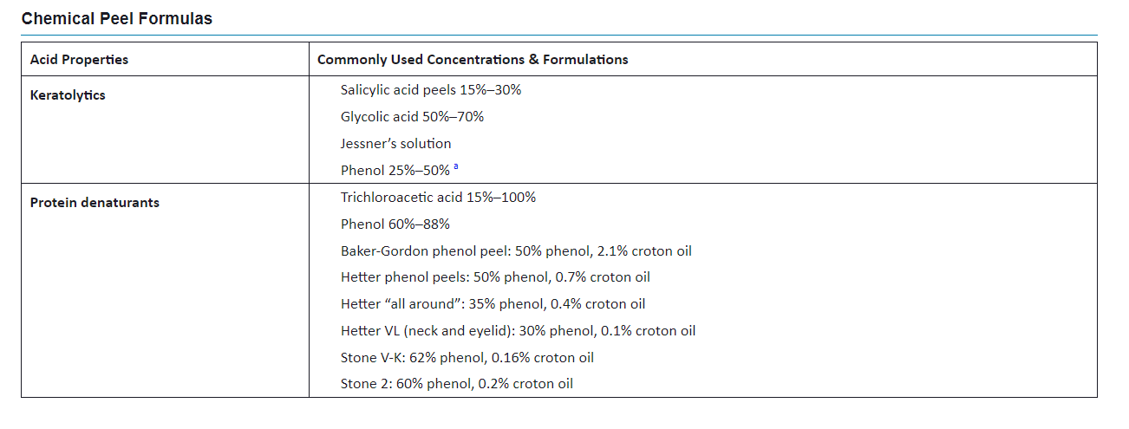

Slide 12


Slide 13
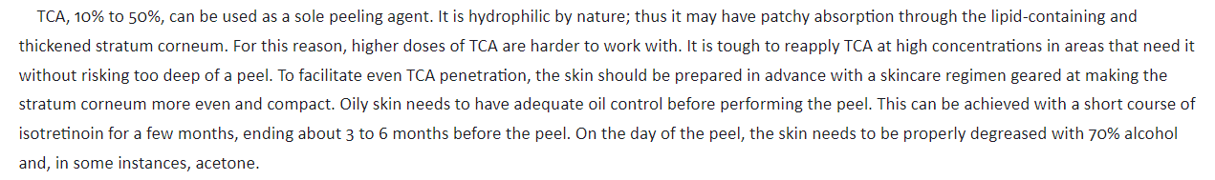
Trichloroacetic Acid Peels

Slide 14
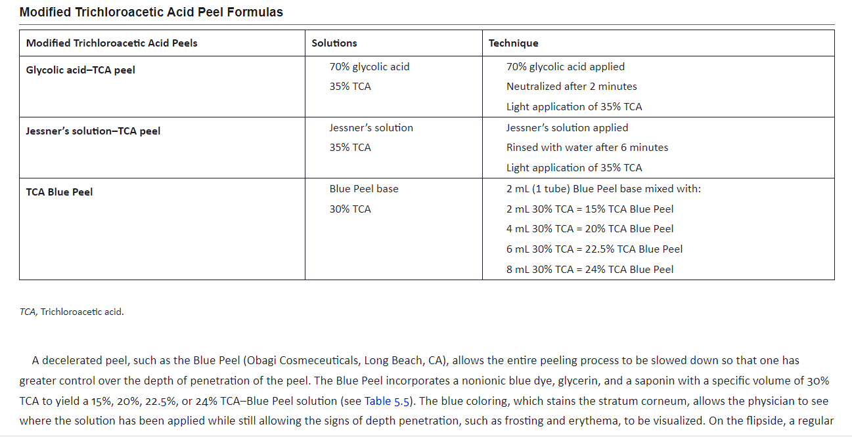

Slide 16
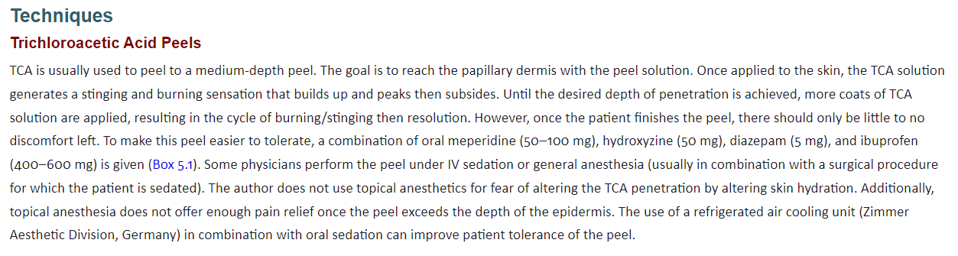

Slide 17
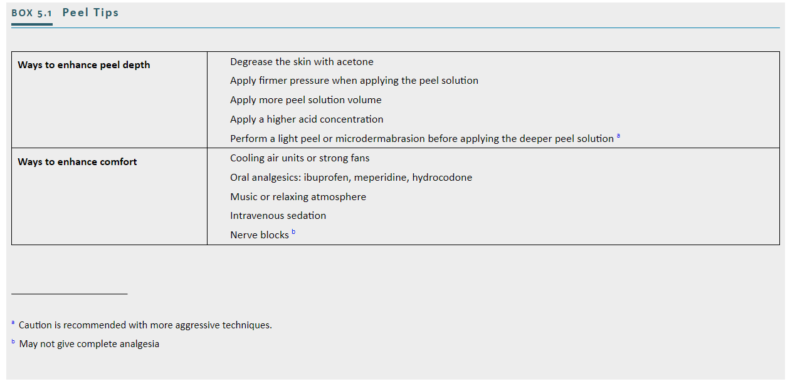

Slide 18
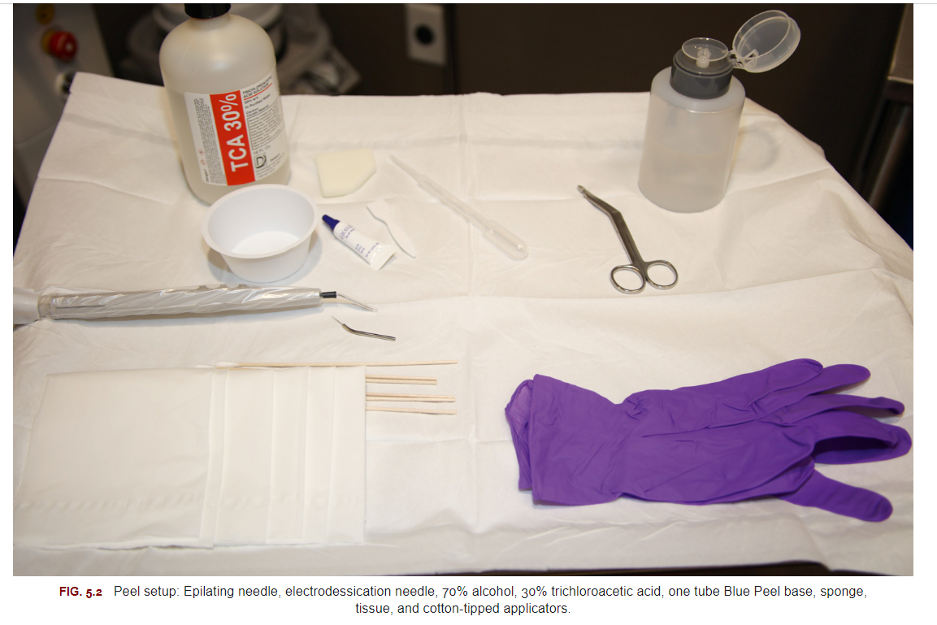

Slide 19
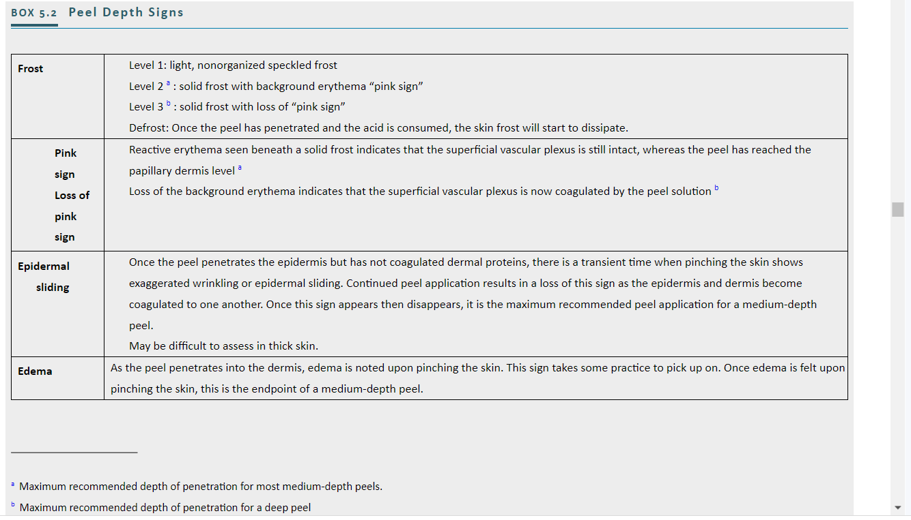

Slide 20
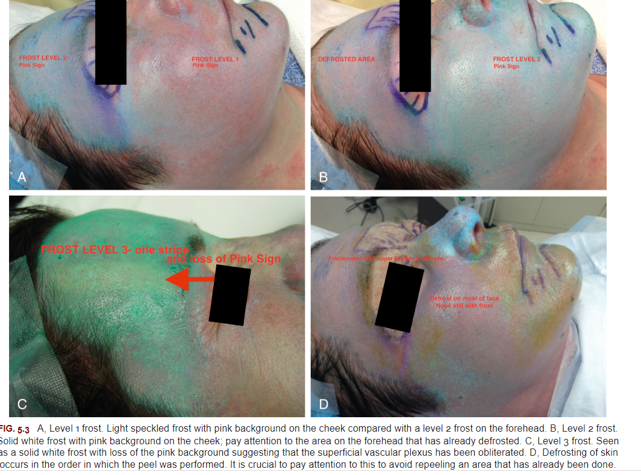

Slide 21
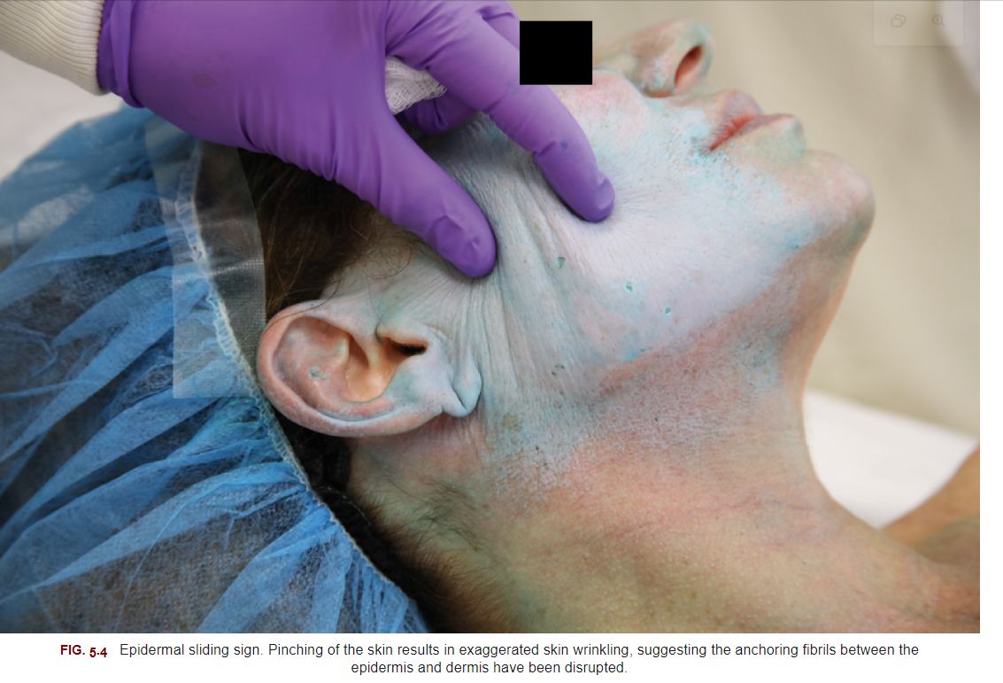

Slide 22
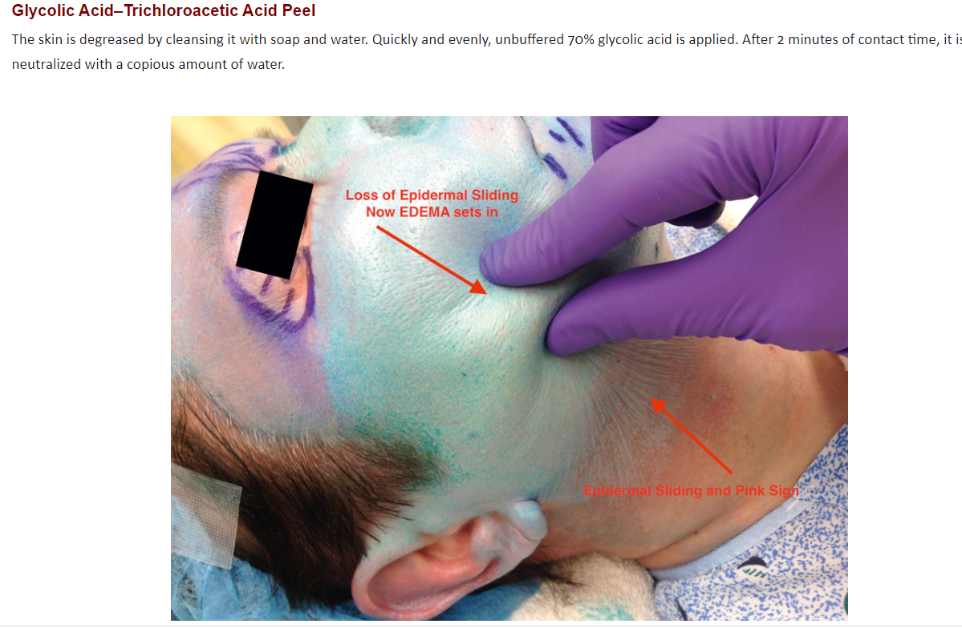

Slide 23
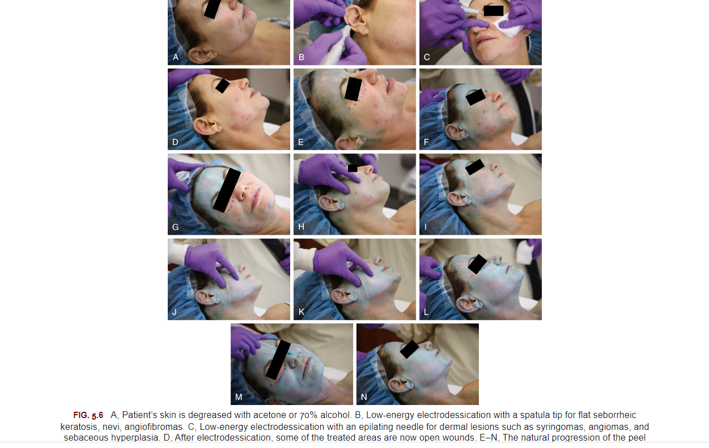
Combination Procedures

Slide 24
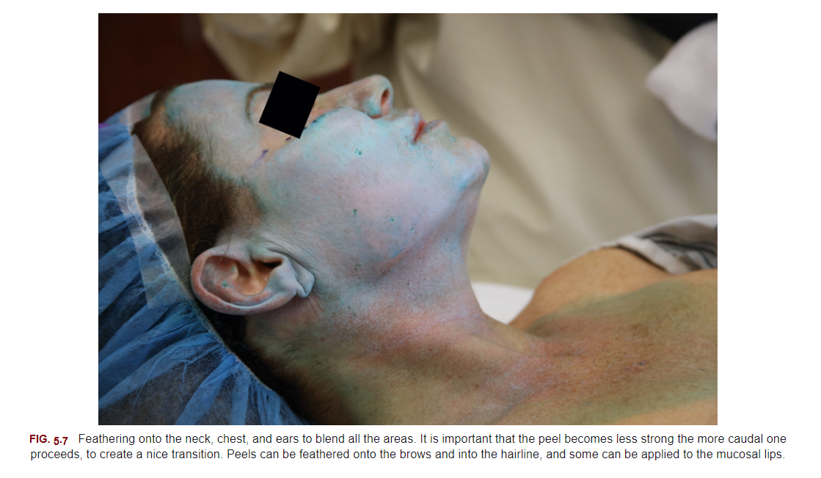

Slide 25
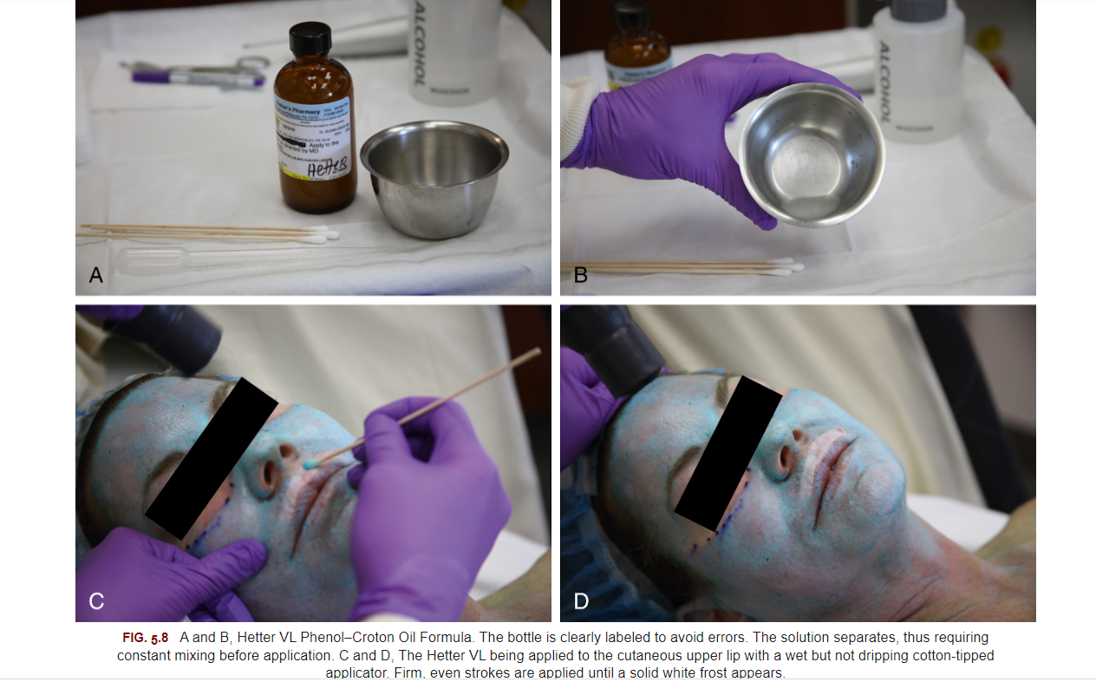

Slide 26
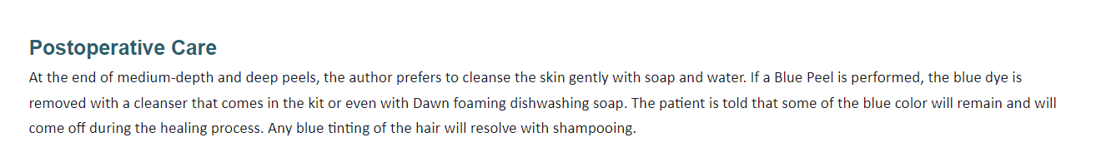

Slide 27
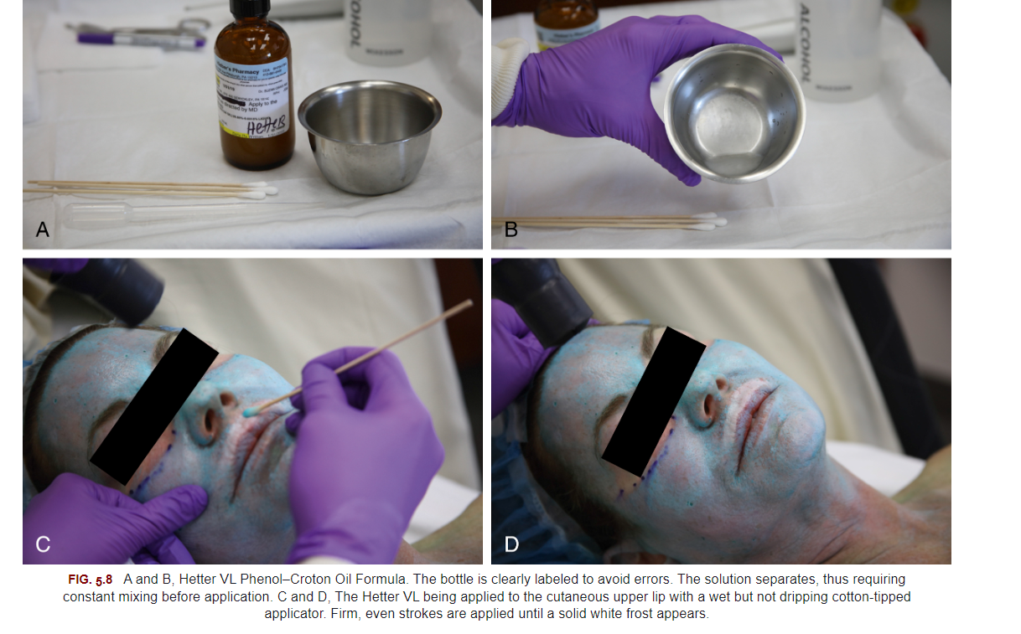

Slide 28
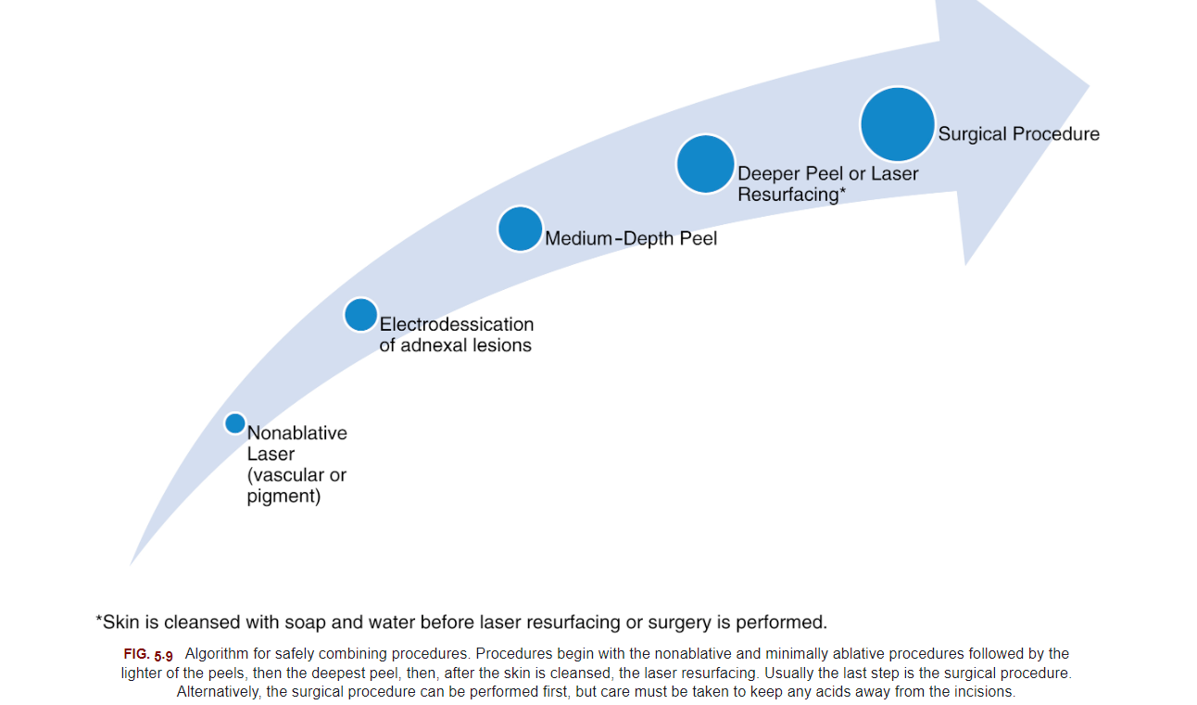

Slide 29

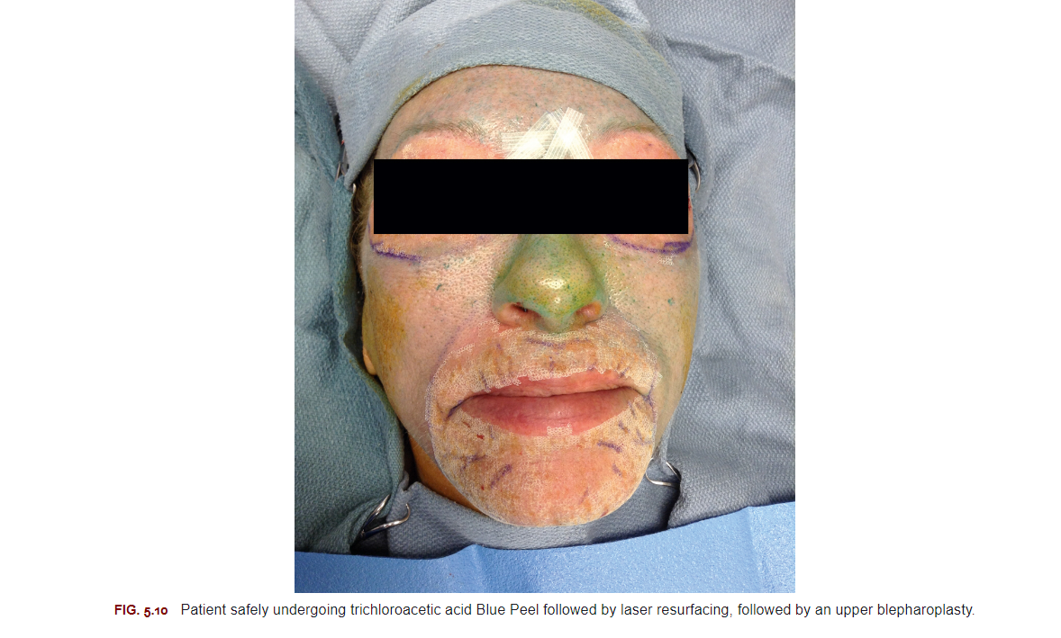

Slide 30
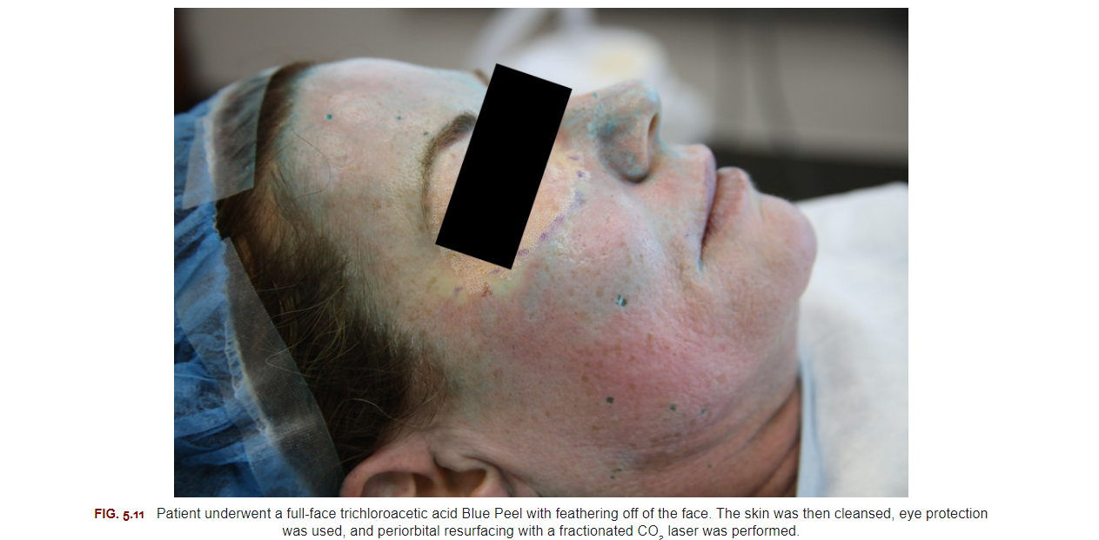

Slide 31
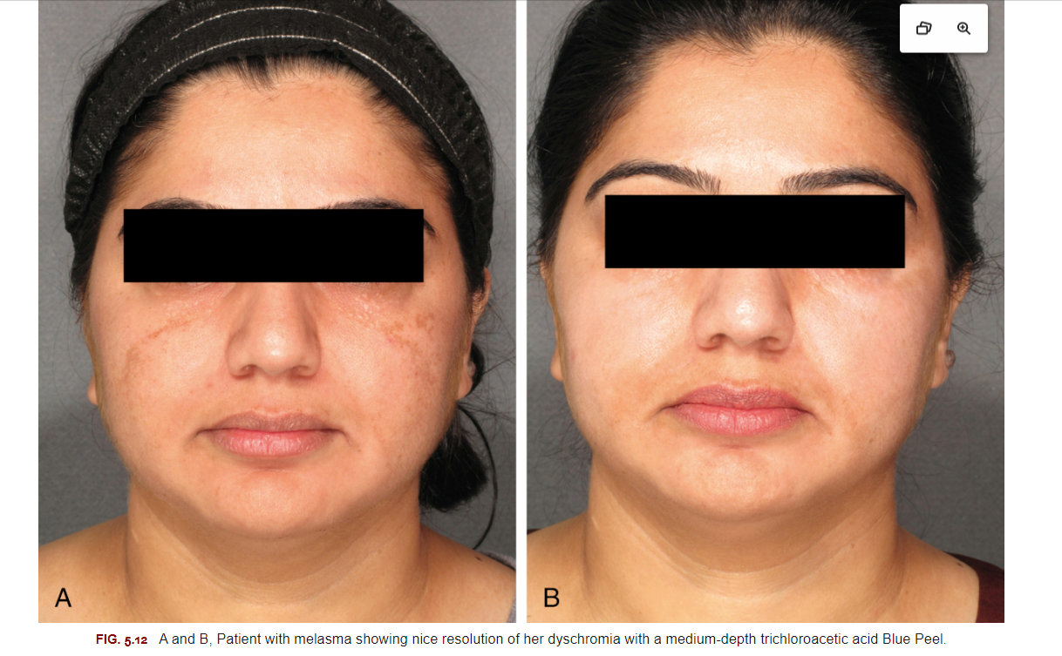

Slide 32
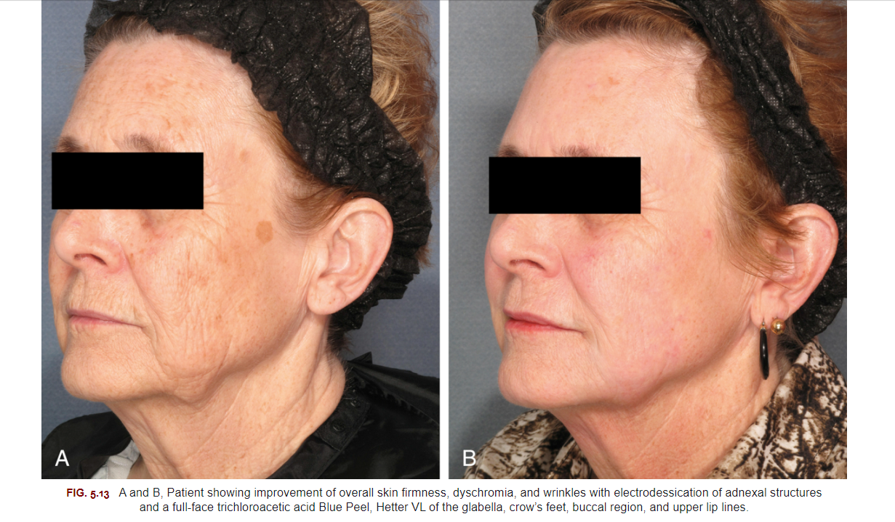

Slide 33
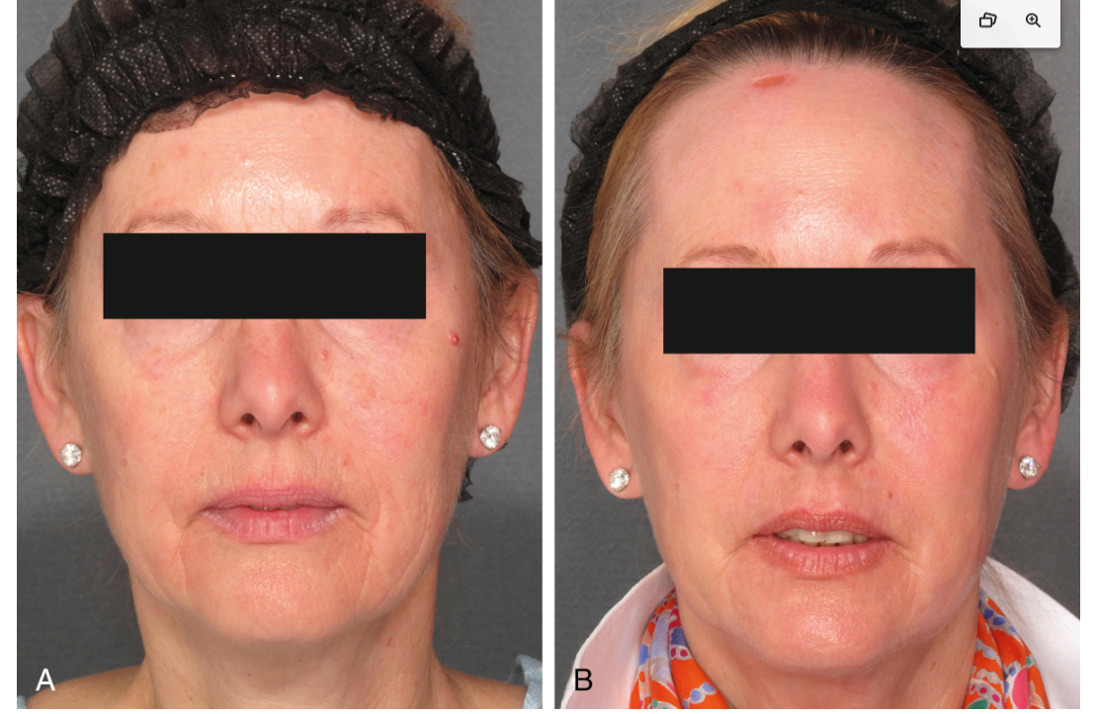

Slide 34
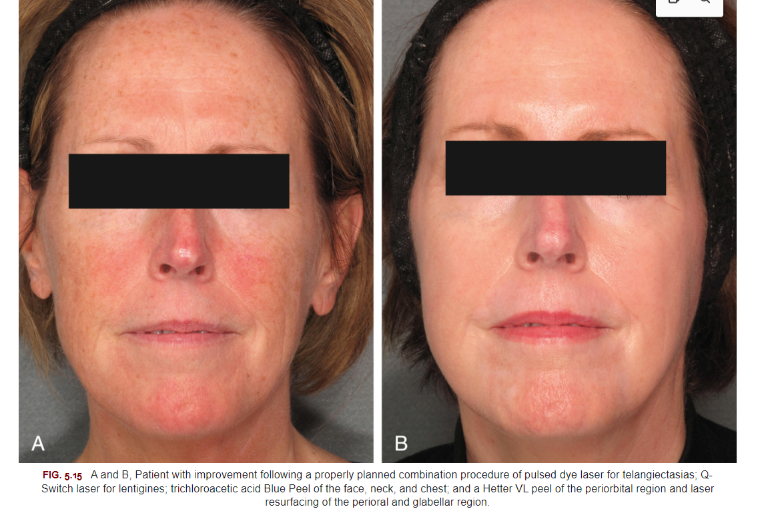

Slide 35
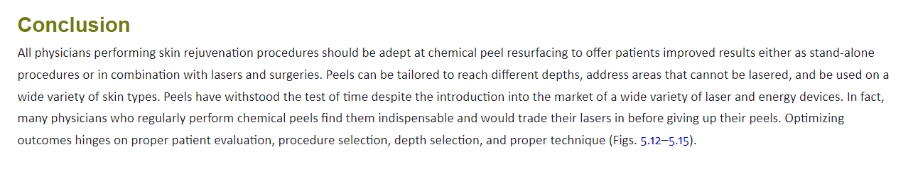

Slide 36

QUESTIONS?

