Slide 1


Medical Esthetics
Identify Pigment Disorders

Slide 2
The genetic background of a person influences pigmentation disorders. Abnormal pigmentation, referred to as dyschromia , can be caused by various internal and external factors. Hyperpigmentation , overproduction of pigment, and hypopigmentation, lack of pigment, are the two types of pigmentation disorders. Sun exposure is the biggest external cause of pigmentation disorders and can make existing pigmentation disorders worse. Drugs may also cause skin pigmentation abnormalities. Hyperpigmentation is a frequent concern for clients.

Slide 3
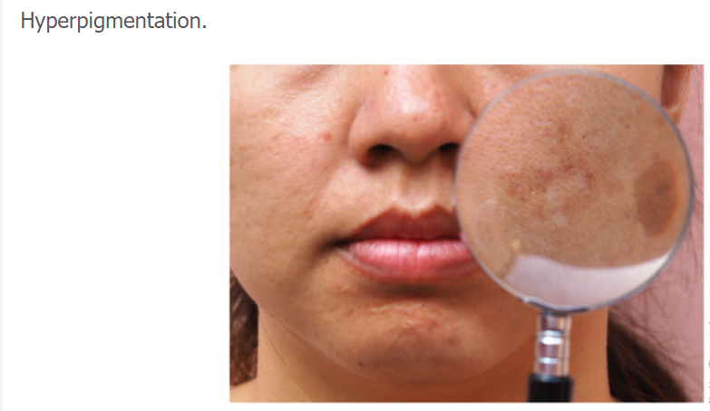
Hyperpigmentation

Slide 4
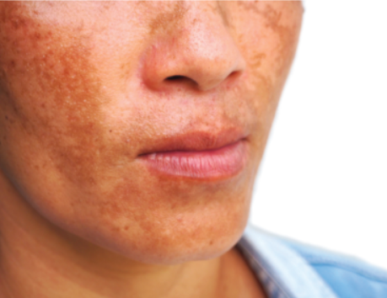
Melasma
Melasma is a type of hormonal hyperpigmentation disorder that first appears during pregnancy or with the use of birth control pills. Melasma has an identifiable pattern of solid fairly symmetrical hyperpigmentation, often on the forehead, cheeks, upper lip, and chin . Sun exposure can exacerbate the pigmentation of melasma, so a person may have melasma and sun damage.

Slide 5
Melasma Facts
Addressing the symptoms of melasma can be a challenge for an esthetician. The pigmentation can fade during times of low UV exposure. Hormones returning to normal levels after pregnancy will alleviate the pigmentation. The consistent use of melanocyte-inhibiting skin care products as well as sunscreen application is essential. A series of chemical peels can lighten the pigmentation. Some high-energy laser devices with nanosecond or picosecond technology and fractional radio frequency treatments can offer visible improvements. Melasma is a condition that requires management; there is no cure.

Slide 6
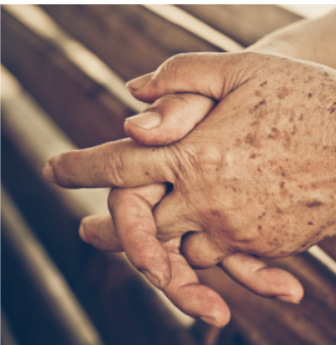
Lentigo
Is a flat, pigmented area similar to a freckle; small, yellow-brown spots . Lentigines are multiple pigmented lesions. Medical professionals identify lentigenes that result from sunlight exposure as actinic, or solar, lentigenes. Your client may call them age spots, as they are associated with aging skin.

Slide 7
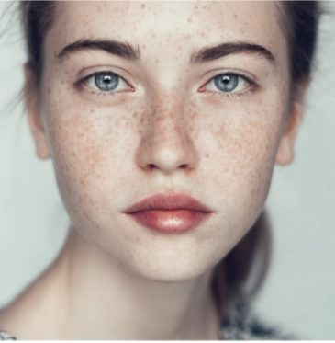
Ephelids
Also known as freckles, are tiny round or oval pigmented areas of skin on areas exposed to the sun . Also referred to as macules, they are small flat colored spots on the skin.

Slide 8
The Sun and the Skin
UV Radiation
The sun and your skin

Slide 9
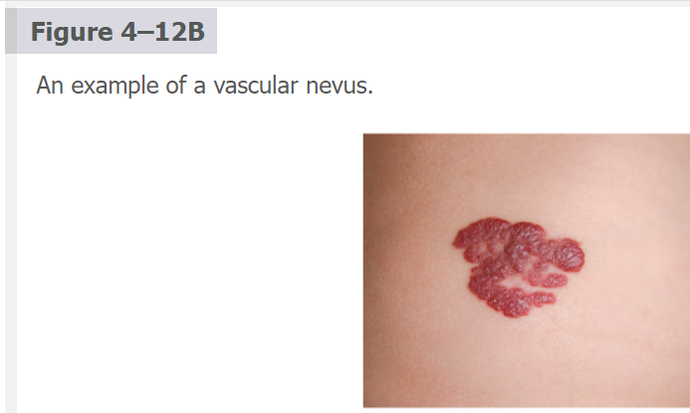
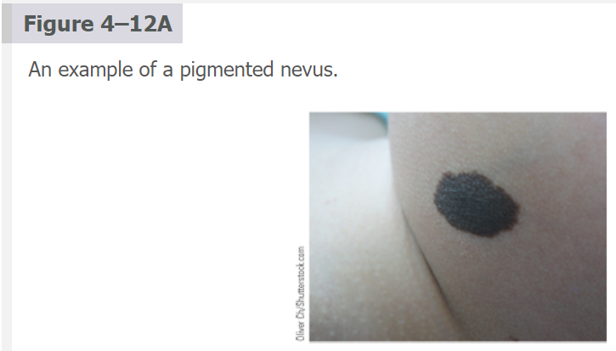
Also known as birthmark, is a malformation of the skin from abnormal pigmentation or dilated capillaries that is present at birth or appears shortly after birth. A port wine stain is a vascular type of nevus. Figure 4–12a is an example of a pigmented nevus. Figure 4–12b is an example of a vascular nevus.

Slide 10
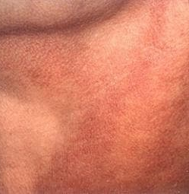
Poikiloderma of Civatte
A skin condition caused by actinic bronzing (chronic sun exposure) to the sides of the face and neck. The skin turns a reddish-brown hue with a distinct white patch under the chin. Poikiloderma is benign, meaning it is not cancerous. Treatment can be a combination of melanocyte-inhibiting skin care, chemical peels, advanced treatments with lasers and IPLs, consistent sunscreen protection, and avoiding irritants, such as heavy fragrances, on the skin.

Slide 11
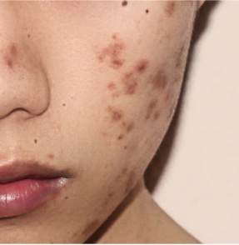
Post-inflammatory Hyperpigmentation
Darkened pigmentation due to an injury to the skin or the residual healing after an acne lesion has resolved . It is often deep red, purple, or brown in appearance.

Slide 12
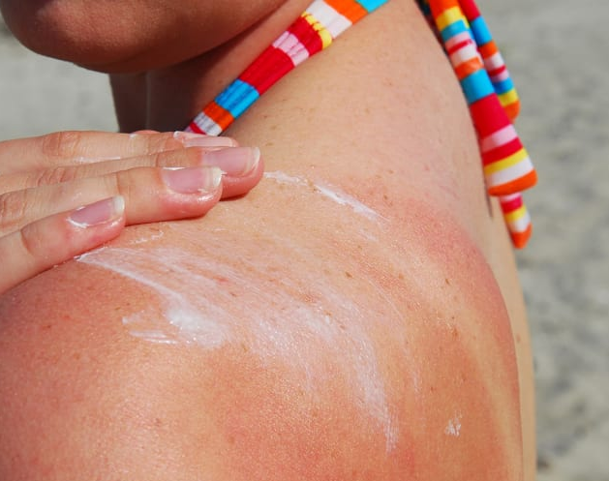
Tan
Results from exposure to the sun. Tanning is a change in pigmentation due to melanin production as a defense against UV radiation that damages the skin. A tan is basically visible skin and cell damage.

Slide 13
Hypopigmentation
Hypopigmentation occurs in various forms. It is seen less commonly than hyperpigmentation disorders.

Slide 14
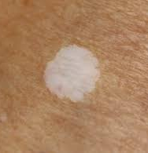
Leukoderma
A loss of pigmentation leading to light, abnormal patches of depigmented skin. It is a congenital disorder acquired due to immunological and post-inflammatory causes. Vitiligo and albinism are leukodermas.

Slide 15
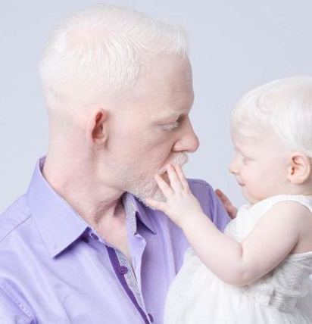
Albinism
A rare genetic condition characterized by a lack of melanin pigment in the body, including the skin, hair, and eyes. The person is at risk for skin cancer, is sensitive to light, and ages early without normal melanin protection. The technical term for albinism is congenital leukoderma or congenital hypopigmentation.

Slide 16
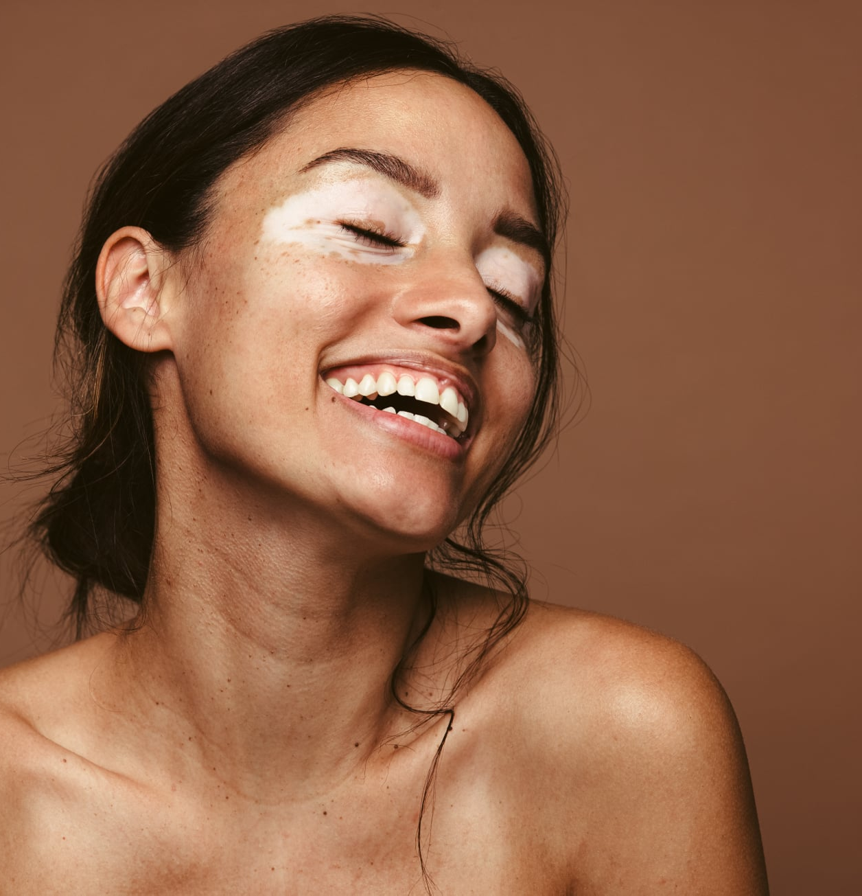
Vitiligo
Is a pigmentation disorder characterized by white irregular patches of skin that are totally lacking pigment . The condition can worsen with time and sunlight. The disorder can occur at any age and is believed to be an autoimmune disorder causing an absence of melanocytes.

Slide 17
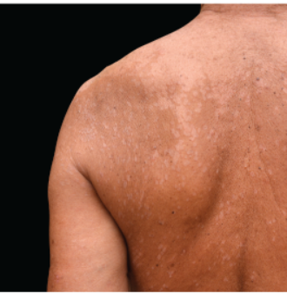
Tinea Versicolor
Pityriasis versicolor, is a fungal condition that inhibits melanin production. It is not contagious because it is caused by yeast, a normal part of the human skin. It is characterized by white, brown, or salmon-colored flaky patches. Sun exposure can stimulate the growth of the fungus. This fungus can be treated with antifungal cream or other medication. Selenium sulfide shampoos can also treat the condition. High humidity and summer heat stimulate the condition. It usually fades in the cold winter season and recurs with warmer weather. To the layperson, tinea versicolor can be misinterpreted as vitiligo, so referral to a medical professional is important.

Slide 18
Free Radical Damage
Oxidation and Antioxidants

Slide 19
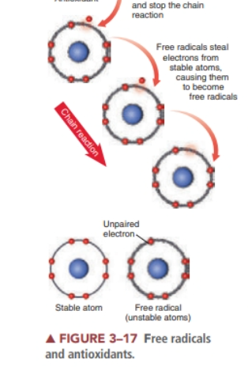
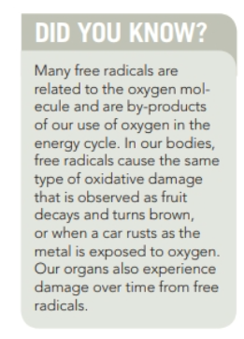

Slide 20
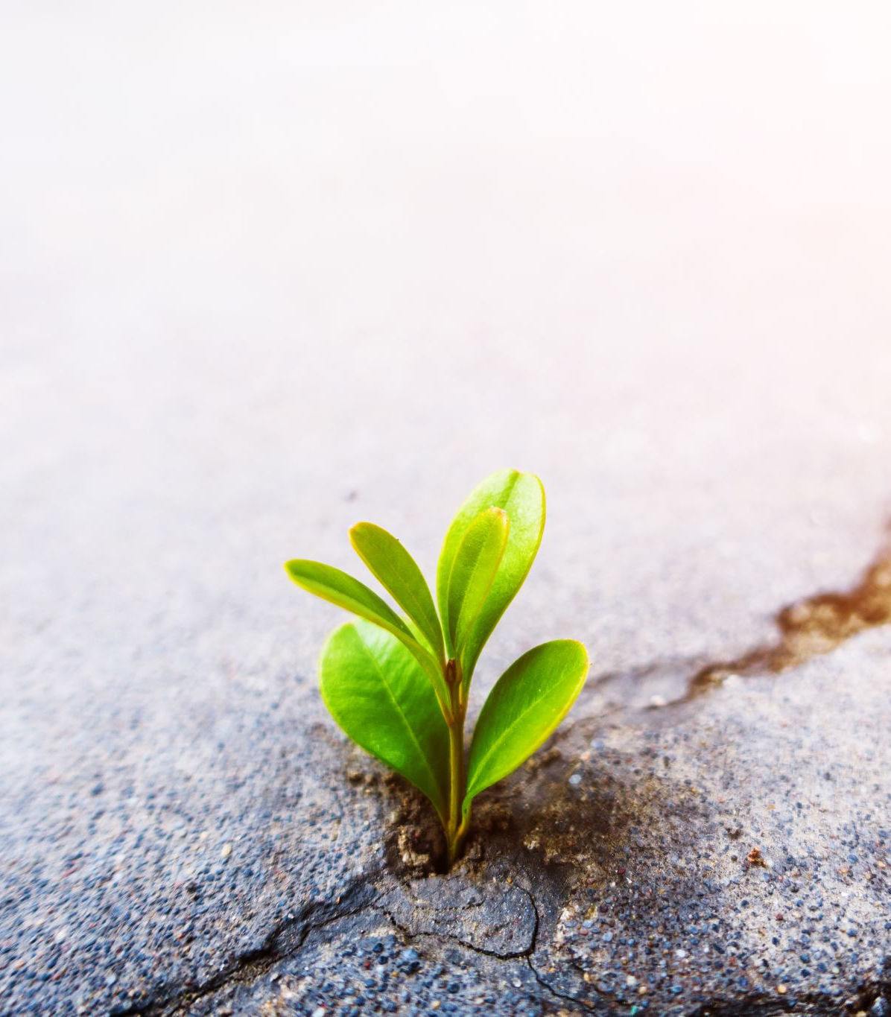
Skin Health and the Environment
Climate, humidity levels, and other environmental factors also affect the skin
Routine cleansing at night helps to remove the buildup of pollutants that have settled on the skin’s surface throughout the day
Applying daily moisturizers, antioxidants, growth factor serums, pep-tides, sunscreen, and even foundation products helps to protect the skin from airborne pollutants and the environment.

Slide 21
Skin Health and Lifestyle Choices
What we choose to put into our bodies significantly affects our overall health.
The impact of poor choices can be seen most visibly on the skin. Smoking, drinking, drugs, and an unbalanced diet with heavily processed foods all greatly influence the aging process.

Slide 22
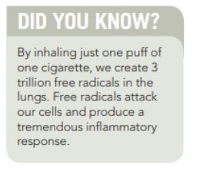

Slide 23
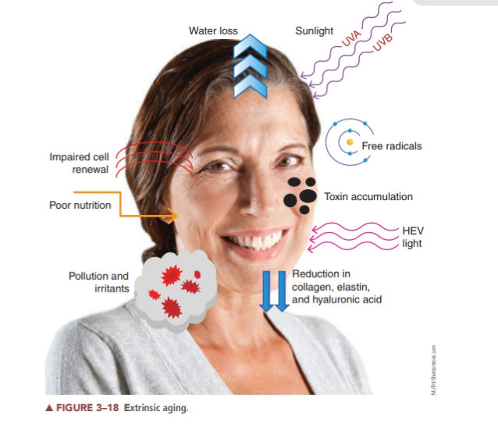

Slide 24
Using some prescription or illegal drugs also affects the skin.
Certain drugs have been shown to interfere with the body’s intake of oxygen, thus affecting healthy cell growth.
Some drugs can even aggravate serious skin conditions, such as acne. Other effects include dryness and allergic reactions on the skin’s surface.
The effects of inhaled cannabis should be a consideration in the skin’s aging processes as well.

Slide 25
Drinking and smoking
Both smoking and drinking contribute to the aging process on their own, but the combination of the two can be even more damaging to the tissues. The constant dilation and contraction of the tiny capillaries and other blood vessels, as well as the constant deprivation of oxygen and water to the tissues, quickly makes the skin appear lifeless and dull. It is very difficult for the skin to adjust and repair itself from this assault. Damage done by our habits can be hard to reverse or even diminished

Slide 26
Glycation
Recent research indicates that an intrinsic part of the aging process involves damaged structures and tissues that gradually accumulate in the body through a destructive process called glycation
Glycation is the binding of a protein molecule to a glucose molecule ( sugar ), resulting in the formation of damaged, nonfunctioning structures known as advanced glycation end products.
Glycation contributes to the aging of skin, contributing to wrinkles and hyperpigmentation.
Many age-related diseases such as arterial stiffening, cataracts, and neurological impairment are partially attributed to glycation.
Scientists have established that anything that causes a rise in our blood sugar results in inflammation on a cellular level. When blood sugar goes up rapidly and continually, the sugar can actually attach to the collagen in the skin, making it stiff and inflexible. This is glycation. When collagen is cross-linked by sugar, it leads to stiff and sagging skin.

Slide 27
Other Factors that age Skin
Too much cortisol ( stress hormone)
Lack of sleep
Hormonal imbalances
Poor diet
Poor Microcirculation in the blood vessels

Slide 28
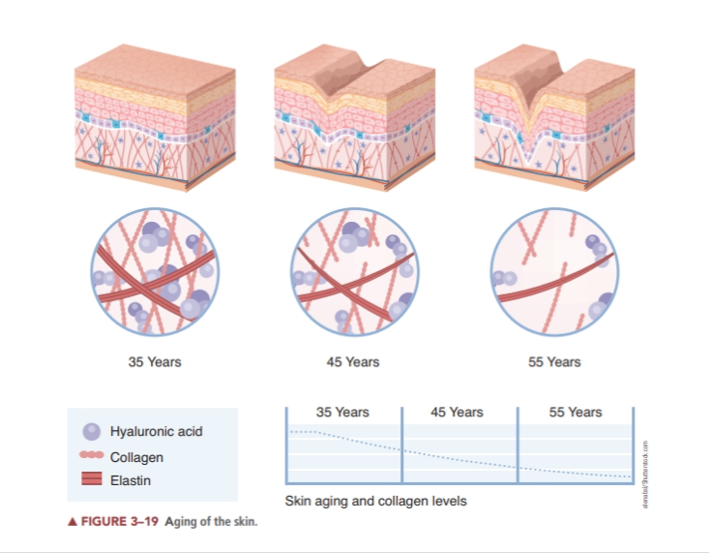

Slide 29
Hormone Replacement Therapy
Hormone replacement therapy (HRT) is often suggested to balance estrogen for women experiencing menopause; however, some HRT may be linked to breast cancer.
It is not within the scope of practice of an esthetician to make recommendations.
In addition to hormone balancing, sustaining good nutrition, the use of good skin care products and treatments, exercise, and a positive outlook can help keep skin looking radiant at any age.

Slide 30
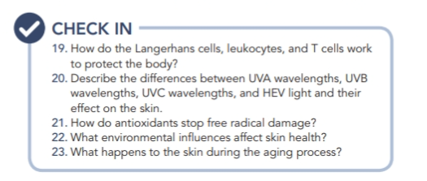
Research Time

Slide 31
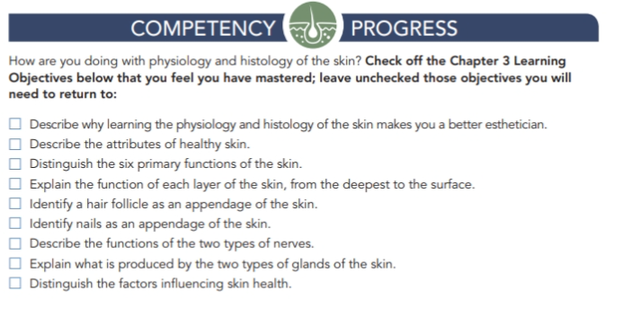

Slide 32

QUESTIONS?

