Slide 1
INFC 15 – Infection Prevention and Control
Donning/Doffing Gown

Slide 2
Donning
Putting ON

Slide 3
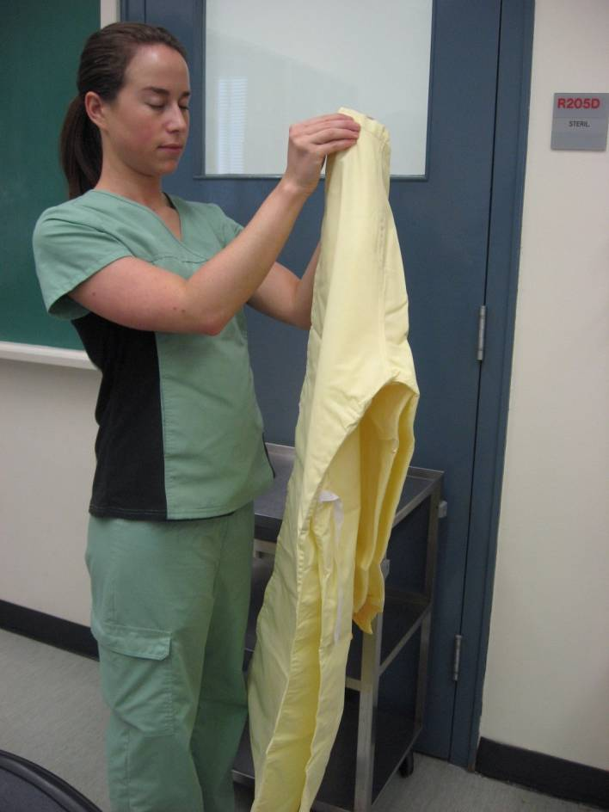
1. Select gown
When?
As part of Routine Practice
(if anticipating splashes)
or if isolation notification indicates that it is required

Slide 4
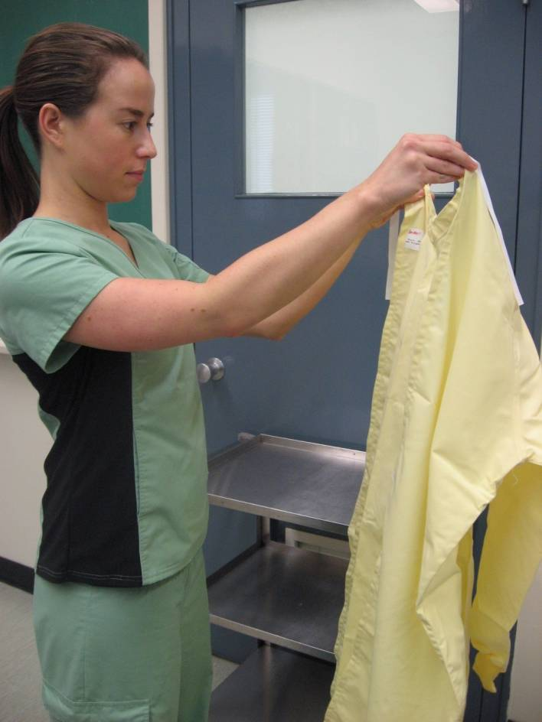
2. Put on Gown
Pick up and let fall open
Do not let it touch the floor

Slide 5
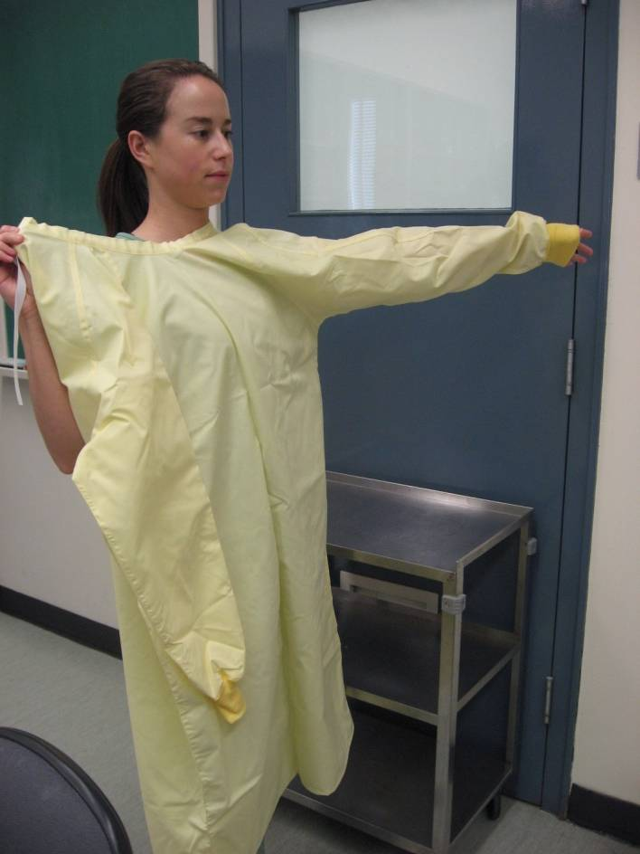
3. Put one arm in

Slide 6
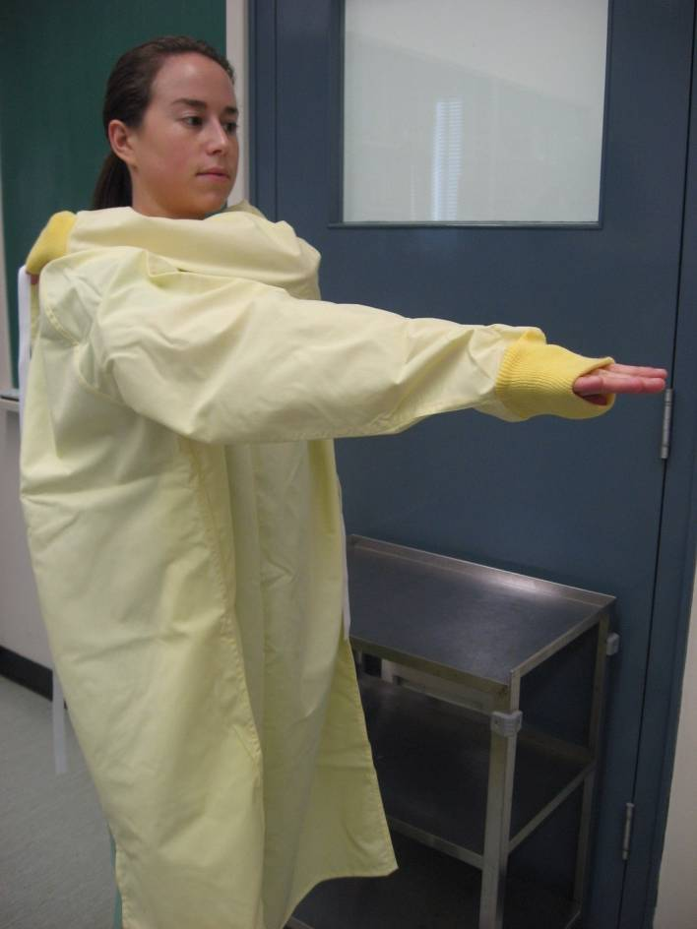
4. Put other arm in

Slide 7
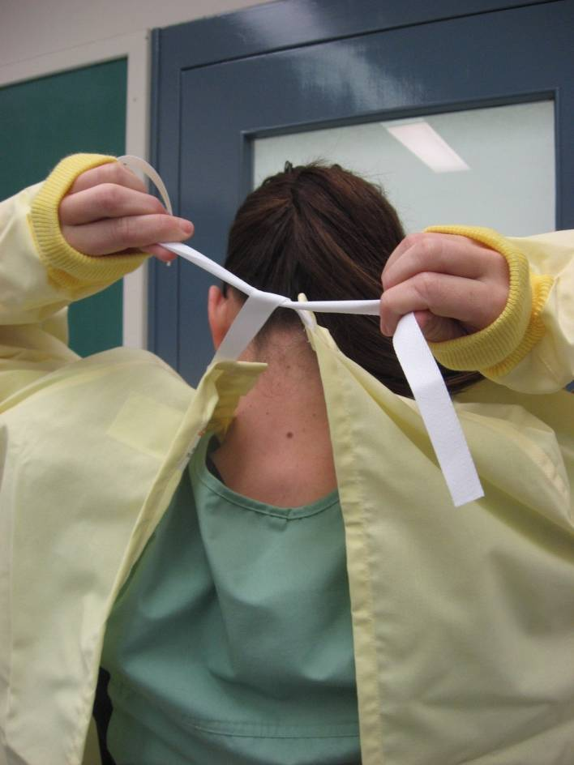
5. Grasp neck ties

Slide 8
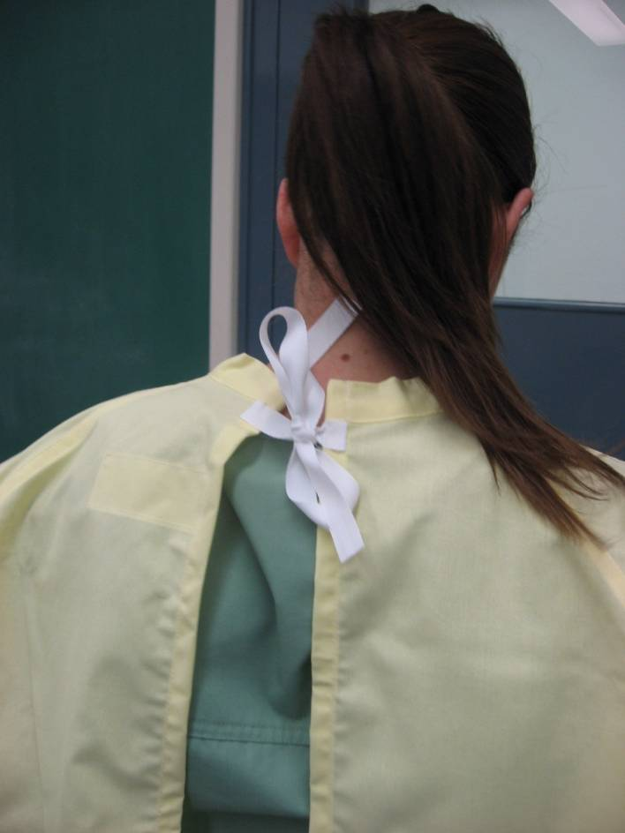
6. Tie in a bow
Do not tie in a knot, so that it can be easily untied later Is the mask properly adjusted?

Slide 9
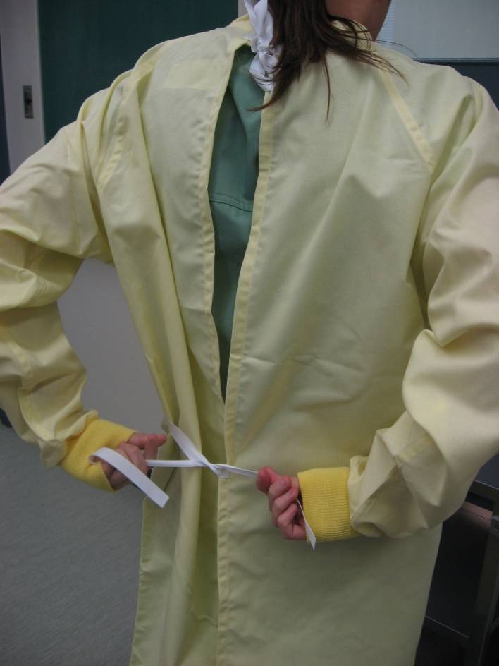
7. Wrap gown around the back of your uniform

Slide 10
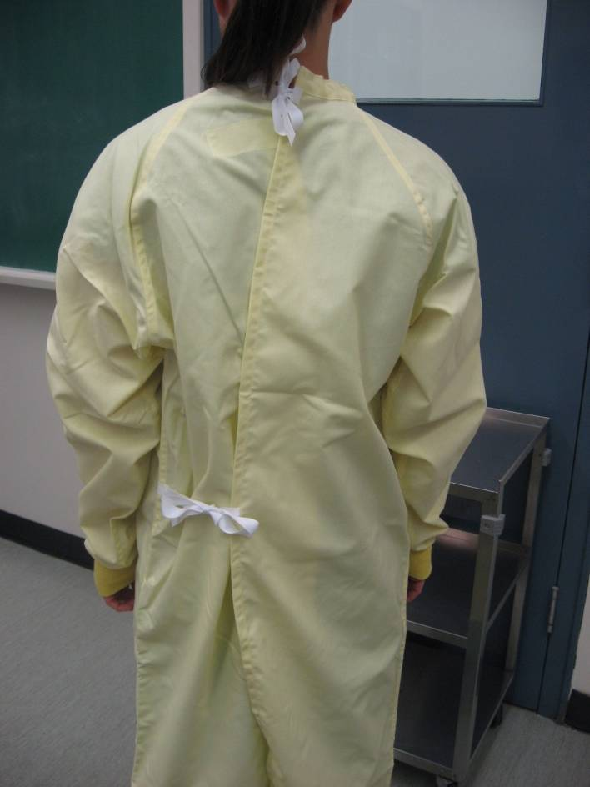
8. Fasten waist ties in a bow
Ensure that your uniform is completely covered

Slide 11
DOFFING
Taking OFF

Slide 12
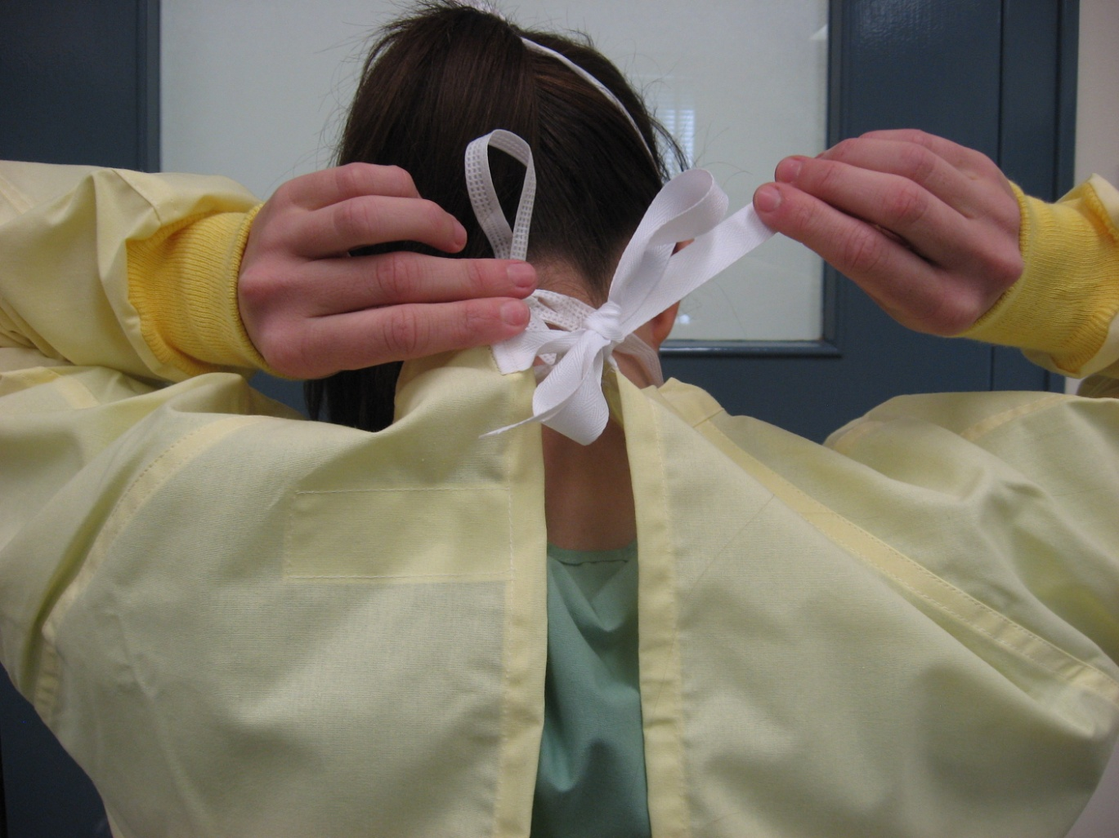
1. Untie neck ties

Slide 13
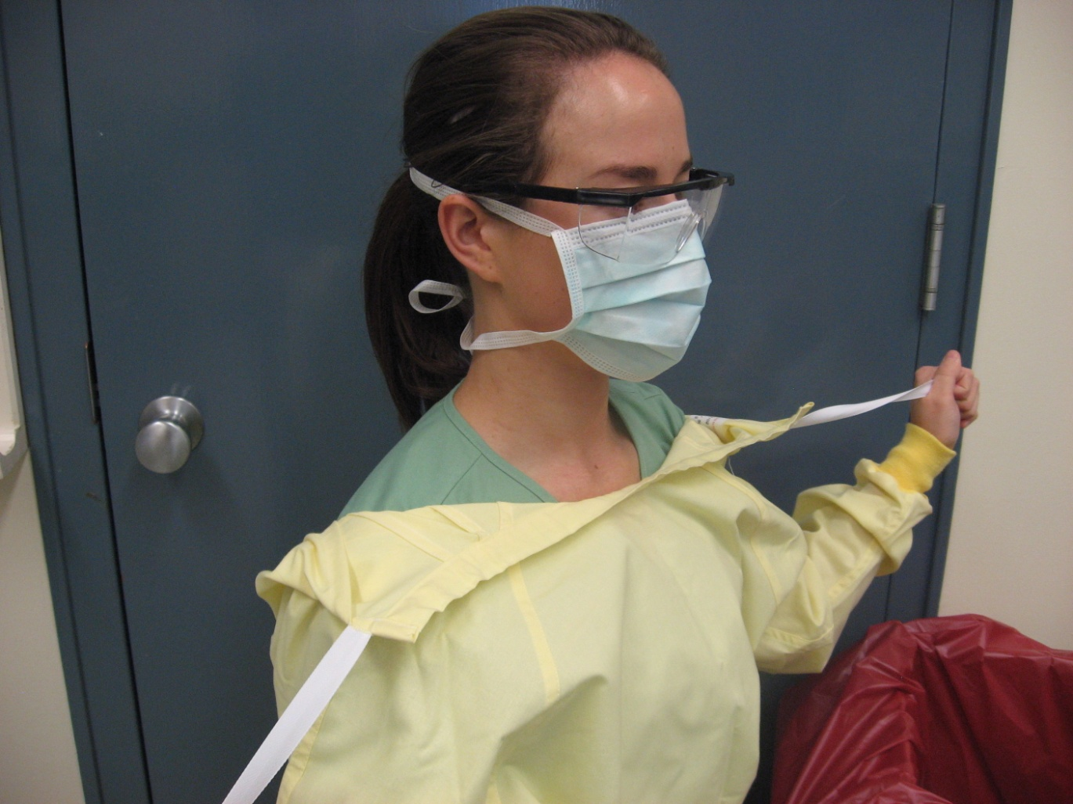
2. Pull forward over the shoulders

Slide 14
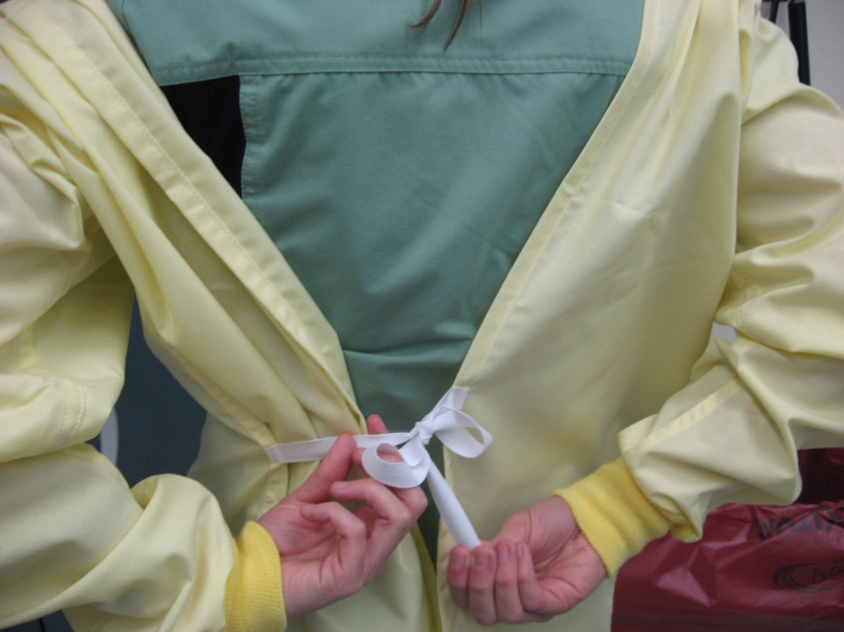
3. Untie waist ties

Slide 15
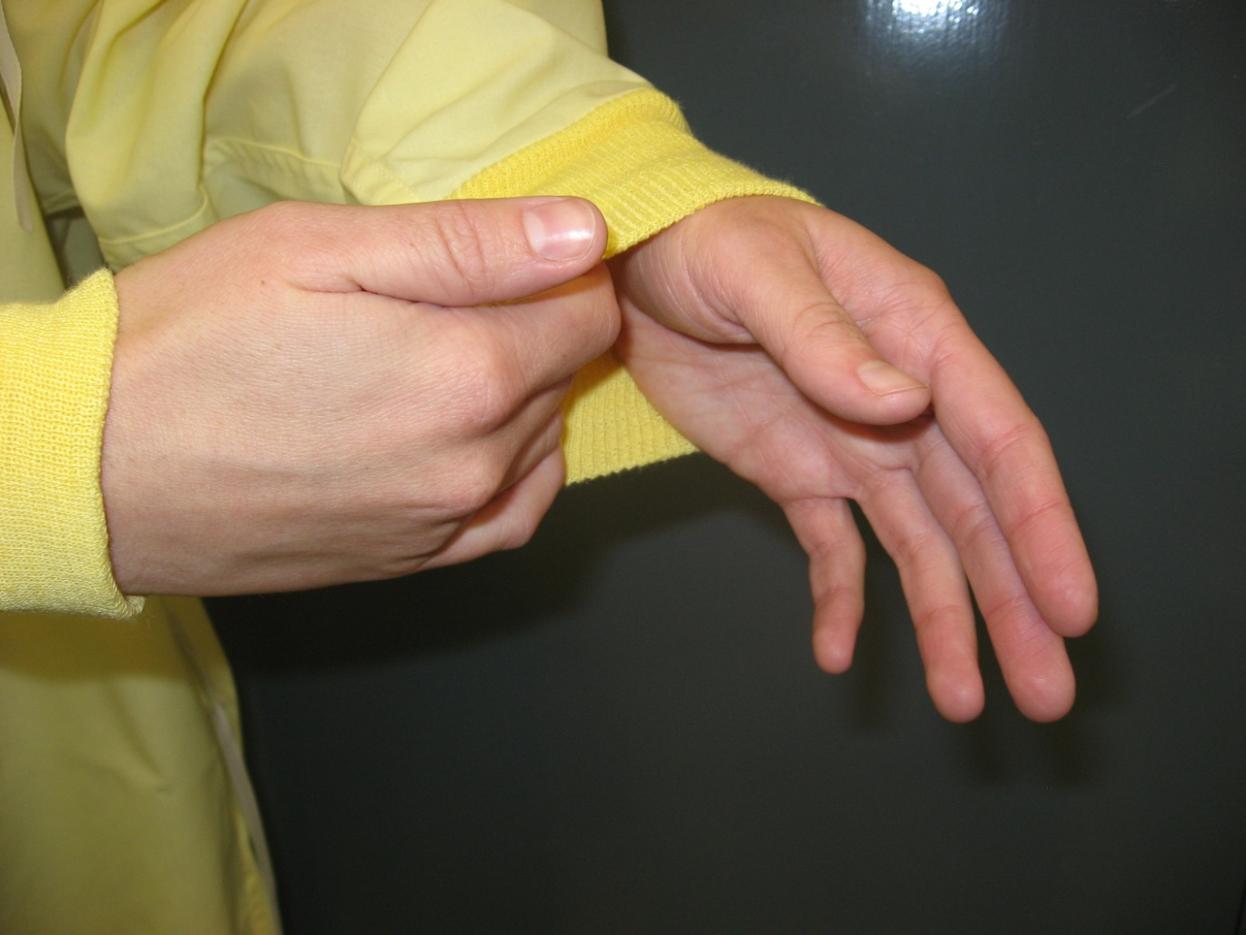
4. Slide fingers of one hand under the edge of the cuff

Slide 16
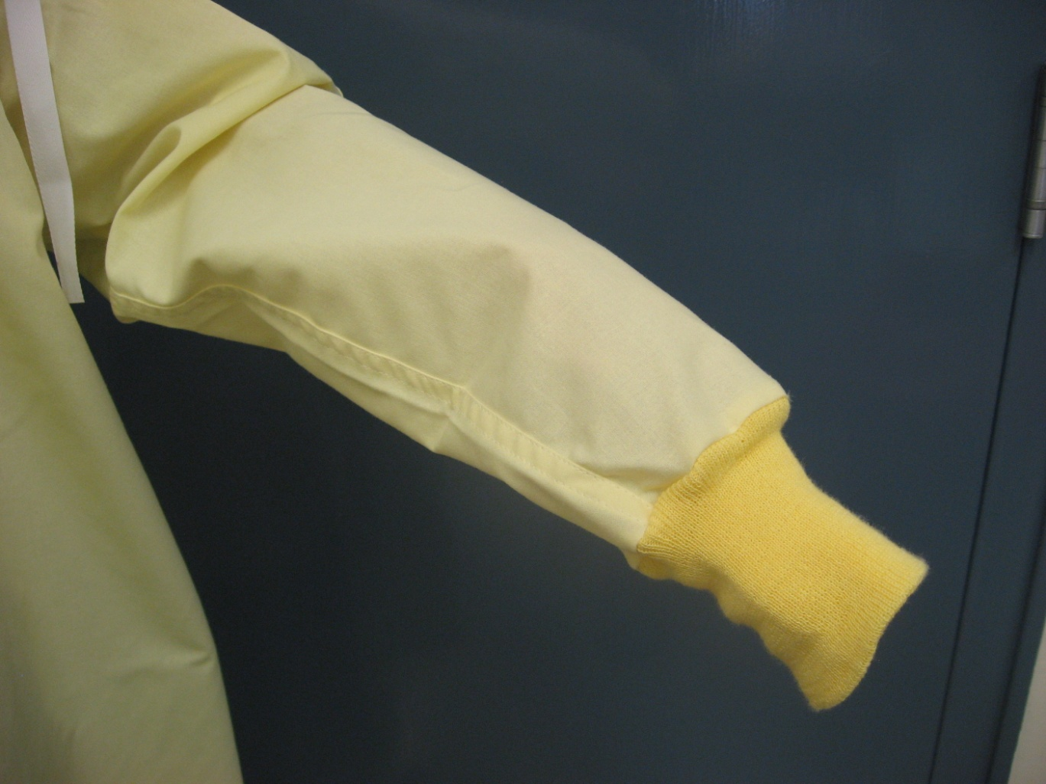
5. With thumb on top of cuff gently pull hand inside sleeve

Slide 17
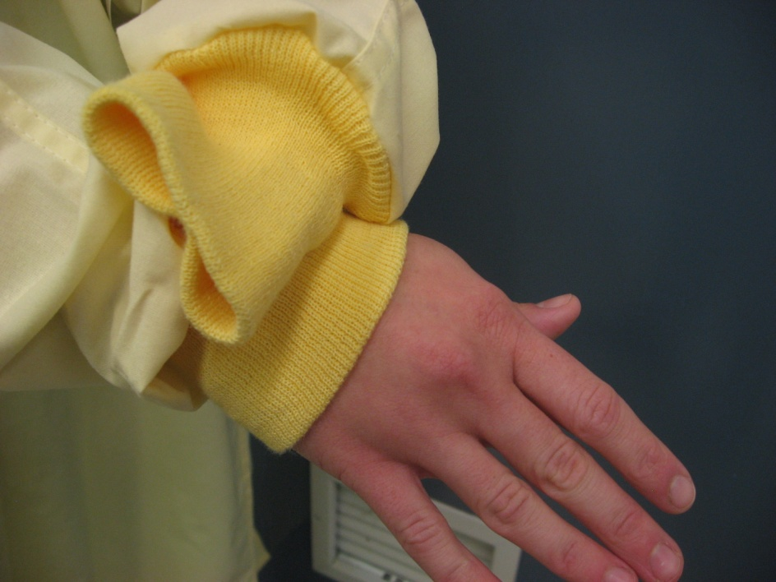
6. Pull sleeves over both hands
Using hand that is inside sleeve grasp your other sleeve to pull over hand

Slide 18
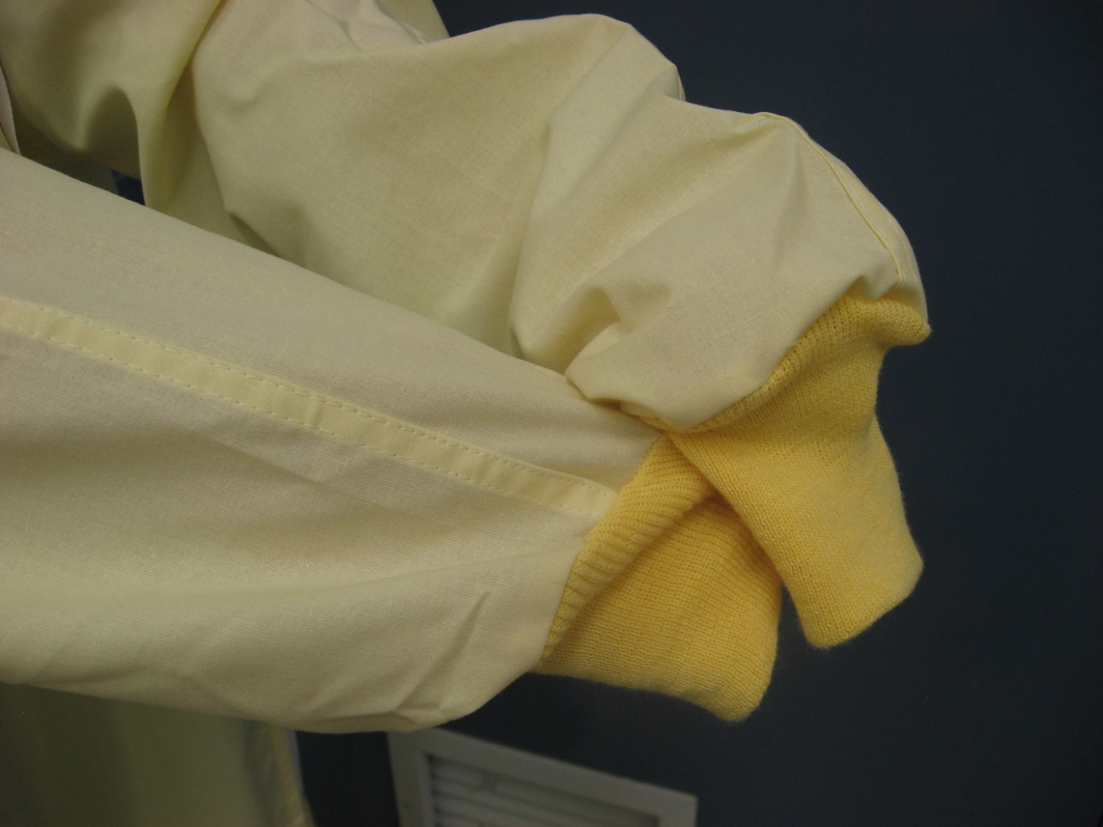

Slide 19
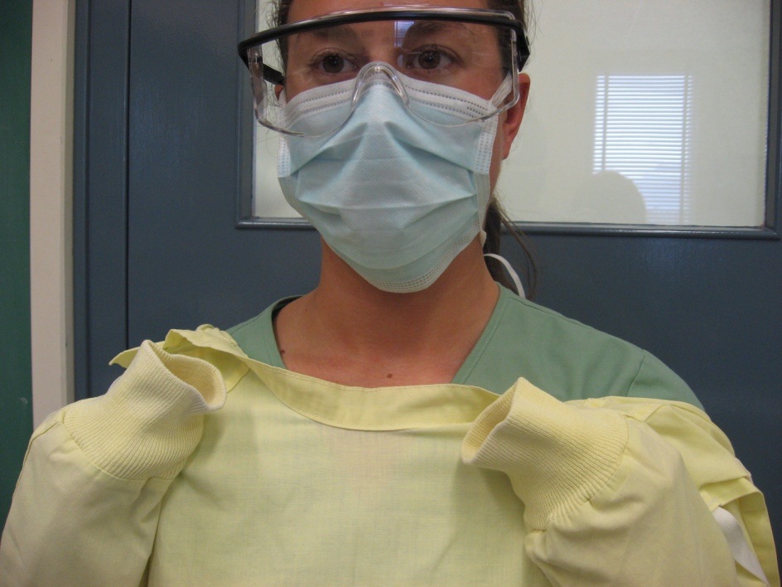
7. Grasp gown at shoulders.
Gown will turn inside out
Pull from each shoulder toward the same hand

Slide 20
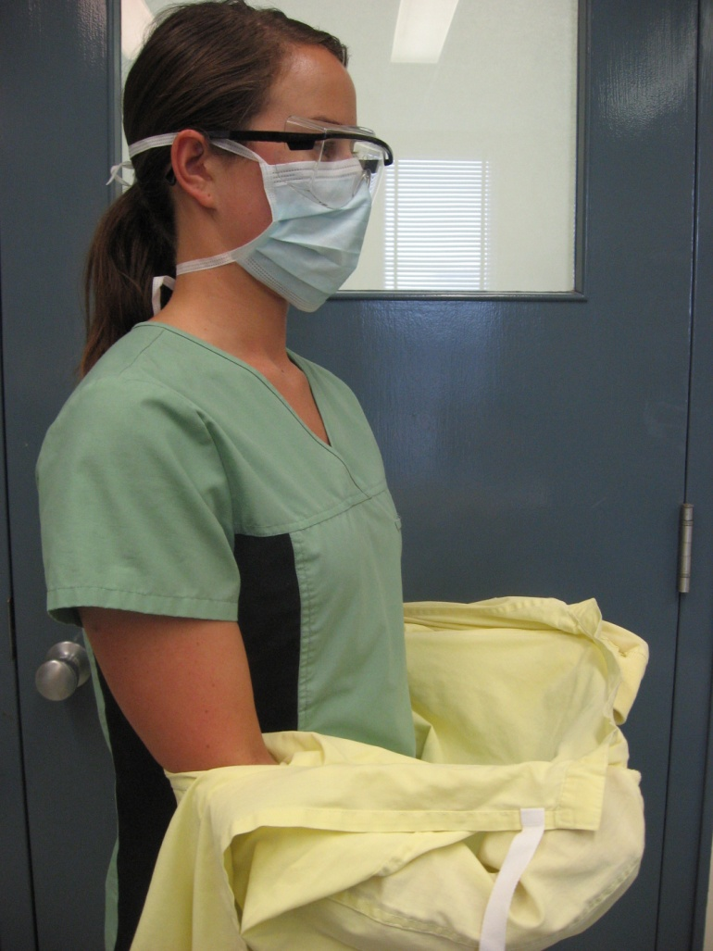
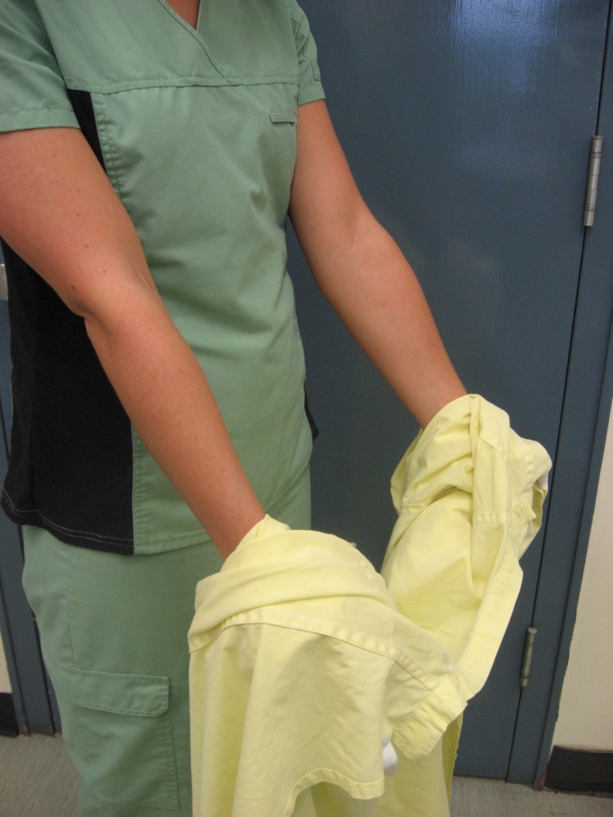
Gown will turn inside out

Slide 21
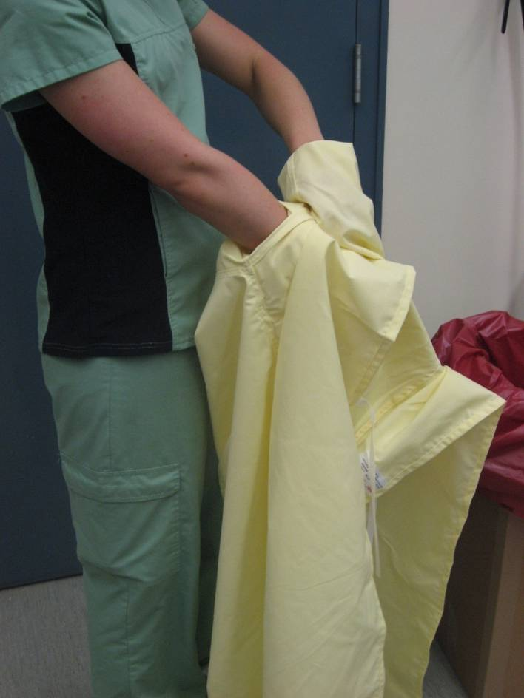
8. Remove hands from sleeves
Make sure that you touch only the inside of the gown

Slide 22
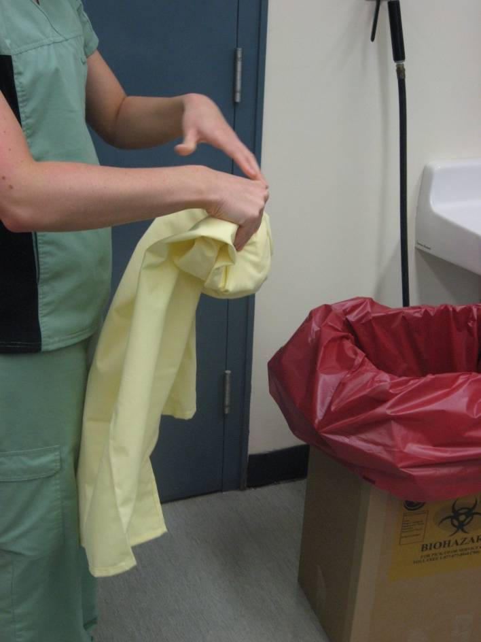
9. Roll gown in to bundle
Fold so that the inside becomes the outside
Roll gently to avoid creating aerosols

Slide 23
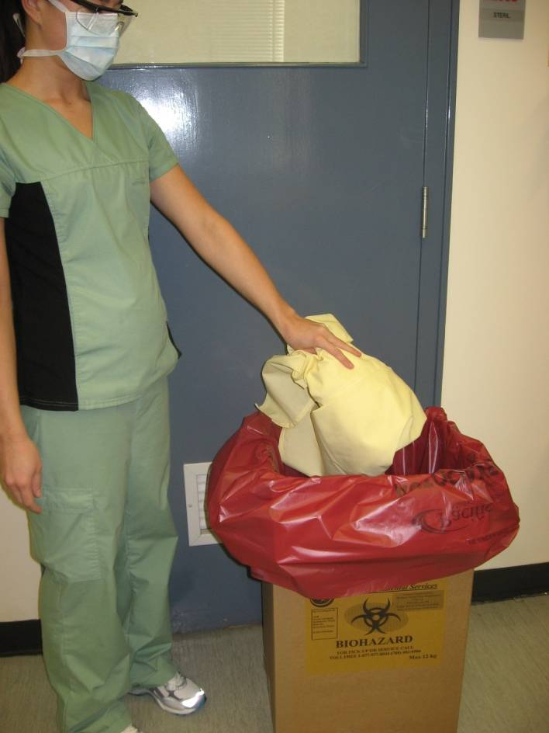
10. Discard gently in to hamper
Avoid creating aerosols

