Slide 1
MRAD 204:
Radiographic Technique 1
Outcome 1-5:
Image Critique – Wrist, Scaphoid, & Forearm

Slide 2
Affiliated Readings
Bontrager
Pgs: 153→156
Pgs: 162-163
Emphasis on the “pink box” Evaluation Criteria in readings.

Slide 3
Overview
Determining Diagnostic Quality - Review
Wrist – image critique
Scaphoid – image critique
Forearm – image critique
Review

Slide 4
Determining Diagnostic Quality - Review
For MRAD 204, an image is considered diagnostic unless:
Anatomy is clipped
Positioning appears more similar to a different projection
    Example: radiograph labelled as a PA projection, but the radiographic anatomy appears more similar to an oblique projection
Radiograph was labelled as underexposed
*reference your “Image Critique” Handout

Slide 5
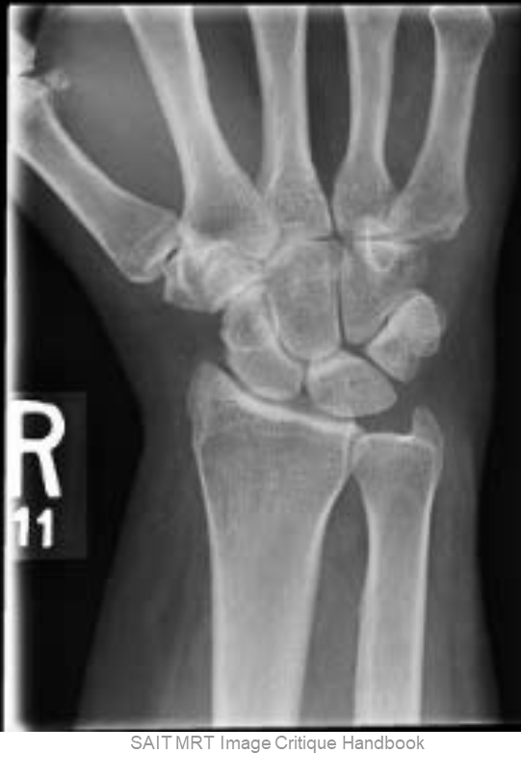
Image Critique – PA Wrist
@ 55 kVp
#1. Anatomy
Ideally, you should visualize:
  Proximal ½ of metacarpals
  All 8 carpals
  2 inches of distal forearm
  Soft-tissue

Slide 6
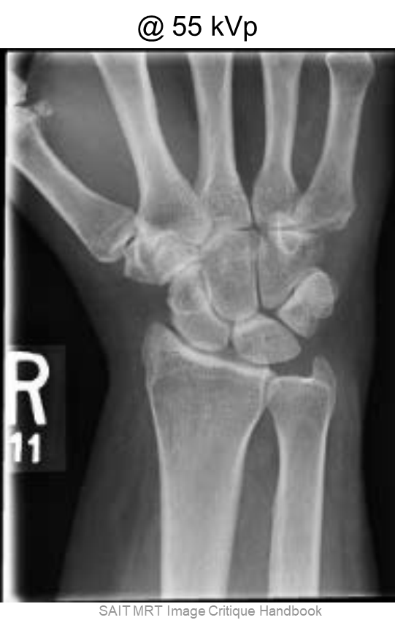
Image Critique – PA Wrist
#2. Position
A true PA projection is evidenced by:
Long axis of wrist aligned with long axis of the IR
Equal concavity on metacarpal shafts
Near-equal distances between the metacarpals
Minimal superimposition of the distal radioulnar joint

Slide 7
Image Critique – PA Wrist
#3. Exposure & Technique
kVp range of 55-65
  *Notes: Ideal for the patient = 55
Optimal density and contrast:
  no motion (i.e. blur)
  soft tissue margins visible
  clear bony trabecular markings

Slide 8

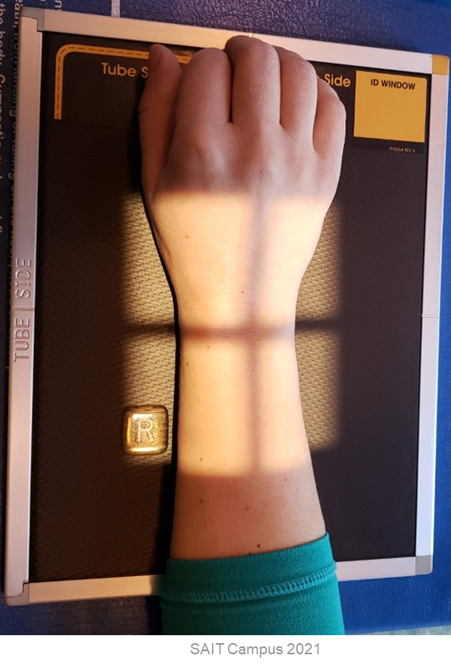
Image Critique – PA Wrist
#4. CR & Collimation
Four sided collimation centered to midcarpal area

Slide 9
Image Critique – PA Wrist
#5. Marker Placement &/or artifacts
No removable artifacts are visible
Marker placement is on the lateral side, not obscuring anatomy of interest

Slide 10
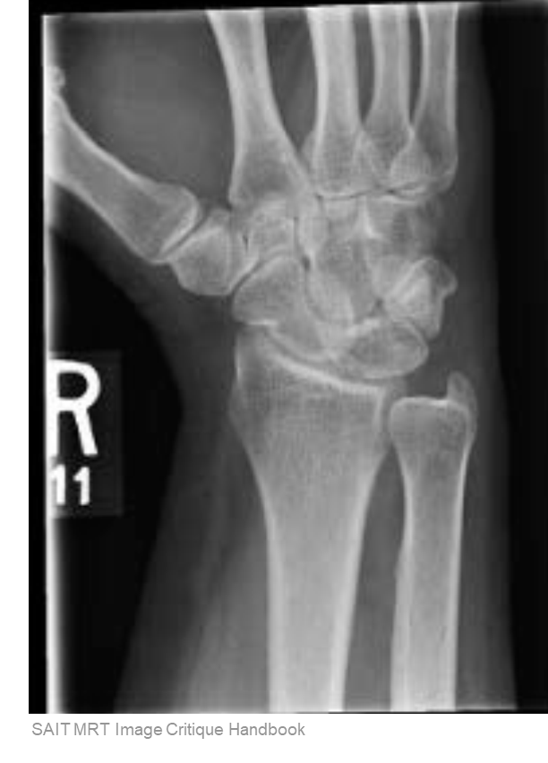
Image Critique – PA Oblique Wrist
@ 60 kVp
#1. Anatomy
Ideally, you should visualize:
  Proximal ½ of metacarpals
  All 8 carpals
  2 inches of distal forearm
  Soft-tissue

Slide 11
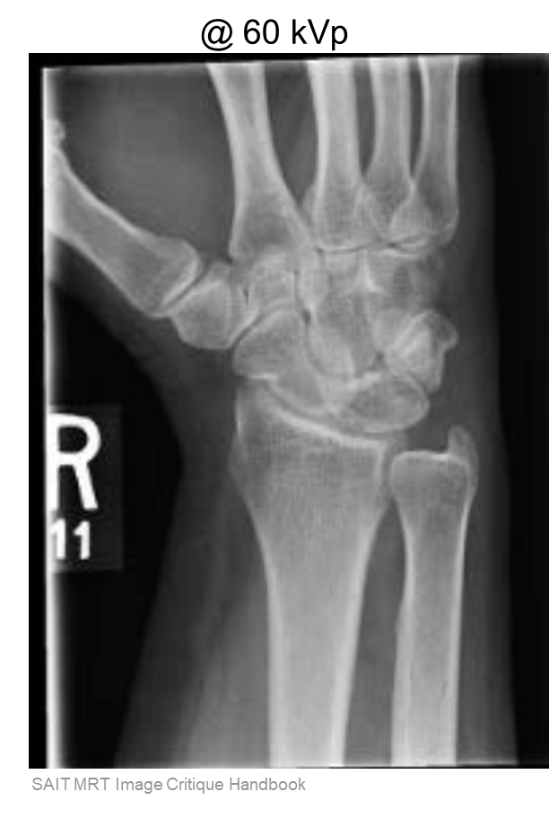
Image Critique – PA Oblique Wrist
#2. Position
A true 45⁰ Oblique of the wrist is evidenced by:
Long axis of wrist aligned with long axis of the IR
Ulnar head partially superimposed by distal radius
3rd→5th metacarpal bases mostly superimposed

Slide 12

Image Critique – PA Oblique Wrist
#3. Exposure & Technique
kVp range of 60-70
  *Notes: Ideal for the patient = 60
Optimal density and contrast:
  no motion (i.e. blur)
  soft tissue margins visible
  clear bony trabecular markings

Slide 13

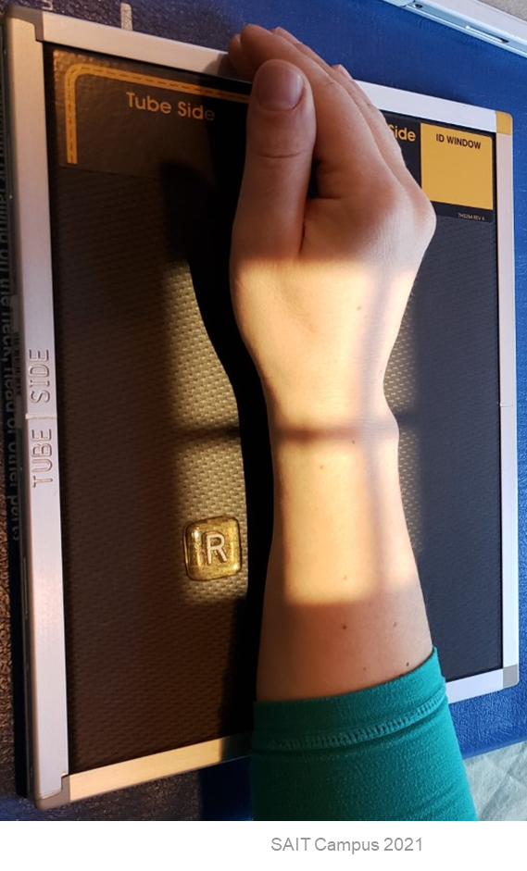
Image Critique – PA Oblique Wrist
#4. CR & Collimation
Four sided collimation centered to midcarpal area

Slide 14
Image Critique – PA Oblique Wrist
#5. Marker Placement &/or artifacts
No removable artifacts are visible
Marker placement is on the lateral side, not obscuring anatomy of interest

Slide 15
Image Critique – Lateral Wrist
@ 60 kVp
#1. Anatomy
Ideally, you should visualize:
  Proximal ½ of metacarpals
  All 8 carpals
  2 inches of distal forearm
  Soft-tissue
SAIT MRT Image Critique Handbook

Slide 16
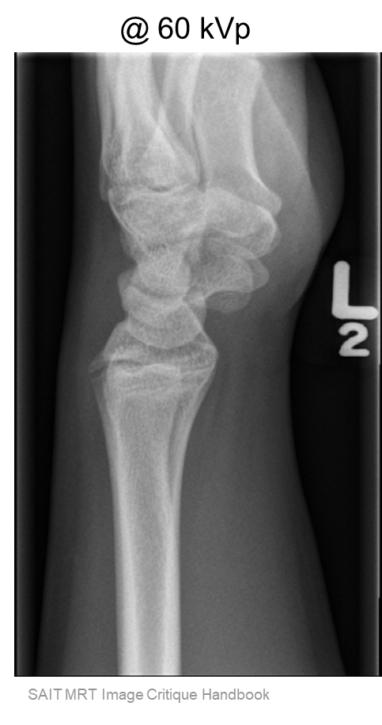
Image Critique – Lateral Wrist
#2. Position
A true Lateral position is evidenced by:
Long axis of wrist aligned with long axis of the IR
Ulnar head completely superimposed by distal radius
Lunate has a cup or “half-moon” shape
Proximal ½ of the 2nd→5th metacarpals superimposed

Slide 17
Image Critique – Lateral Wrist
#3. Exposure & Technique
kVp range of 60-70
  *Notes: Ideal for the patient = 60
Optimal density and contrast:
  no motion (i.e. blur)
  soft tissue margins visible
  clear bony trabecular markings

Slide 18

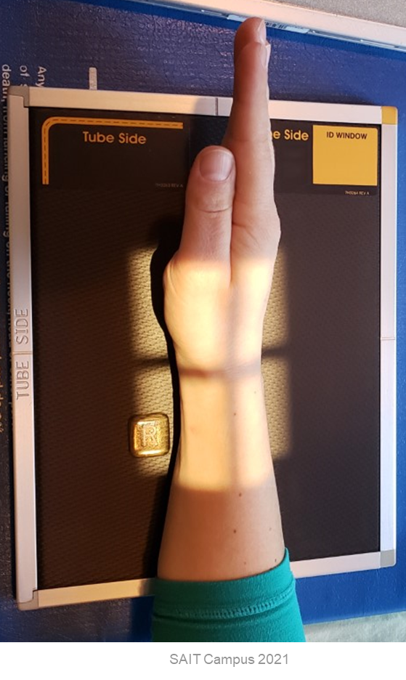
Image Critique – Lateral Wrist
#4. CR & Collimation
Four sided collimation centered to midcarpal area
SAIT MRT Image Critique Handbook

Slide 19
Image Critique – Lateral Wrist
#5. Marker Placement &/or artifacts
No removable artifacts are visible
Marker placement is on the anterior side, not obscuring anatomy of interest

Slide 20
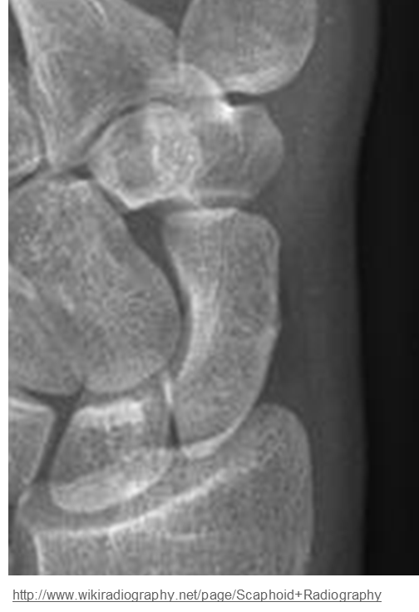
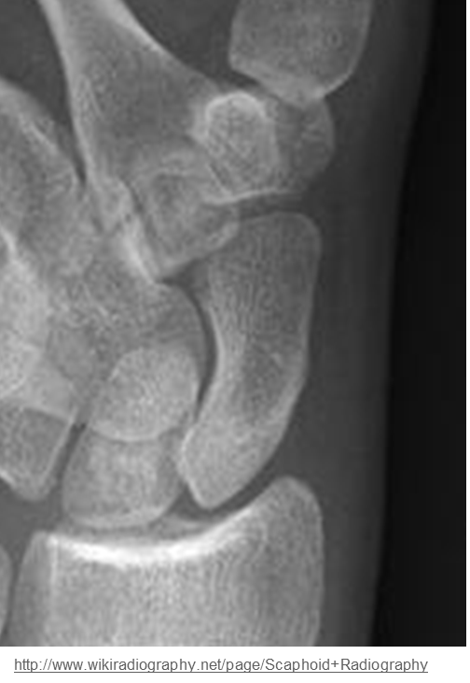
Image Critique – Scaphoid
Ideally, both projections should include:
  Base of 1st→3rd metacarpals
  Small amount of distal radius
  Scaphoid without foreshortening
  All joint spaces surrounding the scaphoid
#1. Anatomy
Both @ 55 kVp
L
L
15⁰

Slide 21
Image Critique – Scaphoid PA
#2. Position
A true PA position, with ulnar deviation is evidenced by:
@ 55 kVp
Wrist parallel to IR
1st metacarpal aligned with radius
Radio-scaphoid joint superimposition
If included: minimal superimposition of the distal radioulnar joint

Slide 22
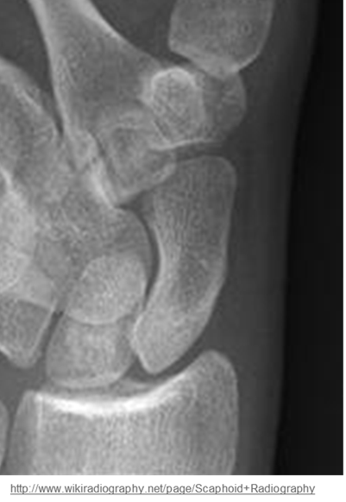
Image Critique – Scaphoid 15⁰ PA Axial
#2. Position
A true 15⁰ Axial projection, with ulnar deviation is evidenced by:
@ 55 kVp
Wrist parallel to IR
1st metacarpal aligned with radius
Elongated scaphoid
Radio-scaphoid joint free of superimposition
If included: minimal superimposition of the distal radioulnar joint

Slide 23
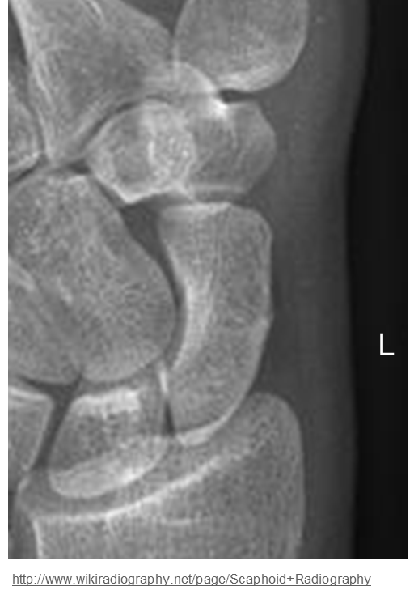

Image Critique – Scaphoid
#3. Exposure & Technique
@ 55 kVp
@ 55 kVp
kVp range of 55-65
Optimal density and contrast:
  no motion (i.e. blur)
  soft tissue margins visible
  clear bony trabecular markings
L
15⁰

Slide 24
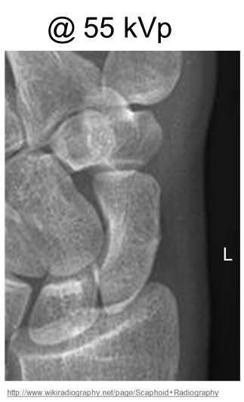
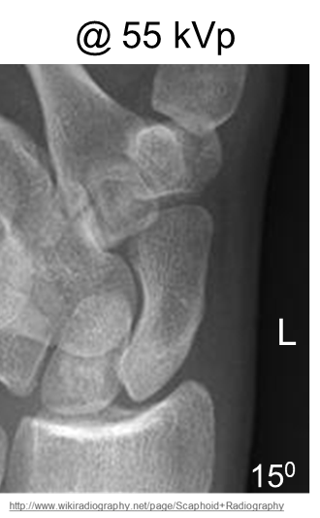
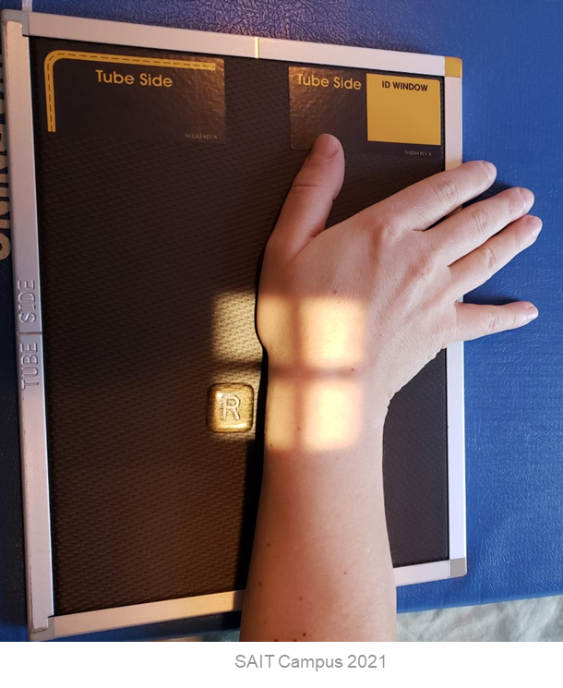
Image Critique – Scaphoid
#4. CR & Collimation
Four sided collimation centered to scaphoid

Slide 25
Image Critique – Lateral Wrist
#5. Marker Placement &/or artifacts
No removable artifacts are visible
Marker placement is on the lateral side, not obscuring anatomy of interest

Slide 26
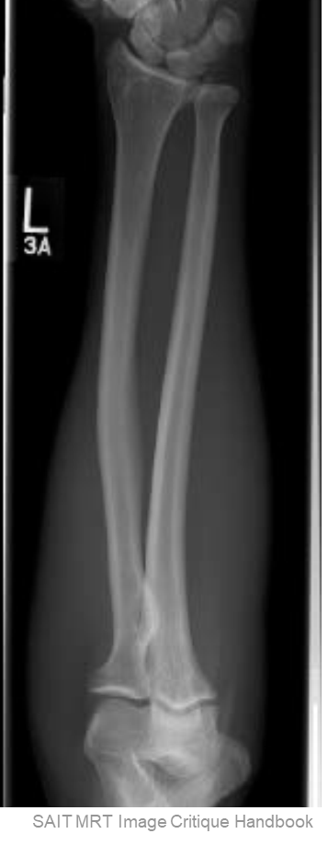
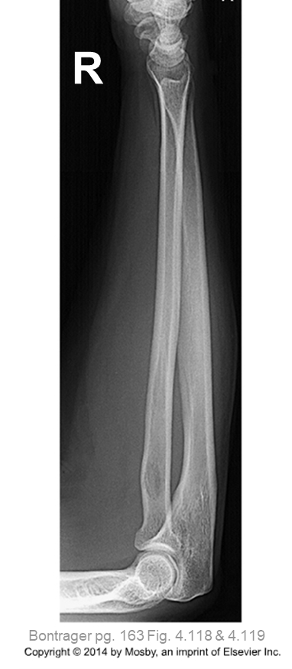
Image Critique – Forearm
#1. Anatomy
Ideally, both projections should include:
Proximal row of carpals
½ inch proximal to humeral epicondyles
Entire radius & ulna
Elbow joint
Soft-tissue
L
L
Both @ 65 kVp
15⁰

Slide 27
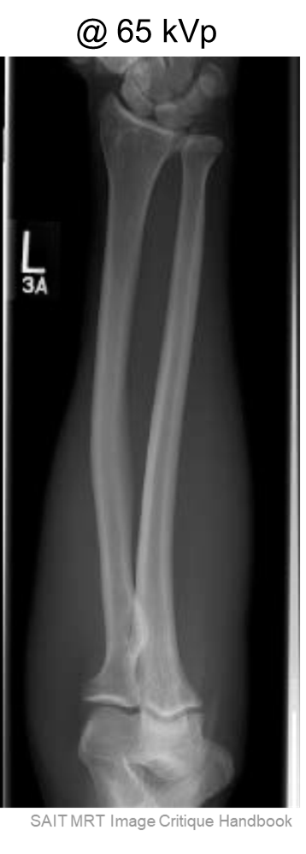
Image Critique – AP Forearm
#2. Position
A true AP position, is evidenced by:
Forearm parallel to length of IR
Slight superimposition of radial head, neck, & tuberosity, over the proximal ulna
No distortion of humeral epicondyles
Partially open wrist & elbow joint spaces

Slide 28
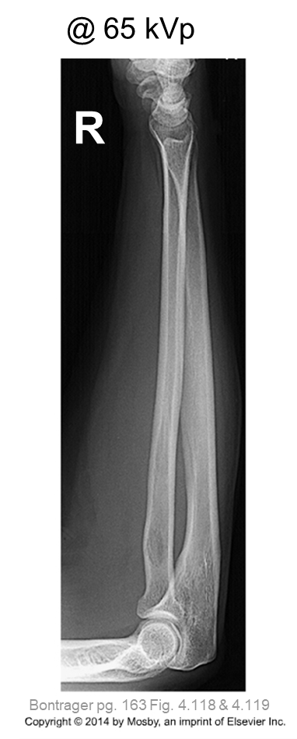
Image Critique – Lateral Forearm
#2. Position
A true lateral position, is evidenced by:
Forearm parallel to length of IR
Superimposition of the distal radius & ulna
Superimposition of the radial head and coronoid process
Superimposed humeral epicondyles
Radial tuberosity facing anteriorly
90⁰ Elbow flexion

Slide 29


Image Critique – Forearm
@ 65 kVp
@ 65 kVp
#3. Exposure & Technique
kVp range of 65-75
Optimal density and contrast:
  no motion (i.e. blur)
  soft tissue margins visible
  clear bony trabecular markings

Slide 30
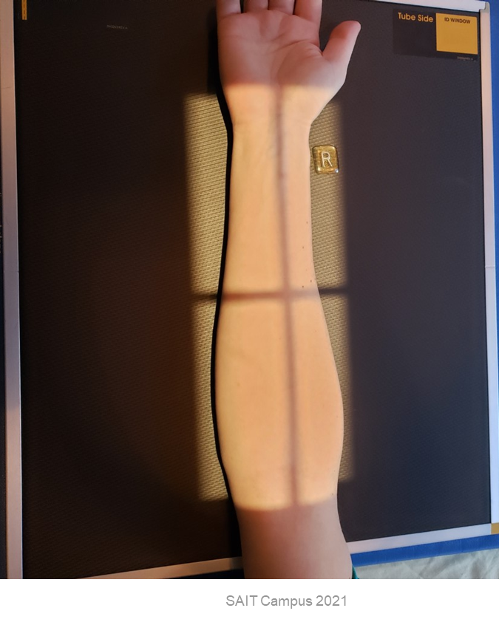
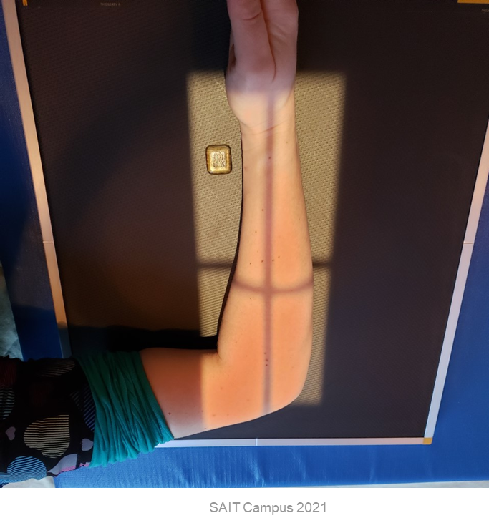
Image Critique – Forearm
#4. CR & Collimation
Four sided collimation centered to mid-forearm

Slide 31
Image Critique – Forearm
#5. Marker Placement &/or artifacts
No removable artifacts are visible
Marker placement is not obscuring anatomy of interest
  Lateral side for AP projection
  Anterior for Lateral projection

Slide 32
Review
AP/PA projections: should demonstrate the most symmetry
  Bones should appear the same size/shape
  Soft-tissue margins should be even
Oblique projections: usually demonstrate some superimposition or remove superimposition
  Small portions of bones may superimpose one another or the patient rotation will eliminate the superimposition
Lateral projections: usually demonstrate the most superimposition
  Bony edges should be superimposed, making displacements easier to identify

Slide 33
Review
When evaluating Anatomy:
Radiographically, if it isn’t clearly visualized in it’s entirety, it is considered clipped
When evaluating Exposure & Technique:
Use your chart to determine if it was acceptable, underexposed, or overexposed
  Remember underexposures render an image undiagnostic
Motion causes image blur, which obscures bony details
When evaluating Marker placement & Artifacts:
Memorize Anderson's marker rules
  Note orientation as well as location
Identify if the artifact can or cannot be removed
  Note if it is over anatomy of interest

Slide 34
Review
When evaluating CR and Collimation:
Determine if the collimation/field size used, is appropriate
  if centered properly would all the required anatomy be included, or would you still clip/include too much?
  Remember collimation may be acceptable when CR centering isn’t
When evaluating Positioning:
Recall the ideal radiographic appearance, to use as a comparison (i.e. if you know what the size/shape of “normal” anatomy should be, it is easier to identify when a positioning error has occurred, and how to correct it)
  Example: A PA Oblique hand appears to have superimposition of the 3rd→5th metacarpal bodies, which demonstrates more superimposition than expected. This suggests the patient was over-rotated in the lateral/external direction.

