Slide 1


Medical Esthetics
The Lymphatic System

Slide 2
Let’s Explore

Slide 3
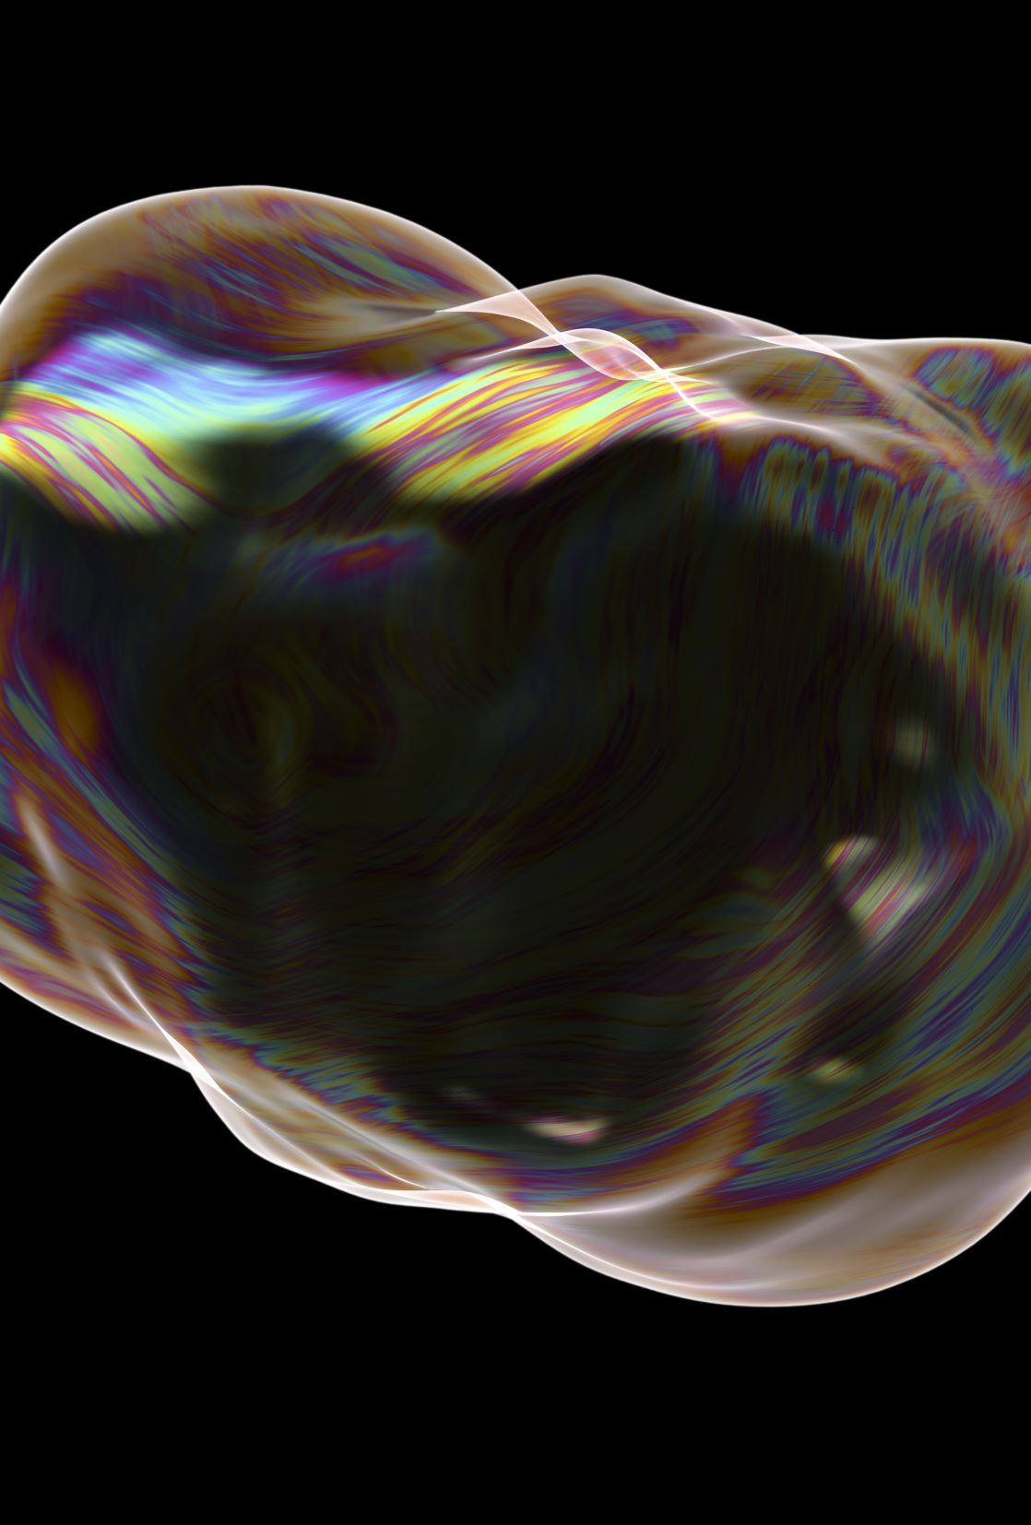
Main Functions
Act as a defense against disease
Drain tissue spaces of excess interstitial fluid
Carry the excess fluid, waste, and impurities away from the cells
Aid in reducing swelling, inflammation, and accumulations in the blood vessels.

Slide 4
How Is This Important?
Many treatments performed on the skin create a mild wounding of the skin. Inflammation occurs due to the wounding. The immune system is alerted to relieve the inflammation and repair the wounding.
Understanding the lymphatic and immune systems is very important when treating the skin. A client with an autoimmune disease may require special considerations

Slide 5
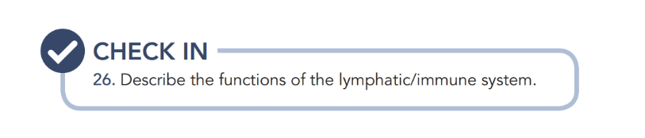

Slide 6

QUESTIONS?

