Slide 1
MRAD 204:
Radiographic Technique 1
Outcome 1-5:
Anatomy of the Radius and Ulna
MRT
Program Anderson College

Slide 2
Affiliated Readings
Module 2
Bontrager
Pgs: 130

Slide 3
Overview
Forearm
Radius
Ulna

Slide 4
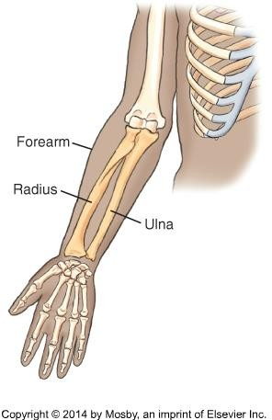
Forearm
Humerus
The radius and ulna form the bones of the forearm
In anatomical position, the radius is on the lateral or thumb side, and the ulna is on the medial or 5th digit side
At their proximal end, these two bones articulate with the humerus to form the elbow joint
Bontrager pg. 130 Fig. 4.13

Slide 5
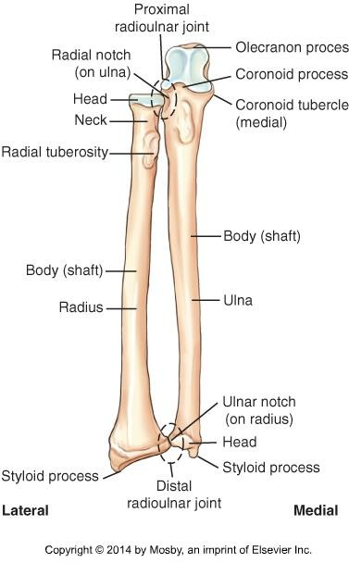
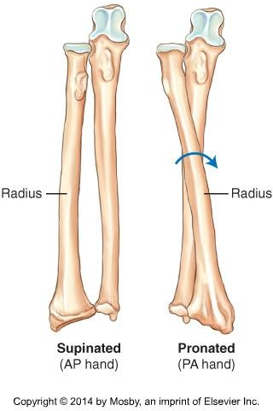
Forearm
The “ends” of the radius and ulna articulate with each other to form the radioulnar joints
Radioulnar joints allow for forearm rotation
Bontrager pg. 130 & 134 Fig. 4.14 & 4.25

Slide 6
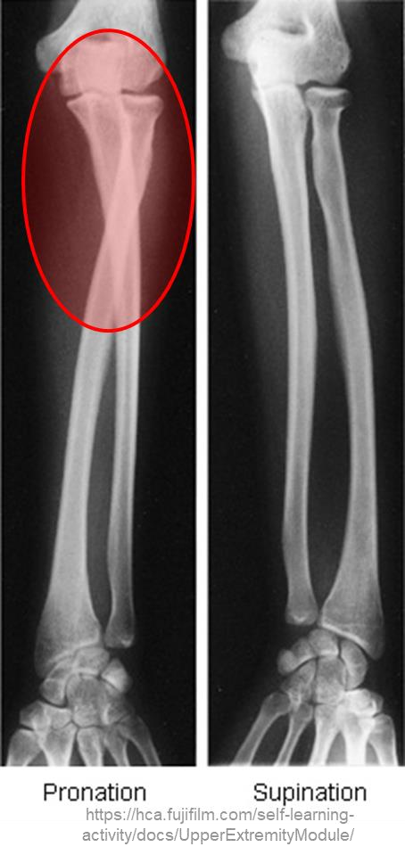
Forearm
From anatomic position, if the hand is pronated: the proximal radius will “cross- over” the proximal ulna
Bontrager pg. 134 Fig. 4.25

Slide 7
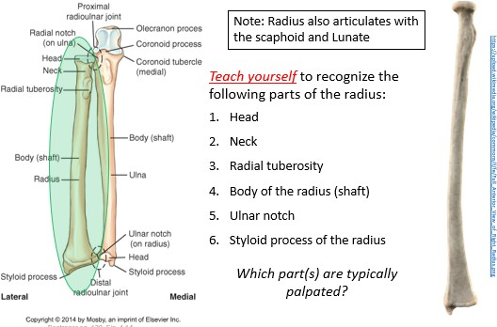
Radius

Slide 8
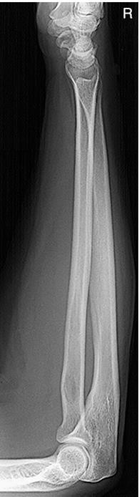
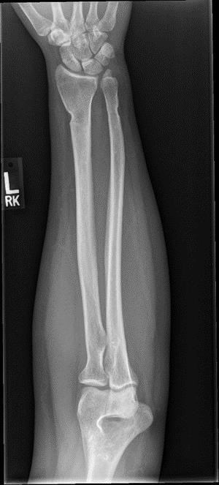
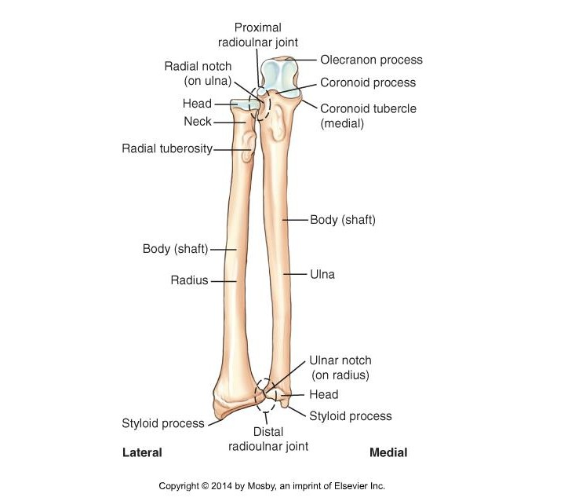
Radius – Radiographic appearance
SAIT imaging library
Bontrager pg. 130
Bontrager pg. 163 Fig. 4.119

Slide 9
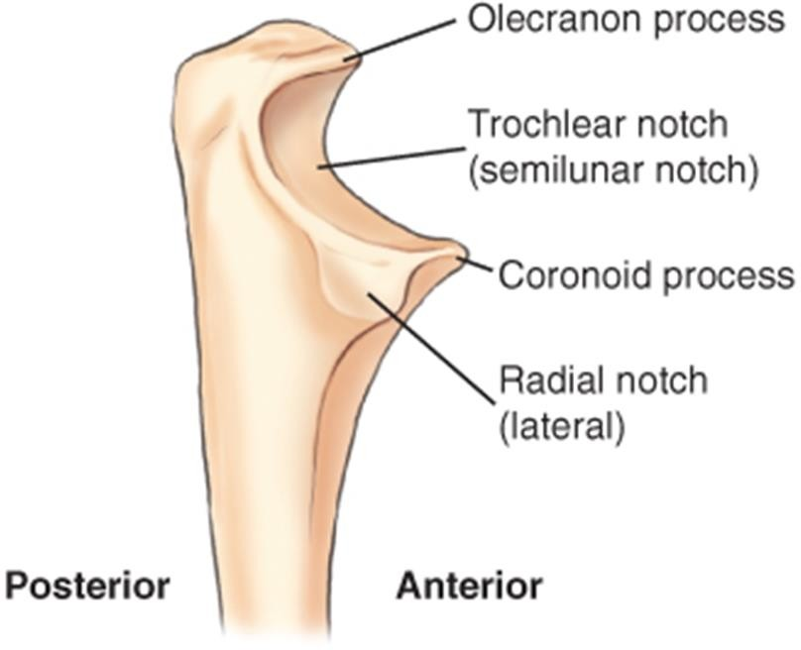
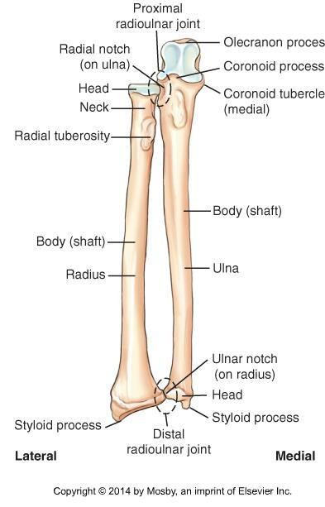
Ulna
Teach yourself to recognize the following parts of the Ulna:
Styloid process of the ulna
Head of the ulna
Body of ulna
Radial notch
Coronoid tubercle
Coronoid process
Trochlear notch
Olecranon process
Which parts are typically palpated?
Bontrager pg. 130 Fig. 4.14 & 4.15

Slide 10
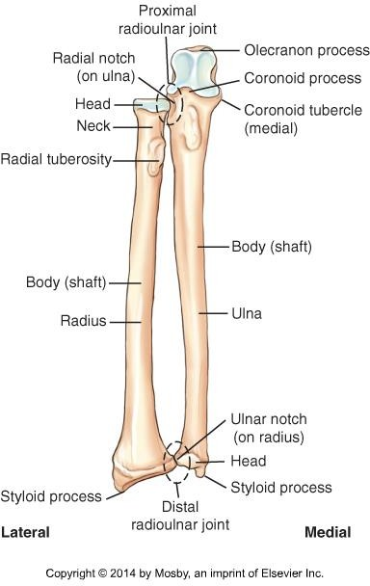
Ulna – Radiographic appearance
SAIT imaging library
Bontrager pg. 130
Bontrager pg. 163 Fig. 4.119

Slide 11
Helpful Resources
Sketchfab: https://sketchfab.com/search?q=human+forearm&sort_by=- relevance&type=models
Radiopaedia: https://radiopaedia.org/
Wikicommons: https://commons.wikimedia.org
  Access to images and animations seen in instructor PowerPoints

