Slide 1
MRAD 204:
Radiographic Technique 1
Outcome 6-10:
Anatomy of the Pelvis

Slide 2
Affiliated Readings
Module Reading
Bontrager
Pgs: 267→270

Slide 3
Overview
Pelvis
Hip bones
Landmarks
True & False Pelvis
Labelling

Slide 4
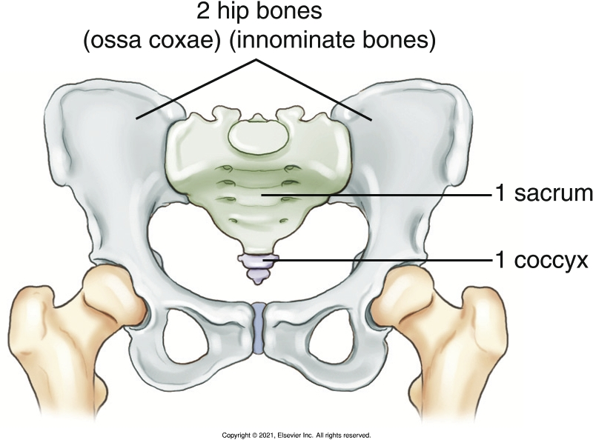
Pelvis
Forms the base of the body’s trunk
Provides a connection between the spine and the lower limbs
Is made up of four bones: 2 hip bones, 1 sacrum, and 1 coccyx
Bontrager pg. 267 Fig. 7.4

Slide 5
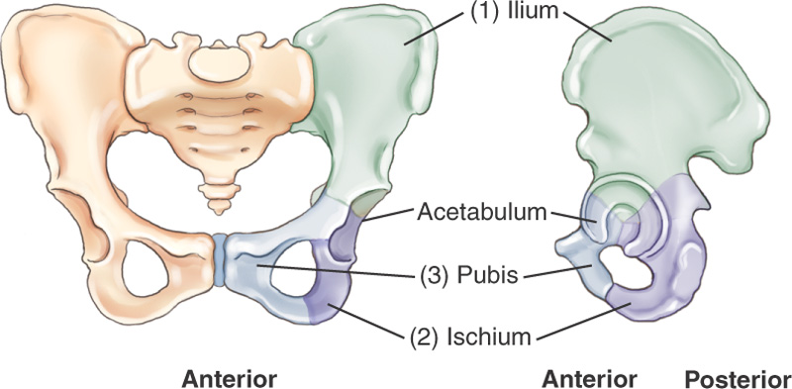
Hip Bones
Each hip bone is a fusion of three bones: ilium, pubis, and ischium
By the mid-teens the three bones have fused together at the acetabulum
Bontrager pg. 267 Fig. 7.5

Slide 6
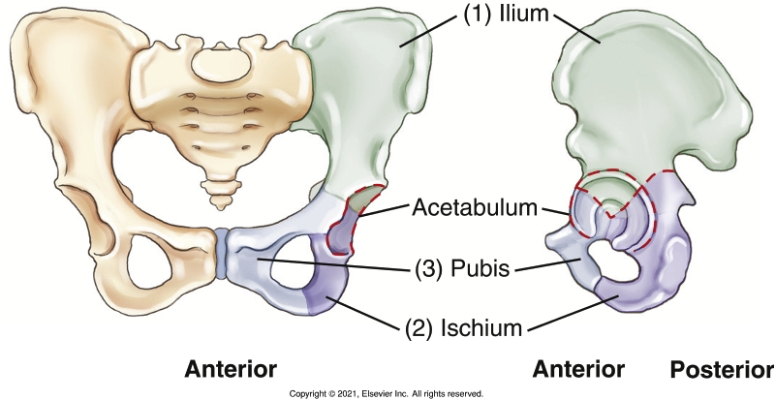
Hip Bones - Ilium
Superior to the acetabulum
Inferior portion known as the body
  Includes superior 2/5th of the acetabulum
Superior flat portion is known as the wing or ala
Bontrager pg. 267 Fig. 7.5

Slide 7
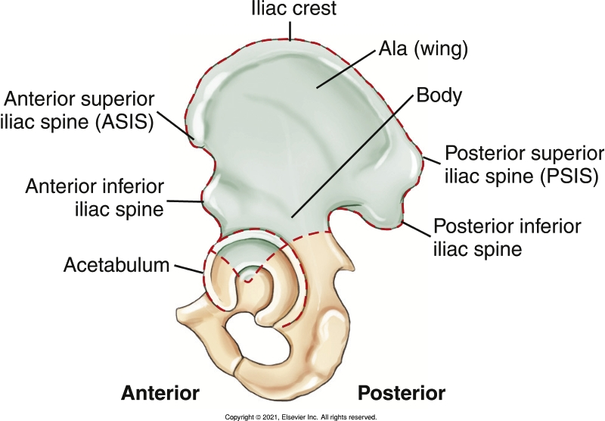
Hip Bones - Ilium
Teach yourself to recognize the labelled parts of the ilium:
Bontrager pg. 267 Fig. 7.6

Slide 8
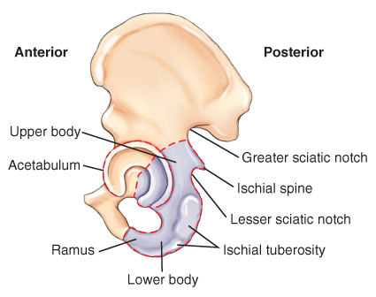
Hip Bones - Ischium
Inferior to the acetabulum
Lower, more anterior portion, is known as the ramus
Superior portion known as the body
  Includes 2/5th of posteroinferior acetabulum
  Ends inferiorly at the ischial tuberosity
Bontrager pg. 268 Fig. 7.7

Slide 9
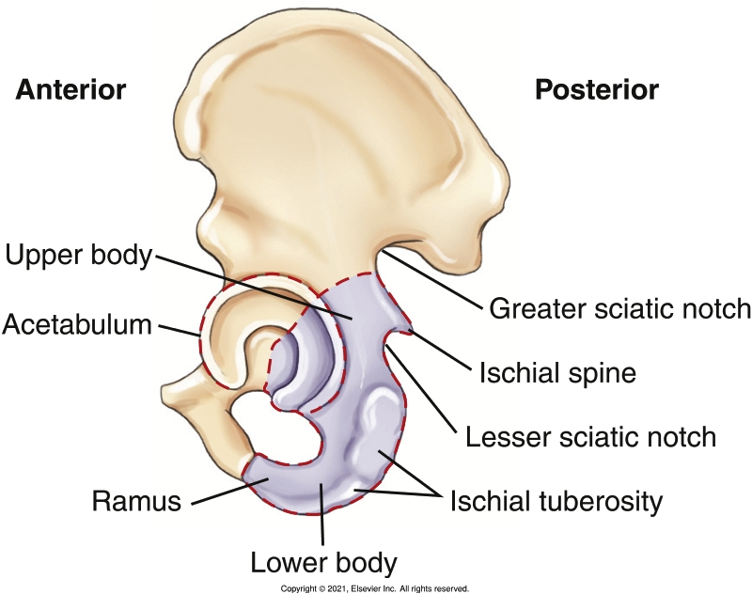
Hip Bones - Ischium
Teach yourself to recognize the labelled parts of the ischium:
Bontrager pg. 268 Fig. 7.7

Slide 10
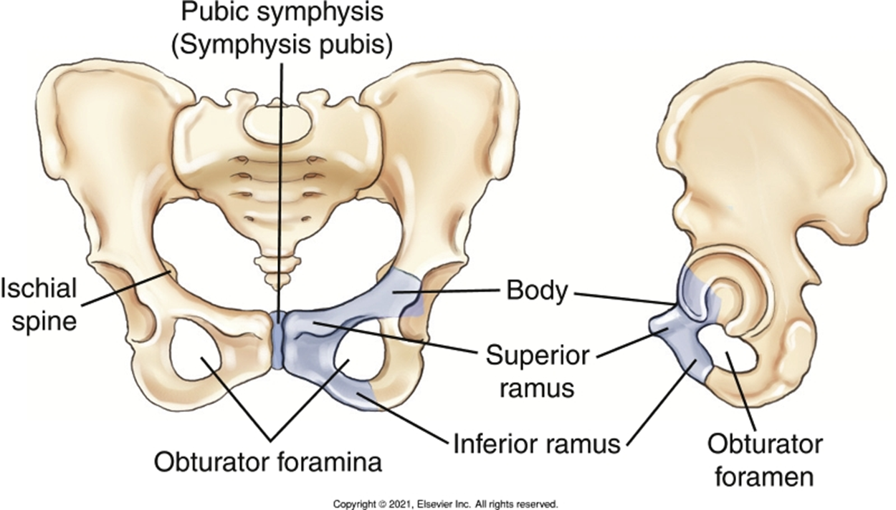
Hip Bones – Pubis
Inferior to the acetabulum
Superior portion known as the body
  Includes 1/5th of anteroinferior acetabulum
  Ends inferiorly at the ramus of the ischium
Lower portion is known as the inferior ramus
Bontrager pg. 268 Fig. 7.8

Slide 11

Hip Bones - Pubis
Teach yourself to recognize the labelled parts of the pubis:
Bontrager pg. 268 Fig. 7.8

Slide 12
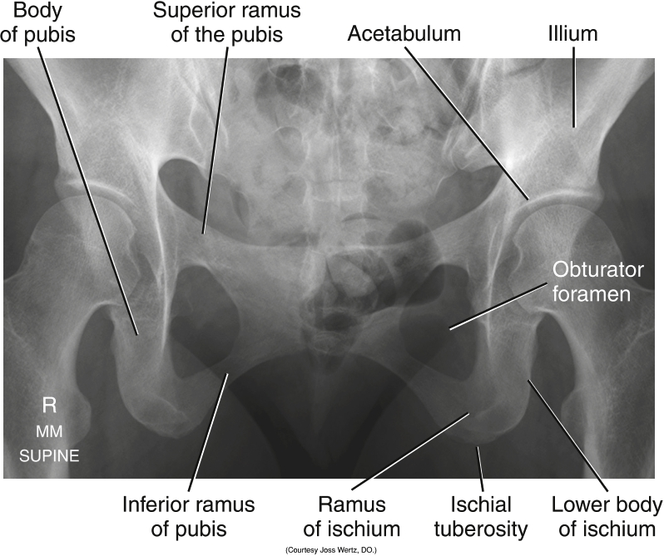
Hip Bones - Pubis
Bontrager pg. 283 Fig. 7.51

Slide 13
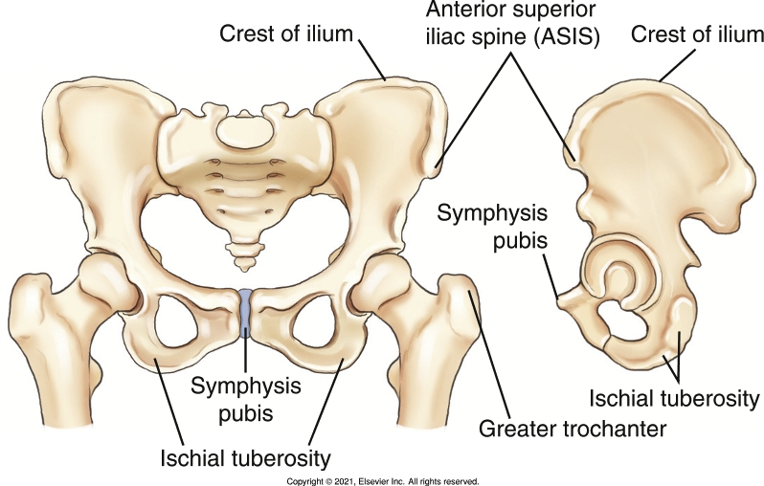
Landmarks
Which landmarks are appropriate to palpate?
Bontrager pg. 268 Fig. 7.9

Slide 14
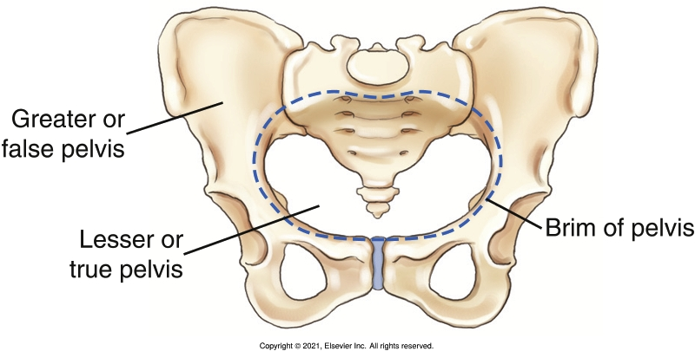
True & False Pelvis
Bontrager pg. 269 Fig. 7.10

Slide 15
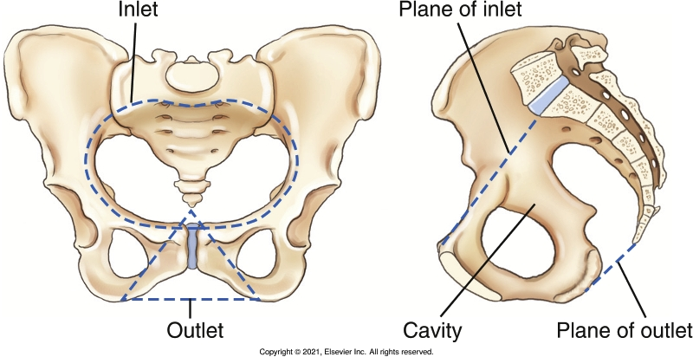
True & False Pelvis
Bontrager pg. 269 Fig. 7.11

Slide 16
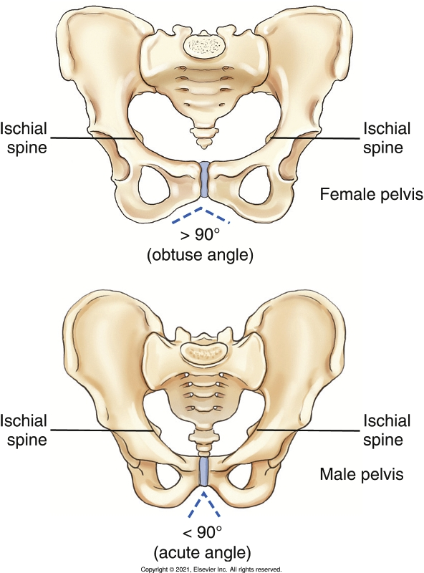
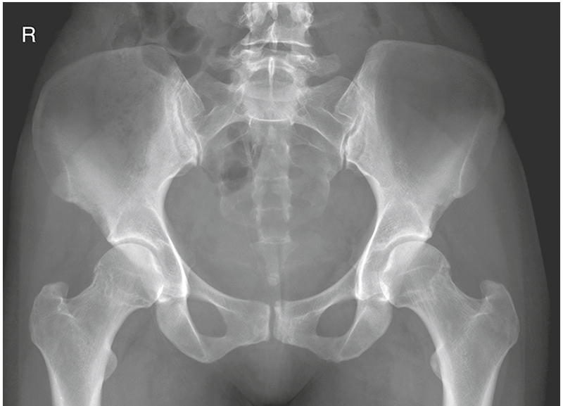
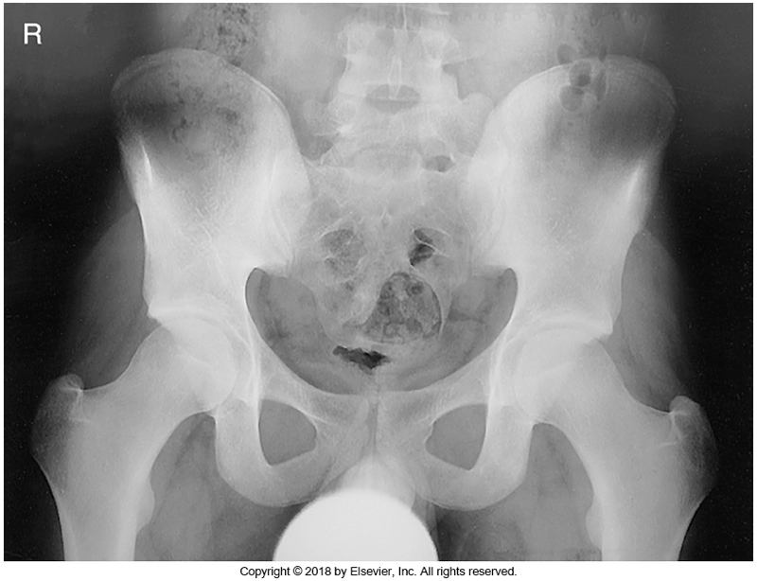
True & False Pelvis – Gender differences
Bontrager pg. 269 & 270 Fig. 7.13-7.15

Slide 17
Labelling
Teach yourself to recognize the following parts on a pelvis radiograph:
Iliac crests
Ischial spine
Acetabulum
Body of ischium
Body of pubis
Superior & Inferior rami of pubis
Symphysis pubis
Obturator foramen
SI joints
Pelvic brim
True & False pelvis
Greater & Lesser sciatic notch
ASIS, AIIS, PSIS, PIIS
Bontrager pg. 270 Fig. 7.14

Slide 18
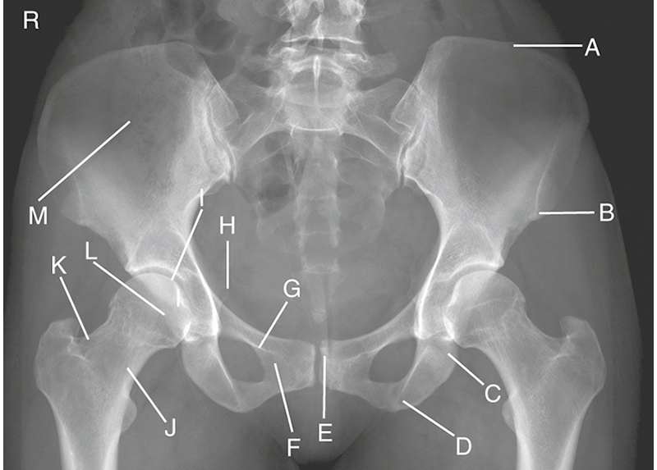
Labelling
Bontrager pg. 271 Fig. 7.16

