Slide 1


Medical Esthetics
Elements of an Esthetician’s Professional Appearance

Slide 2
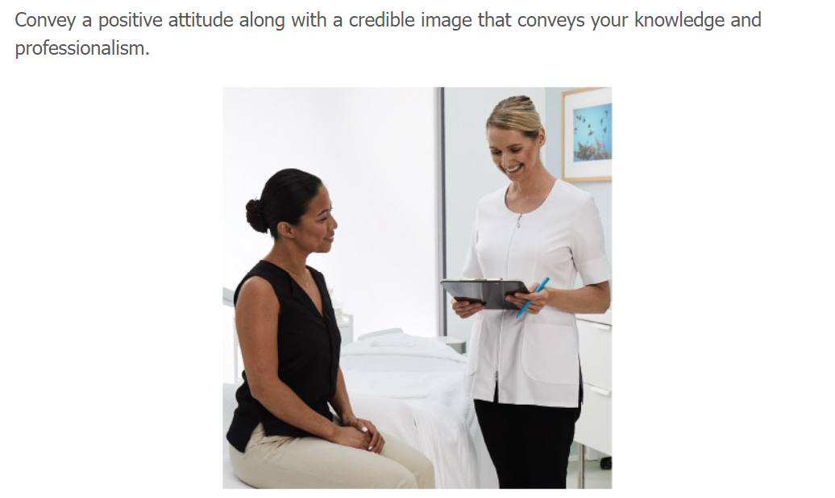

Slide 3
Why is Important ?
Making a good first impression is important in any business setting. Your success depends on many factors, including your image and attitude. An esthetician’s appearance and professionalism reflect on the business. Practicing good hygiene, dressing professionally, and having a neat appearance all convey a polished image. Additionally, employers, coworkers, and clients appreciate working with someone who has a positive attitude. This positive attribute will contribute favorably to the team

Slide 4
Why Do You Need to Wear Your Uniforms?
Developing a professional image starts at school
Developing good habits at school will shape your mind to your future success

Slide 5
Why Being on Time is Important
Being dependable and providing excellent customer service is imperative. Professionalism includes being prepared, that is, taking the initiative to plan enough time to set up the room before the day begins. Plan on arriving at least 30 minutes prior to the start of your shift to make sure your room is well stocked and that all your electrical equipment is in working order. You will project a calm, confident image if you and your treatment room or station are clean, organized, and fully prepared for you to provide treatments

Slide 6
Professional Image Checklist
Well-groomed hair. Hair should be clean and neatly styled and pulled back if worn long. A good cut and color are key to a professional appearance in esthetics. Be diligent about keeping hair in healthy condition. Healthy, beautiful hair is linked to healthy, beautiful skin. Keep hair up and away from clients at all times during treatment. Never let your hair brush against your client’s skin.
Minimal accessories. Jewelry should be kept to a minimum—no jangling bracelets, dangling earrings, long necklaces, or large rings.
Skin. A professional esthetician’s skin is a reflection of their own expertise and the proficiency of their skin care establishment. We must be a reflection of the skin care industry by using professional skin care and taking care of our skin.
Well-groomed nails. Short nails are a must so that the client is never scratched. Well-manicured, short nails with no polish or light polish are acceptable in most working environments.
Makeup. Wear makeup to reflect the image of the spa or salon you are working for. Light makeup is acceptable with well-groomed brows.
Proper uniform. Your lab coat, scrubs, uniform, or apron should be spotless, freshly laundered, crisp, and ironed. Comfortable, closed-toed shoes, in accordance with your state board guidelines, are also part of the uniform.
Positive energy and a healthy lifestyle. A genuine smile, good posture, eye contact, and an engaging handshake will convey that you have a positive attitude, vitality, and energy. Energy may be hard to come by with a busy schedule. One way to maintain it is with healthy eating and drinking plenty of water. Working on multiple clients relies on having plenty of energy throughout your shift. The last client should have the same experience as the first client of the day. Rest, relaxation, hobbies and healthy eating will assist the esthetician to have longevity in the spa industry.

Slide 7
Practical Exams
You will be deducted marks from your practical exams on the following:
Poorly groomed hair.
Wearing accessories. Jewelry should be kept to a minimum—no jangling bracelets, dangling earrings, long necklaces, or large rings.
Long nails. Long nails of any kind will not be accepted
No proper uniform. Your lab coat, scrubs, uniform, or apron should be spotless, freshly laundered, crisp, and ironed. Comfortable, closed-toed shoes, in accordance with your state board guidelines, are also part of the uniform.
Timing, you should be on time and show up on time
Organization, your treatments space should be spotless and ready ahead of time
THERE WILL BE NO EXEPTIONS !!

Slide 8
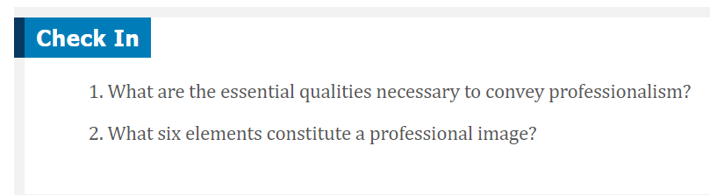

Slide 9

QUESTIONS?

