Slide 1


Fitzpatrick skin typing

Slide 2
Developed by Dr. Thomas Fitzpatrick,
The Fitzpatrick scale is used to measure the skin type’s ability to tolerate ultraviolet (UV) exposure
Differentiate the Six Fitzpatrick Skin Types and Accurately Identify Them
Many skin treatment protocols are based on the client’s Fitzpatrick skin type. Due to mixed genetics, there is no true phototype classification system; therefore, the scale is just a guideline
When it comes to skin treatments, everyone’s level of skin reactivity
is different. Lighter skin types are generally more sensitive. Individuals with dark skin have larger melanin deposits in the stratum corneum (SC), which gives more protection from the sun, but dark skin types face other risks. Adverse reaction like hyper-or hypopigmentation and keloid scar-ring may occur due to aggressive treatments.

Slide 3
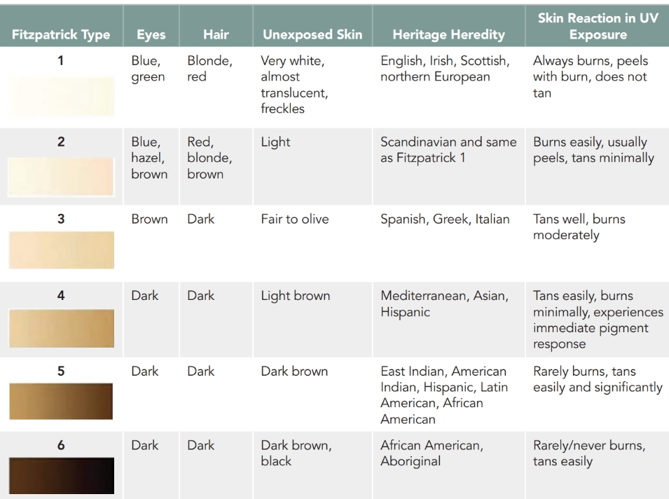
The Fitzpatrick Scale

Slide 4
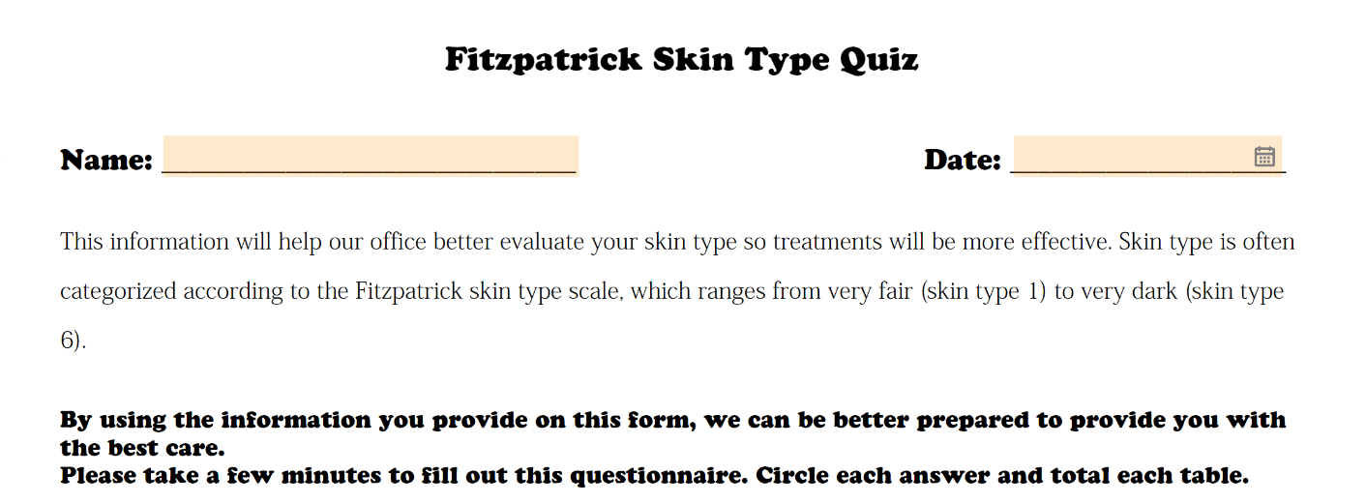

Slide 5
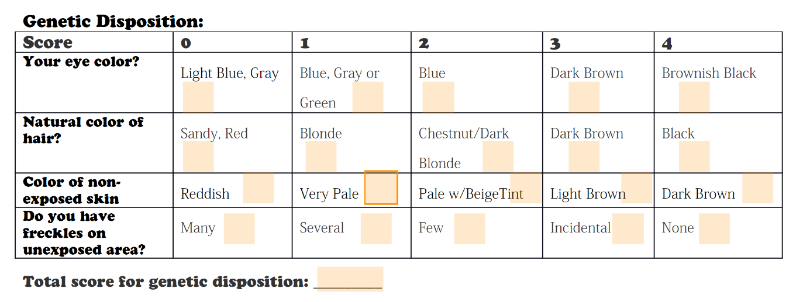

Slide 6
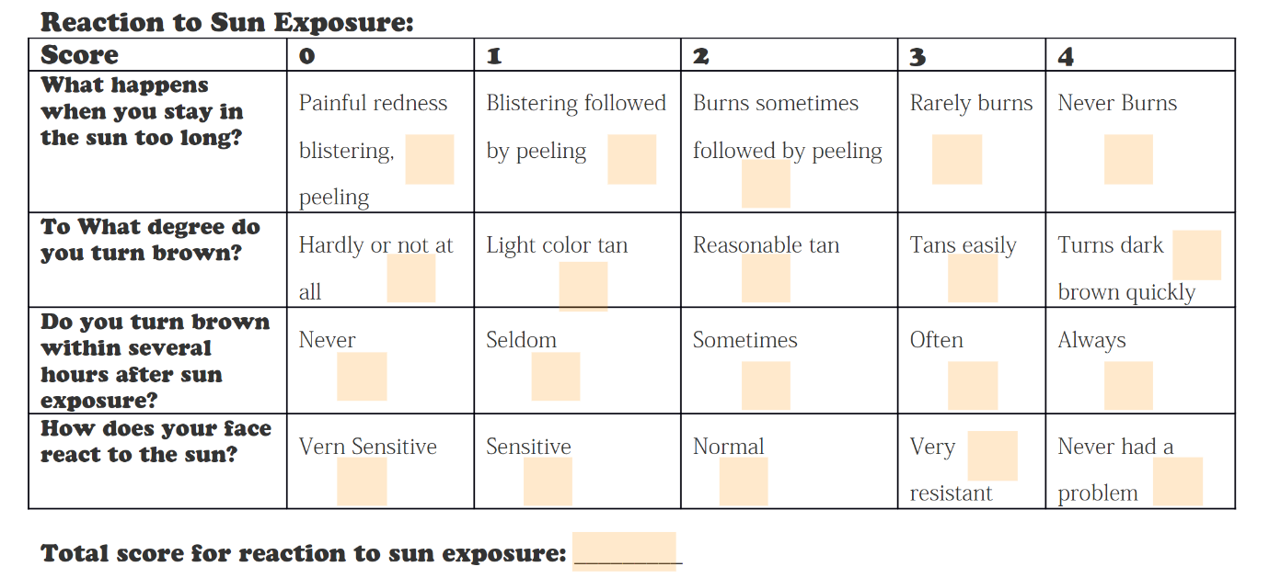

Slide 7
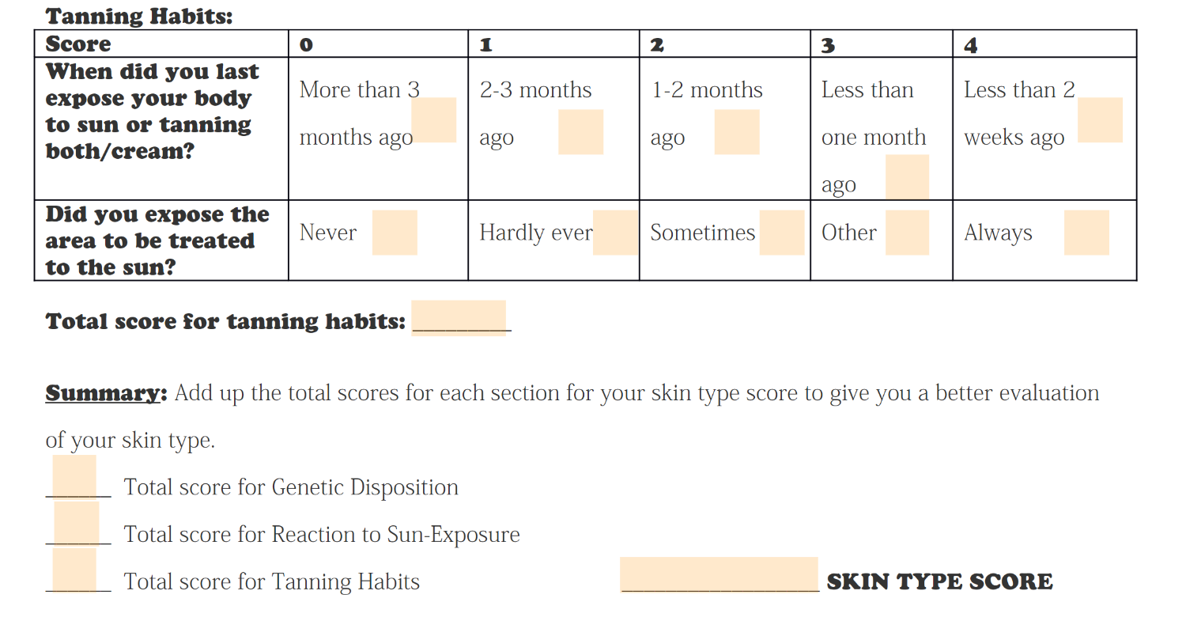

Slide 8
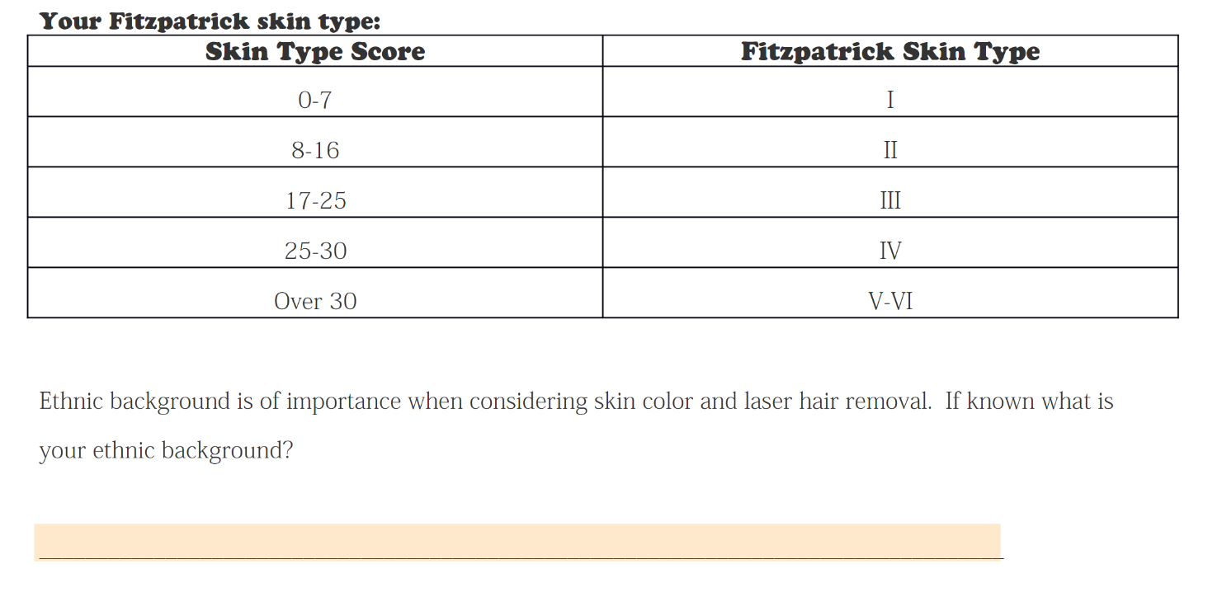

Slide 9
Other Skin Classification System
The Glogau scale
is one of two well-known scales that evaluate the skin. Richard Glogau, M.D., who developed this classification system in the 1990’s, designed it to determine the treatment protocol a physician needed to use (in addition to the Fitzpatrick scale) to address a visible condition. It helps physicians standardize their approach in addressing problems and to communicate with each other about a client’s issues. Because it is based on visual assessment, it is a quick tool for you to use to further evaluate a client

Slide 10
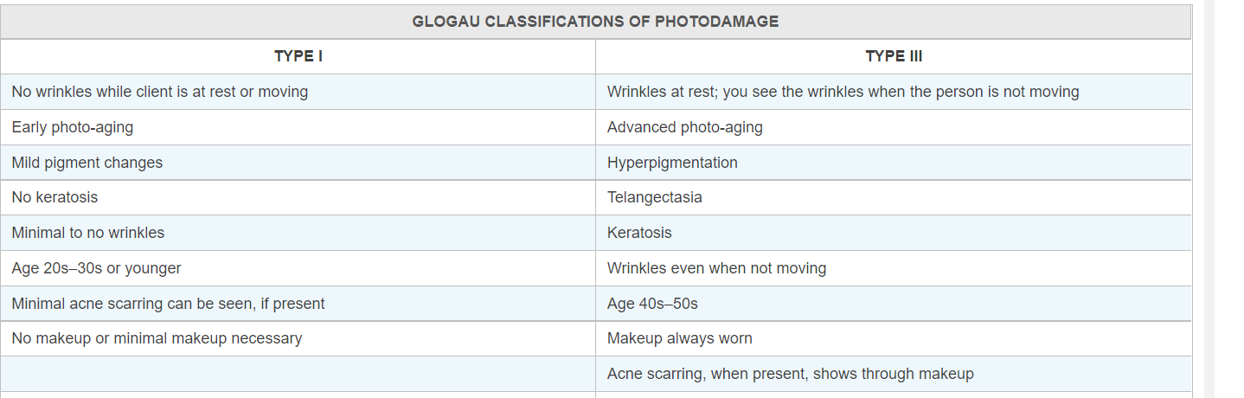

Slide 11
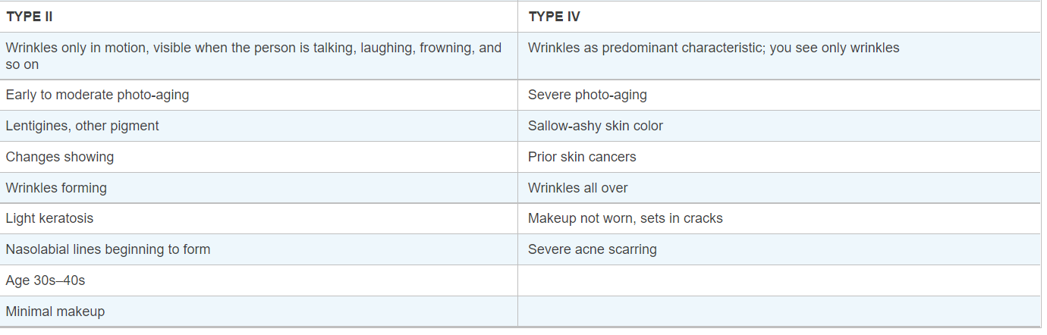

Slide 12
One of the confusing aspects of the Glogau system is the incorporation of acne scarring and the use of makeup in evaluating the skin. As an esthetician you have most likely seen women who fall into all four categories and who all wore makeup differently than described in the chart. Also, a client may fit into Glogau type IV but have no acne scarring. The key factors defining a Glogau category may be how wrinkles appear and the presence of photo-aging. If you focus on the visible signs of aging as your determiner, you will find this scale more useful.

Slide 13
Rubin Classification
Dermatologist Mark G. Rubin, M.D., created a slightly different method for determining the level of photodamage that eliminated the consideration of makeup and acne. The Rubin scale looks at the histologic depth of visible skin changes (Table 11-9). This method of evaluation is based on where damage is present in the skin. If a client has only mild epidermal photo-aging, you would select a different treatment than if the damage extends into the dermis. Keep in mind that some clients may exhibit alterations from more than one category. They may have epidermal skin discoloration but lines that extend into the dermis. Esthetic superficial peels will help the skin discoloration but not dermal wrinkles. A Wood’s lamp will help you determine the depth of the solar damage. To use the Wood’s lamp, turn the device on, then turn off the lights in the treatment room. The light will project different colors, indicating the depth of pigment damage.

Slide 14
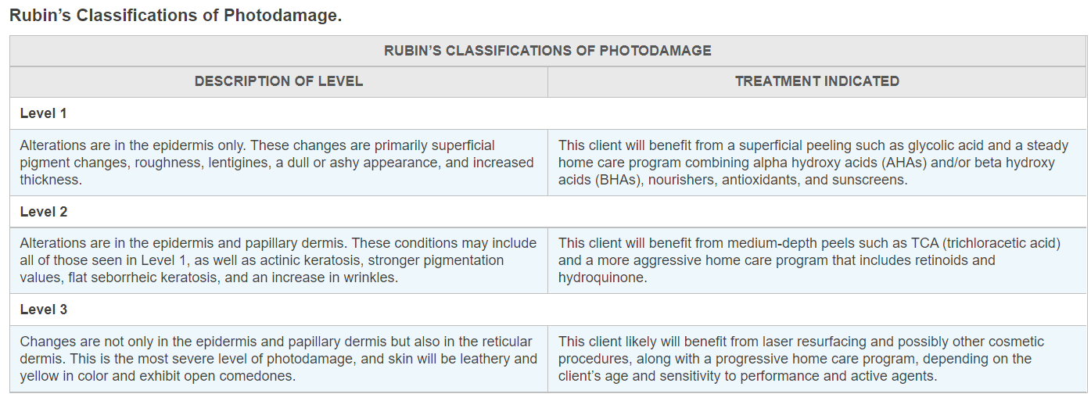

Slide 15
You may find the Rubin classification easier to use than the Glogau scale, but it is important to understand both. The Rubin classification can help you determine how close you will be able to come to achieving your client’s goals. If a client has Level 1 damage, you can successfully help him or her in your clinic. You may be able to offer a client with Level 2 damage some benefit, depending on his or her objectives, or you may advise that client to seek medical assistance. In either case, it is important to gain a clear understanding of the client’s goals for results. He or she may be comfortable with a few wrinkles but may want to focus on improving the feel or texture of the skin. The client may not want the expense or the downtime of medical intervention and may be happier with good home care and a series of esthetic exfoliation treatments.

Slide 16
If a client with Level 2 or Level 3 damage wants it reversed, you should work with a physician, because these cases involve deeper work, a higher risk of complications, and an alteration of the epidermis and the dermal tissue. It will take a combination of your esthetic skills, the services of a medical specialist, and the client’s dedication to home care to achieve the best result. Your role will involve not only treatments but your ability to motivate the client and keep him or her focused on the importance of home care.

Slide 17

QUESTIONS?

