Slide 1
APPH 226:
Tube Conservation
Objectives 2.5

Slide 2
X-Ray Tube Rating Chart
3 types of charts:
  Radiographic Rating Chart
  Anode Cooling Chart
  Housing Cooling Chart

Slide 3
Radiographic Rating Chart
Considered the most important
Provides information about which radiographic techniques are safe for the x-ray tube
All x-ray tubes come with their own series of charts
  A replacement tube will be supplied with a chart, and can be different from that of the original tube

Slide 4
Radiographic Rating Chart
Depends on many factors of tube design:
  Focal spot
  Speed of anode rotation
  Target angle
  Voltage rectification
For a given mA, any combination of kVp and time that lies below the curve is safe
  Most equipment will not allow you to take an unsafe exposure

Slide 5
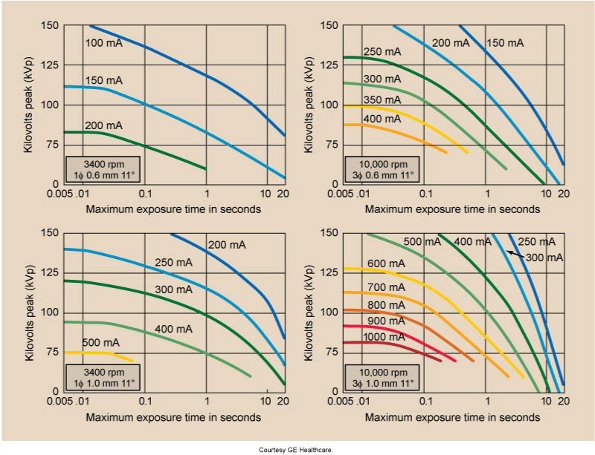
Radiographic Rating Chart
mA indicated by a curve
kVp and time on the x and y axis
Any combination of kVp and time that falls below the curve is safe to use

Slide 6
Radiographic Rating Chart
An exposure is taken at 200 mA, 0.1 s and 125 kVp. Is this a safe exposure for the tube?

Slide 7
Radiographic Rating Chart
An exposure is taken at 200 mA, 0.1 s and 125 kVp. Is this a safe exposure for the tube?
Answer:
Yes
After drawing a
line a 125 kVp
and 0.1 s, the
intersecting point
falls below the 200 mA curve, so this is a safe exposure

Slide 8
Anode Cooling Chart
Anode has a limit for how much heat can be stored
Heat will be dissipated to the oil bath and tube housing, but will still build up on anode
This chart shows thermal capacity and heat dissipation characteristics of the anode
Does not depend on filament size or speed of rotation

Slide 9
Anode Heat Monitoring
Indicates the percentage of heat units (HU) that are used, or still available
  Differs from unit to unit depending on the model
Built in indicator
The units in the MRT lab have thermometer icons
  Starts out as green
  As heat builds up, it will color in and become yellow, then red

Slide 10
Anode Cooling Chart
Chart used to determine:
  How much time is required for the anode to be completely cooled
  Maximum heat capacity of anode
Rate of cooling is rapid at first, and slows as the anode cools
More heat is generated with 3 phase and high frequency units

Slide 11
Anode Cooling Curve
To use this chart, the heat units (HU) must be calculated first
A modification factor is needed
Heat Units (HU) are calculated by:
HU = kVp x mA x time x modification factor

Slide 12
Modification Factor
Generator Type | Factor
Single Phase | 1.0
3 Phase | 1.4
High Frequency | 1.4
*Factors can be found on page 120 of Bushong

Slide 13
Calculating Heat Units
How many HU are generated by an exposure of 80 kVp, 200 mA and 0.2 s on a single phase unit?
HU = kVp x mA x time x modification factor
HU = 80 kVp x 200 mA x 0.2 s x 1.0
HU = 3200 HU

Slide 14
Calculating Heat Units
How many HU are generated by three exposures of 60 kVp, 400 mA, 0.5 s on a three phase unit?
HU = kVp x mA x time x modification factor
HU = 60 kVp x 400 mA x 0.5 s x 1.4
HU = 16800 HU for 1 exposure
16800 HU x 3 exposures = 50400 HU

Slide 15
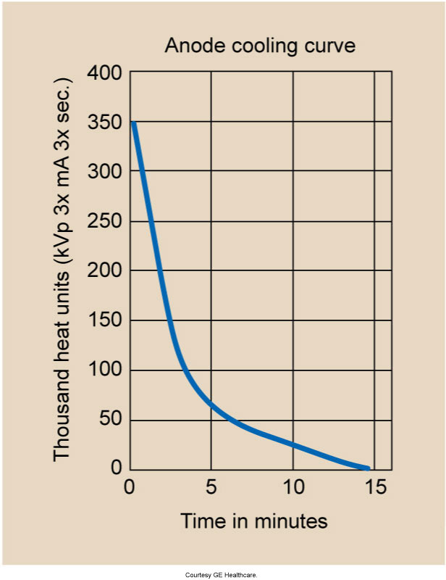
Anode Cooling Chart
Y-axis: HU
X-axis: time for the anode to cool
Draw a horizontal line at the number of HU to the curve
Draw a vertical line down
Then determine the total amount of time for the heat to reach 0
Find the difference between the 2 values to determine the time for complete cooling

Slide 16
Anode Cooling
If a series of exposures produces 200 000 HU, how long will it take to cool the tube completely?

Slide 17
Anode Cooling
If a series of exposures produces 200 000 HU, how long will it take to cool the tube completely?
Answer:
Draw horizontal line first, then the vertical lines and find the difference
15 – 2 min =
13 min

Slide 18
Anode Cooling
How long will it take for the anode to cool from 200000 HU to 70 000 HU?

Slide 19
Anode Cooling
How long will it take for the anode to cool from 200000 HU to 70 000 HU?
Answer
Draw horizontal line at 200000 HU and another at 70000 HU
Then draw vertical lines down from where they meet the curve
Find the difference
5 – 2 min = 3 min

Slide 20
Housing Cooling Charts
Similar appearance to the anode cooling chart and used the same way
Anode will reach its limit before the tube housing will
Maximum heat capacity for the tube housing is in the range of several million heat units as compared to the anode which is in the range of several hundred thousand heat units

Slide 21
Readings
Bushong: Radiologic Science for Technologists 11th Edition
  Pg 118-120

