Slide 1
MRAD 204:
Radiographic Technique 1
Outcome 6-10:
Anatomy of the Knee Joint
MRT Program
Anderson College

Slide 2
Affiliated Readings
Module Reading
Bontrager
Pgs: 218→222

Slide 3
Overview
Distal Femur
Patella
Proximal Tibia & Fibula
Knee Joint
Ligaments

Slide 4

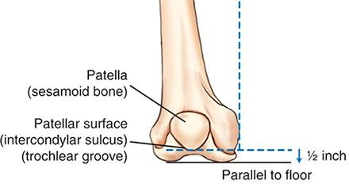
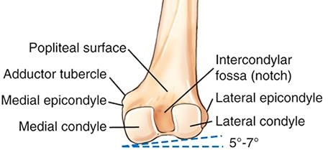
Distal Femur
Anterior View
Patella is located on the anterior side (over the smooth triangular depression)
Lateral
Medial
Large, rounded condyles are on the
posterior side
When weightbearing the lateromedial angle of the femur (determined by the inferior surface of the femur) should be parallel to the floor
Posterior View
Medial
Lateral
When the body of the femur is perfectly vertical or horizontal, the medial side of the femur extends more distally
Bontrager pg. 219 Fig. 6.19-6.20

Slide 5
Distal Femur
Anterior View
Teach yourself to recognize the labelled parts on the distal femur:
Lateral
Medial
Patellar surface (intercondylar
sulcus, trochlear groove)
Popliteal surface
Posterior View
3. Medial & lateral condyles
Medial
Lateral
4. Intercondylar fossa
Adductor tubercle
Medial & lateral epicondyles
Bontrager pg. 219 Fig. 6.19-6.20

Slide 6
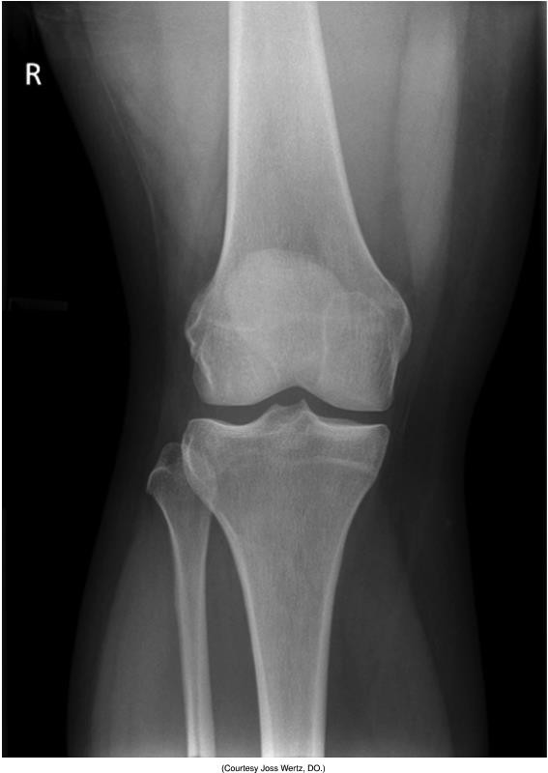
Distal Femur
Anterior View
Lateral
Medial
Posterior View
Medial
Lateral
Bontrager pg. 219 Fig. 6.19-6.20
Bontrager pg. 246 Fig. 6.101

Slide 7
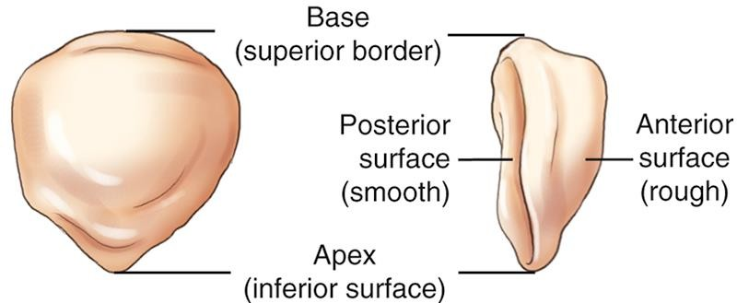
Patella
Anterior View
Largest sesamoid bone in the body
Lateral
Medial
Protects the knee joint anteriorly
Sits ½” superior to knee joint (when leg is fully extended)
Bontrager pg. 219 & 220 Fig. 6.19 & 6.23

Slide 8
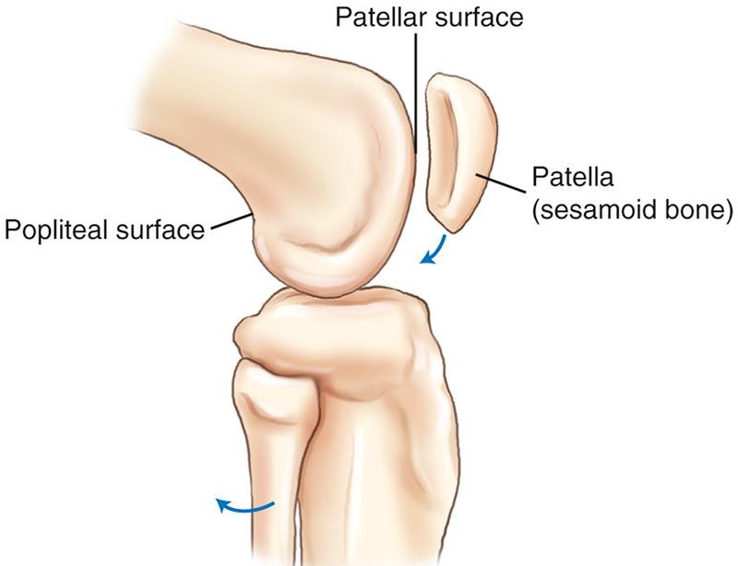
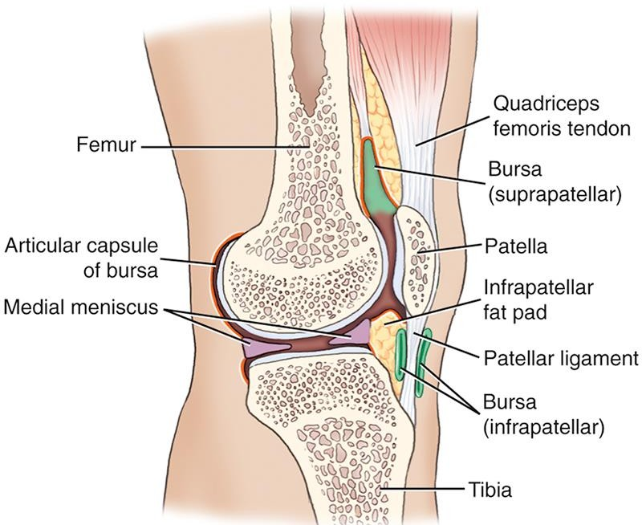
Patella
Embedded in the tendon of the quadriceps femoris muscle
A “pivot point’ for the quadriceps femoris muscle to pull against when the leg is flexed
Moves inferiorly into the intercondylar sulcus when knee is flexed
Easily palpated and movable when
the leg is extended
Bontrager pg. 220 & 221 Fig. 6.21 & 6.26

Slide 9
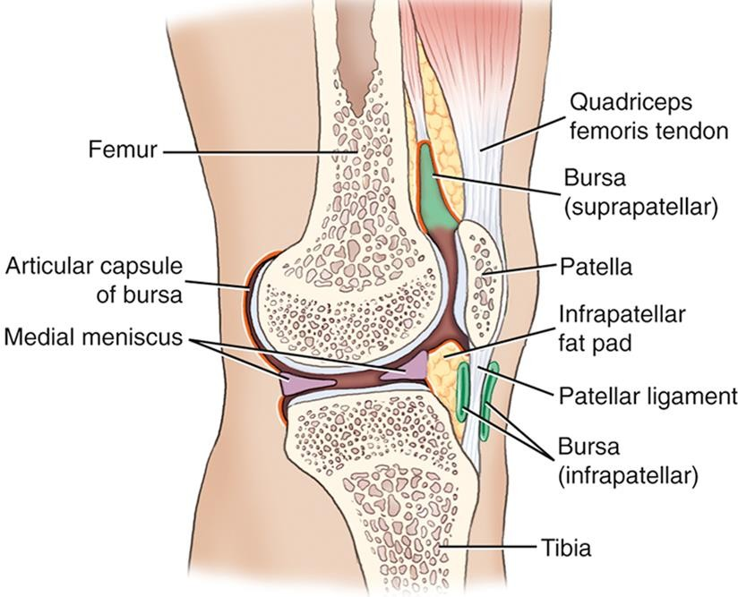
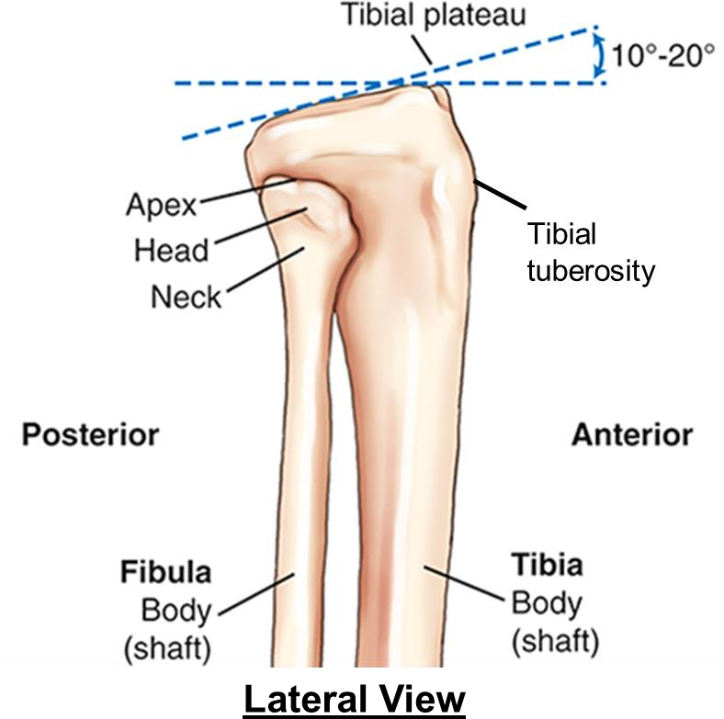
Proximal Tibia & Fibula
Superior surface of tibia sits at a 10-20º posterior sloping angle with respect to the tibial shaft
Patellar tendon (of the quadriceps femoris muscle) attaches to the tibial tuberosity on the anterior side
Note: Proximal fibula is not included in the knee joint as it does not articulate with the femur

Slide 10
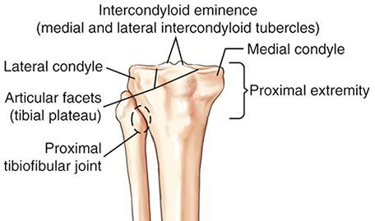
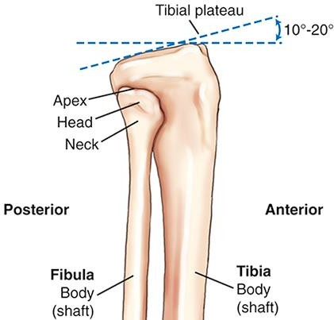
Proximal Tibia & Fibula
Teach yourself to recognize the labelled parts on the proximal tibia and fibula:
1. Intercondyloid eminences
Tibial tuberosity
Anterior crest
2. Tibial plateaus (articular facets)
Lateral
Medial
Anterior View
3. Medial & lateral condyles
4. Head, neck, & apex of the fibula
Tibial tuberosity
5. Tibial tuberosity
6. Proximal tibiofibular joint
Lateral View

Slide 11
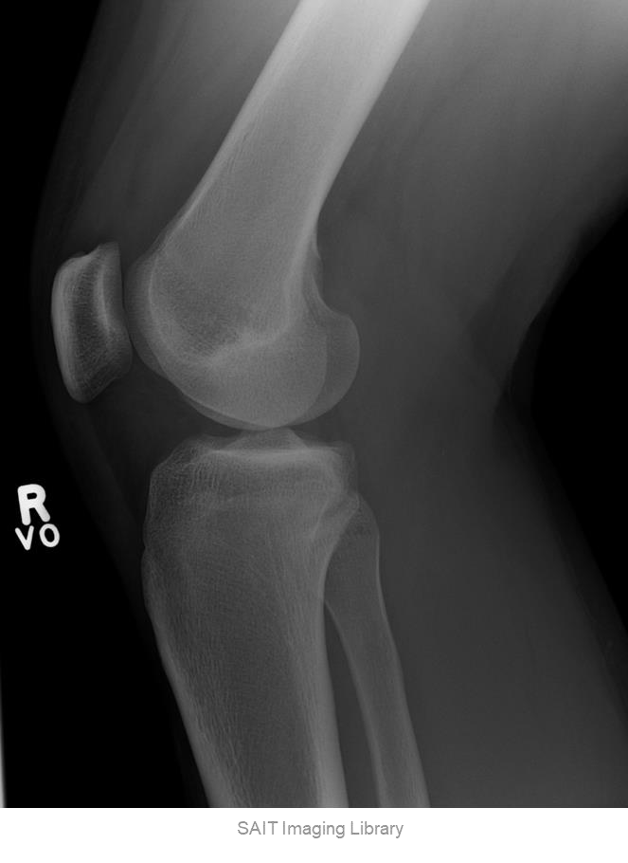
Proximal Tibia & Fibula
Tibial tuberosity
Anterior crest
Lateral
Medial
Anterior View
Tibial tuberosity
Lateral View

Slide 12
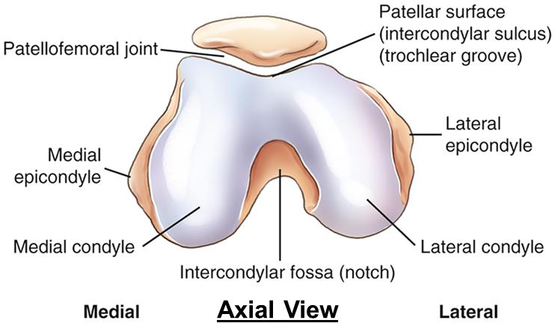
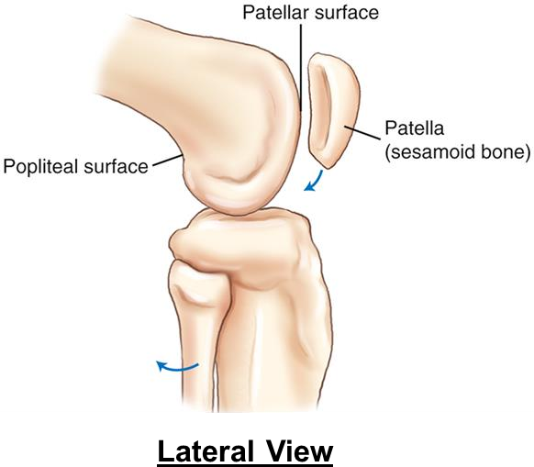
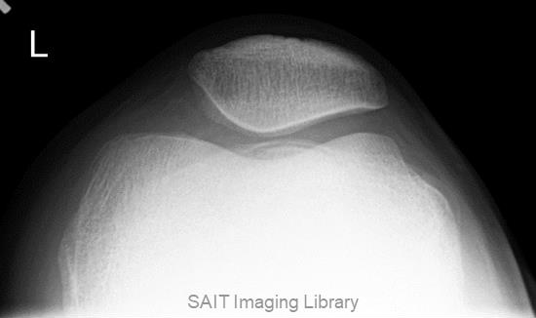
Knee Joint
One of the most complex joints in the human body
Contains two articulations:
  femorotibial joint
  patellofemoral joint
Bontrager pg. 220 Fig. 6.21-6.22

Slide 13
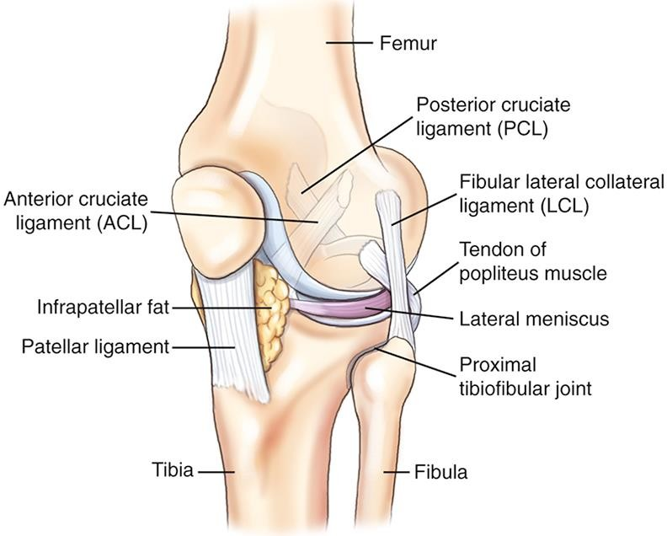
Ligaments
Femur, tibia, fibula, and patella are held together by a complex group of ligaments
Posterior cruciate ligament (PCL)
Anterior cruciate ligament
(ACL)
Tibial collateral ligament
(MCL)
Fibular collateral ligament (LCL)
Provide stability for the knee
joint
Bontrager pg. 220 Fig. 6.24

Slide 14
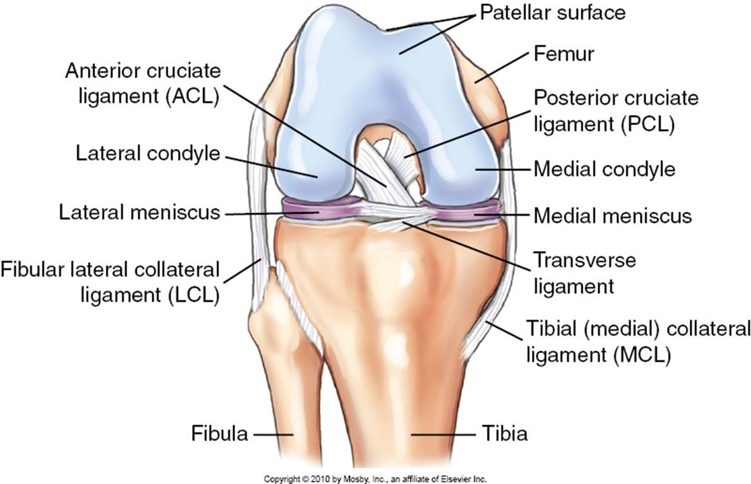
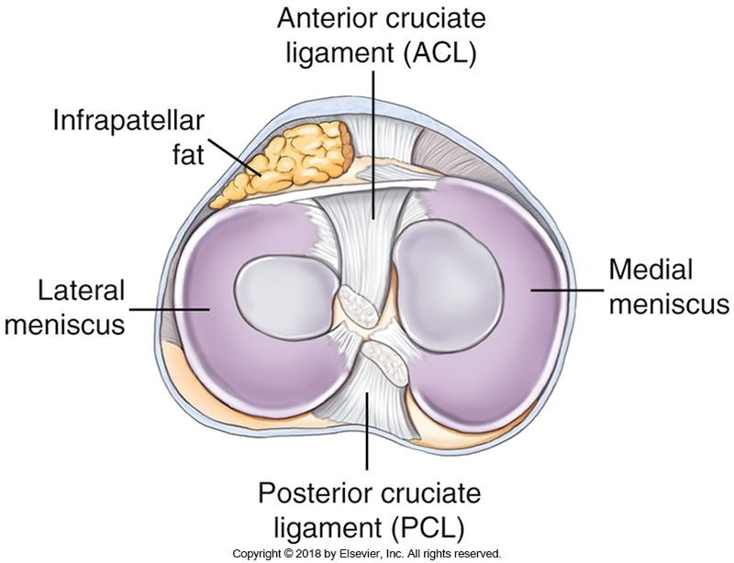
Ligaments
Superior View
Anterior View
Bontrager pg. 221 Fig. 6.25 & 6.28

Slide 15
Helpful Resources
Sketchfab: https://sketchfab.com/3d-models/
  Access to 3D images of bones
    Can tilt/rotate images
    https://sketchfab.com/3d-models/human-femur-886c48f7ee084e5bb5d064d8742afd1b
  Labelling

