Slide 1


Laser Chapter 3 Part 1

Slide 2
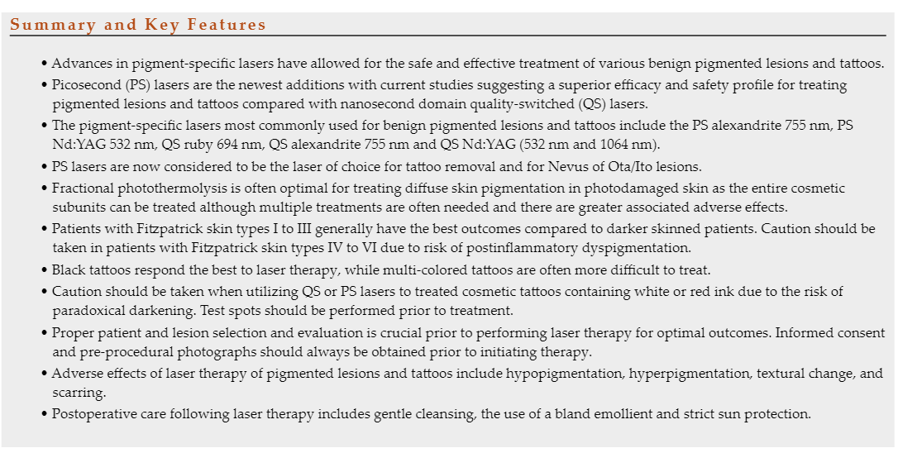

Slide 3
Principles of Pigment Removal with Laser Therapy
Superficial pigmented lesions can be effectively treated with shorter wavelengths
Longer wavelengths are used for lesions with pigment deeper in the dermis.
Longer wavelengths are also preferentially used in patients of darker skin types to decrease risk of post-procedural dyschromia as they have less epidermal damage.
Likewise, for tattoos, given the location of the ink particles within the dermis, longer wavelengths are often preferred, although the appropriate wavelength also depends on the ink particle color.

Slide 4
Shorter wavelength long-pulsed lasers (millisecond domain) including the potassium-titanyl-phosphate (KTP) (532 nm) and the pulsed-dye laser (PDL) (585–595 nm) can also be used for superficial pigmented lesions because of their melanin absorption.
They deliver laser energy over a longer pulse duration, in the millisecond range, with the same wavelengths as their QS counterparts. While the longer pulse duration may cause unacceptable nonselective thermal damage to deeper structures, they may be safely used for epidermal pigmented lesions.
Longer wavelength long-pulsed lasers (millisecond domain) including ruby, alexandrite, and Nd:YAG lasers may also be used to treat larger pigmented targets in the dermis such as hair.
Epidermal cooling is essential with these devices in order to protect the epidermis and dermal epidermal junction.
One should not employ a millisecond domain long-pulsed laser to treat dermal pigment such as nevus of Ota or tattoo pigment,

Slide 5

With your books opened, list the classification of lasers that are used for pigment removal
Look at the wavelengths and techniques and discuss, which ones are the ones that can be used by estheticians ?
Research Time!

Slide 6
Benign Pigmented Lesions
Lesions can be classified based on the distribution of melanin within the epidermis or dermis, which is important to consider when selecting the appropriate laser modality for treatment.
Epidermal
Demo epidermal
Dermal

Slide 7
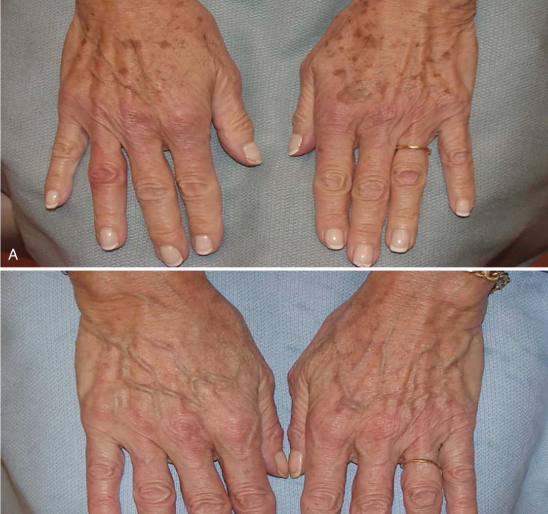
Epidermal Lesions
Lentigo Simplex, Solar Lentgines, Ephelides

Slide 8
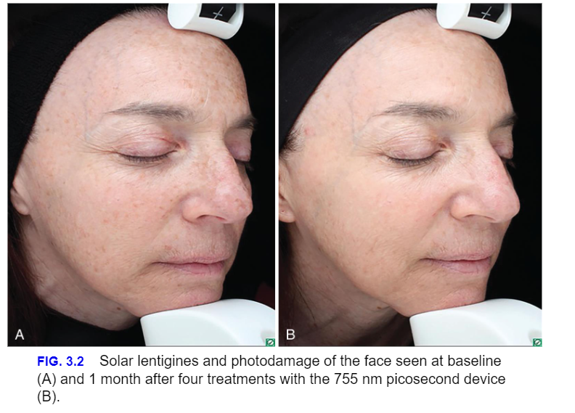

Slide 9
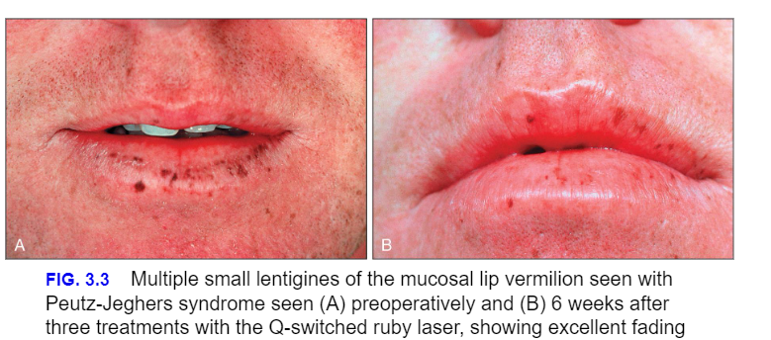
Labial Melanotic Macules

Slide 10
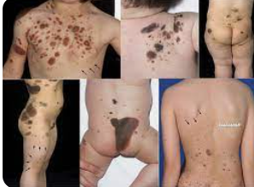
Café-au-lait Macules and Nevus Spilus

Slide 11
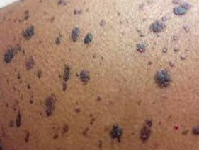
Sbeorrheic Keratoses and Dermatosis Papulosa Nigra

Slide 12
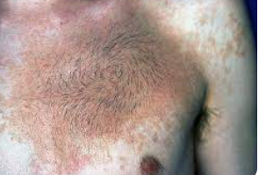
Dermoepderma Lesions
Becker Melanosis (Nevus)

Slide 13
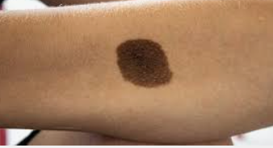
Melanocytic Nevi

Slide 14
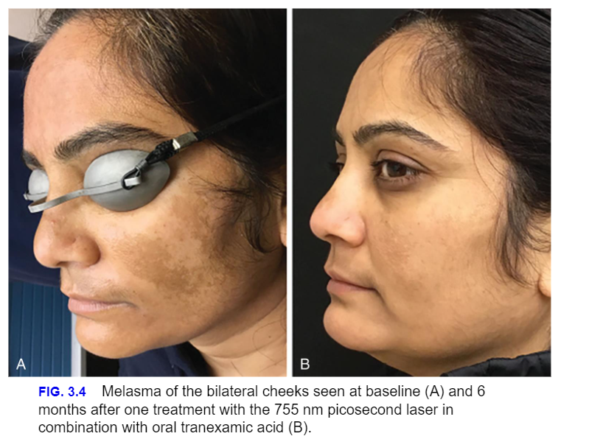
Melasma

Slide 15
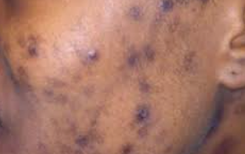
Postinflammatory Hyperpigmentation

Slide 16
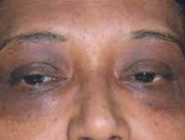
Periorbital Hyperpigmentation

Slide 17
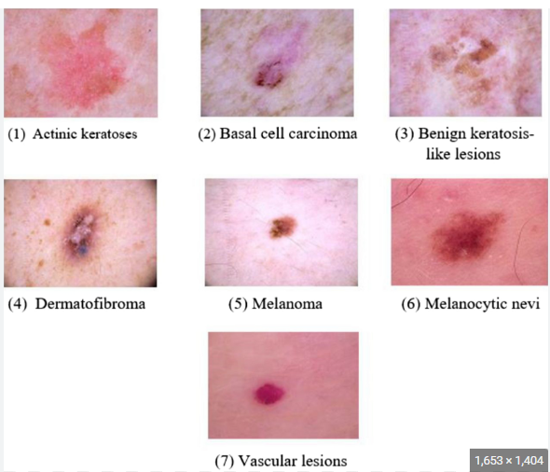
Dermal Lesions

Slide 18
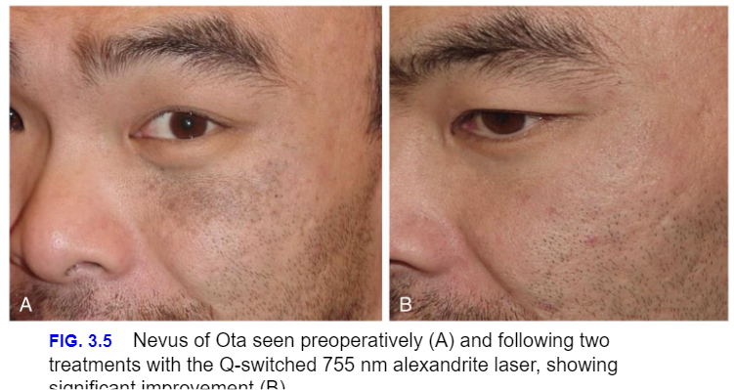
Nevus of Ota, Ito, and Hori’s Nevus

Slide 19
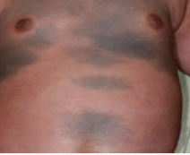
Congenital Dermal Melanocytotic

Slide 20
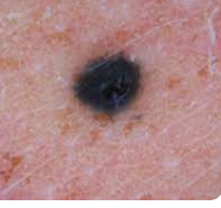
Blue Nevi

Slide 21
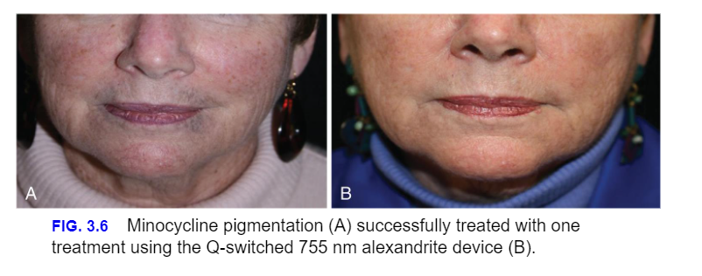
Drug-Induced Hyperpigmentation

Slide 22
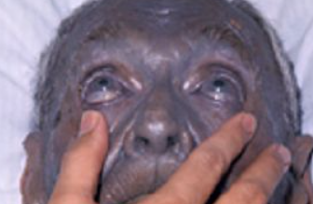
Argyria

Slide 23
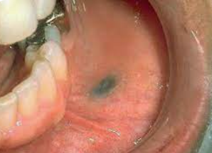
Amalgmam Tattoos

Slide 24

QUESTIONS?

