Slide 1


Medical Esthetics
The Epidermis

Slide 2
Why is important?
As a Medical Esthetician you will be working on the epidermal layer.
Medical Aestheticians need to have a very comprehensive understanding on how the functions of each layer, this knowledge will allow you to target your clients concerns with full knowledge and with an integral manner.

Slide 3
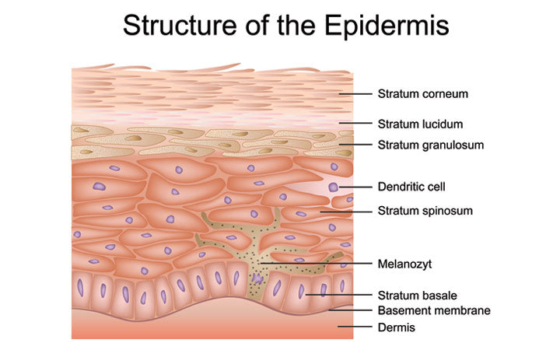

Slide 4
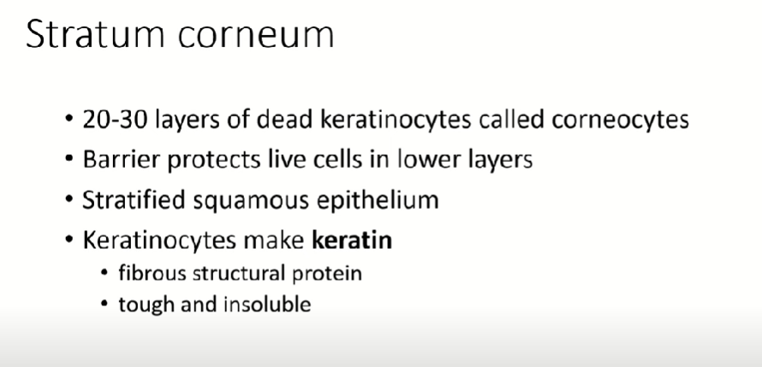

Slide 5

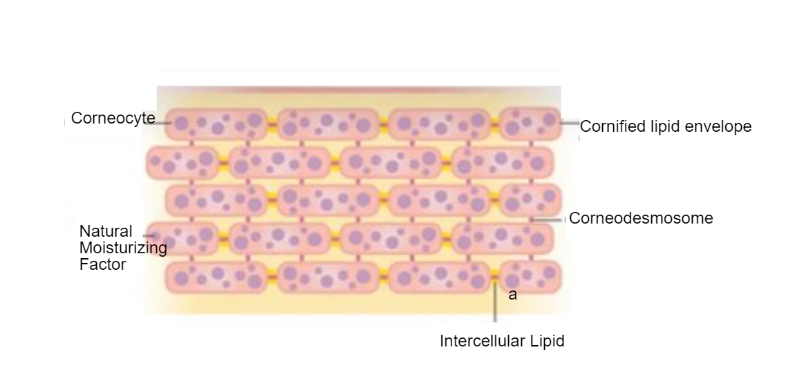


Slide 6
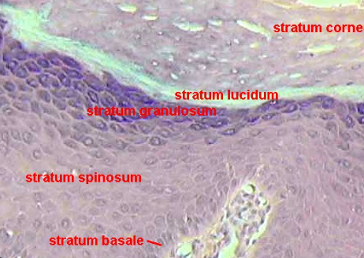

Stratum Lucidum
Found only on palms of hands and soles of feet , layer of translucent cells

Slide 7
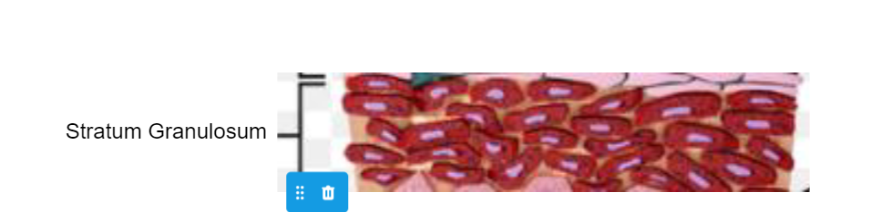
Stratum Granulosum
The granular layer, is composed of cells that resemble granules and are filled with keratin. The production of keratin and intercellular lipids also takes place here. In this layer, enzymes dissolve the structures (desmosomes) that hold cells together. As these cells become keratinized, they move to the surface and replace the cells shed from the stratum corneum.
Natural moisturizing substances such as triglycerides, ceramides, waxes, fatty acids, and other intercellular lipids are made here and are excreted from cells to form components of the skin’s waterproofing barrier function of the top layer. These water-soluble compounds are referred to as natural moisturizing factors (NMFs) and hydrate the lipid layer surrounding cells, absorb water, and prevent water loss.

Slide 8
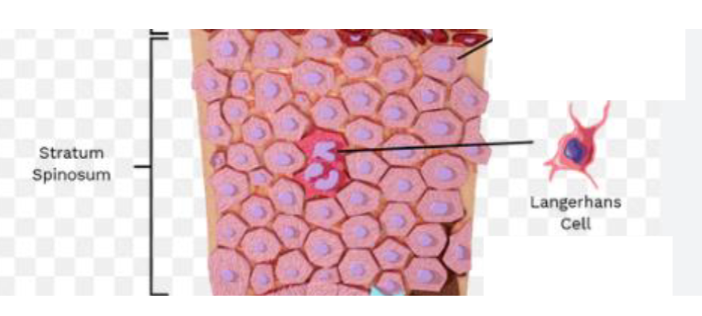
Stratum Spinosum
The spiny layer, is above the stratum germinativum. Cells continue to divide and change shape here, and enzymes are creating lipids and proteins. Cell appendages, which resemble prickly spines, become desmosomes, the intercellular structures that assist in strengthening and holding cells together. Desmosomes are keratin filaments—the protein bonds that create the junctions between the cells. These strengthen the epidermis and assist in intercellular communication.
Also found here are the Langerhans immune cells, which protect the body from infections by identifying foreign material (antigens). The immune cells help destroy these foreign invaders. Keratinocytes and melanocytes work in synergy here, forming the even placement of pigment granules. Lamellar granules are cells that contain lipids to maintain the barrier function. The spinosum is the largest layer of the epidermis.

Slide 9
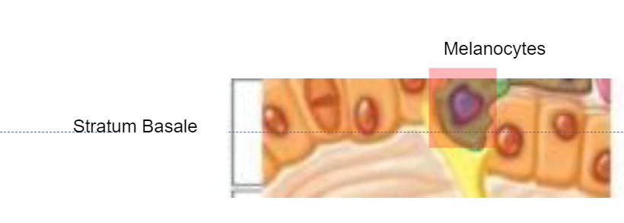
Stratum Basale
The basal cell layer contains cells called melanocytes. Melanocytes produce the skin coloring or pigment known as melanin, which gives skin its tan or brown color and helps protect the deeper layers of the skin from the harmful effects of the sun

Slide 10
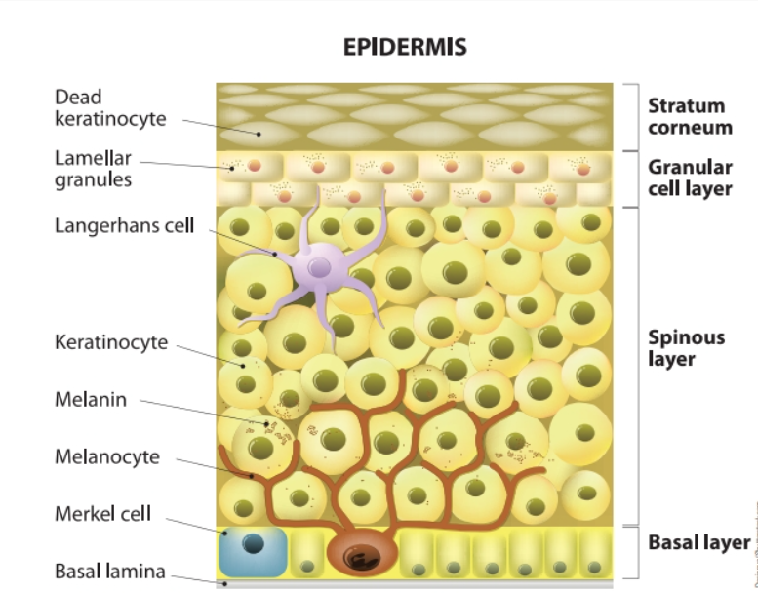

Slide 11
Describe the functions of key cells
Keratocytes
Lamellar granules
Langerhans Cells
Melanocytes
Merkel Cells
Tyrosinase

Slide 12
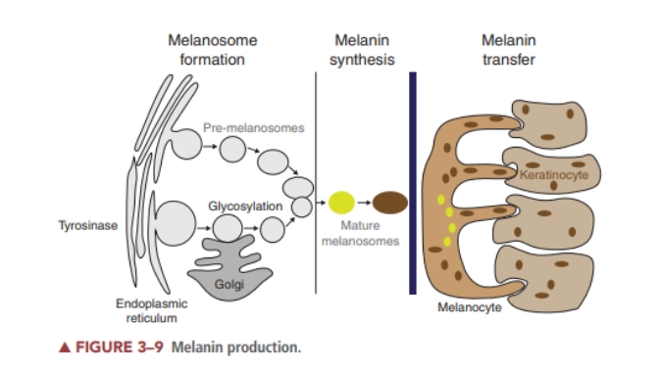
Describe de process of Melanin

Slide 13

QUESTIONS?

