Slide 1
CT Theory
Chest Procedures

Slide 2
CT Imaging of the Chest
Module Objectives
Review anatomy of the chest
Label anatomical structures on a CT image
Scanning protocols including:
  Positioning
  Indications & Contraindications
  Exposure Factors
Most common CT Chest exams done

Slide 3
CT Imaging of the Chest
Positioning for a CT Chest
Patient Position
  Supine, arms elevated and resting behind head
  Feet first into gantry
  Reduce patient motion
  Suspend respiration
Anatomy Position
  No rotation

Slide 4
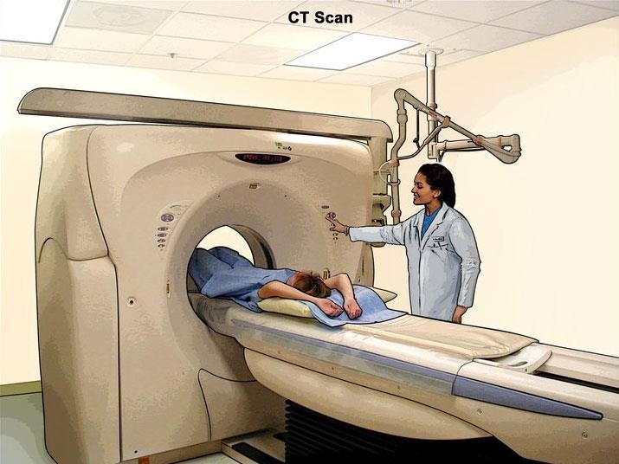
CT Imaging of the Chest
Image Source: https://cancer.gov

Slide 5
CT Imaging of the Chest
How are CT images of the Chest acquired?
  Axial plane
  Helical Scanning =
  Some differences (High-Resolution scans)

Slide 6
CT Imaging of the Chest
Challenges in scanning
Involuntary motion
  Respiration & cardiac function
  Management –
  Alternative – Scan caudal – cranial as there is less motion of respiration at the apices
Patient mobility
  Unable to raise arms above head and hold still
  Management – use immobilization techniques
  Alternative – scan with patient’s arms at size

Slide 7
CT Imaging of the Chest
How are CT images of the chest viewed?
Multiple MPR
Multiple window settings of reformats
Standard / Soft-Tissue WW 500 / WL 50
Lung WW _ WL _

Slide 8
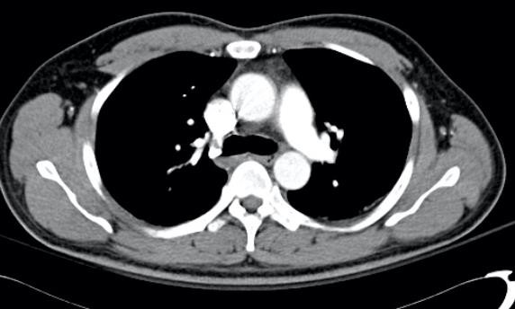
CT Imaging of the Chest
Case courtesy of Dr Ian Bickle, Radiopaedia.org, rID: 52486

Slide 9
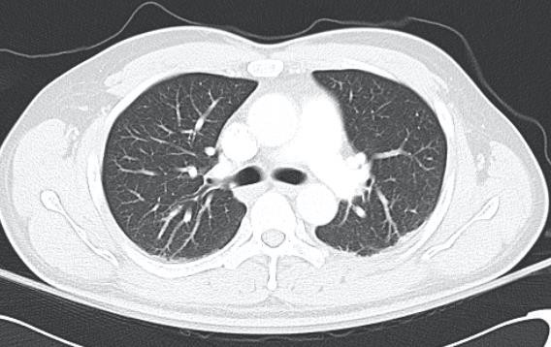
CT Imaging of the Chest
Case courtesy of Dr Ian Bickle, Radiopaedia.org, rID: 52486

Slide 10
CT Imaging of the Chest
Protocols and Pathology
IV contrast is not always used, pay careful attention to requisitions!
Oral contrast is:
3 major protocol categories will be covered in this module / course:
  Routine CECT Chest
  Hi-Res NECT Chest
  CTA Chest for Pulmonary Embolism
Chest and Abdomen scans can be combined, will be covered in the Abdomen module.

Slide 11
CT Imaging of the Chest
NECT vs. CECT Chest
IV contrast not necessary when looking at lung tissue, or diseases of the lung tissue.
Does the differential diagnosis involve lung parenchyma?
  Choose NECT chest.
  Examples:
Does the differential diagnosis involve vascular vs. non-vascular structures or masses?
  Choose CECT chest.
  Examples:

Slide 12
CT Imaging of the Chest
Routine, CECT Chest
Common Indications
•
•
  Empyema
  Correlate with radiographs
  Known or suspected congenital abnormalities
  Trauma
  Lung Ca

Slide 13
CT Imaging of the Chest
CECT Chest (Routine)
Scout(s): AP & Lateral
Anatomy Included:
Scan direction: Caudocranial
Pitch:

Slide 14
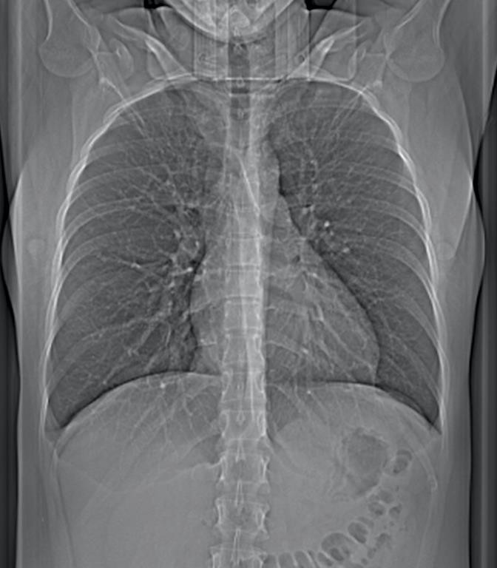
CT Imaging of the Chest
Case courtesy of Dr Bruno Di Muzio, Radiopaedia.org, rID: 41162

Slide 15
CT Imaging of the Chest
CECT Chest (Routine)
SFOV: Large or Body
DFOV: Set to patient
Algorithm: Standard or Soft Tissue
Window: WW 500 / WL 50

Slide 16
CT Imaging of the Chest
CECT Chest (Routine)
Acquisition kVp: 120
Acquisition mA:
  Use ATCM feature
Reconstruction details will vary
  MPR
  Slice Thickness
  Windowing (Lung, WW 1500, WL -700)
  Apply filters (Edge-enhancing)
  3D, if indicated (MinIP, MIP)

Slide 17
CT Imaging of the Chest
CECT Chest (Routine)
IV Contrast: 80 ml at 3.0 ml / sec
Scan delay: 35 seconds
  Phase of enhancement:
Bolus followed by a saline flush.
  Particularly important for chest imaging.
•
Oral Contrast: not used

Slide 18
CT Imaging of the Chest
https://radiopaedia.org/cases/normal-ct-chest?lang=us
https://radiopaedia.org/cases/thoracic-empyema?lang=us
https://radiopaedia.org/cases/squamous-cell-carcinoma-of-lung-necrotic?lang=us

Slide 19
CT Imaging of the Chest
NECT Chest
High Resolution Protocol (HRCT)
Common Indications
  Diffuse lung diseases / Interstitial lung disease –
•
  Inhalation injury (such as asbestos exposure)
  Bronchiectasis
  Airway disease
  Sarcoidosis
  Scleroderma

Slide 20
CT Imaging of the Chest
High-Resolution = optimal spatial resolution
  Thin sections ( or less)
  Fast acquisition
  Edge-enhancing algorithm to optimize spatial resolution ( algorithm)
  DFOV set just to lungs
Can be done incremental or helical.

Slide 21
CT Imaging of the Chest
Incremental (Axial) HRCT
  Images are obtained with an interval of 10mm or more between slices
  Only % of the lung parenchyma is scanned
  Provides representative areas of disease
  Primary disadvantage –
  Primary advantage – lower radiation dose

Slide 22
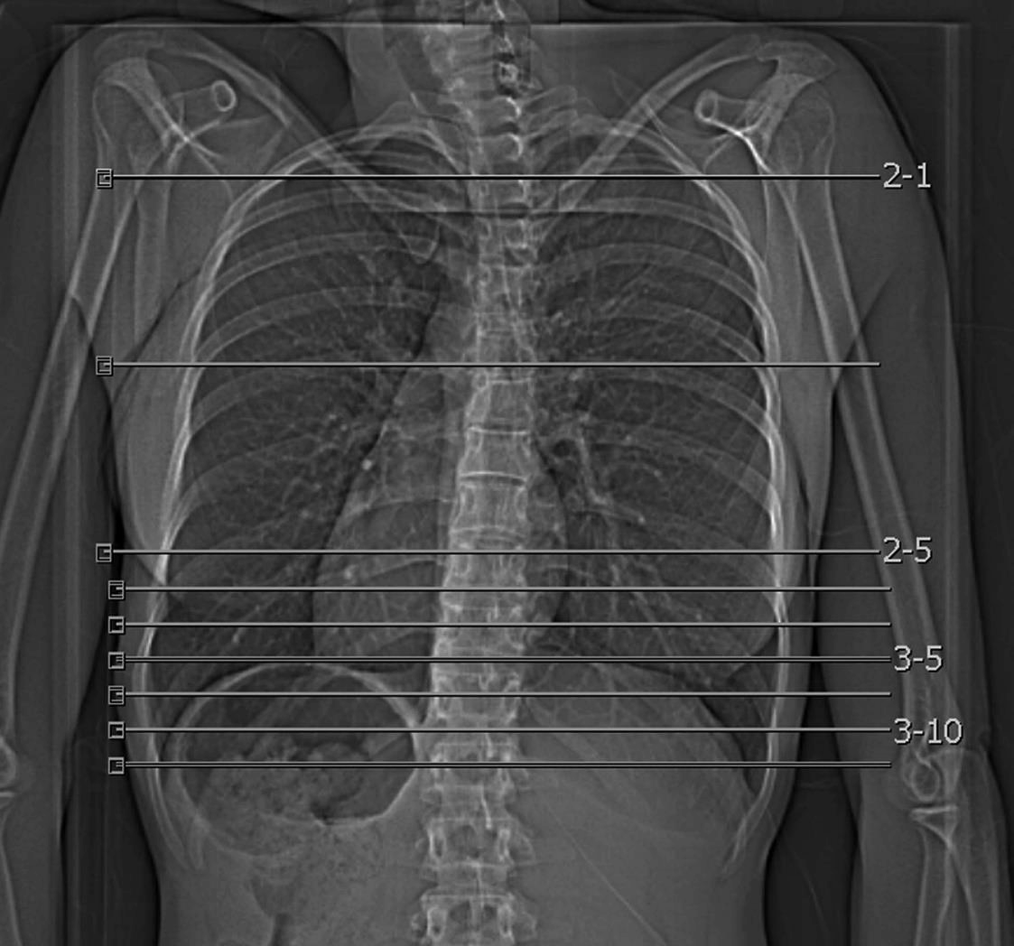
CT Imaging of the Chest

Slide 23
CT Imaging of the Chest
Volumetric (Helical) HRCT
  Images entire lung, rather than representative slices
  Complete assessment of lung
  Capable of 3D post-processing (MIP and MinIP)
  Primary disadvantage -

Slide 24
CT Imaging of the Chest
Many HRCT protocols include more than one series of scans
  Varying patient position
  Varying phases of respiration
  Why?

Slide 25
CT Imaging of the Chest
Supine vs. Prone
  There is a gradual increase in attenuation and vessel size from anterior to posterior lung regions because of the effect of gravity on blood flow and gas volume
  This effect of gravity can:

Slide 26
CT Imaging of the Chest
Respiration
  Inspiratory scans demonstrate
  Expiratory scans demonstrate areas of the lung that do not empty, indicating airway disease
  The effects of gravity on the lung are also more pronounced on expiratory scans
  So how can we get best diagnostic value?

Slide 27
CT Imaging of the Chest
HRCT with 3 series of scans
•
•
•
Consider radiation dose!
  Inspiratory supine – helical acquisition
  Other series – representative axial acquisition
  Lower tube mA

Slide 28
CT Imaging of the Chest
HRCT Chest
*Often, multiple scans of the patient are done.
Supine Inspiration
Supine Expiration
Prone Inspiration
Scout(s): AP & Lateral
Anatomy Included: Just above lung apices – just below costophrenic angles
Scan direction: Caudocranial
Pitch: 1.375
DFOV: Set to patient / lung field only
SFOV: Large body
Algorithm: Bone (edge-enhancement)
  Window: WW 1500 WL -700

Slide 29
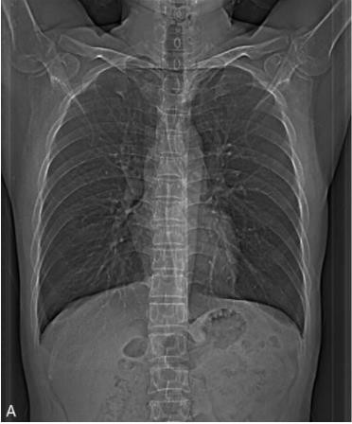
CT Imaging of the Chest

Slide 30
CT Imaging of the Chest
HRCT Chest
SFOV: Large / Body
DFOV: Set to patient / lung field only
Algorithm: Bone (edge-enhancement)
Window: WW 1500 WL -700

Slide 31
CT Imaging of the Chest
HRCT Chest
Acquisition kVp: 140
Acquisition mA: 150-375
  Dependent on patient size
  Use ATCM feature, but consider setting mA for F/U
Reconstruction details will vary
  MPR
  Slice Thickness – thin
  Windowing - Lung WW 1500 WL -700
  Apply filters – edge-enhancing, bone filter
  3D, if indicated – MinIP, MIP

Slide 32
CT Imaging of the Chest
https://radiopaedia.org/cases/normal-hrct?lang=us
https://radiopaedia.org/cases/pulmonary-sarcoidosis-7?lang=us

Slide 33
CT Imaging of the Chest
COVID-19 Imaging
  Imaging studies do not diagnose, but assess progression and complications
Non-enhanced chest CT demonstrates:
  Atypical pneumonia
  Bilateral, peripheral and basal distribution
  Ground glass opacities
  Bronchovascular thickening in lesion(s)

Slide 34
CT Imaging of the Chest
https://radiopaedia.org/cases/covid-19-pneumonia-26?lang=us
https://radiopaedia.org/cases/covid-19-pneumonia-23?lang=us
https://radiopaedia.org/cases/covid-19-pneumonia-66?lang=us

Slide 35
CT Imaging of the Chest
CTA Chest
Also called:
  CT Pulmonary Angiography
  CT Chest for PE
  CTA of Pulmonary Embolism
  Thoracic CTA
  PE
Gold Standard for diagnosing Pulmonary Embolism

Slide 36
CT Imaging of the Chest
Review – Pulmonary Embolus
What is an embolus?
What is the risk of a PE?
What causes a PE?
Other important diagnostic tests for PE:
  Ventilation-Perfusion Scanning (Nuc Med)
  Pulmonary Angiography
  D-dimer (Lab)
How common is PE?

Slide 37
CT Imaging of the Chest
CTA Chest
Advantages of CT
  Peak contrast enhancement
in vessels
Thin slices –
Enhanced MPR ability
Helical = ability to use 3D techniques (MIP)
Fast and widely available
Detects alternate diagnosis if PE is not present

Slide 38
CT Imaging of the Chest
CTA Chest
Limitations of CT
  Small emboli may be missed, poor technique
  Respiratory motion leads to artifact
  Recall – management of respiratory motion is to
scan . Most PE scans will be acquired this way!

Slide 39
CT Imaging of the Chest
Contraindications for CT Chest
  Pregnancy (weigh risk vs. benefit)
  Contraindication to contrast media, if required
Role of technologist if radiation dose is a concern:
  Identify patients of concern (ie – pregnancy or young females)
  Bring to attention of Radiologist

Slide 40
CT Imaging of the Chest
CTA Chest – Pulmonary Embolism
Textbook – includes CTA chest, and a venous “runoff” of the lower extremities to assess for
DVT.
  Not routinely done in practice
  Radiation dose is high
  Peak enhancement in lower extremities is difficult
Focus on “Group 1 Arterial Scan” as listed in textbook
  Bolus Tracking software

Slide 41
CT Imaging of the Chest
CTA Chest – Pulmonary Embolism
Scout(s): AP & Lateral
Anatomy Included:
  Evaluation of pulmonary vessels
  Apices or bases may not be included in entirety
Scan direction: Caudocranial
Pitch: 1.375

Slide 42
CT Imaging of the Chest

Slide 43
CT Imaging of the Chest
CTA Chest – Pulmonary Embolism
SFOV: Large / body
DFOV: 38 cm (set to patient for chest)
Algorithm: Standard / Soft Tissue
Window: Vascular
  WW , WL

Slide 44
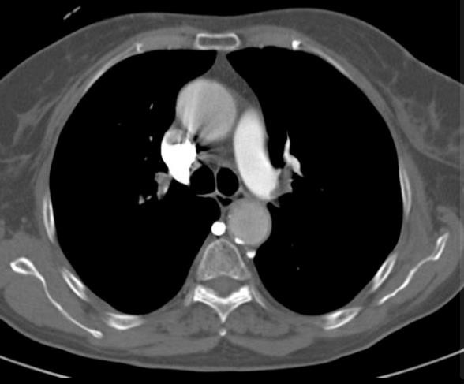
CT Imaging of the Chest
Case courtesy of Dr Bruno Di Muzio, Radiopaedia.org, rID: 19426

Slide 45
CT Imaging of the Chest
CTA Chest – Pulmonary Embolism
Acquisition kVp: 120
Acqusition mA: 80-740
  Huge range for chest PE!
  Use ATCM
Reconstruction details will vary
  MPR
  Slice Thickness –
  Windowing –
  Apply filters
  3D, if indicated -

Slide 46
CT Imaging of the Chest
CTA Chest – Pulmonary Embolism
IV Contrast: 70 mls at 4 mls/sec
  Bolus Tracking
  Localizer scan at the level of the carina
  ROI over the main pulmonary artery
Oral Contrast: none

Slide 47
CT Imaging of the Chest
https://radiopaedia.org/cases/normal-ctpa-2?lang=us
https://radiopaedia.org/cases/pulmonary-embolus-1?lang=us

Slide 48
CT Imaging of the Chest
Summary
Review anatomy of the chest, and its vasculature.
Review indications, contraindications and technical factors involved in different CT examinations of the chest.
Attention to detail and pathology is SO important!
Chest, Abdomen combined studies will be covered in Abdomen module
Cardiac CT will not be tested on!

