Slide 1
MRAD 256:Radiographic Technique 2
Anatomy of the Orbits and Paranasal Sinuses

Slide 2
Orbits and Sinus Readings
Bontrager:
pages: 395-399: anatomy of the paranasal sinuses and orbits

Slide 3
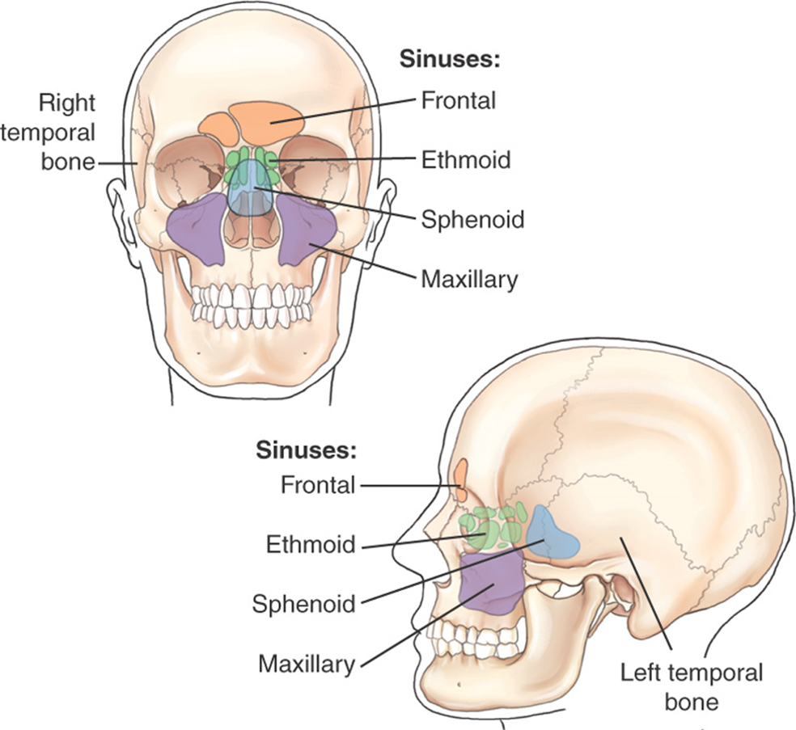
They are all lined with mucous membranes
They are not fully developed until the teenage years
Bontrager 11-57

Slide 4
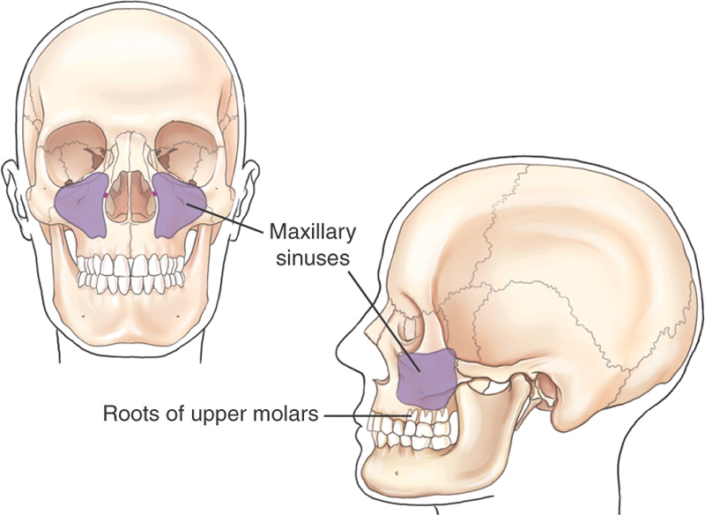
Maxillary Sinuses
Pyramid-shaped in a frontal projection, cubic-shaped in a lateral projection
The bony walls of these sinuses are thin
The floors sit just inferior to the floor of the nasal cavity
Roots of 1st and 2nd molars are closely associated with these sinuses, so an infection in one of these roots can transfer to sinuses
Air-fluid levels visible on erect projections

Slide 5
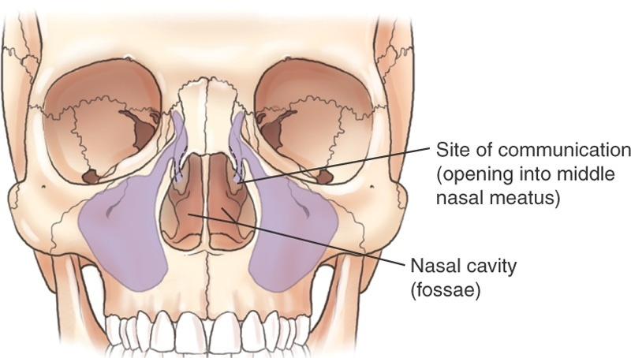
Communication Between Sinuses and Nasal Cavity
All paranasal sinus cavities communicate with one another and with the nasal cavity

Slide 6
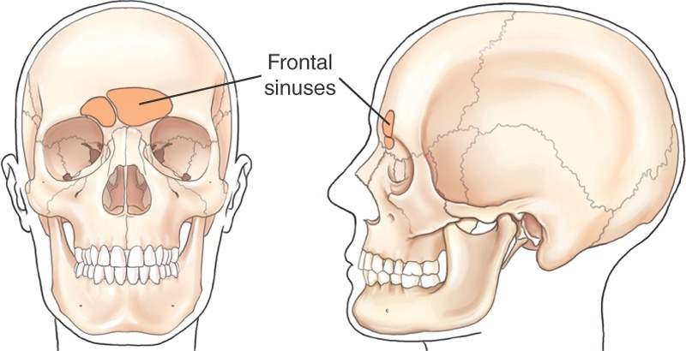
Frontal Sinuses
Located between the inner and outer tables of frontal bone
Rarely symmetric
Usually divided by a septum, but sometimes there is no septum present, resulting in a single cavity
Generally larger in men than in women
Do not aerate until age 6

Slide 7
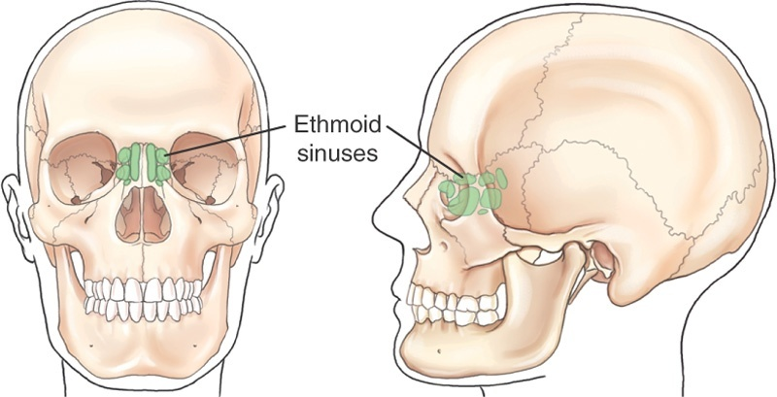
Ethmoid Sinuses
Located in the lateral masses (labyrinths) of the ethmoid bone
The aircells are divided into three collections, anterior, middle and posterior, but all intercommunicate
Communicate with sphenoid sinus and nasal cavity

Slide 8
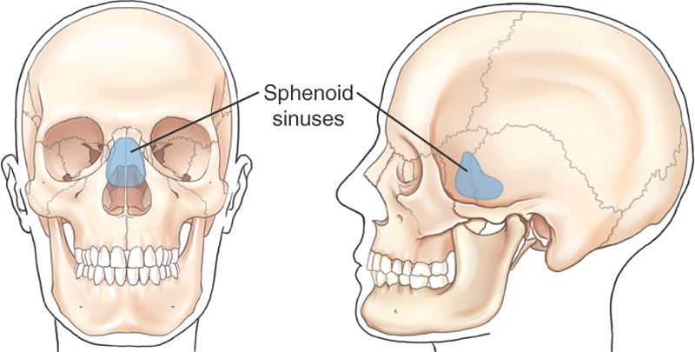
Sphenoid Sinus
Located in the body of the sphenoid bone directly inferior to the sella turcica
Sometimes divided by a septum but not always
Asymmetric
CSF or blood may leak into the sphenoid sinus through a fracture in the cranial floor (basal skull fracture) causing air/fluid levels (sphenoid effusion) to appear in the sphenoid sinus

Slide 9
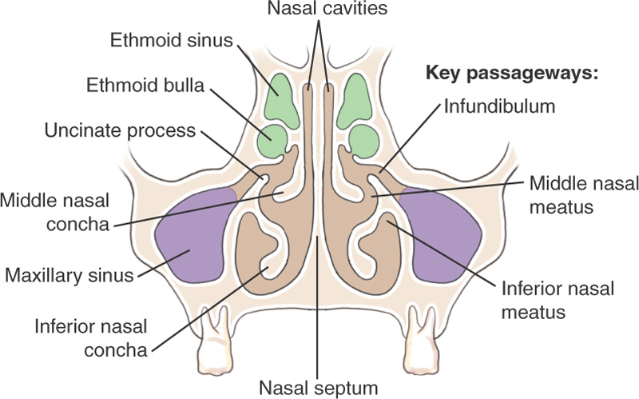
Osteomeatal Complex Coronal View
Osteomeatal complex includes all the paths of communication between the frontal, ethmoid, maxillary sinuses, and the nasal cavity.

Slide 10
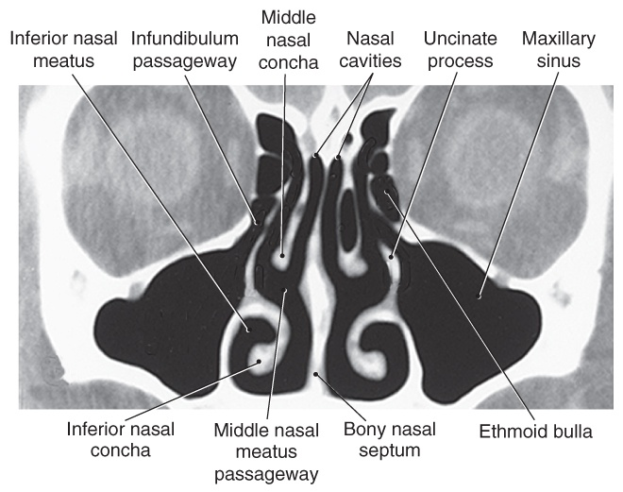
CT of Sinuses: Coronal Perspective

Slide 11
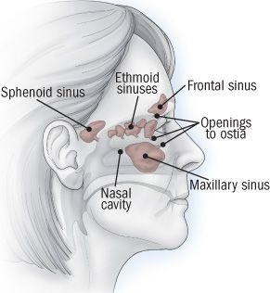

Slide 12
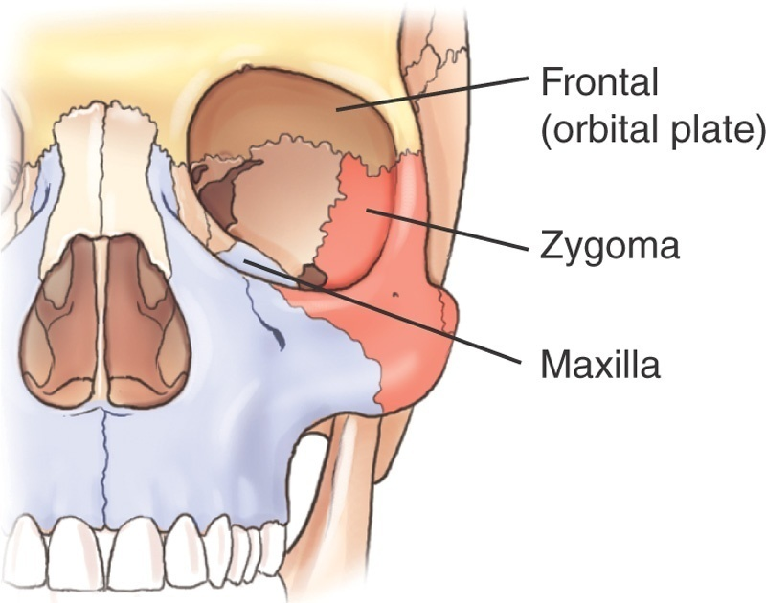
Base of Orbit: 3 Bones

Slide 13
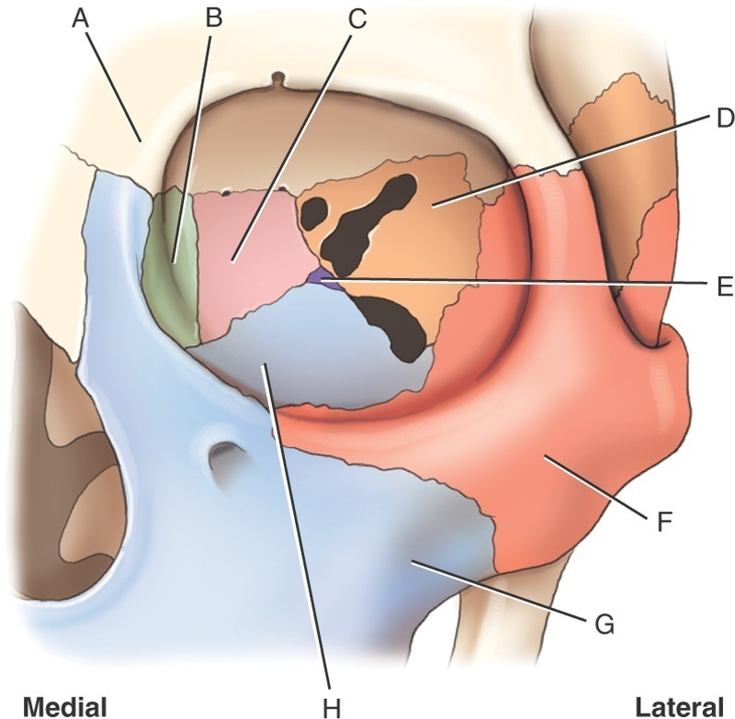
Bony Composition of Orbits
Cranial bones (3)
  Ethmoid, frontal, sphenoid
Facial bones (4)
  Lacrimal, maxilla, palatine, zygoma

Slide 14
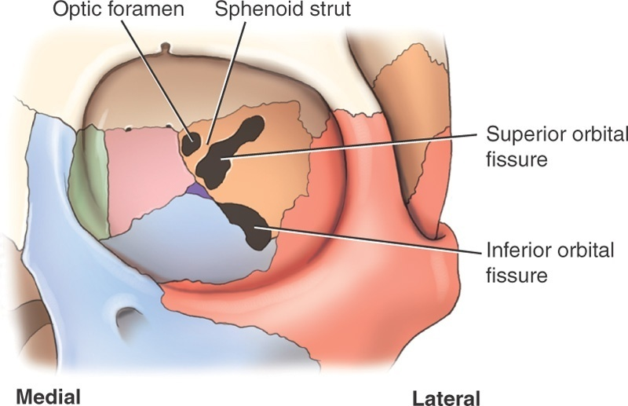
Openings in Orbit

Slide 15
Openings in Posterior Orbit
Optic Foramen
  Located in sphenoid bone
  Allows passage of the optic nerve (CN II), which is a continuation of the retina
Superior Orbital Fissure
  Opening between the greater and lesser wings of the sphenoid, lateral to optic foramen
  Allows transmission of CN III to VI, which control movement of the eye and eyelid

Slide 16
Openings in Posterior Orbit
Inferior Orbital Fissure
  Located between the maxilla, zygoma and greater wing of the sphenoid
  Allows transmission of the maxillary branch of CN V, which provides sensory innervation for cheek, nose, upper lip and teeth
Sphenoid Strut
  Small root of bone that separates the superior orbital fissure from the optic canal

Slide 17
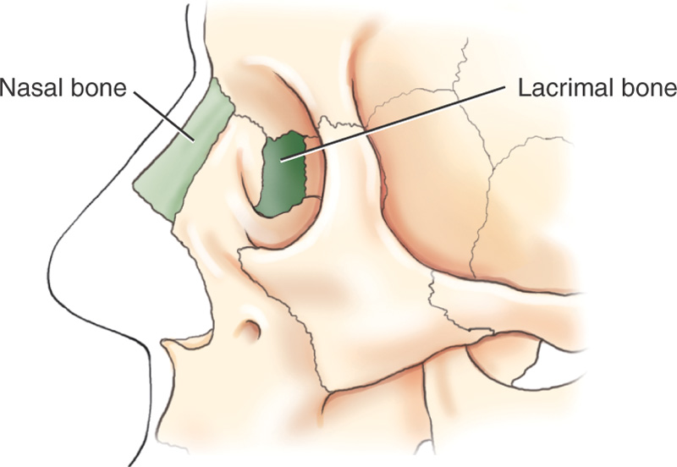
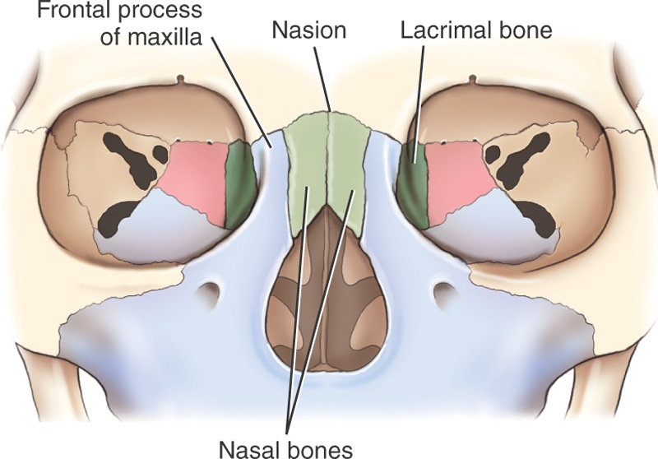
Nasal Bones
Each nasal bone articulates with 2 cranial bones and 2 facial bones
Frontal bone and ethmoid bone
Maxilla and adjacent nasal bone

