Slide 1


Infection Control for Makeup Services

Slide 2
OUR JOURNEY TODAY
Follow Infection Control Requirements for Makeup Services

Slide 3

Following proper infection control is important to keep you and your clients safe. Check your local regulations for proper makeup product and brush infection control requirements. Listed here are some basic infection control rules for makeup products and services. These safety measures should be followed when applying makeup to avoid product contamination.

Slide 4

Wash your hands before touching or applying makeup.
Do not touch product contents with your fingers as this can spread bacteria from your skin, causing contamination.
Do not touch open products with previously used applicators. This is called double dipping and can spread infection. Remove products with disposable, single-use spatulas and distribute onto clean palettes before applying.
When using pressed powders, scrape powders with a clean spatula onto a clean palette or clean tissue before applying.
Never apply lipstick, gloss, or eyebrow colors directly to the client from the container or tube. Use a spatula to remove the product, and then apply with a disposable applicator.
Never apply mascara directly to the lashes from the container. Use a disposable mascara wand to remove the product then apply with a new wand.
If the product is accidentally contaminated, follow your supervisor’s directions to either throw away the product or give it to your client. Do not put it back with your clean products to reuse.

Slide 5
To clean multiuse applicators, pencils, and testers, follow these guidelines:
Applicators—Use new or disinfected applicators, brushes, wands, and spatulas to distribute products. Disinfect multiuse tools after each use. Do not double-dip dirty spatulas, wands, or brushes back into products. Discard single-use applicators such as sponge tips, as these are porous and cannot be disinfected.
Pencils—Sharpen pencils and wipe with tissue; if they cannot be sharpened, they cannot be cleaned. Pencils with auto rollers or felt tips cannot be sharpened and should never be used on a client. Sharpeners must be cleaned and disinfected after each use, ensuring that all product is removed, and the blade is disinfected.
Testers—Keep testers clean in the retail area. To avoid contamination, assist clients who are using testers. Using fingers and double-dipping applicators will spread contaminants that can cause disease. Any contaminated makeup should be removed as a tester and discarded.
Palettes and supplies—Clean and disinfect artist trays, palettes, brushes, sharpeners, and foundation mixing cups after each use.

Slide 6
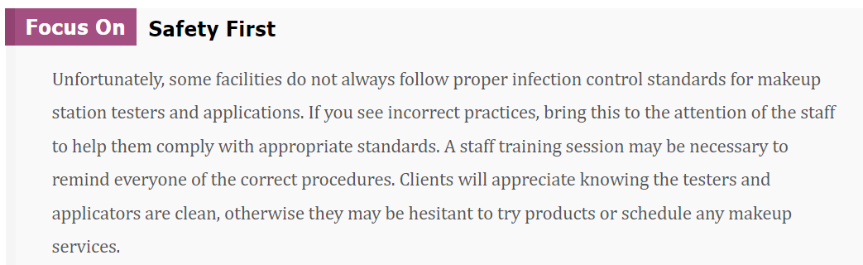

Slide 7


Slide 8

QUESTIONS?

