Slide 1


Process of Consultation, indications, and contraindications for facials
Determine Treatment Contraindications through Evaluation, Analysis, and Consultation

Slide 2
Indications points to or refers to when a treatment, medication, skin therapy, skin care or an esthetics treatment is advised, and will be productive with good outcome for the client
Contraindications are factors that prohibit a treatment from being performed or the use of a certain skin care product being used on a client’s skin. Certain treatments could cause harmful or negative side effects to those who have specific medical or skin conditions.
Indications vs contraindications

Slide 3
Communicable diseases, skin disorders, medical conditions, medications, and skin irritation can all contraindicate, or prohibit, a service or use of a skin care product. The client may list a communicable disease on the client questionnaire. Recognizing diseases is vital to avoid causing harm to clients or to you.

Slide 4
For Example:
Medications or topical exfoliating agents may make the skin too sensitive for facials or waxing.
Certain medical conditions, illnesses, and diseases, such as cancer, may contraindicate any stimulation to the face or body
Allergies and sensitivities to skin care products must be evaluated
Clients who have obvious skin conditions such as open wounds, cold sores (herpes sim-plex), or other abnormal-looking conditions should be referred to a med-ical provider for evaluation and approval for esthetic treatment.

Slide 5
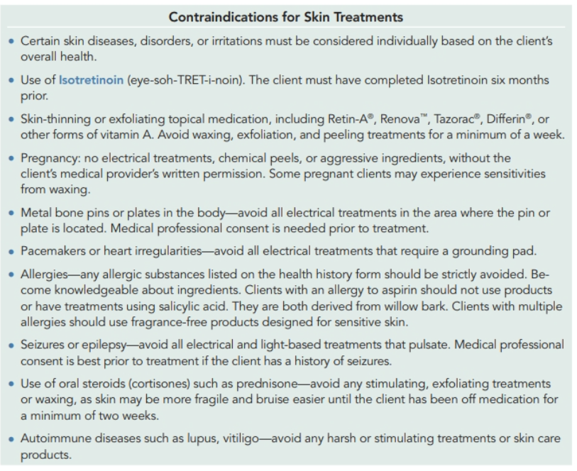

Slide 6
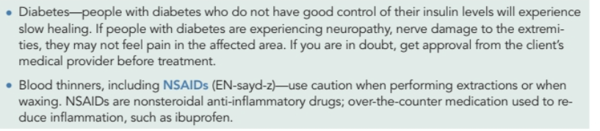

Slide 7
A thorough client consultation is important for many reasons. The mostimportant is to determine that a treatment is appropriate for the client or that the skin care products will benefit the client’s skin. A consultation will help you to determine why a client may be unhappy with their skin or appearance. Health, lifestyle, occupation, and more affect the skin. Sometimes estheticians are like detectives, trying to determine why the client is having a certain skin problem. The more you know about your client, the more you can make appropriate recommendations for skin care and treatments.
The Consultation process

Slide 8
HOW TO PREPARE FOR THE CLIENT CONSULTATION
1. Is the client comfortable? You are about to begin an important conversation with them that will clue you in to their needs and preferences.
2. Is your work area freshly cleaned and uncluttered? 3. Are all other appropriate tools to perform the desired service ready for use?
4. Do you have a pen or laptop/tablet along with vendor-supplied or salon-manufactured pamphlets, photos, articles, or clinical research papers? These items will help you to present the services or explain the benefits of certain ingredients that will be used to perform a treatment.
5. Do you have step-by-step photos of the actual treatment process? Photos can be helpful in letting clients know what to expect. If you have a satisfied client whose progress is significant, it is extremely important to gain their permission to use such photos for promotional purposes.
6. Will you be able to discuss whom the best candidates are for specific treatments to help decide if the treatment is suitable for a client?

Slide 9
FORMS
You should have at least three forms for a new client, but most clinics will have more, depending on how many services they offer:
Intake form: also called a client questionnaire
Health history form, or consultation card
Consent form
Client chart or service record card
Consent forms for each particular invasive service for insurance purposes
For the client: post-procedure guidelines

Slide 10
HOW TO USE THE CLIENT INTAKE FORM
The client intake form should be mentioned the moment a new client calls the skin care salon or spa to make an appointment. When scheduling the appointment, let the client know that you and the Spa will require some information before you can begin the service.
Some salons ask clients to arrive 15 minutes before their appointment time for this purpose.
You will also have to allow time in your schedule to conduct a 5-to 15-minute client consultation, the verbal communication with a client to determine desired results, depending on the type of service you will be performing and the client’s needs.
Some schools or facilities ask clients to sign and date the intake form, especially when more advanced procedures are involved, while other facilities use the consent form for this purpose.

Slide 11
HOW TO USE THE CONSENT FORM
When introducing the consent form to clients, take time to review all the steps involved in the treatment process.
Be sure to carefully explain any home care directions that may be necessary.
Provide the client with a copy of the consent form, and keep the original for your files.
It is also wise to maintain a treatment log and have the client initial and date all subsequent treatment procedures.
These extra precautionary measures go a long way in safeguarding both you and the client

Slide 12
QUESTIONS TO ASK DURING THE CONSULTATION
What is the reason for your visit? (What brought the client in? Is it for a treatment or just relaxation?)
What are your skin concerns? (What are they bothered about?) · What are your skin care goals? Are you preparing for a special event? When is it?
What is your home skin care routine? (How many products does the client use at home? What are the ingredients, and how often are they used?)
Have you had treatments before? (Is this the client’s first treatment of this type?)
Do you have allergies to products or scents? · Is this a normal state for your skin? (Is it normally clearer? Is it usually less irritated?)
How does your skin feel during different times of the day? (What is the degree of oiliness or dryness?)
Do you wear sunscreen? What is the SPF value? · Tell me about your diet. Do you eat a healthy diet? How much processed food do you eat? How often do you eat out?
How much water do you drink? · What is your activity level? Are you often outdoors? · Do you smoke? · Any other allergies? · How stressful is your lifestyle? Are you under a lot of stress right now
Have you had any esthetic procedures prior? How long ago? Are you happy with the results?

Slide 13
The S.O.A.P chart is the most used in the Medical Esthetics Business
S.O.A.P stands for
Subjective
Observation
Assessment
Plan
The S.O.A.P Chart

Slide 14
Subjective : During the initial consultation, you will ask what brings the client in, and what are the main concerns
Objective: During the consultation, you will analyze the real and possible solution that can be achieved with treatment
Assessment: You will educate the client on what is the real expectation and treatment to be provided and what are the real areas that need to be addressed
Plan: This will be your plan of treatment and homecare that you will share with your client

Slide 15

The skin care consultation and skin analysis is your moment to make the clients aware of what you note about their skin condition, and what services or products you offer that could benefit them.
The consultation is also a marketing and educational opportunity to introduce services and products to the client. Once you learn about ingredients and start performing skin care treatments, you will be recommending products.
Think about how you can help the client through treatments, home care suggestions, and preventative measures.
Conduct the consultation, discuss what you see with the client, and give recommendations during the analysis or after the treatment.
It is beneficial to practice skin analysis before diving into products and treatments.
Each subject you study gives you a foundation to build upon for the next step.

Slide 16
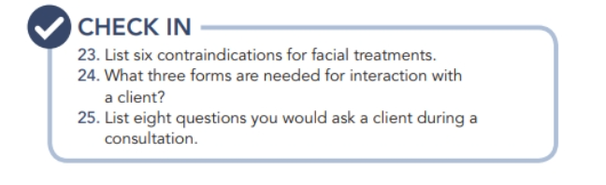

Slide 17

QUESTIONS?

