Slide 1


Hormones and the Skin

Slide 2
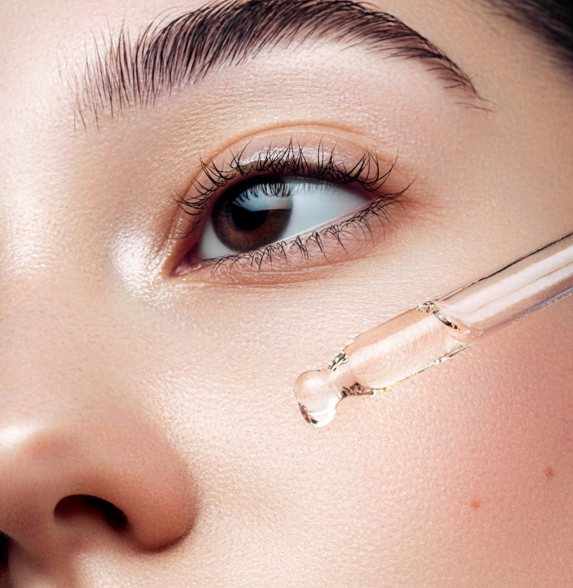
Hormonal Changes in the Reproductive System Can Affect the Skin

Slide 3
Why is it important?
with the reproductive system affect the skin in many ways. Understanding that you cannot cure acne because of the hormonal changes of puberty or perimenopause will help you create skin care options that will help your clients treat the symptoms. Loss of collagen and elastin related to hormonal changes with aging, assisting your client with hair removal options due to fluctuations in hormones, or spending time treating your client’s melasma will be rewarding because you have a solid understanding of the cycles of the reproductive system.

Slide 4
The reproductive system produces the hormones estrogen, progesterone, and testosterone
Estrogen is dominant in females, and testosterone is dominant in males.
Hormone balance, or lack thereof, affect the skin in several ways. Acne, loss of collagen and elastin, loss of scalp hair, facial hair growth and color, and changes in skin pigmentation such as melasma (pregnancy mask) are some of the results of changing, or fluctuating, hormones.

Slide 5

Hormones and skin health

Slide 6
Research activity Time. 30 min
Close your books and do your own interent research,
How do hormones affect skin health?
Write down the main factors
Share with the rest of the class

Slide 7

QUESTIONS?

