Slide 1

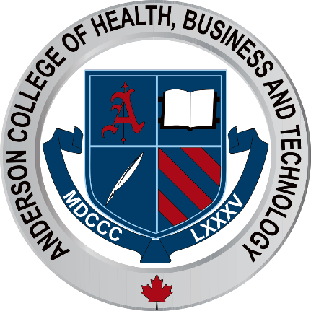
Hydrafacial Oxygen Jet Peel Machine

Slide 2
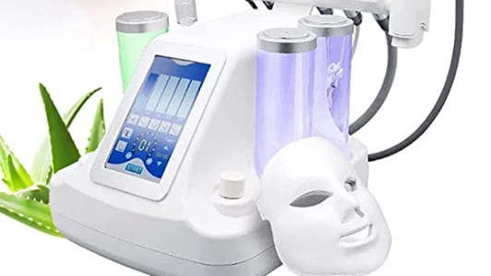
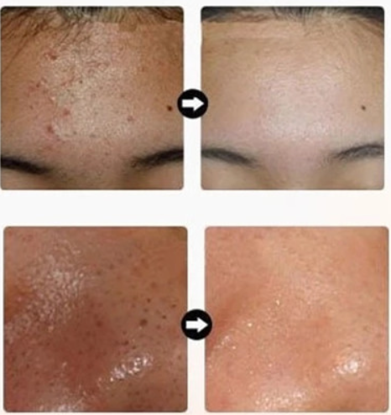
Hydrogen Oxygen Facial Machine

Slide 3
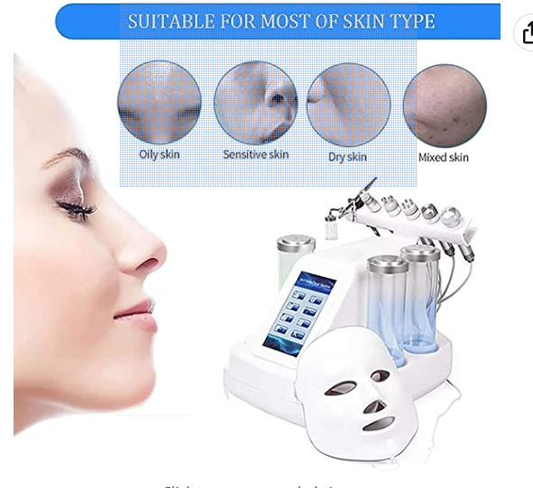

Slide 4
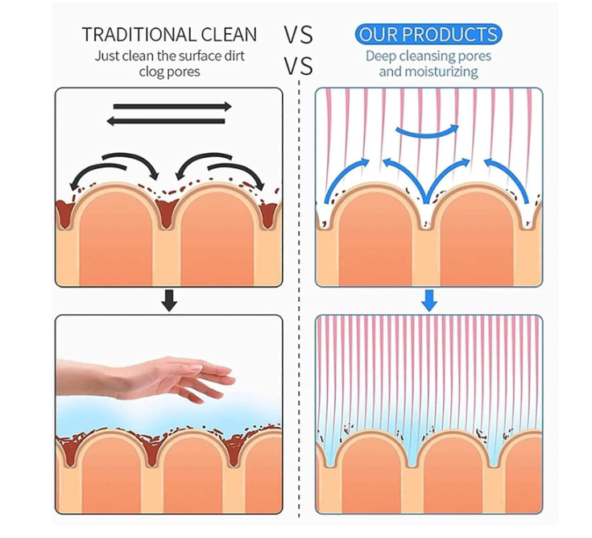

Slide 5
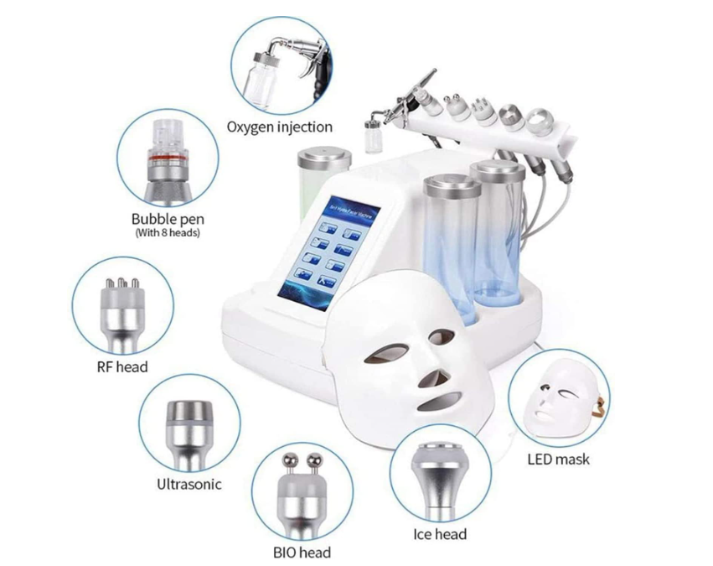

Slide 6
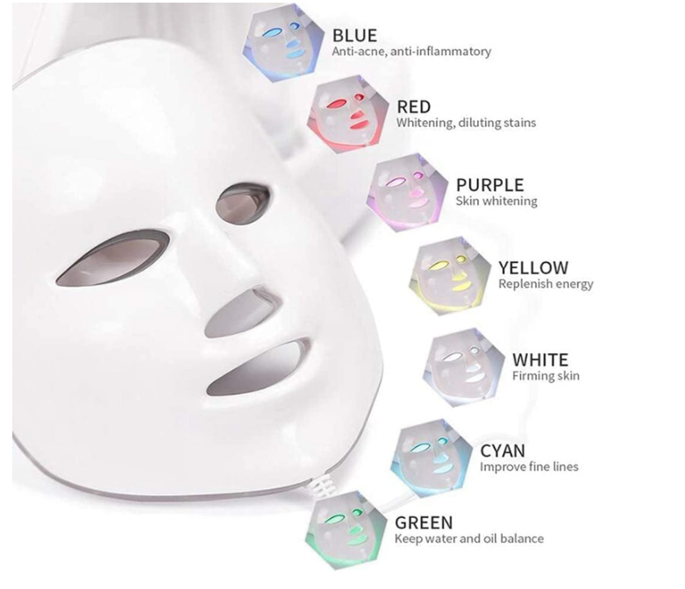

Slide 7
Features
8-in-1 facial beauty massager with multiple facial skin care functions: removes skin debris replenishes natural nutrients to rejuvenate cells; firm skin and reduce fine lines Increasing suppleness
Deep clean skin. Helps to gently exfoliate and cleanse the face of blackheads, dirt, dead skin, blemishes, oil and grime. Helps reduce fine lines and wrinkles, soften semi-hardened sebum pores, cleanse sebum metabolism in oil ducts, and keep pores clean.
Through advanced technology, pure water is converted into hydrogen-oxygen so that solution can quickly penetrate the skin, cleaning and improving blood circulation, increasing metabolism and stimulating the growth of collagen cells.

Slide 8
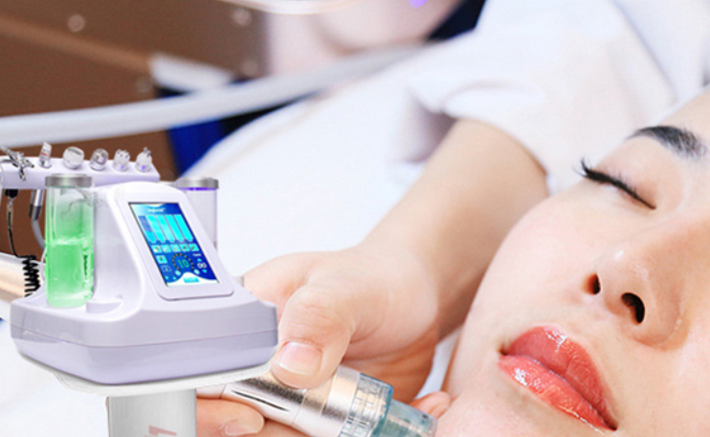
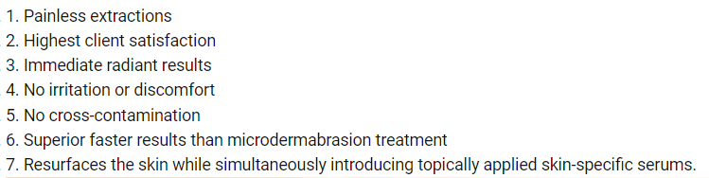

Slide 9
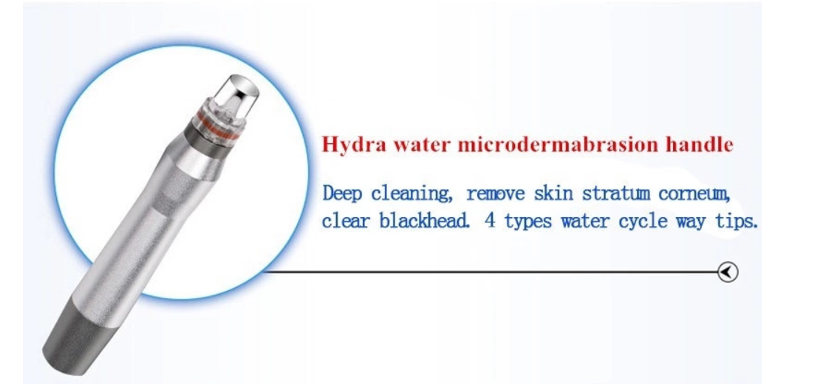
Handle Introduction

Slide 10
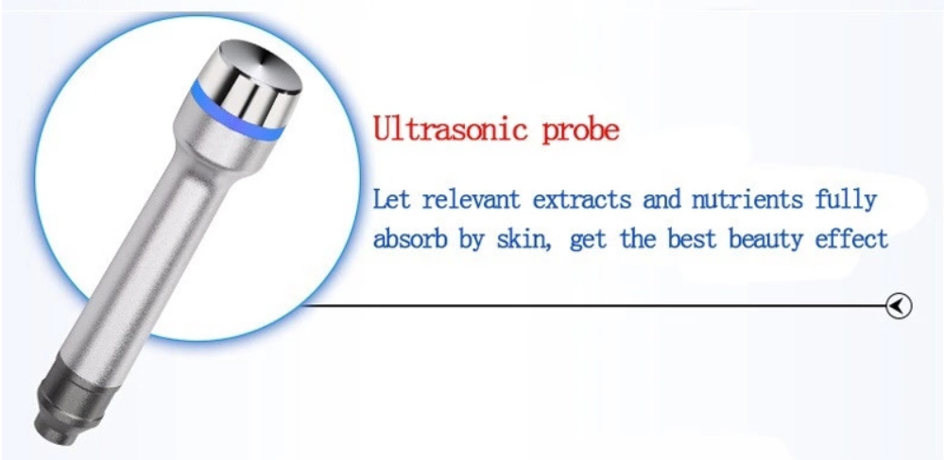

Slide 11
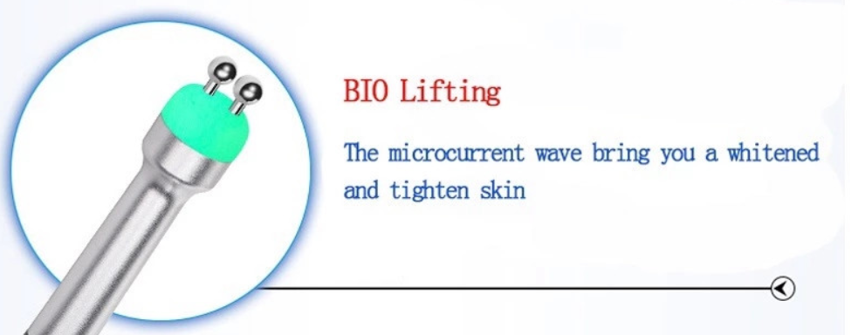

Slide 12
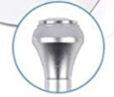
Cold Hammer
Calms Skin
Good for puffy eyes
Cools down skin after heat treatments
Soothing and refreshing

Slide 13
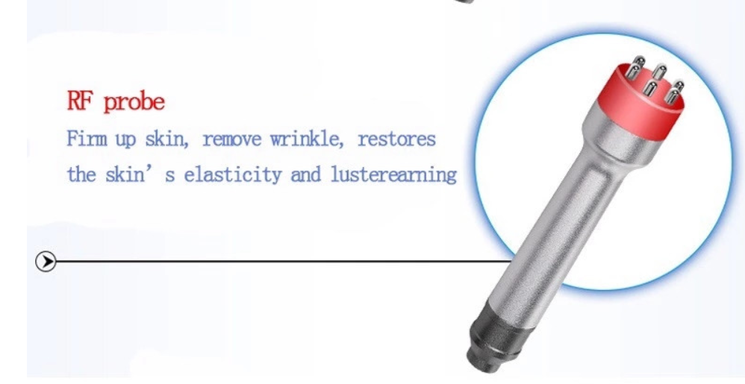

Slide 14
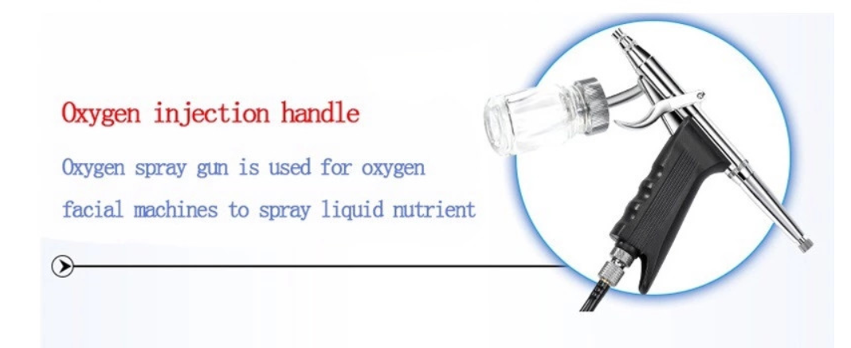

Slide 15
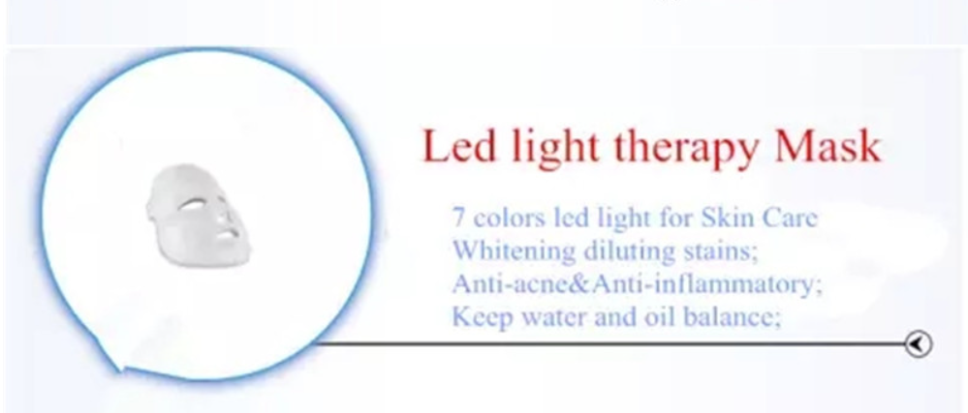

Slide 16
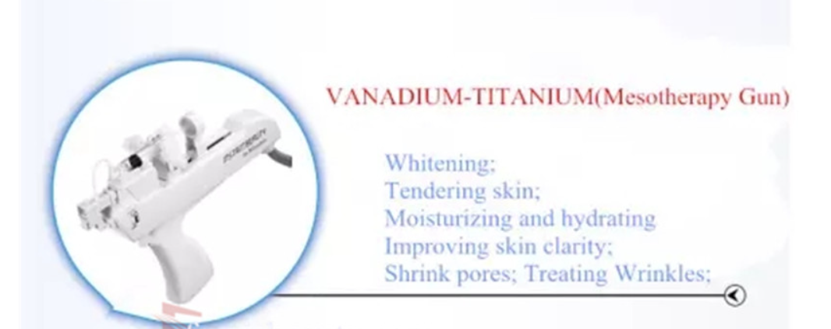

Slide 17

QUESTIONS?

