Slide 1


Medical Esthetics
Infection Control Lesson #2

Slide 2
Professional Duties and Responsibilities
Understand what causes disease
Understand how diseases are transmitted
To apply infection and transmission control by providing a safe environment
To become well educated with chemical products
Prevention begins and ends with you

Slide 3
Terminology
Disease:
is any abnormal condition of all or part of the body, its systems, or its organs that makes the body incapable of carrying on normal functions
Infection :
the invasion of body tissues by disease-causing pathogens

Slide 4
Modes of transmission
DIRECT
INDIRECT

Slide 5

QUIZ TIME
What do you think direct transmission is?

Slide 6
What do you think indirect transmission is ?
???

Slide 7

Activity
Look around your classroom and identify all the surfaces, tools, doorknobs, fixtures, etc., that constitute routine sources of contamination. List them as a class, along with possible preventive measures you can take to reduce this transmission.

Slide 8
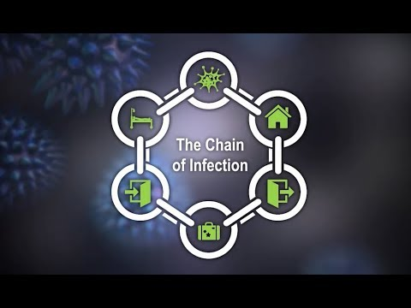
Let's learn precautions !

Slide 9
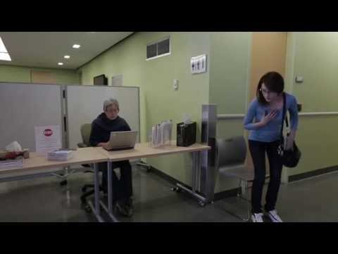
Airborne Transmission

Slide 10
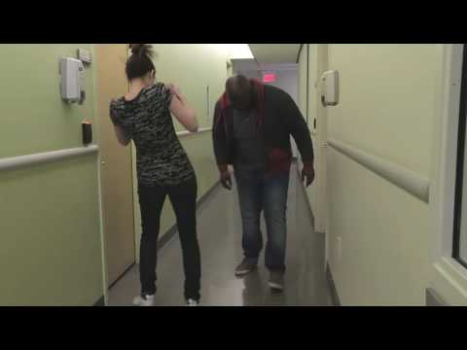
Droplet transmission

Slide 11
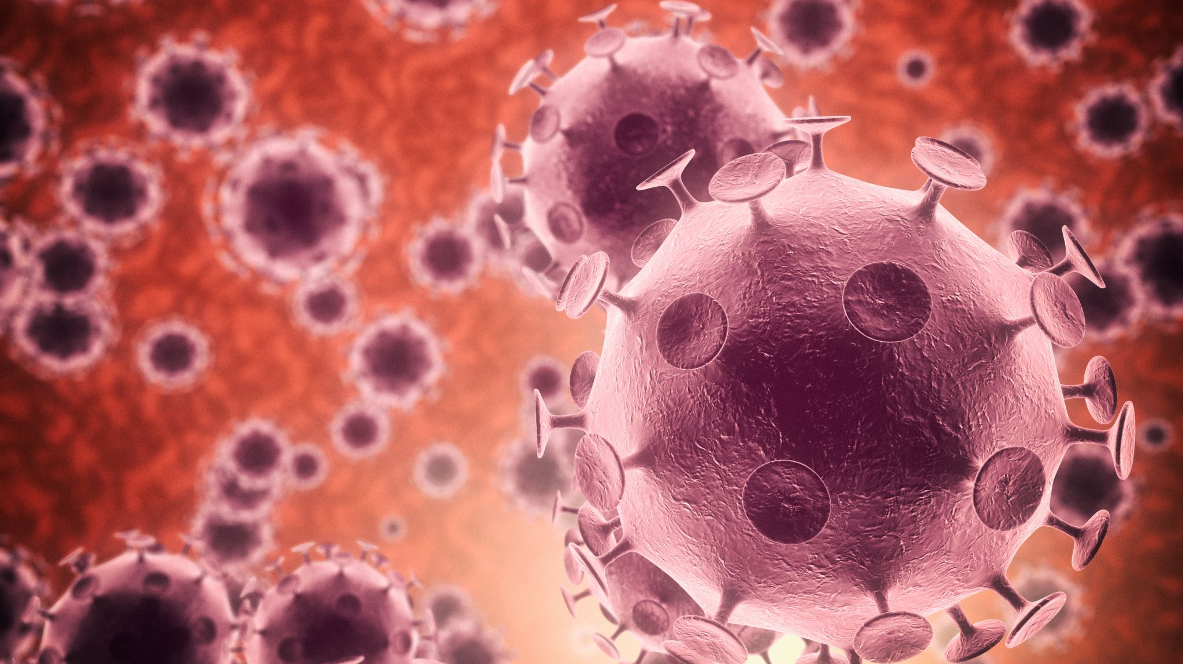
Infectious Disease

Slide 12
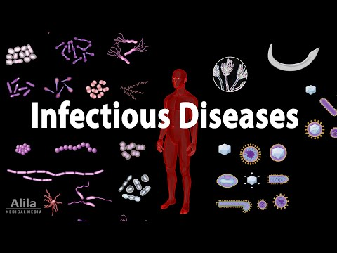

Slide 13
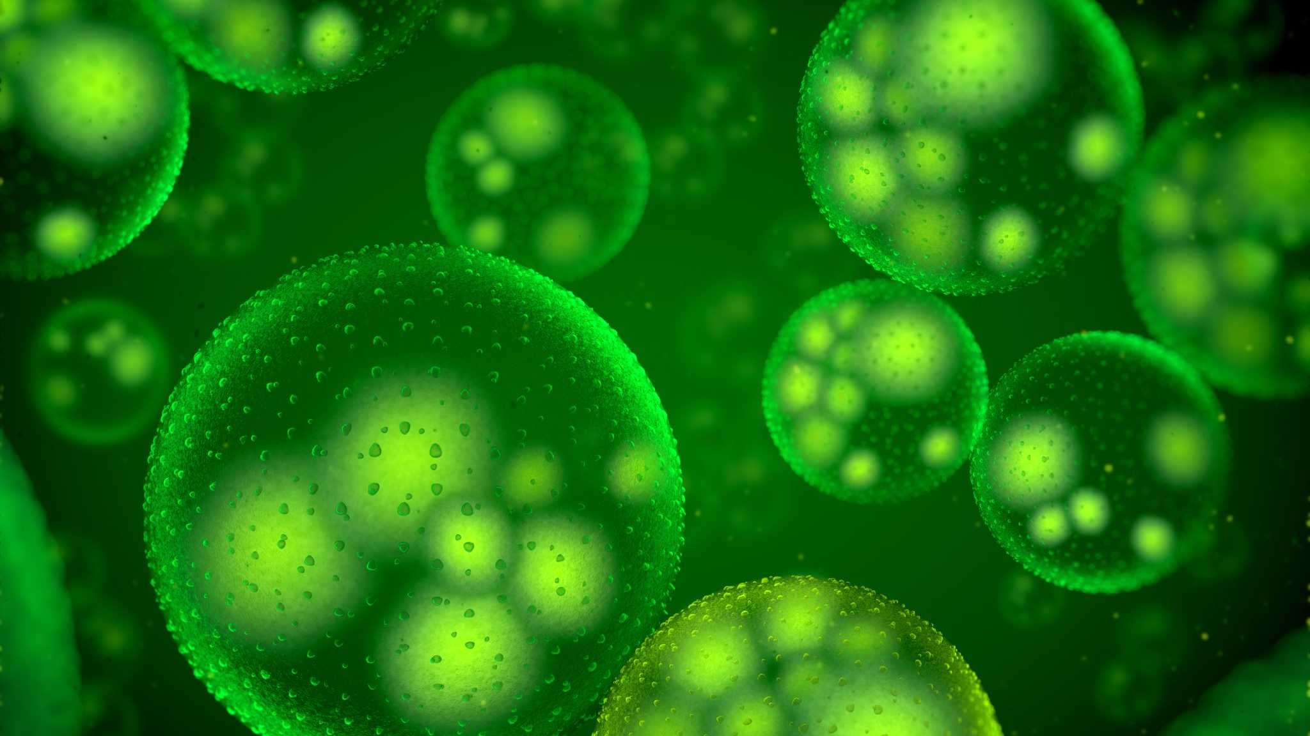
Bacterial Spores

Slide 14
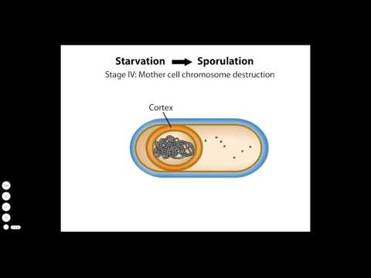

Slide 15
Terminology
Bactericidal : capable of destroying bacteria
Virucidal : capable of destroying viruses
Fungicidal : capable of destroying fungi

Slide 16

Quiz Time !
What is the difference between direct transmissions and indirect transmission

Slide 17
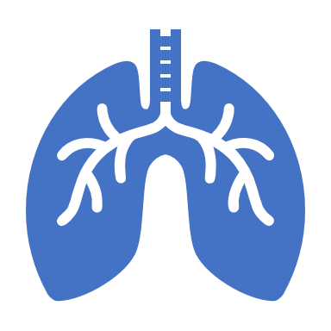
What is the difference between airborne transmission and respiratory droplet?

Slide 18

Conclusion
Safety starts with you and ends with you !

