Slide 1


Medical Esthetics
Treatment Room Preparation

Slide 2
Treatment Room Preparation Is an Integral Part of Providing Treatments
Treatment room setup includes choosing and properly installing and arranging furniture, equipment, supplies, and products. Included in this chapter are easy-to-use checklists and advice for setting up, cleaning and disinfecting, and keeping the room well stocked. Whether you intend on becoming a salon or spa owner, being a member of an esthetic staff, or performing treatments at a spa or salon on a freelance basis, maintaining the highest standards in professionalism, personal hygiene, and image, as well as following proper protocol, is vital to your success. After the facial service, it is critical to follow proper cleaning and disinfection protocols to prepare the treatment room or station for the next client.

Slide 3
Cell Protection
The health of skin cells depends on the cellular membrane and the water-holding capacity of the stratum corneum. Phospholipids, glycolipids, cholesterol, triglycerides, squalene, and waxes are all different types of lipids found in the stratum corneum and cell membranes.
Intercellular lipids and proteins surround cells and provide protection, hydration, and nourishment to the cells.
Ceramides are a group of waxy lipid molecules such as glycolipids that are important to barrier function and water-holding capacity.
Fifty percent of the lipids in the stratum corneum are ceramides.
Fatty acids are also components of the intercellular substances.
Lipids are reduced if the skin is dry, damaged, or mature.

Slide 4
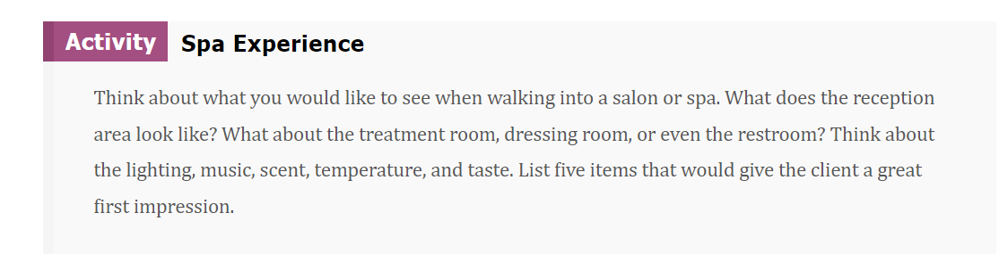
The Ideal Ambience

Slide 5
The Proper Spa Environment Should Engage
All Five of the Senses
Proper lighting
The music selection
Temperature is very important as well to keep clients feeling warm enough in the treatment room, or properly cooled if it is hot outside.
Scent is crucial in a spa environment. Scents should be soothing and natural.
Taste. Offer naturally flavored waters and small healthy snacks for refreshment in the reception area to promote the energy and well-being of your clients. All these engagements will heighten the client’s positive perception of the spa.

Slide 6
When setting up a room for treatments, think about the services you will perform and how you will work at the station. Another consideration is how comfortable the client will be on the treatment table (be sure to consider the needs of all genders as well). Ensuring client safety and following health regulations are the two most important considerations before, during, and after treatments.

Slide 7
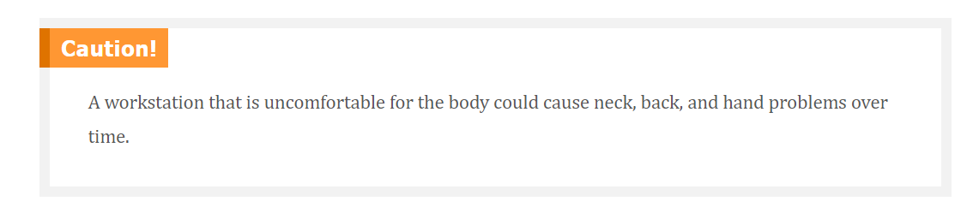

Slide 8
Checklist
A. Treatment table (also called a facial chair, table, or bed)
B. Esthetician’s chair, or operator’s stool
C. Step stool—If you do not have an electric treatment bed or table, a step stool helps clients get on and off the bed safely. Make sure the stool is stable. Assist clients if they need help.
D. Trolley or utility cart
E Magnifying lamp or light
F. Steamer (only when needed )
G. Galvanic, high-frequency, brush, vacuum, and spray machines ( Only when needed )
H. Towel warmer, or “hot cabi”—Hot towel cabinets keep warm, moist towels ready
I. Closed, covered waste container for trash—
J. Closed, covered laundry hamper with foot pedal is ideal for preventing contamination.
K. A sink or basin for water is essential in a treatment room. You should always have access to clean water during treatments.

Slide 9
For This Beginning Weeks You Will Need Only
A. Treatment table (also called a facial chair, table, or bed)
B. Esthetician’s chair, or operator’s stool
C. Step stool—If you do not have an electric treatment bed or table, a step stool helps clients get on and off the bed safely. Make sure the stool is stable. Assist clients if they need help.
D. Trolley or utility cart
E Magnifying lamp or light

Slide 10
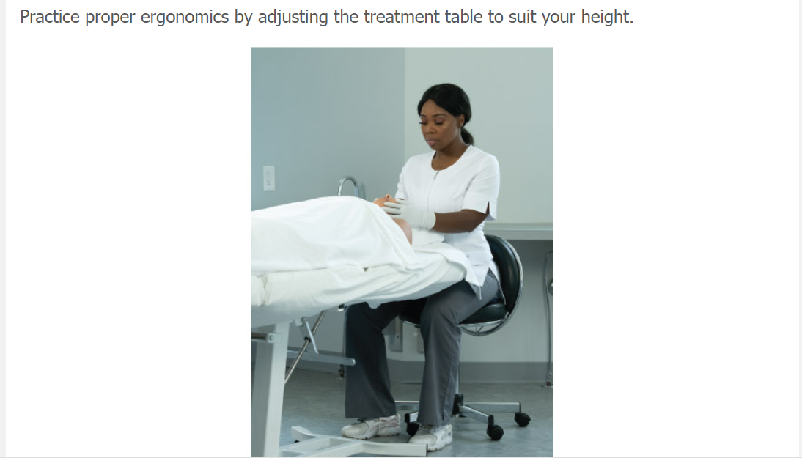

Slide 11
Properly Manage Treatment Room Supplies and Products
Part of your success as an esthetician involves properly managing supplies. Like a great chef, having a clean, uncluttered workspace with all the items you need to perform the service easily within reach is key to performing a successful treatment or procedure. If you have to stop a procedure to find supplies, it decreases the client’s satisfaction. Also, supplies such as facial masks, moisturizers, and other high-end products can be costly, so proper inventory control is important to either helping sustain your employer’s business or keeping to your own budget if you are self-employed.

Slide 12
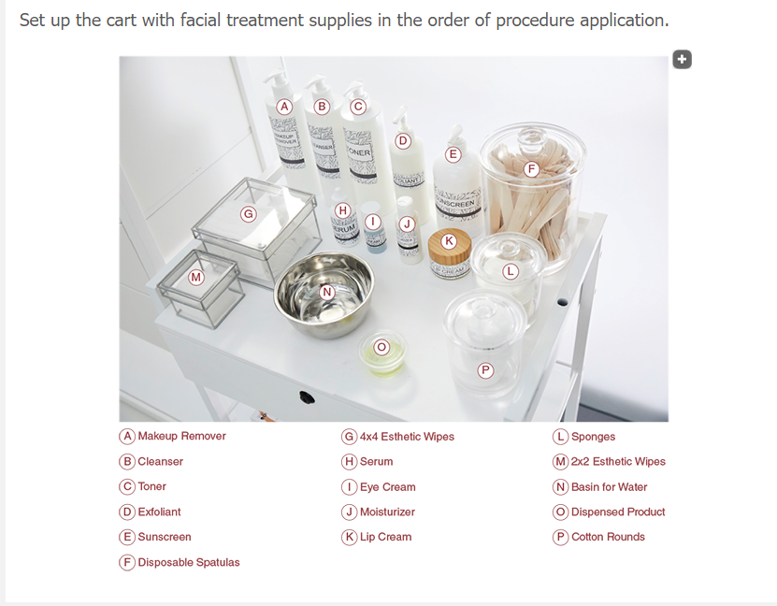

Slide 13
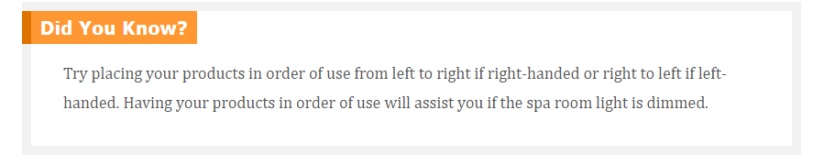

Slide 14
Supplies can be multiuse, as in sheets or a hand-held mirror, or single-use, such as a cotton swab or lancet.
Single-use items must be disposed of immediately after use in a closed-lid trash can or sharps container.
Proper storage is necessary to keep items clean and sterile, so they must be kept in clean, covered, labeled containers.
If supplies and products are not kept in the treatment room or at workstations, then they are typically kept in a dispensary or storage closet, which is a separate room for storing supplies
For proper inventory control, please adhere to your instructor directions on how to properly use the products and how to set up the treatment trolley accordingly.

Slide 15
Facial Treatment Supplies and Implements (beginning )
A bed warmer (optional)
A bolster for back support, placed under the knees
A hand-held mirror
A pillow or rolled hand towel for neck support
Blankets to cover the client
Bowl or basin for water
Client chart and home care prescription card/pad or computer for database
Client gown/wrap for the client to change into
Glass or plastic containers to hold cotton pads or other supplies or products
Linens such as sheets and face and hand towels (either cloth or disposable)
Rubber mixing bowls to warm or mix product in
Metal or wood spatulas to disperse products from jars
Tongs to handle hot towels and retrieve clean items

Slide 16
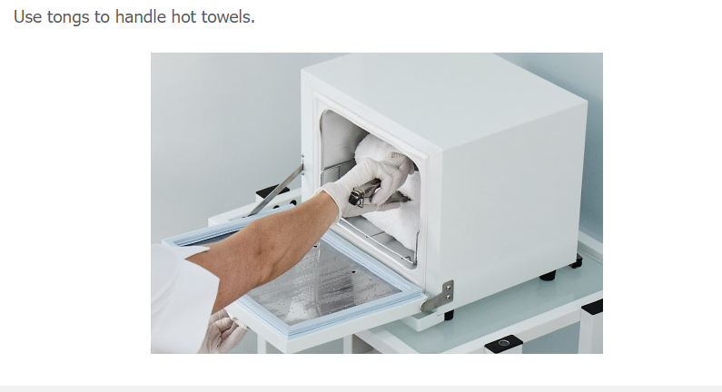

Slide 17
Single-Use Items
Client headband to protect the hair and hold it out of the way
2” × 2” (5 cm × 5 cm) esthetics wipes, for cleaning and for product application
4” × 4” (10 cm × 10 cm) esthetics wipes or single-use sponges to remove product from the skin (sponges are porous and cannot be disinfected or reused)
Disposable vinyl or nitrile gloves (latex is not recommended, as many people are allergic to latex and oil can break down the latex, compromising the protection of the gloves)
Fan and mask brushes to apply masks or massage lotions.
Fragrance-free tissues
Gauze squares for use with certain facial treatment
Paper towels

Slide 18
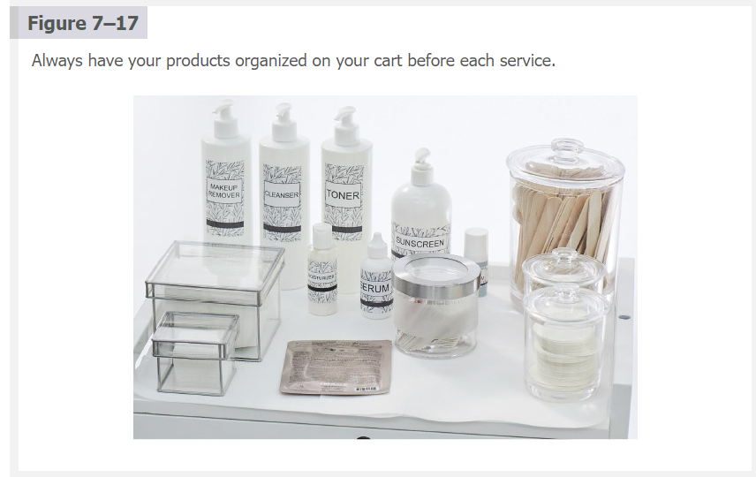

Slide 19
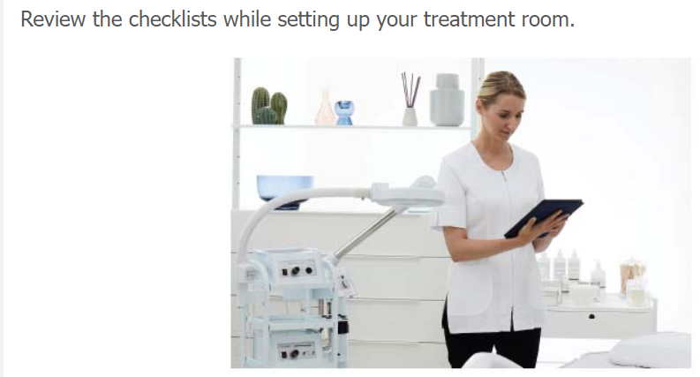

Slide 20
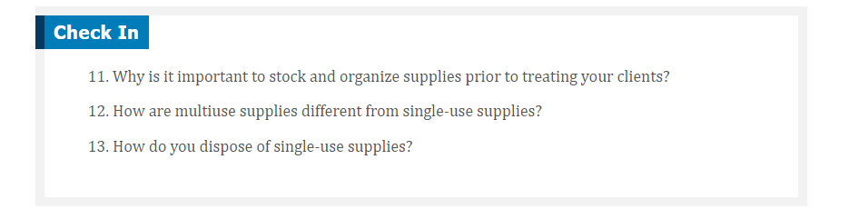

Slide 21

QUESTIONS?

