Slide 1
MRAD 285: Radiographic Applied Skills
Trauma, Adaptive and Non-Routine Patients

Slide 2
Trauma vs Adaptive Radiography
Adaptive Radiography is an umbrella term for any imaging that is out of the norm
  Variation from the norm
  Adaptations are often made without even realizing it!
    Adjusting centering points
    Compensating for body habitus
    SID
    Mobility
Trauma is a type of adaptive radiography

Slide 3
Positioning
Basic Principles – important to have good knowledge of the ‘textbook’ positioning techniques
  Centering points
  Required anatomy
  Angulation of tube
  Bony landmarks used for positioning
  What is best visualized? What is this position for?

Slide 4
Adaptations for Trauma
Exams typically done upright, may need to be modified to be done on the table
Instead of moving patient into position, may need to adjust IR and tube to achieve view
  Lateral vs x-table lateral
  Tube/IR angulation to compensate for part position
Working around support devices
  Collars, splints, casts, immobilization

Slide 5
Trauma Principles
Principle #1:
  Two projections at 90° to each other with true CR – Part- IR alignment
Principle #2:
  Entire structure or trauma area on IR
Principle #3:
  Maintain the safety of the patient, health care workers and the public

Slide 6
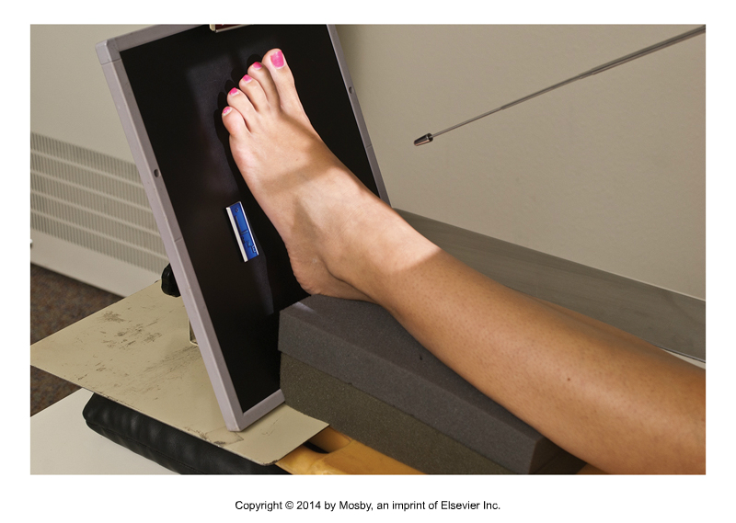
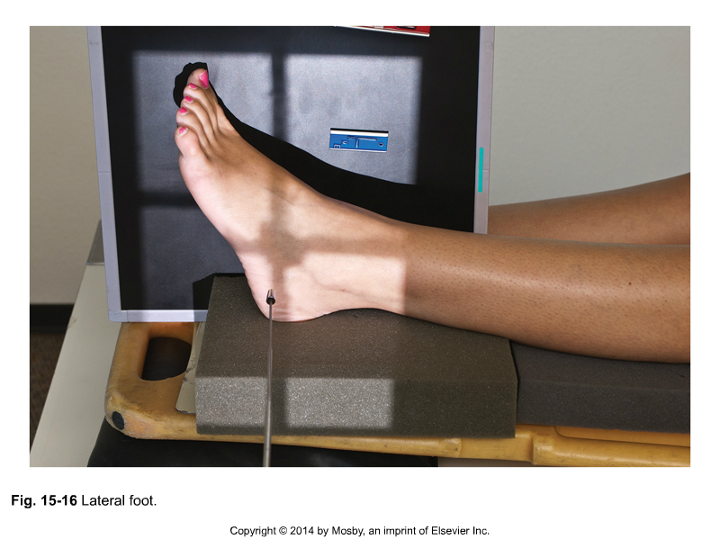
Principle #1 – 2 images at 90°
Bontrager 15- 23, 15-24
Trauma exams generally require 2 images at 90° to each other
  One image of true AP/PA and the second image a lateral
  If part cannot be positioned or turned, can achieve this by angling CR and IR as needed

Slide 7
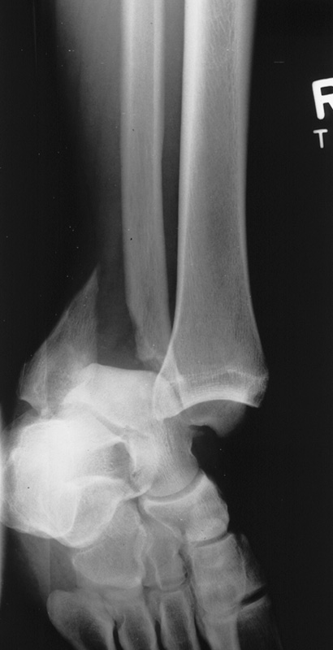
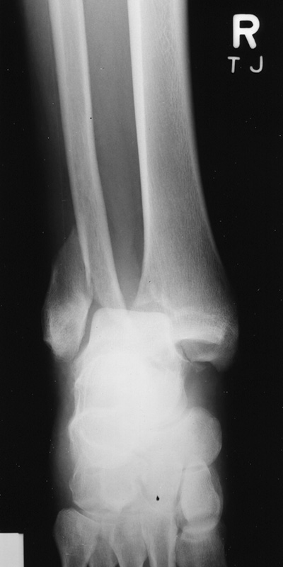
Examples of Principle #1
Two projections 90° from each other
Adapt CR angles
and IR placement
to minimize further
injury or discomfort
to the patient

Slide 8
Principle #1
If adaptations are made, important to document information regarding how the image was achieved
  i.e. x-table, PA vs AP, R lateral, CR angle, pt position
Exceptions:
  True AP and Lateral
    Still try to achieve 2 images at 90° to each other, even if both are slightly rotated/oblique
      Might be working with unavoidable obstructions (i.e. traction bars, large splints/supports, etc)
    Only as last resort, just one projection

Slide 9
Exception
CR- Part – IR alignment
  Purpose is to minimize distortion of image
  Exceptions can be made within reason to achieve image (i.e., axial, oblique)
    Minimal part distortion can be an acceptable option
    e.g., oblique c-spine as shown
      Anything else?

Slide 10
Principle #2 – Entire structure/area on IR
Entire structure should be included on image
  Use more than one IR if needed
Long bones – include both joints
  i.e., tib/fib, humerus
Ensure part is not projected off of IR due to divergent beam
  Check the shadow
  Elevate part where possible, or drop IR lower
    Keep in mind any spinal precautions when elevating part – may have to adjust IR placement instead

Slide 11
Principle #3: Safety
Safety is a priority
Equipment may need to be moved around
  Be careful and observant
    IV lines, catheters, oxygen, other equipment
  Rails – stretcher or bed
    Do not assume pt will not move – put the side rails up whenever possible
Conscientious of all x-ray equipment
  Mobile, CR cassettes, grids, lead
When the exam is finished, put things back the way they were found
  e.g., siderails

Slide 12
Adaptive Radiography
For all exams, stick as closely to routine criteria and positioning as possible
We will be discussing some of the common modifications that can be made to routine positions
Review MRAD 204 and MRAD 256 positioning materials as needed
  Part position, IR size, SID
  Anatomy demonstrated
  Evaluation criteria

Slide 13
Chest X-Ray
Regular routine:
  PA and lateral done standing
Trauma/Adaptive Routine:
  AP and lateral (if possible)
  SID 180 cm when possible

Slide 14
AP Chest
Note: In situations of severe trauma or possible spinal injury – do not move patient without consultation or assistance from other medical personnel
Some stretchers will have a tray underneath where the IR can be placed
Alternatively, there are some stretchers that can be x-rayed
  Trauma stretchers can have images taken right through them - radiolucent

Slide 15
AP Chest
Semi-erect is ideal when possible, supine is the alternative
  Confirm the purpose of the exam
    i.e., for line placement, sometimes supine is preferable and a lateral is not required
Almost always non-grid
*Elevate the head end of the stretcher/bed as high as possible
If pt is not able to sit up high enough, then put them in a supine position
  If overcompensating for pt position with tube angle, image quality is compromised
    Too much distortion will occur

Slide 16
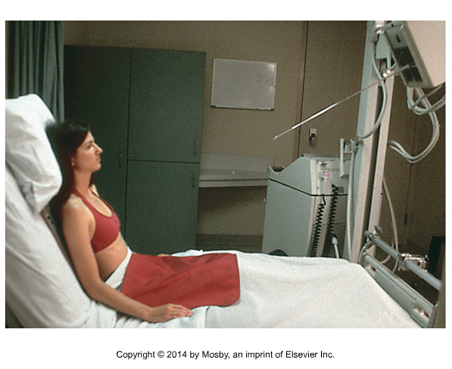
AP Chest
Need to add 5°
SID 180cm
CR perpendicular to the IR + add 5° caudad
  This places the CR ⊥ to the sternum
    Compensates for the upward divergence of the beam, preventing the clavicles from superimposing apices
Center midway between jugular notch and xiphoid process
  Include from apices (5cm/~3 fingers above jugular notch) to LCM
  Collimate (side to side) to AC joints
  Rotate arms internally if possible
  Expose on inspiration
Match angles first, then add the extra 5°
Hint: step back to determine angles, difficult to assess from up close
Bontrager 8th Edition 15-42, not included in 9th Ed.

Slide 17
Lateral Chest
Can be obtained in the department, if the patient can raise arms at least 90° from body
  Not done portably
Need to place radiolucent sponge behind patient’s back to move them off of the stretcher/bed/wheelchair
Same positioning criteria as routine exam
  SID 180
  Can turn collimator if needed

Slide 18
Decubitus Chest
Lateral Decubitus AP Chest
  Purpose: to determine air-fluid levels when the patient cannot sit up high enough for an upright
    For suspected fluid (pleural effusion) – affected side down
    For possible small amounts of air (pneumothorax) – affected side up
  Can be taken in bed with the IR behind the patient, or on a stretcher in front of the wall detector
  If possible, use sponges under the thorax and shoulders to include the “side down” on the IR
  Raise arms above the head
  Similar centering as AP supine chest
    Often both sides will be done for comparison

Slide 19
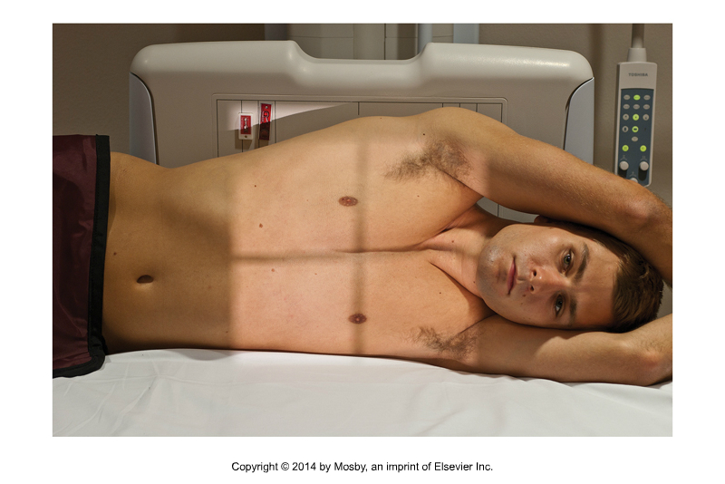
Decubitus Chest
Bontrager 15-43

Slide 20
Abdomen
AP supine and decubitus
SID: 110 cm (detector) or 100 cm (CR)
Left lateral decubitus – check the site protocol
  To be performed for patients who cannot stand
  Allows determination of air-fluid levels
  Can be taken in bed portably, or on a stretcher in the dept with the wall detector
  Always use a grid
  Can be done AP/PA, AP is often preferred
  Ideally: pt should lie on their side for a minimum of 5 minutes before exposure to demonstrate any free intra-abdominal air

Slide 21
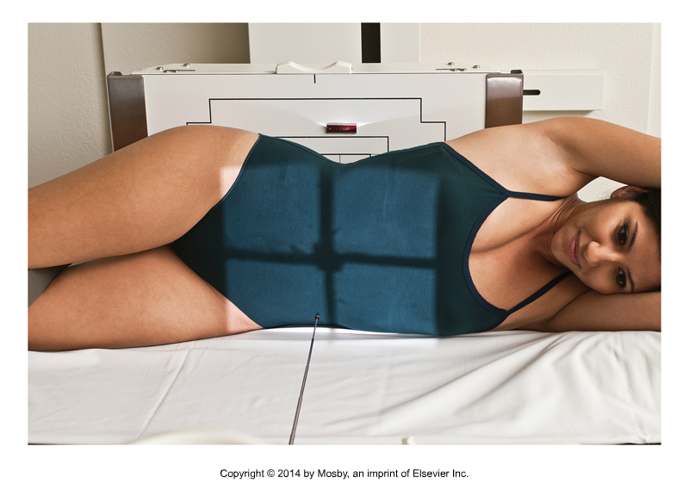
Abdomen – Left Lateral Decubitus
Ensure diaphragm and upper abdomen are included
If possible, put pt on a slider board or firm support – prevents pt from sinking into mattress
Check for rotation
CR is 1-2” above iliac crests
Bontrager 15-34

Slide 22
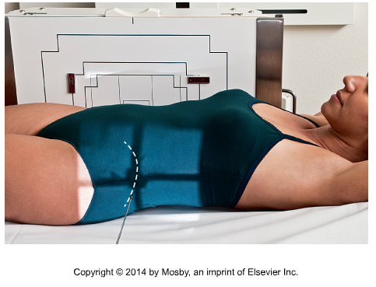
Abdomen – Dorsal Decubitus
Only to be used if patient is unable to be moved/positioned for the lateral decubitus
Patient remains supine, arms raised, and the image is taken with a horizontal beam
Bontrager 15-35

Slide 23
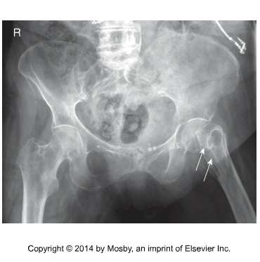
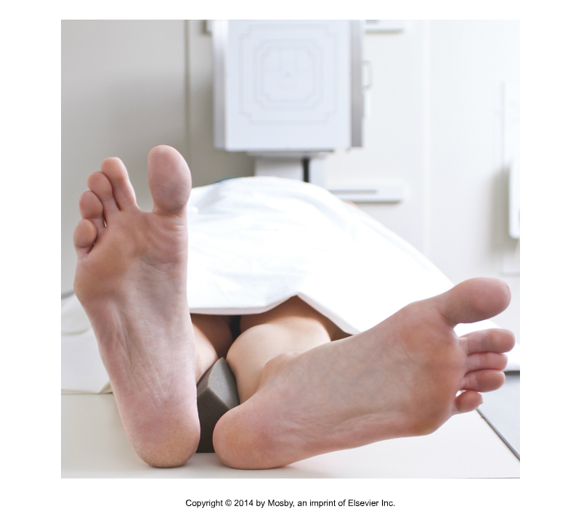
Pelvis and Hip (Femur)
***Caution: If # is suspected, do not attempt to rotate affected leg

Slide 24
Pelvis and Hip
AP Pelvis
  SID 110 cm on table or SID 100 cm on CR
  Initial examination for hip trauma should first include the AP pelvis
    Allows for bilateral comparison of both hips
  Same criteria as routine protocol – if injury is unilateral, still attempt the internal rotation of uninjured side
  If performed bedside with
  mobile – use grid

Slide 25
Hip - AP
AP Hip
  Position as routine
  Rotate leg 15° internally if possible
    Do not grab/rotate leg for patient
    Assess how much movement the patient has
    SUPPORT the movement, assist with immobilization if necessary
      i.e., Sandbags to help hold rotation if patient can tolerate it

Slide 26
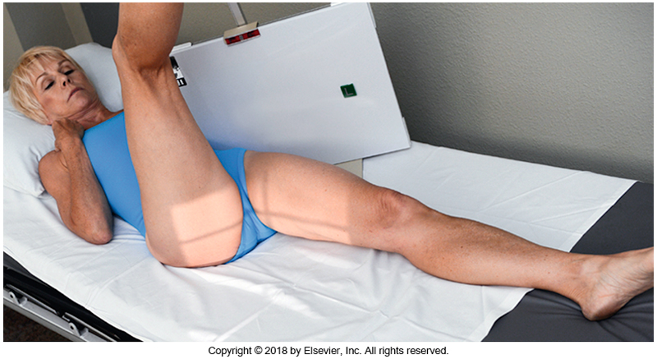
Hip- Axiolateral inferosuperior
IR size 24 x 30 cm with grid
Shielding can be placed on top of patient, ensuring it does not obstruct light field
Place IR against patient’s side for the hip being imaged, top of IR should be just above the crest
Elevate other leg – try to have pt bring knee towards chest not just up
CR positioned perpendicular to femoral neck and centered to grid
Bontrager 15-70

Slide 27
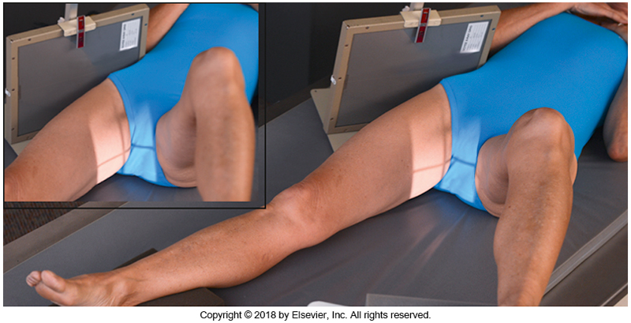
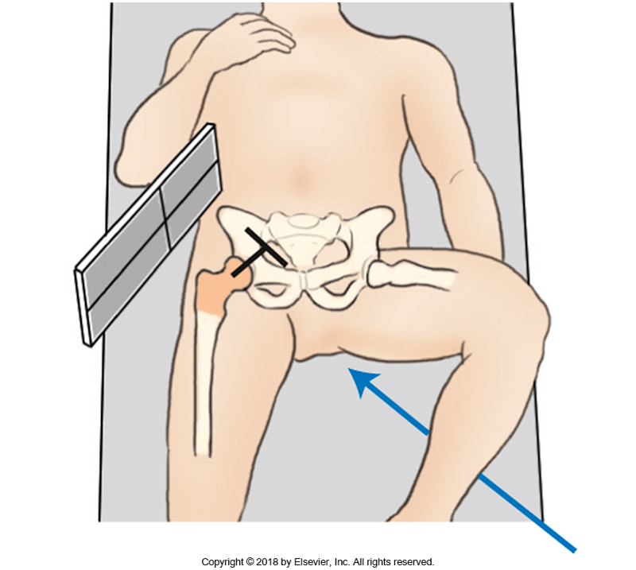
Axiolateral Inferosuperior Hip
IR needs to be perpendicular to
the central ray (CR)
Stand back to check angle of IR and tube
~ 45°
Bontrager Fig 7.69-7.70

Slide 28
Modified Axiolateral Hip
This is used when the patient is unable to tolerate the inferosuperior projection
  Limited movement in lower limbs
  Cannot lift leg
Can be done with CR and grid, or on the upright detector
  CR and grid method is ideal, as there is less distortion, but the upright detector method is more commonly performed

Slide 29
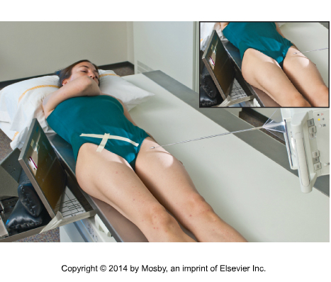
Modified Axiolateral Hip
Leg in neutral
position
Patient as close
to edge of the
table as possible
15° caudad angle
CR with grid on
edge with 15° tilt from vertical – to match tube angle
Angle CR mediolaterally to be perpendicular and centered to femoral neck
Bontrager Fig 7.74

Slide 30
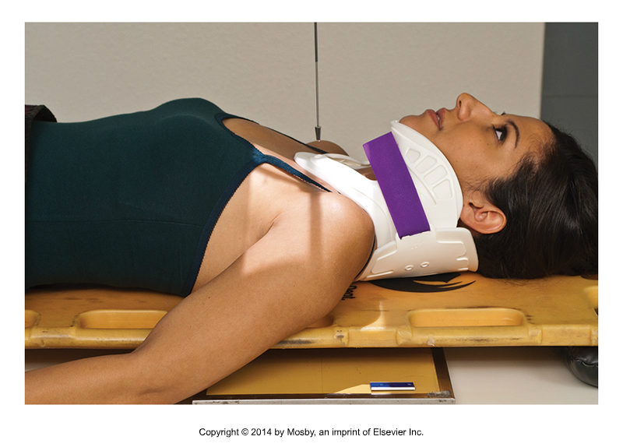
Adaptive Shoulder
AP can be done supine on the table/stretcher
Glenoid may/may not be required by physician
  i.e., post reduction exam – read the requisition!
  If required, can also be done on the table/stretcher, with pt obliqued using
  sponge
    Pt must be cleared of
    spinal precautions
Bontrager Fig 15.51

Slide 31
Adaptive Shoulder
Lateral Scapular Y (AP)
  110 SID
  24 x 30 IR
  Rotate pt into posterior oblique position with affected side elevated until the scapula is in true lateral – about 25-30°
    Hint: rotate the patient until the medial border of the scapula and the AC joint are lined up perpendicular to the IR
  Support patient with a sponge
  Arm can remain in neutral position by side
  Center CR to the midlateral border of the scapula
    * this will look strange, like you are centered on the arm

Slide 32
Adaptive Shoulder- Inferosuperior Axial
  *Can be used for any patient that has limited mobility and unable to tolerate the supero-inferior axial
18 x 24 cm IR
Position pt supine close to edge of table/stretcher
Turn head away from affected side, put IR as close against neck as possible and support
Abduct arm away from body (90° ideal), but for trauma, can be much less
Direct CR medially, centered to axilla and humeral head
  15-30° if arm is at 90°, decrease angle if arm is less than 90°
  *Hint: tube head and CR should be parallel – step back

Slide 33
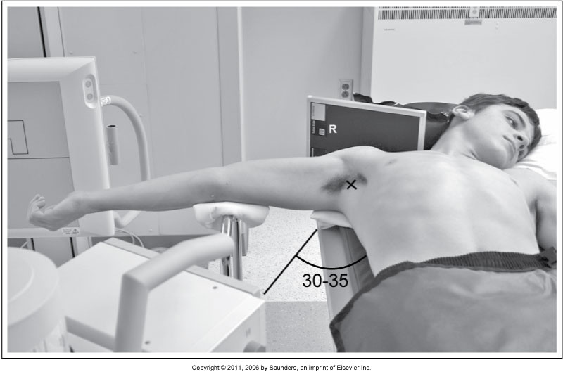
Adaptive Shoulder - Axial
McQuillen Fig 5-10

Slide 34
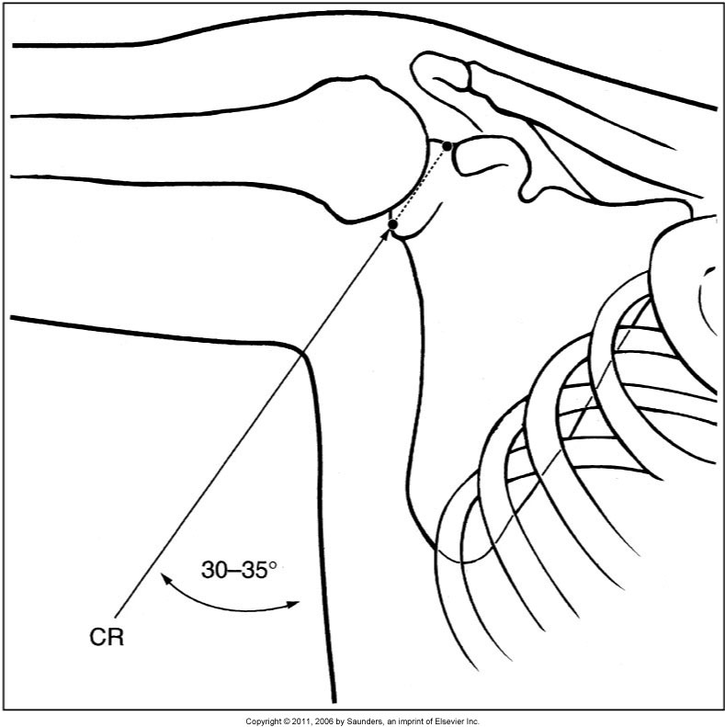
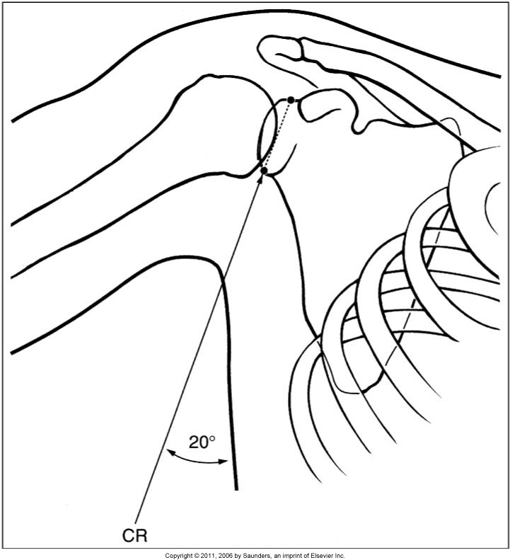
Adaptive Shoulder - Axial
Notice how the CR angle changes with the degree of arm abduction, so the CR can pass through glenoid
McQuillen Fig 5-11, 5-12

Slide 35
Trauma Spines
Do not remove c-spine collars, or move the patient’s head/neck until spines have been cleared by the physician
Make modifications around the patient as needed to obtain best images possible
  Some images may need to wait until the spine is cleared and collar is removed – annotate and communicate this to the physician

Slide 36
Trauma C-Spine Routine
AP
AP odontoid
X-table Lateral
Swimmers Lateral* (done x-table)
  Depends if C7-T1 are well visualized on x-table lateral

Slide 37
Trauma C-Spine Routine
AP
  24 x 30 cm IR
  IR placement with the top of IR 3-5 cm above the level of the EAM
  CR will be angled 15-20° cephalad to exit at the level of C4 (enter at the level of the lower margin of thyroid cartilage)
Odontoid
  If possible, have patient open mouth as much as possible WITHOUT moving head/neck
  Angle the CR if needed to be parallel to the line from lower margin of teeth to mastoid tip

Slide 38
Optional AP Axial C1-C2
If unable to attain open mouth odontoid
This image will show the dens within the foramen magnum
Similar to Fuchs method, but without extension of MML
CR angled to match MML
Angle approx. 35-40° or as needed to align the CR parallel with the MML
  Center CR to enter just inferior mentus

Slide 39
X-Table Lateral C-Spine
Place IR right up against shoulder, parallel to MSP – decrease OID
Top of IR (24 x 30) should be about 3-5 cm above level of EAM, level of C7-T1 should also be included
Important to have pt do their best to relax and lower shoulders as much as possible
If using a grid, ensure the CR is aligned to the center of the grid
Use SID of 180 cm if possible

Slide 40
Trauma Swimmers
X-table method, IR will be beside patient
5° caudad angle will be helpful if patient has trouble dropping shoulder
Check site protocol for what anatomy needs to be included
  Some may include EAM
Swimmers and Lateral can also be performed
with the patient on a stretcher, using the upright detector

Slide 41
Trauma T-Spine
This can also be performed if a patient does not have the mobility, or cannot tolerate being upright, or turning on their side
AP as routine
Lateral
  Careful consideration not to clip the spinous processes
    If taken on the table, pt will need to be built up
    Typically done on stretcher with board, mattress, or table mattress
  Raise arms above head or at least across chest
  Center at T7, at posterior half of MCP on spine
    Will appear low, but keep in mind where the spine lies
    Should not have light past MCP – just like routine

Slide 42
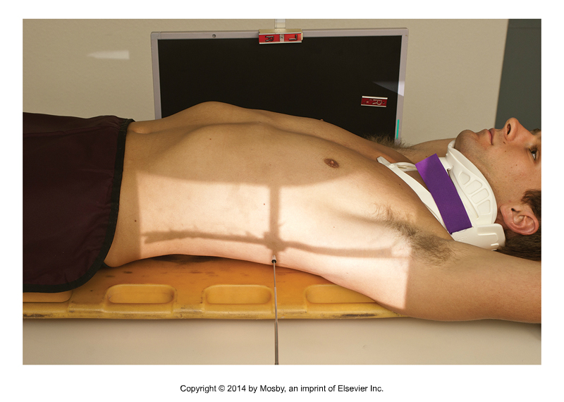
T-Spine Lateral
X
X
Bontrager 15.73

Slide 43
Trauma L-Spine
AP as routine
Lateral
  Keep in mind that the lordotic curve may be accentuated if patient is laying flat – this could result in a wider light field required
  Center on the spine – close to MCP, slightly posterior
    May not have as much light on mattress as T-spine because lumbar vertebrae are more anterior
  Centering is still at the level of L3
    Bontrager states L4, as they are using the large IR and including entire sacrum

Slide 44
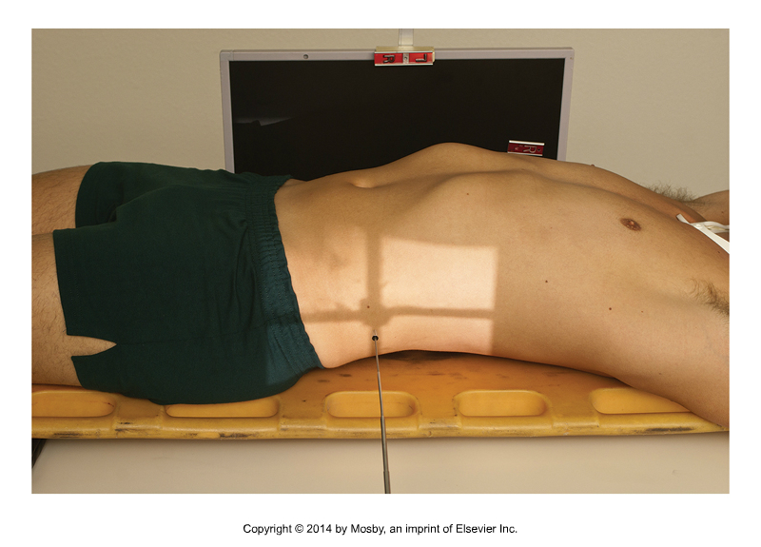
Trauma Lateral L-spine
X
Bontrager 15.74

Slide 45
Adaptive Extremity and Cranium Work
Focus on relationships between CR, IR and part
What needs to be:
  Aligned
  Superimposed
  Parallel
  Perpendicular
Get creative, more than one way to achieve image
May need to sacrifice, so then ask, what MUST be demonstrated?

Slide 46
Adaptive Skull
Spinal precautions must be cleared before attempting to move the patient’s head or neck
Lateral – X-table method
  Remove all artifacts from head area
  If able to, carefully elevate patient’s head with sponge
  If unable to, carefully move patient closer to the edge of the table and place IR at least 2.5 cm below tabletop – catch the divergent beam on IR, minimizing clipped posterior skull

Slide 47
Adaptive Skull
Trauma Skull – assuming that pt’s head and neck cannot be moved
The degree of CR angulation is the only variation – no movement of patient
Required anatomy is the same as routine
AP Reverse Caldwell
  CR is 15° cephalad to OML
AP Axial Townes
  CR is 30° caudad to OML

Slide 48
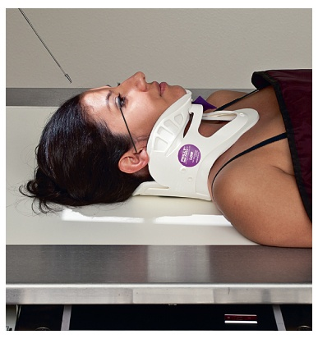
Adaptive Cranium
How do we find OML?
  Use laser light/cross hair as it passes across the face
  Align it with the OML
  Look at the tube head to see what angle the tube is at
  That becomes the new “zero”
  Angle the tube as needed from there
  This method can be used with all trauma cranium exams

Slide 49
Non-Routine Patients
What is a non-routine patient?
  Physical deficits
  Psychological deficits
  Limitations that may affect their ability to comply with the requirements of a routine radiographic exam
    Some deficits are self-evident (e.g. reduced LOC, visibly injured)
    Some require more investigation by the technologist

Slide 50
Proper Patient Assessment
This is critical to determine if they fall into the “non-routine” category
Ensures safety of patient and staff
Exam considerations
Optimize image quality

Slide 51
Patient Transfers
This can provide valuable information regarding what they may/may not be able to do
How does the patient arrive in the department? (Erlich pg 214)
  Wheelchair?
    Mode of transport for patients who
    can stand and sit with safety and comfort
    Should be able to weight bear
  Stretcher?
    Usually patients who cannot stand, or have not stood/walked since an accident, surgery, stroke or heart attack
    Precautions and care should be taken before standing these patients

Slide 52
Assessing a patient
Similar to the assessment used prior to a patient transfer
  Equipment (e.g. oxygen, IV)
  Assistive devices (e.g. splint, sling, cast)
  Transfer method (e.g. wheelchair, stretcher)
  Patient position (e.g. supine)
  Patient LOC (e.g. alert, drowsy)
  Medical signs/symptoms (e.g. exam ordered, history)

Slide 53
Assessing a patient
How do they respond to basic introduction of the exam, staff, explanation?
Direct questioning is useful
  If I helped you, would you be able to:
    Sit up: on a stool/in or on the edge of your stretcher?
    Lie flat on your back?
    Roll onto your side?
    Stand up, turn, and sit on the x-ray table?
    Shuffle to the x-ray table on your own?
    Stand in front of the x-ray machine?

Slide 54
Assessing a Patient
Be careful not to take all responses at face value
This takes practice
Patients may be unsure of capabilities
  “Sure I can stand”, but as they do, they are noticeably swaying
    Don’t wait, take immediate action for safety. Have them sit down
  “No, I can’t move”
    Try to be more specific about what is required
      “If I bring you closer to the x-ray table, do you think you could slide over?”

Slide 55
Assessing a Patient
Useful questions to ask for general radiography exam
  This will help you formulate a plan, considering modifications
    How did the injury occur?
    Can you show me exactly where it hurts?
    If I help you, do you think you can straighten/bend ___?
    Do you have any pain/numbness? On which side?

Slide 56
Strategies to prioritize multiple exams on ONE patient
Complete images that will provide crucial diagnostic information first.
E.g. AP pelvis will demonstrate a hip fracture before abducting the leg for hip x-rays
Establish their positioning preferences (standing vs lying down) and try to minimize movement by completing all of the examination at either the wall stand or the table stand when possible.
Observe the patient’s position when they first arrive and take any of the images that can be completed “as is” with little or no movement.
Minimize the excess patient movement by completing all of the AP projections followed by all of the lateral projections or vice versa.
**on practicum, check site specific protocols and technologist preference**

Slide 57
General Examination Priority
The most ill or unstable patients must be done first
  Highest risk when in medical imaging dept, should not be left unattended
Remaining examinations should be completed in the order that they arrive
  Never pick and choose the ‘easy ones’ first
If a tech is alone in the dept and requires assistance with a slide, the tech should wait for assistance. Depending on the circumstances, the patient may need to be returned to the unit until staffing in the dept can support the transfer
  Never attempt a slide without enough help

Slide 58
Readings
Bontrager 9th Edition
  Pg 95, 97, 181, 192, 286, 288, 317, 570-593
Ehrlich 9th Edition
  Pg 189-191 (Table 11-1), 213-214

