Slide 1
INFC 215 Infection Prevention and Control
Donning/Doffing
N 95 Mask for Airborne
Precautions
Molded Cone Type

Slide 2
Donning
Putting ON

Slide 3
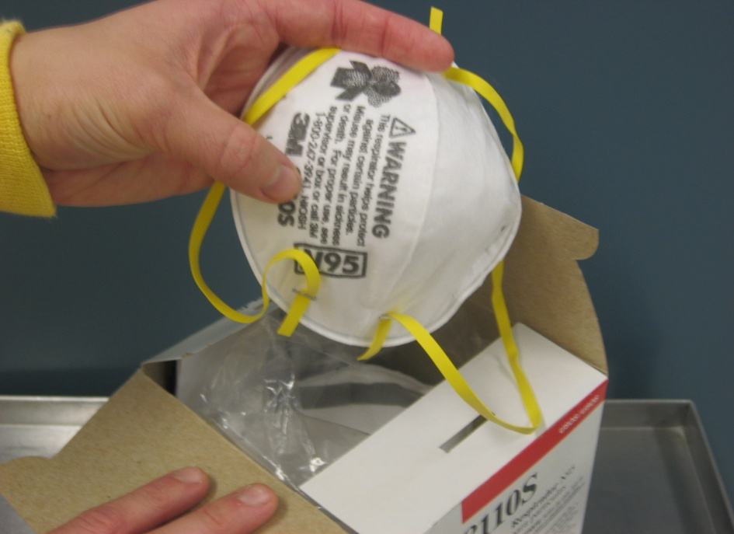
1. Select N 95 Mask
When?
Patient requires airborne isolation precautions
Select Brand and style number for which you have been fit tested

Slide 4
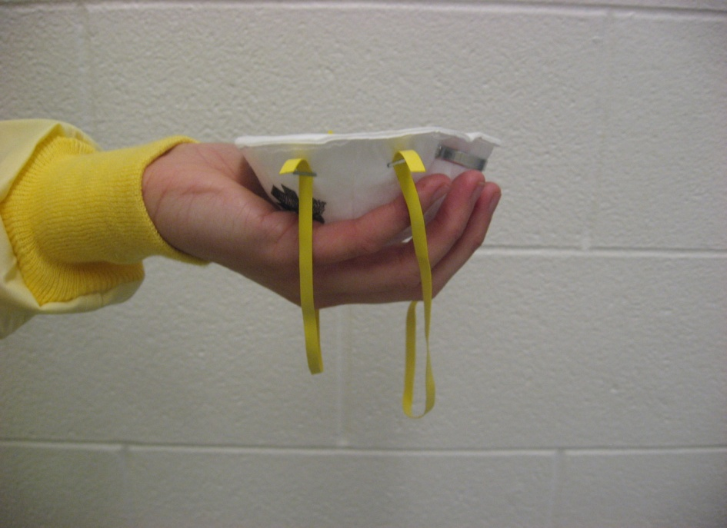
2. Hold mask in one hand
Move elastics to the front of the mask over your hand

Slide 5
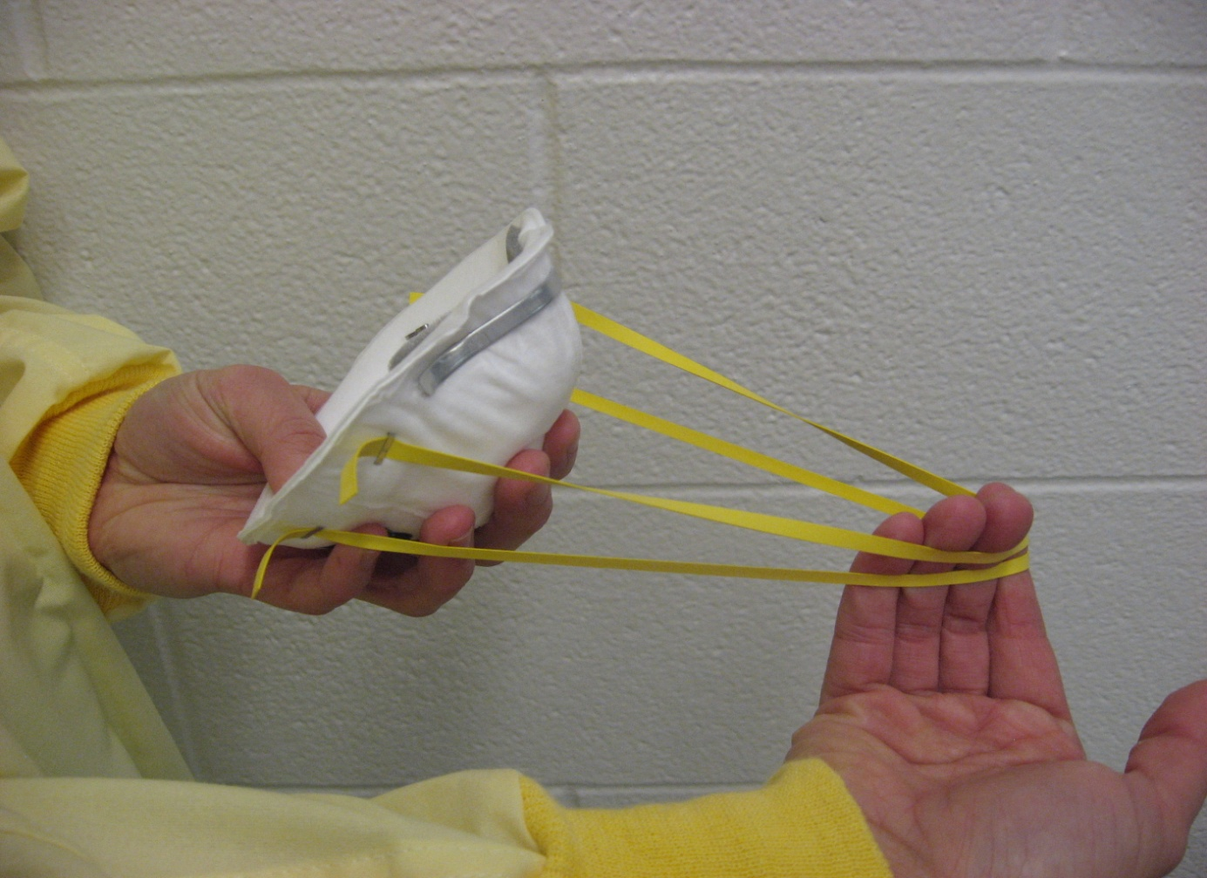
3. Stretch elastics

Slide 6
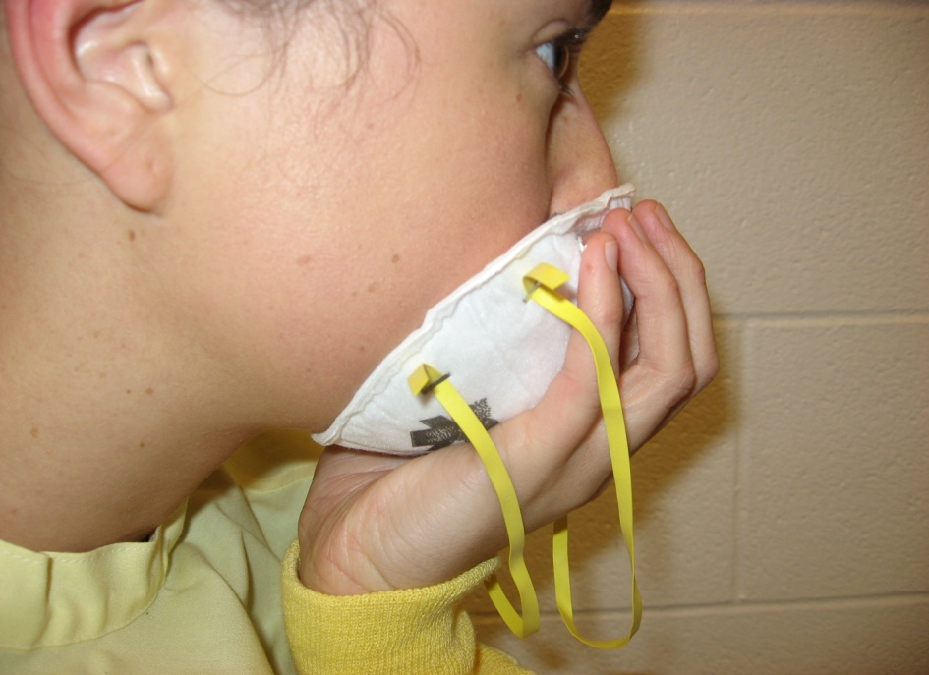
4. Hold mask to your face
Use one hand to place over your nose, mouth and chin

Slide 7
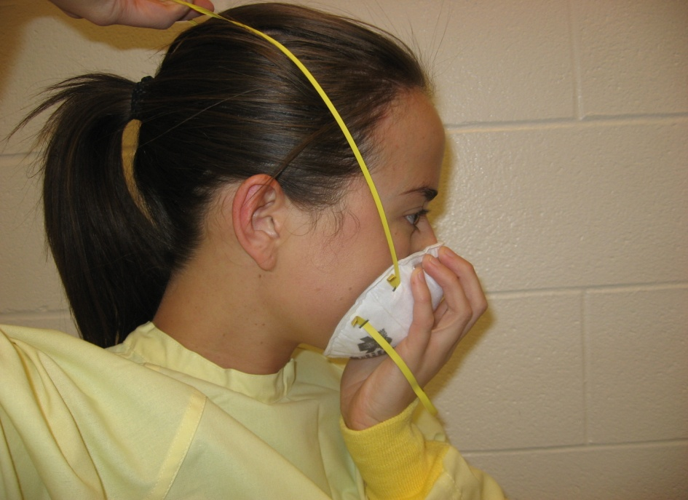
5. Stretch top elastic over your head
Adjust to comfortable position near the crown of your head

Slide 8
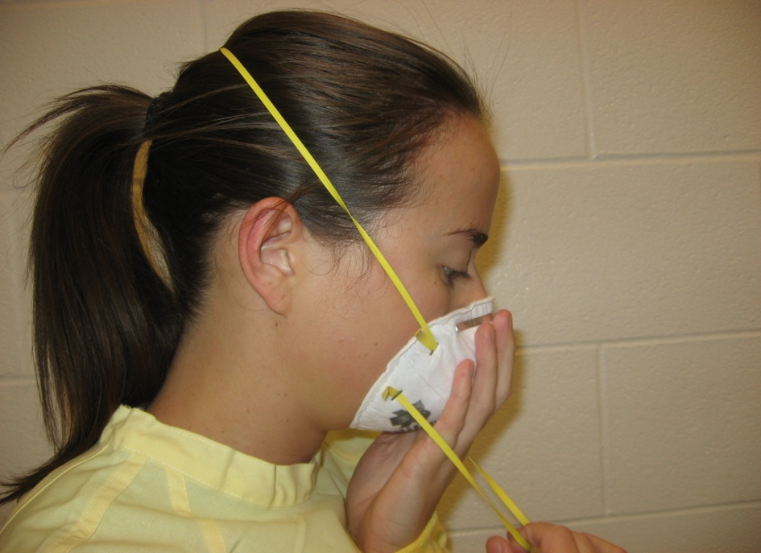
6. Stretch bottom elastic over your head
Hold on to mask as you pull elastic up and over your head.
Ensure that elastic is ultimately placed under your ears and pony tail, if present

Slide 9
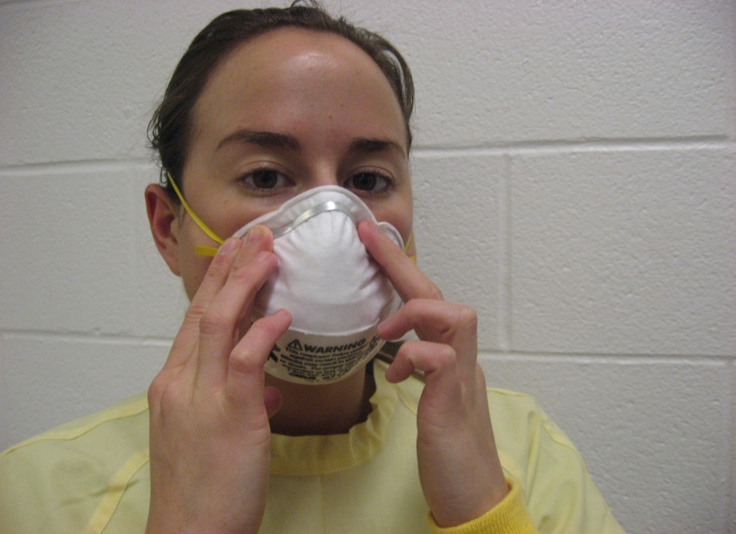
7. Ensure a snug fit over your nose and cheeks
Use fingers of both hands to press the metal strip

Slide 10
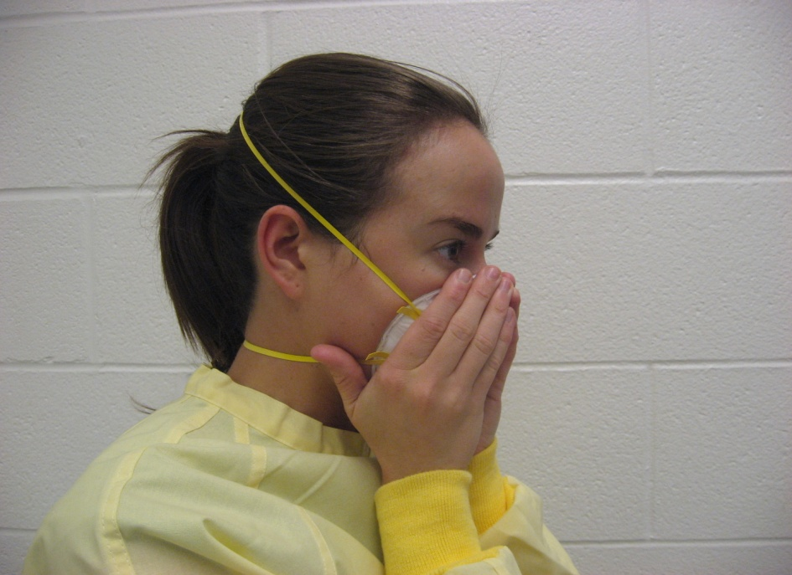
8. Fit check
Inhale deeply to insure that mask adheres to your face
Exhale to ensure that there are no air leaks

Slide 11
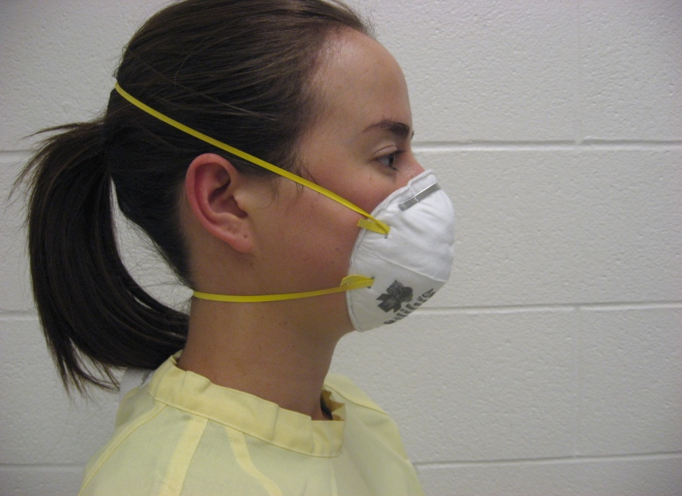
9. Check appearance
Is the mask properly adjusted?

Slide 12
Doffing
Taking OFF

Slide 13
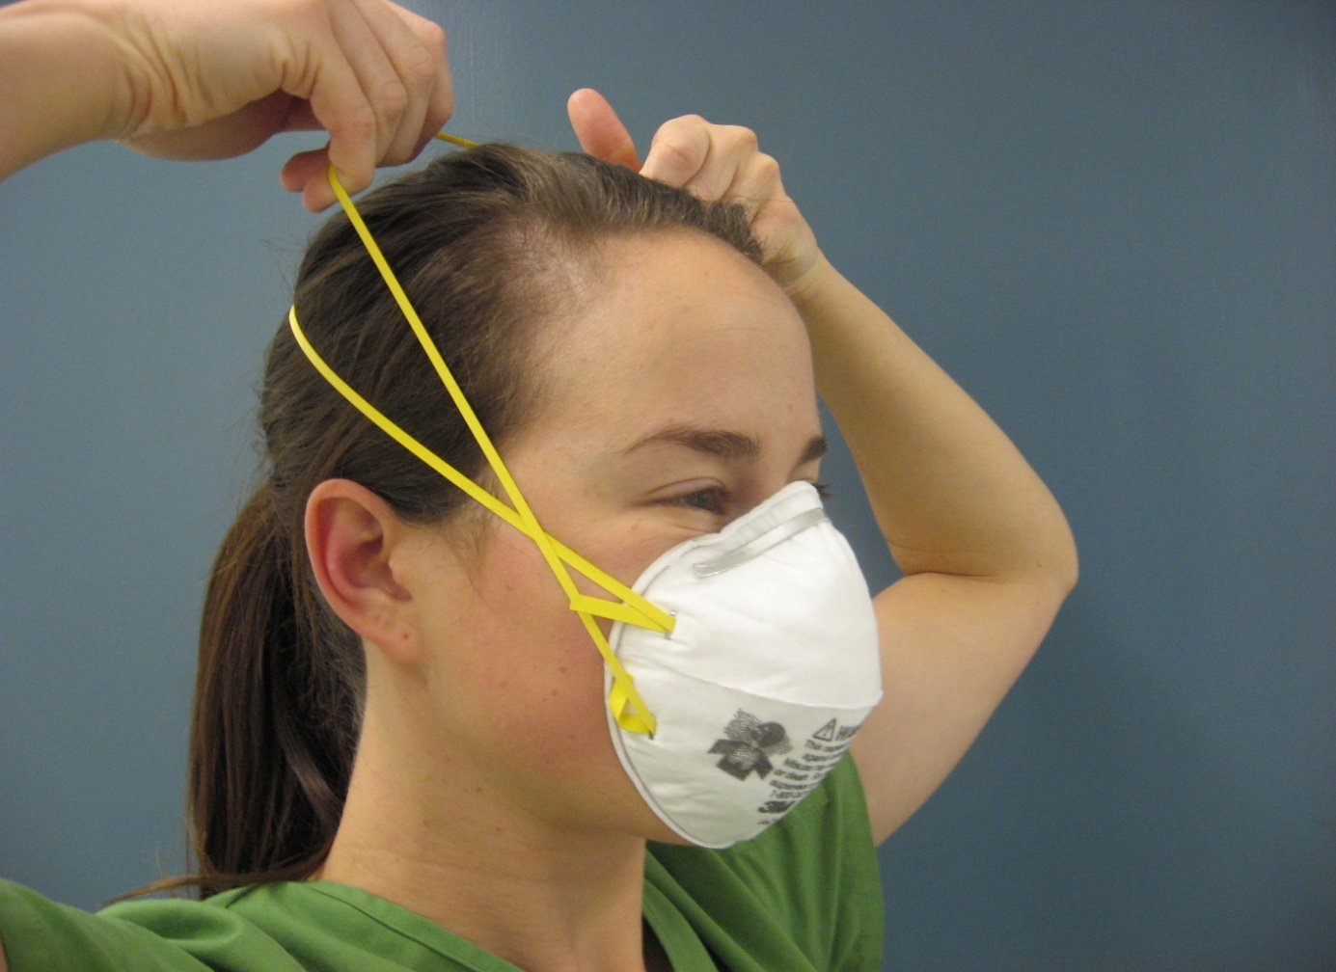
1. Pull bottom elastic forward over your head

Slide 14
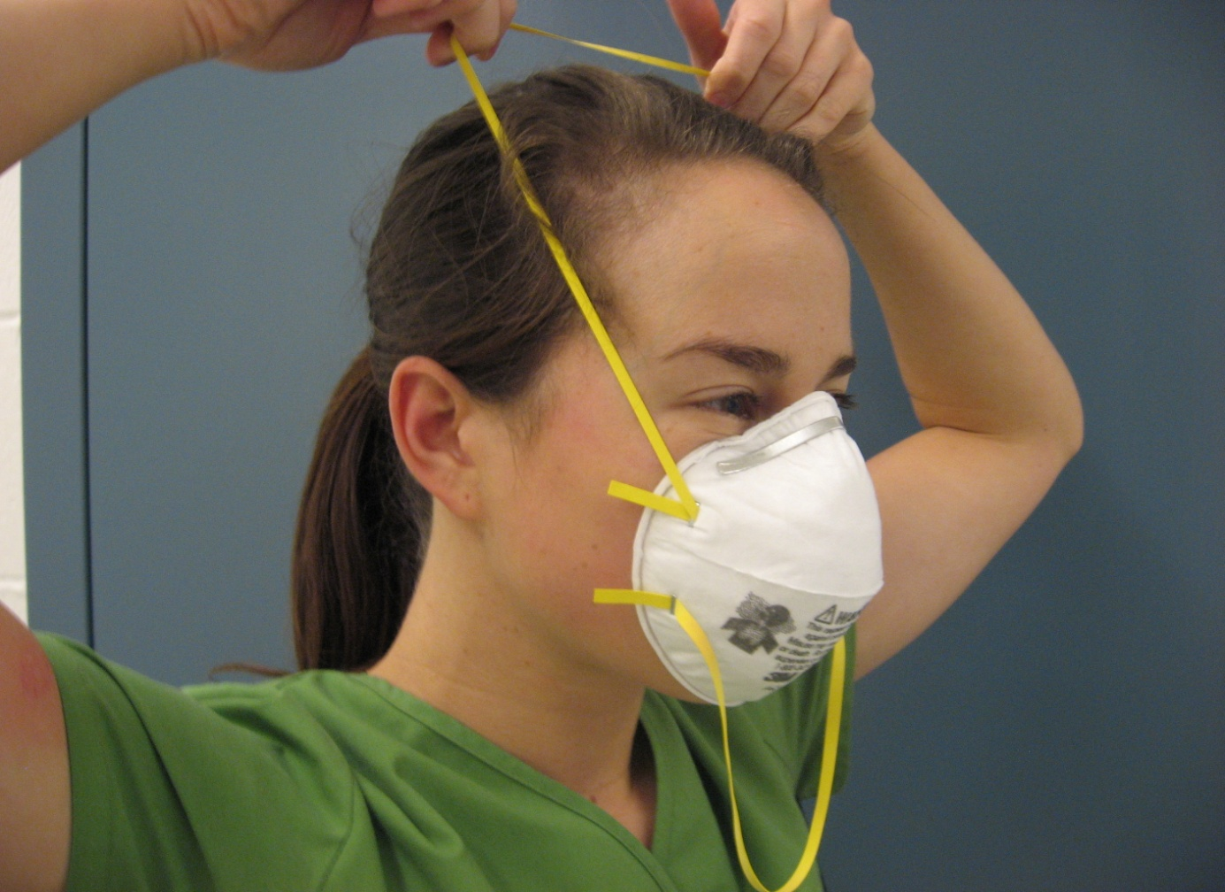
2. Pull top elastic forward over your head

Slide 15
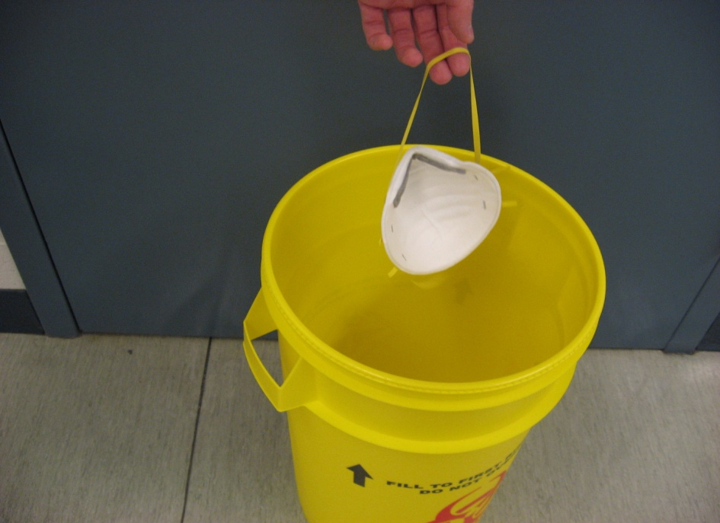
3. Discard into disposal container
Do not touch outer surface of mask
Use elastic to handle mask

