Slide 1
APPH 226:
Screens, IR Speeds and Characteristic Curves
Objectives: 4.1, 4.2, 4.3, 6.1

Slide 2
Where it all began
Digital radiography was developed based on film-screen radiography
Primary purpose of radiographic imaging is:
  Transfer information from the x-ray beam to the eye
  After the x-ray beam passes through matter, the image-forming x-rays need to be captured and transferred to a form that can be visualized by the human eye
  Examples of appropriate mediums
    Film, fluoroscopic image intensifier, TV/flat panel monitor, laser imaging system, solid state detectors

Slide 3
Film
Construction and characteristics of radiographic film are similar to that of photographic film
Radiographic film is manufactured with extremely high quality control, and low threshold acceptance limits
  Slightest bit of contaminant would affect the film’s ability to reproduce information from the x-ray beam

Slide 4
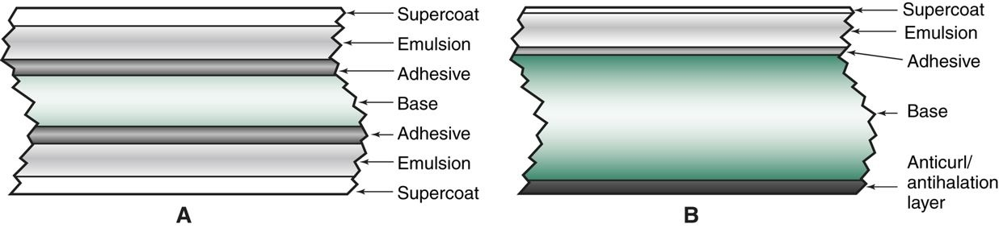

Slide 5
Film Construction
Film Base or Base Layer
  Foundation of the film
  Typically made of polyester or plastic
    Flexible
    Thicker than photography film
  Emulsion is fragile, the base is needed so that film can be handled and processed
  Lucent
  Blue dye/tint is added to reduce eye strain

Slide 6
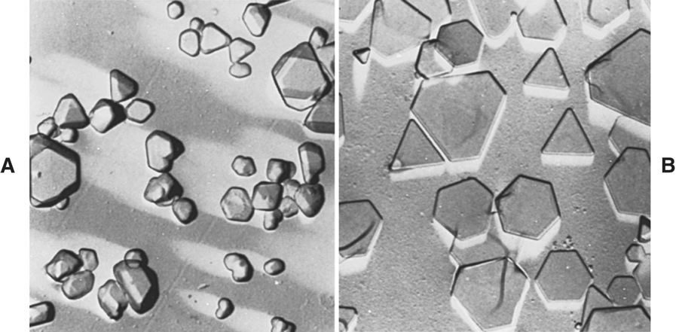
Film Construction
Emulsion
  Functional layer
  Radiation sensitive and light sensitive
  Consists of silver halide crystals suspended in gelatin
    ~90-99% Silver bromide (AgBr) and ~1-10% silver iodide (AgI)
    Approximately half a billion crystals per cubic mm of film
  X-ray film has emulsion on both sides (duplitized)
  Some films only have emulsion on one side (specialty films like mammography film)

Slide 7
Latent Image Formation
What is the latent image?
  The invisible image that exists – after exposure and before processing
Invisible change occurs in the silver halide crystals
  Radiation activated and inactivated crystals make up the latent image
Processing the film changes the latent image into a manifest image (visible)

Slide 8
Film Construction
Adhesive Layer
  This is between the emulsion and base layer
  Holds the layers together
  Essentially the “glue” holding the film together
Supercoat
  Durable protective layer
  Made of hard gelatin
  Purpose is to protect the emulsion layer beneath it
    Allows handling, hanging on view boxes
  Can be torn by paper clips and staples

Slide 9
Types of Film
Direct Exposure Film
  Aka nonscreen film
  Used in a cardboard holder, instead of a cassette
  Single emulsion - requires more exposure (10-100x more)
Specialty Film
  Duplicating/copy film
    Already exposed to maximum OD
    Behaves opposite to normal (solarization)
    Notch in the corner

Slide 10
Screen Film
Most widely used radiographic film
  Used in combination with intensifying screens
  More light sensitive, less sensitive to x-rays
Can be single or double emulsion
  Single
    Used in mammography, duplication (copy) films, subtraction films
  Double
    General radiography

Slide 11
Cassettes
Container that holds intensifying screens and film
Must be:
  Light proof and portable
  Rigid enough to support patient’s weight without bending, but allow maximum radiation to pass through to the screen
    Front layer made of low x-ray absorbing material
      E.g. Bakelite, magnesium, graphite carbon
    Back layer needs to absorb backscatter before it exposes film
      Usually a thin sheet of lead foil

Slide 12
Intensifying Screens
Device that is found inside cassettes, it contains phosphors that convert x-rays into light
Phosphors are a chemical compound that emit visible light when struck by radiation
  This light then exposes the radiographic film
Why were they developed?
  To decrease patient dose
    Less mAs is required to obtain exposure in comparison to using non-screen film
  If film is used alone, much higher doses are required in order to achieve diagnostic images
    Less than 1% of x-rays incident on film will interact and contribute to the latent image
    This would result in increased exposure in order to achieve the appropriate radiographic density

Slide 13
Intensifying Screens
“Intensifies” the energy to which film is exposed
  Without using screens, 100% of the exposure reaching film would have to be from x-rays
  With screens, 90-99% of exposure reaching film is from light, and 1-10% would be from x-rays
Pros
  Less dose to patient
  Shorter exposure times
Cons
  Recorded detail reduced on image, increased blur

Slide 14
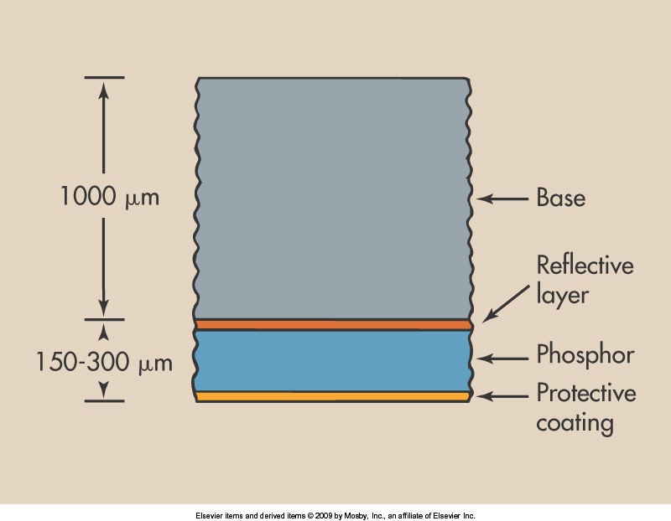
Intensifying Screens
Base
  Farthest from film
  Mechanical support for the phosphor layer, usually made of polyester
Protective Coating
  Closest to the film
  Protects the active layer of the screen
  Transparent
  Allows handling and cleaning of the screen

Slide 15
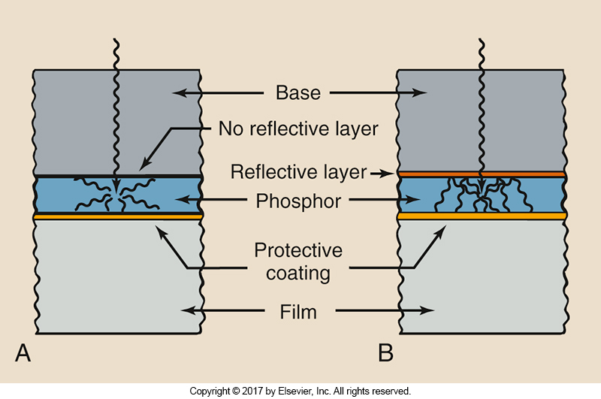
Reflective Layer
  Between phosphor and base
  Shiny substance to reflect light – magnesium oxide or titanium dioxide
  Purpose is to redirect light towards the film – increase efficiency
    Light is emitted isotropically from phosphor

Slide 16
Phosphor Layer
Active layer that converts x-rays to light when radiation hits the phosphors
  Used to be calcium tungstate, now modern screens use rare earth elements: gadolinium, lanthanum, and yttrium
    Faster, lower patient dose, less load on tube
Concepts of luminescence are used in CR/DR
Important characteristics:
  DQE – Detective Quantum Efficiency
    % of x-rays absorbed by screen
    High atomic number is important
  CE – Conversion Efficiency
    Amount of light emitted for each x-ray absorbed
    High CE – a large amount of light emitted/x-ray

Slide 17
Luminescence
A material that will emit light in response to external stimulation
  Luminescent material or phosphor
Two types
  Fluorescence
    Light emitted only while being stimulated
  Phosphorescence
    Light continues to be emitted after stimulation

Slide 18
Spectral Matching
Major consideration when selecting screens and films
Film sensitivity must be properly matched to the spectrum of light emitted by the screen
  E.g. green sensitive film paired with green emitting screens
If the film and screen are mismatched, the IR speed is greatly reduced, which results in:
  Increased exposure time/techniques
  Increased patient dose

Slide 19
Phosphors and Image Quality
When using film-screen imaging, most of the imaging characteristics are due to the composition of the phosphor layer
  Material composition
  Thickness of layer
  Concentration
  Size
  Dye

Slide 20
Phosphors and Image Quality
Material Composition
  Efficiency of material – calcium tungstate vs rare earth
    Calcium tungstate ~5% of x-rays into light
    Rare earth ~20% of x-rays into light
Thickness of the Layer
  The thicker the layer, the more DQE increases
  High speed screens have thicker layers
Concentration
  Higher crystal concentration
  Higher screen speed

Slide 21
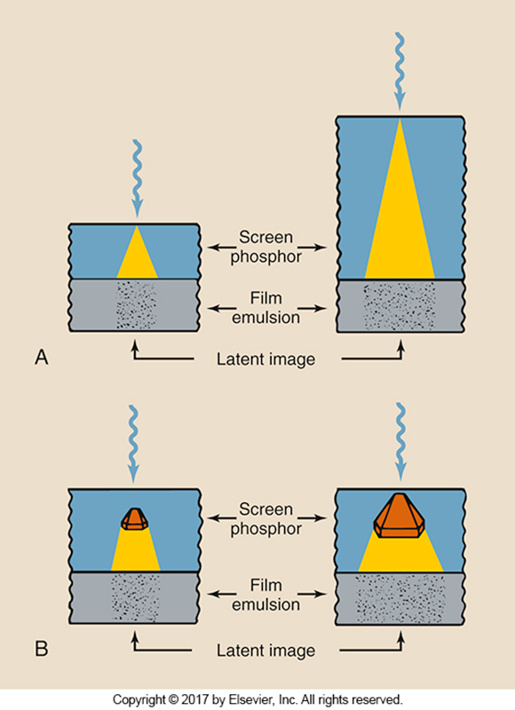
Thickness of Layer

Slide 22
Phosphors and Image Quality
Size of phosphor
  The larger the phosphor, the more light is produced per x-ray interaction
  Higher screen speed
Dye
  Light absorbing dye is added to some phosphor layers
  Helps to control light spread
  Reduces screen speed

Slide 23
Intensification Factor
The purpose of utilizing intensifying screens is to decrease patient dose, but how much did the dose actually decrease?
Intensification factors gives information about patient dose
IF = Exposure without screen
Exposure with screen

Slide 24
Screen Speeds
Identified by relative speed (RS) expressed numerically
Describes efficiency of x-ray conversion into light
Can range from 50-1200
Calcium tungstate is used as basis of comparison
  Assigned value is 100
  High speed screens – up to 1200
  Detail screens – 50 to 80

Slide 25
What affects the screen speed?
Ultimately the speed is determined by the number of x-rays interacting with the phosphor and how efficiently the x-ray energy is converted into visible light
  Some factors are controlled by the technologist, but many are controlled by the manufacturer
  A faster screen produces more light than a slower screen

Slide 26
Speed Factors - Uncontrolled
These are the factors that the tech cannot control:
  Phosphor composition
  Phosphor thickness
  Reflective layer
  Dye in phosphor layer
  Crystal size
  Crystal concentration

Slide 27
Screen speed will increase with:
Type of phosphor – rare earth
Thicker layer
Reflective layer
No dye
Larger crystal size
Increased concentration (more crystals)

Slide 28
Speed vs Image Quality
So if higher speeds result in less patient dose, and lower exposures… this is great, we should use the highest speed possible, right?
  Unfortunately… with high speed comes some drawbacks to image quality
    Image blur
    Image noise

Slide 29
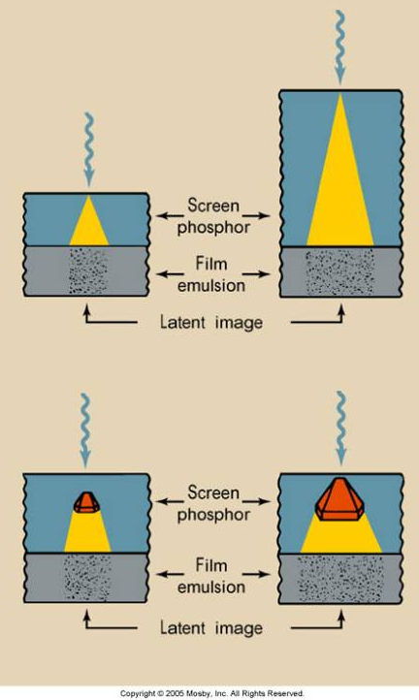
Image Blur
When x-rays interact with phosphors, the area of the film/IR activated by the light is larger than it would be with direct x-ray exposure
  Reduced spatial resolution and increased image blur
  For the most part, the conditions that increase the IF will reduce spatial resolution
    Large phosphor size
    Thicker layer

Slide 30
Image Noise/Quantum Mottle
Appears splotchy, mottled, grainy
This occurs when there are not enough photons to produce the image
  E.g. high speed systems with very short exposures
  Density may be reasonable, but with faster speeds, fewer photons have been used to produce the image
    Fewer photons = more noise

Slide 31
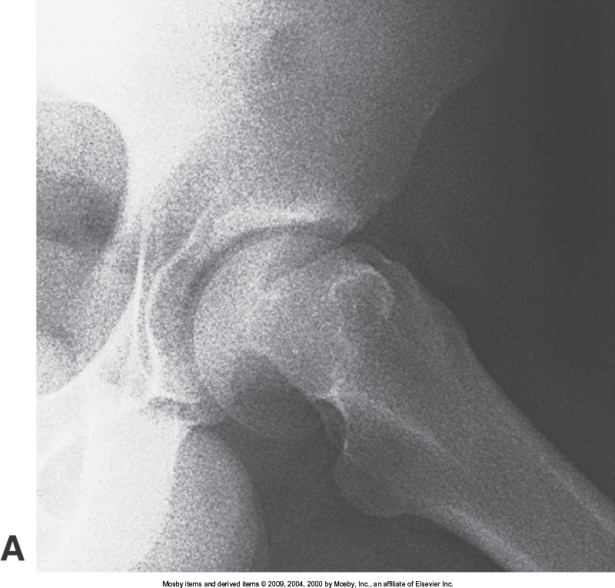
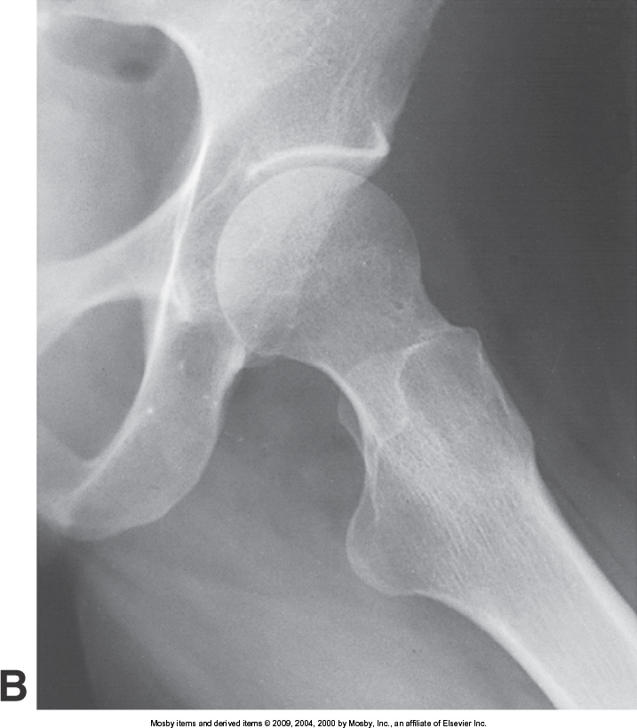
Quantum Mottle (noise)

Slide 32
Image Noise/Quantum Mottle
What does this mean for image quality?
  Decreases it
  Limits diagnostic value of image
How can quantum mottle be reduced?
  Need more x-ray photons
    Increase mAs
    Use slower speed system
    Decrease kVp, increase mAs (density maintenance)

Slide 33
DQE vs CE
DQE: Detective Quantum Efficiency
  The percentage of x-rays absorbed by the screen
CE: Conversion Efficiency
  The quantity of light emitted for each x-ray absorbed
Which one will affect image noise? CE or DQE?
Increasing CE will increase image noise, but an increase in DQE will not
  If CE is increased, fewer x-rays are needed

Slide 34
Speed Factors- Controllable
These are the factors that can be controlled by the technologist
  Radiation Quality
    If the kVp is high, the IF will be higher due to increased probability of interactions within the phosphors (high Z number compared to film)
  Processing
    Mostly to do with film processing and development
  Temperature
    External environment
    Higher IF at a low temp vs high temp

Slide 35

Screen Care
Must be handled gently
Scratches can produce artifacts and degrade the image
  Often fingernails, edges and corners of the film
When loading cassettes, try to avoid sliding films in
Films should be removed by tipping opened cassette
Cassettes should not be left open
Only handle and clean screens when necessary
  With proper care, screens can last forever, phosphors do not wear out

Slide 36
Digital Imaging and Speeds
Essentially the same concept, based on the efficiency of x-ray conversion
Instead of using film, using the digital image receptors
Same scale
  Higher speed = less exposure required
  Lower speed = more exposure required

Slide 37
Characteristic Curve
Sensitometry is the study of the relationship between the intensity of the exposure of the film and the blackness after processing (OD)
Two principal measurements
    Exposure to the film
    % of light transmitted (OD)
The relationship between OD and radiation exposure
  Called the characteristic curve
    H & D (Hurter and Driffield)
    Sensitometric curve

Slide 38
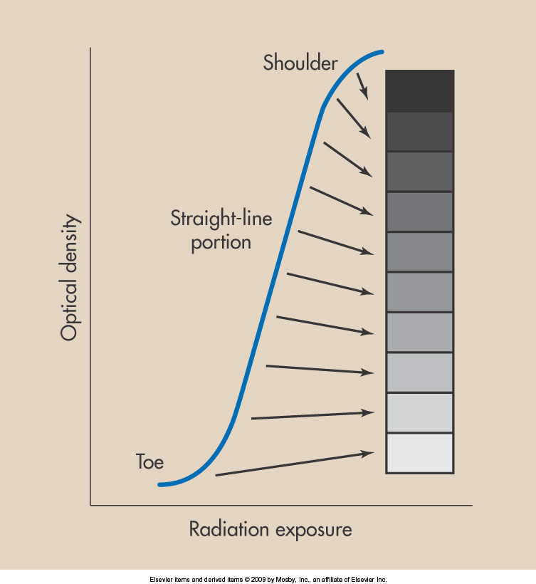
Characteristic Curve
Toe and Shoulder
  High and low exposure levels
  Large variations in exposure will produce only small changes in OD
Straight line portion
  Between the toe and shoulder
  A properly exposed radiograph should appear in this range
  This is the ideal density range

Slide 39
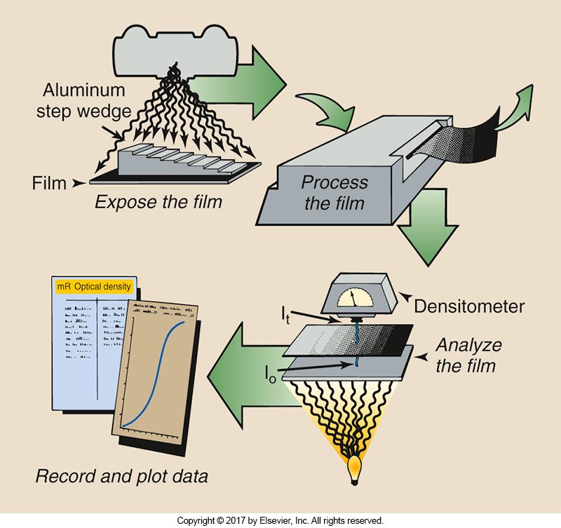
Constructing a Curve
Need two pieces of equipment
Densitometer
  Measures the OD
Sensitometer or Penetrometer (step wedge)
  Produces the range of densities

Slide 40
Constructing a Curve
1. The film is exposed to visible light with the sensitometer
2. Processed film is analyzed/measured with densitometer
3. Data is recorded and analyzed
4. Data is plotted, into the characteristic curve

Slide 41
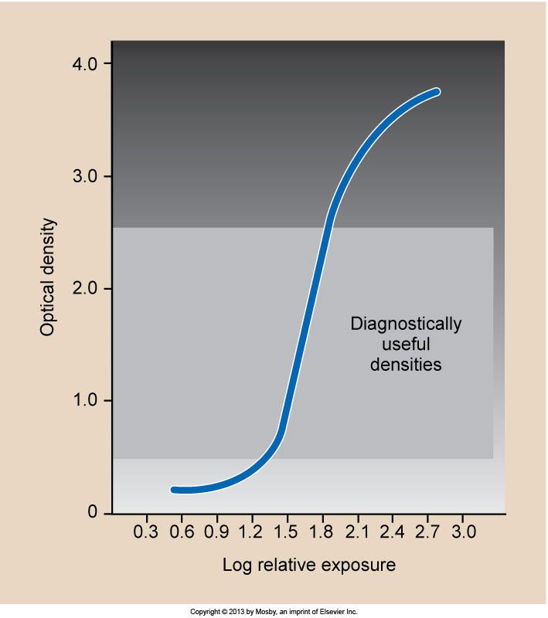
Characteristic curve
Exposure values for a characteristic curve are presented in a logarithmic fashion
It is the change in OD over each exposure interval that is of interest
The x-axis is log relative exposure (LRE)
The y-axis is optical density (OD)

Slide 42
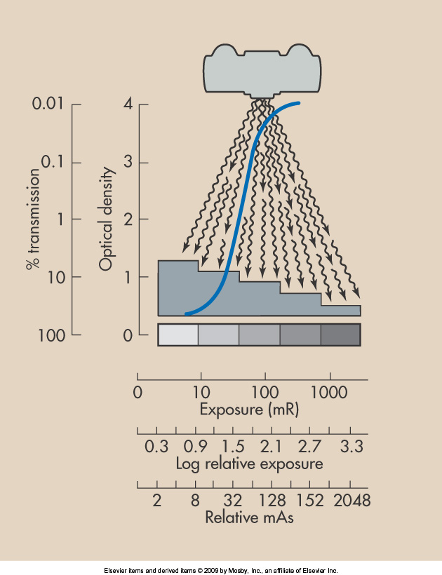
Optical Density
OD is a logarithmic function
  Meaning it’s a small number that represents a wide range of values
OD = 4 is black
  1/10000 light photons penetrate the film
Useful range is 0.25-2.5 OD

Slide 43
Film - OD
Unexposed film will always have an OD
Why?
Base plus fog
  Base – color added to the film base
  Fog – any exposure during storage, processing or contamination

Slide 44
Purpose of the Curve
Characteristic curve can show the relative degree of contrast for an IR at a glance
The slope/steepness of the straight line portion
Characteristic curve = 1, angled at 45 degrees
  For 1 unit increase in exposure (x-axis), there is 1 unit increase in OD (y-axis)

Slide 45
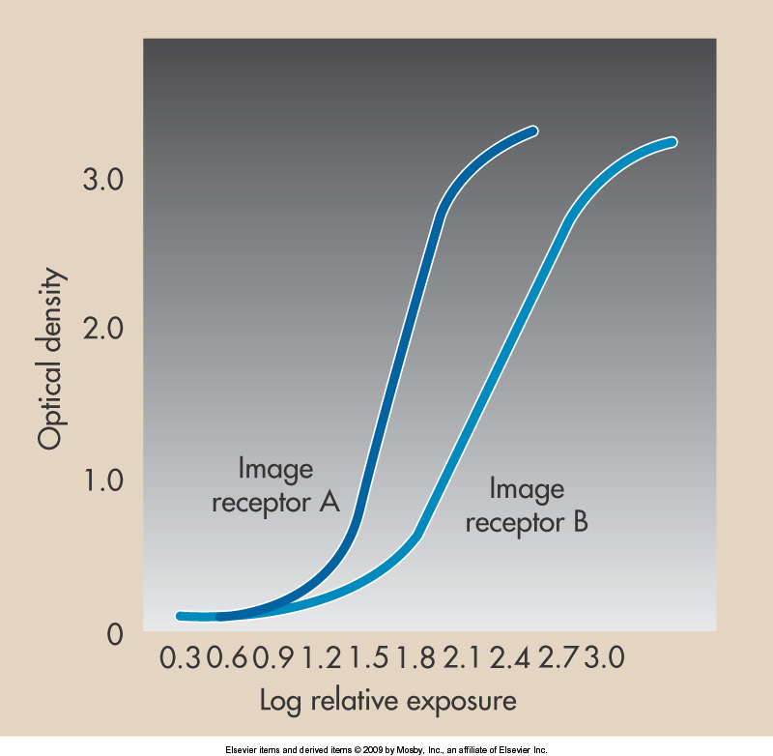
Contrast
Contrast = 1
  Very low contrast
Contrast = 3
  High contrast
  This would amplify subject contrast
  One to the right, will result in an increase in height of 3
  Very large changes in OD with a small change in exposure

Slide 46
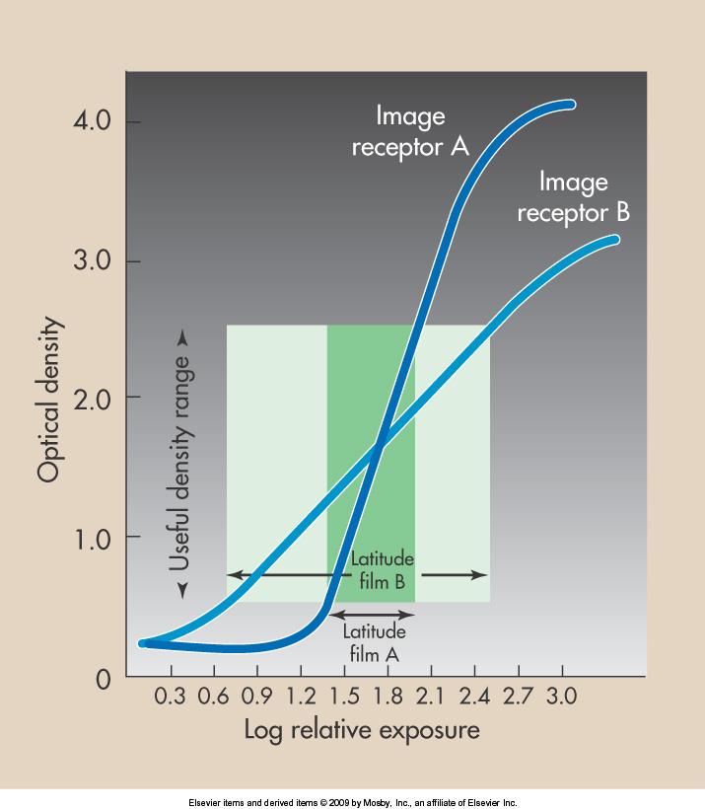
Latitude
Refers to the range of exposures over which the IR responds with OD in the diagnostically useful range
  Can also be thought of as the margin of error
Wider latitude – mAs can vary more
  Lower contrast
Narrow latitude – less variation of mAs allowed
  Higher contrast

Slide 47
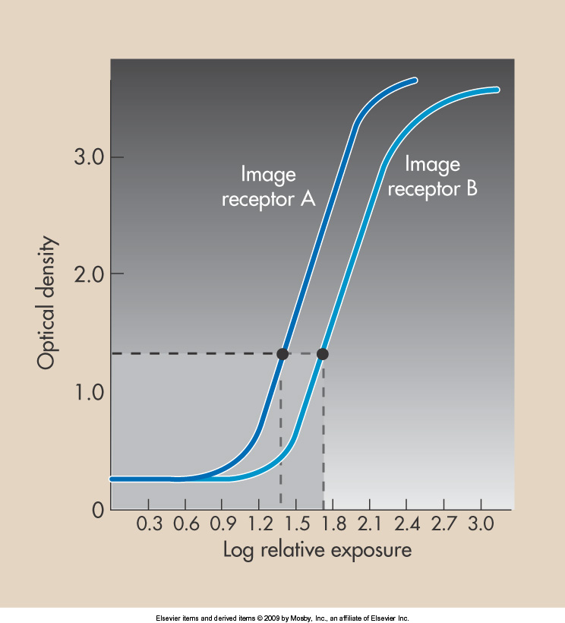
Speed
Defined as the ability of an IR to respond to an x-ray exposure
  Also called measure of sensitivity
Characteristic curve can be used to identify speed at a glance
Speed < 100 = detail IR
Speed > 100 = fast/high speed IRs

Slide 48
Changing Speeds
If the speed is changed, a modification must be made to the mAs settings to maintain the same OD
  E.g. if the speed is doubled, the mAs must be halved to maintain radiographic density

Slide 49
Formula

Slide 50
Example
Using a 400 speed image receptor, the technique for a wrist is 60kVp and 2 mAs. What would the technique be if you switched to a 800 speed image receptor?

Slide 51
Readings
Radiologic Science for Technologists 11th Ed
  Pp. 163-172 (Stop before “Film processing”)
  Pg 208-213 (Stop before “Handling & Storage of Film”)
  Pg 214- 226 (Start at “Formation of the Latent Image’. Stop before “Film Processing)

