Slide 1


Ingredients benefits on skin types

Slide 2
Objectives
Compare how sunscreens function and the potential regulations regarding ultraviolet A (UVA) protection.
Describe how moisturizers work on the skin and why moisturization is key to proper skin functioning.
Explain the difference between natural and organic with respect to botanical ingredients.
Write about the future impact of nanotechnology in skin care.
Notes:
2
2
Learning Motivation (Why?)
Estheticians work with both skin-care products and color cosmetics. Cosmetic chemistry is the science of formulating and producing the products used in the esthetics profession and by consumers at home. Cosmetic chemistry includes both the formulation of skin-care products and color cosmetics, such as lipstick or eye shadow. Cosmetic chemists often specialize in either skin-care or color cosmetics. Using chemicals as well as ingredients obtained from plants and nature, the cosmetic chemist produces cleansers, moisturizers, foundation makeup, and literally dozens of other products.
Estheticians should study and have a thorough understanding of skin-care products and their chemistry, ingredients, and selection because:
• To explain the benefits of a cosmetic product, you must understand the building blocks of that product, including the role of performance ingredients, the importance of emulsifiers and stabilizers, the concept of preservative systems, and why fragrances may be used.
• Ingredient technology is moving so fast that you need a clear grasp of advanced concepts in cosmetic chemistry to understand new ingredients on the market and make intelligent product selections for a client’s home care regimen as well as for the facility.
• Without a general understanding of what already exists, it is difficult to keep up with new ingredients, new products, and new technologies, which could lead to expensive business investment mistakes because of poor product choices.
• By understanding the chemistry of a cosmetic, the specific properties and functioning of key ingredients, and what to look for according to skin type and condition, you can avoid falling into the trap of marketing claims and make informed decisions for your facility and educate clients.

Slide 3
Related Scientific Topics
(continues)
Biology: to understand how products will absorb and how skin and individual cells will react to ingredient combinations
Chemistry: to understand how different chemicals interact and how ingredients are mixed to produce products
Medicine: some products are actually drugs, such as topical medication
Notes:
3
3

Slide 4
Related Scientific Topics
Pharmacology: to understand how drugs and chemicals affect the body’s function
Cosmetology: to understand why the product is needed, how it will be used, and the appearance change achieved by the use of the product
Notes:
5
5

Slide 5
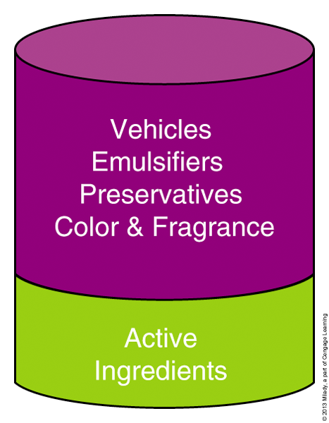
Ingredient Categories
Performance ingredients
  Provide the greatest benefit to skin
  Give cosmetic products their treatment value
  Correct and prevent common skin concerns seen by estheticians
Notes:
6
6

Slide 6
Functional Ingredients
Cause product to spread across skin
Keep products properly mixed
Determine texture and feel
Regulate the pH
Prevent spoiling and contamination
Do not cause appearance changes
Notes:
7
7

Slide 7
Why People Use
Performance Skin Care
To look younger by erasing fine lines and wrinkles
To solve a specific problem such as getting rid of dark spots, blemishes, or lifting tired skin
Notes:
8
8

Slide 8
Cosmetic Ingredient Categories
Performance ingredients: referred to as active principles
Performance ingredient therapeutic effects:
  Healing and hydrating
  Soothing and exfoliating
  Antiaging
Notes:
9
9

Slide 9
Botanical or Chemical
Performance ingredients can be either entirely botanical or can be a fraction botanical.
Performance ingredients can also be chemical such as found in some sunscreen ingredients.
Synthetically derived ingredients are better for consistency of action, purity, and stability.
Notes:
10
10

Slide 10
Delivery Systems
Form of vehicle that carries performance ingredients to the targeted site of action
Reduce skin’s reaction
Enhance efficacy
Notes:
11
11

Slide 11
Vehicles
Also called carriers
Dilute performance ingredients
Regulate penetration
Facilitate surface application
Notes:
12
12

Slide 12
Emulsifiers,
Surfactants, and Preservatives
Emulsifiers bind water-based and oil-based ingredients to form creams, lotions, and gels.
Without emulsifiers, products would separate
Surfactants facilitate the spreadability of products.
Notes:
13
13

Slide 13
Preservatives ensure product microbiological safety and stability; prevent mold, fungus, and bacteria oxidation.
Different preservatives perform these functions with varying degrees of efficacy
An ideal preservative system should include a broad antibacterial/antifungal spectrum and be nontoxic, non-irritating, non-sensitizing and compatible with all other ingredients
The use of preservatives is a regulatory requirement
Notes:
14
14

Slide 14
Color
Certified color: passes the FDA’s certification for analysis and are permitted to carry the designated approval prefixes
Certification-exempt color: can be organic or inorganic compounds and may be derived from a variety of sources including plants and minerals
U.S. formulators use 35 certified and
29 certification-exempt colors.
Notes:
15
15

Slide 15
Fragrance
Fragrances are added to cosmetics to provide a particular aroma, to mask a chemical odor, or give the product a particular market position.
Fragrance ingredients are natural or synthetic compounds and can sometimes be responsible for an allergic reaction; thus, some products marketed as “hypoallergenic” are without fragrance.
Notes:
16
16

Slide 16
Product Penetration
Penetration ability: depends on the product’s molecular size; the stratus corneum can act as both a barrier and a reservoir
Barriers: stratum corneum is the first barrier to penetration; the epidermal-dermal junction is the second obstacle
Target site: the site of action; performance ingredients need to arrive at site of action
Notes:
17
Cosmetics are intended to be delivered onto the skin rather than through it.
17

Slide 17
Alpha Hydroxy Acids (AHAs)
AHAs were introduced in skin-care cosmetics in early 1980s creating a new concept of cosmetics with a pharmaceutical-like action
The use of pharmaceuticals in cosmetics – cosmeceuticals which refers to cosmetics that contain ingredients that help improve the skin instead of temporarily affecting the way it looks or feels
Notes:
18
18

Slide 18
The cosmeceutical revolution occurred in the late twentieth and early twenty-first centuries establishing the mechanism action of AHAs.
Cosmeceuticals are usually sold by skin care professionals, estheticians and doctors that work in the medical esthetics field

Slide 19
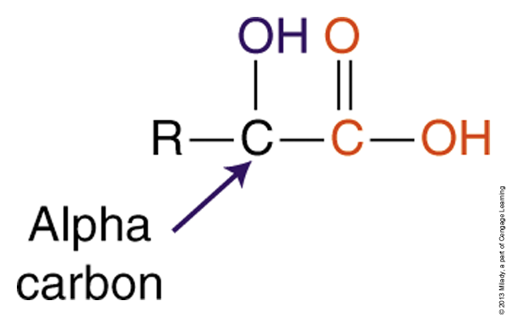
What Is an AHA?
AHA is a generic name for a group of acids that occur naturally in foods.
It is called alphahydroxy because they have a hydroxyl group in the alpha carbon position.
Notes:
20
20

Slide 20
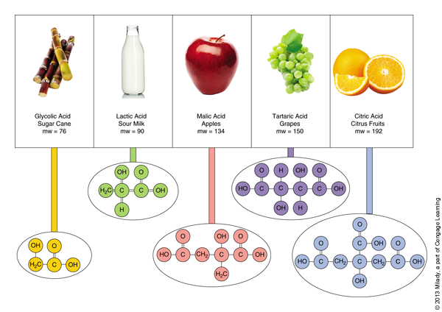
Commonly Used AHAs
Notes:
21
21

Slide 21
Exfoliant Functions
Facilitate desquamation of abnormal keratinocytes
Occur in clusters working on groups of cells rather than “sheets” of cells
Increase superficial skin firmness and dermal thickness while the stratum corneum becomes thinner
Accelerate epidermal metabolism
Delay the formation of fine lines and wrinkles
Prevent skin from becoming dull, sallow and coarse
Benefits will remain 3-4 weeks after discontinuing the use
Notes:
22
22

Slide 22
You will learn more about chemical
exfoliation on the Advanced Esthetics Module

Slide 23
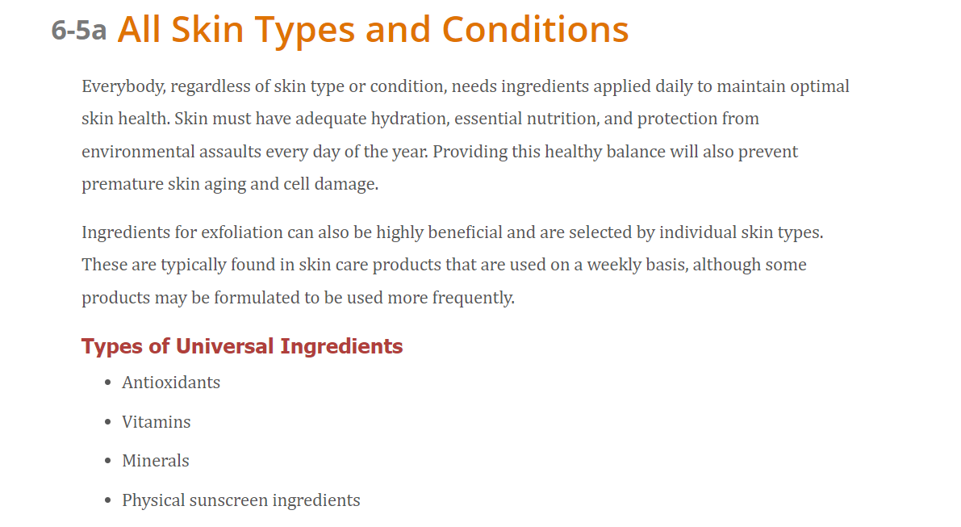

Slide 24
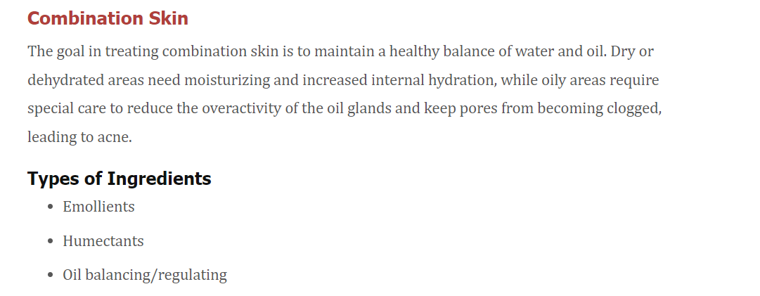

Slide 25
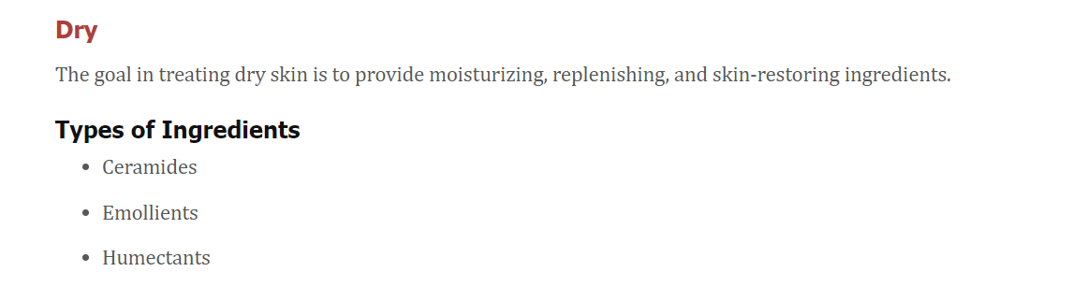

Slide 26
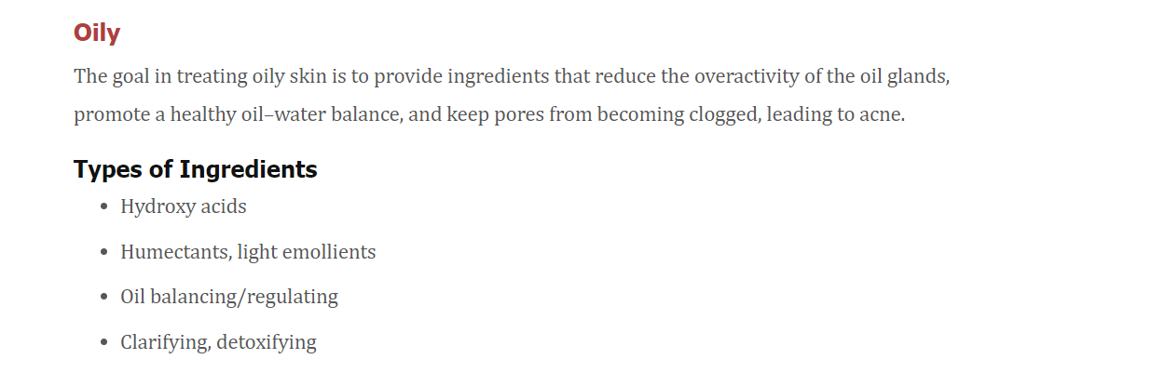

Slide 27
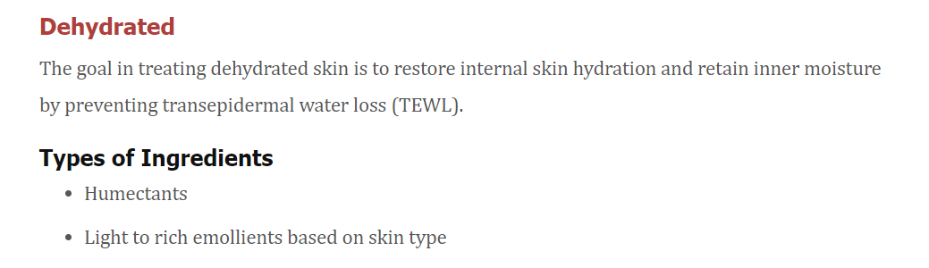

Slide 28
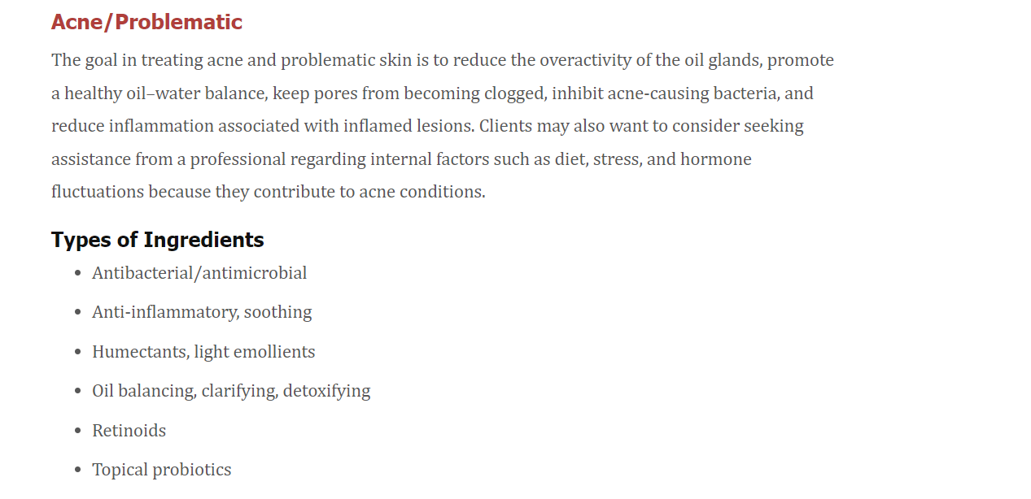

Slide 29
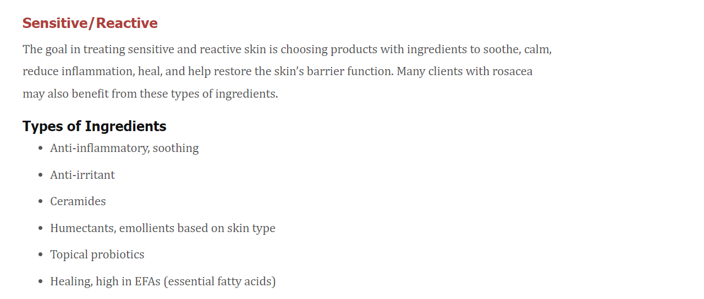

Slide 30
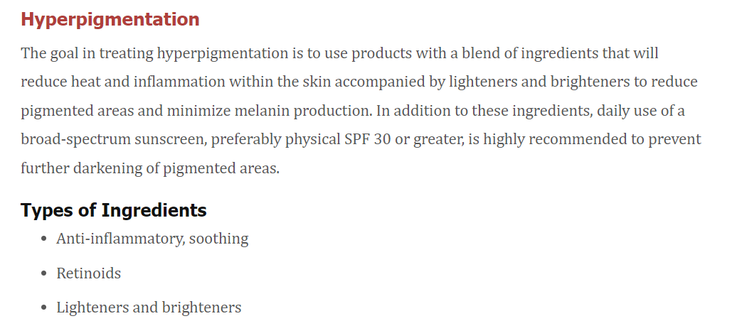

Slide 31
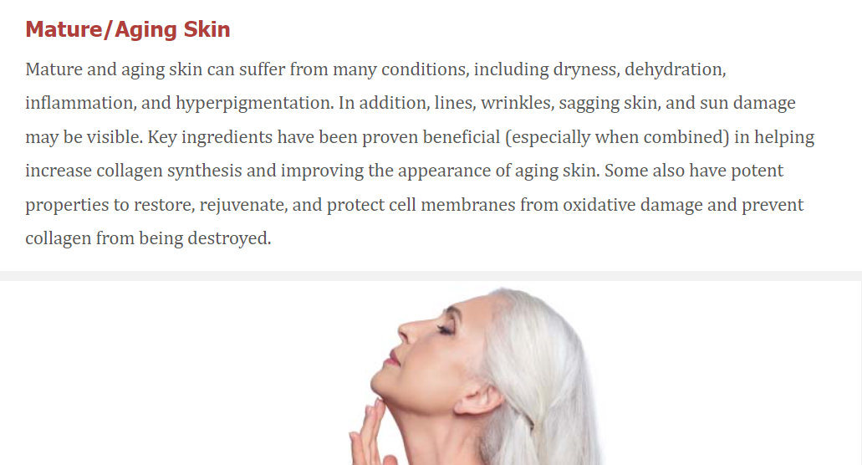

Slide 32
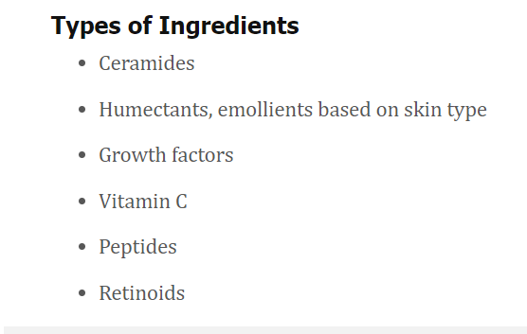

Slide 33
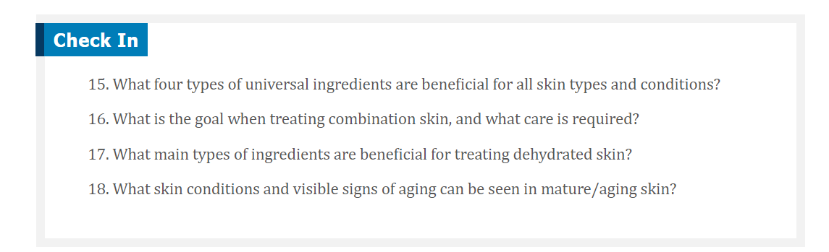

Slide 34

QUESTIONS?

