Slide 1

ANPH 202: Anatomy and Pathology I
Endocrine System Guided Reading

Slide 2
Endocrine System
Endocrine glands are made up of cells that produce and release hormones into the intercellular spaces of surrounding tissues. The hormones are quickly picked up by the blood stream and distributed to target organs and cells. Endocrine glands of interest to radiographers include the pituitary, thyroid, parathyroids, adrenals, pineal glands
Exocrine glands are collections of glandular tissue within an organ that produce and release non-
hormonal substances into ducts.

Slide 3
Read about how the body maintains homeostasis…
Patton and Thibodeau
Feedback mechanisms:
Chapter 1: pages 14 -16
Chapter 12: page 324
Electrolyte and fluid balance:
Chapter 21 pgs. 583-584

Slide 4
Negative Feedback
Negative feedback mechanisms or loops between the hypothalmus, pituitary gland, and target organs, allows the brain and body to have control over the secretion rates of hormones

Slide 5
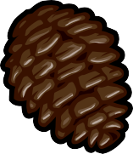
Pineal gland
The pineal gland is attached to the roof of the 3rd ventricle in the center of the brain.
Pine cone shaped… hence its name
The pineal gland secretes the hormone melatonin, which helps to set the body’s biological clock,
by regulating sleep/wake patterns.
Radiographic significance:
The pineal gland contains calcium salts (brain sand) that can be visible on radiographic images, especially CT

Slide 6
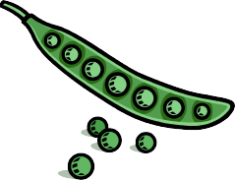
Pituitary Gland
Attached inferiorly to the hypothalamus by a stem-like structure
Encased in dura mater, and surrounded by the Circle of Willis
Size and shape of a pea
Made up of an anterior and a posterior portion

Slide 7
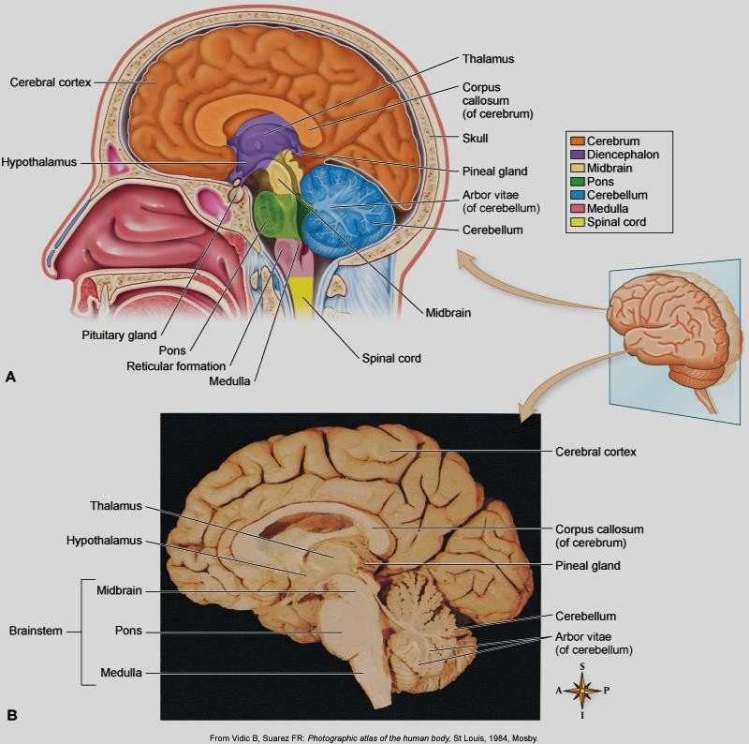
Cerebrum, cerebellum, brain stem
Patton and Thibodeau fig. 10-12

Slide 8
The posterior pituitary has a cellular structure similar to nervous tissue. It does not manufacture any hormones. Instead, it stores two hormones made by the hypothalmus. The only one of these that is pertinent to radiography is:
ADH – Antidiuretic Hormone:
“Diuresis” is the medical term for urine production. A “diuretic” such as coffee makes you urinate.
Antidiuretic hormone stops you from producing urine so you urinate less. It causes the kidneys to conserve water.

Slide 9

The anterior pituitary has the cellular structure of a true endocrine gland and it manufactures six hormones. The ones pertinent to radiography include:
TSH - thyroid stimulating hormone – (self explanatory)
GH - growth hormone (self explanatory)
ACTH – Adrenocorticotropic hormone (stimulates the adrenal glands)

Slide 10
Hyperpituitarism – can cause overproduction of hormones

Slide 11
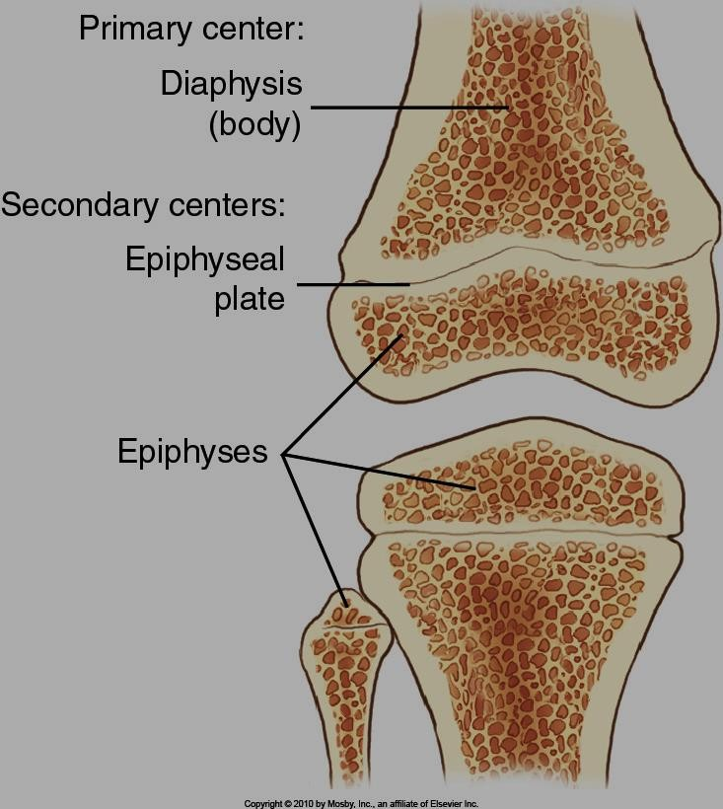
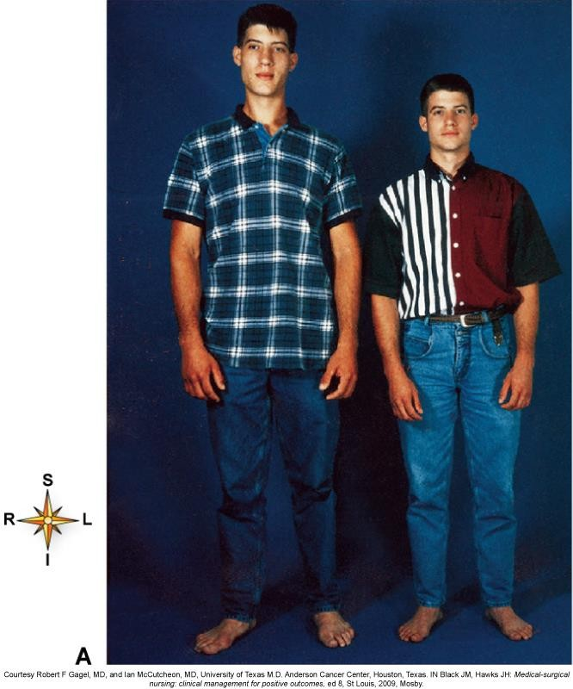
Hyperpituitarism before the fusion of growth plates will cause gigantism
Bontrager 1-21
Patton and Thibodeau fig. 12-5

Slide 12
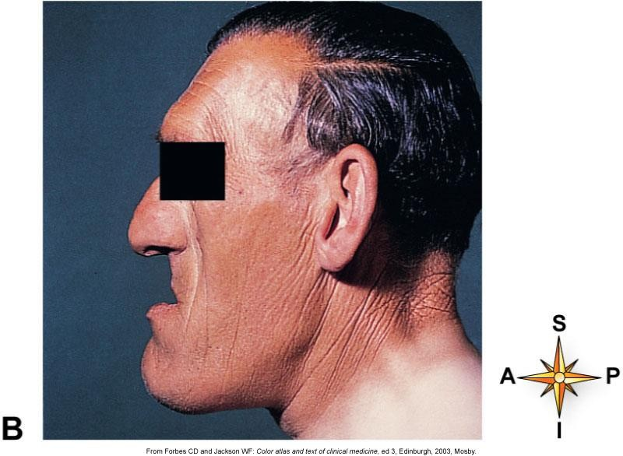
Hyperpituitarism after the fusion of growth plates will cause acromegaly
Patton and Thibodeau fig. 12-5

Slide 13
Hypo-pituitarism is usually due to a pituitary tumor, or pituitary ischemia which can be caused by:
post partum pituitary infarction (Sheehan’s syndrome)
shock
sickle cell anemia
meningitis
syphilis
head trauma
radiation
surgery
Diagnosed with CT, MRI ,or angio
Treated with hormone replacement

Slide 14
Hypopituitarism – can cause achondroplasia

Slide 15
Achondroplasia
Genetic condition that prevents cartilage in epiphyses from converting to bone
Normal trunk with shortened extremities
Person is usually no more then 4 feet tall
Widening at distal end of bone shafts (trumpeting)

Slide 16
Parathyroids
Tiny yellow/brown glands, located on posterior surface of thyroid
Secrete parathyroid hormone (PTH) which increases blood calcium levels by stimulating osteoclasts (bone absorbing cells) to breakdown bony matrix, thereby freeing calcium and phosphorus I
Note! Maintaining blood calcium levels at homeostatic levels is a matter of life and death.

Slide 17
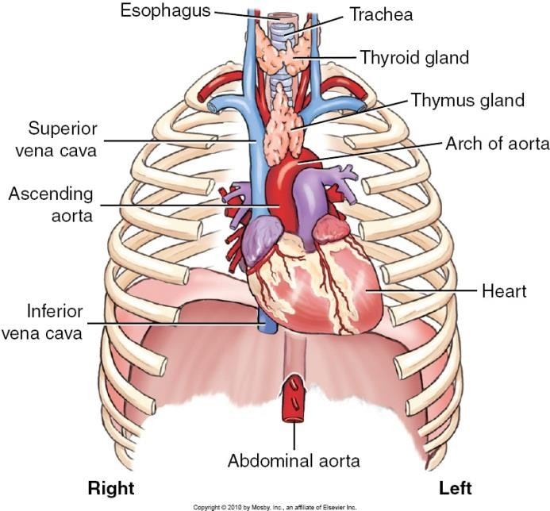
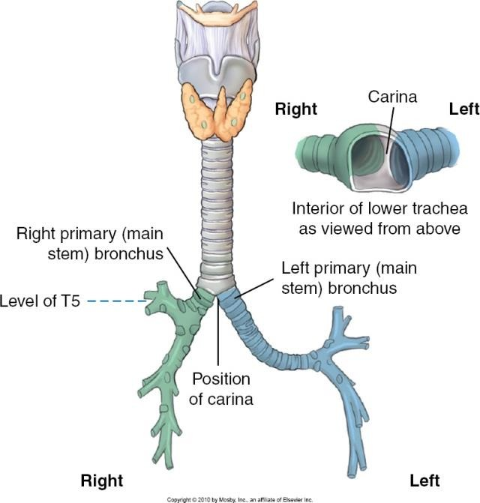
Thyroid Gland
Butterfly shaped
Located on anterior side of neck, sits anterior to tra
Isthmus connects two lateral lobes
chea, inferior to larynx
Point of Adam’s apple
Bontrager, K.L. And Lampignano, J.P. (2014). Textbook of radiographic positioing and related anatomy (8th ed.) Philadelphia, PA: Elsevier Mosby, page 74 and 77

Slide 18
Thyroid Gland
Stores and secretes thyroid hormone (TH) and calcitonin
TH production and release is controlled through the negative feedback loop shown in. Note that iodine is a key ingredient of TH, therefore a limited supply of iodine in the diet means the thyroid gland cannot produce functional thyroid hormone which causes the feedback loop to fail: target cells do not receive functioning TH so they cannot, in turn, produce the chemical inhibitors that stop the hypothalmus and pituitary glands from releasing more thyroid stimulating hormone.
Thyroid hormone speeds up cellular metabolism which causes an increased level of energy in the body. This can be used to increase body temperature, maintain blood pressure, and to regulate tissue growth and development, especially in the skeletal, nervous, and reproductive systems
Calcitonin is a hormone that decreases blood calcium levels

Slide 19
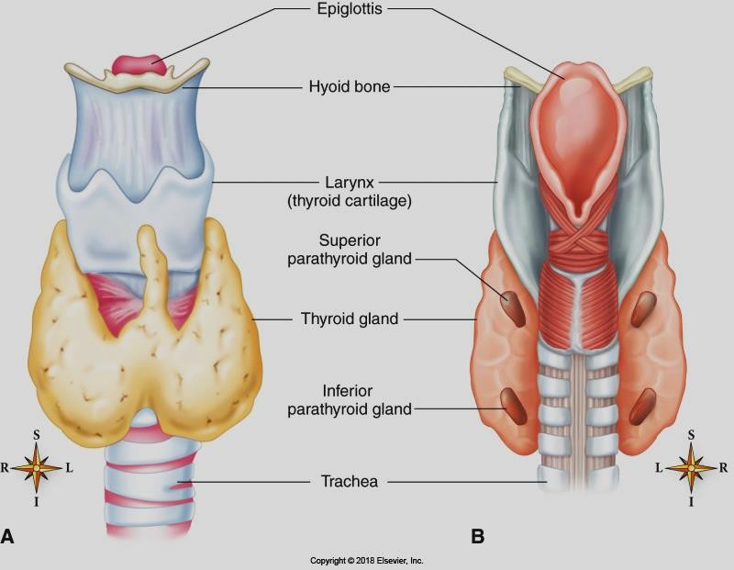
Hyperthyroidism
Patton and Thibodeau 12-7
What would an over active thyroid gland do to you?
Nervousness, emotional instability, inability to sleep, tremors, tachycardia, palpitations, excessive sweating, heat intolerance

Slide 20
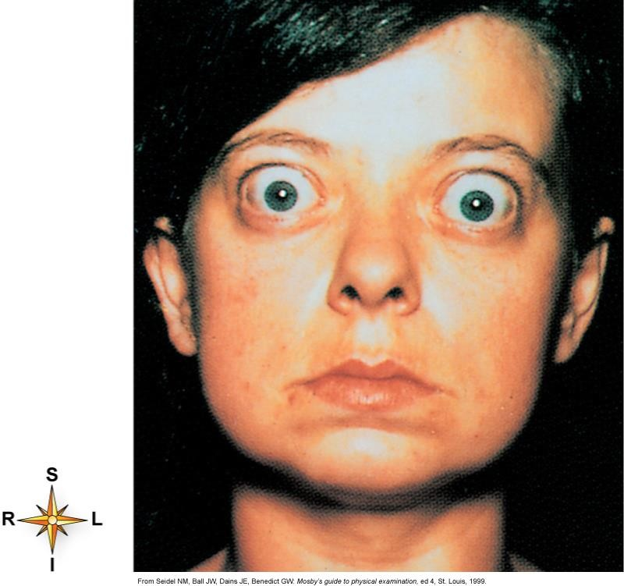
Hyperthyroidism
Graves disease is most common cause of hyperthyroidism. It is an autoimmune disea where the body produces antibodies that mi TSH so TH is continuously released into blo stream
It can be triggered by smoking, stress, radia to the neck, medications and viruses, thyro neoplasms
Hereditary autoimmune disease
Diagnosed with blood tests
se
mic
od
tion id
Treated with anti thyroid drugs or radiactive
iodine, or surgery
Grave’s disease -
demonstrating exophthalmus
Patton and Thibodeau fig. 12-9

Slide 21
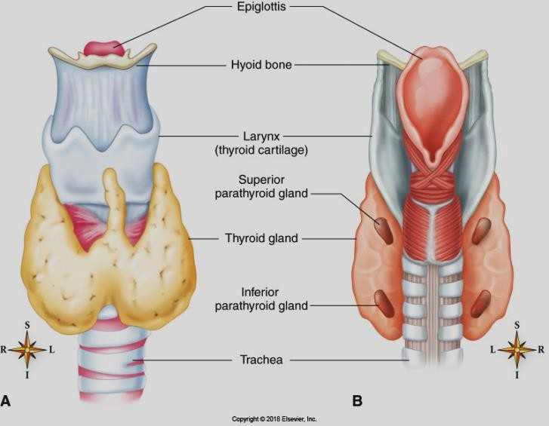
Hypothyroidism - adults
Today the most common cause is Hashimotos’s disease (autoimmune thyroiditis) but can also be caused by diet, by surgery, and by pituitary problems
Patton and Thibodeau 12-7
What would an under active thyroid gland do to you?
Slow down metabolism – fatigue, cold sensitivity, weight gain, constipation, myxedema (non pitting
edema in the face and shin), dry flaky skin, puffy face, hoarseness, mental sluggishness

Slide 22
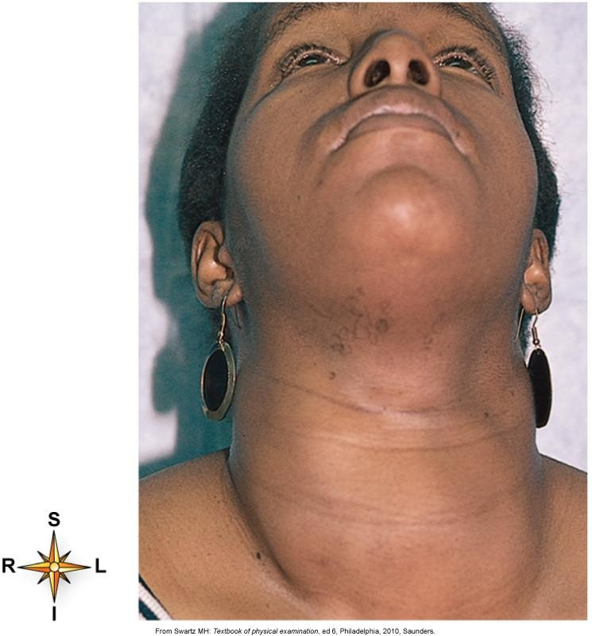
Hypothyroidism can cause goiter…
Patton and Thibodeau fig. 12-10

Slide 23
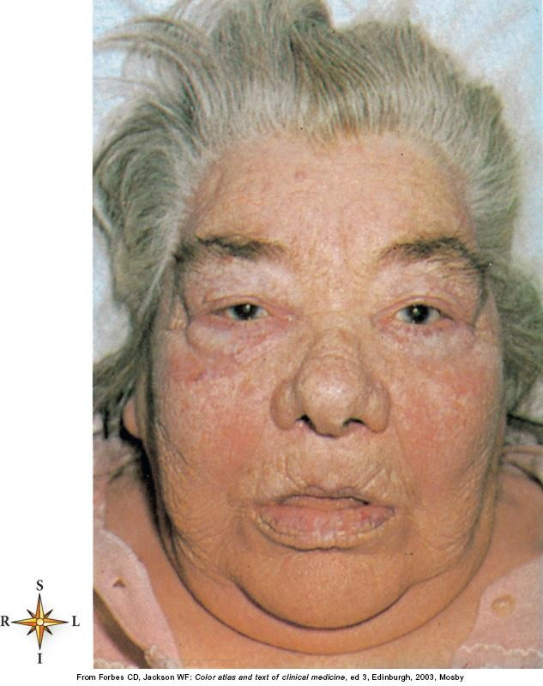
Myxedema…
Patton and Thibodeau fig. 12-11

Slide 24
Cretinism
(Congenital hypothyroidism- caused by low thyroid during fetal development)
Short in stature; coarse features with protruding tongue, broad flattened nose, widely set eyes, etc.
On X-ray - Absence of epiphyseal plates on femur and tibia
Increased thickness of the skull
Non-aerated sinuses
Delayed teeth
Must be treated before 3 months of age to avoid long term effects

Slide 25
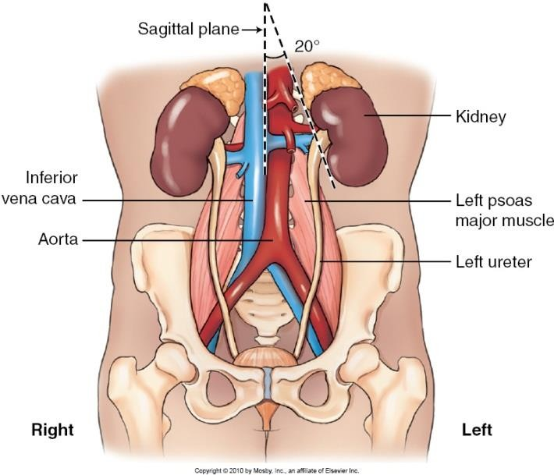
Adrenal Glands
Pyramid shaped glands perched on superior end of kidneys. Visible on CT
Often called “suprarenal glands”
The adrenal glands are like “two glands in one” because the cortex secretes different hormones than the medulla
All adrenal hormones help us cope with stress! – epinephrine, norepinephrine, cortisol (glucocorticoid)
Bontrager, K.L. And Lampignano, J.P. (2010). Textbook of radiographic positioing and related anatomy (7th ed.) Philadelphia, PA: Elsevier Mosby, page 527

Slide 26
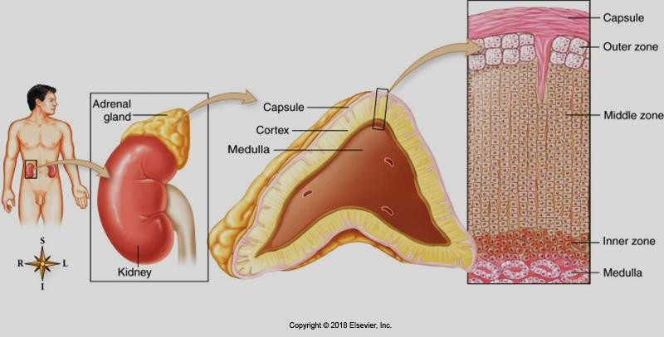
Patton and Thibodeau fig. 12-13

Slide 27
Adrenal Glands – continued
Intensive exercise or strong emotions such as anger or fear stimulates the sympathetic nervous system which causes the adrenal medullae to immediately “dump” epinephrine (adrenalin) and nor-epinephrine into the blood stream. This initiates the powerful “fight or flight” mechanism described on page 277 of the course text: a rapid increase in blood pressure, heart rate, blood sugar level, and an immediate diversion of blood to the skeletal muscles. The mechanism allows us to deal effectively with a short term threat such as a swarm of killer bees.
When stimulated by ACTH (adrenocorticotropic h.) from the anterior pituitary gland the adrenal cortex
produces the glucocorticoid cortisol, which has three affects on the body:
  It balances blood sugar and blood pressure, so that we can accommodate metabolic stressors that
occur during daily living. For eg. inconvenient scheduling that causes us to having a late lunch
  It suppresses the immune system.
  It has an anti-inflammatory/anti-allergic effect.
Marieb, Elaine N. and Hoehn, K. 2013. Human Anatomy and Physiology (9th ed.) Glenview Illinois: Pearson Education Inc.

Slide 28
Cushing’s Disease/Syndrome
(Abnormally high levels of cortisol in blood stream)
Cushing’s Disease results from chronic exposure to excess cortisol in the blood.
Most common cause of Cushing’s Syndrome is the long term, high dose use of cortisol. Or from pathology, tumor, when the body produces too much cortisol. Tumor can originate from the pituitary gland or adrenal gland.
Complications of the disease is increased levels of water, lipids and salt in the
blood.

Slide 29
Cushing’s Syndrome –
Classic signs and symptoms include:
“moon face” and “buffalo hump”
male characteristics
H20 and salt retention
loss of bone and muscle mass – patient can eventually end up bed-ridden
chronic hyperglycemia
severe infections to go un-noticed because of intense inflammatory effects of increased cortisol

Slide 30
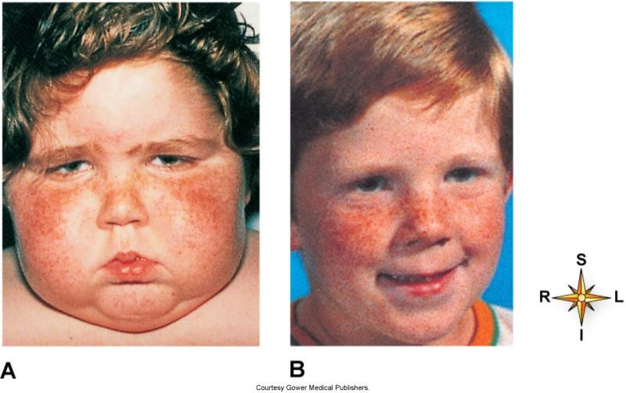
Treatment after 4 months
Patton and Thibodeau fig. 12-15

Slide 31
Pancreatic Islets
Pancreatic islets (Islets of Langerhans) are clusters of two different types of hormone producing cells that work against each other to maintain blood sugar levels
  Alpha cells – glucagon (hyperglycemic hormone)
  Beta cells – insulin (hypoglycemic hormone)
Glucagon
    Stimulates the liver to release glucose into the blood to raise blood sugar levels. One molecule of glucagon can signal the liver to release 100,000,000 molecules of glucose.
Insulin
    Is the only hormone that can decrease blood sugar levels! It accelerates the movement of glucose out of the blood stream into the cells where it can be metabolized

Slide 32
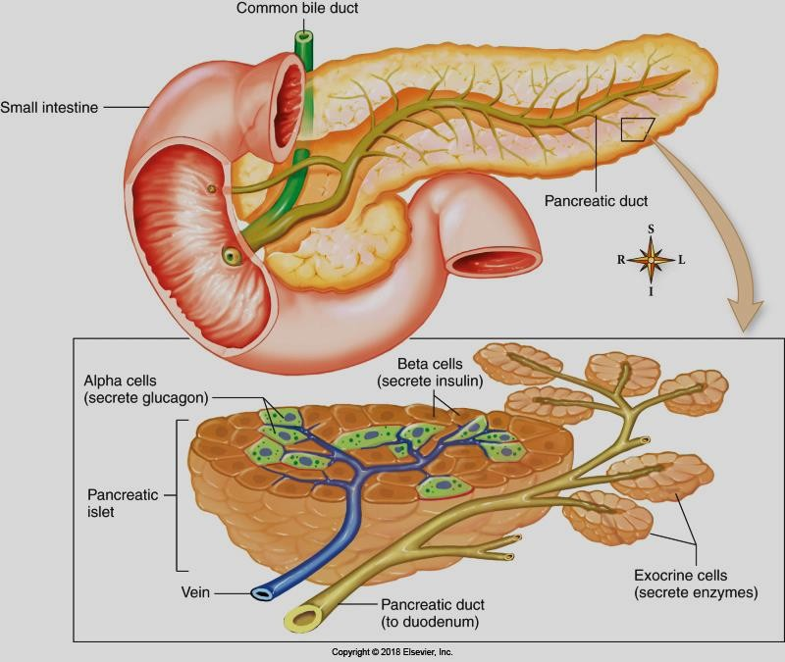
Patton and Thibodeau fig. 12 -17

Slide 33
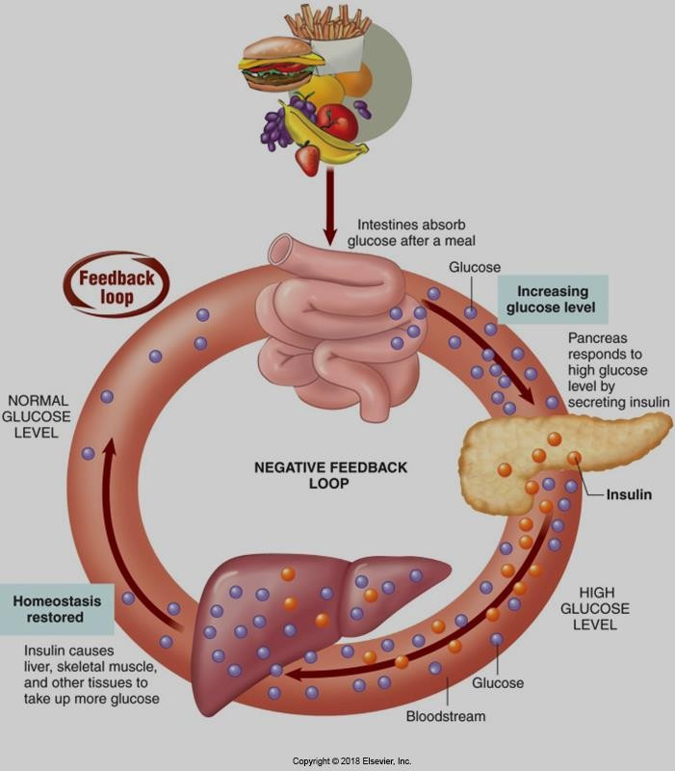
Beta cells at work….
Patton and Thibodeau fig. 12-4

Slide 34
Diabetus Mellitus
Low insulin levels leading to excessive hyperglycemia
Blood sugar cannot be metabolized for energy so the body starts to digest fats leading to ketoacidosis, heart and nervous system depression and then diabetic coma (Marieb p. 622)
Polyuria, polydypsia, polyphagia
Opposite problem is hypoglycemia can result from insulin overdose – give sugar

Slide 35
Other complications
Atherosclerosis – MI, stroke, or gangrene
Development of infections (osteomyelitis) due to poor circulation
Kidneys are always affected – kidney failure often cause of death
Blindness due to rupture of retinal blood vessels

Slide 36
Diabetes Mellitus
Type I = Juvenile diabetes - Genetic defect in insulin production
Type II - insulin resistant diabetes
May be genetically predisposed but obesity and inactivity are risk factors. Insulin receptors on cells are not functioning normally so they do not uptake glucose as they should when insulin is released into the blood stream
Increased risk of CAD, stroke, and DVT

Slide 37
Diabetus Mellitus
Low insulin levels leading to excessive hyperglycemia. Blood sugar levels can be 3 or more times the normal amount
Blood sugar cannot be metabolized for energy, so the body starts
to convert fat to glucose, which releases “keto-acids” into the blood stream causing
ketoacidosis (low blood PH = too acidic), heart and nervous system depression, and potentially diabetic coma (Marieb p. 622)
Can be diagnosed with blood and urine tests

Slide 38
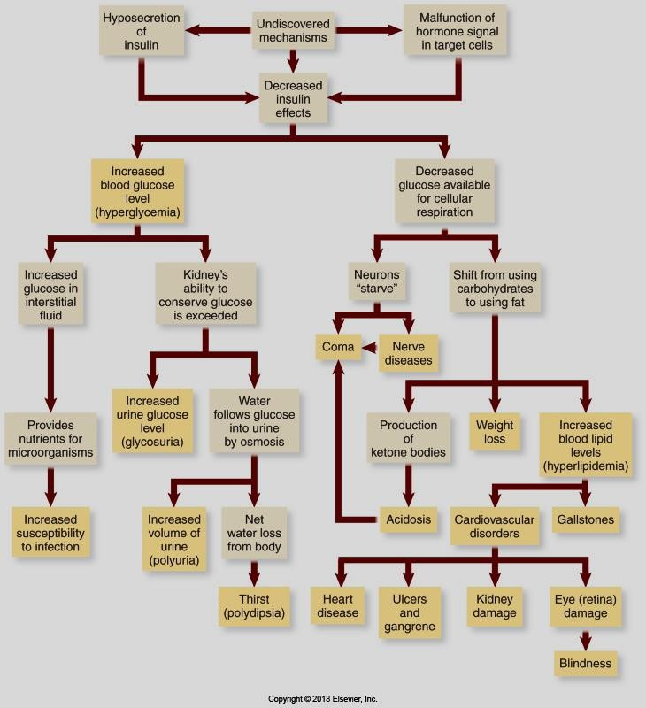
Patton and Thibodeau fig. 12-18

Slide 39
Other complications
Bad news:
Atherosclerosis – MI, stroke, or gangrene
Development of infections (osteomyelitis) due to poor circulation
Kidneys are always affected – kidney failure often cause of death
Blindness due to rupture of retinal blood vessels
Good news:
All forms of diabetes can be treated with exercise therapy because aerobic
training increases the number and efficacy of insulin receptors on target cells

Slide 40
Insulin overdose:
If too much insulin is released into the blood stream, too much glucose will be taken up by the cells and the person will become hypoglycemic. In this case the person needs to be given sugar

