Slide 1


Understanding the Controlled Epidermal Wound for Skin Rejuvenation

Slide 2
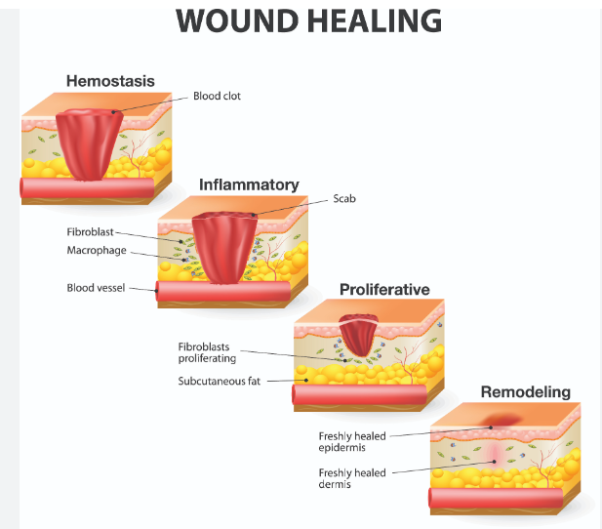
OUR JOURNEY TODAY

Slide 3
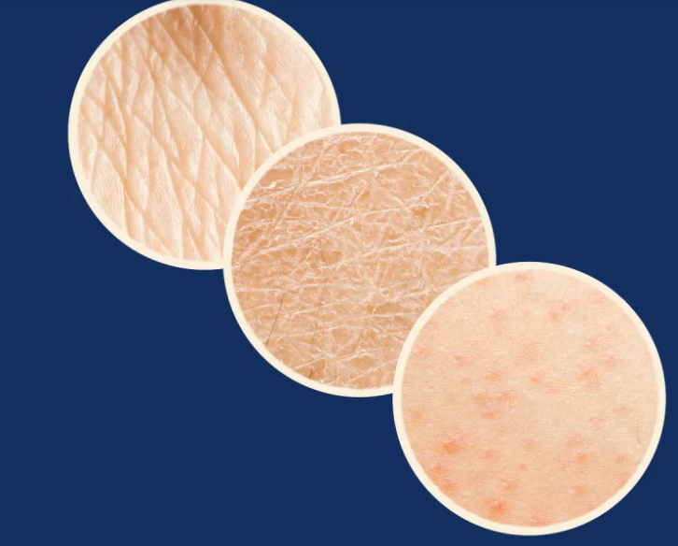
How Skin Heals During the Ages

Slide 4
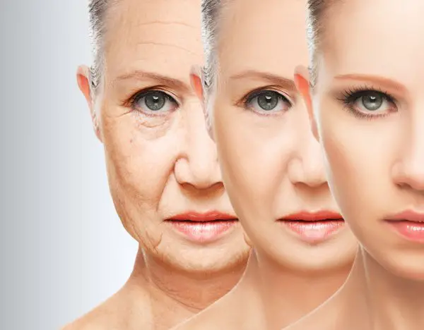
During your early 20s
Your skin’s health and appearance is smooth and tight, cells regenerate every 28 days, wounds heal fast and have less down time
During your 30 and 40’s skin will renew every 28 to 48 days
After 50’s skin cells will renew every 84 days

Slide 5

The Medical Esthetics Field works will many advanced devices
This devices produce a controlled wound on the Epidermis and slight on the Dermis.
This controlled wounds are meant to trigger the skin to renew and produce new skin tissue
Why are this facts important ?

Slide 6

Part of being a skilled esthetician is knowing how the process of healing works with each applied therapy
How and when to book follow up appointments
How to manage complications after procedures
How to manage client expectations

Slide 7
How Hormones Affect the Skin
The endocrine system is made up of organs and tissues that produce hormones. Hormones are natural chemicals produced in one location, released into the bloodstream, and then used by other target organs and systems.
Hormones control the target organs. Some organ systems have their own internal control systems along with, or instead of, hormones.
As we age, changes naturally occur in the way body systems are controlled. Some target tissues become less sensitive to their controlling hormone. The amount of hormones produced may also change.
Blood levels of some hormones increase, some decrease, and some are unchanged. Hormones are also broken down (metabolized) more slowly.
Many of the organs that produce hormones are controlled by other hormones. Aging also changes this process. For example, an endocrine tissue may produce less of its hormone than it did at a younger age, or it may produce the same amount at a slower rate.

Slide 8
Aging Changes
The hypothalamus is located in the brain. It produces hormones that control the other structures in the endocrine system, including the pituitary gland. The amount of these regulating hormones stays about the same, but the response by the endocrine organs can change as we age.
The pituitary gland is located just below (anterior pituitary) or in (posterior pituitary) the brain. This gland reaches its maximum size in middle age and then gradually becomes smaller. It has two parts:
The back (posterior) part stores hormones produced in the hypothalamus.
The front (anterior) part produces hormones that affect growth, the thyroid gland (TSH), adrenal cortex, ovaries, testes, and breasts.
The thyroid gland is located in the neck. It produces hormones that help control metabolism. With aging, the thyroid may become lumpy (nodular). Metabolism slows over time, beginning at around age 20. Because thyroid hormones are produced and broken down (metabolized) at the same rate, thyroid function tests are most often still normal. In some people, thyroid hormone levels may rise, leading to an increased risk of death from cardiovascular disease.

Slide 9
The average fasting glucose level rises 6 to 14 milligrams per deciliter (mg/dL) every 10 years after age 50 as the cells become less sensitive to the effects of insulin. Once the level reaches 126 mg/dL or higher, the person is considered to have diabetes.
The adrenal glands are located just above the kidneys. The adrenal cortex, the surface layer, produces the hormones aldosterone, cortisol, and dehydroepiandrosterone.
Aldosterone regulates fluid and electrolyte balance.
Cortisol is the "stress response" hormone. It affects the breakdown of glucose, protein, and fat, and it has anti-inflammatory and anti-allergy effects.

Slide 10
Aldosterone release decreases with age. This decrease can contribute to lightheadedness and a drop in blood pressure with sudden position changes (orthostatic hypotension). Cortisol release also decreases with aging, but the blood level of this hormone stays about the same. Dehydroepiandrosterone levels also drop. The effects of this drop on the body are not clear.
The ovaries and testes have two functions. They produce the reproductive cells (ova and sperm). They also produce the sex hormones that control secondary sex characteristics, such as breasts and facial hair.
With aging, men often have a lower level of testosterone.
Women have lower levels of estradiol and other estrogen hormones after menopause.

Slide 11
Effect Of Changes
Overall, some hormones decrease, some do not change, and some increase with age. Hormones that usually decrease include:
Aldosterone
Calcitonin
Growth hormone
Renin
In women, estro

Slide 12
Hormones that most often remain unchanged or only slightly decrease include:
Cortisol
Epinephrine
Insulin
Thyroid hormones T3 and T4

Slide 13
Hormones that may increase include:
Follicle-stimulating hormone (FSH)
Luteinizing hormone (LH)
Norepinephrine
Parathyroid hormone

Slide 14

QUESTIONS?

