Slide 1
INFC 215 – Infection Prevention and Control
Donning/Doffing Gloves

Slide 2
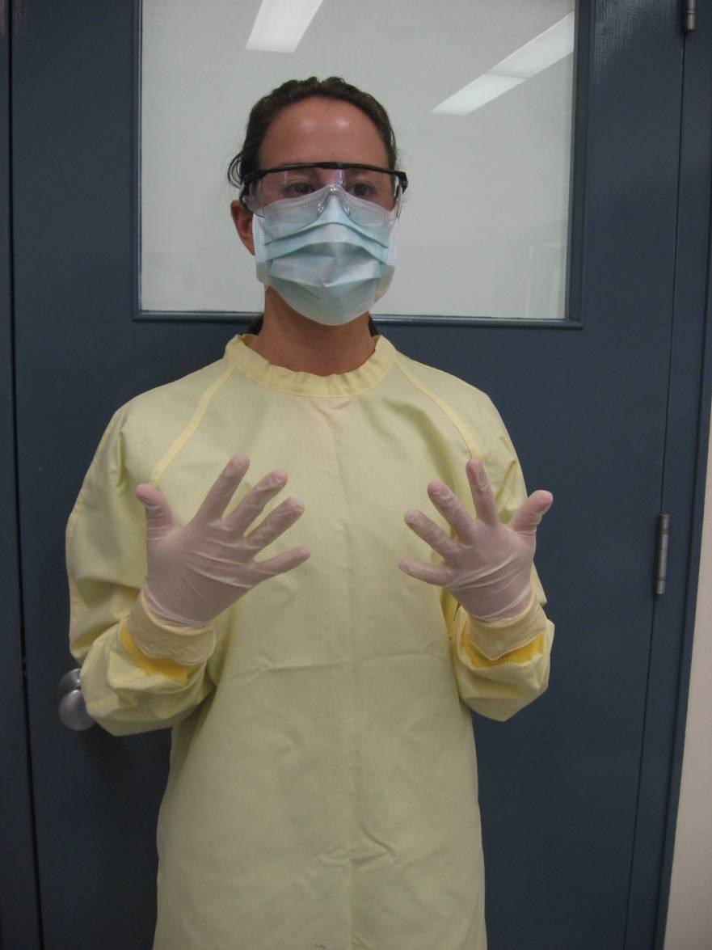
Donning

Slide 3
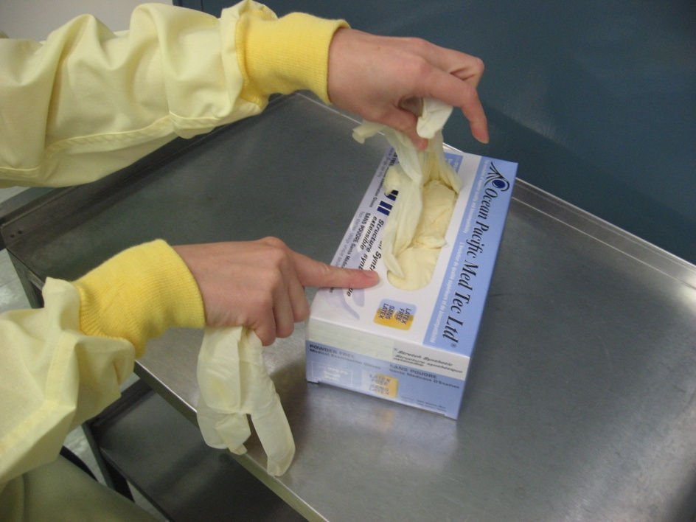
Select Gloves
Correct type
vinyl, nitrile, latex
nonsterile, sterile)

Slide 4
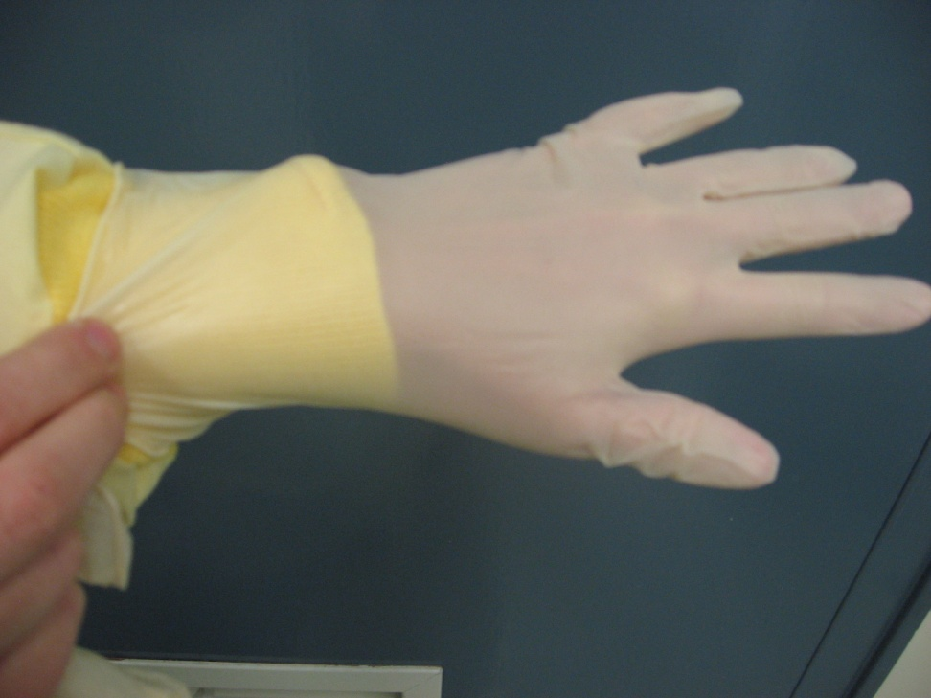
1. Put on first glove
Pull over cuff

Slide 5
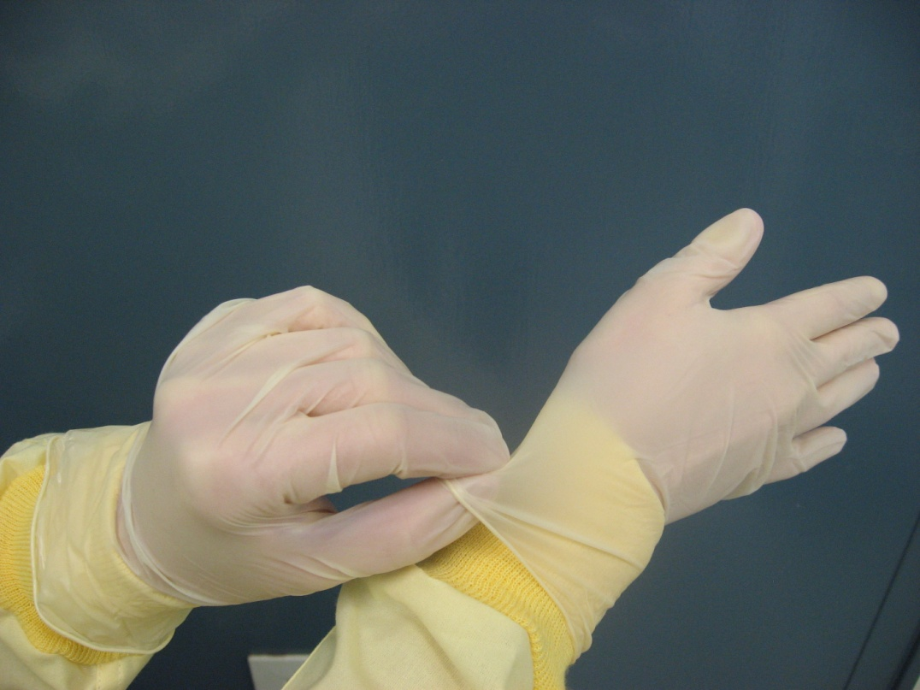
2. Put on second glove and pull over cuff

Slide 6
Doffing
Taking off

Slide 7
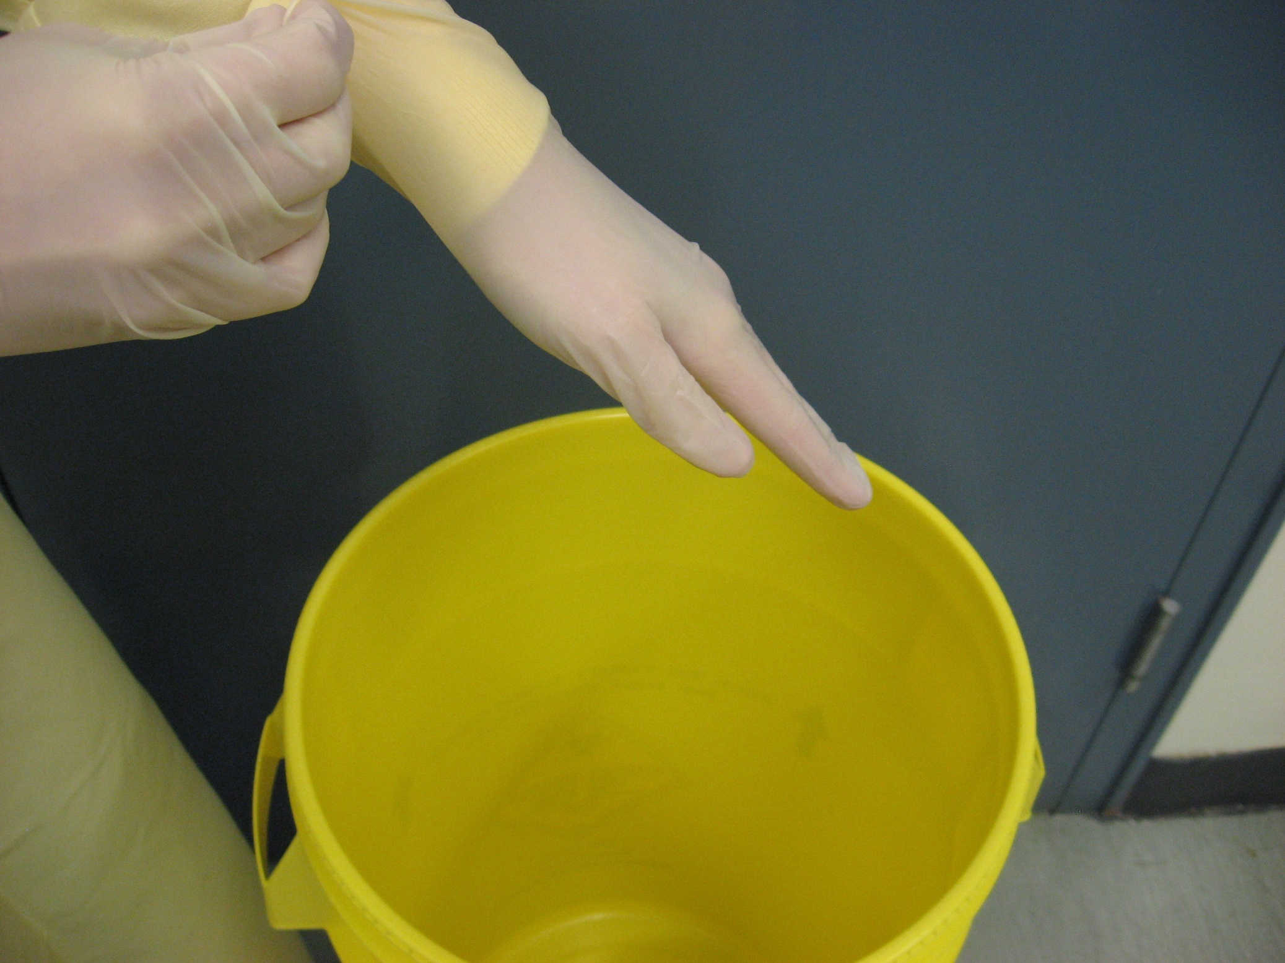
1. Grasp outside of glove with other hand. Do not touch gown cuff.

Slide 8
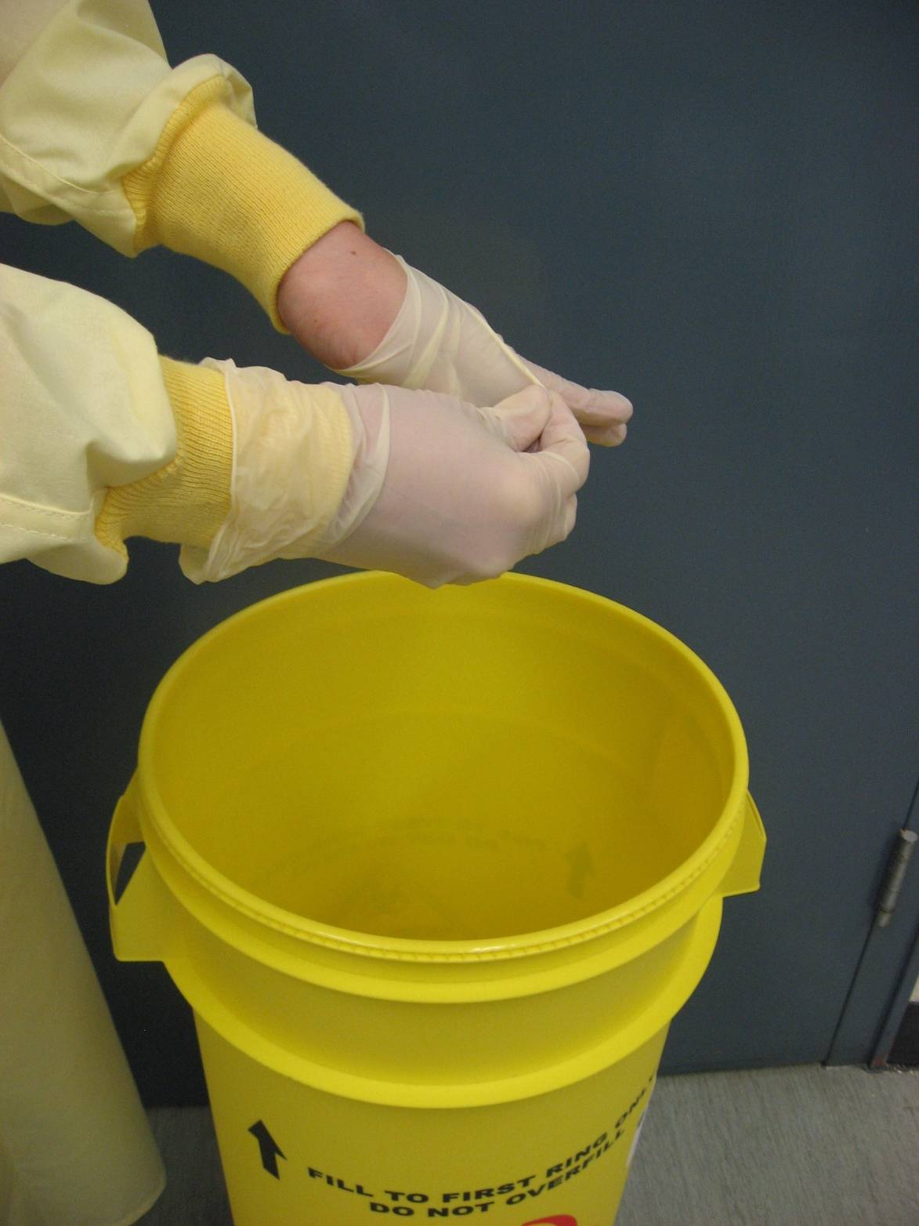
2. Peel off, turning glove inside out

Slide 9
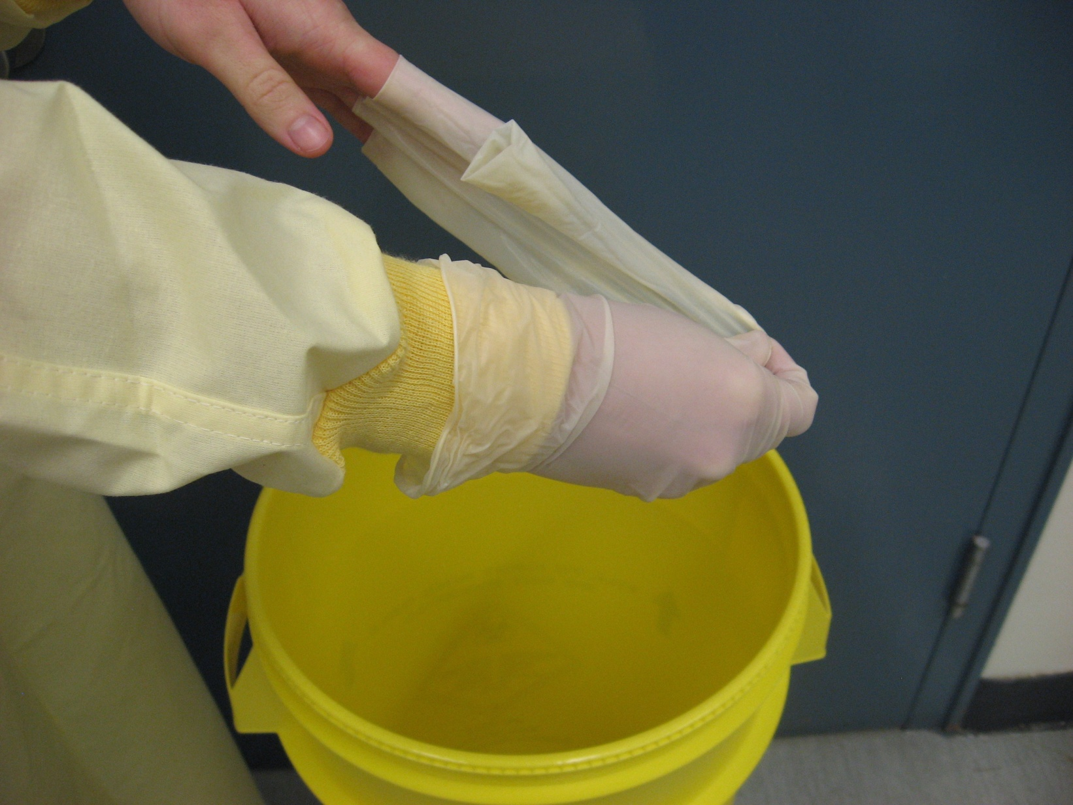
3. Hold removed glove in gloved hand

Slide 10
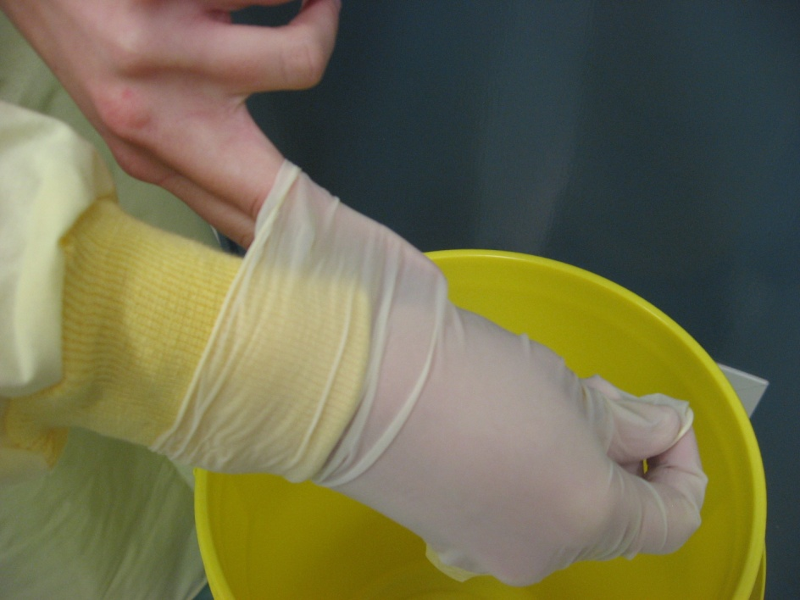
4. Slide one or two bare fingers inside cuff of other glove

Slide 11
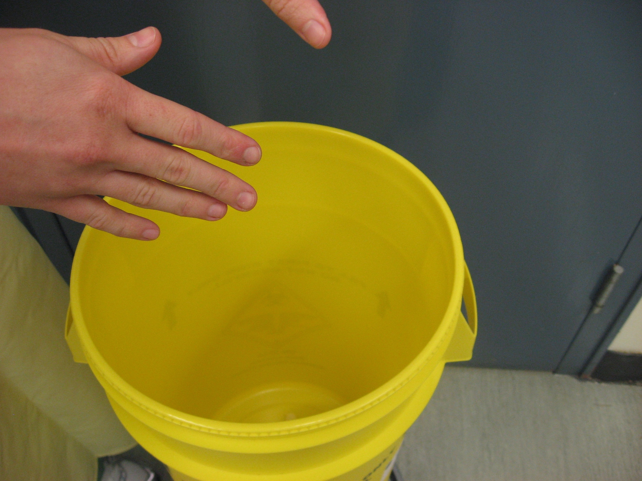
6. Drop gloves into disposal

