Slide 1


Wax Indications and Contraindications

Slide 2
Indications are outward signs that the desired service would be successful and beneficial. In relation to waxing indications include:
· Hair to be waxed should be a minimum of 1⁄4 inch long if it is virgin hair, meaning previously untreated hair, or fine regrowth.
· Hair should be 1⁄2 inch long if it is shaven and coarse, which is approximately 10 to 14 days’ growth post-shaving.
· If possible, the client should lift ingrown hairs four days to a week prior to the service, leaving the hair in the follicle and allowing the follicle to heal and normalize.
· Working the area of the body with a loofah or using an exfoliating body scrub prior to waxing is recommended, but not on the day of the service.
· The client should avoid tanning (sun or booths) for 24 hours before and after the area is depilated.

Slide 3
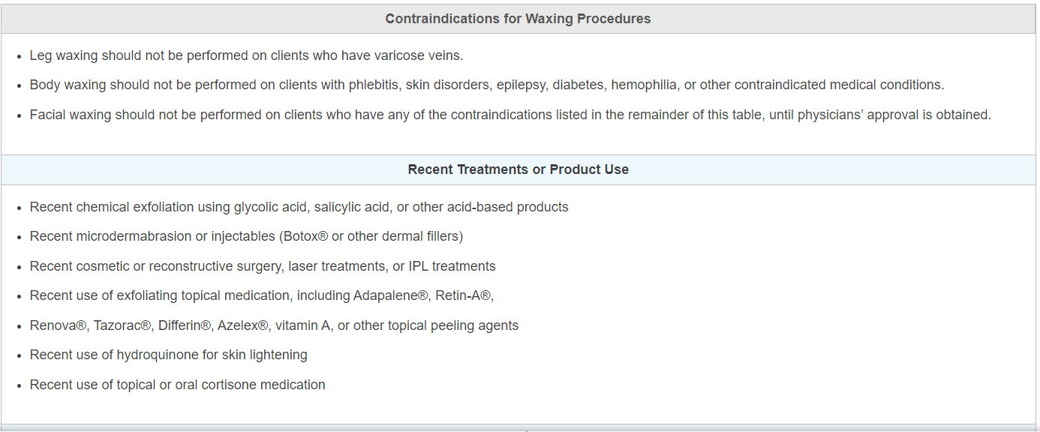

Slide 4
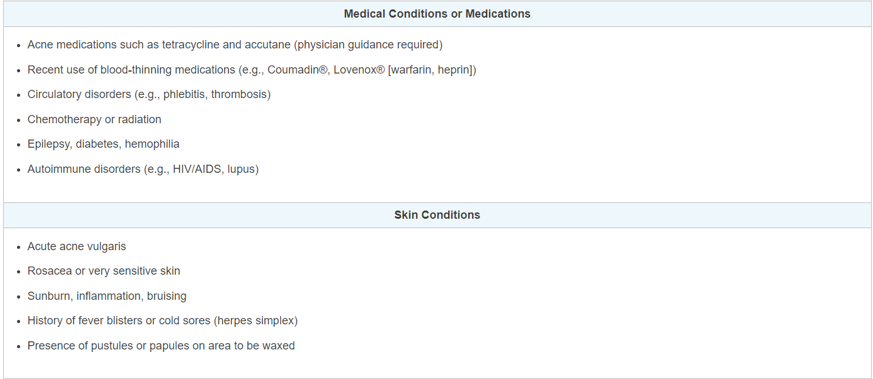

Slide 5
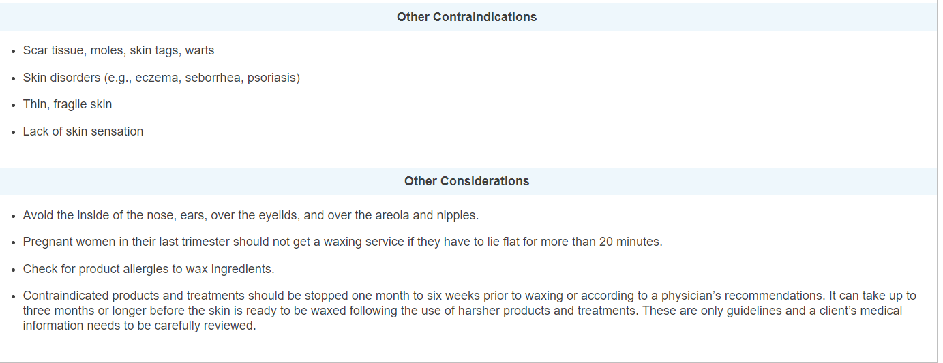

Slide 6
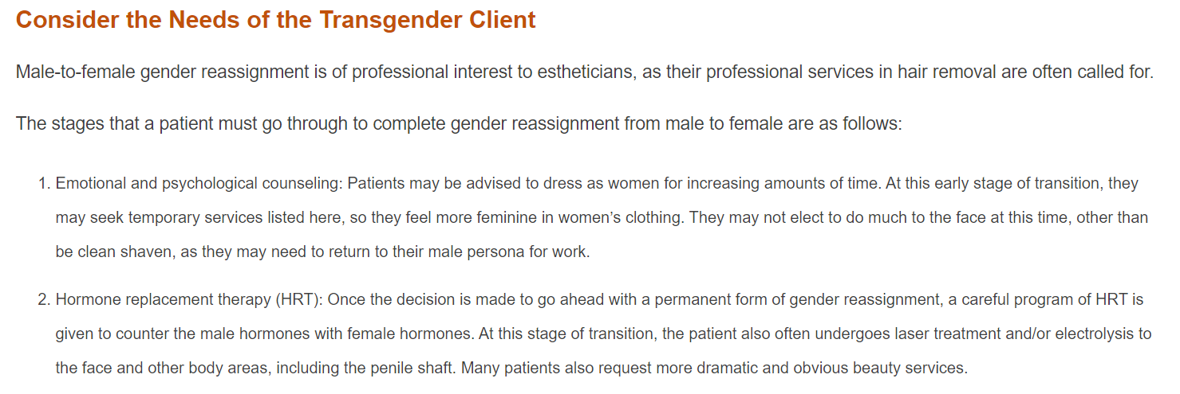

Slide 7
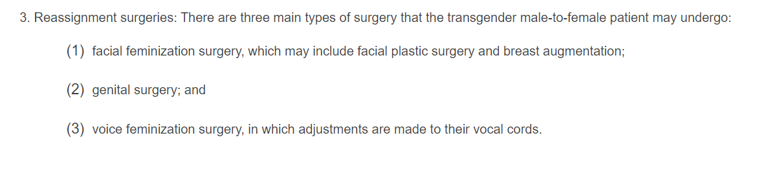

Slide 8
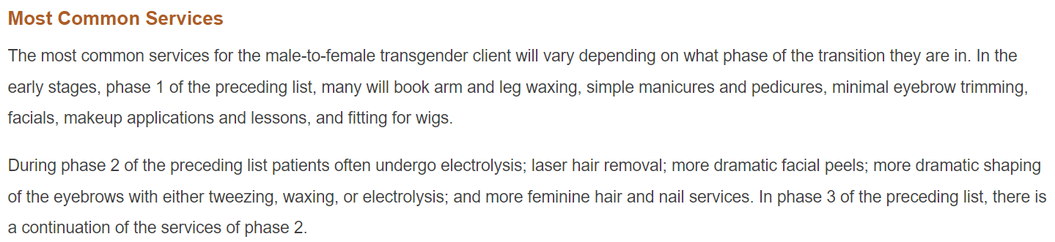

Slide 9

QUESTIONS?

