Slide 1
MRAD 256
Radiographic Technique 2
Positioning of the sinuses, orbits, and nasal bones

Slide 2
Routine Sinus Protocol
Water’s open mouth
Caldwell
Lateral
Use a horizontal beam
Examine patient upright

Slide 3
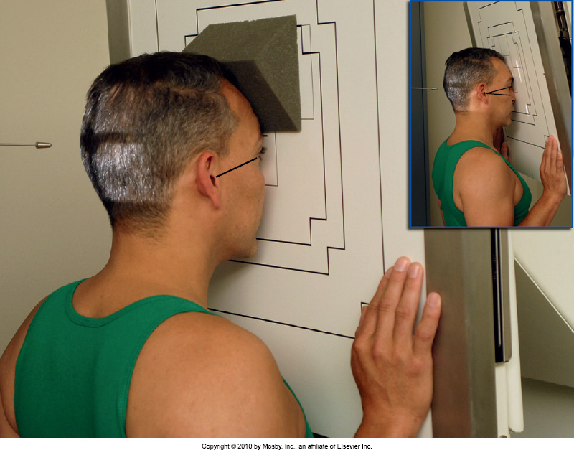
Caldwell for Sinuses
Place patient in an erect position
Elevate OML 15° from horizontal, CR MUST remain horizontal for air-fluid levels
Adjust CR to exit near the nasion
Set collimation to 14cm x 14cm and include squamous portion of frontal bone, and then you “get what you get” inferior to nasion
Bontrager 11-189

Slide 4
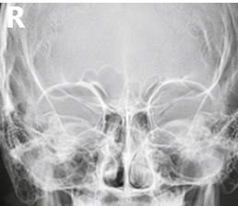
Evaluation Criteria
Frontal sinuses projected above the frontonasal suture
Anterior ethmoid bones lateral to nasal bones
Superior orbital fissures within the orbits
Petrous ridges in lower 1/3 of orbits
No rotation or tilt

Slide 5
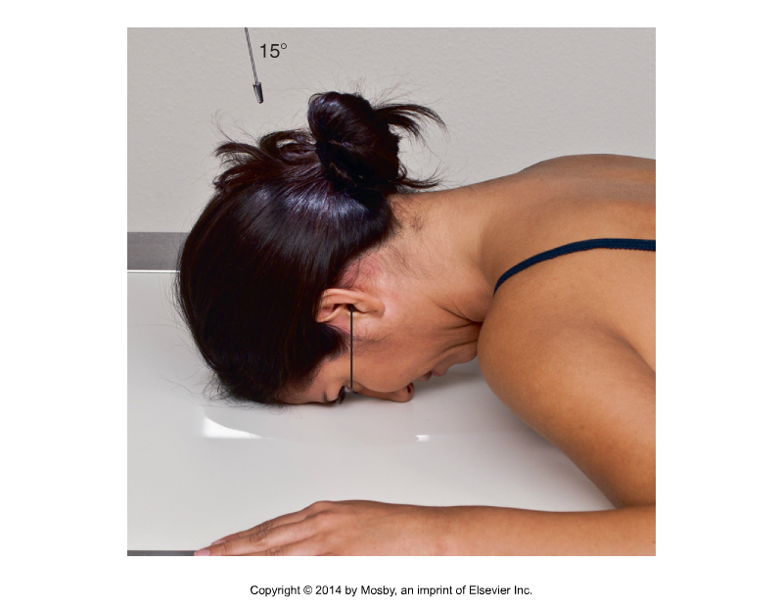
Remember!
For sinuses we raise the OML and leave the central ray perpendicular to the IR
For skull or facial bones we angle the CR and place the OML perpendicular to the IR

Slide 6
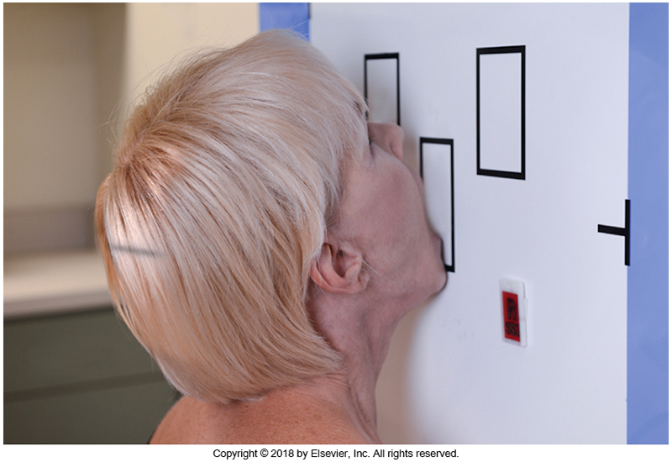
Waters Open Mouth
Place patient in an erect position
Extend neck to place a line formed by the TEA and the corner of the mouth perpendicular to the IR
Collimation set to 14cm x14 cm
Central ray to exit at the acanthion
Instruct patient to “drop jaw” to open mouth, without moving head
Bontrager 11-198

Slide 7
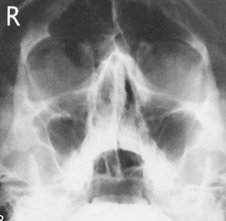
Evaluation Criteria
Maxillary sinuses visualized without superimposition alveolar processes of maxillae or petrous ridges
Sphenoid sinus viewed through the open mouth
No rotation or tilt
Orbits and maxillary sinuses are symmetric on each side

Slide 8
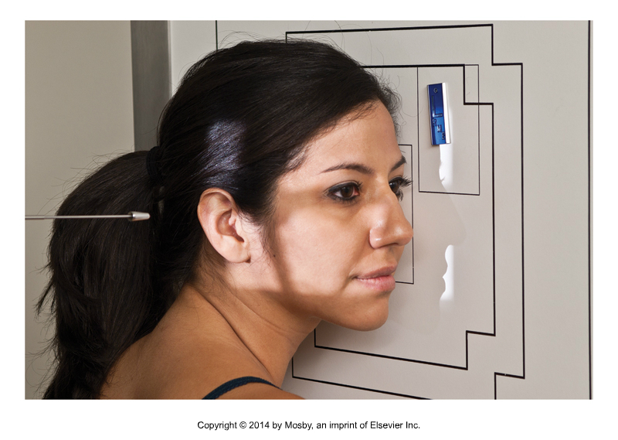
Lateral
Place patient in an erect position
Place CR ½ way between outer canthus and EAM
Adjust flexion by placing the IOML perpendicular to the IR
Collimate cross-wise to include all anatomy anterior to EAM
Collimate lengthwise to include all four sinuses
Bontrager 11-183

Slide 9
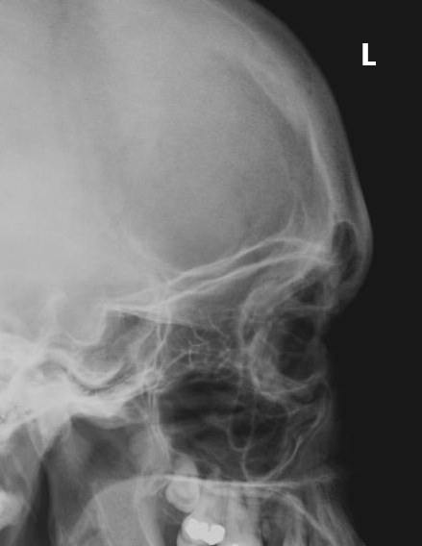
Evaluation Criteria
All paranasal sinuses are demonstrated
No rotation or tilt

Slide 10
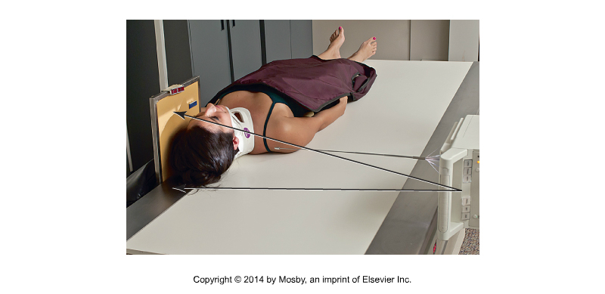
X-table lateral skull (dorsal decubitus)
The only projection that will demonstrate a sphenoid sinus effusion secondary to basal skull fracture
Bontrager 15-76

Slide 11
Routine Protocols for Orbits
Two 30° Caldwell images (exaggerated Caldwell)
Lateral
Always clean IR first
Upright detector is best option

Slide 12
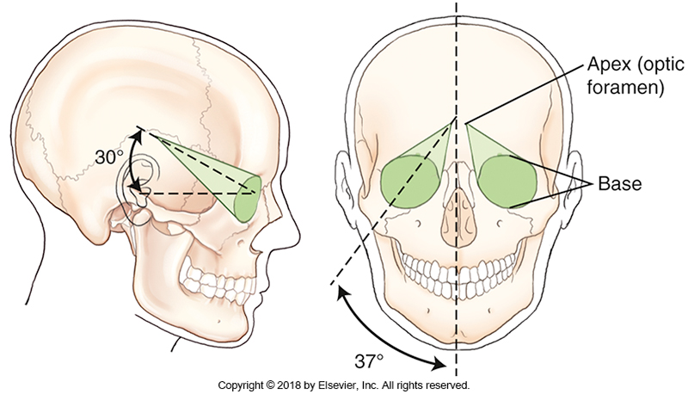
Orbits

Slide 13
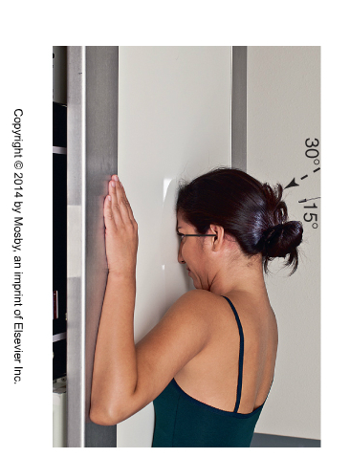
PA 30º Exaggerated Caldwell
Angle CR 30˚ caudad
Place OML perpendicular to IR
Collimate to include orbital bases
Use an arrow marker to designate the position of the eyes during exposure. i.e. “looking up” or “looking down”
Bontrager 11-113

Slide 14
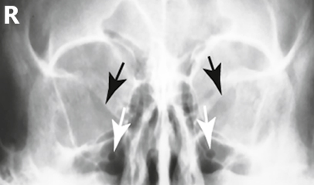
30˚ Caldwell for Orbits
Take two identical images; one with patient looking up, and one with the patient looking down. Be sure to include an arrow marker

Slide 15
Evaluation Criteria
  No rotation or tilt
  Petrous ridges visualized below infraorbital rim
  Directional arrow marker included

Slide 16
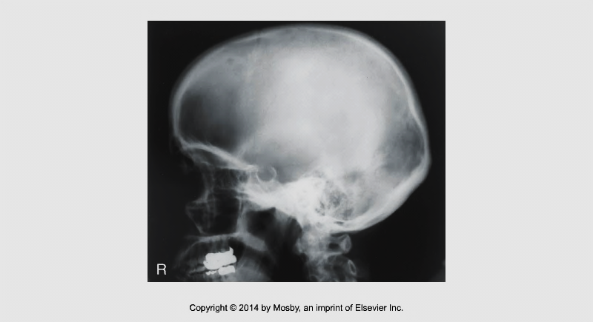
Lateral orbits (not in Bontrager)
When you are collimating, remember that the orbit is cone shaped
Lengthwise collimation should include up to EAM
Bontrager (7th ed.) 12-52

Slide 17
Nasal bones routine
Waters (collimated to nasal bones)
Lateral

Slide 18
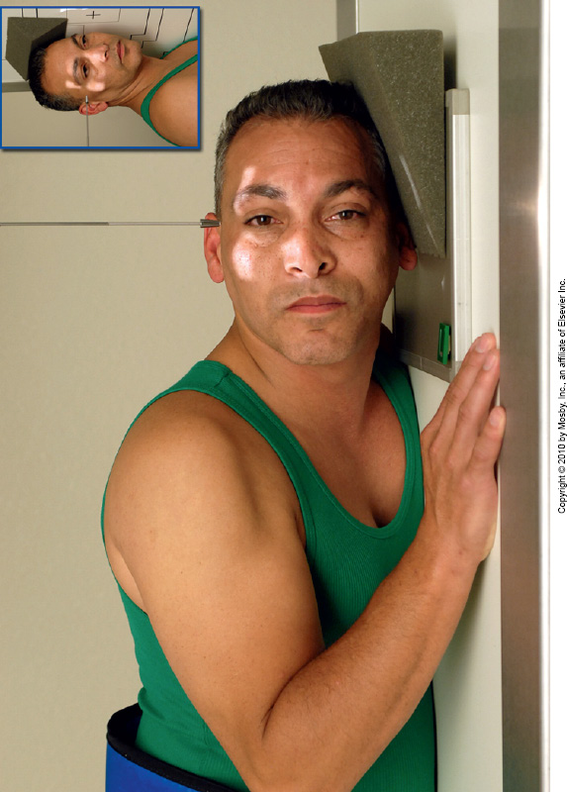
Lateral
CR ┴ to nasal bones
Collimate to include from nasion to anterior nasal spine
Set a manual technique
Bontrager 11-138
Notes:
MS plane is parallel to IR
Interpupillary line is perpendicular to the IR
IOML is aligned to the long axis of the IR

Slide 19
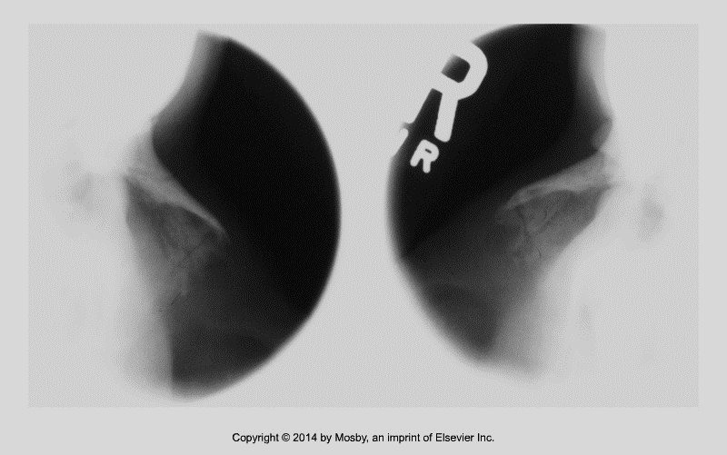
Evaluation Criteria…
Nasal bones with associated soft tissue structures (entire nose)
Frontonasal suture (nasion)
Anterior nasal spine
No rotation
Bontrager (9th ed.) fig.11-139

Slide 20
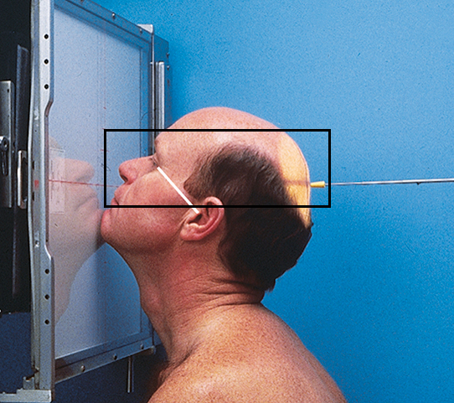
Waters

Slide 21
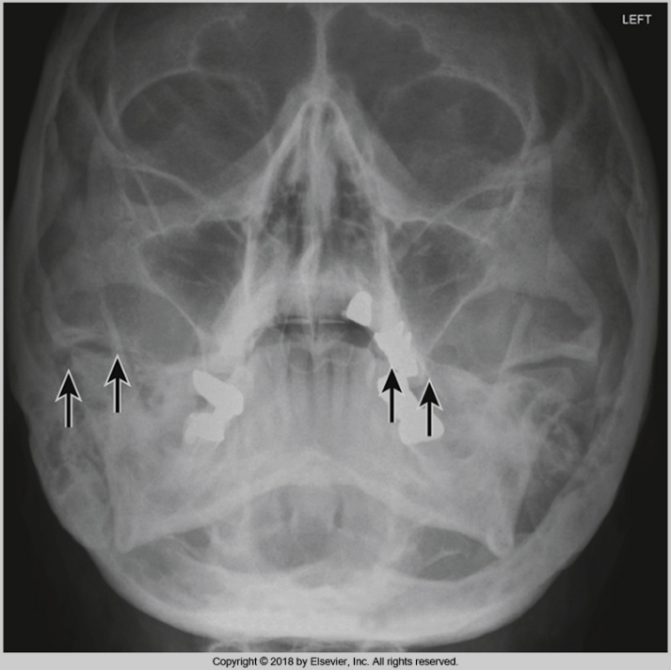
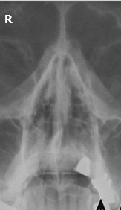
Evaluation Criteria
A regular Waters, collimated to nasal bones
No rotation
Petrous ridges projected below maxillary sinuses
Collimation to include anterior nasal spine to frontonasal suture (nasion), and to include 2cm on either side of anterior nasal spine. Some sites want the entire maxillary sinuses included side to side

